Slide 1
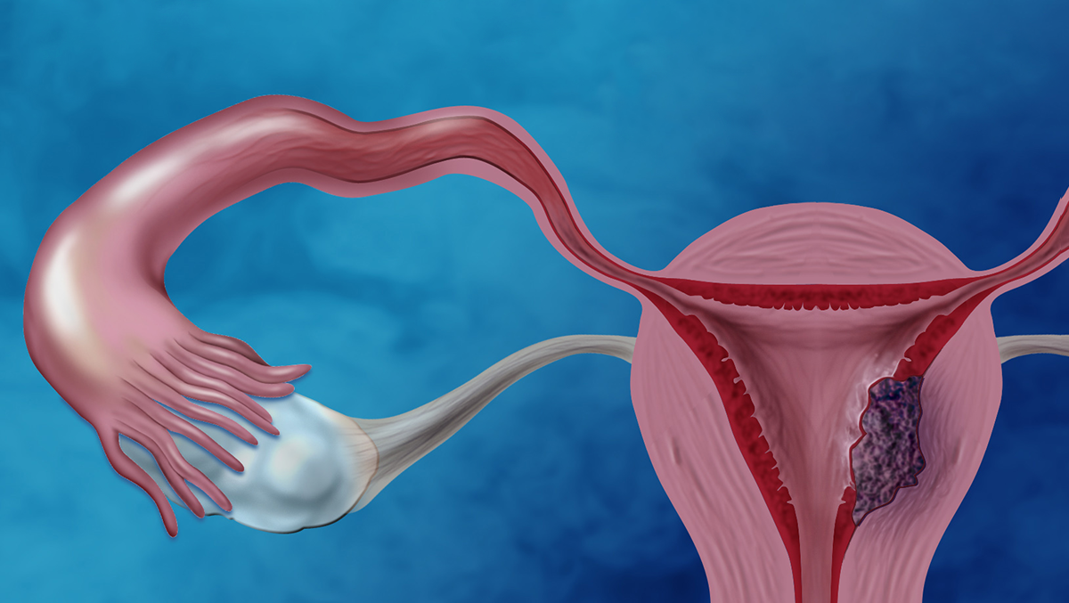
Endometrial & ovarian tumors: approach to, diagnosis, and management
Presented by: Ali Kharabsheh, Ahmed Jowher, Abdalsalam Ibrahim, Noor Nawafleh, Sarah Abu-Shameh, & Adeem Sharawneh
Supervise by: Dr. Omar Dabbas

Slide 2
Ovarian Neoplasms

Slide 3
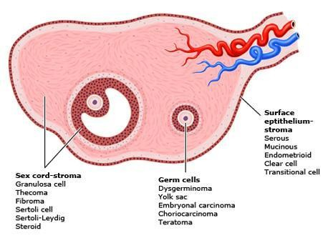
Ovarian Neoplasms
Ovarian neoplasms arise from the surface epithelium, germ cells, and sex-cord- stromal tissue and may be benign, borderline or malignant. These neoplasms persist unless excised.

Slide 4
EPIDEMIOLOGY
● The second most common gynecologic malignancy
● The most common cause of gynecologic cancer death and the fifth leading cause of
cancer death in women.
● The lifetime risk of developing ovarian cancer in US is. 1.4%.
● The majority of ovarian malignancies (95 %) are derived from epithelial cells;
● Serous carcinoma, the most common histologic subtype (75 percent of epithelial carcinomas).
● The majority of ovarian cancers are diagnosed at an advanced stage

Slide 5
Epithelial Ovarian Cancer

Slide 6
Risk factors
Age:
The incidence increases with increasing age.
2) Reproductive and hormonal factors:
Early menarche ( < 12 years )
late menopause ( > 52 years )
Nulliparity
Infertility (ovulation induction)
Endometriosis
Polycystic ovarian syndrome

Slide 7
Risk factors
3) Genetic factors:
primarily BRCA1 and 2 and the mismatch repair genes (associated with Lynch syndrome).
The estimated lifetime risk of ovarian cancer is 35-46 % for BRCA1 mutation carriers and 13-23 % for BRCA2 mutation carriers.
The lifetime risk of ovarian cancer in women with Lynch syndrome is 3-14 % compared with 1.5 % in the general population.
4) Family history of ovarian cancer:
A personal or family history of breast cancer
5) Environmental factors:
Cigarette smoking : increase the risk of mucinous ovarian cancer
Talc and asbestos : e.g, genital use of talcum powder (talc).
Obesity

Slide 8
Protective factors
Oral contraceptives
Multiparity
Bilateral Salpingo-oophorectomy,
Tubal ligation
Hysterectomy
Breastfeeding/pregnancy
Intrauterine device

Slide 9
Histopathology
based upon histopathology the five main subtypes of epithelial ovarian carcinomas:
High-grade serous carcinoma (70-80 %)
Endometrioid carcinoma (10 %)
Clear cell carcinomas (10 %)
Mucinous carcinoma (3 %)
Low-grade serous carcinoma (<5 %)

Slide 10
Clinical features
Ovarian cancer rarely causes symptoms in its early stages. When symptoms do occur, they are often nonspecific and may not correlate with the stage or severity of the disease.
may present in either an acute or subacute manner:
1. Acute Presentation
Women with advanced disease may present acutely, requiring urgent evaluation and care. Common acute presentations include:
Pleural effusion
Bowel obstruction
Venous thromboembolism (VTE)
2. Subacute Presentation
Epithelial ovarian cancer (EOC) may also present subacutely, in both early and advanced stages. These cases are usually evaluated in an outpatient setting. Common subacute symptoms include:
Gastrointestinal symptoms such as: Nausea, Vomiting, Constipation, Acid reflux
Adnexal mass (pelvic pain or pressure or incidentally found during a routine pelvic examination)
Pelvic or abdominal symptoms : Bloating, pressure symptoms on bladder or rectum,Difficulty eating or feeling full quickly

Slide 11
Other subacute presentations :
Postmenopausal bleeding.
Rectal bleeding.
Symptoms of fallopian tubal carcinoma, a classic triad of symptoms: clear or blood-tinged vaginal discharge, pelvic pain, and a pelvic mass.
Atypical glandular cells on cervical cytology : Women with a finding of atypical glandular cells should be evaluated for cervical and endometrial carcinoma.
Paraneoplastic syndromes : cerebellar degeneration, polyneuritis, dermatomyositis,
hemolytic anemia, disseminated intravascular coagulation, acanthosis, or nephrotic
syndrome.
Palpable inguinal or cervical lymphadenopathy.
Incidental operative finding.

Slide 12
On Physical Examination
General examination(cachexia,anemia, jaundice,virchow's LN)
Abdominal examination:- Abdominal distention ,flank fullness and shifting dullness implies the presence of ascites or a large pelvic-abdominal mass, Recent eversion of the umbilicus
Lymph Node examination :- the supraclavicular and inguinal areas,Sister
Mary Joseph's nodule refers to a metastatic implant in the umbilicus.
4. Pelvic examination:- pelvic mass.-
Benign mass:- Mobile, smooth, cystic, unilateral
malignant mass:- fixed, irregular, sold or firm, bilateral.•
Other D.D for mass: Endometrioma, Fibroid, Functional cyst, Ectopic pregnancy , Dermoid tumor (younger women)

Slide 13
Tumor serum biomarkers
Cancer antigen 125 ( CA 125 )
Cancer antigen 19-9 (CA 19-9)
Human epididymis protein 4 (HE4)
Carcinoembryonic antigen (CEA)

Slide 14
Cancer antigen 125 ( CA 125 )
The CA 125 antigen is a large transmembrane glycoprotein derived from both coelomic (pericardium,
pleura, peritoneum) and müllerian (fallopian tubal, endometrial, endocervical) epithelia.
Normal value : CA 125: ≤35 U/Ml.
Serum CA 125 is the most commonly used laboratory test for the evaluation of adnexal masses for
epithelial ovarian cancer (EOC).
CA 125 testing alone has a low sensitivity, particularly for early stage ovarian cancer. only raised in
50% of early stage disease.
CA-125 being raised in numerous conditions including fibroids, endometriosis, adenomyosis , pelvic inflammatory disease, liver cirrhosis with or without ascites , Cancers of the endometrium, breast, lung, and pancreas.

Slide 15
In postmenopausal women, the sensitivity for ovarian cancer was 69-87 %, specificity was
81-93 %. For premenopausal women, the sensitivity was 50 –74%, specificity was 69-78 %.
CA 125 is not consistently produced by some histologic types of epithelial ovarian cancer,
including: mucinous, clear cell, and mixed müllerian ovarian tumors.
Serum CA 125 >200 U/mL had been used as a criterion for referral to a gynecologic oncologist.

Slide 16
Imaging
Pelvic ultrasound is the single most effective way of evaluating an ovarian mass. With
transvaginal ultrasonography being preferable due to its increased sensitivity over
transabdominal ultrasound.
CT or MRI are used for the presence of distant extension of the disease.
Chest radiography is performed in most patients to evaluate for pleural effusion, pulmonary
metastases, and mediastinal lymphadenopathy.

Slide 17
Risk of Malignancy index (RMI)
Is a multimodality approach that combines three presurgical features: serum CA 125, pelvic ultrasound, and menopausal status into an index score to predict the risk of ovarian cancer in women with an adnexal mass.
The ultrasound result is scored 1 point for each of the following characteristics: multilocular cysts, solid areas, metastases, ascites and bilateral lesions. U = 0 (for an ultrasound score of 0), U = 1 (for an ultrasound score of 1), U = 3 (for an ultrasound score of 2–5).
The menopausal status is scored as 1 = premenopausal and 3 = postmenopausal.
Serum CA-125 is measured in IU/ml and can vary between zero to hundreds or even thousands of units.
RMI I score of >200 = high risk ( risk of cancer <80%) RMI I score < 25 = low risk ( risk of cancer < 3%)
RMI = U * M * CA-125

Slide 18
Once an adnexal mass has been identified, the evaluation to exclude malignancy includes a medical history, physical examination, imaging studies, and laboratory evaluation for tumor markers.
Definitive diagnosis of ovarian cancer requires surgery and histopathology.

Slide 19
Staging System
Cancer of the ovary is surgically staged according to the 2014 International Federation of
Gynecology and Obstetrics (FIGO) :
STAGE I (Tumor confined to ovaries)
IA : Tumor limited to 1 ovary,capsule intact, no tumor on surface, negative washings
IB : Tumor involves both ovaries , otherwise like IA
IC : Tumor limited to 1 or both ovaries
IC1 : Surgical spill
IC2 : Capsule rupture before surgery or tumor on ovarian surface
IC3 : Malignant cells in the ascites or peritoneal washings
STAGE II (Tumor involves 1 or both ovaries with pelvic extension (below the pelvic
brim) or primary peritoneal cancer)
IIA : Extension and/or implant on uterus and/or Fallopian tubes
IIB : Extension to other pelvic intraperitoneal tissues

Slide 20
STAGE III (Tumor involves 1 or both ovaries with cytologically or histologically confirmed spread to the peritoneum outside the pelvis and/or metastasis to the retroperitoneal lymph nodes)
IIIA : Positive retroperitoneal lymph nodes and/or microscopic metastasis beyond the
pelvis
IIIA1 : Positive retroperitoneal lymph nodes only
IIIA1(i) : Metastasis ≤ 10 mm
IIIA1(ii) : Metastasis > 10 mm
IIIA2 : Microscopic, extrapelvic (above the brim) peritoneal involvement ± positive retroperitoneal lymph nodes
IIIB : Macroscopic, extrapelvic,peritoneal metastasis ≤ 2 cm ± positive retroperitoneal
lymph nodes. Includes extension to capsule of liver/spleen
IIIC : Macroscopic, extrapelvic, peritoneal metastasis > 2 cm ± positive retroperitoneal
lymph nodes. Includes extension to capsule of liver/spleen
STAGE IV (Distant metastasis excluding peritoneal metastasis)
IVA : Pleural effusion with positive cytology
IVB : Hepatic and/or splenic parenchymal metastasis, metastasis to extra-abdominal organs (including inguinal lymph nodes and lymph nodes outside of the abdominal cavity)

Slide 21
Cyto-reductive surgery (De-bulking surgery)(Staging laprotomy):
Total abdominal hysterectomy
Bilateral salpingo-oophorectomy
Peritoneal cytology
Infra-colic omentectomy
Pelvic and para-aortic lymph node dissection

Slide 22
There are several potential benefits of aggressive primary surgical management in women with
epithelial ovarian carcinoma (EOC), particularly for those with advanced disease :
Optimal response to postoperative systemic chemotherapy is achieved in the setting
of minimal disease burden.
Disease-related symptoms (eg, abdominal pain, increased abdominal girth, dyspnea, early satiety) are related to tumor burden. Removal of bulky disease rapidly improves symptoms and quality of life.
Ovarian neoplasms produce multiple cytokines, at least some of which are immunosuppressive (eg, interleukin-10, vascular endothelial growth factor). Removal of tumor bulk may improve or restore host immune competence.
Cytoreduction is associated with increased survival. The volume of residual disease
remaining after cytoreductive surgery correlates inversely with survival.

Slide 23
The terminology regarding extent of cytoreduction is:
Complete cytoreduction – Cytoreduction to no grossly visible disease.
Optimal cytoreduction – The Gynecologic Oncology Group (GOG) defines optimal
cytoreduction as residual disease that is ≤1 cm in maximum tumor diameter.
Suboptimal cytoreduction – Cytoreduction with tumor nodules >1 cm remaining.

Slide 24
Adjuvant therapy
Women with EOC should undergo adjuvant treatment with the exception of those with stage IA EOC.
Neoadjuvant therapy
refers to the administration of systemic chemotherapy before definitive surgery.
The goal of NACT is to reduce perioperative morbidity and mortality and increase the likelihood of a complete
resection of disease at the time of cytoreductive surgery.
In most cases of women treated with NACT, further chemotherapy is administered following surgery (ie,
adjuvant chemotherapy).

Slide 25
Epithelial ovarian cancer (EOG) occurs primarily in postmenopausal women, and those with a family history of ovarian or breast cancer (eg,BRCA mutation carrier) are particularly susceptible. EOG commonly presents with advanced disease as early symptoms (eg, bloating, abdominal pain) tend to be vague and nonspecific. A firm, non-mobile pelvic mass with nodularity in a postmenopausal patient is concerning for EOG thathas extended beyond the adnexa. In addition, this patient has symptoms of ascites (eg, shortness of breath, decreased appetite, abdominal distension, decreased bowel sounds), which is likely due to peritoneal spread of cancer causing increased capillary permeability and decreased intravascular oncotic pressure.
Imaging (eg, pelvic ultrasound) is done to confirm the presumed clinical diagnosis of ovarian cancer and ascites; it may also evaluate for metastatic disease. CA-125 should be drawn to correlate with clinical findings and to monitor treatment in the future. Exploratory laparotomy with cancer resection and inspection of the entire abdominal cavity for metastases (ie, surgical staging) is required when there is a high clinical
suspicion of EOG, particularly with an acute presentation, as in this patient. During surgery, the ovaries,
uterus, omentum, and any visually apparent cancerous lesion will be removed and pelvic and paraaortic
lymph nodes will be dissected. Chemotherapy with platinum-based agents is initiated after surgery.

Slide 26
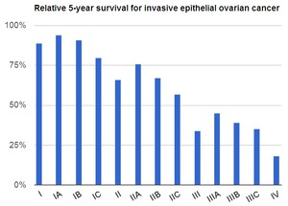
Prognosis
Overall five-year survival in women with ovarian cancer is less than 45 %.

Slide 27
The major prognostic factors associated with improved outcome were :
younger age : Younger patients are more likely to have a favorable prognosis because they are more likely to have tumors of less aggressive histology and lower grade, and better baseline performance status.
Low volume of residual disease.
Good performance status.
Serous histology.

Slide 28
POSTTREATMENT SURVEILLANCE
Office visits (including physical and pelvic exams) every three to six months up to five years
posttreatment, then annually.
CA-125 or other tumor markers (eg, HE4) every visit if initially elevated, if indicated
Other testing (ie, chemistry profile or complete blood count, CT scan, or transvaginal ultrasound in
women who underwent fertility-sparing surgery) only as clinically indicated.

Slide 29
Screening for ovarian cancer
Screening for high risk women : There is a consensus that women at average risk for
ovarian cancer should NOT undergo screening.
Screening tests : Measurement of CA 125 and transvaginal pelvic ultrasound.

Slide 30
Ovarian cancer is one of the leading causes of cancer mortality in the World as the disease is typically diagnosed in advanced stages with widespread metastasis. For average-risk patients (eg, no hereditary cancer syndromes), no screening tests exist to detect ovarian cancer in its early, more treatable stages. This patient's family history of a single second-degree relative with ovarian cancer does not impart increased likelihood of a hereditary cancer syndrome.

Slide 31
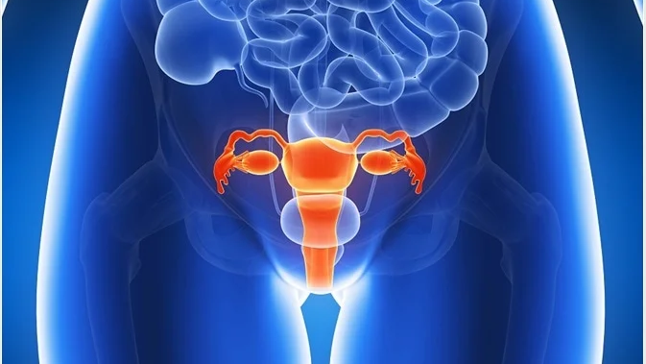
Endometrial hyperplasia

Slide 32
Definition
Abnormal proliferation of endometrial glands due to unopposed estrogen stimulation. Leads to an increased gland-to-stroma ratio.

Slide 33
etiology
In general, all premalignant and malignant uterine conditions are estrogen-dependent. Therefore, increased estrogen exposure leads to endometrial hyperplasia, which may progress to endometrial carcinoma.
Obesity (peripheral conversion of androgens to estrogen).
Unopposed estrogen exposure: Chronic anovulation (e.g., PCOS, perimenopause).
Estrogen-only therapy without progestogens. HRT
Tamoxifen use
Late menopause / Early menarche
Estrogen-secreting tumors (e.g., granulosa cell tumors)

Slide 34
Classification according to the WHO 2014
Endometrial hyperplasia
Endometrial Hyperplasia without Atypia
• Glands are proliferative and may be crowded, but there is no cytologic atypia.
• Low risk of progression to cancer (1–3% over 10–20 years).
Atypical Endometrial Hyperplasia/nuclear changes (also called Endometrial Intraepithelial Neoplasia – EIN)
• Presence of cytologic atypia, with glandular crowding and architectural complexity.
• High risk of progression to carcinoma (up to 30% or more).
• Considered pre-malignant.

Slide 35
Clinical presentation
Abnormal uterine bleeding: menorrhagia, intermenstrual bleeding, postmenopausal bleeding.

Slide 36
diagnosis
Step 1: Clinical History
Evaluate all women with abnormal uterine or postmenopausal bleeding.
Identify risk factors
Step 2: Transvaginal Ultrasound (TVS)
First-line imaging modality.
Assess endometrial thickness (ET):
Premenopausal: ET >16 mm → biopsy recommended.
** Keep in mind the cycle phase (proliferative or luteal).
Postmenopausal: ET ≥4 mm → requires biopsy.
**Any woman >40 years old with abnormal uterine bleeding requires biopsy regardless of the endometrial thickness.

Slide 37
diagnosis
Step 3: Endometrial Sampling
A. Pipelle Biopsy
Office-based procedure.
60–90% sensitivity.
Minimally invasive and cost-effective.
Limitations: May miss focal lesions → if negative but suspicion remains, proceed to hysteroscopy.
B. Hysteroscopy + Biopsy
Gold standard: Allows direct visualization + targeted biopsy.
Indicated if:
Pipelle is inconclusive/inadequate.
Imaging suggests focal lesions.

Slide 38
diagnosis
For the evaluation of abnormal uterine bleeding, endometrial biopsy should be considered in:
Patients > 45 years old as first-line test
Patients with abnormal uterine bleeding that persists despite medical management, regardless of age
Patients < 45 years old with risk factors for endometrial cancer (Strong Recommendation)

Slide 39
management
A. Non-Atypical Hyperplasia
First-Line: Mirena IUS (Levonorgestrel-releasing)
Delivers local progestogen to the endometrium.
~90% regression rate at 6 months.
Alternative: Oral Progestogens
Continuous or cyclic dosing.
Used when IUS is contraindicated or not tolerated.
Follow-up:
Repeat biopsy at 6-12 months to assess regression.

Slide 40
management
B. Atypical Hyperplasia (EIN)
First-Line: Hysterectomy
Due to the high risk of coexisting or progressing to endometrial cancer.

Slide 41
management
Fertility-Sparing Option
I must counsel her about the consequences of preserving the uterus since there is a 25% of cases of EH with hidden malignancy.
High-dose progestogens (e.g., megestrol acetate, Mirena + oral progestin).
Requires:
Biopsy every 3-6 months.
Plan for early conception and later hysterectomy.
Up to 30% may fail medical management → Close monitoring is critical.

Slide 42
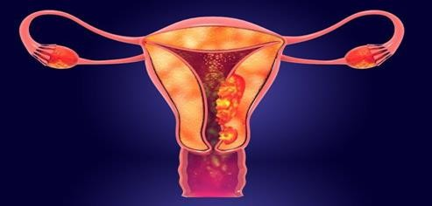
Endometrial cancer

Slide 43
Endometrial carcinoma is the fifth leading cancer in the women worldwide.
In developed countries it’s the most common gynecological cancer and second most common in developing countries after cervical CA.
Mean age of presentation is 56 years . 75% after menopause.
20% perimenopausal.
5% before age of 40.

Slide 44
Etiology
It is a case of hyperestrogenemia, so any case that include an increase in estrogen level will increase the risk of Endometrial carcinoma,
- indiscriminate use of oestrogen.
- unopposed oestrogen.
- Theca granulosa cell tumours.

Slide 45
Risk factors:
Diabetes or abnormal glucose tolerance test.
Hypertension.
Fibroids.
Polycystic ovarian syndrome.
overnight or obese patients .
Infertility, Arthritis, and Thyroid disease.
Early menrach and late menopause .
Use of TAMOXIFEN.
Previous pelvic irradiation.
Positive family history of breast, ovarian, and colon cancer.
ATYPICAL ADENOMATOUS HYPERPLASIA (complex atypical)
25% will progress into endometrial CA.

Slide 46
Protective factors:
Smoking
Use of oral contraceptive.
Use of progesterone.

Slide 47
Each is further graded according to
Broder’s classification
Grade 1 tumors are more often seen than anaplastic , therefore carries a better prognosis .

Slide 48
Spread :
Invasion through the myometrium and by filling the uterine cavity.
Invasion to the cervix with subsequent lymphatic spread
involving the iliac and para-aortic nodes.
From upper uterus may spread to round ligament to the deep inguinal nodes.
In advanced cases, the blood-stream spread may carry to the lungs, liver, and to the bone.

Slide 49
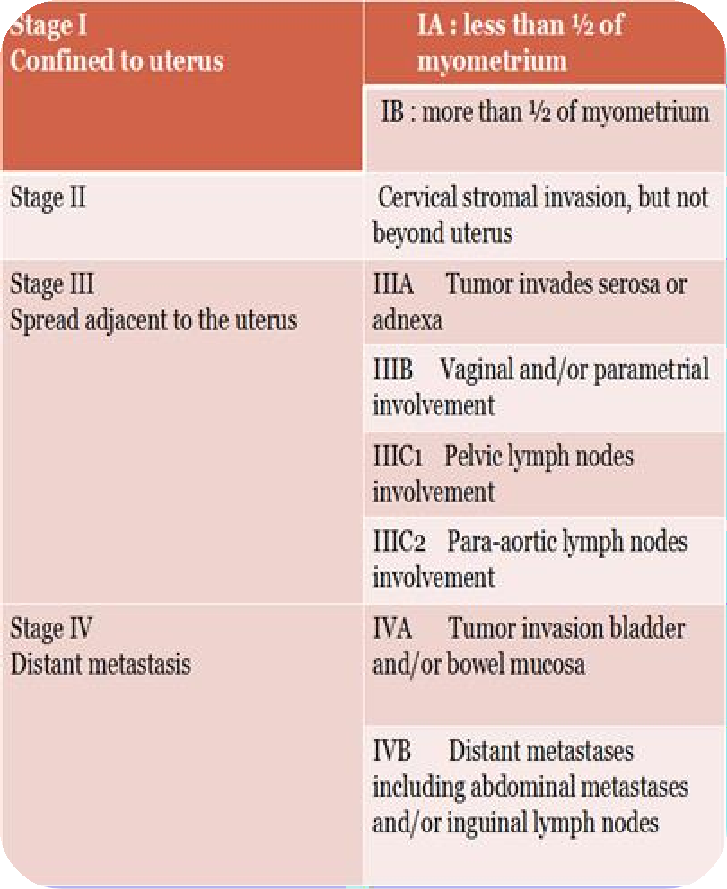
Staging is made surgically by the following procedure:
Laparatomy, peritoneal wash to detect the presence of mets.
Total abdominal hystrectomy with bilateral salpingophrectmoy.
3. Lymph nodes dissection.

Slide 50
History:
postmenopausal bleeding or staining( this symptom should be assumed to be caused by carcinoma of the endometrium until proved otherwise), only 10% of PMB have endometrial carcinoma.
Perimenopausal menstrual irregularities.
Blood stained vaginal discharge.
Heavy and irregular vaginal bleeding
Dysuria
Dysparenia
Back pain
pain or mass in the pelvis

Slide 51
Examination:
physical examination of the patient with endometrial carcinoma is frequently entirely normal, it should include palpation of supraclavicular and inguinal lymph nodes, abdominal palpation might be difficult due to obesity.
Gynaecological examination:
inspection of vulva, vaginal skin in suburethral area
and cervix.
Bimanual vaginal examination assesses uterine size, and mobility, state of parametria and adnexa.
Bimanual recto-vaginal examination. (rectal and
uterosacral ligament infiltration).

Slide 52
Investigations and imaging:
CBC.
Liver function test.
Renal function test.
Chest X ray.
Ultrasound: reveals a thick endometrium in a postmenopausal woman.(>5mm)
(must be thin as estrogen should be very low).
Cytology brush from lower cervical canal and posterior fornix to analyze the cells.

Slide 53
Thick endometrium
Thin endometrium
Endometrial Cytology brush

Slide 54
Definite diagnosis is made by biopsy, which will be obtained by:
1. Endometrial biopsy, blind sample. Fractional curettage, piplle, jet irrigation and suction.
2. Examination under general anasthesia and D&C
3. Hysteroscopy and biopsy, the best, under vision, any abnormal lesions seen will be biopsied.
for staging:
proctoscopy and / or sigmoidoscopy, cystoscopy,

Slide 55
management
During surgery, if a frozen section facility is available we can do so, if the stage is IA,
no need for lymph nodes dissection.
Stage IA grade I (well differentiated) require surgery (TAH with BSO), no need for
lymph nodes dissection, no need for postop chemotherapy or radiotherapy.
Stages IB-III all require surgery, postop radio/chemotherapy, stage III require both to reduce the risk of recurrence.
stage IV adenocarcinoma: Rare
Symptomatic management ,control of tumour growth, so: “Palliative”
-hysterectomy to reduce the bleeding.
-Radiotherapy to decrease the bleeding.
-Cytotoxic drugs.
-Hormonal therapy
May all be required. Rarely limited surgery to stop the bleeding as palliative procedure is carried out.

Slide 56
Indications for post operative radiotherapy:
Moderate or poor differentiation(G2,G3).
Other histological type than adenocarcinoma as papillary or clear cell carcinoma.
Invasion of myometrium of> 1/2. (IB)
Positive peritoneal wash.
Positive lymph nodes. (III)

Slide 57
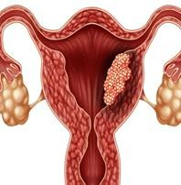
Complications
peritonitis
hematometra (collection of blood within uterus due to lower uterine or cervical obstruction) and if it gets infected may result in pyometra
malignant fistula (bladder, rectum, ureters)

Slide 58
Prognosis
Generally endometrial CA has good prognosis, better than cervical CA due to:
Early presentation, as patient is symptomatic.
Slow growth.
Well differentiated .
Late lymph nodes involvement.
5 years survival:
Stage I : 80-90%
Stage II: 70-80%
Stage III: 20-60%
Stage IV: 15%

Slide 59
Thank you

