Slide 1
Puerperium and It’s Complication

Slide 2
Definition
The period following delivery of the baby and placenta to about 6 weeks postpartum
The ACOG considers postpartum care to extend up to 12 weeks after delivery.
although menses may not return for much longer.

Slide 3
1- Postpartum shivering:
Postpartum shivering or chills are observed in 25 to 50 % of women. Shivering usually starts 1 to 30 minutes post-delivery and lasts for 2 to 60 minutes. The cause is unknown.
Treatment is supportive with warm blankets and/or warm air.
Notes:
it may be a response to a fall in body temperature following labor, fetal-maternal bleeding, micro-amniotic emboli, placental separation, anesthesia, bacteremia, or administration of certain drugs (e.g., misoprostol).

Slide 4
2- Uterine involution: Immediately after delivery of the placenta, the uterus begins to return to its nonpregnant size and condition, a process termed uterine involution.
Immediately after delivery, the fundus is normally firm, nontender, globular, and located midway between the symphysis pubis and umbilicus.
In the next 12 hours, it rises to just above or below the umbilicus, then recedes by approximately 1 cm/day to again lie midway between the symphysis pubis and umbilicus by the end of the first postpartum week.
It is not palpable abdominally by two weeks postpartum and attains its normal nonpregnant size by six to eight weeks postpartum.
The weight of the uterus decreases from approximately 1000 g immediately postpartum to 60 g six to eight weeks later.
Notes:
Myometrial retraction (brachystasis) : It enables the uterine muscle to maintain its shortened length following successive contractions.
Inadequate myometrial contraction will result in atony (i.e., a soft, boggy uterus), which is the most common cause of early postpartum hemorrhage.
Contraction of the interlacing myometrial muscle bundles constricts the intramyometrial vessels and impedes blood flow, which is the major mechanism preventing hemorrhage at the placental site.
Pitocin

Slide 6
- It’s a blood stained uterine discharge that flows after delivery to about 3-5 weeks postpartum
.- It is composed of cervical mucous, vaginal transudate and necrotic debris. 3 types:
Lochia Rubra : Blood and decidua, bright red or red-brown, heaviest during 1st 2 hours after delivery, lasts for 1-3 days, may have clots
Lochia Serosa : The discharge becomes increasingly watery, Pinkish brown ,lasts 2-3 weeks after delivery, no clots
Lochia Alba : Yellowish white, it can last till 6 weeks postpartum.
Persistent red lochia suggests delayed involution that is usually associated with infection or a retained piece of placental tissue.
lochia , Lochia flow slightly increased after breastfeeding (oxytocin release).
3 - Lochia:
Notes:
During uterine involution, the superficial layer of the endometruim becomes necrotic and is sloughed in lochia.
The basal layer adjacent to the myometrium remains intact and is the source of new endometrium.
The total volume of postpartum lochial secretion is 200 to 500 mL, which is discharged over a mean duration of one month. Up to 15 percent of women continue to pass lochia when seen for a routine postpartum visit six to eight weeks after delivery. The duration of lochia does not appear to be related to lactation or to the use of either estrogen-containing or progesterone-only contraceptives, but women with bleeding diatheses may be prone to a longer duration of passing

Slide 7
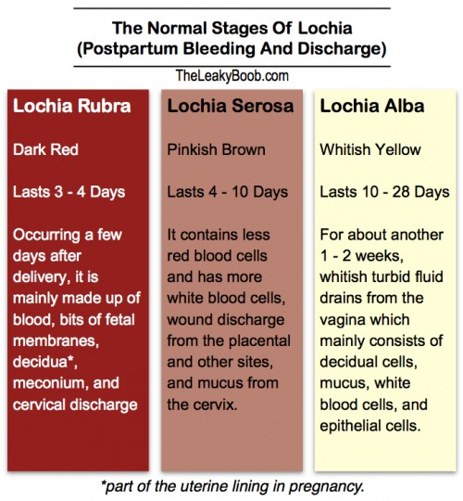

Slide 8
4- After Pain
Uterine contractions that continue following delivery. To Stop the bleeding from the area where the placenta was attached.
Characteristic of after pain:
Occur during the 1st 2-3 days of puerperium
Abdominal pains (like cramps) and back pain.
Strong, regular, and coordinated.
The intensity, frequency and regularity of contraction decrease after the 1st postpartum day.
More severe in breastfeeding mother and multiparas women
May require analgesia for pain relief (like ibuprofen).
More spacing between children reduces these pains.

Slide 9
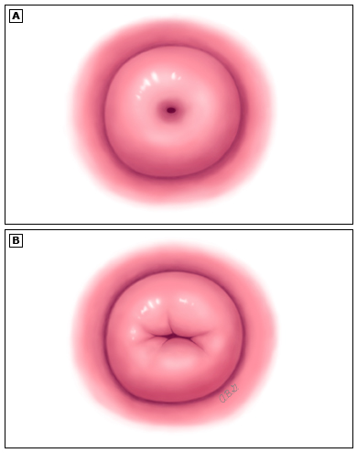
5- Cervix
In the first few days the cervix can readily admit two fingers.
By the end of the 1st week → it should
become increasingly difficult to pass more than one finger
By the end of the 2nd week→ the internal os is closes
the external os can remain open permanently, giving a characteristic funnel shape to the parous cervix.
Notes:
It loses its elasticity and regains its prepregnancy firmness.
Initially soft and edematous, and has little tone.
Small lacerations may be seen.
The cervix reverts back to the non-pregnant state, but never to the nulliparous state.

Slide 11
Vagina, hymen, pelvic muscles
The vagina is capacious and smooth immediately after delivery. It slowly contracts, but not to its nulligravid size; rugae are restored in the third week as edema and vascularity subside.
Vaginal dryness occurs due to drop in estrogen levels making sexual activity painful. (it is recommended to avoid sexual activity ( deep dyspareunia ) for 6 weeks PP)
The hymen is replaced by multiple tags of tissue called the carunculae hymenales .
Fascial stretching and trauma during childbirth result in pelvic muscle relaxation, which may not return to the pregravid state (Kegel exercises) .

Slide 12
6- hCG , hot flashes
Human chorionic gonadotropin (hCG) levels: HCG values typically return to normal, non-pregnant levels 2-4 weeks after a term delivery, but this can take longer.
The most serious concern in women with rising hCG levels postpartum is gestational trophoblastic disease
Hot flashes – Caused by estrogen withdrawal after placental delivery.

Slide 13
Ovulation and Menstruation
Menstrual flow usually returns by 6-8 weeks in women who do not breastfeed and they may ovulate as early as 27 days of delivery
Women who breastfeed have longer period of amenorrhea and anovulation and 50% of them return to period within 36 weeks of delivery
Although Ovulation may not occur for several months. Contraceptive counselling and use should be emphasized to avoid undesired pregnancy.
Notes:
The delay in the return to normal ovarian function in the lactating mother is caused by the suppression of ovulation due to the elevation in Prolactin.
This depends on some factors; which include how much and how often the baby is fed and whether the baby's food is supplemented with formula.

Slide 14
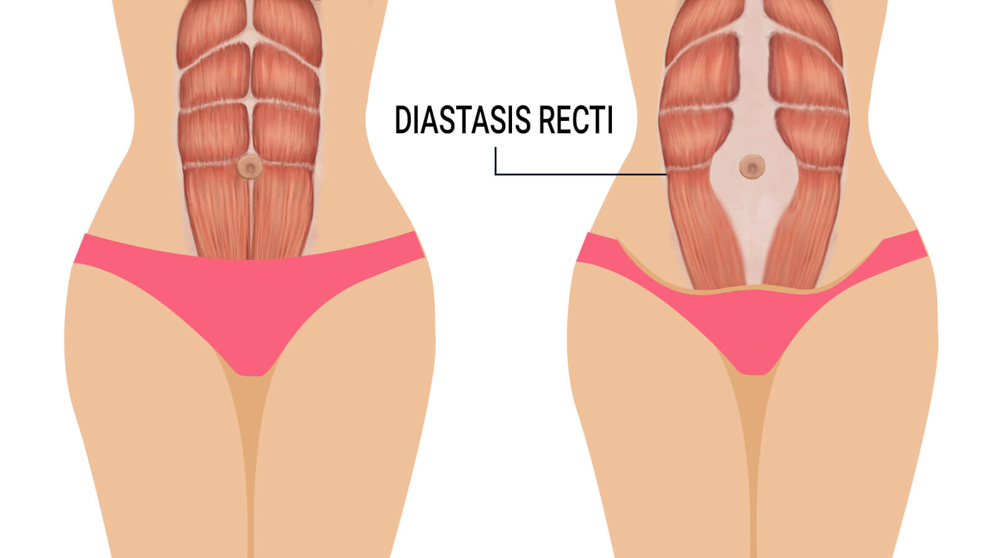
Abdominal wall
The abdominal wall is lax postpartum but regains most, if not all, of its normal muscular tone over several weeks; however, separation (diastasis) of the rectus abdominis muscles may persist.
Notes:
Long-term sequelae may include abdominal discomfort and cosmetic issues, which may be managed conservatively or surgically

Slide 16
Cardiovascular System
Immediately following delivery, there is marked increase in peripheral vascular resistance due to the removal of the low-pressure uteroplacental circulatory shunt
The cardiac output and plasma volume gradually returns to normal during the first 2 weeks of puerperium.
Rises of pulse may indicate presence of hemorrhage or infection.
Notes:
The changes that occurred during pregnancy (e.g., increases in heart rate, cardiac output, and blood volume) generally return to baseline by approximately 6 weeks postpartum.

Slide 17
Blood
Leukocytosis and thrombocytosis occur during and after labour.
Hematocrit drops because of blood loss during delivery, rises after 3 to 7 day of postpartum.
Blood volume returns nearly to pre-pregnant state in about 1 week.
Hypercoagulable state of pregnancy continues in the first 2 weeks of puerperium (risk of DVT and PE)

Slide 18
Bowel function + urinary system
Constipation : due to:
Low fiber diet , dehydration during labour
Fear of evacuation due to pain from :
– sutured perineum
Prolapsed haemorrhoids
Anal fissure
Urinary retention
The first 24 hours after childbirth, especially with difficult, traumatic or instrumental delivery, or if regional anesthesia (spinal/epidural) is used
There is diuresis during the first five days after delivery .
Increase urine production in puerperium:
Fluid overload , edema . Diuresis body’s mechanism of getting rid of the excess fluid retained during pregnancy
Increased fluid intake of breastfeeding mothers
Notes:
(advice ; on adequate fluid intake , increase fiber intake , stool softener )

Slide 19
General Physiological Changes
Weight loss
Uterine evacuation & normal blood loss: 5-6 kg.
Loss of plasma volme and diuresis of extracellular fluid: 2-3 kg.
Temperature
A reactionary increase may occur following difficult delivery, but does not exceed 38°C and drops within 24 hours. This rise in temperature is due to the absorption of waste products of muscular contractions of labor.
Notes:
Weight loss depends on mother’s weight gain during pregnancy, and activity
Well management of weight can help reduce risk of cardiovascular diseases.

Slide 20
Hair and Skin
Striae, if present, fade from red to silvery but are permanent.
Abdominal skin may remain lax if extensive rupture of elastic fibers occurred during pregnancy.
Chloasma resolves, although the timing is not known.
The increase in the ratio of "growing" or anagen hair relative to the "resting" or telogen hair during pregnancy reverses in the puerperium.
Notes:
Telogen effluvium is the hair loss commonly noted one to five months after delivery. It is usually self-limited with restoration of normal hair patterns by 6 to 15 months after delivery.

Slide 21
Psychological problems:
Baby blues
* 50 to 85% of women experience postpartum blues during the first few weeks after delivery.
Symptoms : feelings of sadness, mood lability, tearfulness, anxiety or irritability , Feeling overwhelmed and that you cant take care of the baby
Onset : 4-5 day after delivery and may last for a few hours or a few days.
Remitting spontaneously within two weeks of delivery

Slide 22
Post Partum Depression PPD
Related solely to pregnancy and childbirth
PPD generally lasts for 3-6 months, with 25% of patients still affected at 1 year.
PPD greatly affects the patient's ability to complete activities associated with daily living.

Slide 23
The symptoms of postpartum depression include:
Depressed or sad mood
Tearfulness
Loss of interest in usual activities
Feelings of guilt
Feelings of worthlessness or incompetence
Fatigue
Sleep disturbance
Change in appetite
Poor concentration
Suicidal thoughts

Slide 24
Who is at Risk for Postpartum Depression?
Previous episode of PPD
Depression during pregnancy
History of depression or bipolar disorder
Recent stressful life events
Inadequate social supports
Marital problem
This Photo by Unknown Author is licensed under CC BY

Slide 25
Postpartum Psychosis
The most severe form of postpartum psychiatric illness.
It is a rare event (1 to 2 per 1000 women) after childbirth.
Onset of symptoms: as early as the first 48 to 72 hours after delivery. The majority of women with puerperal psychosis develop symptoms within the first two postpartum weeks.

Slide 26
Symptoms :
Hallucinations
delusions
a manic mood
a low mood
sometimes a mixture of both a manic mood and a low mood - or rapidly changing moods
loss of inhibitions
feeling suspicious or fearful
restlessness
feeling very confused
behaving in a way that's out of character
Notes:
hearing, seeing, smelling or feeling things that are not there
thoughts or beliefs that are unlikely to be true
talking and thinking too much or too quickly, feeling "high" or "on top of the world“
. showing signs of depression, being withdrawn or tearful, lacking energy, having a loss of appetite, anxiety, agitation or trouble sleeping

Slide 28
Puerperal complications

Slide 29
Puerperal Pyrexia

Slide 30
definition
temperature of 38ºC or higher on any two of the first 10 days postpartum exclusive of the first 24 hours (orally)
Notes:
any pyrexia associated with tachycardia merits investigation
sites associated with puerperal pyrexia include chest, throat, breasts, urinary tract, pelvic organs, Caesarean or perineal wounds

Slide 31
Wound infection
Inflammation in the site of cesarian incision, episiotomy, laceration associated with delivery,
On exam, painful erythematous and edematous wound and discharge or vulvar edema
with fever persistent despite antibiotic treatment
develop around postoperative day 4
Treatment
remove suture under tension
Clean and dress with antiseptic solution
Analgesia + antibiotics
Sitz bath
Healing by primary intension or secondary suturing

Slide 32
Breast engorgement
2-3 postpartum day if breastfeeding has not been effectively established
Breast engorgement may give rise to puerperal fever of up to 39ºC in 13% of mothers, however other infective causes must be excluded
Primary engorgement → interstitial edema and onset of copious milk production
Secondary engorgement → mother's milk supply exceeds the amount of milk removed by her infant
Treatment :
manual expression, firm support, applying an ice bag and an electric breast pump, warm compresses before feeding to enhance let-down and facilitate milk removal
mild analgesics such as acetaminophen, ibuprofen

Slide 33
Infectious Mastitis
Mastitis can occur when a blocked duct obstructs the flow of milk and distends the alveoli so milk extravasates into the perilobular tissue, initiating an inflammatory process
affected segment of the breast is painful and appears red and oedematous , Flulike symptoms develop associated with a tachycardia and pyrexia
The most common infecting organism is Staphylococcus aureus, which is found in 40 % of women with mastitis. Other bacteria include (coagulase-negative , staphylococci and Streptococcus viridans.)
The most common sources of infection are, first, from the baby’s nose or throat and, second, from an infected umbilical cord

Slide 34
Management:
includes isolation of the mother and baby, stop breastfeeding from the affected breast, expression of milk either manually or by electric pump
microbiological culture and sensitivity (Flucloxacillin can be used while awaiting sensitivity results)
Then appropriate antibiotic should be continued for 7 to 10 days
As complication
About 10 % of women with mastitis develop a breast abscess. Treatment is by a radial surgical incision and drainage under general anaesthesia.

Slide 35
Chest complications
first 24 hours after delivery particularly after general anesthesia
Atelectasis
Aspiration pneumonia
Ass. With general anasthesia
associated with fever
can be prevented by physiotherapy
Mendleson’s syndrome
spiking temperature, wheezing, dyspnea, and hypoxia

Slide 36
Venous thromboembolism and pulmonary embolism
RISK FACTORS
age >35 years
hypertension
and postpartum bleeding.
Previous VTE
High body mass index / immobilization
Caesarean delivery or operative delivery
Clinical Picture:
Pulmonary embolism: Acute-onset dyspnea, sharp pain, and hemoptysis
DVT : Edema, Leg pain, Tenderness, Warmth or erythema of the skin over particular area
Notes:
thromboembolic disease rises five-fold during pregnancy and the puerperium (hypercoagulable state ) The last trimester and immediate postpartum carry the highest risk
more common after Caesarean section

Slide 37
INVESTIGATION:
lower limb compression ultrasound done within 24-48 hr
Venography and MRI can b useful
Treatment:
full anticoagulant therapy (ex: Heparins, warfarin, factor Xa inhibitors)
Endovascular and surgical interventions
Percutanous transcatheter treatment of DVT (Thrombus removal, Mechanical thrombectomy, Angioplasty, Stenting)

Slide 38
Hypertension
patients with severe pre-eclampsia should be managed for the first 24 hours on a high-dependency unit until their blood pressure is controlled and they achieve a good diuresis.
Their blood pressure should be kept under 150/100mmhg
Labetolol or slow-release nifedipine are good choices for this, and are commonly needed for 1–2 weeks postnatally
Patients who still hypertensive beyond 6weeks should be referred to a specialist
Blood pressure should be tested in every postnatal visit
Notes:
as most of eclamptic fits occur postnataly and it’s the highest risk to have fluid overloud during this period

Slide 39
Urinary complications Urine retention
Leave an indwelling catheter on continuous drainage for 48 hours.
After the bladder has been continuously emptied, the catheter can be removed and then the volumes of urine passed can be monitored.
Notes:
Other than infection, urinary retention is the commonest complication following delivery, especially if there has been any trauma to the urethra and resulting oedema round the bladder neck.
A painful episiotomy may make it very difficult for women to spontaneously micturate and retention of urine may occur.
Following epidural anaesthesia, there may be temporary interruption of the normal sensory stimuli for bladder function and over‐ distension of the bladder may occur.
It is extremely important that in the immediate postnatal period urinary retention is avoided as over‐distension may lead to an atonic bladder, which is then unable to empty spontaneously.

Slide 40
Incontinence of urine
Urinary incontinence will occur in approximately 15% of women who will have it to persist for 3 months after birth.
It is more frequently seen following instrumental delivery and least frequently after elective caesarean section.
Complications to the ureter are most commonly seen after a complicated caesarean section, when ureteric injury may either result in a ureteric fistula or ureteric occlusion.
Notes:
Women with this type of urinary problem should referred to a urological colleague for surgical management.

Slide 41
Urinary tract infection
Clinical picture :
Lower urinary symptoms : frequency, urgency, dysuria , haematuria
For pyelonephritis : fever, vomiting and flank pain and tenderness
Management :
Fluid if there is signs of dehydration
Proper antibiotic : Trimethoprim-sulfamethoxazole , nitrofurantoin, ciprofloxacin
Notes:
Voiding difficulty and over-distension of the bladder are common after childbirth specially after epidural anesthesia (the bladder may take up to 8 hours to regain normal sensation) Overstretching of the detrusor muscle
who have undergone a traumatic delivery
may find it difficult to void because of pain
increase the chance for retention

Slide 42
Incontinence of feces
35% of women undergoing their first vaginal delivery develop anal sphincter injury. Approximately 10% will still have anal symptoms of urgency or incontinence at 3 months after birth.
Etiology include
instrumental delivery (use of vacuum 16% extraction is associated with less perineal trauma than forceps 32% delivery)
Prolonged second stage of labour,
birthweight over 4.0 kg,
occipito‐posterior position
episiotomy.
In women who have a recognized anal sphincter rupture, 37% continue to have anal incontinence despite primary sphincter repair.

Slide 43
Puerperal sepsis (Genital tract infection)
Placental separation exposes area equivalent to an open wound, retained products of conception and blood clots within the uterus can provide a culture medium for infection. Although associated lacerations of the genital tract, Caesarean section wound and episiotomy.
Etiology
usually polymicrobial (mixed flora normally colonizes the perineum and lower genital tract.)
Notes:
Maternal and Child Health in UK reported that, in 2003–5, genital tract sepsis accounted for 14% of direct causes of maternal death. Although some followed miscarriage or after preterm prelabour rupture of membranes (PPROM) majority of deaths occurred post-natally indicating that puerperal fever was a significant factor in maternal death.

Slide 44
Risk factors
Antenatal intrauterine infection
Caesarean section
Cervical cerclage
Prolonged labour or Prolonged rupture of membranes
Instrumental delivery
Multiple vaginal examinations
Manual removal of the placenta
Retained products of conception
Non-obstetric, e.g. obesity, diabetes, human immunodeficiency virus (HIV)

Slide 45
Symptoms and signs
general : fever, Malaise, rigors headache
Abdominal: discomfort, vomiting and diarrhoea,
Genitals: Offensive lochia and Secondary post partum hemorrhage
Pyrexia, tachycardia
toxic look, pallor
Infected wounds – Caesarean/episiotomy
Peritonism
Paralytic ileus
Uterus –subinvluoted, boggy, tender
Indurated adnexa (parametritis)
Bogginess in pelvis (abscess)

Slide 46
Investigations
CBC
Urea and electrolytes
Clotting screen
ABG
High vaginal swabs
Pelvic ultrasound
Notes:
CBC …..Anaemia, leukocytosis, thrombocytopenia
Urea and electrolytes ….Fluid and electrolyte imbalance
High vaginal swabs….. Infection screen and blood culture
Pelvic ultrasound….. Retained products, pelvic abscess
Clotting screen …..(haemorrhage or shock) DIC ,
ABG….. Acidosis and hypoxia (shock)

Slide 47
Complications
Early :
wound infection, metritis, pelvic cellulitis, pelvic abscess, pelvic thrombophlebitis and septic shock
Late :
Infertility : like in perisalpingitis and Tubo-ovarian abscesses
Intrauterine adhesion
Rare :
Necrotizing fasciitis
Notes:
endotoxins produced during bacteriolysis
Clostridium perfringens

Slide 48
Treatment
Bed rest
Increase oral fluid intake / IV fluid
Analgesia , antipyretics
IV antibiotics
clindamycin 900mg every 8 h plus gentamicin 5mg/kg every 24h
If GBS colonize : plus ampicillin 2g IV every 6h
Isolate baby just if the mother severely ill
Notes:
PREVENTION
awareness of general hygiene
Control medical condition like anemia and diabetes
aseptic cautions during delivery
prophylactic antibiotics during emergency Caesarean section (amoxiclav or cephalosporin plus metronidazole)

Slide 49
Subinvolution of the uterus : The involution is impaired and retracted
Causes : grandmultiparity , multiple gestation, polyhydrominous, cesarian section, prolapsed uterus , uterine fibroids
Clinical features : mainly asymptomatic
Abnormal lochial discharge either excessive or prolonged
Excessive uterine bleeding
Irregular cramp like pain due to presence of retained products or rise in temperature in case of sepsis

Slide 50
continue
Signs :
the uterine height is greater than the normal for the particular day of puerperium
Presence of features responsible for subinvolution
Management : only when present with other pathology
antibiotics in endometritis
Exploration of uterus in retained products
Pessary in prolapse
Early ambulation postpartum
Daily document of fundal height

Slide 51
PPH : Defined as Bleeding of more than 500cc in the first 24hs after vaginal delivery More than 1000cc after Cesarean section OR according to ACOG : 10% drop in Hematocrit value between the admission and puerperium
Types
PPH occurring in the first 24 hours after delivery: primary or early PPH
PPH occurring from 24 hours to 6weeks after delivery: secondary, late, or delayed PPH.
Notes:
Epidemiology :6% of all delivery

Slide 52
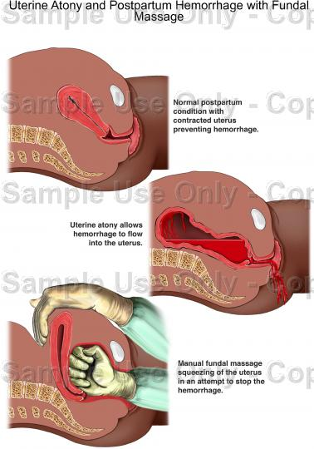
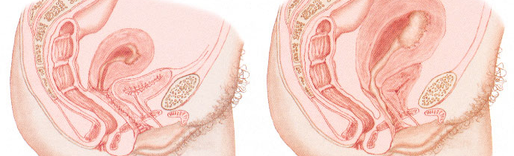
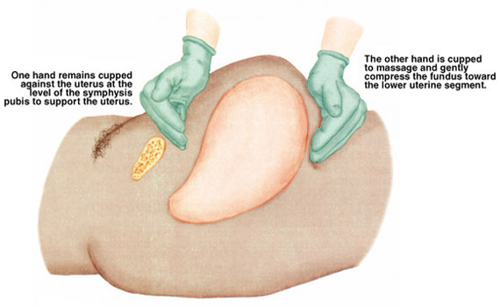
Causes of PPH uterine:
1-uterine atony
Management
1- uterine massage of fundus
2-drugs: uterotonic agents (e.g. oxytocin, methylergonovine, or carboprost)
3-compression
4-surgery
Notes:
Marked hypotonia of the uterus
Uterus is flaccid after detachment of all parts of the placenta, brisk venous bleeding occurs
Leading cause of PPH
Associated with high parity, polyhydramnios, macrocosmic fetus,multifetal gestation,Traumatic birth,Magnesium Sulfate,Rapid or prolonged labor,Chorioamnionitis, vitamin D defiecncy,Use of Oxytocin for labor induction or augmentation
Uterus is overstretched and contracts poorly after birth
Clinical findings: a soft spongy boggy uterus

Slide 53
2.Retained Placenta
May result from partial separation of a normal placenta
Entrapment of the partially or completely separated placenta by an hourglass constriction ring of the uterus
Mismanagement of the third stage of labor
Abnormal adherence of the entire placenta or portion of the placenta to the uterine wall
Adherent Retained Placenta
Clinical features : incomplete placenta on inspection
crampy low abdominal pain, a uterus larger than appropriate
Management : manual removal ,curettage , manage accreta
Notes:
Adherent Retained Placenta
Result from zygotic implantation in an area of defective endometrium so that there is no separation between the placenta and decidua
Manual removal of the placenta is generally unsuccessful
Degrees of attachment
Placenta accreta- slight penetration of myometrium
Placenta increta- deep penetration of myometrium by placenta trophoblast
Placenta percreta- deep perforation of uterus by placenta

Slide 54
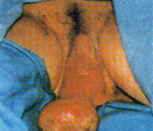
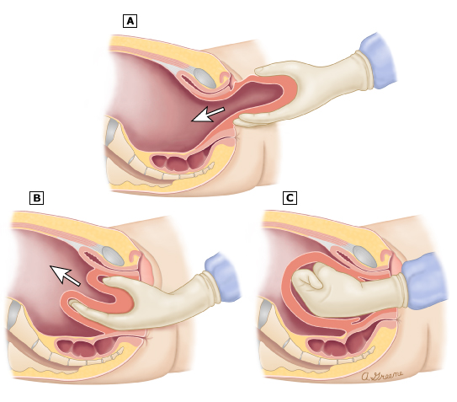
3.Uterine inversion
Inversion- a large, red, rounded mass , the endometrium is exposed (perhaps with placenta attached) protrude 20 to 30 cm outside the introitus
Contributing factors are:
Myometrial weakness , traction of cord in an unprofessional way, fibroids, polyps
Management : correct inversion (push fundus inside then give uterotonic agents)

Slide 55
4-Uterine rupture: complete disruption of all uterine layers
Non-uterine
Lower genital tract lacerations(vagina, cervix, perinium; suspected when the bleeding continues despite firm contracted uterus and use of assisted vaginal delivery)
Pelvic hematomas (vulvar(most common ), vaginal) Woman complains of a persistent perineal or rectal pain, or a feeling of pressure in the vagina
Coagulation disorders DIC :amniotic fluid embolism, placental abruption, sever preeclampsia , retention of dead fetus
Inherited coagulopathy

Slide 56
Precautions for high risk groups :
Obtain 2 large bore IV access before delivery
Hydration
Oxytocic agents
Cross match 2 units of blood

Slide 57
Prevention of PPH
Active management of 3rd stage of labor:
Administration of a utero-tonic (IM slowly) with delivery of anterior shoulder or within 1 min of birth
Early cord clamping
Applying controlled cord traction
Inspection of placenta and
Exploration of cervix & upper vagina and make sure there’s no active bleeding
Massage the abdomen for a few minutes every 15 minutes for the first two hours to help the uterus to continue to contarct
Notes:
2 by two sponge forceps with 2-3 cm in between and cutting (delay of 1 minute is advisable)
3 while applying counter-traction on uterus by pressing one hand just above the mothers pubic bone (don’t pull immediately, maintain tension until next uterine strong contraction ((round uterus)), to not dislodge the placenta)

Slide 59
contraception
Sterilization can be offered to mothers who are certain that they have completed their family
breast feeding: fully breastfeeding her baby has a less than 2% chance of conceiving in the first 6 months
Barriers
IUCD (it is best to wait for 4–8 weeks to allow for involution)
Progesterone only pills
Injectable contraception,
Notes:
such as depot medroxyprogesterone acetate (Depo-Provera™) or norethisterone enantate (Noristerat™)

Slide 60
Breastfeeding
Notes:
CBC …..Anaemia, leukocytosis, thrombocytopenia
Urea and electrolytes ….Fluid and electrolyte imbalance
High vaginal swabs….. Infection screen and blood culture
Pelvic ultrasound….. Retained products, pelvic abscess
Clotting screen …..(haemorrhage or shock) DIC ,
ABG….. Acidosis and hypoxia (shock)

Slide 61
Physiology of lactation
At puberty, the milk ducts that lead from the nipple to the secretory alveoli are stimulated by oestrogen to sprout, branch and form glandular tissue buds from which milk‐secreting glands will develop.
During pregnancy, breast tissue is further stimulated so that pre‐existing alveolar–lobular structures hypertrophy and new ones are formed.
At the same time milk‐collecting ducts also undergo branching and proliferation. Both oestrogen and progesterone are necessary for mammary development in pregnancy but prolactin, growth hormone and adrenal steroids may also be involved.
During pregnancy only minimal amounts of milk are formed in the breast despite high levels of the lactogenic hormones prolactin and placental lactogen. This is because the actions of these lactogenic hormones are inhibited by the secretion of high levels of oestrogen and progesterone from the placenta and it is not until after delivery that copious milk production is induced.

Slide 62
Colostrum
Colostrum is a yellowish fluid secreted by the breast that can be expressed as early as the 16th week of pregnancy, but is replaced by milk during the second postpartum day.
Colostrum has a high concentration of proteins (immunoglobulin (Ig) A, which plays an important role in protection against infection).
It also contains large fat globules (but contains less sugar and fat than breast milk).
Colostrum is believed to have a laxative effect, which may help empty the baby's bowel of meconium.

Slide 63
Breast milk
The major constituents of breast milk are lactose, protein, fat and water. However, the composition of breast milk is not constant.
Lactalbumin is the major protein in breast milk.
In addition to IgA, breast milk contains small amounts of IgM and IgG and other factors such as lactoferrin, macrophages, complement and lysozymes.

Slide 64
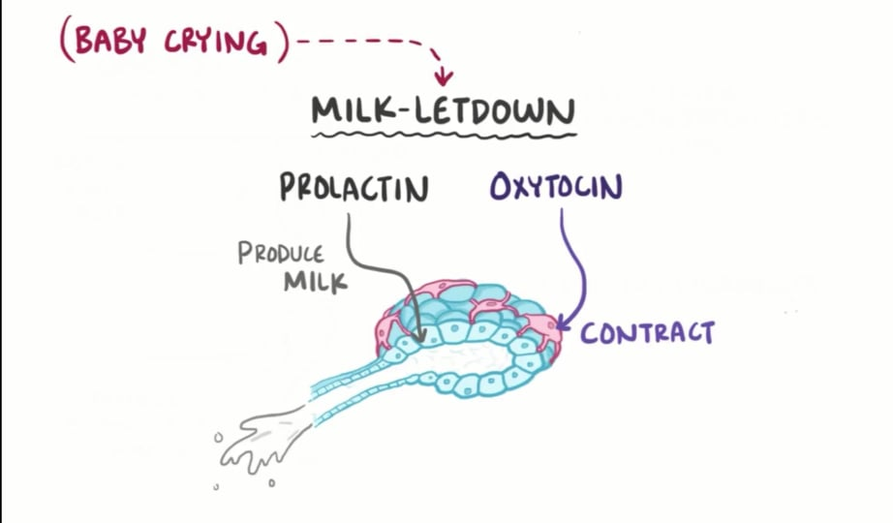
Milk ejection reflex
Successful breastfeeding depends as much on effective milk transfer from the breast to the baby as on adequate milk secretion.
The milk ejection reflex is the release of oxytocin from the posterior pituitary gland .
Oxytocin causes contraction of the sensitive myoepithelial cells that are situated around the milk‐secreting glands and also dilates the ducts by acting on the muscle cells that lie longitudinally in the duct walls.
Contraction of these cells therefore has the dual effect of expelling milk from the glands and of encouraging free flow of milk along dilated ducts.
This is recognized by the mother as milk ‘let‐down’ and she may be aware of milk being ejected from the opposite breast from which the baby is suckling.

Slide 65
In contrast to prolactin, which is secreted only in response to suckling, oxytocin can be released in response to sensory inputs such as the mother seeing the baby or hearing its cry.
Oxytocin has a very short half‐life in the circulation and is released from the posterior pituitary in a pulsatile manner.

Slide 66
The milk ejection reflex is readily inhibited by emotional stress and this may explain why maternal anxiety frequently leads to failure of lactation.
Successful breastfeeding depends on engendering confidence in the mother and ensuring correct fixing and suckling on the nipple.
Another factor that is of potential physiological importance as an inhibitor of breast milk is: when the milk is not effectively stripped from the breast at each feed, this will inhibit lactopoiesis and lead to a fall in milk production.

Slide 67
Mechanisms of lactational amenorrhoea
The key event is a suckling‐induced change in the hypothalamic sensitivity to the feedback effects of ovarian steroids.
During lactation, the hypothalamus becomes more sensitive to the negative feedback effects and less sensitive to the positive feedback effects of oestrogen.
This means that if the pituitary secretes enough follicle‐stimulating hormone to initiate the development of an ovarian follicle, the consequent oestrogen and inhibin secretion will inhibit gonadotrophin production and the follicle will fail to mature.
From a clinical standpoint, the major factor is the frequency and duration of the suckling stimulus, although other factors such as maternal weight and diet may be important confounding factors.
If supplementary food is introduced at an early stage, the suckling stimulus will fall and early ovulation and a return to fertility.

Slide 68
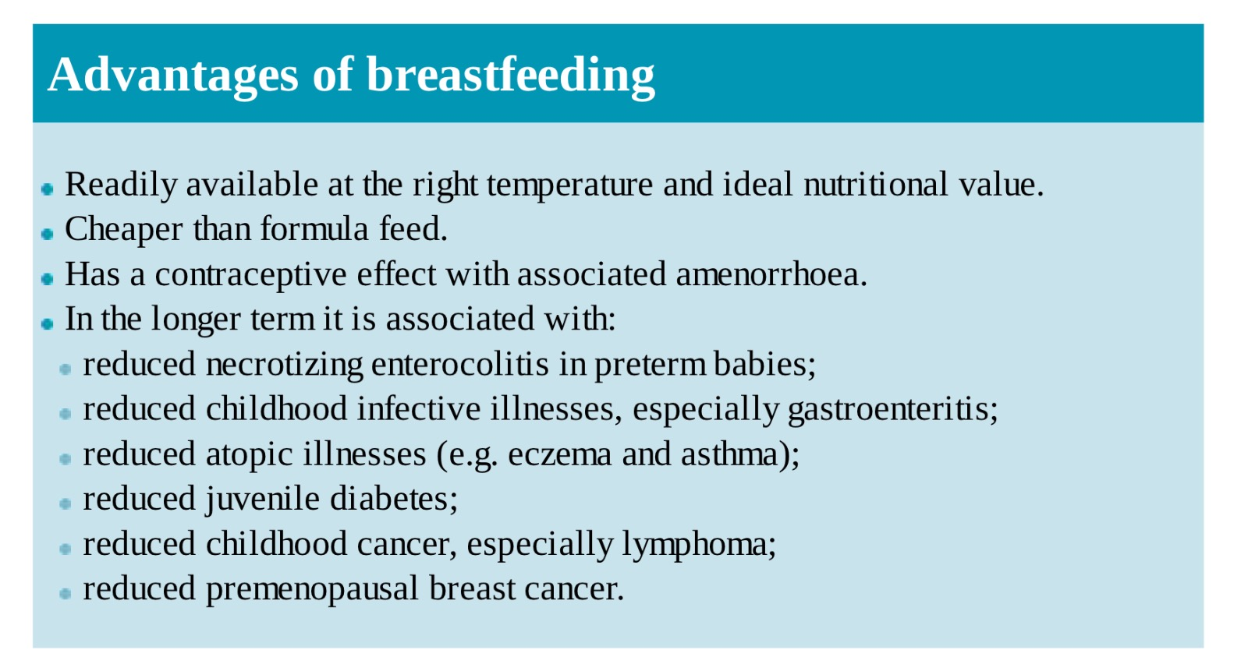

Slide 70
Non-breastfeeding mothers
Non-breastfeeding mothers may suffer considerable engorgement and breast pain.
Dopamine receptor stimulants, such as bromocriptine and cabergoline, inhibit prolactin and thus suppress lactation. However, both commonly cause drowsiness, hypotension, headache and gastrointestinal side-effects.
Furthermore, fluid restriction and a tight brassiere have been shown to be as effective as bromocriptine usage by the second week and therefore this is the method of choice for the suppression of lactation.

Slide 71
Thank You (:

