Slide 1
The Rickettsiae HLS Module 2022-2023
Dr. Mohammad Odaibat
Mutah university
Faculty of Medicine

Slide 2
The Rickettsiae
The rickettsiae are a heterogeneous group of small, obligately intracellular, gram-negative coccobacilli and short bacilli, most of which are transmitted by a tick, mite, flea, or louse vector.
The rickettsiae has six genera:
Rickettsia
Coxiella
Orientia
Ehrlichia
Anaplasma
Neorickettsia

Slide 3
The Rickettsiae
The clinical manifestations of all the acute presentations are similar during the first 5 days: fever, headache, and myalgias with or without nausea, vomiting, and cough.
As the course progresses, clinical manifestations—including ocurrence of a macular, maculopapular, or vesicular rash; pneumonitis; and meningoencephalitis— vary from one disease to another.

Slide 4
Coxiella burnetii

Slide 5
Coxiella burnetii
The causative agent of Q fever.
he “Q” comes from “query” fever, the name of the disease until its true cause was discovered in the 1930s
Highly resistant to environmental stresses.
It can survive standard disinfectants
It replicates in host monocytes and macrophages. (Resistant to the phagolysosomal environment).
The organism is killed by pasteurization.
Notes:
Survive 7 to 10 days on wool at room temperature, 1 month on fresh meat in cold storage, 120 days in dust and more than 40 months in skim milk.

Slide 6
Transmission
This bacteria naturally infects some animals, such as goats, sheep, and cattle.
C. burnetii bacteria are found in the birth products (i.e. placenta, amniotic fluid), urine, feces, and milk of infected animals.

Slide 7
How do people become infected with C. burnetii bacteria?
Most infections are contracted by breathing in air contaminated with the C. burnetii organism from animals aborting or birthing
From dried contaminated materials
Through direct contact between infected materials (tissues, fluids, wool, straw, manure, etc) and skin abrasions or mucous membranes.
By drinking unpasteurized milk
Via tick bites

Slide 8
Transmission
Person-to-person transmission is extremely rare.
Transplacental transmission may occur resulting in congenital infection.
Transmission from blood transfusions, bone marrow transplants, and intradermal inoculations have also been reported.
Sexual transmission in a rare number of human cases.
Persons at risk include
Farmers, livestock producers, veterinarians, abattoir workers
Laboratory personnel performing culture and diagnostics

Slide 9
Disease in Human
Incubation period
Varies from 2 to 40 days (mean around 20 days).
Infectious dose
As few as one organism is capable of causing disease.
Clinical illness
60% asymptomatic
40% show signs of clinical illness.
The clinical forms of the disease are:
Acute (less than 6 months duration)
Chronic (greater than 6 months duration).

Slide 10
Acute Infection
Disease in Human
Symptoms :
Vary in severity and duration; a self-limited febrile or flu-like illness often occurs.
Signs include
Fever, chills, “sweats”, headache, fatigue, anorexia, malaise, myalgia, and chest pain.
Duration of illness:
From 1-3 weeks.
Outcomes of acute infection:
30 to 50% of patients with symptomatic illness will develop pneumonia. In more severe cases, a nonproductive cough with pneumonitis may develop.
-

Slide 11
Acute Infection
Disease in Human
Many clinically ill patients will have abnormal liver enzymes, and some will develop hepatitis although jaundice is rare.
Exanthema (rash) occurs in about 10% of cases.
Rarely meningoencephalitis or pericarditis may occur with acute infection.
Only 2% of acute infections require hospitalization and a similar percentage result in death.

Slide 12
Human Disease
Chronic Disease
Occurs in 1 to 5% of cases.
It is typically develops in persons with pre-existing cardiac valvular disease, Immunocompromised persons and pregnant women
Endocarditis is the major clinical presentation and accounts for 60 to 70% of all chronic Q fever cases.
Infection can also affect the liver causing granulomatous hepatitis or cirrhosis. Kupffer cells are considered to be target cells for C. burnetii.
Involvement in bone has also been reported.

Slide 13
Human Disease
Risk to Pregnant Women
Most asymptomatic
Transplacental transmission
Reported complications
In-utero death
Premature birth
Low birth weight
Placentitis
Pregnants may pose a degree of risk to medical staff
Animal Disease
Sheep, cattle, goats
May be asymptomatic
Reproductive failure
Abortions
Stillbirths
Infertility
Weak newborns
Low birth weights
Carrier state

Slide 14
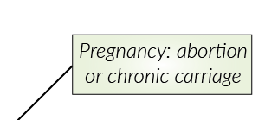
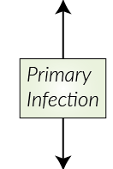
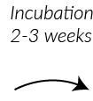
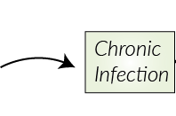
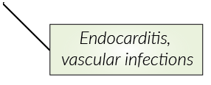
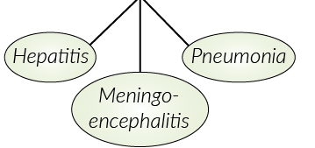

Slide 15
Prognosis
Self-limiting: resolve within 2-14 days.
50 to 60% of cases are asymptomatic, and complications from the acute form of disease are rare.
2% of persons infected develop severe disease and require hospitalization.
The mortality rate is 1% or lower if treated.
Active chronic disease is usually fatal if untreated.
In patients with endocarditis, the fatality rate can range from 45 to 65%; additionally, 50 to 60% need valve replacement surgery.

Slide 16
Prevention and Control
Pasteurization
Disinfection (10% bleach)
Eradication not practical
Too many reservoirs
Constant exposure
Stability of agent in environment
Q Fever as a Biological Weapon
Low infectious dose
Stable in the environment
Aerosol transmission

Slide 17
Prevention and Control
Tick prevention
Disposal of birth products
Separate new or sick animals
Treatment
Treatment
Doxycycline
Chronic disease – long course
2 to 3 years of medication
Immunity
Long lasting (possibly lifelong)

Slide 18
Case
Male dairy farmer
Age 46
Sudden onset of fever, chills, cough
Initially diagnosed as influenza
Symptoms persisted for 2 weeks
Presented to emergency room
Again diagnosed as influenza
Referral to infectious disease specialist
Tested positive for Q fever
Antibiotics for 5 days
Resolved in 2 weeks
Notes:
Now let’s look at a few case studies of Q fever. A 46 year old male dairy farmer from Georgia reported a sudden onset of fever, chills, cough, and weight loss. A physician initially diagnosed influenza in the patient. Two weeks later the symptoms still persisted and the patient presented to the emergency room where he was again diagnosed with influenza.

Slide 19
Rickettsia prowazekii

Slide 20
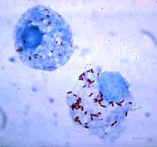
Rickettsia- Introduction
Rickettsia
Nonmotile, intracellular gram-negative, nonspore-forming, highly pleomorphic bacteria.
The term "rickettsia" has nothing to do with rickets (vitamin D deficiency ); but it was named after its discovery by Howard Taylor Ricketts.
Notes:
may occur in the forms of cocci (0.1 μm in diameter), bacilli (1–4 μm long), or threads (up to about 10 μm long).

Slide 21
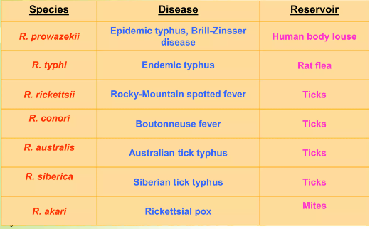
Diseases caused by Rickettsia

Slide 22
Disease caused by Rickettsia
Typhus refers to a group of infectious diseases that are caused by rickettsial organisms and results in an acute febrile illness.
Epidemic typhus (also called "camp fever", "jail fever", "hospital fever", "ship fever“, "petechial fever", "Epidemic louse-borne typhus,“ and "louse-borne typhus”
The name typhus comes from the Greek meaning hazy or smoky and commonly used as a word for delusion, describing the state of mind of those infected.

Slide 23
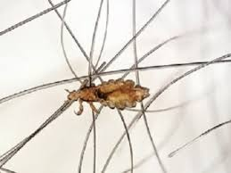
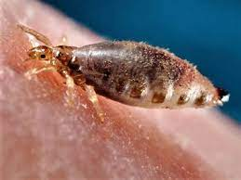
Epidemic typhus
Cause: Rickettsia prowazekii.
Vector: Body lice.
Pediculus corporis (common).
Pediculus capitis.

Slide 24
Pathophysiology
The rickettsia harbouring louse bites a human to engage in human blood meal and causes a pruritic reaction on the host’s skin.
A louse defecates as it eats; when the host scratches the site, the lice are crushed and Rickettsia is inoculated into the bite wound.
The rickettsia travel to the blood stream and rickettsaemia develop.
Rickettsia parasitizes the endothelial cells of the blood vessels.
The organisms proliferate and cause endothelial cellular enlargement with resultant multi-organ vasculitis.

Slide 25
Pathophysiology
Multi-organ vasculitis may cause thrombosis (deposit of leucocytes, macrophages and platelets).
Gangrene of the distal portions of the extremities, nose, ear lobes and genitalia may occur as the result of thrombosis of supplying blood vessels
Vasculitis may also result in loss of intravascular colloid with subsequent hypovolaemia and decrease tissue perfusion and possibly organ failure and loss of electrolytes.
Notes:
Hyperplasia of endothelial cells and localized thrombus formation lead to obstruction of blood flow, with escape of RBC's into the surrounding tissue. Inflammatory cells also accumulate about affected segments of blood vessels. This angiitis appears to account for some of the more prominent clinical manifestations, such as petechial rash, stupor and terminal shock. Death is ascribed to damage of endothelial cells, resulting in leakage of plasma, decrease in blood volume, and shock.

Slide 26
Clinical findings
The incubation period is approximately 12 days for the typhus group.
Abrupt onset of fever.
Headache occurs abruptly and continues constantly.
Non-productive cough.
Rigors, Myalgia, Malaise.
Rash: appears after 4-5 days (is macular/papular/petechial).
Tachypnoeia
Digital gangrene.
Mild hepatosplenomegaly
Conjunctival congestion
Relative bradycardia consistent with the rise of temperature.
Lymphadenopathy (regional or generalized).

Slide 27
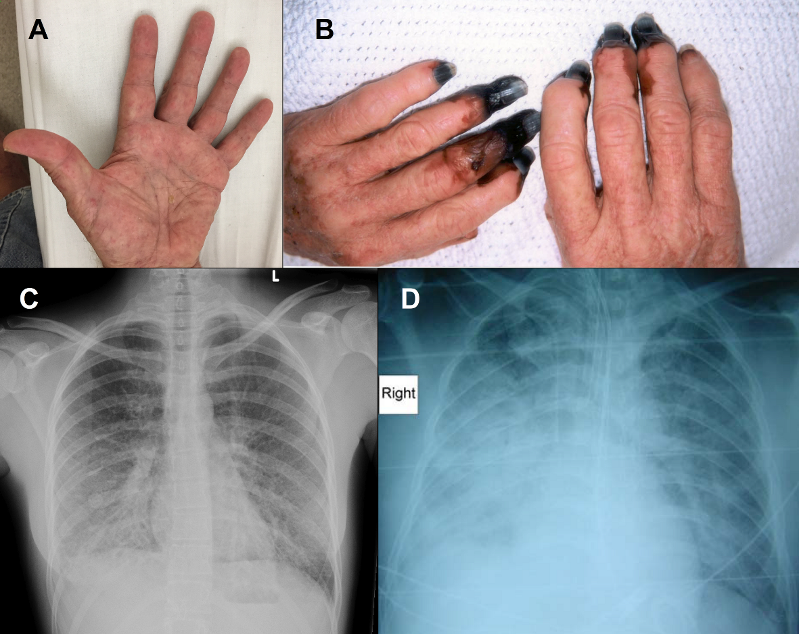
Clinical findings

Slide 28
Epidemic typhus
Diagnosis
Renal function test
Urinalysis.
Liver functional tests.
Full blood picture.
Electrolytes.
Indirect immunofluorescence (IFA) or enzyme immunoassay (EIA) testing.
Polymerase chain reaction (PCR).
Complement fixation (CF) tests.
Histology of biopsied tissues sections.

Slide 29
Epidemic typhus
Treatment
Doxycycline 200 mg PO or IV for 3 days, then maintenance dose 100 mg PO or IV Plus Chloramphenicol.
Alternatives in doxycycline resistance:
- Azithromycin.
- Rifampicin

