Slide 1
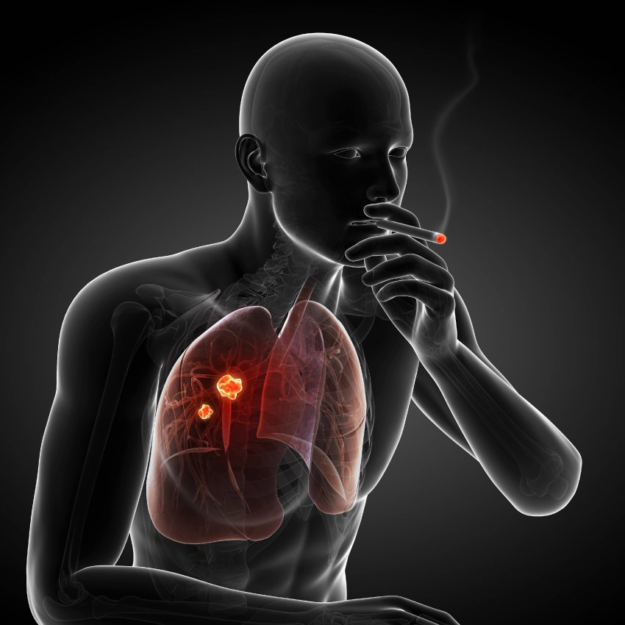
RSM-8 LUNG TUMORS-2
Dr.Eman Kreishan,M.D.
25-10-2022

Slide 2
Clinical Features
Carcinomas of the lung are insidious lesions that in many cases have spread so as to be unresectable before they produce symptoms.
chronic cough and expectoration call attention to localized, resectable disease.
Hoarseness.
chest pain.
superior vena cava syndrome.
pericardial or pleural effusion.
persistent segmental atelectasis or pneumonitis

Slide 3
symptoms caused by metastasis!!
spread to sites such as:
brain (mental or neurologic changes).
liver (hepatomegaly).
bones (pain).
Although the adrenal glands may be nearly obliterated by metastatic disease, adrenal insufficiency (Addison disease) is uncommon, because islands of cortical cells sufficient to maintain adrenal function usually persist.

Slide 4
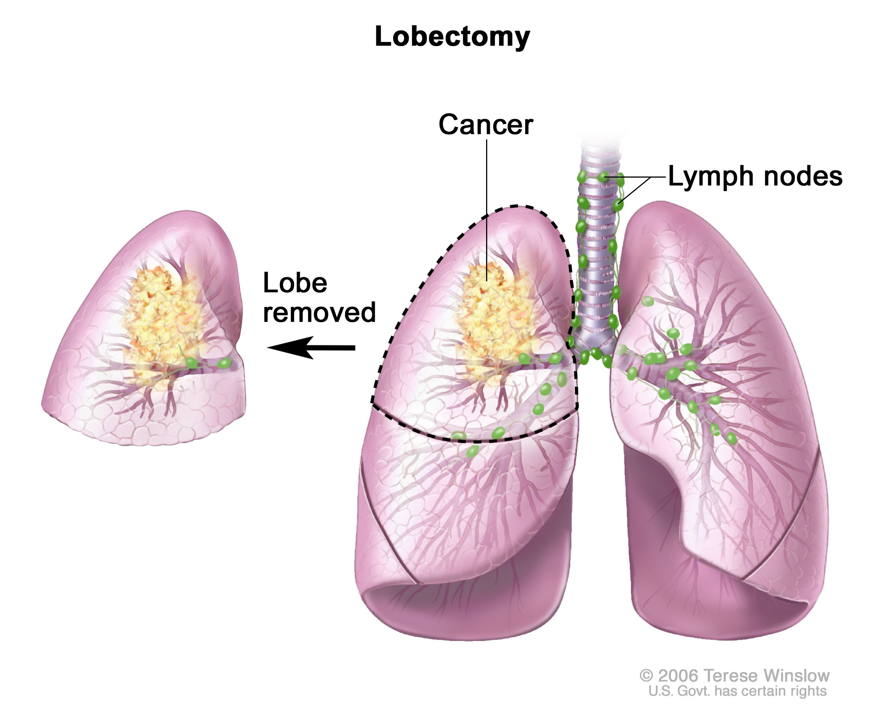
Prognosis
squamous cell carcinoma and adenocarcinoma carry a more favorable prognosis than small cell carcinoma.
When squamous cell carcinomas or adenocarcinomas are detected before metastasis or local spread (as in high-risk patients undergoing surveillance imaging), cure is possible by lobectomy.
Unrespectable adenocarcinomas associated with targetable mutations in tyrosine kinases such as EGFR may show remarkable responses to specific inhibitors.

Slide 5
Small cell carcinoma have invariably spread by the time they are detected, even if the primary tumor appears to be small and localized; thus, surgical resection is not a viable option.
Small cell carcinoma are very sensitive to chemotherapy but invariably recur, and as of yet targeted therapies are unavailable.
The median survival even with treatment remains only 1 year

Slide 6
paraneoplastic syndromes
(1) hypercalcemia caused by secretion of a parathyroid hormone–related peptide.
(2) Cushing syndrome (from increased production of adrenocorticotropic hormone).
(3) syndrome of inappropriate secretion of anti-diuretic hormone.
(4) neuromuscular syndromes, including a myasthenic syndrome, peripheral neuropathy, and polymyositis.
(5) clubbing of the fingers and hypertrophic pulmonary osteoarthropathy.
(6) coagulation abnormalities, including migratory thrombophlebitis, nonbacterial endocarditis, and disseminated intravascular coagulation

Slide 7
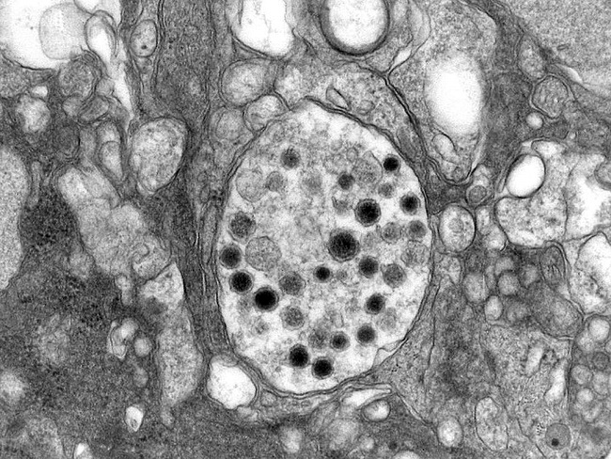
Carcinoid Tumors
Carcinoid tumors are malignant tumors composed of cells that contain dense-core neurosecretory granules in their cytoplasm and, rarely, may secrete hormonally active polypeptides.
They are best thought of a low-grade neuroendocrine carcinomas and are subclassified as:
typical.
atypical.
both are often resectable and curable

Slide 8
They occasionally occur as part of the multiple endocrine neoplasia syndrome.
Although 5% to 15% of carcinoids have metastasized to the hilar nodes at presentation, distant metastases are rare

Slide 9
MORPHOLOGY
Most carcinoids originate in main bronchi and grow in one of two patterns:
(1) an obstructing polypoid, spherical, intraluminal mass.
(2) a mucosal plaque penetrating the bronchial wall to fan out in the peribronchial tissue.

Slide 10
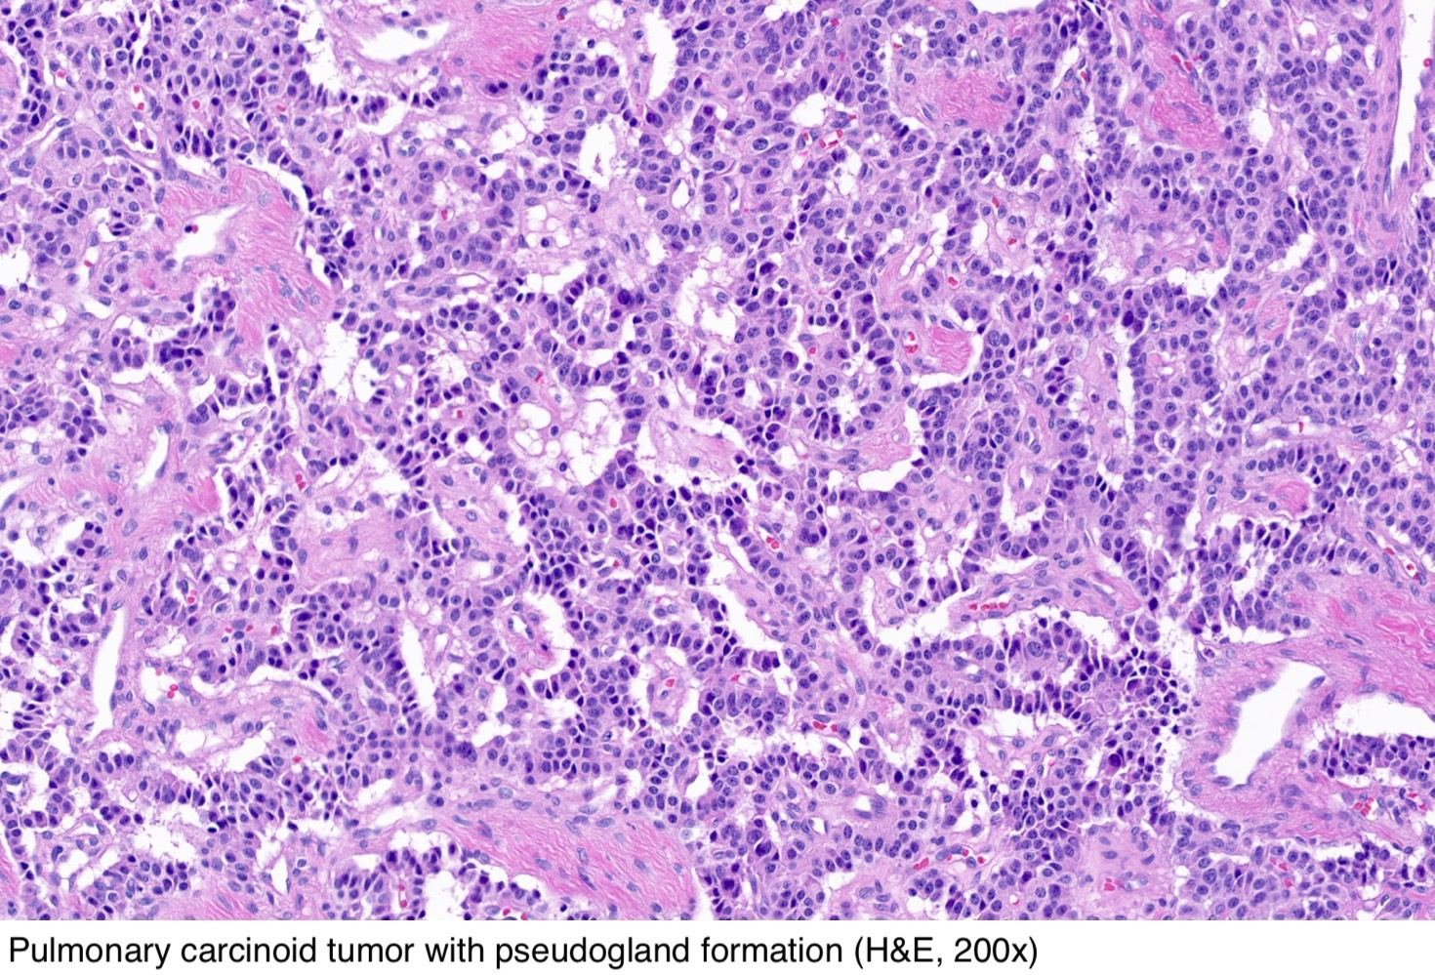
Histologically
typical carcinoids:
are composed of nests of uniform cells that have regular round nuclei with “salt-and-pepper” chromatin, absent or rare mitoses and little pleomorphism.

Slide 11
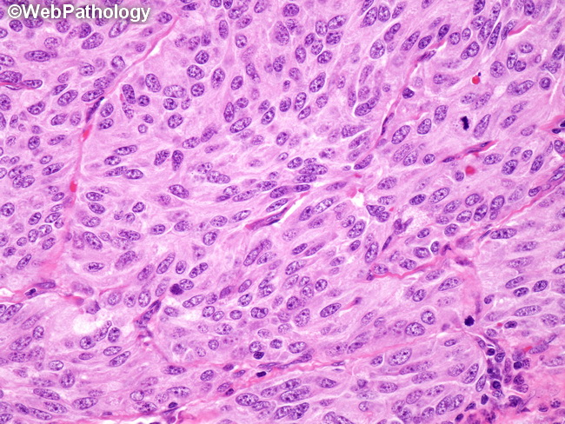
Atypical carcinoid tumors :
display a higher mitotic rate and small foci of necrosis.
These tumors have a higher incidence of lymph node and distant metastasis than typical carcinoids. Unlike typical carcinoids, the atypical tumors have TP53 mutations in 20% to 40% of cases

Slide 12
Clinical features
Most carcinoid tumors manifest with signs and symptoms related to their intraluminal growth, including cough, hemoptysis, and recurrent bronchial and pulmonary infections.
Peripheral tumors are often asymptomatic and are discovered incidentally on chest radiographs.
Only rarely do pulmonary carcinoids induce the carcinoid syndrome, characterized by :
intermittent attacks of diarrhea.
flushing.
cyanosis

