Slide 1
Aortic Dissection
Done by :
Musab Alsoud
Lara Dmour
Yakeen Rawashdeh

Slide 2
Aortic dissection
AORTIC DISSECTION: is a tearing of the layers within the aortic wall, classically associated with sudden-onset chest or back pain , a pulse deficit and mediastinal widening on a chest radiograph ((depending in the degree of involvement ,it may result in marked hemodynamic instability and often a rapid death)) *the tear usually originate in the intima .

Slide 3
The DeBakey and the stanford classification
The DeBakey classification describes three types of dissection: Type I: extends from aortic root to beyond the ascending aorta Type 11: involves only the ascending aorta type III: Begins distal to the takeoff of the left subclavian artery and has two subtypes 1-Type III A: limited to the thoracic aorta 2-Type III B : extends below the diaphragm
The Stanford classification has two types of dissection : Type A : involves the ascending aorta Type B : involves the descending aorta , distal to the left subclavian artery

Slide 5
Risk factors
1- hypertension (present in 70-90% of patient with acute aortic dissection) 2-advanced age (mean age 63) 3-male patient ( represented by 65% of male patient ) 4-family history (present as Marfan syndrome in almost 5% of patient) 5-pregnancy (50% of dissections in women under age 40yr old and most frequently occurring in the 3rd trimester) 6-circadian and seasonal variation (higher frequency in morning hours and in the winter months) 7-iatrogenic (as a consequence of invasive procedures or surgery. (EX: cardiopulmonary bypass)

Slide 6
Symptoms
1- pain
- Type A dissection(ascending aorta )
Sudden onset of sever anterior chest pain with extension to the back occurs that is described as ripping or tearing in nature .
- Type B dissection (descending aorta ): -
Patients with type B dissection are more likely to be seen with back pain alone . (interscapular region)
2- syncope
3- diaphoresis : (excessive sweating) 4- confusion or agitation.

Slide 7
Complication
1- Myocardial ischemia or infarction ( coronary artery occlusion).
2- aortic regurgitation: One half to two thirds of cases , which is mainly due to dilation of the aortic root and thus valves leaflets pulled apart .
3- cardiac tamponade :blood could back up from aorta to heart and enter pericardium and prevent the heart from filling properly (very dangerous complication).
4- hypertension: Occurs in greater than 50% of patients with dissection, more commonly with distal disease.

Slide 8
Cont...
5- Hypotension /shock: May present in up to 20% of patients with dissection.
6- pulmonary complications : Causes include rupture of the dissection into the pleural space or weeping of fluid from the aorta as an inflammatory response to the dissection.
7-Asymmetry in pulse and blood pressure.

Slide 9
Laboratory abnormalities
1- Anemia (from blood loss into false lumen can occur)
2-moderate leukocytosis (10000-14000 white cells per ml is sometimes seen)
3-lactic acid dehydrogenase and bilirubin levels may be elevated because of hemolysis within the false lumen
4-disseminated intravascular coagulation has been reported

Slide 10
Diagnosis
1-chest radiograph (it should be obtained as part of initial diagnostic evaluation ,a radiograph abnormality is seen in up to %90 of patient with aortic dissection ,most frequent is widening of the aorta and mediastinum ) however,%40 of radiograph in acute dissection lack widened mediastinum and as many as %16 are normal
2- CT and MRI and TEE (trans esophageal echocardiography ): are all highly accurate imaging modalities that can be used to make diagnosis ,all can provide acceptable diagnostic accuracy (the choice between them is best based on which is most readily available) prompt surgical consultation should be initiated in any patient with suspected dissection

Slide 11
Radiograph imaging

Slide 12
CT scan

Slide 13
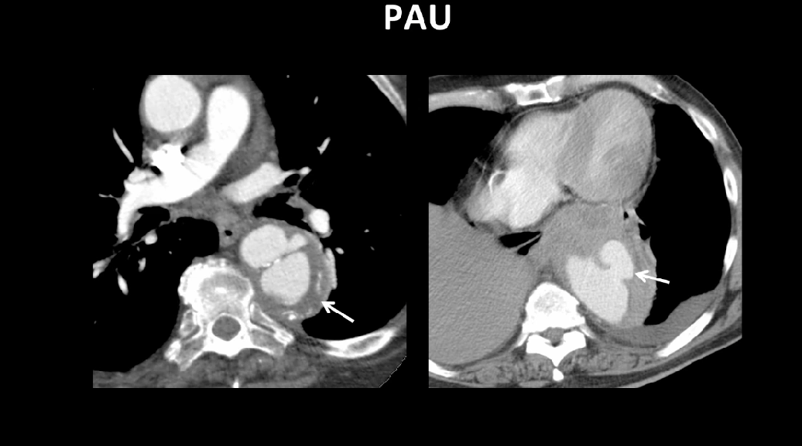

Slide 15
Treatment
People with an aortic dissection are admitted to an intensive care unit, where their vital signs (pulse, blood pressure, and rate of breathing) are closely monitored.
Death can occur a few hours after an aortic dissection begins. Therefore, as soon as possible, drugs are given intravenously to reduce the heart rate and blood pressure to the lowest level that can maintain a sufficient blood supply to the brain, heart, and kidneys.

Slide 16
Soon after drug therapy begins, we must decide whether to recommend surgery or to continue drug therapy without surgery according to the type and complications of dissection.

Slide 17
Type A Aortic Dissection
Type A is a medical emergency So it is treated surgically by : removal of dissected aorta blocks entry of blood into wall of aorta wall reconstructed with graft which is synthetic, bendy, flexible and withstand pressure graft act as aorta. the aortic valve may also need repair If damaged or leaking. Removal and repair of a dissected aorta usually takes 3 to 6 hours, and the hospital stay is usually 7 to 10 days

Slide 18
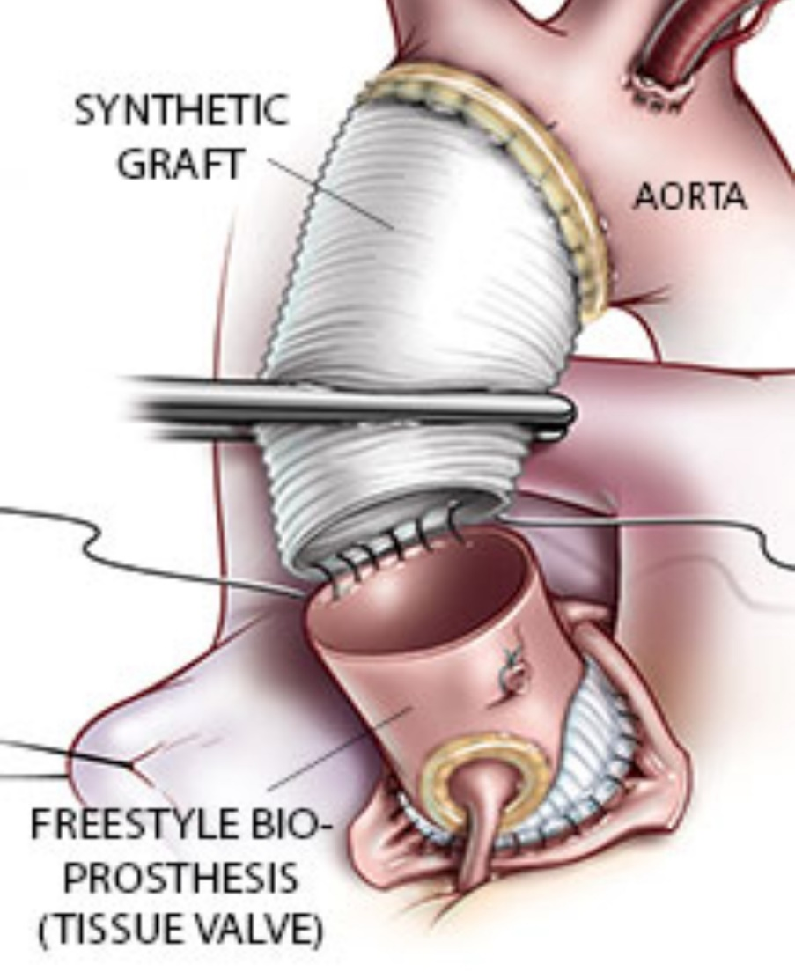
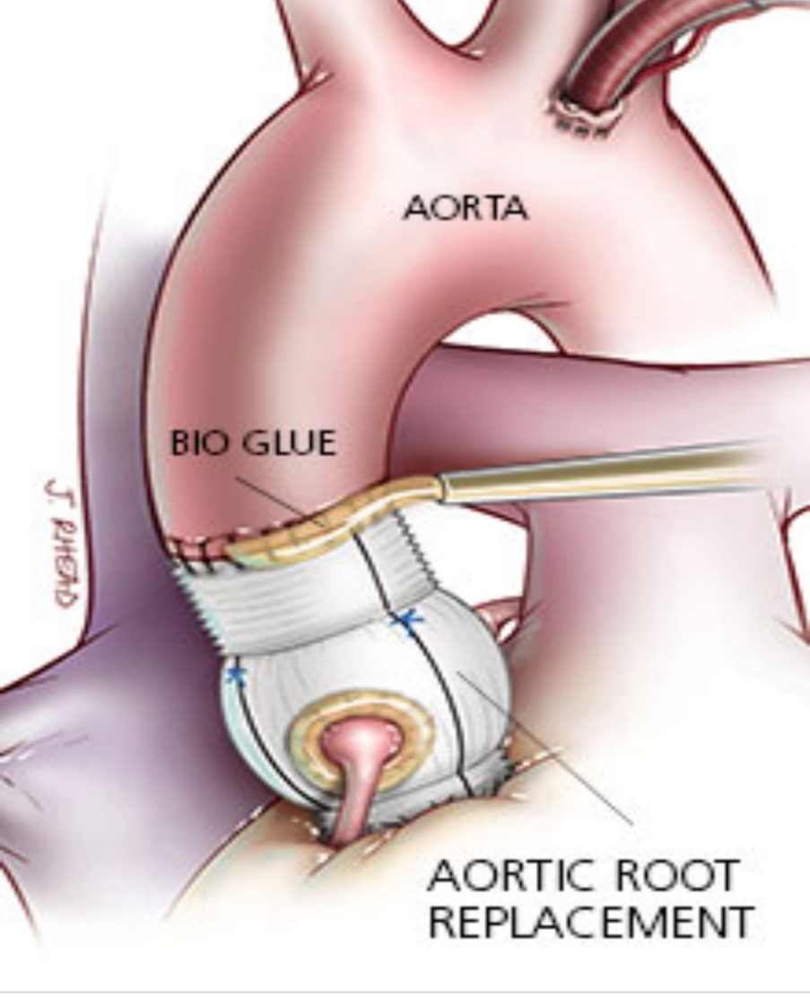

Slide 19
Type B Aortic Dissection
Patients with uncomplicated type B dissection are prefrably managed medically by beta blockers and antihypertensive drugs
Type B aortic dissection requires minimal invasive surgery like (Endovascular stent grafting Or endovascular fenestrating procedures) if the dissection cuts off blood flow to the vital organs including kidneys, intestines, legs or even the spinal cord. Urgent surgery is needed if there are certain high-risk features noted on CT scan imaging. Less severe cases may be treated with medication initially, delaying surgery until complications develop.

Slide 20
Beta blockregurgitationers | Vasodilators | Calcium channel blockers
Intravenous esmolol, labetalol, propranolol, metoprolol | Nitroprusside Nicardipine Nitroglycerine | Non-dihydropyridine -verapamil -diltiazem
IV beta blockers are considered 1st line to achieve a HR of <60-70 and a SBP <120 … And only if BP goal wasn’t met, may add a vasodilator ( HR should be controlled 1st as it may cause reflect tachycardia)
Hydralazine should be avoided, as it can increase aortic wall shear stress .

Slide 21
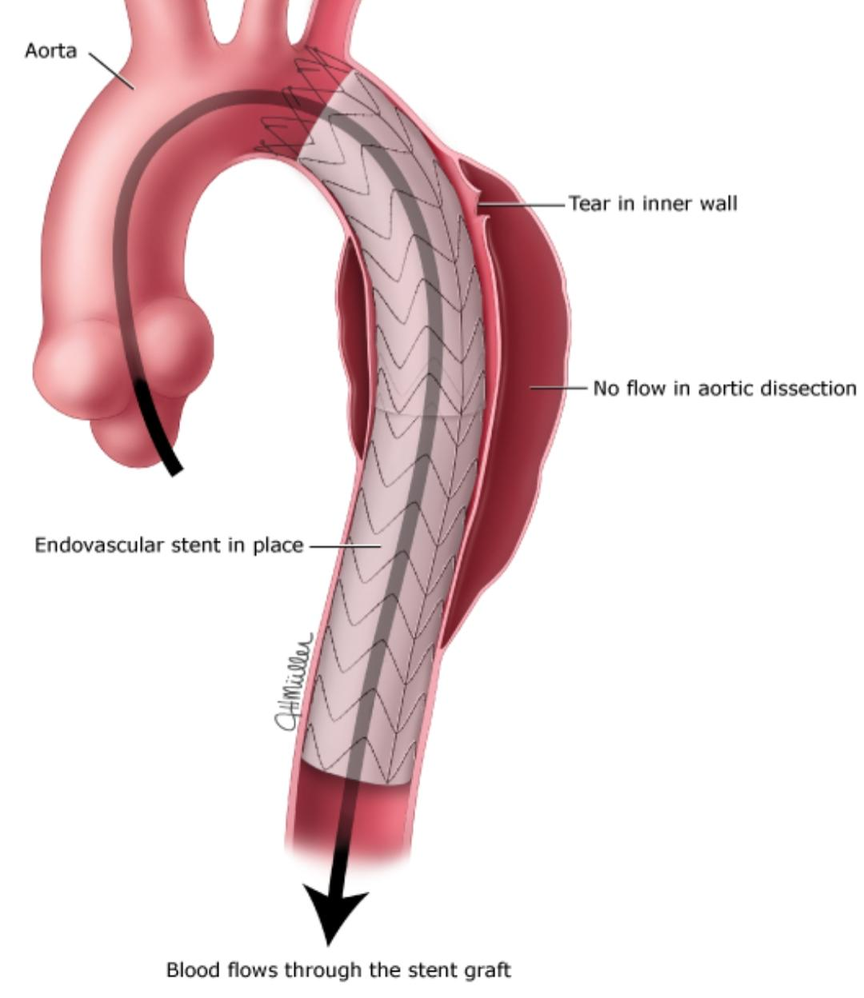
Cont..
To do endovascular stent graft procedure: thread a long, thin wire through the large artery in the groin (femoral artery) and up to the dissecting area. Then slide the stent graft, which is a hollow tube like a collapsible straw, over the wire and inside the damaged area of the aorta. Then the stent graft is opened, forming a stable channel for blood flow. *This procedure takes 2 to 4 hours, and the hospital stay is usually 1 to 3 days.

Slide 22
All people who have an aortic dissection, including those treated surgically, have to take drug therapy to keep their blood pressure down, usually for the rest of their lives.

Slide 23
Thank you

