Slide 1
CONTRACEPTION
Dr. Samer Yaghi
Consultant infertility &IVF (Barcelona University)
Consultant OBS & Gynaecology (JBOG)

Slide 2
WHAT IS CONTRACEPTION?

Slide 3
IDEAL CONTRACEPTIVE
Cheap
Highly 100% effective
Acceptive
Safe
Reversible
Having non-contraceptive benefits
Simple to use
Requiring minimal motivation, maintainence and supervision

Slide 5
NATURAL METHOD
Certain methods used to achieve and avoid pregnancies.
Based on observation of the naturally occurring signs and symptoms of the fertile and infertile phases of a woman's menstrual cycle.
No drugs, devices, or surgical procedures are used.

Slide 6
WITHDRAWAL
RHYTHM METHOD
Coitus Interruptus.
Removal of penis from the vagina before ejaculation occurs.
Effectiveness rate is 60-80%.
Failure due to
Delay withdrawal.
Presence of sperm in the pre-ejaculatory fluid.
Based on identification of the fertile period of a cycle and to abstain from sexual intercourse during that period.
Requires partner's co-operation.
Methods to determine:
Calendar Rhythm
Temperature Rhythm c Mucus Rhythm

Slide 7
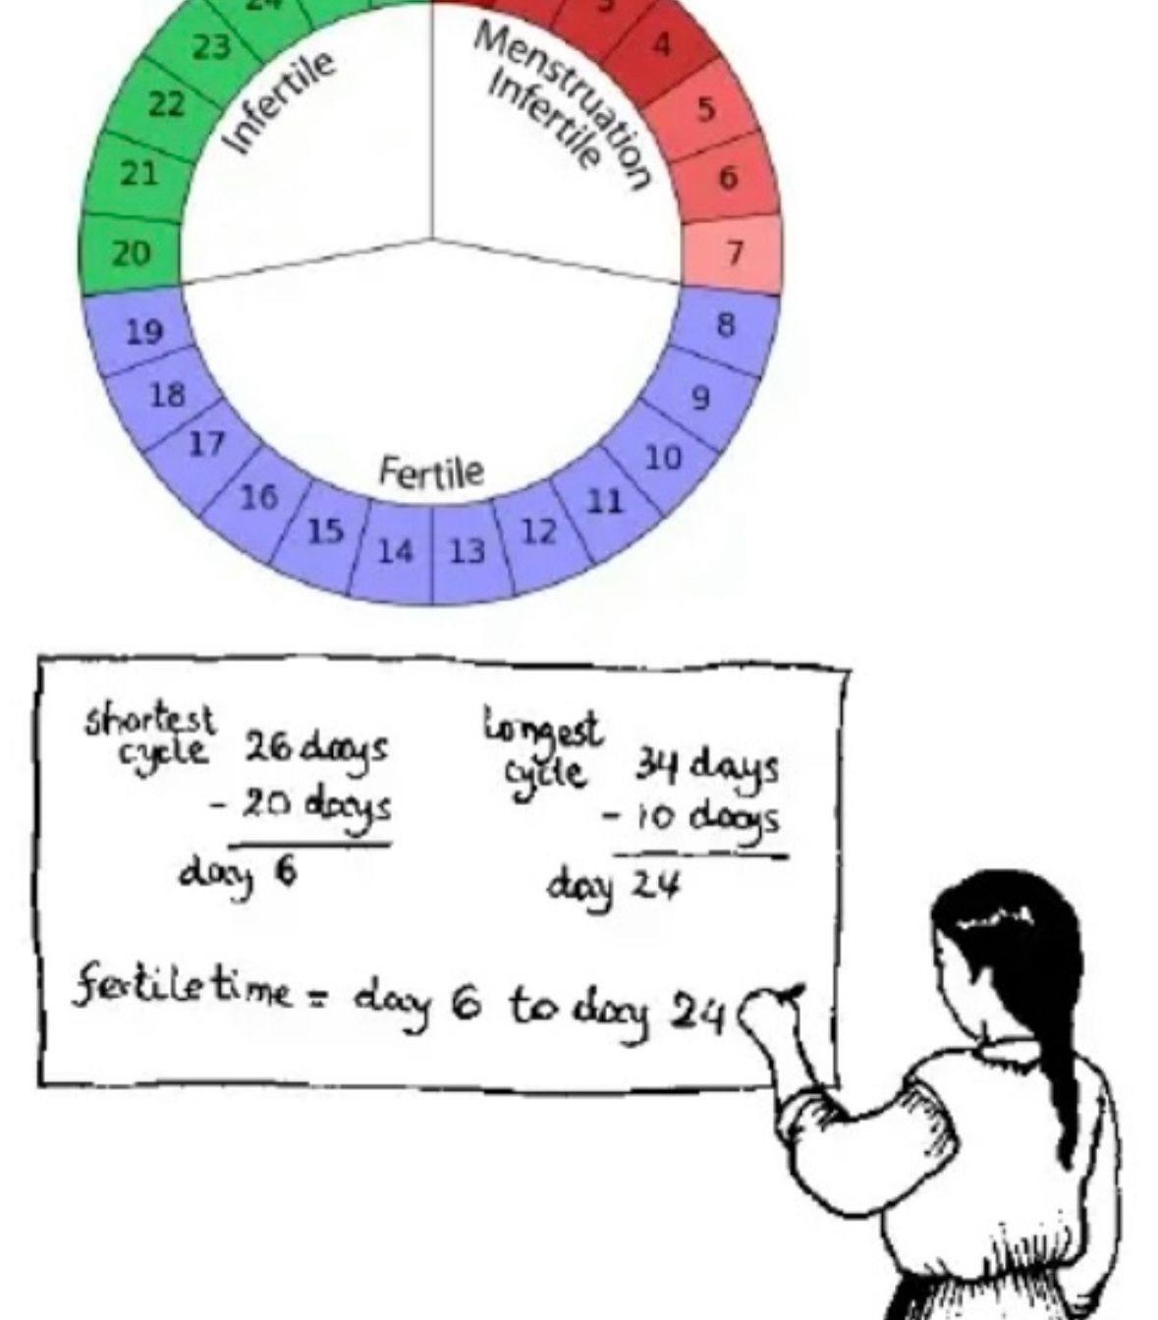
A) CALENDAR
What? Predicting fertility based on menstrual cycles.
How? The first unsafe day is obtained by substracting 20 days from lengths of the shortest cycle and the last unsafe day by deducting 10 days from the longest cycle.
This technique works best when a woman's menstrual cycle is very regular.

Slide 8
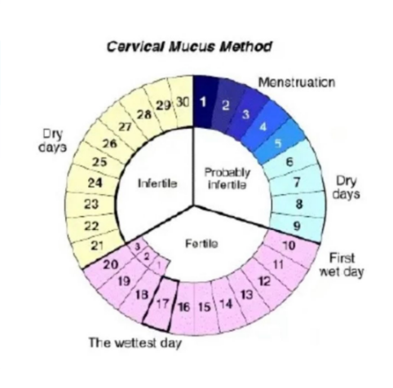
B) MUCUS
Tracking changes in the amount and texture of vaginal discharge, which reflect rising levels of estrogen in the body.
For the first few days after your period, there is often no discharge, but there will be a cloudy, tacky mucus as estrogen starts to rise.
When the discharge starts to increase in volume and becomes clear and stringy, ovulation is near.
A return to the tacky, cloudy mucus or no discharge means that ovulation has passed.

Slide 9
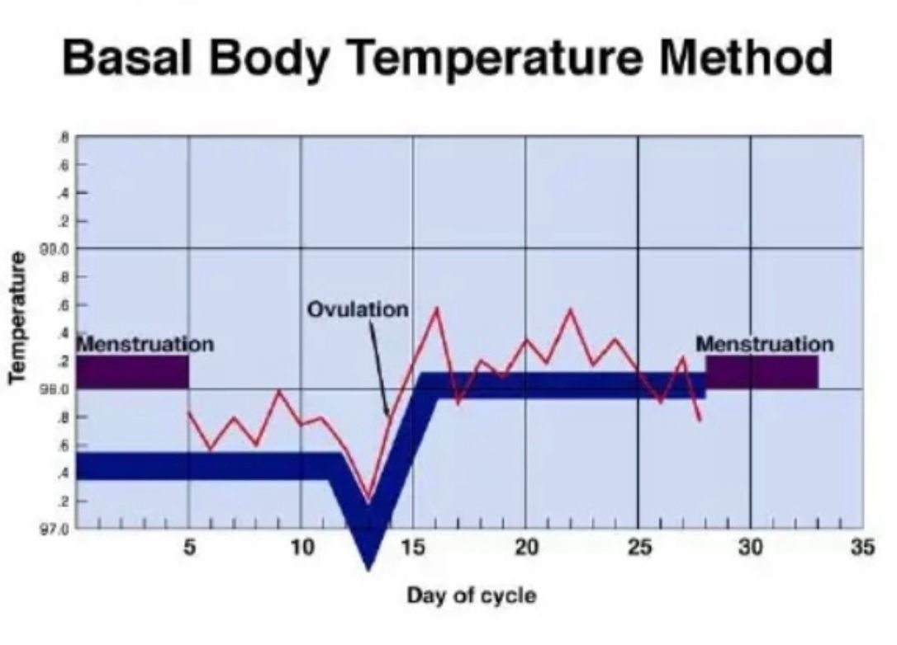
C) TEMPERATURE
• What? lowest temp of the body at rest (Body Basal Temperature).
• How? Ovulation raises body temp ½ - 1 degree F, and temp will drop if fertilization does not occur.
• Require abstinence until the third day of the rise of temperature.

Slide 11
BREAST FEEDING LACTATION ALAMENORRHEA (LAM)
Prolonged and sustained breastfeeding offers a natural protection of pregnancy.
More effective in women who are amenorrhea than those who are menstruating.
Risk of pregnancy who fully breastfeed an amenorrhea < 2% in the first 6 months.

Slide 12
HORMONAL
Hormonal compound taken in order to block ovulation and prevent occurrence of pregnancy.

Slide 13
ORAL CONTRACEPTIVE PILL :
Oestrogen
Ethinyl oestradiol (common) Mestranol (rare)
Progestogen
Desogestrel Norethisterone Ethynodiol Norgestimate Gestodene Levonorgestrel

Slide 14
HORMONAL CONTRACEPTION

Slide 16
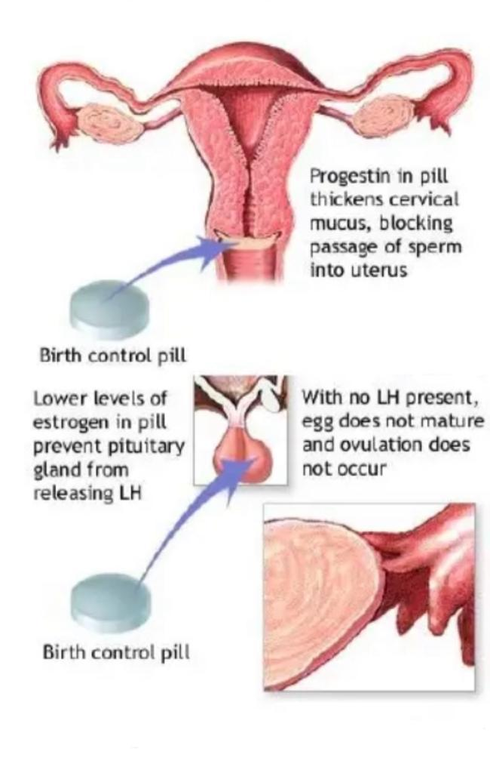
Progestin prevents ovulation
• suppress luteinizing hormone
• thicken cervical mucus (thick, viscid and scanty) - retarding sperm passage -> endometrium unfavorable to implantation (endometrium non receptive to the embryo)
Estrogen prevents ovulation
• suppress follicle-stimulating hormone
• stabilize the endometrium-> prevents breakthrough bleeding

Slide 17
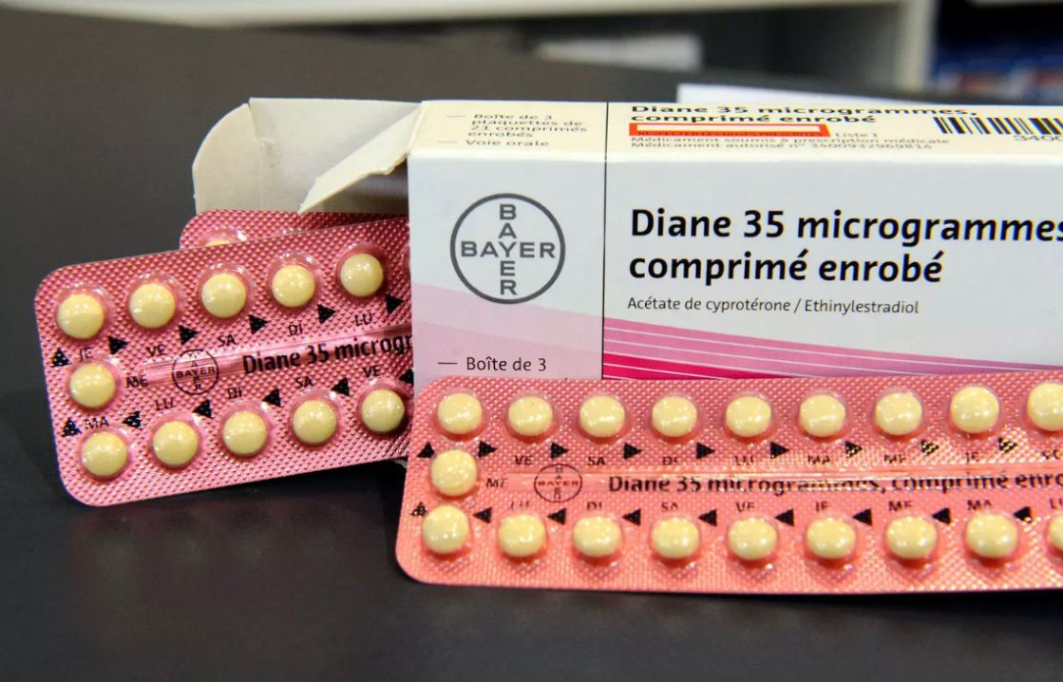
COMBINED ORAL CONTRACEPTIVE PILL
Oral contraceptives consist of a combination of an estrogen and a progestational agent: Eithylestradiol (20mcg - 35mcg) and a progestogen (Levonorgestrel/ norethisterone/ desogestrel).
Meant to be taken for 21 days with a pill-free week.
taken daily for 3 weeks and then omitted for 1 week, during which time there is withdrawal uterine bleedingDiane 35 microgrammes, comprimé enrobe.
Low dose pills now more commonly used :
• Mercilon, Loette, Yasmin, Diane.
• 99% effective if used correctly.

Slide 18
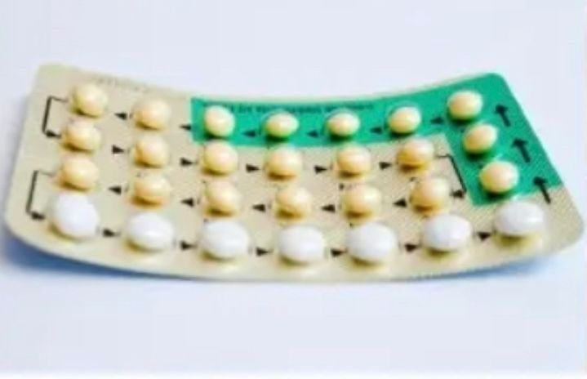
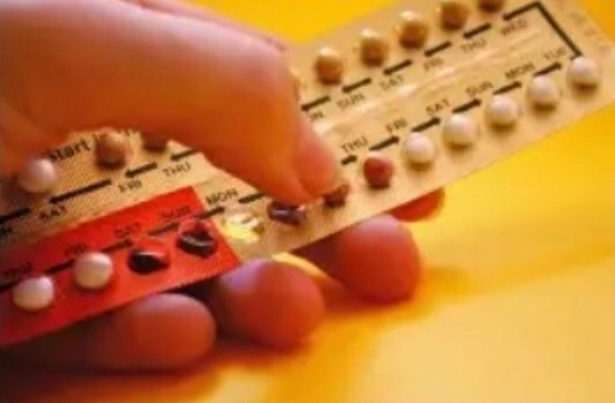
More info :
ADVANTAGES
• Reversible. • Intercourse unaffected. • Reduce incidence of ovarian and endometrial cancer. • Controlled timing menses.
DISADVANTAGES
• Effective only if taken consistently. • Effectiveness is reduced by; phenytoin antibiotic like ampicillin • Vomiting and diarrhea – impair absorption.
SIDE EFFECT
• Nausea/ Vomitting. • Mastalgia. • Thromboembolism. • Strokes. • Weight gain. • Headache. • Hypertension.
CONTRAINDICATION
• History of cardiovascular disease. • Hypertension. • Obesity. • Migraine. • Chronic hepatitis. • Breast cancer.

Slide 19
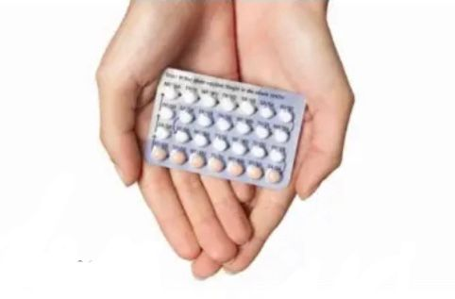
PROGESTIN ONLY PILL (MINI-PILL):
Small dose of progestogen daily without break.
• Levonorgestrel 75 ug
• Norethsterone 350 ug
• Desogestrel 75 ug
• Failure rate 2-3 %
Contraceptive effect by;
• Alterations in cervical mucus and effects on the endometrium.
The first pill has to be taken on the first day of the cycle then continuously and regularly and at the same time of the day -> to be maximally effective
No breaks between packs.
|
|
|

Slide 20
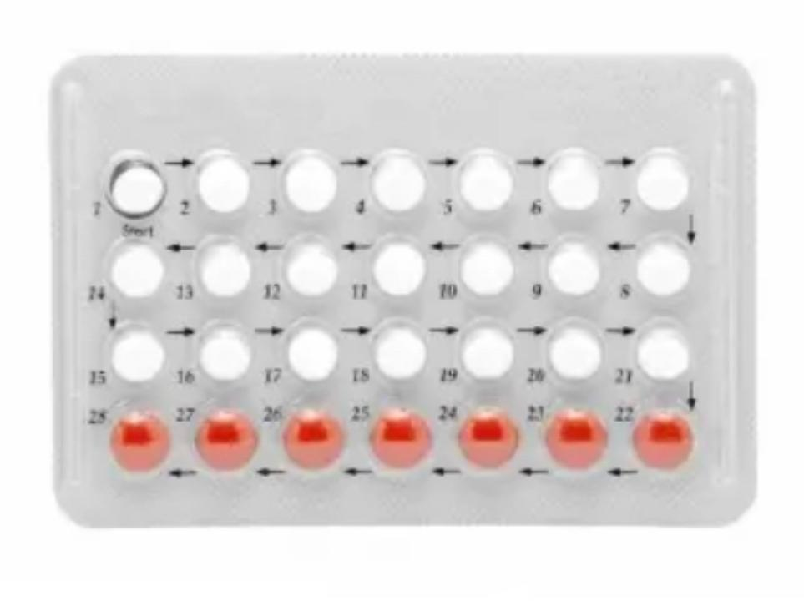

Slide 21
ADVANTAGES :
DISADVANTAGES :
• Absence of major metabolic disturbance.
• Excellent choice for lactating women.
• Easy to take.
• Reduced the risk of PID and endometrial cancer.
• Acne.
• Mastalgia.
• Headache.
• Disturbance of menstrual cycle.
• Functional ovarian cysts develop.
• Must be taken at the same or nearly the same time daily.
INDICATION :
CONTRAINDICATION :
• Older women.
• Lactation.
• Smokers over 35.
• Intolerance or contraindication s to estrogen.
• Hypertension.
• Pregnancy.
• Unexplained uterine bleeding.
• Recent breast cancer.
• Arterial disease.
• Thromboembolic disease.

Slide 22
INJECTABLE PREGESTIN INTRAMUSCULARLY
DEPO-POVERA
Depo medroxyprogesterone acetate (every 3 months) Absorbed more slowly
NORGEST
Norethisterone oenanthate (2 monthly)
Dose:
• 150mg IM, every 12 weeks.
• reach active levels within 24 hrs.
• levels decrease by 4 - 5 months.
•undetectable by 7 - 9 months.

Slide 23
INDICATION | CONTRAINDICATION | ADVANTAGES | DISADVANTAGES
•Good option for women who find it difficult to remember to take pill. • Useful if oestrogen is contraindicate. •Lactation. | •High risk for osteoporosis. •Same as POP. | •Safe during lactation. •No estrogen related side effect. • Menstrual symptoms reduced. •Protective against endometrial cancer Diminised anemia. | •Irregular bleeding. •Delay in return of fertility of 6 months. •Injections. •Depression Weight Gain. •Low failure rate (<1%). •Reduce risk of ovarian and endometrial cancer. •Long term use (>2 years) can lead to decreased bone density.

Slide 24
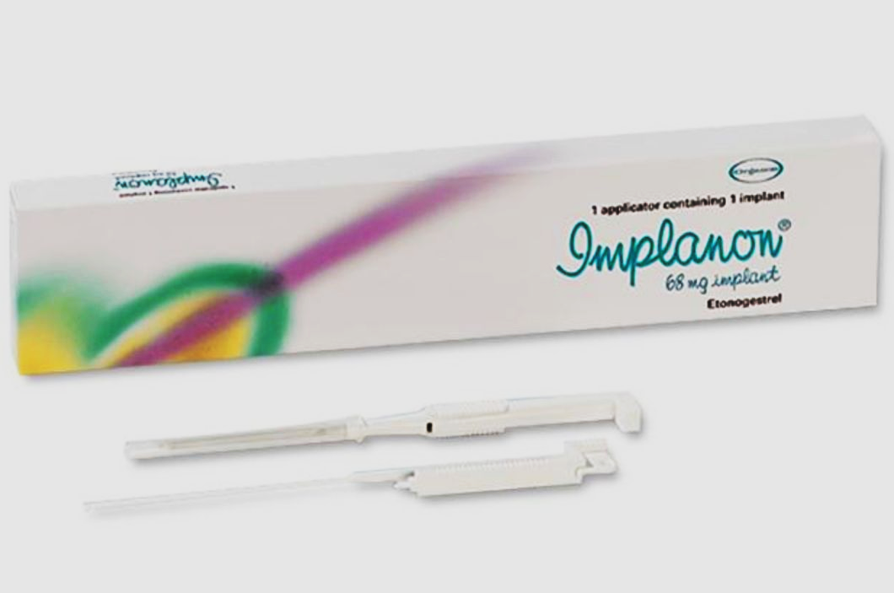
IMPLANON
Progestin only delivery system containing: Etonorgestrel 68mg.
Single closed capsule - Sub dermal implant-40mm × 2mm road, inserted on day 1-5 of the menstrual cycle.
into the non-dominant arm in between the head of the biceps and triceps.
It release hormone about 60 mcg, gradually reduced to 30 mcg/ day over 3 years.
Efficacy 99%.
Long-lasting (3 years).

Slide 26
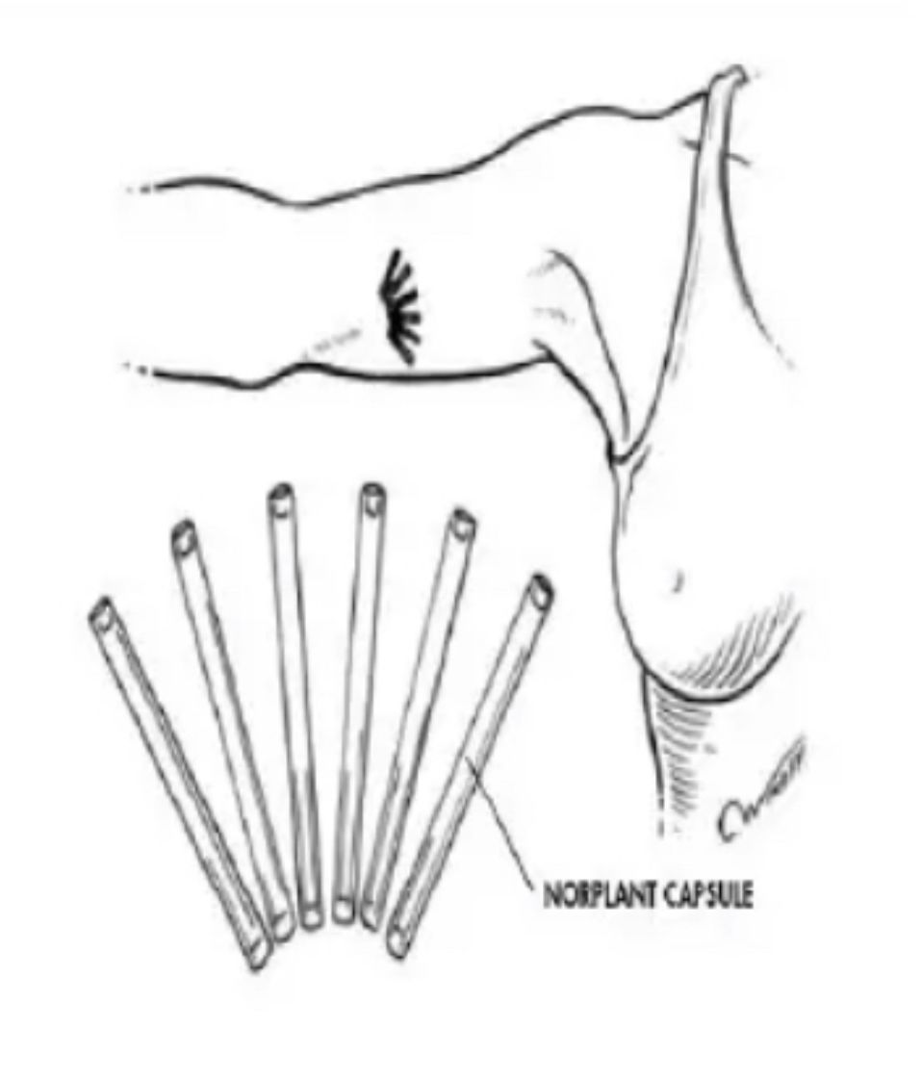
NORPLANT I vs. NORPLANT II
• NORPLANT I : Six capsules (Five years).
• NORPLANT II : Two capsules (Three years) .
Rods: 4 cm long with diameter of 2.5 mm.
Each rod contains 75mg of levonorgestrel.
It release 50 mcg of levonogestrel / day.
Administration: Under LA 6 slicone rubberrods Effective within 6 hours of insertion 5 years action.

Slide 27
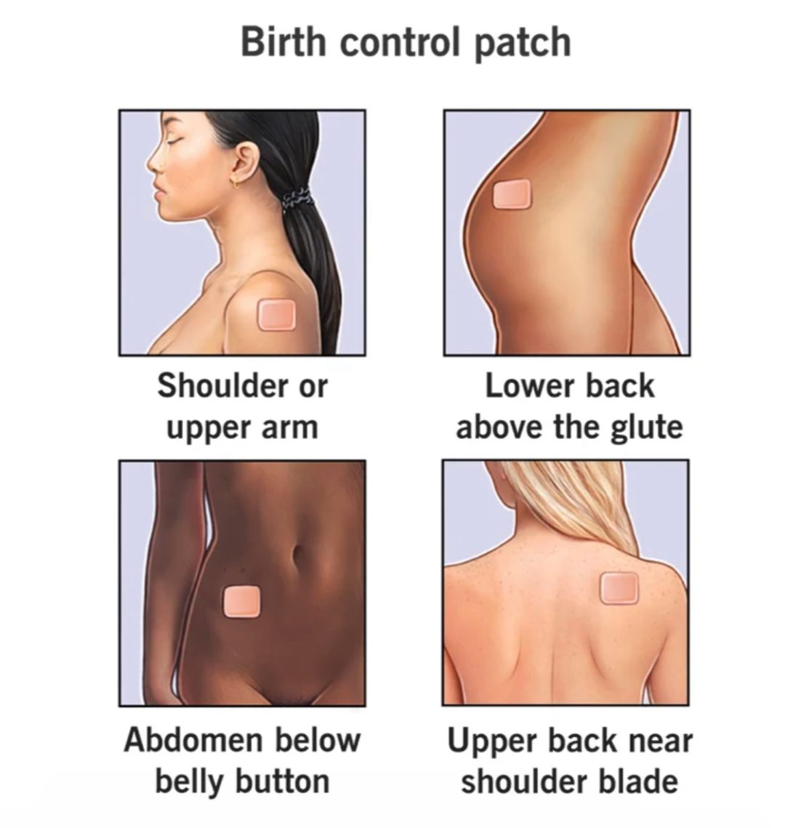
PATCH (EVRA)
Delivers 150 g progestin norelgestromin + 20 g of ethinyl estradiol daily.
Patch (Evra) is applied to :
• Buttocks.
• Upper outer arm.
• Lower abdomen.
• Upper torso (avoiding the breasts).
A new patch is applied weekly for 3 weeks.
→ followed by a patch-free week to allow for withdrawal bleeding.
The patch was slightly more effective than a low-dose oral contraceptive in preventing pregnancy.

Slide 28
ADVANTAGES
Well tolerated
Safe overall
DISADVANTAGES
Dysmenorrhea.
Breast tenderness.
Breakthrough bleeding in the first Two.
3% of women →
• - application site reaction severe enough to limit usage.

Slide 29
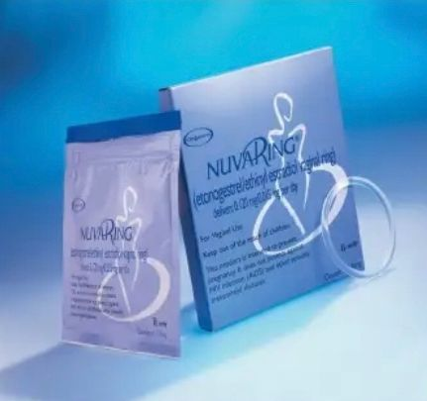
INTRAVAGINAL RING
Flexible polymer ring.
Contains ethinyl estradiol + etonogestrel.
Released rates: 15 g and 120 g per day.
Highly effective → failure rate was 0.65 per100 woman-years.
The ring is placed within 5 days of the onset of menses and is removed after 3 weeks of use for 1 week to allow withdrawal bleeding.

Slide 30
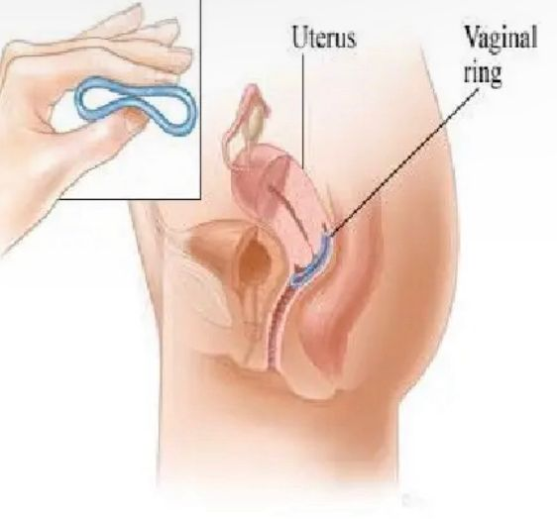
• Breakthrough bleeding is uncommon.
• 20% of women, 35% of men reported being able to feel the ring during intercourse.
• If this is bothersome, may be removed for intercourse BUT should be replaced within 3 hours.

Slide 31
EMERGENCY CONTRACEPTIVE PILL
• Each pill contain Levonorgestrel and Ethinyl estradiol.
• After unprotected intercourse.
• Highly effective and decrease the risk of pregnancy by 75%.
• 100 women had unprotected intercourse during the second to third week of their menstrual cycle, 8 would be expected to conceive.
• Contain high dose of contraceptive hormones.
• Take within 72 hours of SI.
• Dosage:
Take 2 pills per dose
2. Another 2 pills 12 hours later.

Slide 33
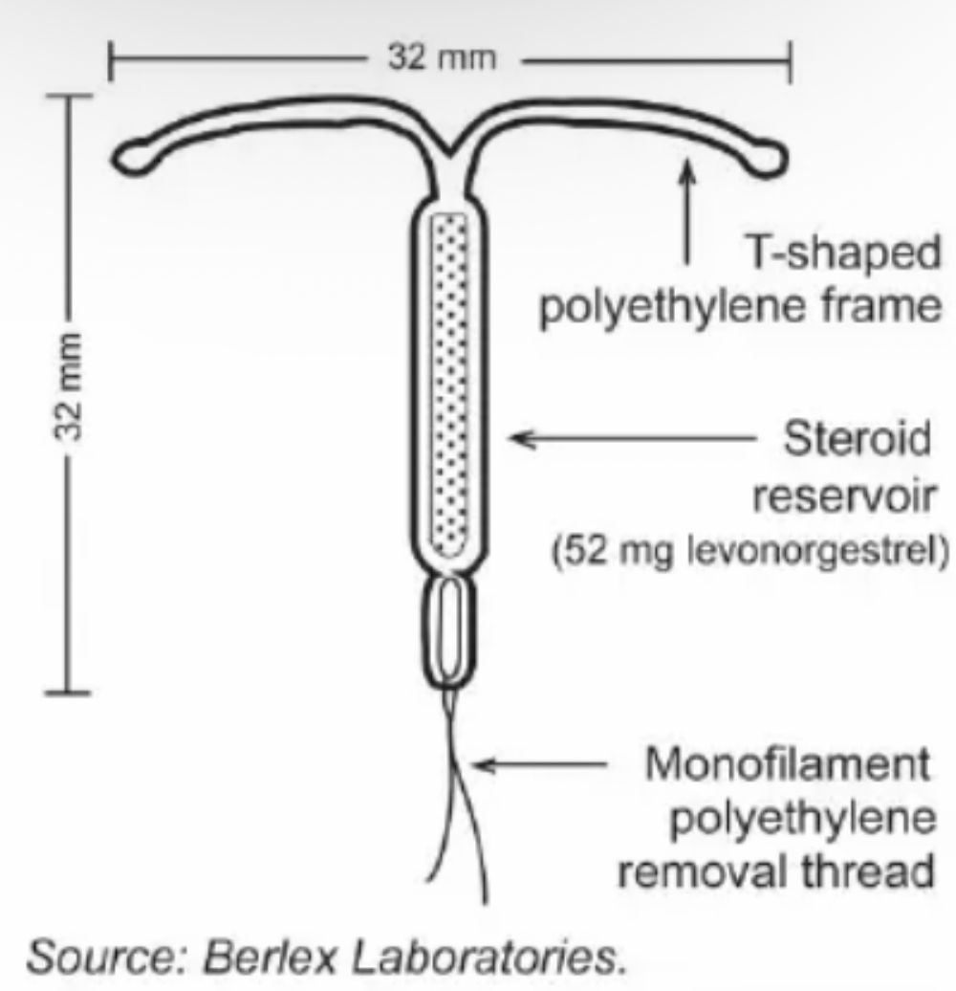
INTRAUTERINE CONTRACEPTION SYSTEM (MIRENA)
Device contain progestogen- releasing rod, (reservoir releasing levenorgestrel 20 microgram 12 hourly).
Levonorgestrel released directly into uterine cavity from a T-shaped plastic intra uterine device.
Most effective contraceptive, failure rates<2/1000.

Slide 34
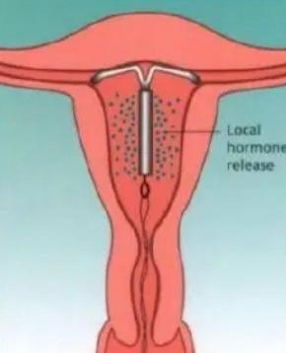
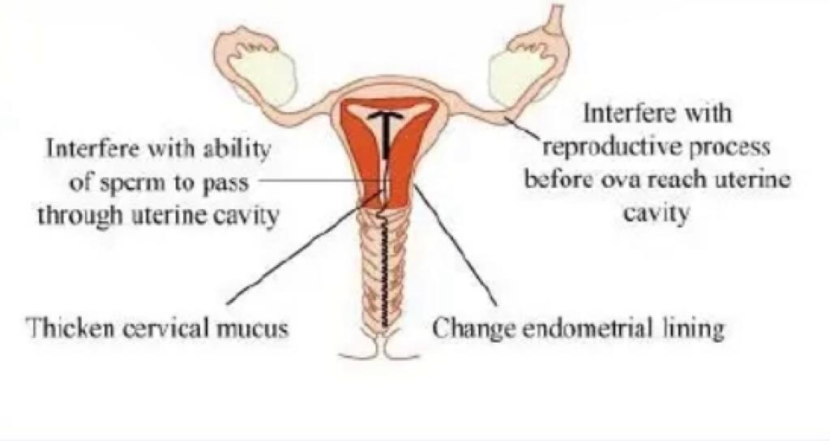
NON-CONTRACEPTIVE USES
• Menorrhagia.
• To oppose ostrogen in HRT.
• To oppose effects of Tamoxifen on endometrium.
SIDE EFFECTS
• Minimal.
• Amenorrhoea (20%).
• Irregular bleeding (up to 6 months).
• PMS -like symptoms (rarely) If conception occurs - risk of ectopic pregnancy.
MODE OF ACTION
• Thickens cervical mucus
• Thins endometrium
• Local inflammatory reaction

Slide 35
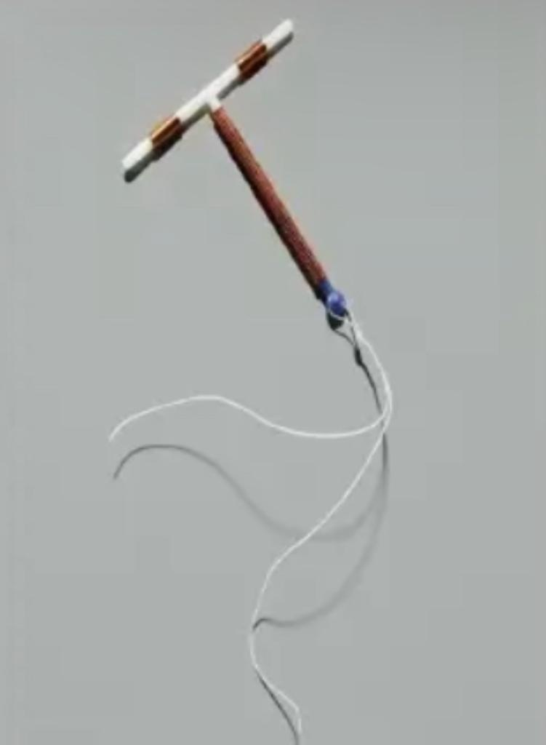
COOPER IUCD:
• Copper effects are by causing a toxic effect to sperm and the egg.
• Licensed for use for up to 10 years.
• 99% effective.
• Has an increased risk of infection associated with the first 3 weeks of insertion Copper IUCD associated with increased menstrual loss.
• Occasionally can have problem of missing strings, lost IUCD that may require investigation or surgical exploration/ removal.

Slide 36
BENEFITS
CONTRAINDICATION
SIDE EFFECTS
• Does not require a person to take medication.
• Good for those with a contraindication to taking oestrogen.
• Useful for patients who are not compliant to taking medicines.
• Pregnancy.
• Current STI or PID.
• Distortion of the shape of uterine cavity.
• Severe dysmenorrea.
• Valvular heart disease.
• Cooper allergy.
• Heavy periods.
• Pain.
• Menstrual loss.
• Expulsion <3%.
• Uterine perforation 1 in 1000.
• Salpingitis 1.5-7.5 per 1000.
• Endometritis.

Slide 37
TIME OF INSERTION :
INTERVAL :
•6 Weeks following childbirth or abortion.
• 2-3 days after the period is over.
• During lactational amenorrhea - can be anytime.
POSTABORTAL:
• Immediately following termination of pregnancy
• Prevent uterine synechia
POSTPARTUM:
• 6 weeks following child birth when the uterus will be involuted to near normal size.
POSTPLACENTAL DELIVERY:
• Immediate insertion can be done.
• Rate of expulsion is high.

Slide 38
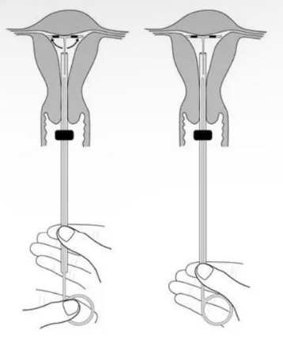

Slide 39
BARRIER METHODS
Prevent pregnancy by blocking the egg and sperm from meeting.
Barrier methods have higher failure rates than hormonal methods due to design and human error.

Slide 40
MALE CONDOM
• Most common and effective → when used properly.
• Latex and Polyurethane.
•Benefit.
• v risk of venereal infection.
• Controlling the spread of HIV.
• Perfect effectiveness rate = 97%.
•Combining condoms withspermicides raises effectivenesslevels to 99%.

Slide 41
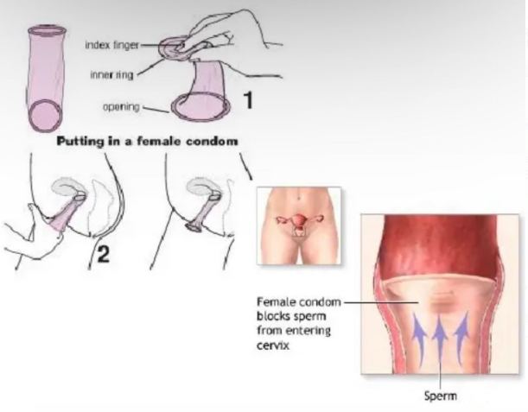
FEMALE CONDOM
• Made as an alternative to male condoms.
• Polyurethane.
• Physically inserted in the vagina.
• Perfect rate = 95%.
• Woman can use female condom if partner refuses.

Slide 42
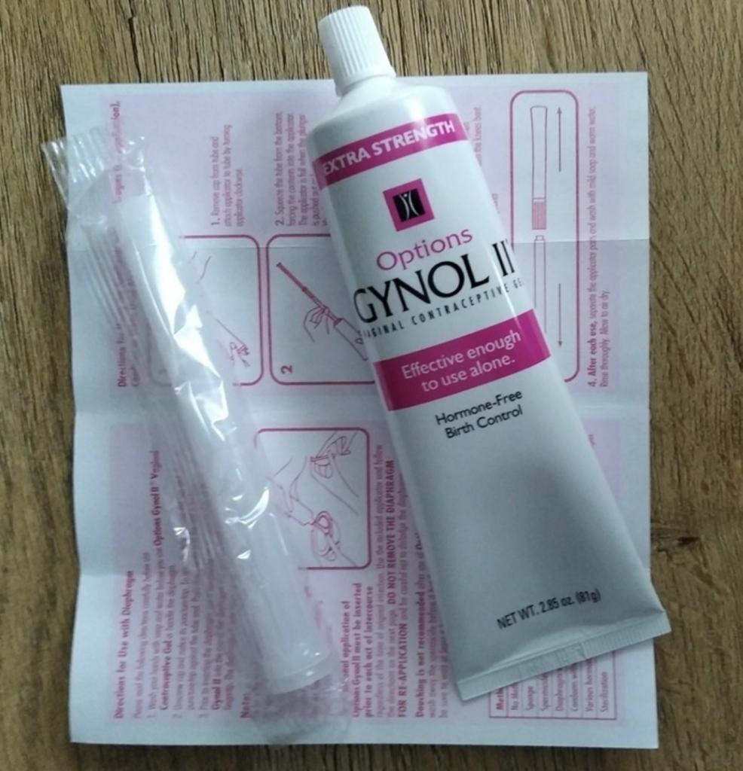
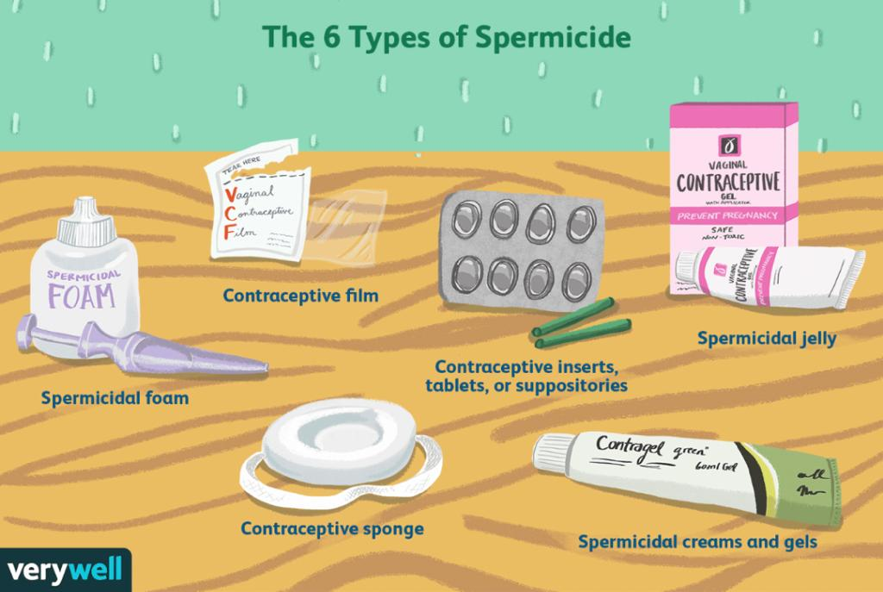
SPERMICIDES
Chemicals kill sperm in the vagina.
Different forms:
• Jelly
• Film
• Foam
• Suppository
Some work instantly, others require pre-insertion.
Only 76% effective (used alone), should be used in combination with another method i.e., condoms.

Slide 43
DIAPRAGHM
CERVICAL CAP
• Perfect Effectiveness Rate = 94%.
• Typical Effectiveness Rate = 80%.
• Latex barrier placed inside vagina during intercourse.
• Fitted by physician• Spermicidal jelly before insertion.
• Inserted up to 18 hours before intercourse and can be left in for a total of 24 hours.
• Perfect effectiveness rate = 91%.
• Typical effectiveness rate = 80%.
• Latex barrier inserted in vagina before intercourse "Caps" around cervix with suction.
• Fill with spermicidal jelly prior to use.
• Can be left in body for up to a total of 48 hours.
• Must be left in place six hours after sexual intercourse.

Slide 45
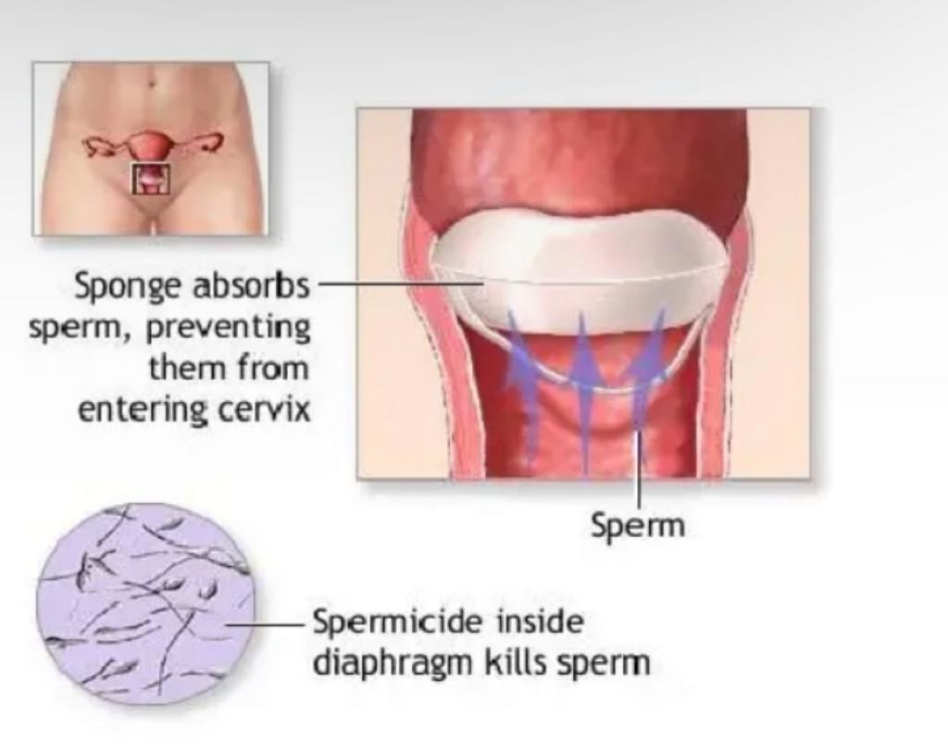
SPONGE
The sponge is inserted by the woman into the vagina and covers the cervix blocking sperm from entering the cervix.
The sponge also contains a spermicide that kills sperm.

Slide 46
STERILIZATION
Medical techniques that intentionally leave a person unable to reproduce in the future.
Generally permanent birth control techniques that surgically disrupt the normal passage of ova or sperm.

Slide 47
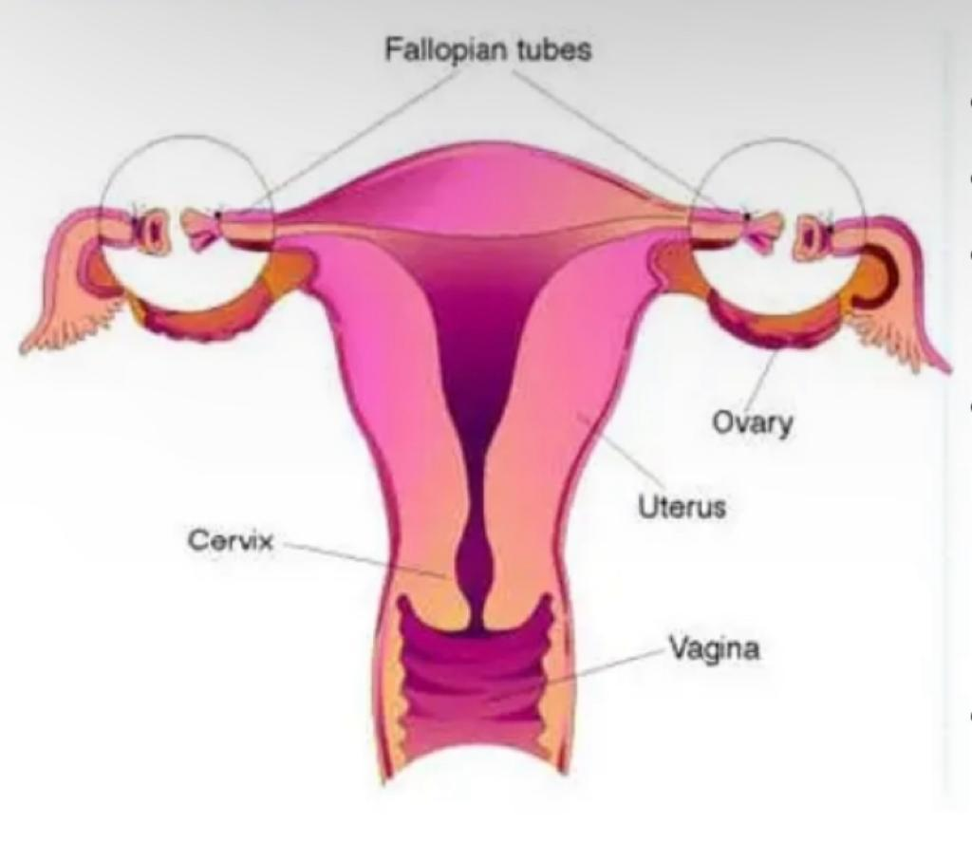
STERILIZATION
• 45% couples between 40-45 years.
• Have completed family.
• Have no other acceptable method.
• Female sterilization (laparoscopic / mini-lap or during CS).
failure 1:200, not 100% reversible.
10% risk of ectopic pregnancy.
• Male sterilization.
• failure 1:10 000, not 100% reversible.

Slide 48
TUBAL LIGATION
VASECIOMY
• A small incision is made in the abdomen to access the fallopiantubes.
• Fallopian tubes are cut, tied, cauterized, blocked, burned, or clipped shut to prevent the egg from traveling through the tubes.
• Recovery usually takes 4-6 days.
• Failure rates vary by procedure, from 0.8%-3.7%.
• May experience heavier periods.
• A small incision is made to access the vas deferens, the tube the sperm travels from the testicle to the penis, and is sealed, tied, or cut.
• No-scalpel Vasectomy (NSV).
• Faster and easier recovery than a tubal ligation• Failure rate = 0.1%, more effective than female sterilization.
• After a vasectomy, a male will still ejaculate, but there won't be any sperm present.

Slide 49
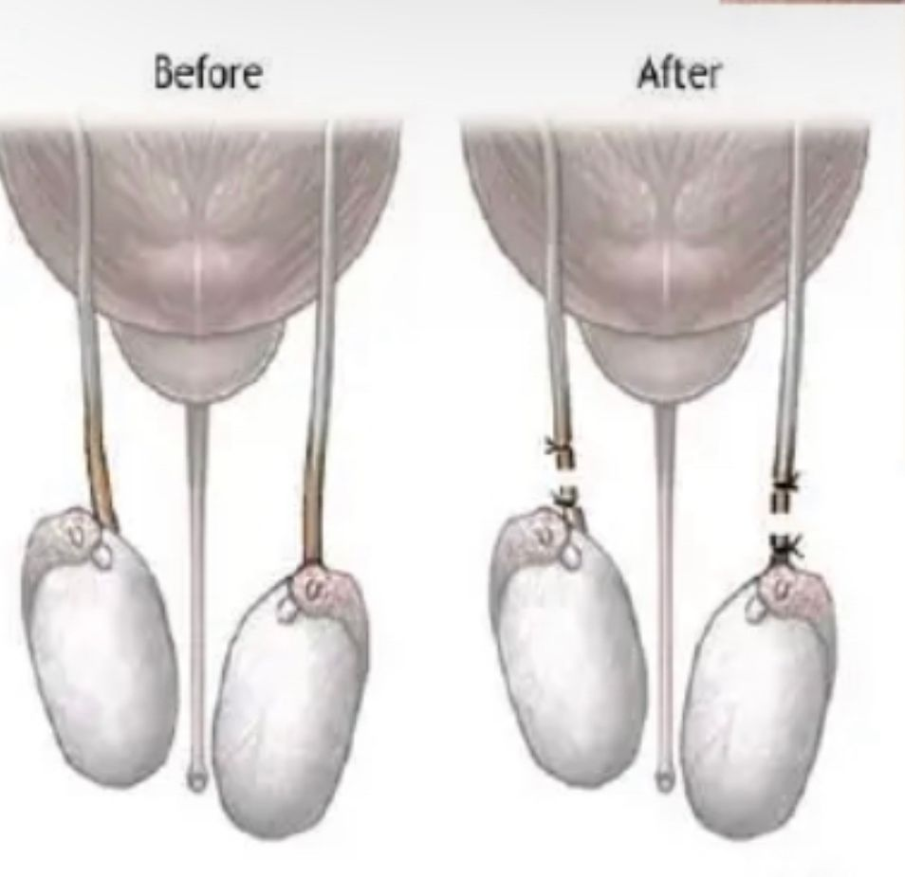
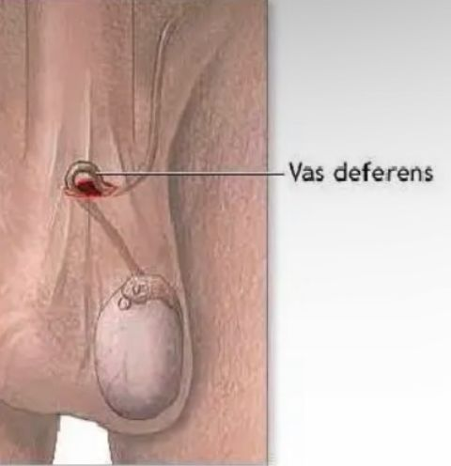
During a vasectomy ("cutting the vas") a urologist cuts and ligates (ties off) the ductus deferens.
Sperm are still produced but cannot exit the body.
Sperm eventually deteriorate and are phagocytized. A man is sterile, but because testosterone is still produced he retains his sex drive and secondary sex characteristics.

Slide 51
CONCLUSION :
• There are many forms of contraception available.
• Important to know the advantages and disadvantages of these options.
• Useful to see what is being advised for our post-natal patients and relate the types of contraception recommended with each individual patient.

Slide 53
THANK YOU FOR YOUR ATTENTION !

