Slide 1
Congenital Adrenal Hyperplasia
Hazem Tarawneh
Joud Zeitoon
Zaid Muqbel
Tala Abdelqader
Rama Bitoni
Supervised by : Dr . Randa S.Alqaisi

Slide 2
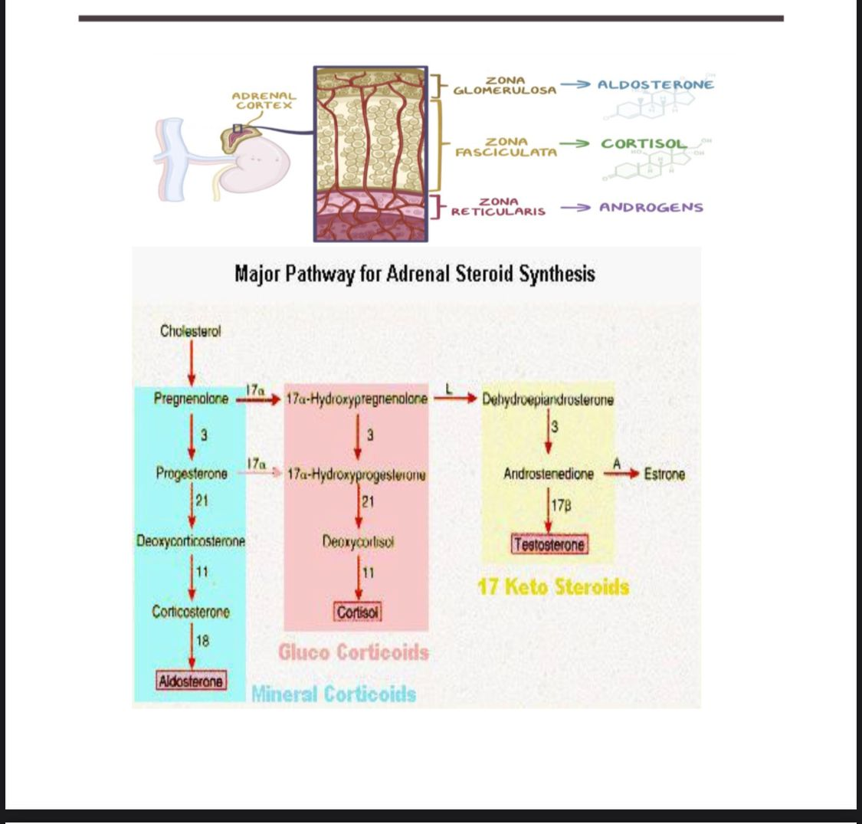

Slide 3
Pathophysiology

Slide 4
Ok, now the first step for the synthesis of all three adrenal hormones is when cholesterol desmolase converts cholesterol to pregnenolone.
In the zona glomerulosa, pregnenolone is first converted to progesterone, with the help of 3-beta-hydroxysteroid dehydrogenase, or 3-beta-HSD.
Progesterone becomes 11-deoxycorticosterone under the influence of 21-hydroxylase.
11-deoxycorticosterone becomes corticosterone with the help of 11-beta hydroxylase, and finally, aldosterone synthase turns corticosterone into... well, aldosterone, what'd you expect.
Some of the pregnenolone and progesterone can be used to make cortisol, by making their way in the zona glomerulosa.
Here, 17 alpha -hydroxylase turns pregnenolone into 17 hydroxypregnenolone and turns progesteroneinto 17 hydroxyprogesterone.
17 hydroxypregnenolone is then also turned into 17 hydroxyprogesterone by the enzyme 3 beta-hydroxysteroid dehydrogenase.
Then, all of the 17 hydroxyprogesterone is turned into 11 deoxycortisol by the same 21 hydroxylase enzyme, and 11 beta-hydroxylase makes 11 deoxycortisol become cortisol.
Finally, some of the 17 hydroxypregnenolone and 17 hydroxyprogesterone are also used to make androgens.
The enzyme 17, 20 lyase turns 17 hydroxypregnenolone into dehydroepiandrosterone and turns 17 hydroxyprogesterone into androstenedione.
Dehydroepiandrosterone can also be turned into androstenedione by the same 3 beta-hydroxysteroid dehydrogenase enzyme.
Both dehydroepiandrosterone and androstenedione can then be converted to testosterone.

Slide 5
Congintal adrenal insufficiency
- primary adrenal insufficiency
- secondary adrenal insufficiency ( central adrenal insufficiency)

Slide 6
• Adrenal insufficiency is a potentially life threatening condition , defined by : the inability of the adrenal cortex to produce sufficient glucocorticoid and/or mineralocorticoid hormones
•Adrenal insufficiency may result from a wide variety of congenital or acquired disorders of hypothalamus, pituitary, or adrenal cortex.
Destruction or dysfunction of the adrenal cortex is the cause of primary adrenal insufficiency,
while secondary adrenal insufficiency is a result of pituitary or hypothalamic disease.

Slide 7
Primary adrenal insufficiency
Primary adrenal insufficiency results from disease that is intrinsic to the adrenal cortex; the most common cause in childhood congenital adrenal hyperplasia (CAH)
being included among the disorders of steroidogenesis secondary to deficits in enzymes.
•Primary AI is rare with a prevalence of approximately 10–15 per 100,000 individuals
•It has an autosomal recessive transmission.
Because all forms of congenital adrenal hyperplasia are autosomal recessive disorders, both sexes are affected with equal frequency…
Two copies of an abnormal gene are required for disease to
occur.
• Not all mutations and partial deletions result in disease.

Slide 8
The process can be local or a manifestation of systemic disorders, such as autoimmune disease (either isolated or as part of the polyglandular autoimmune syndrome), granulomatous diseases such as tuberculosis and histoplasmosis, and hemorrhage associated with meningococcemia.
Primary AI can also be due to rare genetic diseases, which include disorders of steroidogenesis, peroxisomal defects, and abnormal adrenal gland development due to mutations
(as in Table next slide ).
The result is inadequate secretion of glucocorticoids, mineralocorticoids, and androgens.

Slide 9
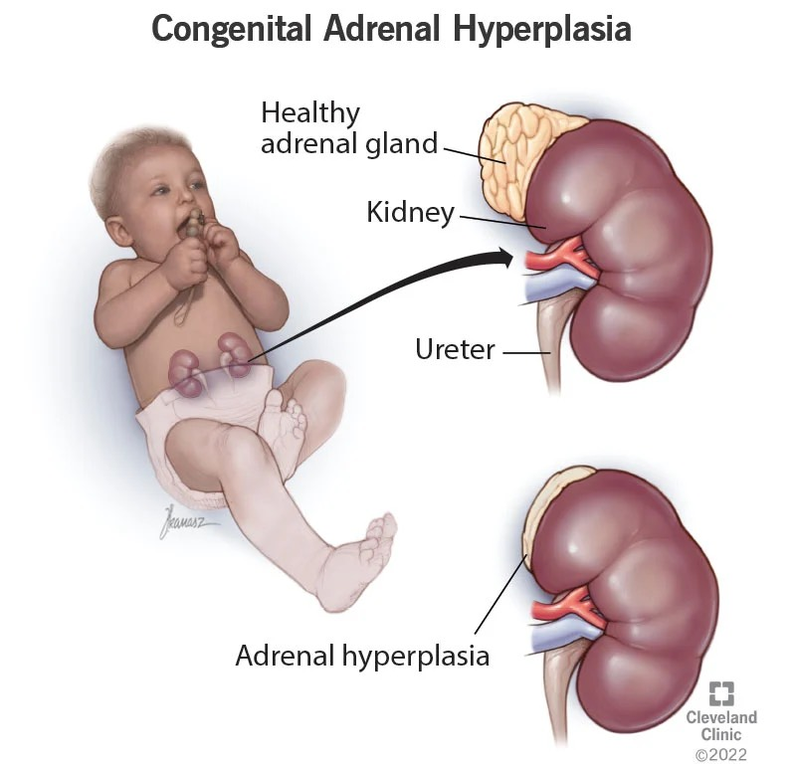
PRIMARY adrenal hyperplasia causes :
(i) Congenital adrenal hyperplasia
(ii) Congenital adrenal hypoplasia due to gene mutations (e.g. DAX-1, SF1 mutations)
(iii) Peroxisome defects (adrenoleukodystrophy [childhood or neonatal], Zellweger syndrome)
(iv) Bilateral adrenal hemorrhage of the newborn
(v) Adrenal hemorrhage of acute infection (Waterhouse-Friderichsen syndrome)
(vi) Autoimmune adrenalitis (isolated or part of autoimmune polyglandular syndrome type 1 and 2)
(vii) Infection (e.g. tuberculosis, fungal infection, human immunodeficiency virus, cytomegalovirus)
(viii) Triple A syndrome or Allgrove syndrome (alacrimia, achalasia, adrenal insufficiency)
(ix) Adrenal unresponsiveness to ACTH due to gene mutations
(x) Familial glucocorticoid deficiency
(xi) Drug effects (mitotane, ketoconazole, aminoglutethimide, metyrapone, megestrol, rifampin)

Slide 10
CAH depends on disease-causing mutations and residual enzyme activity.
90% of cases of CAH : 21-hydroxylase deficiency (21OHD)
Others : Less frequent forms of CAH include
11 β -hydroxylase deficiency (8% of cases)
17α-hydroxylase
3β-hydroxysteroid dehydrogenase deficiency (3BHDS)
P450 oxidoreductase deficiency
Steroidogenesis may also be impaired by steroidogenic acute regulatory (StAR) protein deficiency,
which is involved in cholesterol transport into
mitochondria, or P450 cytochrome side-chain cleavage
(P450scc) deficiency, that converts cholesterol into pregnenolone.

Slide 11
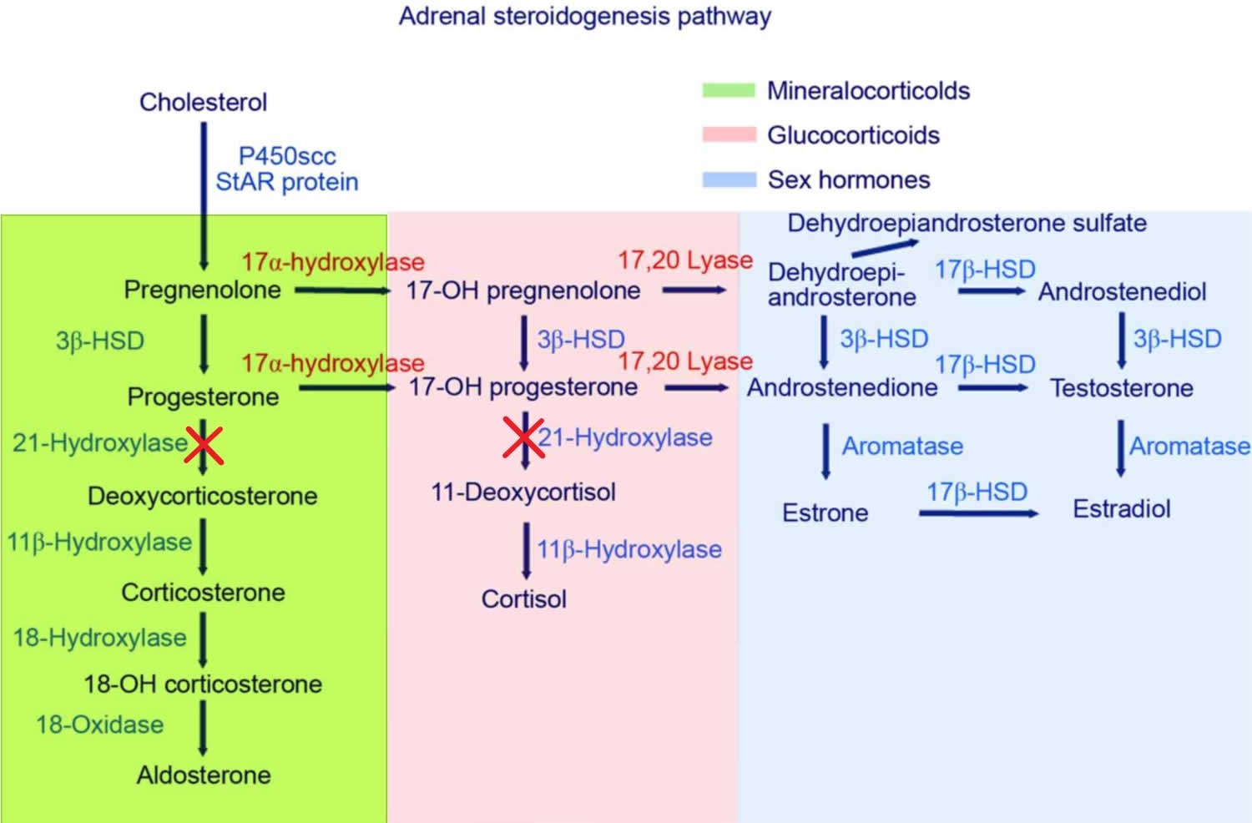

Slide 12
Deficiency of 21-hydroxylase
Resulting from mutations or deletions of CYP21A.
Is the most common form of CAH, accounting for more than 90% of cases.
Clinically divided into 3 phenotypes:
– Classic salt wasting 70%
– Classic simple virilizing 30%
– Nonclassic 0.1 %

Slide 13
The phenotype depends on the degree or type of gene deletion or mutation and the resultant deficiency of the steroidogenic enzyme.
#The phenotype can vary from clinically inapparent disease to (occult or cryptic adrenal hyperplasia) or to
a mild form of disease that is expressed in adolescence or adulthood (nonclassic adrenal hyperplasia) is generally recognized at or after puberty because of oligomenorrhea or virilizing signs in females.
to severe disease that results in adrenal insufficiency in infancy with or without virilization and salt wasting (classic adrenal hyperplasia).
Classic congenital adrenal hyperplasia is generally recognized at birth or in early childhood because of ambiguous genitalia, salt wasting, or early virilization

Slide 14
Signs & Symptoms
The classic form presents with symptoms in infants or young children, and it results in one of two clinical syndromes:
a salt-losing form, or a non-salt-losing( simple virilizing) form.
Both of these are caused by a genetic mutation on chromosome 6, but the simple virilizing form has only a cortisol deficiency, whereas the salt wasting form has an aldosterone and cortisol deficiency.
Non-classic 21-hydroxylase deficiency is even milder than the simple virilizing form, so it presents later in childhood, during adolescence, or in young adulthood.
Now, in both classic and non-classic presentations, there are excess androgens which lead to different symptoms depending on genetic sex, and the age of presentation

Slide 15
With classic 21 hydroxylase deficiencyhave
ambiguous genitalia at birthgenital anomalies range from complete fusion of the labioscrotal folds and a phallic urethra to clitoromegaly, partial fusion of the labioscrotal folds, or both.
neonate girls have meaning an enlarged clitoris, and sometimes a urogenital sinus, which is when the urethra and the vagina have the same opening ,Partial or complete fusion of the labial folds may also occur.
Internal female reproductive organs and structures - like the uterus and ovaries - are normal.
Male infants usually have normal male external genitalia, but may have subtle findings such as hyperpigmentation of the scrotum or an enlarged phallus.
With the salt losing form, both male and female neonates can have a salt-losing adrenal crisis, because of the aldosterone deficiency.
This crisis is associated with hyponatremia, hyperkalemia, and a general failure to thrive.
The simple virilizing form, Females are identified later in childhood because of precocious pubic hair, clitoromegaly, or both, often accompanied by accelerated growth and skeletal maturation on the other hand, does not lead to a salt losing crisis, and can cause in male toddlers, like early growth of pubic and axillary hair, phallic enlargement,accelerated linear growth and advancement of skeletal maturation

Slide 16
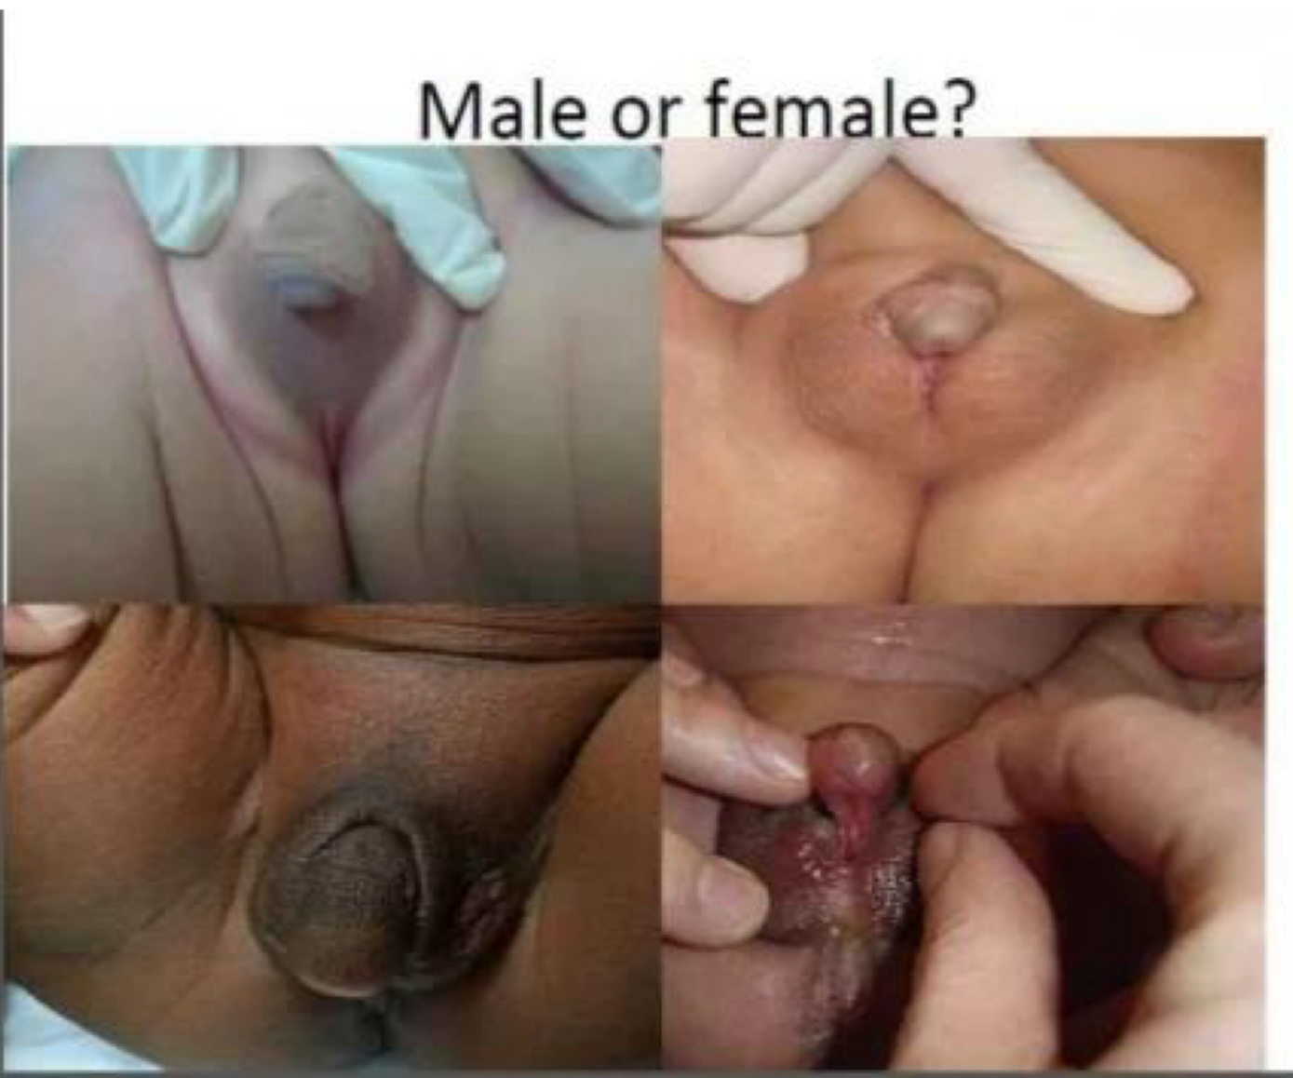
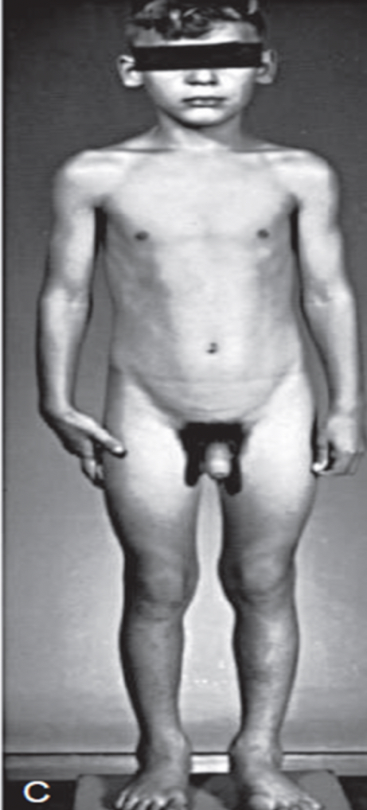
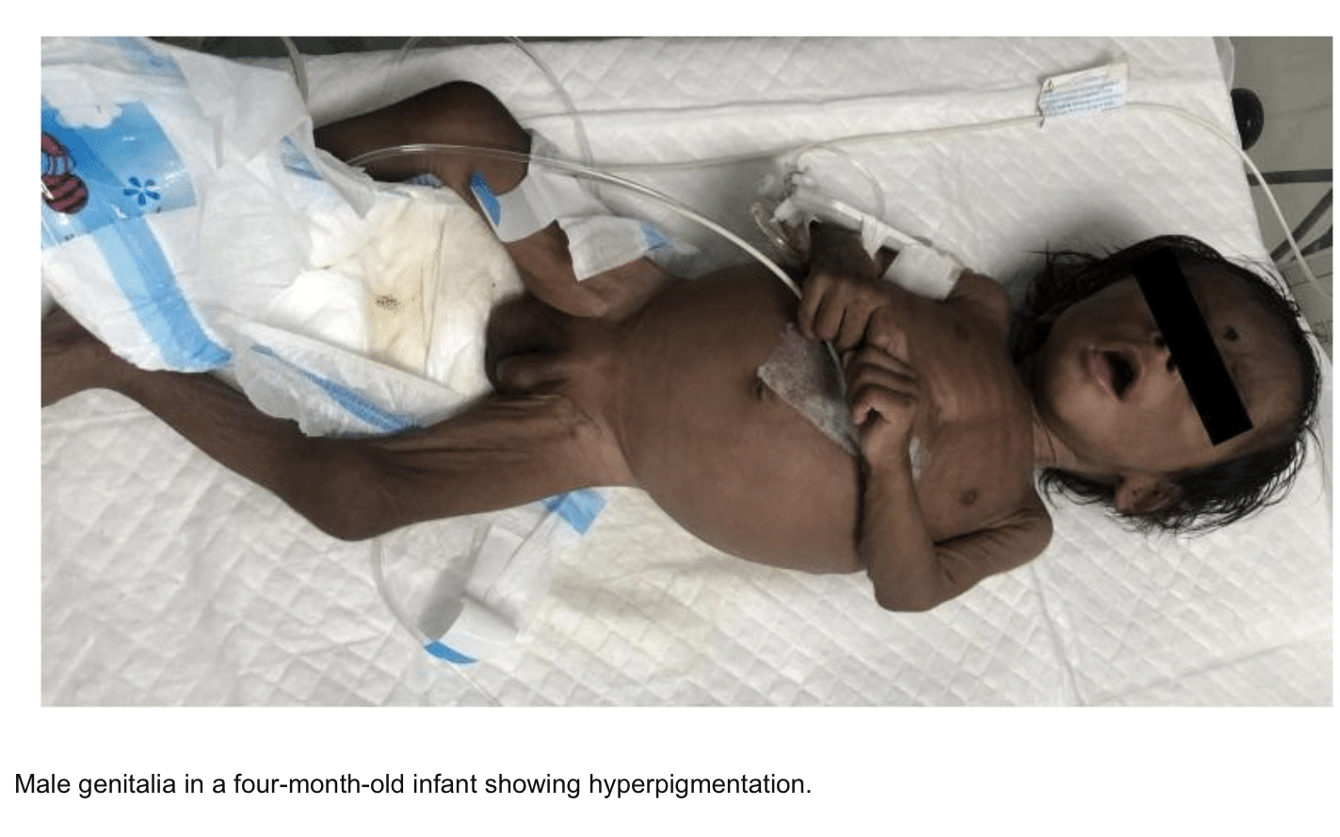

Slide 17
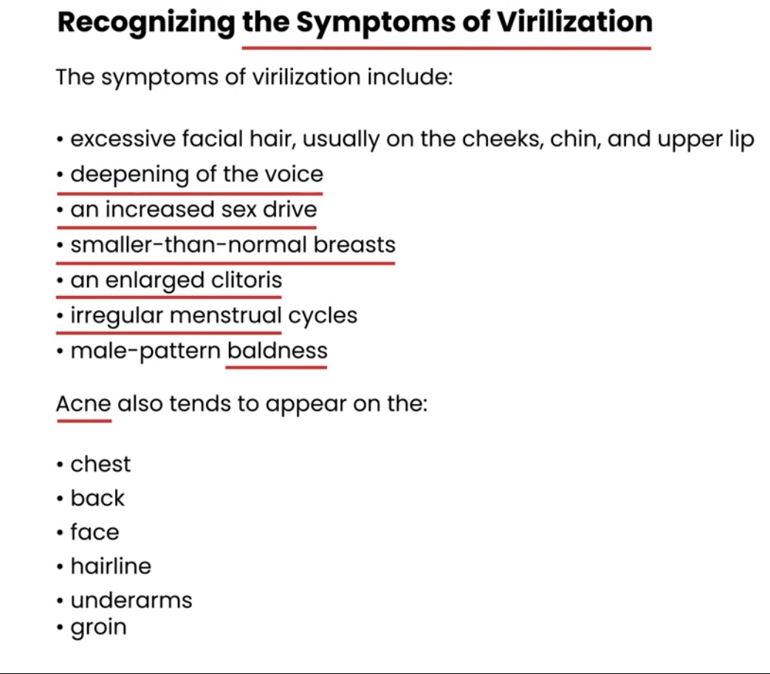
(nonclassic adrenal hyperplasia)
may present in adolescence or adulthood with oligomenorrhea, hirsutism, and/or infertility or virllization sign in female

Slide 18
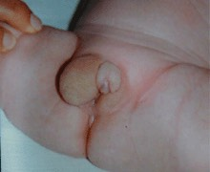
17-alpha-hydroxylase deficiency
which leads to a cortisol and androgen deficiency, and a buildup of 11 deoxycorticosterone and corticosterone.
Elevated levels of these weaker versions of aldosterone result In hypernatremia, hypokalemia, and hypertension, as well as primary amenorrhea and sparse body hair in females, and undervirilization in males due to the cortisol and androgen deficiencies.

Slide 19
11 beta hydroxylase deficiency
This also leads to low cortisol, and while aldosterone levels are low, there's a build-up of 11 deoxycorticosterone, which has a weak mineralocorticoid activity and results in hypertension.
Also, a lot of progesterone gets converted to excess dehydroepiandrosterone sulfate, causing virilization in females.
So 11 beta hydroxylase deficiency is a lot like 17-alpha-hydroxylase deficiency, except it presents with androgen excess instead of androgen deficiency.
Classically, female neonates have ambiguous genitalia, including clitoral enlargement and labioscrotal fusion, and male neonates may have an enlarged phallus.
In children who are not diagnosed at birth, 11 beta hydroxylase deficiency presents as premature adrenarche, with body odor and axillary and pubic hair development.

Slide 20
3-beta-hydroxysteroid-dehydrogenase deficiency
This is a very rare disorder, which results in deficiency of all adrenal hormones - cortisol, aldosterone, and androgens.
The resulting ACTH excess leads to excessive production of 3-beta-hydroxy-delta-5-steroids, like pregnenolone, 17-hydroxypregnenolone, and dehydroepiandrosterone.
With 3-beta-hydroxysteroid-dehydrogenase deficiency, both male and female infants are born with ambiguous external genitalia - so a karyotype should be done to confirm the genetic sex of the infant.
Similar to 21-hydroxylase deficiency, infants have clinical manifestations of both cortisol and aldosterone deficiency, like feeding difficulties, failure to thrive, vomiting, hyponatremia, and hyperkalemia.

Slide 21
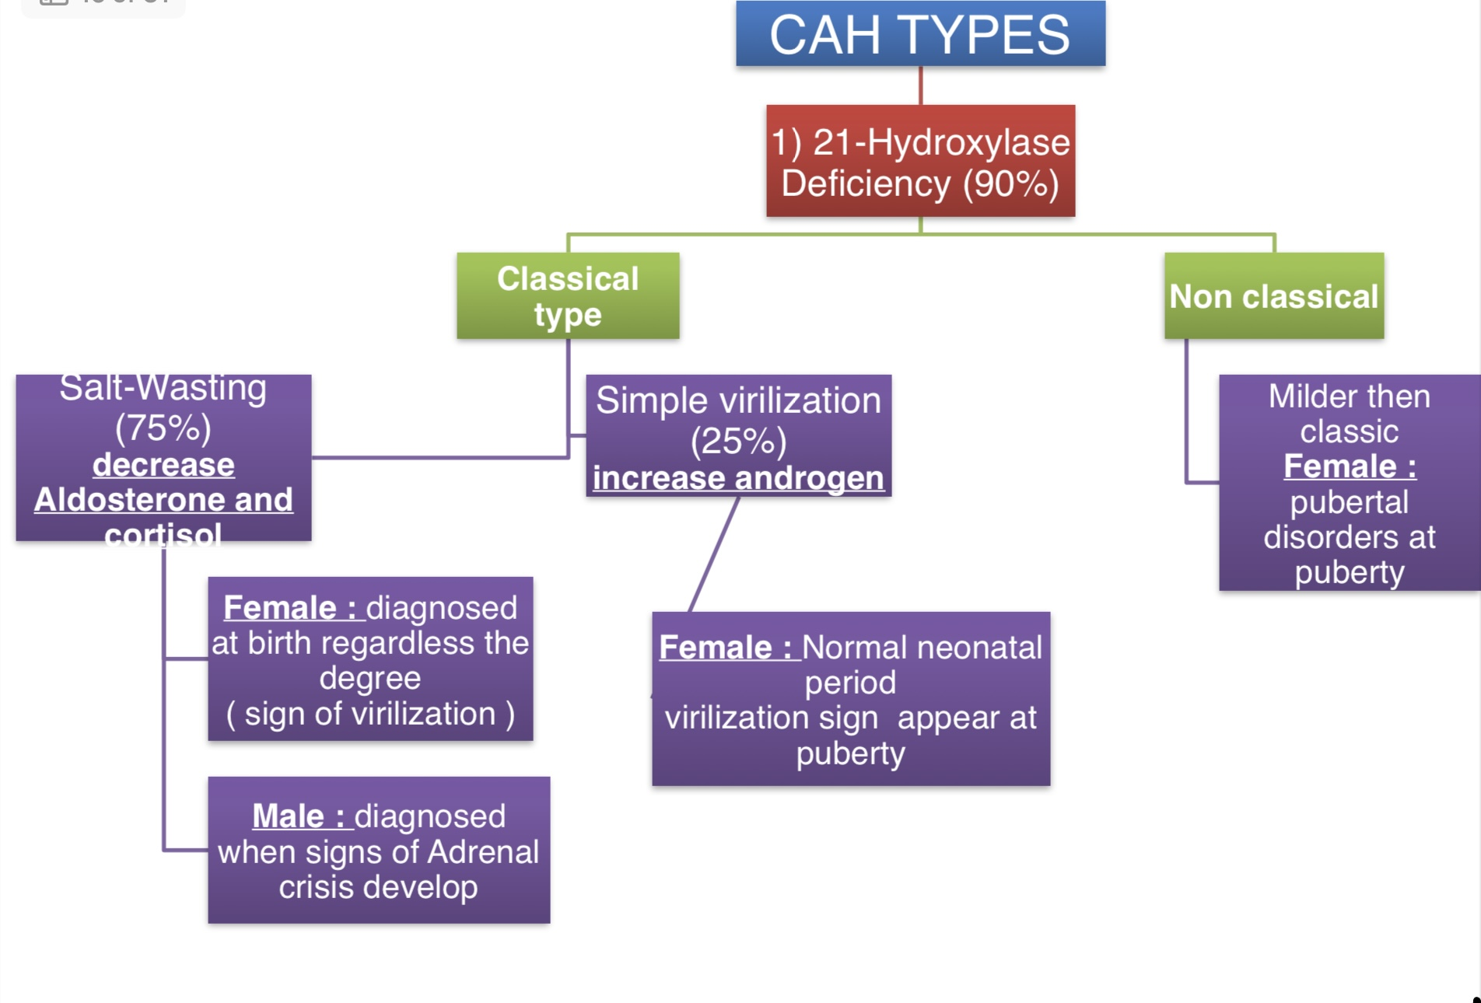

Slide 22
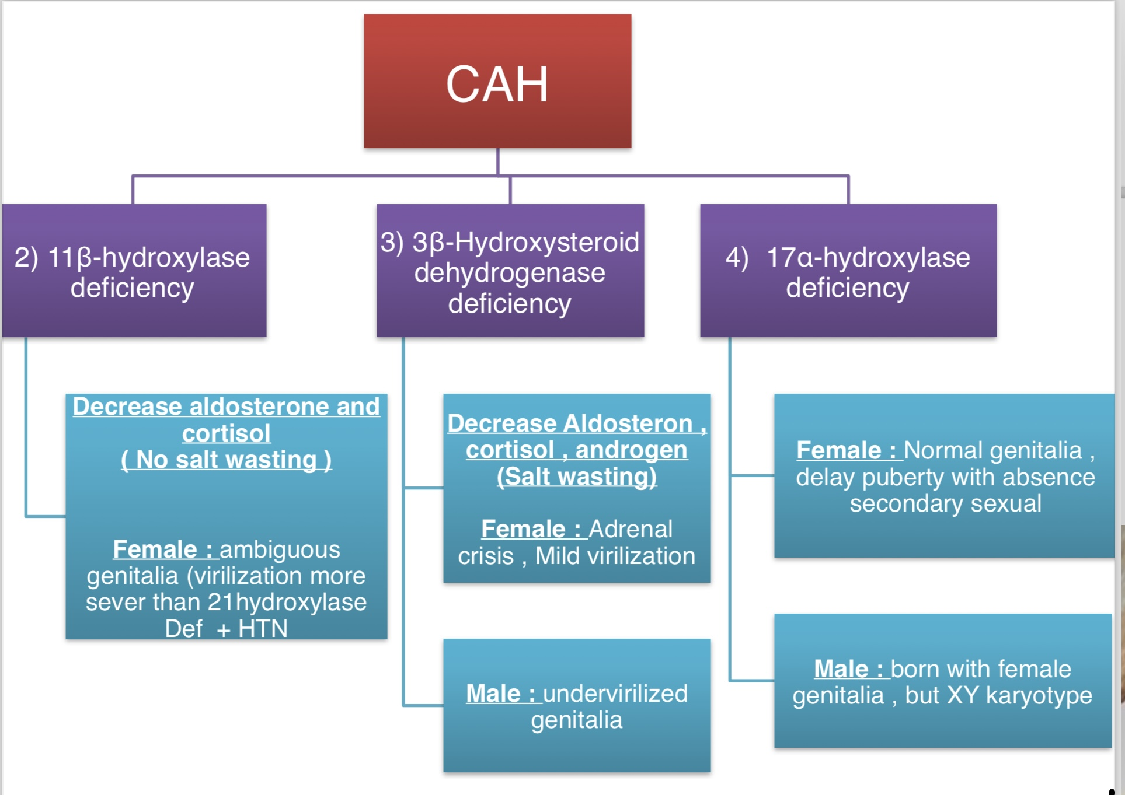

Slide 23
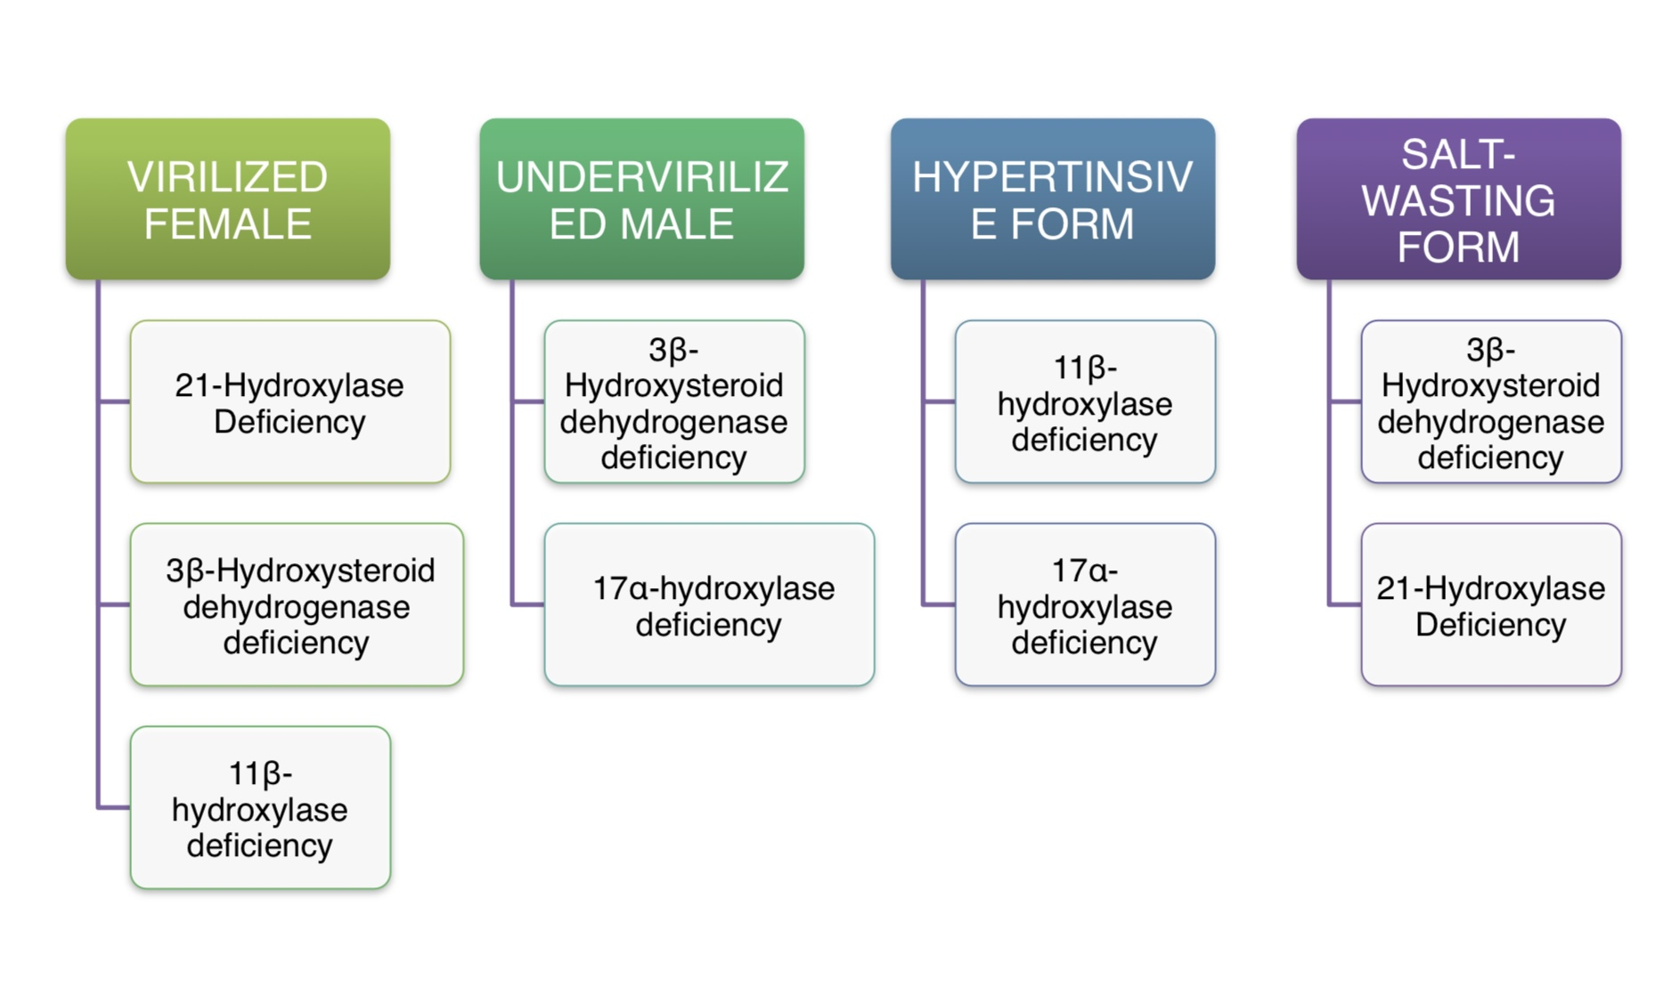

Slide 24
Diagnosis:
Classic 21-hydroxylase deficiency is usually diagnosed at birth, through neonatal screening.
Additionally, a karyotype should be obtained in neonates with ambiguous external genitalia, to confirm genetic sex.
The screening test is performed a few days after birth, and a serum concentration of
17 hydroxyprogesterone above 1000 nanograms per milliliter is diagnostic of 21-hydroxylase deficiency.

Slide 25
17-alpha-hydroxylase deficiency
Diagnosis
The diagnosis is established based on having high levels of 11- deoxycorticosterone and high levels of
corticosterone , and low levels of cortisol, androgens, and estrogen. Also, serum 17- hydroxyprogesterone is typically low.
11 beta hydroxylase deficiency.
The diagnosis is based on having high levels of 11-deoxycortisol, 11-
deoxycorticosterone, , as well as testosterone.
Or an elevation In ratio of 24h urinary tetrahydropound s (metabolite of 11-deoxycortisol ) to tetragydrocompound F (metabolite of cortisol)
Individuals have low cortisol and corticosterone levels, and there’s usually hypokalemia due to the mineralocorticoidexcess.

Slide 26
3-beta-hydroxysteroid-dehydrogenase deficiency.
So a high ratio of delta-5-17-hydroxypregnenolone to delta-4-17-hydroxyprogesterone in the serum is
characteristic for 3-beta-hydroxylase deficiency.

Slide 27
Central adrenal insufficiency
CAI incidence is estimated between 150 and 280 per million.
Central adrenal insufficiency is when the pituitary gland (a small gland underneath the brain that controls other glands) does not make enough adrenocorticotrophic hormone (ACTH). ACTH is a hormone that helps control how much cortisol your adrenal glands release. Causes of central adrenal insufficiency include:
When the pituitary gland does not develop properly
Injury to the pituitary gland, like trauma or radiation
Tumors or other growths near the pituitary gland
Having surgery to remove the pituitary gland
Long-term use of high-dose glucocorticoid medications, like dexamethasone, prednisone, prednisolone or certain inhaled glucocorticoids (which suppresses the hypothalamic-pituitary-adrenal axis)

Slide 28
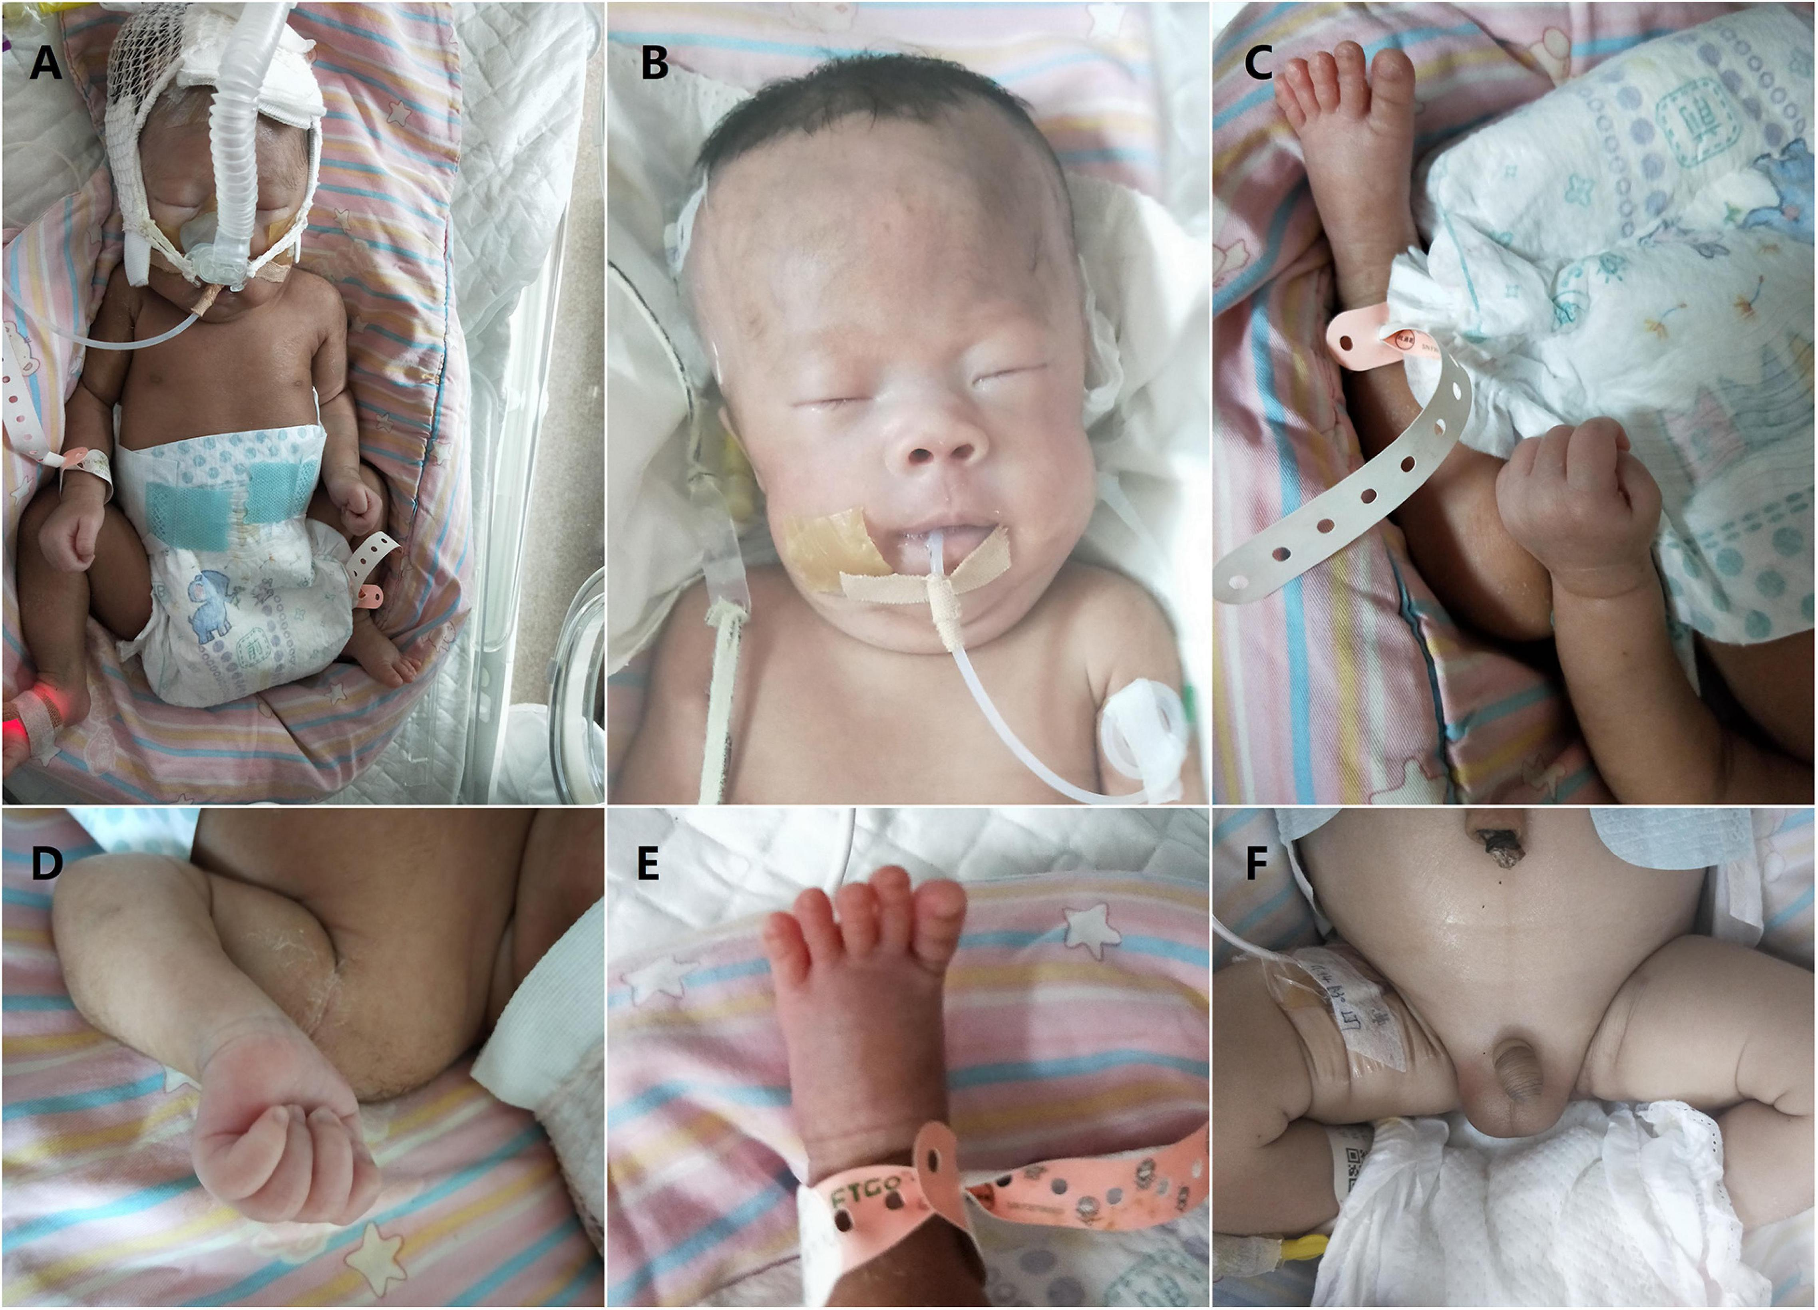
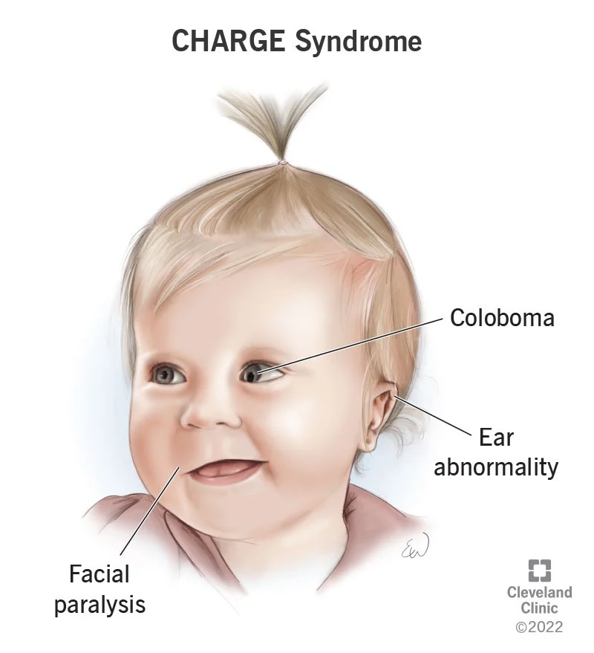
Mainly, it occurs as part of complex syndromes in which a combined
multiple pituitary hormone deficiency (CMPD)
is associated with craniofacial and midline defects, such as
Prader-Willi syndrome, CHARGE syndrome, Pallister-
Hall syndrome (anatomical pituitary abnormalities),
white vanishing matter disease (progressive
leukoencephalopathy)
CMPD can be caused by several defective genes,
such as GLI1, LHX3, LHX4, SOX2, SOX3, HESX1

Slide 29
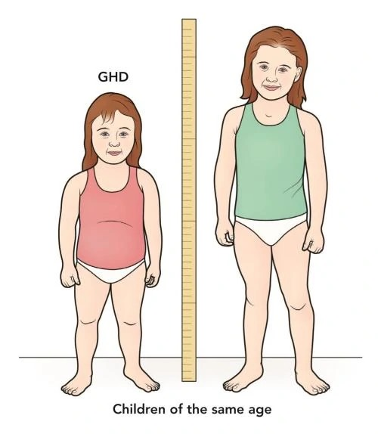
Individuals with an isolated pituitary deficiency, usually a growth hormone deficiency (GHD) may develop multiple pituitary hormone deficiencies
over the years.
Therefore, excluding a latent CAI at GHD onset and periodically monitoring of HPA axis is of upmost importance.
Notably, cortisol reduction secondary to an increased basal metabolism when starting GHD or thyroxin substitutive therapy may unleash a misdiagnosed CAI in such cases, hypoglycemia or small penis with undescendedtestes may respectively suggest concomitant GH and gonadotropins deficits.

Slide 30
The clinical presentation of CAI
may be more complex when caused by an underlying central nervous system disease or by CMPD.
In the case of a pituitary or hypotha- lamic tumor, patients may present headache, vomiting, visual disturbances, short stature, delayed or precocious puberty.
In the case of CMPD, manifestations vary con- siderably and depend on the number and severity of the associated hormonal deficiencies.
In CAI, aldosterone production duction is spared, which means that serum electrolytes are usually normal. However, cortisol contributes to regulating free water excretion, so patients with CAI are at risk for dilutional hyponatremia, with normal serum potassium levels. Since adrenal androgen secretion is under the con trol of ACTH.
girls with ACTH deficiency may present light pubic hair. Patients with partial and isolated ACTH defects can be “asymptomatic”, and adrenal crisis appears during stress or in case of major illness (high fever, surgery).

Slide 31
Genetic Disorders and Other
Conditions at Increased Risk for
Adrenal Insufficiency

Slide 32
Cholesterol Biosynthesis Disorders
Smith-Lemli-Opitz Syndrome (SLOS)
Genetic cause (defective 7-dehydrocholesterol reductase)
Lysosomal Acid Lipase A Deficiency
Adrenal gland calcification due to lipid accumulation

Slide 33
Adrenal Development Disorders
X-linked Congenital Adrenal Hypoplasia (AHC)
Genetic cause (defective nuclear receptor DAX-1)
Syndromes combining Adrenal Hypoplasia with IUGR
IMAGe Syndrome
MIRAGE Syndrome

Slide 34
Adrenal Insufficiency due to ACTH Resistance
Familial Glucocorticoid Deficiency (FGD)
FGD1 and FGD2
Genetic causes (defective ACTH receptor and MRAP)

Slide 35
Autoimmune Causes of Adrenal Insufficiency
including Addison's disease
Autoimmune pathogenesis (Addison disease) accounts
for approximately 15% of cases of primary AI in children,
in contrast with adolescents and adults where it is the most
common mechanism; half of these children present other
glands involvement as well

Slide 36
Subclinical Adrenal Insufficiency
It represents the preclinical stage of Addison disease when 21-hydroxylase autoantibodies are already detectable but still absent from evident symptoms.
21-hydroxylase autoantibodies positivity carries a greater risk to develop overt AI in children than in adults: in a study, estimated risk was 100% in children versus 32% in adults on a medium six-year period of follow-up.
As the adrenal crisis is a potentially lethal condition, it is essential to recognize and adequately manage subclinical AI .

Slide 37
Symptoms
Although asymptomatic by definition, subclinical AI may present with non-specific symptoms such as fatigue, lethargy, gastrointestinal symptoms (nausea, vomiting, diarrhea, constipation), hypotension; physical or psychosocial stresses may sometimes exacerbate these symptom.
When symptoms lack, subclinical AI may be identified thanks to the co-occurrence with other autoimmune endocrinopathies.

Slide 38
Risk factors
Risk factors for the disease evolution include young age, male sex, hypoparathyroidism or candidiasis coexistence, increased renin activity, or an altered synacthen test with normal baseline cortisol and ACTH.
ACTH elevation has been reported as the best predictor of progression to the clinical stage in 2 years

Slide 39
Management of subclinical AI
Management of patients with subclinical AI should include serum cortisol, ACTH, renin measurement, and a synacthen test.
If normal, cortisol and ACTH should be repeated in 12–18 months, while synacthen test every two years.
After synacthen test results are subnormal, cortisol and ACTH should be assessed every 6–9 months if ACTH remains in range or every six months if ACTH becomes elevated.
In the 2nd case, therapy with hydrocortisone should be started.
This strategy will prevent acute crises and possibly improve the quality of life in patients reporting non-specific symptoms.

Slide 40
Other Genetic Disorders and Conditions
Allgrove or Triple-A Syndrome
Genetic cause (defective Aladin protein)
Metabolic Disorders Associated with AI
Sphingosine-1-Phosphate Lyase (SGPL1) Deficiency
Adrenoleukodystrophy (ALD)
Zellweger Syndrome
Autoimmune Polyglandular Syndrome Type 1 (APS1, or APECED)
and APS2

Slide 41
Apart from a genetic disorder, a strong link between autoimmune conditions and autoimmune primary AI has been established, with more than 50% of patients with the latter also having one or more other autoimmune endocrine disorders; on the other hand, only a few patients with T1DM or autoimmune thyroiditis or Graves’ disease develop AI. As an example, in a study of 629 patients with T1DM, only 11 (1.7%) presented 21-hydroxylase autoantibodies, with three of them havingAI.41 Nevertheless, these patients are to be considered at increased risk for a condition that is potentially fatal yet easy to diagnose and treat; that is why it is reasonable to screen for autoimmune AI at least patients with T1DM, significantly if associated with DQ8 HLA combined with DRB*0404 HLA alleles, who have been observed to develop AI in 80% of cases if also 21- hydroxylase autoantibodies positive.

Slide 42
Regarding immunological disruption, the link with celiac disease is instead well established: celiac patients have an 11-fold increased risk for AI, while in a study, 6 of 76 patients with AI had celiac disease, so that mutual evaluation should be granted in these patients

Slide 43
Adrenal Crisis
is a condition in which your adrenal glands don't make enough of the hormone cortisol. It's a life-threatening complication of adrenal insufficiency

Slide 44
Cortisol affects almost every organ and tissue in your body. Some of its functions include:
Regulating your body’s stress response.
Helping control your metabolism.
Suppressing inflammation.
Regulating blood pressure.
Regulating blood sugar.
Helping control your sleep-wake cycle.

Slide 45
What can trigger an adrenal crisis?
The following stressors may trigger an adrenal crisis:
Not receiving treatment for an adrenal insufficiency such as Addison’s disease.
Damage to your adrenal gland, including adrenal gland diseases or surgery.
Dehydration..
Infection.
No longer taking glucocorticoid medications (prednisone) after taking them for a long time.
Mental or emotional stress.

Slide 46
Why is an adrenal crisis an emergency?
An adrenal crisis may cause a lack of blood flow (shock). Shock progresses quickly and may damage your organs. Without treatment, up to 20% of people in shock may die from an adrenal crisis.
An adrenal crisis may also cause seizures or a coma.
Who do adrenal crises affect?
An adrenal crisis can affect anyone.
How common are adrenal crises?
Adrenal crises aren’t common. Studies estimate that 42% of people with an adrenal insufficiency will have an adrenal crisis. In the United States, adrenal insufficiencies affect 1 in 100,000 people.
Some studies suggest that up to 25% of people who have an adrenal crisis die from it.

Slide 47
The most common symptoms of an adrenal crisis include:
Abdominal pain or pain in your side (flank).
Long-lasting fatigue.
Loss of appetite.
Darker patches of skin (hyperpigmentation).
Weakness.
Unexplained weight loss.
Other warning signs of adrenal crisis may include:
Dehydration.
Diarrhea.
Dizziness, confusion, light-headedness, fainting or coma.
Fever.
Headache.
Joint pain.
Low blood glucose.
Low blood pressure.
Nausea and vomiting.
Rapid breathing (respiratory rate).
Rapid heart rate.

Slide 48
Diagnosis and Tests
How is an adrenal crisis diagnosed?.
Serum Cortisol : Less than 20 mcg/dL in severe stress or after ACTH stimulation is indicative of adrenal insufficiency.
CBC: Anemia (mild and nonspecific),
pH blood test.
Potassium blood test.
Sodium blood test.
Blood sugar tests

Slide 49
Management and Treatment
ABC
3( S)?
1-Steroid ( hydrocortisone injection)
2-saline
3-suger
It may take 24 hours or longer to feel better after receiving treatment for an adrenal crisis.

Slide 50
How To Prevent An Adrenal Crisis?
Adrenal crisis can often be prevented by early treatment when physical stresses occur. If your child has CAH, hypopituitarism or is on long-term steroid medicine, then you need to watch out for the following common illnesses that may lead to an adrenal crisis.
Diarrhoea
vomiting
Fever
Injury
Surgery or anaesthetic

Slide 51
Diagnosis of Adrenal Insufficiency
Laboratory evaluation of a stable patient with suspected AI should start with combined early morning (between 6 and 8 AM) serum cortisol and ACTH measurements

Slide 52
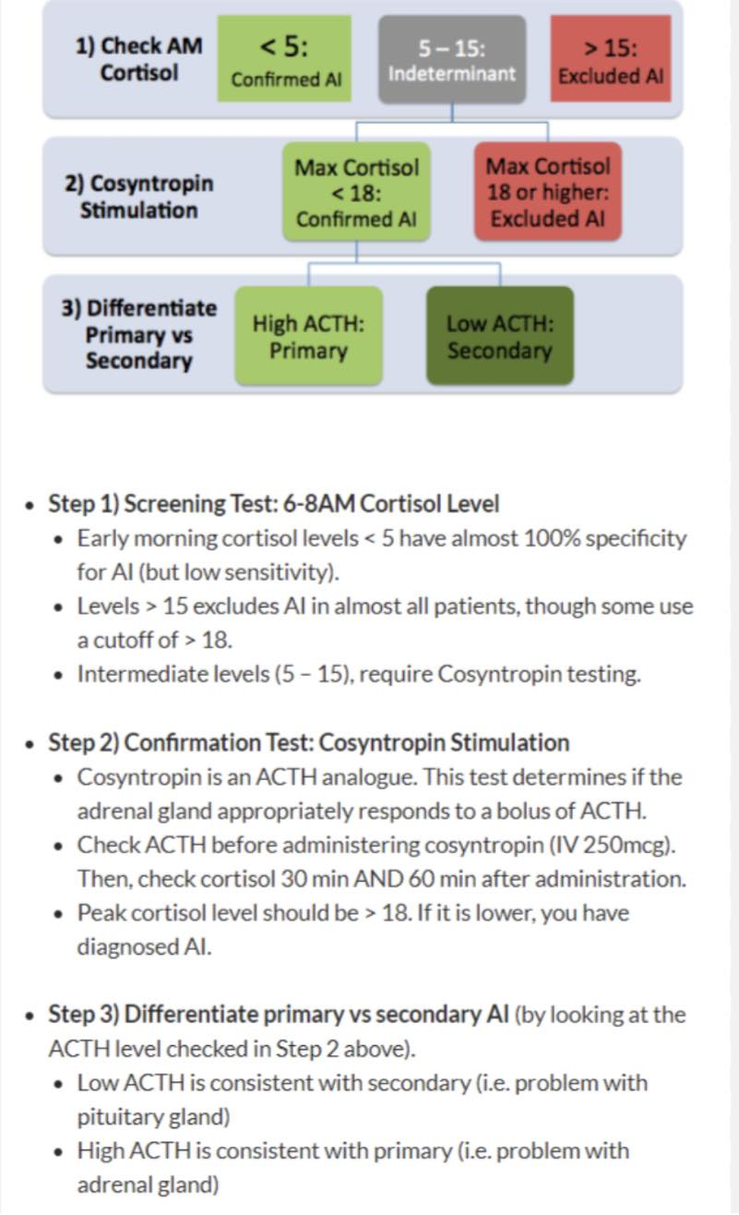

Slide 53
Management

Slide 57
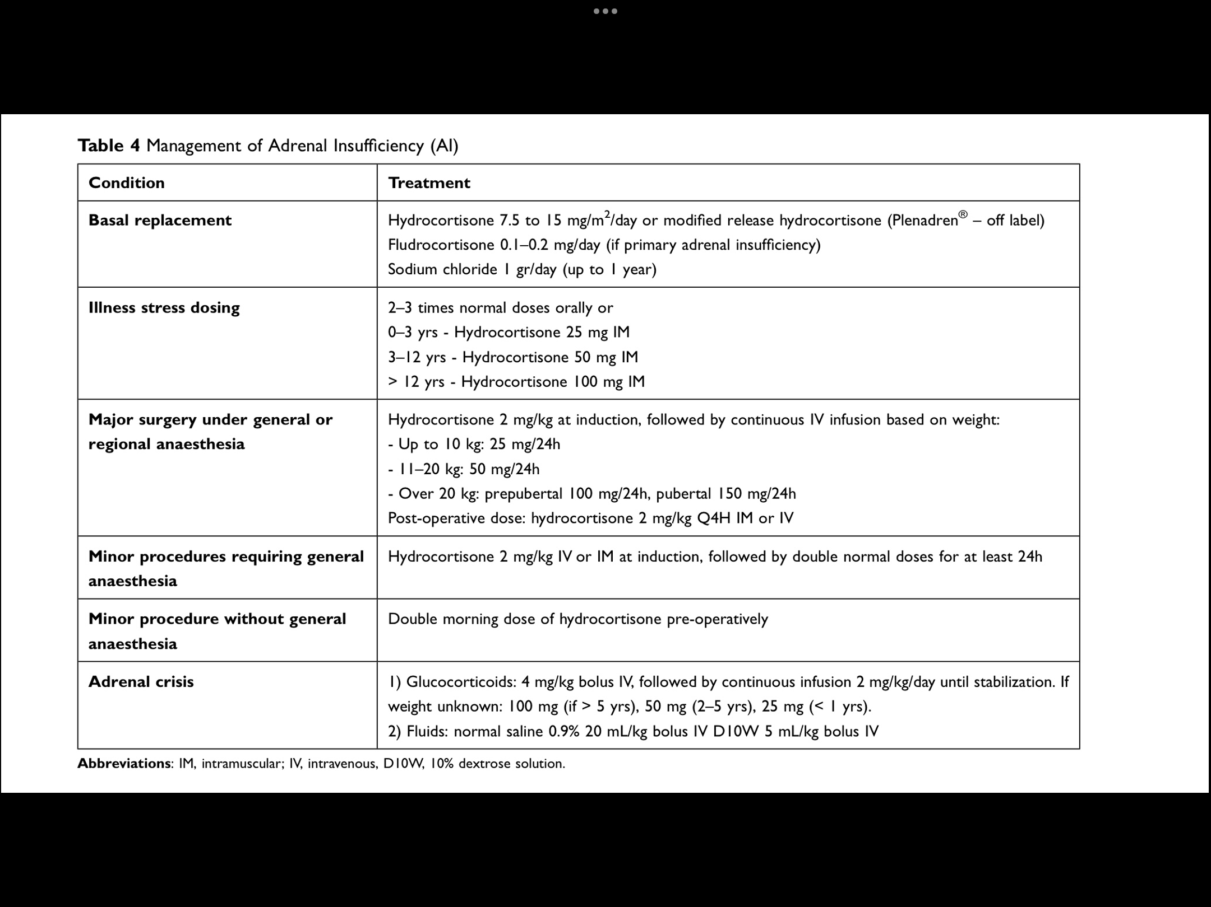

Slide 62
Thank you

