Slide 1
AIRWAY ANATOMY& ASSESSMENT

Slide 2
AIR WAY ANATOMY SIGNIFICANCE IN ANESTHESIA AND ICU
Accurate knowledge of anatomy and physiology of the respiratory tract is important in anaesthesiology and critical care
for safe and smooth conduction of anaesthesia and icu managment. as General anaesthesia sedation and muscle relaxation are associated with alterations in the respiratory function and carry with them at least a small risk of airway obstruction and apnea.

Slide 3
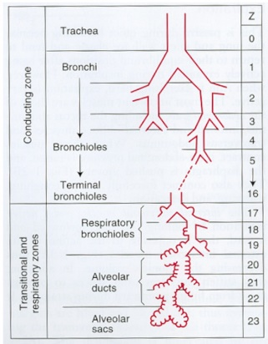
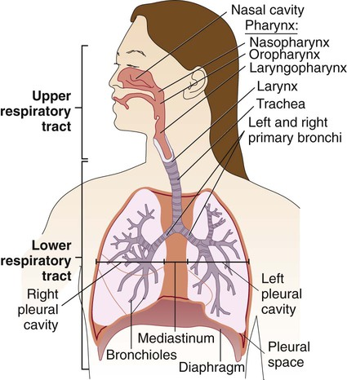

Slide 4
Air way is defined as a passage through which the air/ gas passes during respiration.
Functionally divided into: *conductive zone – till terminal bronchioles
*respiratory zone – includes respiratory bronchioles,alveolar ducts,alveoli
And anatomically divided into:
*upper airway (oral and nasal cavities,pharynx,larynx)
More vulnerable to obstruction
*lower air way (trachea,bronchi,bronchioles,alveoli)

Slide 5
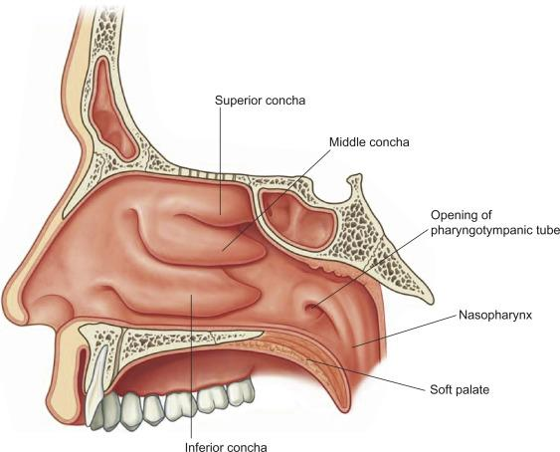
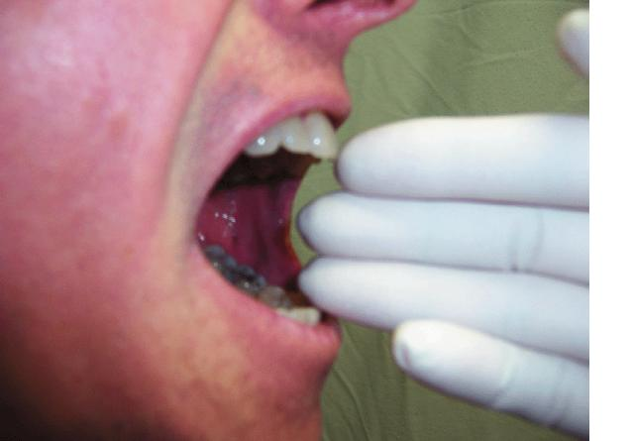
ORAL CAVITY
NASAL CAVITY
Extending from nostrils to posterior nasal aperture.
Divided by nasal septum into 2 halves (right and left)
Aims in humidification, heating and filtering of inspired air.
Extending from lips into oropharyngeal isthmus.
During evaluation for airway assessment, mouth openening must at least 3 fingers width (>6cm)

Slide 6
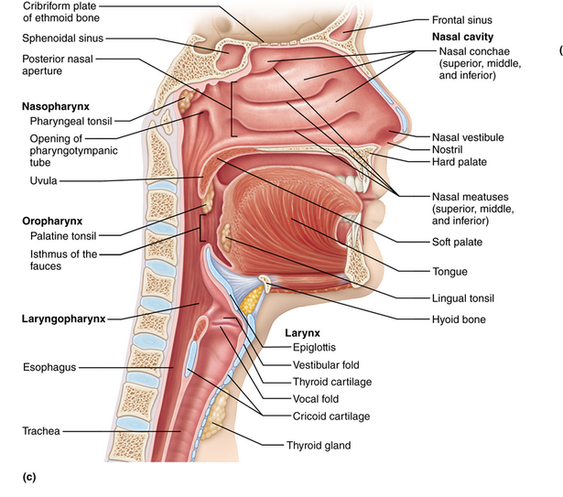
PHARYNX = THROAT
A hollow muscular tube inside the neck that
connects the posterior nasal and oral cavities
to the larynx and esophagus.
*12-14 cm in length
nasopharynx | oropharynx | Laryngopharynx
Behind the nasal cavity and above the soft palate. | Behind the oral cavity, between soft palate and top of hyoid bone. | Behind the larynx and below the epiglottis to the beginning of esophagus.
vallecula: a depression between epiglottis and base of the tongue
*where blade of laryngoscope rests.

Slide 7
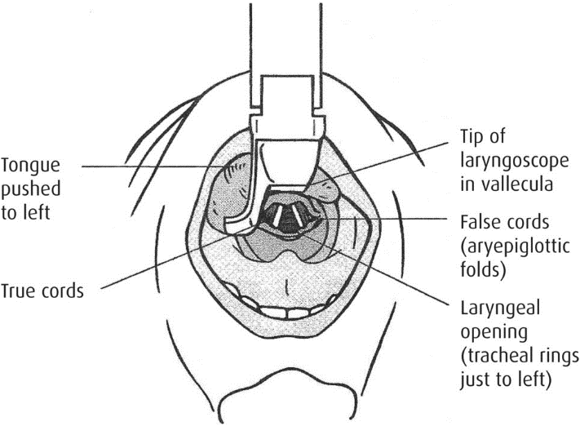
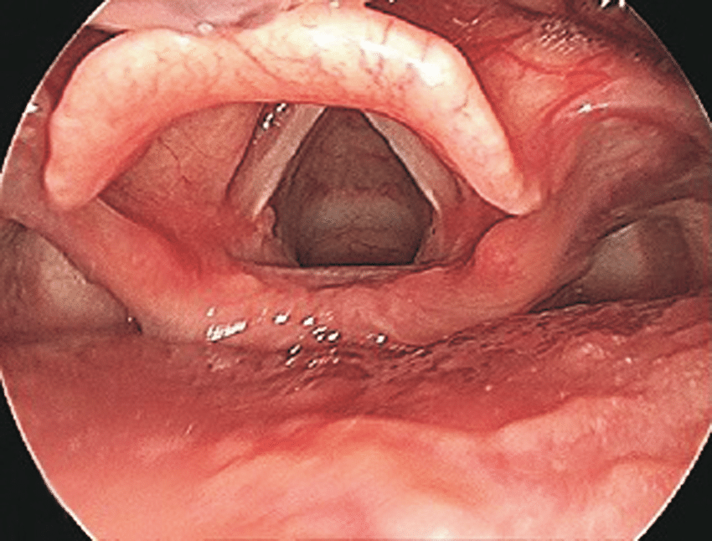
LARYNGOSCOPY FOR TRACHEAL INTUBATION
Endoscopy of the larynx to obtain
a good view for vocal cords and glottis.
*Used for placement of the ETT into the trachea.

Slide 8
JAW THRUST MANEUVER
In cases of decreased consciousness as in GA and due to decreased muscle tone, tongue may be posteriorly displaced into oropharynx obstructing the airway.
These maneuvers are used to maintain patient’s airway.
performed by placing the index and middle fingers to physically push the posterior aspects of the lower jaw upwards and outwards while their thumbs push down on the chin to open the mouth.

Slide 9
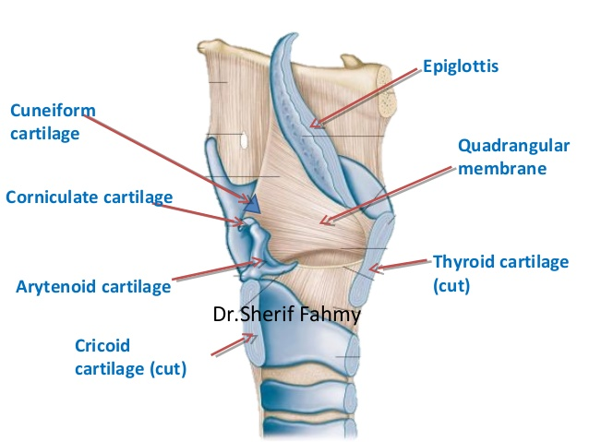
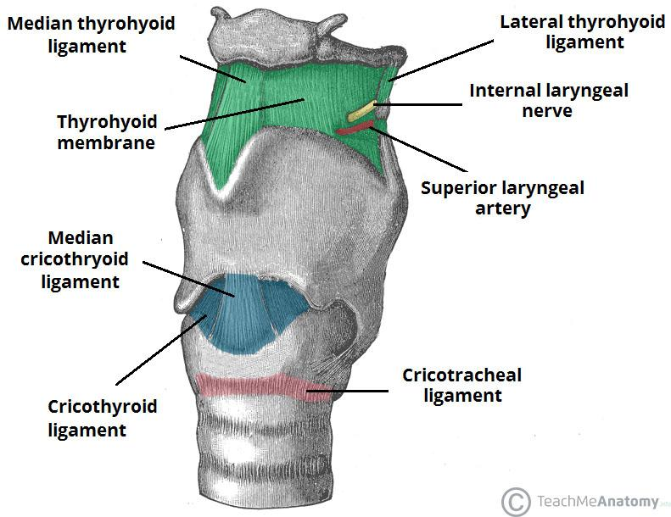
LARYNX = SOUND BOX
The passageway for air between the pharynx above and the trachea below.
Extends from C3-C6 in adults.
It is formed a number of cartilages which articulates by synovial joints and connected together by ligaments and membranes and moved by number of muscles.
Laryngeal cavity has 2 pairs of mucous membrane folds :
*upper folds=false vocal cords
*lower folds= true vocal cords, which could be injuried during intubation.
CRICOTHYROTOMY
Surgical airway made via the cricothyroid membrane in acute emergency when obstruction at or above the larynx not relieved.

Slide 10
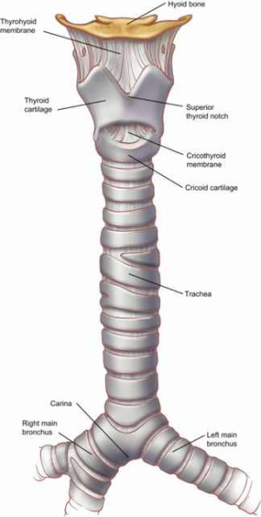
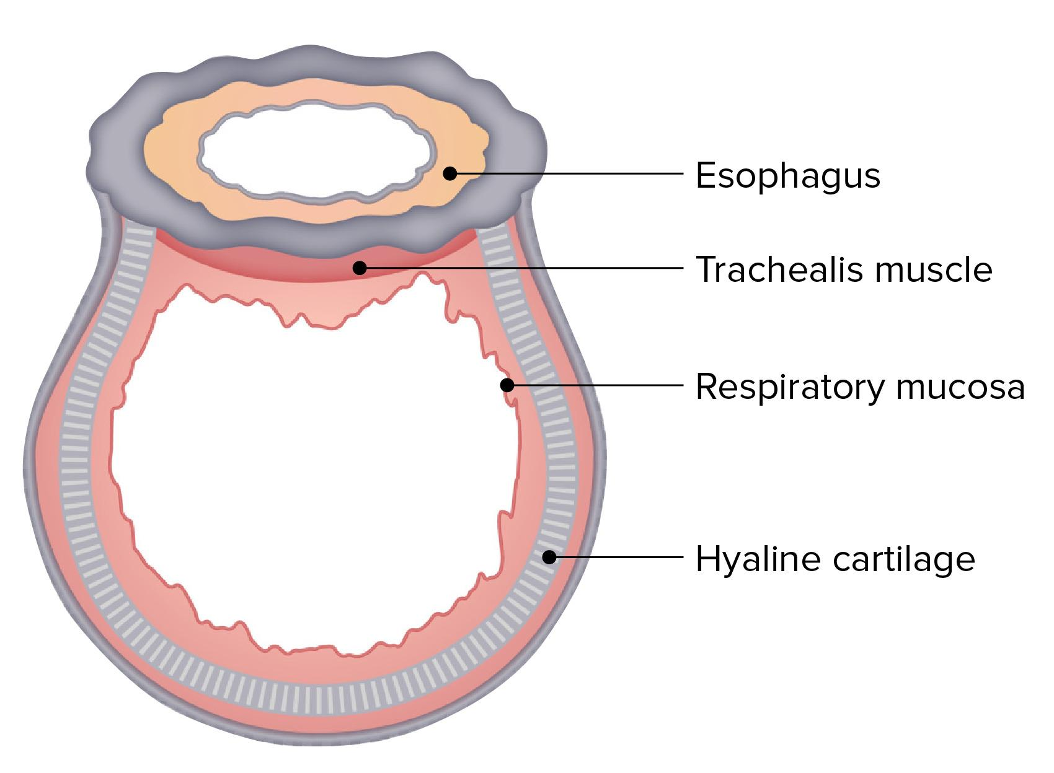
THE TRACHEA
The trachea is a mobile cartilaginous and membranous tube composed of 15-20 “C” shaped cartilages .
Posteriorly there is no cartilage and consists of ‘Trachealis Muscle’ and ligamentous membrane.
• It begins as a continuation of the larynx at the lower border of the cricoid cartilage at the level of the 6th cervical vertebra
• Trachea ends at the carina by dividing into right and left principal (main) bronchi at the level of the sternal angle (opposite the disc between the fourth and fifth thoracic vertebrae
• The carina is a cartilaginous ridge within the trachea at the site of the tracheal bifurcation • In adults the trachea is about 4½ in. (11.25 cm) long and 1 in. (2.5 cm) in diameter

Slide 11
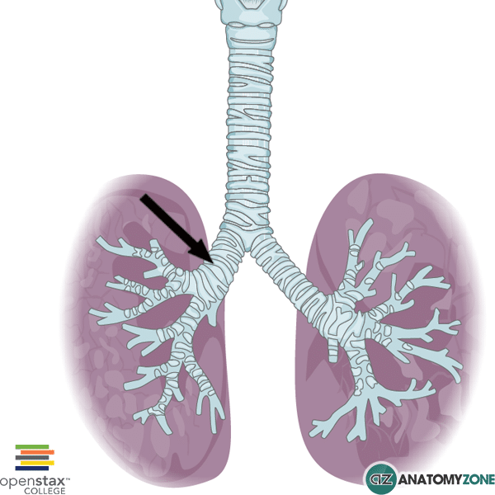
BRONCHI
Right bronchus is shorter and wider and is more vertical than the left bronchus.
Foreign bodies usually enter the right bronchus

Slide 12
Carina clinical significance
Foreign bodies that fall down the trachea are more likely to enter the right bronchus. The mucous membrane of the carina is the most sensitive area of the trachea and larynx for triggering a cough reflex.

Slide 13
AIR WAY ASSESSMENT

Slide 14
ASSESSMENT
1) History
2) Regional &local examination
3) Specific test for assessment
4)Radiographic presentation

Slide 15
DEFINITION
Airway assessment is the first step in successful airway management. Several anatomical and functional manoeuvres can be performed to estimate :
1- difficulty of endotracheal intubation; account 17% of respiratory related injury and result in significant morbidity and mortality
2- Oesophageal intubation
3- Inadequate ventilation
28%of anaesthesia related death are secondary to the inability to mask ventilate or intubation

Slide 16
WHY IT IS NECESSARY ¿
TO DIAGNOSE THE POTENTIAL FOR DIFFICULT AIRWAY FOR :
1- Optimal patient preparation
2- Proper selection of equipment and technique
3- Participation of personnel experienced in difficult airway management

Slide 17
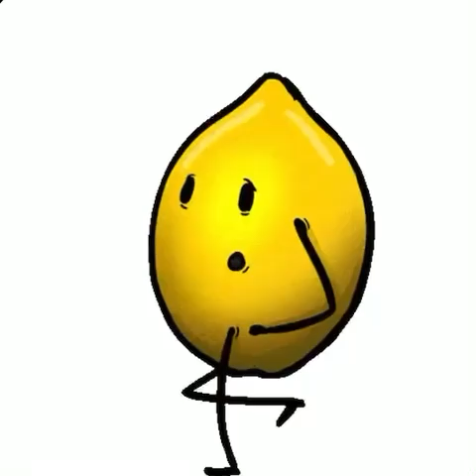
LEMON
Look
Evaluation
Mallampati
Obstructive
Neck mobility

Slide 18
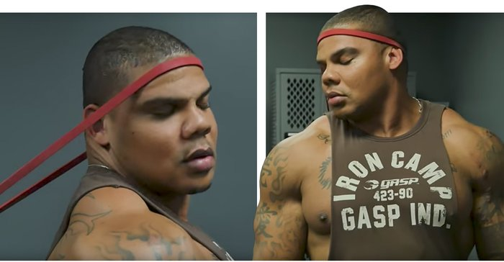
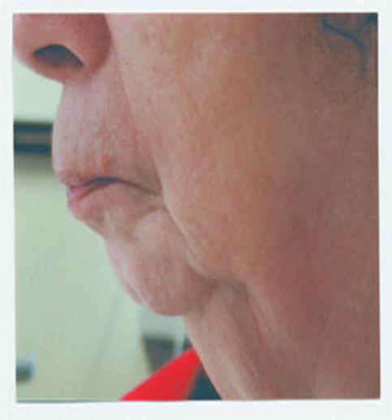
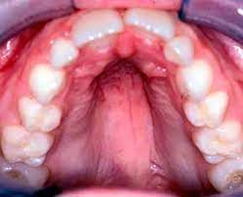
LOOK

Slide 19
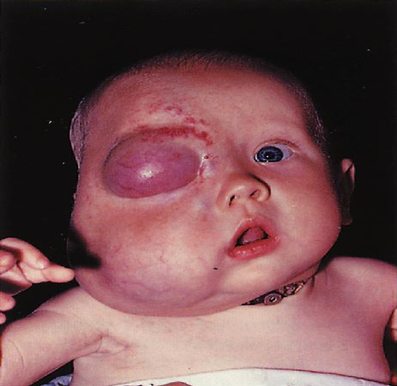
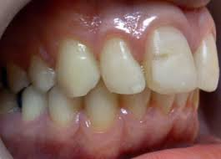
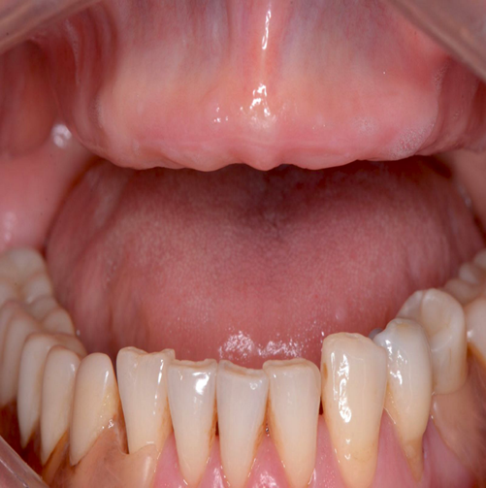
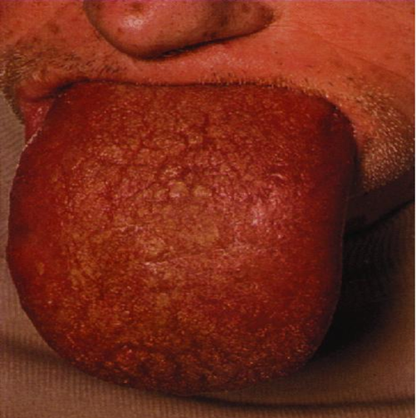
● tumor that could obstruct air flow
● Limited temporomandibular joint mobility
Missing teeth

Slide 20
Predictor of difficulty encountering ventilation mask )
Bearded man MOANS
Bearded
2. mask sealing difficult due to receding mandible syndromes with facial abnormality burn stricture .etc
3. Obesity, upper airway obstruction
4. Advanced age
5. no teeth
6.Snorer

Slide 21
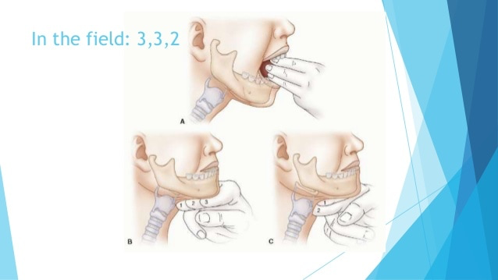
EVALUATE 3 3 2
Mouth Opens at least three finger widths (>6cm)
Thyromental distance Three finger widths(>6cm)
hyomental distance Two finger widths

Slide 22
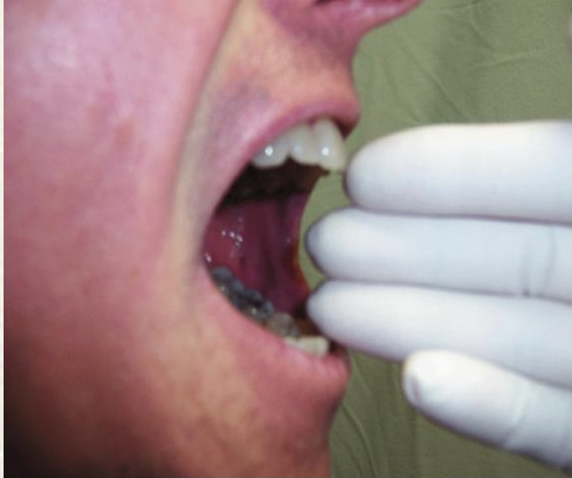
INTER - INCISOR GAP (MOUTH OPENING )
Inter - incisor distance with maximal mouth opening
Minimum acceptable value > 5 cm
Significance:
< 3 cm: difficult laryngoscopy
< 2 cm: difficult LMA insertion

Slide 23
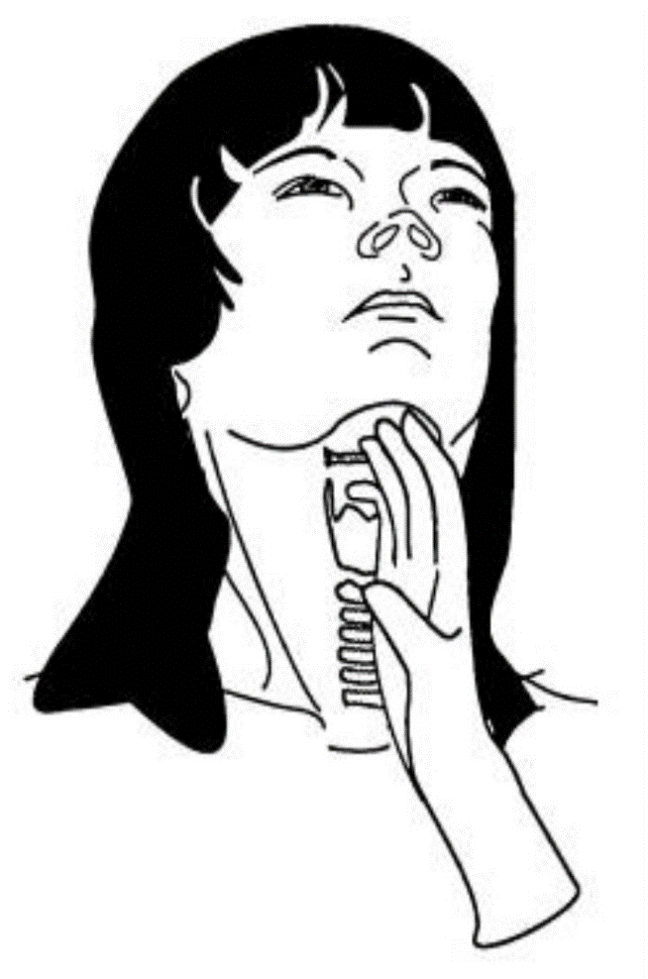
THYROMENTAL DISTANCE (PAIL’S TEST )
Distance from the tip of thyroid cartilage to inside of the mentum
Neck full extended / mouth closed
>6.5cm _no problem with laryngoscopy & intubation
6-6.5 –difficult laryngoscopy but possible
< 6cm –laryngoscopy is impossible

Slide 24
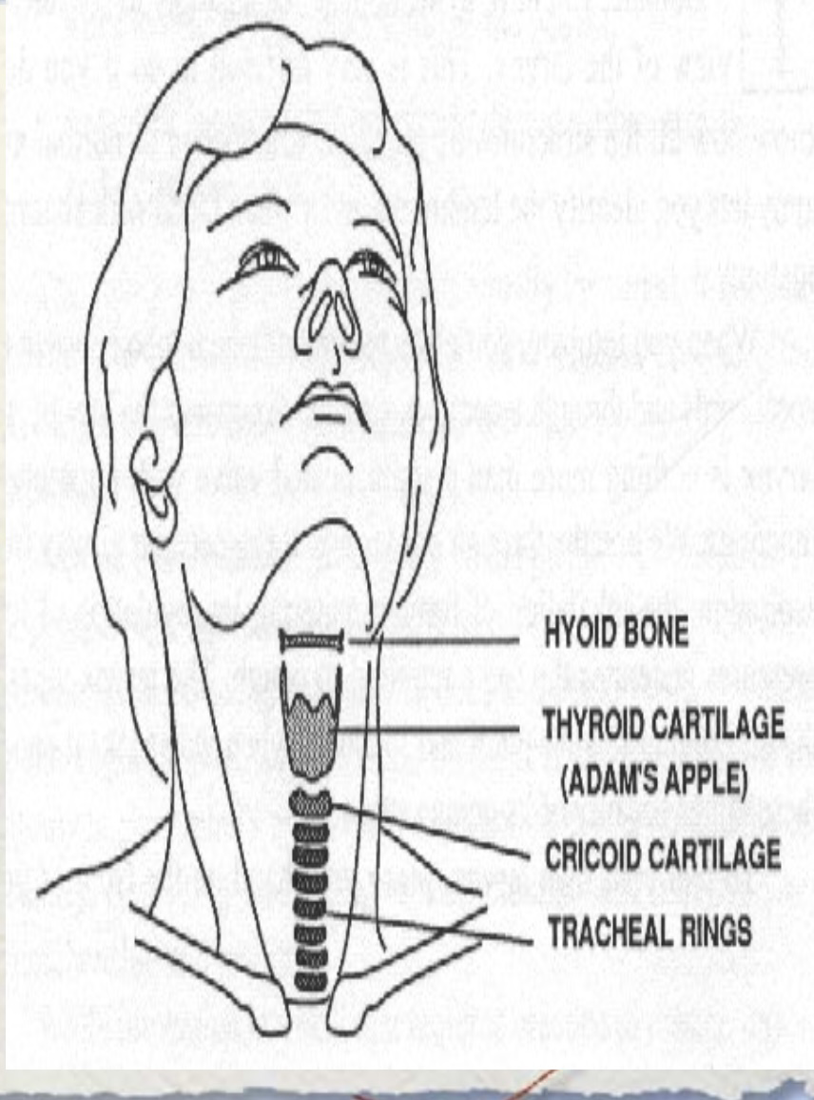
HYOMENTAL
Measured from the mentum to the top of the hyoid bone >2 fingers
-The position of the hyoid bone marks the entrance to the larynx.
-<2 = Less space to displace tongue tend to be more difficult to intubate.

Slide 26
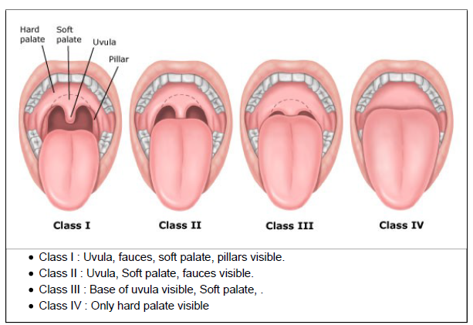
MALLAMPATI SCORE
)LEMON(
The assessment of the size of tongue relative to the size of pharyngeal opening to predict intubation difficulty.
Performed with patient in a sitting position, head neutral, mouth open wide and tongue protruding to the maximum.
Class I: 46% prevalence(No Difficult intubation) Class II:40% prevalence(No Difficult intubation)
Class III:<13% prevalence(Moderate Difficult intubation) Class IV:<1% prevalence(Severe Difficult intubation)

Slide 27
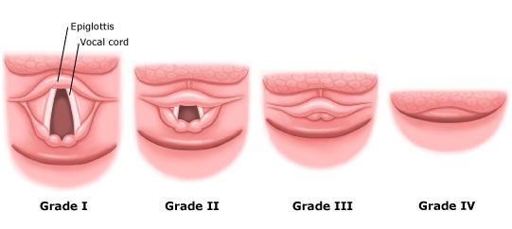
CORMACK GRADING LARYNGOSCOPIC VIEW GRADES
Grade 1: Full view of glottis.
Grade 2: Only posterior extremity of glottis seen or only arytenoid cartilages.
Grade 3: Only epiglottis seen.
Grade 4: Neither glottis nor epiglottis seen ( very rare).
Class I view is a Grade I Intubation 99% of the time. Class IV view is a Grade III or IV intubation 99% of the time.

Slide 28
)LEMON(
Airway obstruction
Partial or complete blockage in any part of the airway resulting in a
decreasing the ability to ventilate.
Airway obstruction can be either acute or chronic.
EX:
Tongue.
foreign body.
trauma (burn, bleeding).
Infections (epiglottitis).
allergic reactions.
tumors.
abscess(Peritonsillar abscess, Retropharyngeal abscess).

Slide 29
PARTIAL & COMPLETE AIRWAY OBSTRUCTION SYMPTOMS.
Complete:
Lack of any air movement.
Lack of breath sounds with stethoscope.
Retraction of the sternum and rib cage.
Choking sign(hands clutched throat).
Cyanosis.
Hypoxemia
Hypercarbia
Partial:
Noisy breathing (stridor, snoring).
Coughing.
Retraction of the sternum.
Hypoxemia.
Hypercarbia.

Slide 30
AIRWAY OBSTRUCTION MANAGEMENT
Quick history and clinical examination can help in determining the site of obstruction.
Investigation: X-ray, CT and bronchoscopy.
Heimlich maneuver : subdiaphragmatic abdominal thrust create an artificial cough and expel a foreign body from airway.
Head-tilt\ chin-lift : contraindication in suspected cervical injury.
Jaw thrust maneuver.
Surgical intervention.

Slide 31
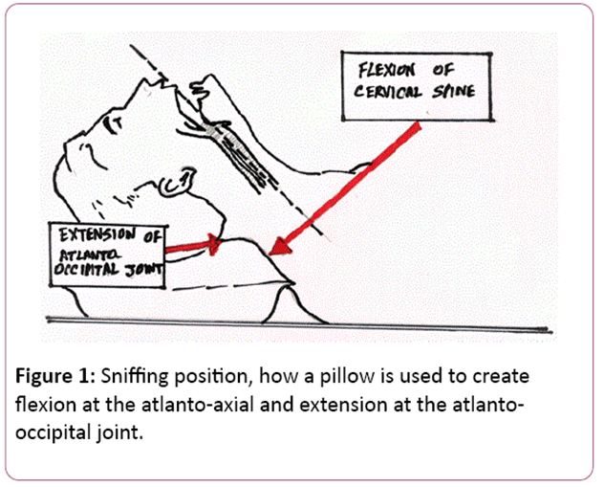
NECK MOBILITY
)LEMON(
Ideally the neck should be able to extend back approximately 35°.
the best position for intubation is the sniffing position.
Atlanto-occipital movement assesses neck mobility.

Slide 32
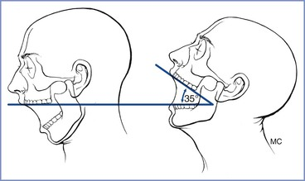
Problems: - Cervical Spine Immobilization - Ankylosing Spondylitis - Rheumatoid Arthritis - Halo fixation

Slide 33
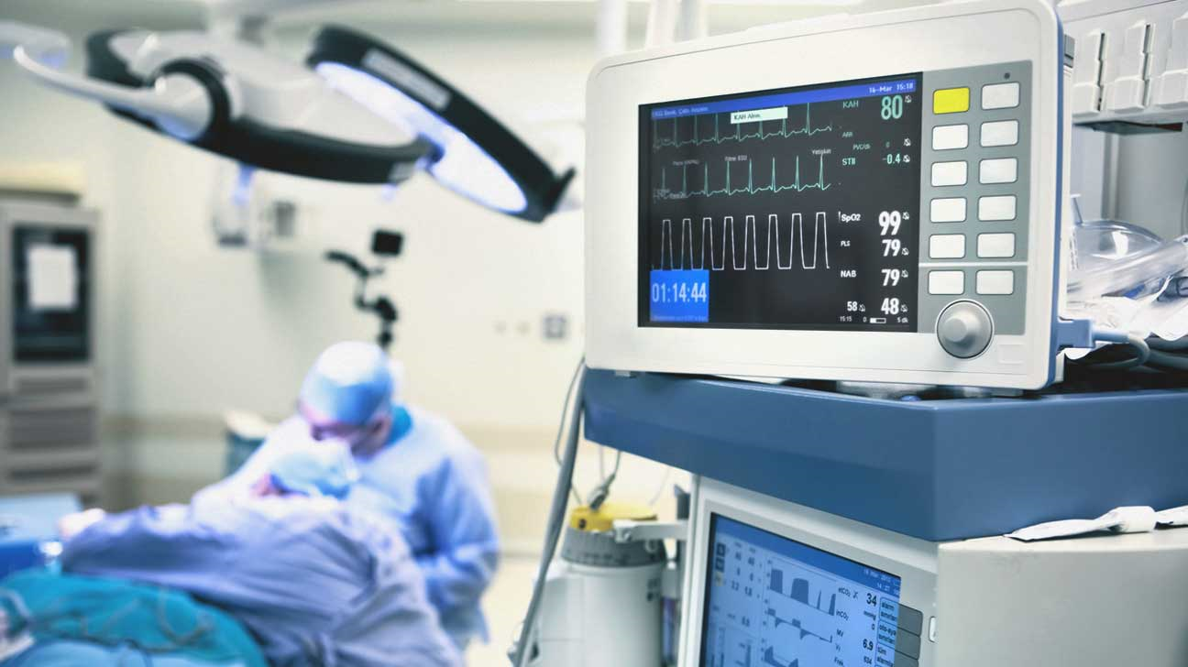
THANK YOU
Done by
حنين الجرابعة
بشرى البشايرة
اسراء الرفوع
منار محمد
لما حاتم
نبال عيال سلمان
يقين عيال عواد
Supervised by:
دكتور محمد عمير

