Slide 1
Introduction to anemia , classification and strategies for diagnosis.
Dr. Bushra AlTarawneh, MD
Anatomical pathology Mutah University School of Medicine- Department of Laboratory medicine & Pathology HLS lectures 2021

Slide 2
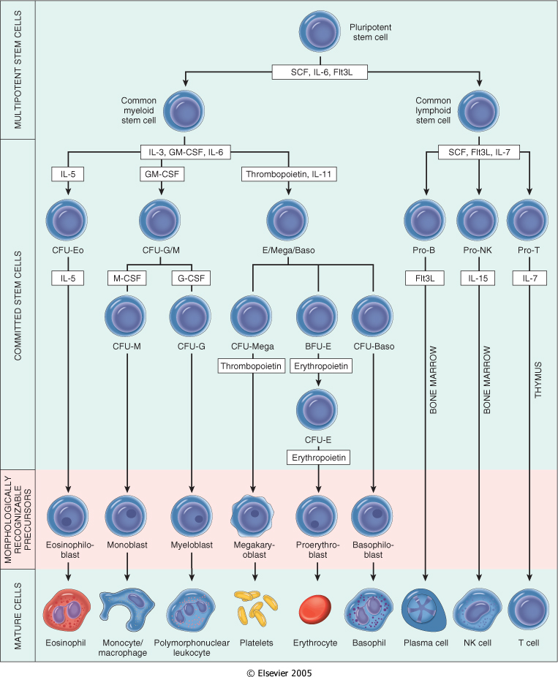
Downloaded from: StudentConsult (on 30 January 2012 06:04 PM)
© 2005 Elsevier

Slide 3
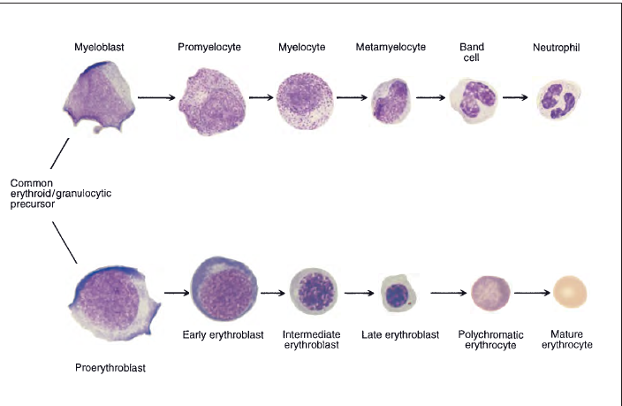

Slide 4
Introduction
The hematopoietic and lymphoid systems are affected by
a wide spectrum of diseases.
Classification of hematolymphoid disorders based on Predominant involvement of :
1- red cells
2- white cells
3- the coagulation system, which includes platelets and clotting factors.
Although these divisions are useful, in reality the production, function, and destruction of red cells, white cells, and components of the hemostatic system are closely linked, and derangements primarily affecting one cell type or component of the system often lead to alterations in others.

Slide 5
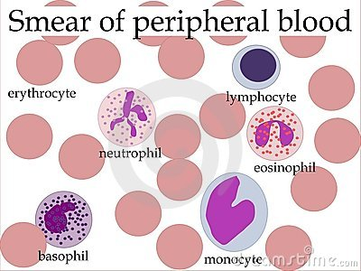
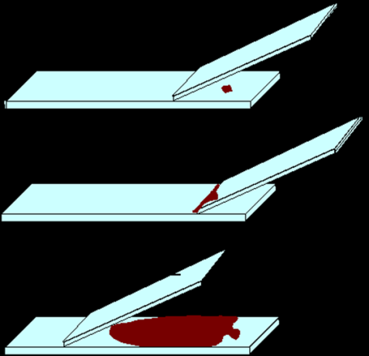

Slide 6
Complete Blood Count ( CBC )
The CBC offers a quantitative assessment of each of the blood’s cellular elements.

Slide 7
Classification on the basis of red cell morphology
• Hemoglobin (HGB): (g/dl)
• Mean cell volume (MCV): the average volume per red cell, expressed in femtoliters (cubic microns). Hematocrit/ RBCs count.(fl)
• Mean cell hemoglobin (MCH): the average mass of hemoglobin per red cell, expressed in picograms. Hemoglobin / RBCs count.
• Mean cell hemoglobin concentration (MCHC): the average concentration of hemoglobin in a given volume of packed red cells, expressed in grams per deciliter. Measures concentration of Hb in a given volume of packed RBCs.
Hemoglobin (g/dl) / Hematocrit .
• Red cell distribution width (RDW): the coefficient of variation
of red cell volume
Packed Cell Volume (PCV): The ratio of the volume of red cells to the volume of whole blood [%]

Slide 8
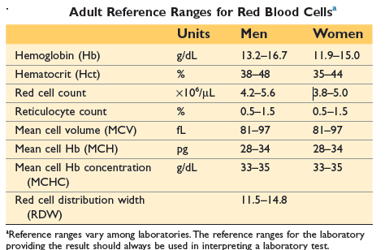

Slide 9
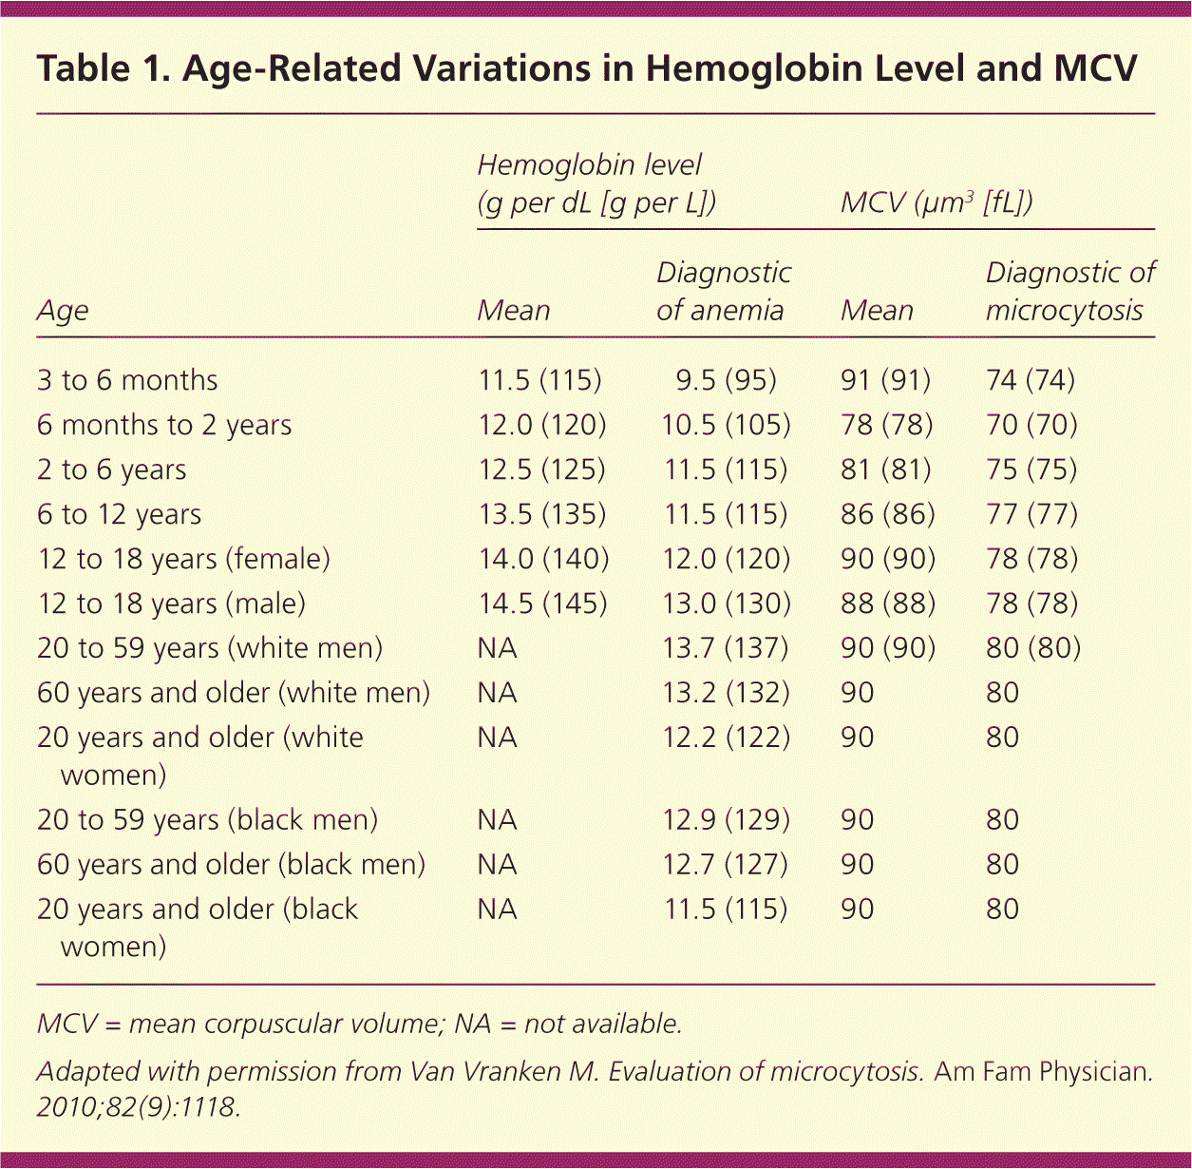

Slide 10
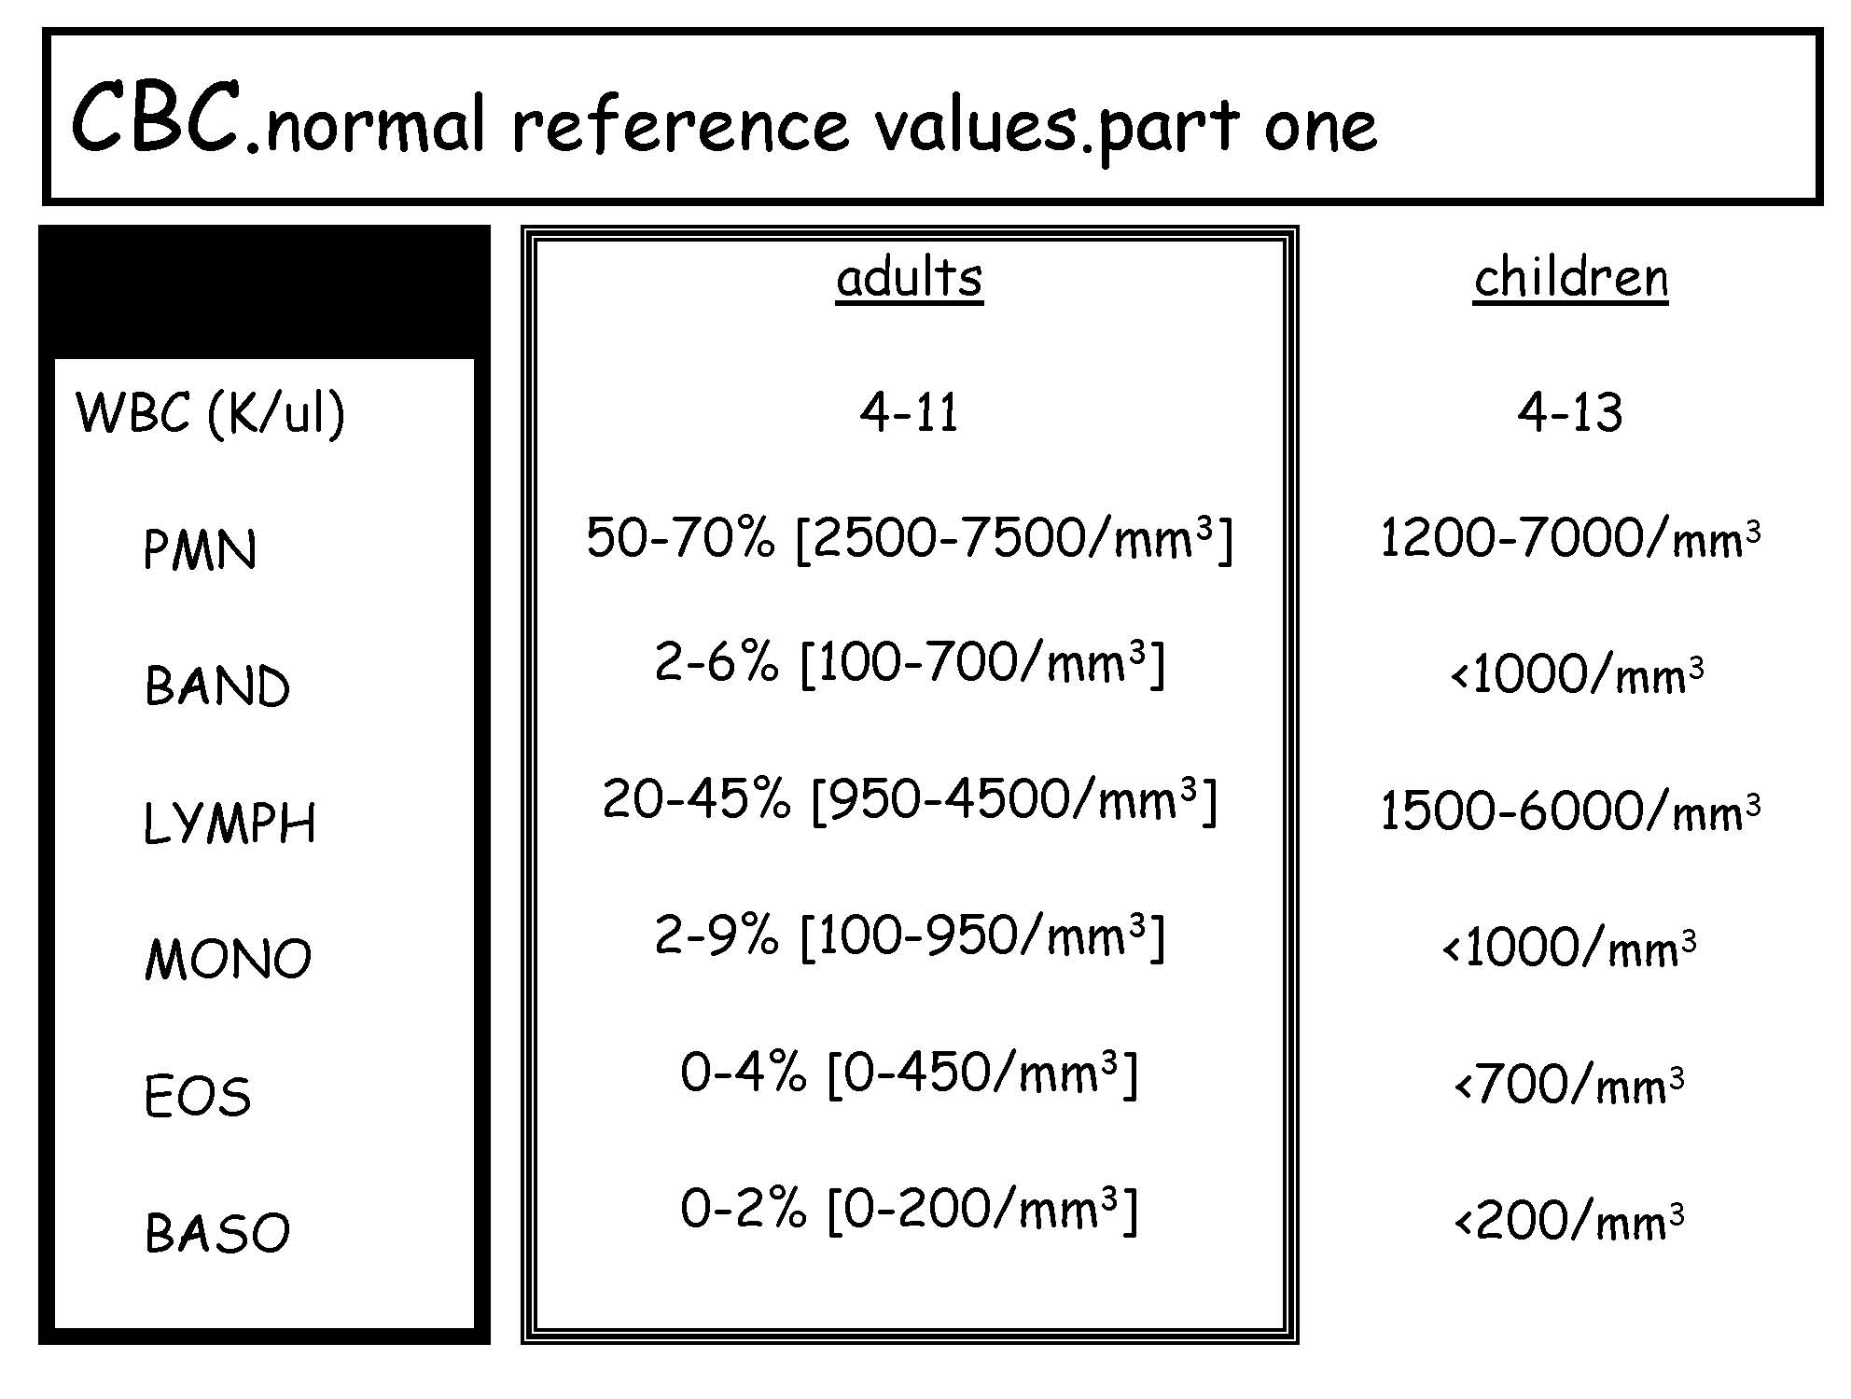

Slide 11
Reticulocyte Count
A reticulocyte is a newly released RBC (<36 hours), it contains residual RNA.
Normal reticulocyte count is less than 1.5%.
In anemia, one should correct the % of reticulocytes.
Corrected reticulocyte count= Retic. count x Hct/45.
Notes:
• Reticulocyte count: a simple measure that distinguishes between hemolytic and aregenerative anemia.

Slide 12
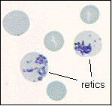
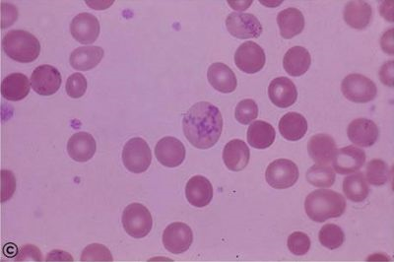
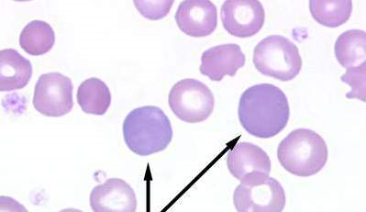

Slide 13
Red Cell Disorders

Slide 14
Disorders of red cells can result in anemia or, less commonly, polycythemia (an increase in red cells also known as erythrocytosis).
Anemia is defined as a reduction in the oxygen-transporting capacity of blood, resulting from a decrease in the red cell mass to subnormal levels.
Anemia can stem from bleeding, increased red cell destruction, or decreased red cell production.
Anemia also can be classified on the basis of red cell morphology. Features that provide etiologic clues include the size, color, and shape of the red cells.
the clinical consequences of anemia are determined by its severity, rapidity of onset, and underlying pathogenic mechanism.

Slide 15
The decrease in tissue oxygen tension that accompanies anemia triggers increased production of the growth factor erythropoietin from specialized cells in the kidney →a compensatory hyperplasia of erythroid precursors in the bone marrow and, in severe anemia, the appearanceof extramedullary hematopoiesis within the secondary hematopoietic organs.
The rise in marrow output is signaled by the appearance of increased numbers of newly formed red cells (reticulocytes) in the peripheral blood. By contrast, anemia caused by decreased red cell production (aregenerative anemia) is associated with subnormal reticulocyte counts (reticulocytopenia).
Notes:
secondary hematopoietic organs (the liver, spleen, and lymph nodes).

Slide 16
Anemia
Definition
Hb<13 g/dl (male)
Hb<12 g/dl (female)
Anemia is not a diagnosis but a sign of disease.

Slide 17
Classification of Anemia: *Functional
1. Blood Loss.
acute
chronic
2.i Hypoproliferative
Marrow aplasia
Myelophthisic anemia
Anemia of chronic disease
Anemia with organ failure
Dilutional Anemias
Pregnancy
2.ii Maturational Defect
Cytoplasmic
Nuclear
Combined
3. Hemolytic Anemia
Immune hemolysis
Membrane defects
Hemoglobinopathies
Enzymopathies
Toxic hemolysis
Traumatic hemolysis
Hypersplenism

Slide 18
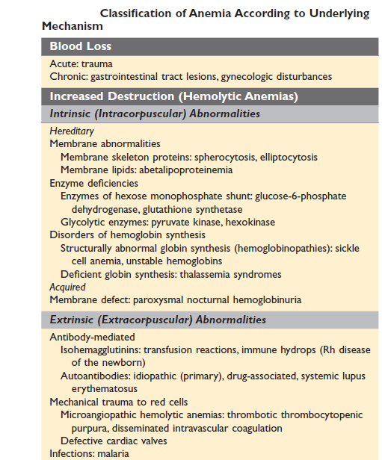
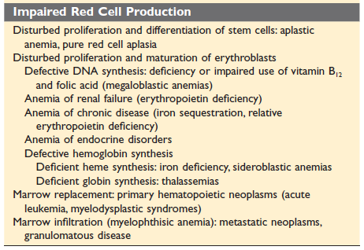

Slide 19
*Morphologic:
Microcytic (MCV < 80 fl).
Normocytic (MCV 80-100 fl).
Macrocytic (MCV > 100 fl).

Slide 21
The approach: *clinical clues: - Fainting, pallor…anemia in general - Jaundice, gallbladder stones, red urine…hemolysis - Age of presentation, gender, past medical history, family history

Slide 22
The approach: (1) do cbc/pb smear (2) Ret. # (3) MCV, MCH, RDW (4) BM?

Slide 23
https://www.picswe.com

Slide 24
https://www.news-medical.net/news/20161130/Iron-deficiency-an-interview-with-Dr-Thierry-Teil.aspx

Slide 25
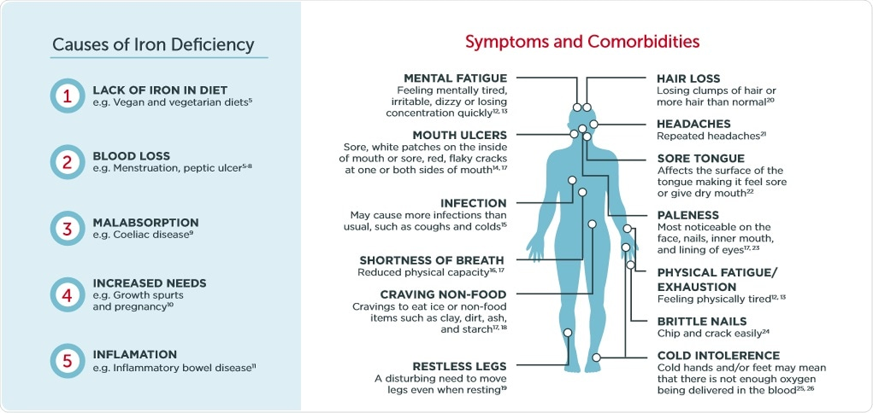
https://www.news-medical.net/news/20161130/Iron-deficiency-an-interview-with-Dr-Thierry-Teil.aspx

Slide 26
Iron Deficiency Anemia
*no regulated pathway for iron secretion (1-2 mg/day)..shedding
Iron balance maintained by regulating iron absorption/retention
Hepcidin induced by IL-6
Hepcidin increased intramucosal ferritin
Hepcidin inhibits ferroportin in macrophages

Slide 27
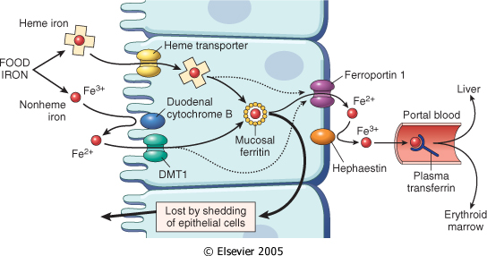
Ferric +3 to Ferrous+2 (reductase)
DMT1 via apical membrane
Adequate Iron....most iron will handed off to ferritin...shed again
Low iron...basal mambarane via ferroportin
Ferrous+ to Ferric+3 (oxidase)
In plasma via Transferrin
Hepcidin produced by liver..induced by IL-6...Inhibits Ferroportin via internalization and degradation
High Hepcidin...Low Ferroportin...Low iron absorption..more Ferritin
Iron Body Mass:2.5-3.5g
Daily loss: 1-2mg
Absorption:20% of Heme Iron and 1% of non-Heme Iron
Usual diet Iron content: 10-20mg
Downloaded from: Robbins & Cotran Pathologic Basis of Disease (on 20 February 2005 11:19 AM)
© 2005 Elsevier

Slide 28
Iron Deficiency Anemia
Early: decrease in stores (liver, spleen, & BM)
(Ferritin less than 12-300 ng/ml)
Decrease in S. Iron
Increase in Transferrin
Increase in TIBC
PB smear changes
Response to treatment
BM: normal or slight increase in cellularity
*Transferrin saturation (S.Iron/TIBC) less than 15%.
Anemia of chronic disease: Disordered iron metabolism as manifested by a low serum iron, decreased serum transferrin, decreased transferrin saturation, increased serum ferritin, increased reticuloendothelial iron stores, increased erythrocyte-free protoporphyrin, and reduced iron absorption, is a characteristic feature of the anemia of chronic disease and has been thought to be a major factor contributing to the syndrome

Slide 29
Importance of Diagnosis:
It is easy to treat.
It may be the earliest manifestation of a serious underlying diseases (10-20% of iron deficient patients have cancer, up to 50% have GER/PUD).
Save unnecessary tests/treatments.

Slide 30
