Slide 1
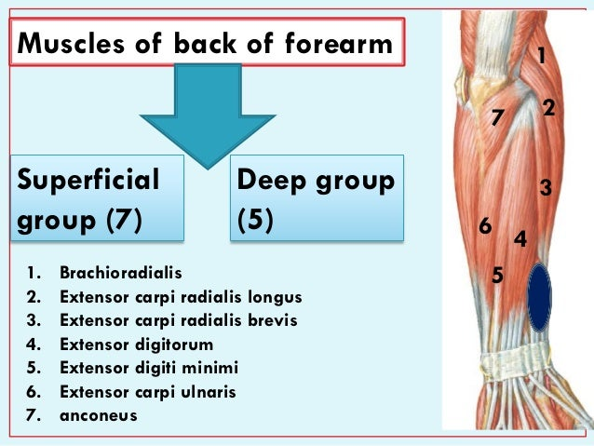

Slide 3
1- Brachioradialis
Origin:
Upper 2/3 of lateral supracondylar ridge of the humerus.
Insertion:
Base of styloid process of radius.
Nerve supply:
Radial nerve.
Action:
Flexion of elbow at midprone position.

Slide 4
2- Extensor carpi radialis longus
Origin:
Lower 1/3 of lateral supracondylar ridge of the humerus.
Insertion:
Posterior surface of base of 2nd metacarpal bone.
Nerve supply:
Radial nerve.
Action:
Extension and abduction of wrist.

Slide 5
3- Extensor carpi radialis brevis
Origin:
Common extensor origin (front of lateral epicondyle of the humerus).
Insertion:
Posterior surface of base of 3rd metacarpal bone.
Nerve supply:
Posterior interosseous nerve.
Actions:
Extension and abduction of wrist.

Slide 6
4- Extensor digitorum
Origin: Common extensor origin.
Insertion:
The tendons expands on the posterior surface of proximal phalanges of the medial 4 fingers forming the extensor expansion. Each extensor expansion splits into 3 slips: a central slip inserted into the base of the middle phalanx, and 2 lateral slips which are inserted into the base of distal phalanx. The extensor expansion receives also the insertion of the corresponding lumbrical and interossei muscles
Nerve supply: Posterior interosseous nerve.
Actions:
Extension of all joints of the medial 4 fingers.
It helps in extension of the wrist.

Slide 7
5- Extensor digiti minimi
Origin:
Common extensor origin.
Insertion:
Extensor expansion of the little finger.
Nerve supply:
Posterior interosseous nerve.
Actions:
Extension of all joints of little finger + Extension of wrist.

Slide 10
6- Extensor carpi ulnaris:
Origin:
Common extensor origin.
Posterior border of ulna.
Insertion:
Posterior surface of the base of 5th metacarpal bone.
Nerve supply:
Posterior interosseous nerve.
Actions:
Extension and adduction of the wrist.

Slide 11
7- Anconeus
Origin:
Posterior aspect of lateral epicondyle of humerus.
Insertion:
Lateral surface of olecranon process of ulna
Nerve supply:
Radial nerve.
Action:
It helps in extension of elbow.

Slide 12
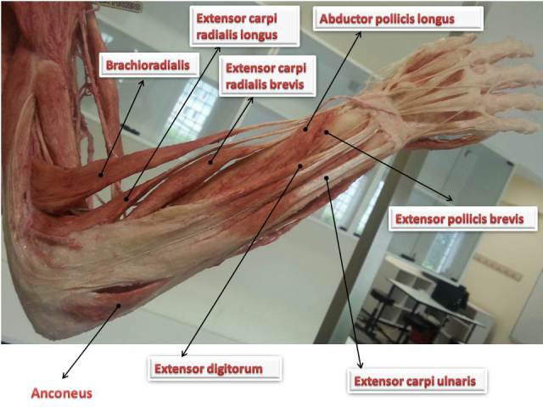

Slide 13
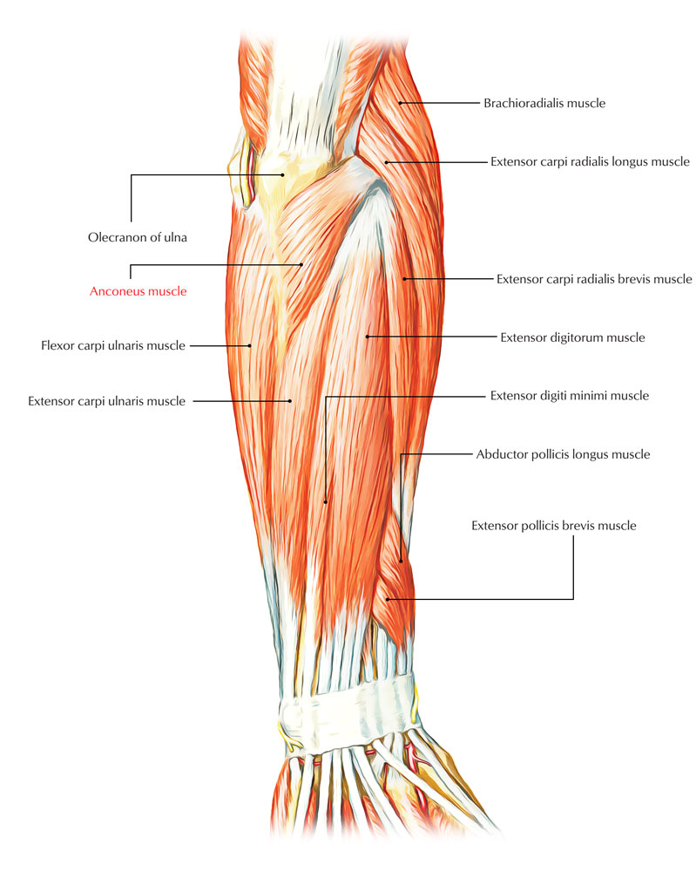

Slide 14
II- Deep group of extensor muscles:
Supinator.
Abductor pollicis longus.
Extensor pollicis brevis.
Extensor pollicis longus.
Extensor indicis.

Slide 16
1- Supinator:
Origin:
Supinator crest and fossa in ulna.
Lateral epicondyle of humerus.
Lateral ligament of elbow joint.
Annular ligament.
Insertion:
Upper 1/3 of shaft of radius.
Nerve supply:
Posterior interosseous nerve.
Action:
Supination of the forearm.

Slide 18
2- Abductor pollicis longus
Origin:
Posterior surface of ulna.
Posterior surface of radius.
Interosseous membrane.
Insertion:
Posterior surface of the base of 1st metacarpal bone.
Nerve supply:
Posterior interosseous nerve.
Action:
Abduction of the thumb.
Helps in Extension of the thumb at the carpometacarpal joint.

Slide 19
3- Extensor pollicis brevis
Origin:
Posterior surface of radius
Interosseous membrane.
Insertion:
Proximal phalanx of the thumb.
Nerve supply:
Posterior interosseous nerve.
Action:
Extension of metacarpophalangeal and carpometacarpal joints of the thumb

Slide 20
4- Extensor pollicis longus:
Origin:
Posterior surface of ulna
Interosseous membrane.
Insertion:
Distal phalanx of the thumb.
Nerve supply:
Posterior interosseous nerve.
Action:
Extension of all joints of the thumb.

Slide 21
5- Extensor indicis
Origin:
Posterior surface of ulna
Interosseous membrane.
Insertion:
Extensor expansion of the index finger.
Nerve supply:
Posterior interosseous nerve.
Action:
Extension of all joints of index finger.

Slide 23
