Slide 1
Malnutrition
Ashraf Almahameed
Toqa Almawajdeh
Majd Albawaneh

Slide 2
Introduction
Is defined as imbalance between the body’s need and intake of nutrients,
which can lead to nutritional disorders.
Is the condition that develops when the body does not get the right amount of the vitamins
,minerals and other nutrients it needs to maintain healthy tissues & organ function.

Slide 3
Malnutrition
•Is globally the most important risk factor for illness and death.
Contributing to more than 50% of death children worldwide, Observed most frequently in developing countries.
Children may be affected by micronutrients deficiencies,
which also have a detrimental effect on growth and development.
•The most common and clinically significant micronutrients deficiency in children and childbearing women throughout the world include deficiencies of iron, iodine, zinc and vitamin .A

Slide 4
Definition: (WHO)
"the cellular imbalance between nutrient (supply &
energy) and the body's demand for them to ensure growth, maintenance and specific function".
Undernutrition: - means structural and functional changes due to inadequate intake of nutrients and energy sources. i.e. deficiency of a single nutrient like vitamin c-deficiency is an example of undernutrition
Overnutrition:- resulting from overeating or excessive intake of specific nutrients

Slide 5
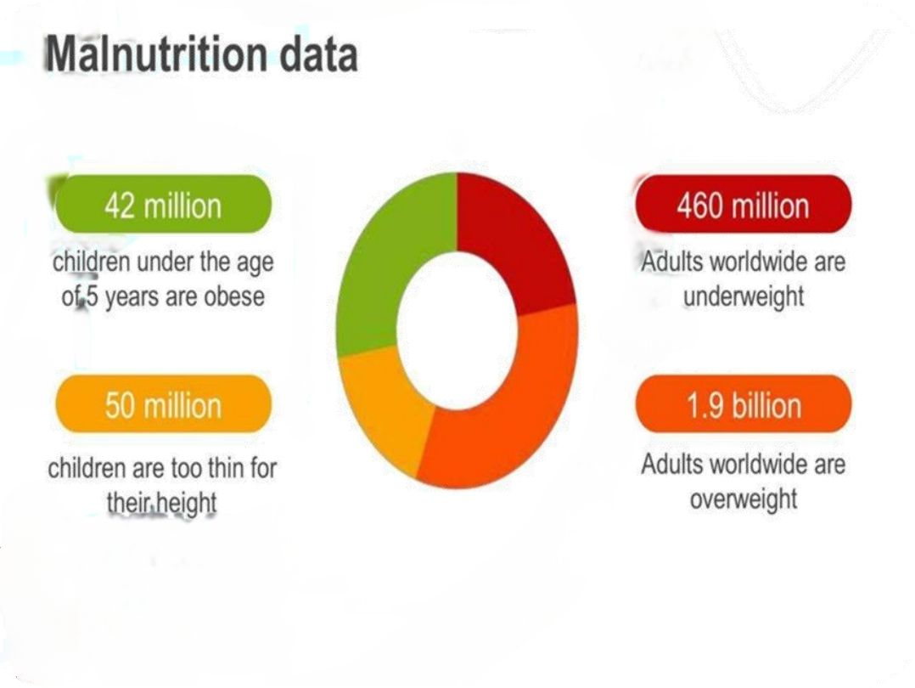
Causes of malnutrition
Primary :
1) Low income, low purchasing power. 2)Ignorance & erroneous food habits.
3) Scarcity of food supply & overpopulation. Secondary :
Diarrhea and intestinal malabsorption.
Metabolic & renal diseases. 3)Hepatobiliary disorders & insulin resistance.

Slide 6
Risk factors
Social factors. 2. Chronic diseases.
3.Eating disorders . 4. Mental diorders.
5.Dental disorders. 6. Age

Slide 7
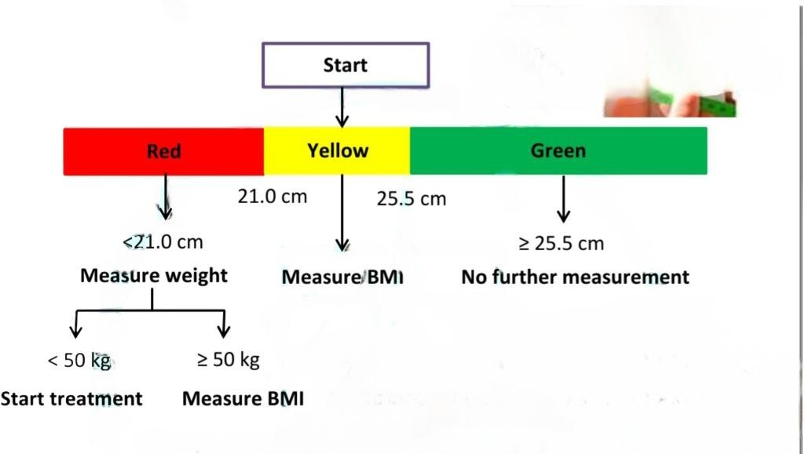
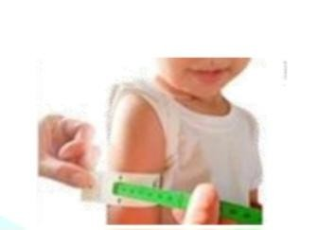
MUAC

Slide 8
Prevention of malnutriotion
Use of modern agricultural techniques to increase the agricultural production.
Proper education to people regarding importance of food .
Enrichment of food.
Fortification of food.
Genetic engineering for the development of new varieties eg, golden rice.
Government projects to provide healthy food to pregnant women.
Use of probiotic microorganism.
Global public health and disease control measures.

Slide 9
Disorders due to Malnutrition
Protein energy malnutrition.
Under nutrition of vitamins and minerals.
Obesity.

Slide 10
Zinc deficiency
Classic Triad: Alopecia (hair loss), Diarrhea, Dermatitis (an inflammatory skin rash,
usually around the mouth, eyes, and in the limb extremities).
Impaired wound healing
Dysgeusia (altered sense of taste)
Anosmia (loss of smell)
Immune dysfunction (weakened immune system)
Male hypogonadism (reduced function of the gonads)
Growth and Development: Zinc deficiency can impair normal growth and development, especially in children.

Slide 11
Copper deficiency
Skin and Hair Changes: Depigmentation of the skin , Abnormal hair growth.
Muscle and Physical Weakness: Muscle weakness.
Organ Enlargement: Hepatosplenomegaly (enlargement of the liver and spleen).
Fluid Retention: Edema.
Bone Health: Osteoporosis (weakened bones, increased fracture risk).
Neurologic Symptoms: Ataxia (loss of coordination), Neuropathy (nerve damage leading
to numbness, tingling, or pain)
Wound Healing: Delayed wound healing.

Slide 15
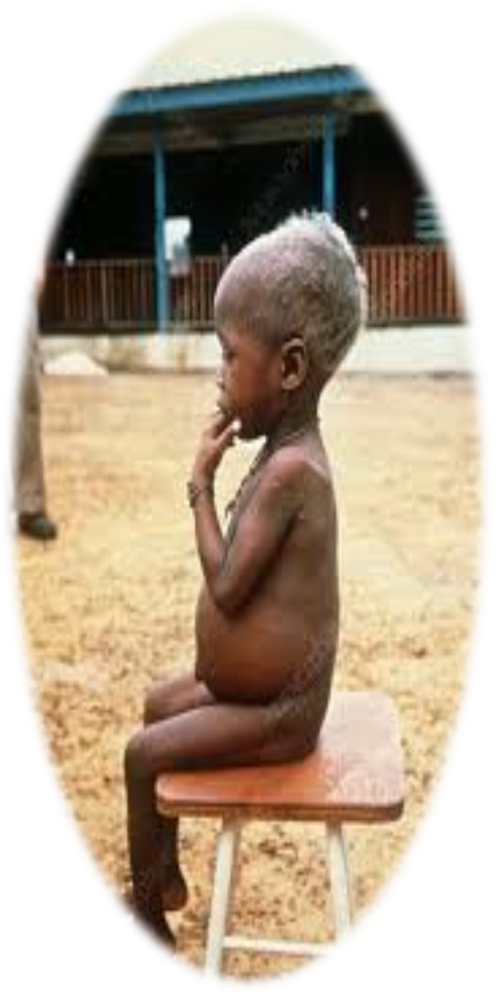
Definition
Severe form of Acute protein Deficiency with normal or even high caloric intake.
Age: 6m to 2 y.
Due to:
1) premature cessation of breastfeeding.
2)Infections such as malaria and measles.
3) Protein deficient diet.

Slide 16
pathophysiology
Muscle atrophy.
Low Plasma protein (especially albumin)→ low plasma oncotic pressure → Edema
Low Apolipoprotein synthesis → decrease secretion of hepatic triglycerides → Enlarged fatty liver.

Slide 17
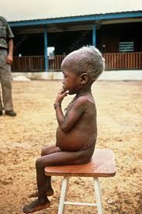
Clinical presentation
✓ Bilateral pitting edema.
✓ Distended abdomen: (due to hepatomegaly, intestinal distention, and weakened abdominal muscles).
✓ Hepatomegaly.
✓ Skin changes: thin, dry, peeling skin with areas of hyperpigmentation and hyperkeratosis (flaky skin).

Slide 18
Clinical presentation
✓ Hair changes: dry, hypopigmented hair that falls out easily.
✓ Rounded cheeks (moon face).
✓ Muscle atrophy.
✓ Variable weight for height.
✓ Apathetic affect

Slide 19
Marasmus

Slide 20
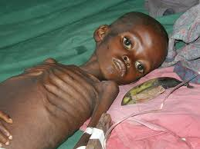
Marasmus
All major nutrients ,with deficient calorie intake.
Pathophysiology :
Severe energy deficiency leads to a catabolic state breakdown of adipose tissue, muscle, and ultimately, organ tissue for energy.

Slide 21
Clinical presentation :
Profound muscle wasting (broomstick extremities).
Loss of subcutaneous fat.
Pronounced chest bone, ribs, and facial bones.
Failure to thrive: Low weight for height
Thin, dry skin
Thin, sparse hair
No edema .
Irritable affect.

Slide 23
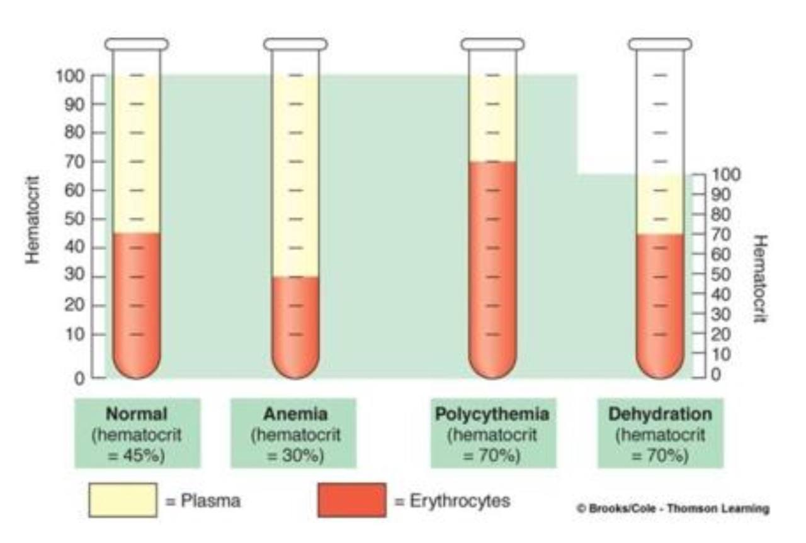
Investigation
blood tests:
✓ Anemia due to folate ,iron and copper deficiency is often present ,but the Hematocrit may be high owing to dehydration.
✓ Eosinophilia suggests parasitic infestation.
✓ Electrolyte disturbances are common.
✓ Malarial parasites should be sought.

Slide 24
Investigation
HIV tests.
Stools should be examined for parasitic infection.
Chest X-ray ,TB is common and is easily missed if a chest X-ray is not performed.

Slide 25
Treatment
1. Hydration (typically oral) .
2. Nutritional rehabilitation: must occur slowly to prevent refeeding syndrome.
▪ Should be initiated slowly at ~ 20% above the child's recent intake.
▪ Slowly increase calorie intake while monitoring lab.
For kwashiorkor:
protein should slowly be introduced into the diet to avoid acute liver injury.
3. Treat complications (e.g., infection).

Slide 26
Vitamin defecincy

Slide 27
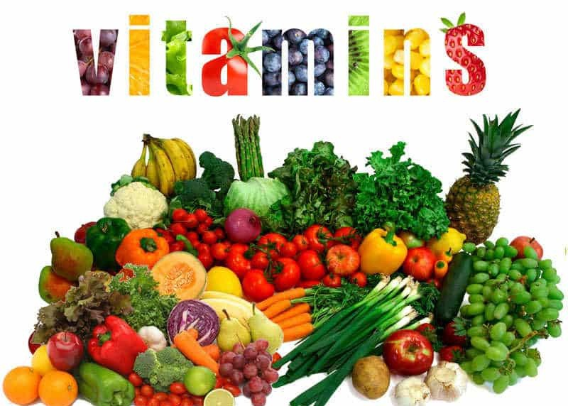
vitamins are essential micronutrients require for various biochemical and physiological functions deficincy can lead to wide range of health issues

Slide 28
B1(thiamin) defecincy
Beriberi disease
Is a condition caused by thiamin defecincy types of Beriberi:
1Dry : peripheral neuropathy
2
wet
:cardiovascular
3: infantile
4:wernicke korsakoff syndrome

Slide 29
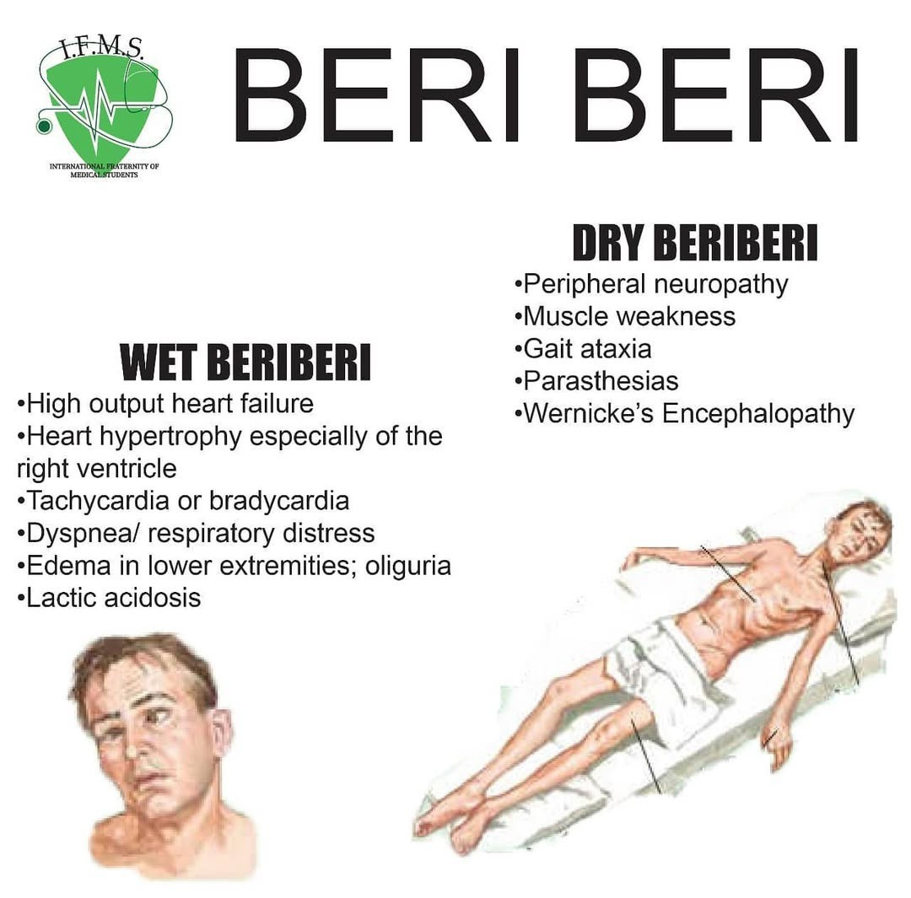

Slide 30
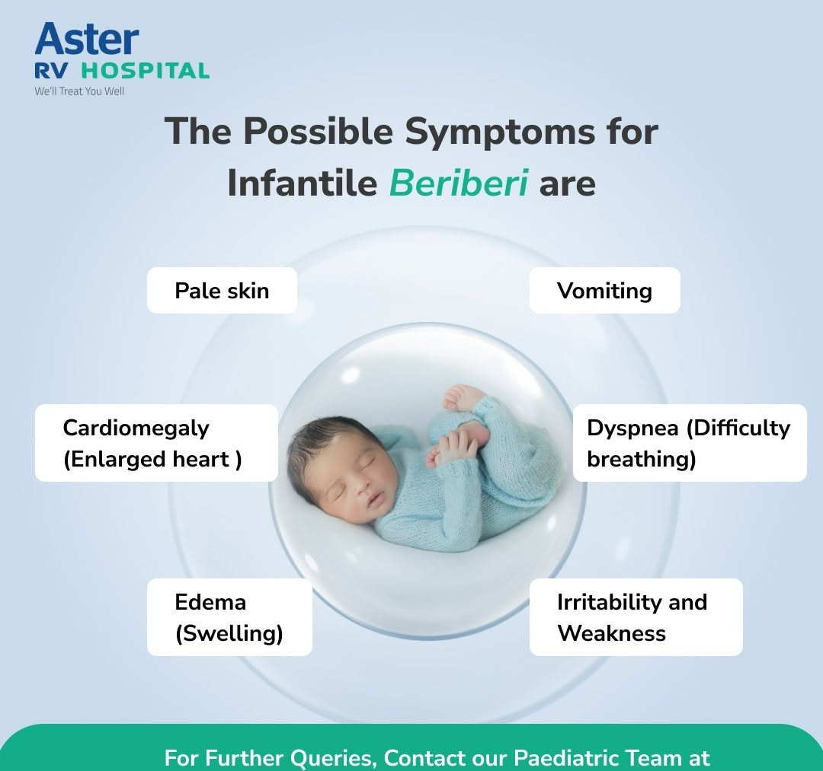

Slide 32
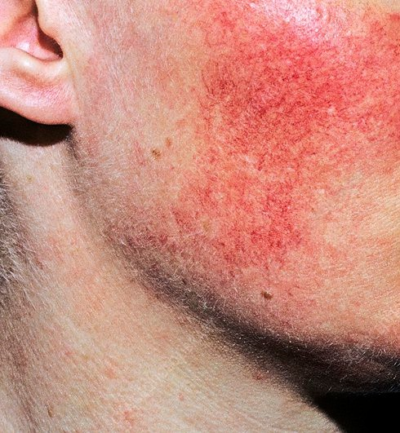
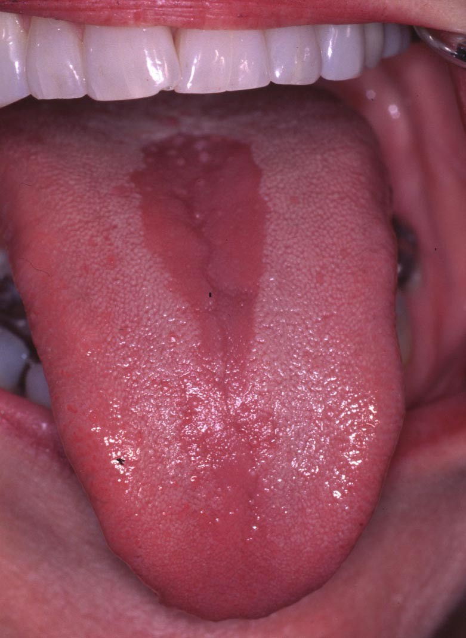
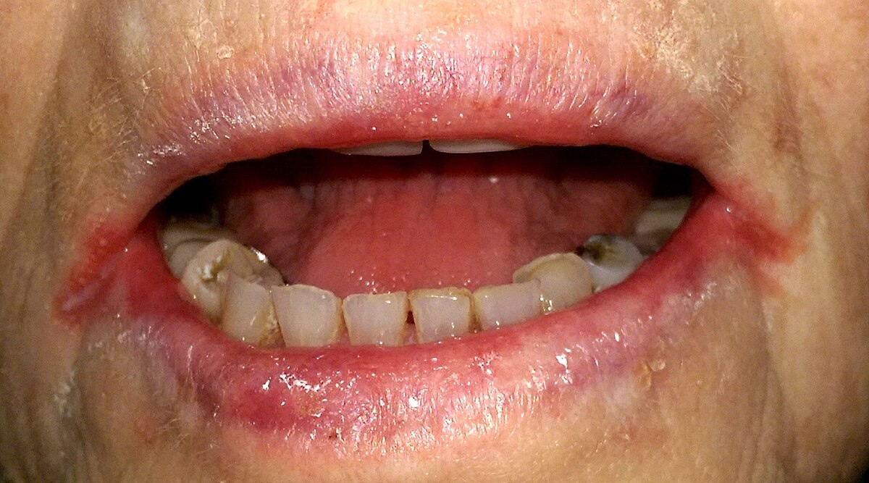
B2(riboflavin)
Dermatitis
Glossitis
cheilosis

Slide 33
B3(niacin)
B5(pantothenae(
B6(pyridoxin)
Lead to pellagra Dermatitis Diarrhea
Death
burning feet syndrome: distal parasthesia
due to adrenal insufficiency
Sidroplastic anemia
Pellagra:
hyperpigmented skin lesion in sun exposed area especially on the limb

Slide 34
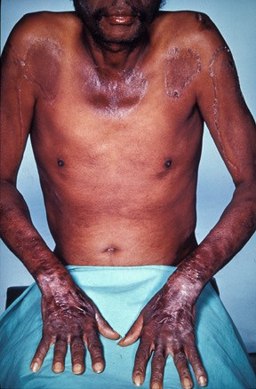

Slide 35
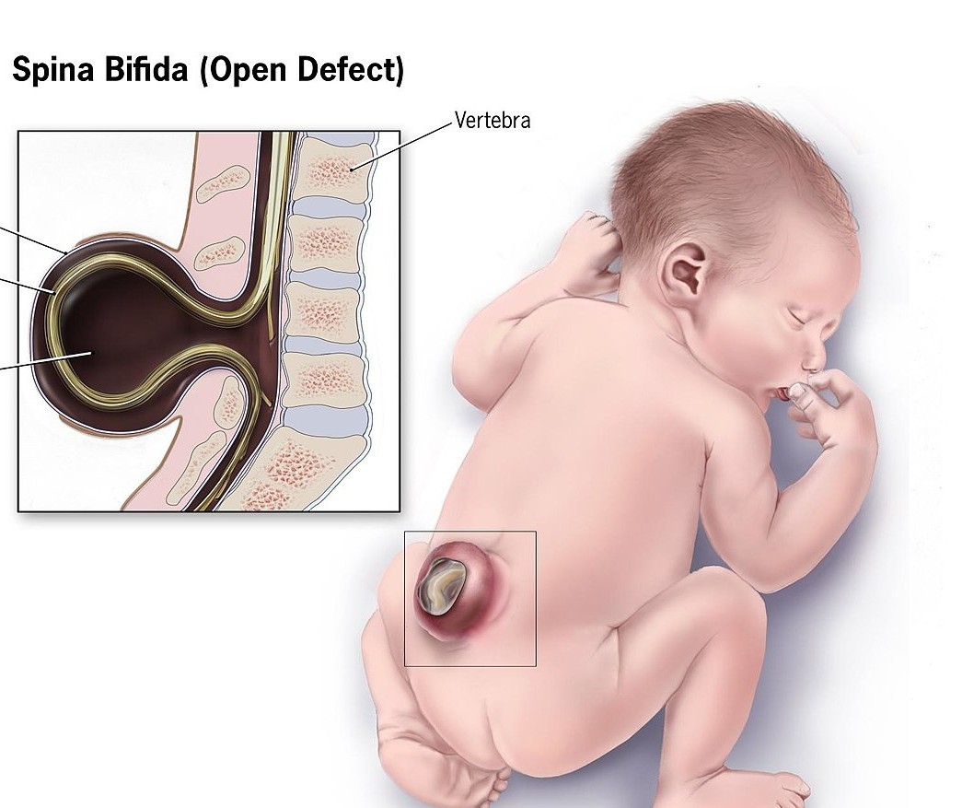
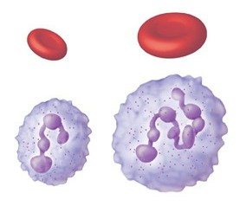
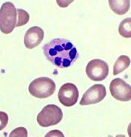
B9 (folate)
lead to:
megaloblastic anemia
neural tube defect
hypersegmented neutrophils

Slide 36
B12 (cobalamin)
lead to :
megaloblastic anemia
peripheral neuropathy
neuropsychiatric symptoms

Slide 37
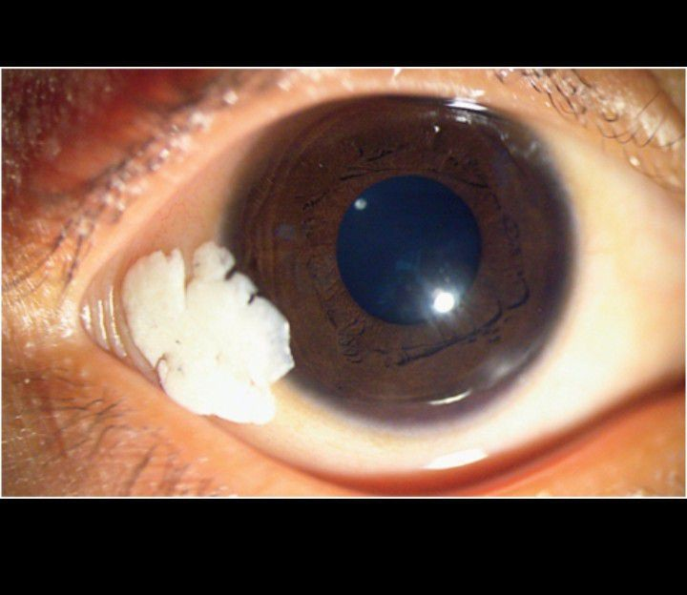
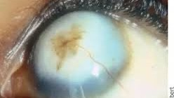
Vitamin A deficiency
Clinical features
night blindness
xerophthalmia
immunosupression
keratomalacia : softening and clouding of the cornea
bitot spot: dry patchy covered with foamy appearance

Slide 38
Obesity
Malnutrition in obesity: is it possible???

Slide 39
Why are obese people malnourished????
too much calorie dense food with low nutrient content
disability ,physical and mental health difficulties
poor absorbtion
metabolic demand
inflammation and oxidative stress

Slide 40
1 …Determine overall risk
Malnutrition screening tool MST
2…Decision and action

Slide 41
