Slide 1
CNS infections
Done by : Mays Madanat
Yumna Al-Tawarah

Slide 2
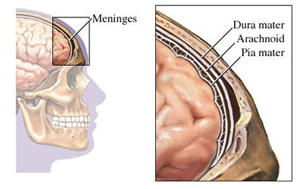
Meningitis
Is an Inflammation of the leptomeninges ” the tissues surrounding the brain and spinal cord “ and is defined by an abnormal number of WBC in the CSF
The meninges consist of three parts : pia , arachnoid and dura
Ususally caused by infection : viral, bacterial, Fungal
Rarely: malignancies, Sarcoidodsis ,SLE
When it’s caused by viruses, tuberculosis, fungi or parasites, it’s called aseptic meningitis

Slide 3
Route of Entry
Invasion of the bloodstream
Retrograde transport along cranial (eg:olfactory) or peripheral nerves
Contagious spread from sinusitis , otitis media , surgery or trauma .
Can be classified as acute or chronic depending on the onset of symptoms:
Acute : onset within hours to days (sush as : Bacterial meningitis )
Chronic : within weeks to months ( sush as tuberculosis , fungal , parasite , Lyme disease )

Slide 4
Bacterial Meningitis
Causes Depend on Age
Neonate | Children>3 Months | Adults (age 18-50) | Elderly >50
Group B streptococcus E-Coli Listeria monocytogens | Neisseria Meningitides S.pneumonia H.influenzae | S.Pneumonia N.meningitide H.influenzae | S.Pneumoniae N.meningitide L.Monocytogens Gram-negative Bacilli
Immunocompromised – L.monocytogens , Gam-negative Bacilli S.pneumoniae
Notes:
It’s very serious require immediate care it can lead to disability brain damage and death

Slide 5
Streptococcus pneumoniae
Most common cause of meningitis in all ages
Gram positive cocci in pairs
Can follow strep respiratory infection
Risk factors:
Asplenic patients
Sickle cell anemia
Otitis media(children), pneumonia, sinusitis.
N.meningitides
Gram negative diplococci
Hematogenous spread
Transmitted by respiratory droplets
Collage students and military recruits
Bacteremia can complicate meningitis
Meningococcemia
septic shock, fever, chills, tachycardia and hypotension
purpuric rash , DIC
Waterhouse-Friderichsen syndrome
Notes:
Waterhouse-Friderichsen syndrome (WFS) is a group of symptoms resulting from the failure of the adrenal glands to function normally as a result of bleeding into the gland.
WFS is caused by severe infection with meningococcus bacteria or other bacteria, such as:
Group B streptococcus
Pseudomonas aeruginosa
Streptococcus pneumoniae
Staphylococcus aureus
Symptoms occur suddenly. They are due to the bacteria growing (multiplying) inside the body. Symptoms include:
Fever and chills
Joint and muscle pain
Headache
Vomiting
Infection with bacteria causes bleeding throughout the body, which causes:
Bodywide rash
Disseminated intravascular coagulation in which small blood clots cut off blood supply to the organs
Septic shock

Slide 6
Neisseria meningitidis is transmitted in respiratory droplets, people in close contact with individuals should receive antibiotic prophylaxis. Rifampin is classically used, but ciprofloxacin and ceftriaxone are also good options.
Listeria
Gram positive rod
Immunocompromised
neonates, elderly, HIV, steroids, hematological malignancies, organ transplants and pregnancy

Slide 7
Aseptic Meningitis
Is most commonly caused by a variety of non bacterial pathogen , most commonly viruses sush as enterovirus and herpes simplex virus , it can also be caused by certain bacteria (TB) , parasite , and fungi
Fungi Less common , most commonly occurs in immunocompromised individuals
It mays be difficult to distinguish it clinically from acute bacterial meningitis
It is associated with better prognosis than acute bacterial meningitis (self limiting disease ) usually recovery in days
Management : no specific therapy (supportive )

Slide 9
Clinical features :
Symptoms : Triad
Fever
Altered mental status
Stiff,painful neck
Other symptoms:headache, Nausea and vomiting , Malaise , photophobia, ( confusion ,lethargy, even coma)

Slide 10
Signs :
Nuchal rigidity
Kerning Sign
Brudzinski Sign
Jolt sign
Rashes :
Maculopapular rash with petechiae ( N.meningitidis)
Vesicular lesions in Vericella or HSV
5. Papilledema , seizure ( manifestation of increase ICP)
6. Cranial Nerve Palsies
these signs aren’t particularly sensitive, so negative Kernig and Brudzinski signs don’t exclude meningitis.
Notes:
Rotation of the head horizontally at a frequency of 2-3times per second a positive test is indicated upon exacerbation of headache

Slide 11
Kernig’s sign
Notes:
Kernig sign, place the individual in a supine position. Then, flex the hip to 90 degrees and attempt to extend the knee. If the individual has pain with full extension of the knee, that’s a positive Kernig sign.

Slide 12
Brudzinski’s sign
Notes:
Brudzinski sign, you have to passively flex the neck, and if there’s involuntary flexion of the hips due to pain, then that’s a positive Brudzinski sign.

Slide 13
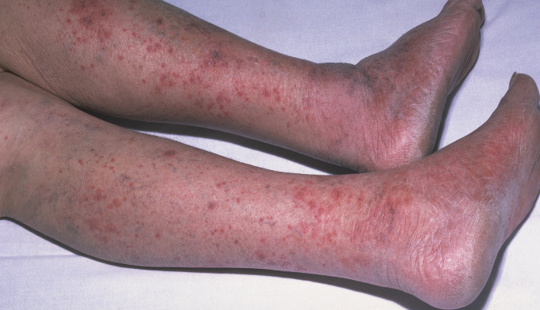
Maculopapular rash with petechiae

Slide 14
Diagnosis
History and examination
Lumbar puncture (definitive diagnosis )
CT Scan
Obtain Blood culture

Slide 15
When meningitis or encephalitis is suspected, it’s important to first identify any risk factors for increased intracranial pressure because increased intracranial pressure is a risk factor for cerebral herniation precipitated by a lumbar puncture, and that can be lethal.
The risk factors that suggest increased intracranial pressure are: 1) Papilledema 2) a focal neurological deficit 3) prior history of a tumor or stroke 4) an abnormal level of consciousness 5) new-onset seizure
In individuals without any of these risk factors, the lumbar puncture is done right away without needing a CT scan.

Slide 16
Spinal Tap
Notes:
left lateral position with neck flexion and knee in full extension (fetal position)
Determine L4 –L5 depend on post. iliac crest .
Sterile the area in circular manner .
Inject local anesthesia under the skin .
By spinal needle enter to subarachnoid space.

Slide 17
We have to take 4 tubes of CSF, for :
1- Cytology
2- Chemistry
3- Gram stain
4- Culture (including acid fast bacilli )

Slide 18
CSF analysis
Normal CSF appearance is clear if:
Bacterial —> Purulent (cloudy)
Viral —> Clear
Fungal —> Fibrin

Slide 19
Treatment
After you’ve obtained the cerebrospinal fluid sample, you can obtain blood cultures, and then start IV dexamethasone 15 min before empiric antibiotics
Empiric treatment of meningitis depends on an individual’s age :
Age | Organism | Empiric treatment
Neonate | Group B streptococcus E-Coli Listeria monocytogens | Cefotaxime + ampicillin + vancomycin
3 Months- 50years | Neisseria Meningitides S.pneumonia H.influenzae | Ceftriaxone or cefotaxime + vancomycin
Elderly >50 | S.Pneumoniae N.meningitide L.Monocytogens Gram-negative Bacilli | Ceftriaxone or cefotaxime + vancomycin + ampicillin
Immunocompromised | L.monocytogens , Gam-negative Bacilli S.pneumoniae | Ceftazidime +vancomycin + ampicillin
Notes:
The logic behind giving IV dexamethasone before IV antibiotics is that it reduces that inflammatory response that usually occurs when antibiotics destroy bacterial cells.
Steroids decrease mortality and the risk of complications like hearing loss, cranial nerve palsies and seizures, particularly from Streptococcus pneumoniae as well as Haemophilus influenzae in children. So, if these pathogens are suspected or found based on the gram stain or culture, then dexamethasone is continued for 4 days. If not, the IV dexamethasone is stopped.

Slide 20
Vaccination :
Vaccinate all adults more than 65 for streptococcus pneumonia
Vaccinate asplenic patients for S.pneumonia N.meningitides H.influenza
Vaccinate immunocompromised patient for N.meningitides

Slide 21
Tuberculous meningitis
Rare in developed countries
Seen frequently as a secondary infection in patients with AIDS
TB meningitis occurs most commonly shortly after a primary infection or as apart of miliary tuberculosis
Fatal if left untreated
If treatment started a later stage the recovery rate 60% or less and the survivors show permanent neurological deficit

Slide 23
Management
Steroids + anti TB drugs for 9-12 months
Isoniazid
Rifampin
Pyrazinamide
Ethambutol

Slide 24
Encephalitis

Slide 25
Encephalitis
Encephalitis is a diffuse inflammation of the brain parenchyma and is often seen with meningitis
It is usually viral in origin
Herpes simplex virus -1 (most common)
Enterovirus
Arbovirus – for examples West Nile virus
Less common : measles, mumps , EBV ,CMV , VZV

Slide 26
Clinical features
Headache
Fever
Focal neurological signs ( sush as hemiparesis , aphasia , cranial nerve lesions )
Seizures
Altered mental status
Meningism

Slide 27
Investigations
Routine laboratory test including CXR , urine and blood culture ,serum chemistries ( to rule out the non viral causes)
LP ( CSF analysis)
CSF PCR (most sensitive and specific)
MRI ( to rule out focal neurologic causes ,such as abscess)

Slide 28
Management
HSV-1: IV Acyclovir for 2-3 weeks
CMV : ganciclovir
Steroids
Anticonvulsant for seizure

Slide 29
Thank you

