Slide 1
Neuromedicine Archive
Last edit :Mustafa Al-Fawwaz

Slide 2
Neuromedicine 30-11-2022
Islam Al-Banawi
Deema Shnaikat

Slide 3
1- Which disease that cause unilateral sensorineural hearing loss and tinnitus :
Meniere’s disease
2-What is the Glasgow coma scale for eye open to verbal command, Incomprehensible sound, and Withdraws from pain:
GCS=9

Slide 4
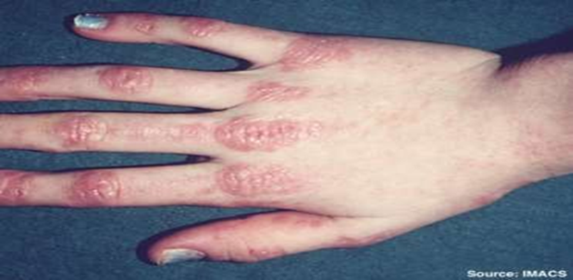
3- What is the diagnosis ?
Curschmann-Steinert disease
proximal myotonic myopathy
Polymyositis
Dermatomyositis
Duchenne muscular dystrophy

Slide 5
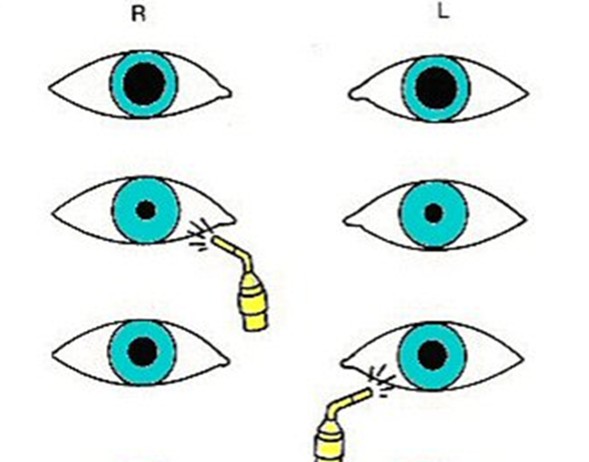
4-What is the cause for this ?
Right optic neuritis
Left optic neuritis
Right oculomotor palsy
Left oculomotor palsy
Horner’s syndrome

Slide 6
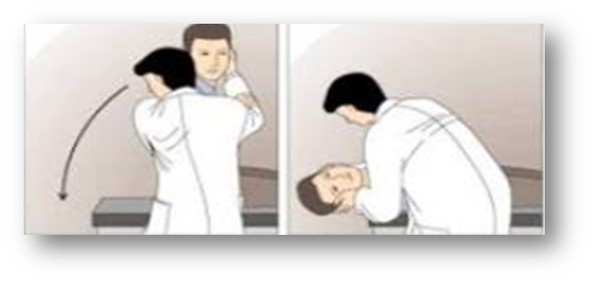
5- if this test is positive what does it mean:
Otoliths in posterior semicircular canal

Slide 7
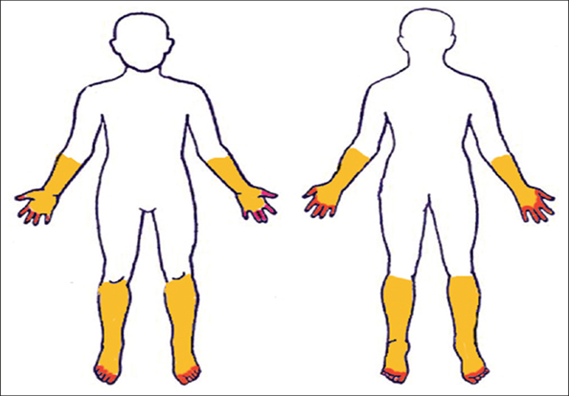
6- all the following can cause this condition except :
Transverse myelitis
Chronic polyneuropathy
GBS
MS

Slide 8
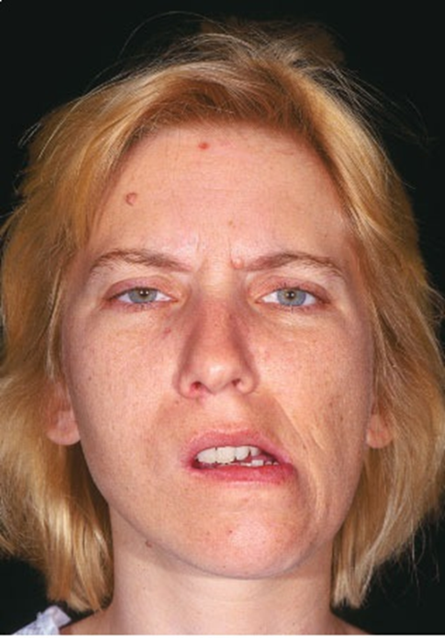
7-what is the affected muscle?
Left pterygoid muscle
Right pterygoid muscle
Left buccinator
Right buccinator
Left temporalis

Slide 9
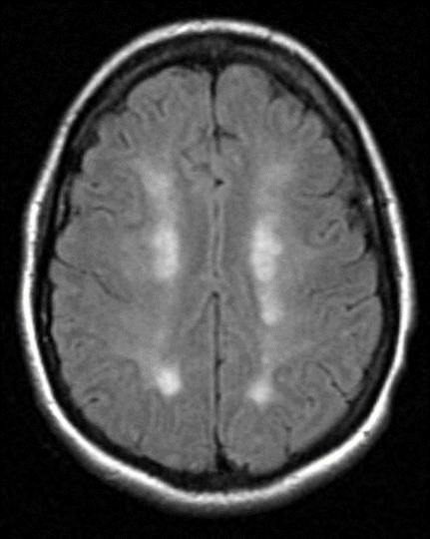
8- This condition is caused by ?
Severe hypotension

Slide 10
9- according to mini mental status examination which is wrong:
MMSE is 30 points screening tool
used to diagnose dementia
100-7 tests recall
score of 27 risk for mild dementia
السؤال كان فيه خيارين صح
10-Which Guillain-Barre variant is associated with opthalmoplegia, ataxia
and areflexia and tends to be associated with GQ16 antibodies?
Miller fisher syndrome

Slide 11
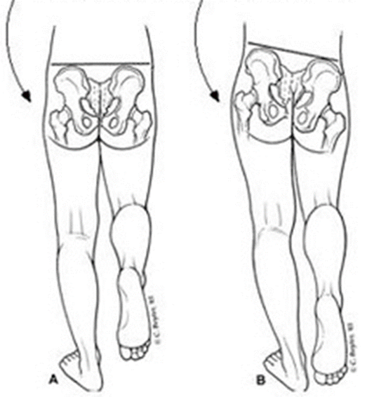
11- what is the name of this test:
Trendelenburg's gait

Slide 12
12- wrong about pseudobulbar palsy :
Absent jaw jerk
13- what cause positive Romberg’s test:
All of the above

Slide 13
14- Patient look to left, fast phase of nystagmus to right, what the type of nystagmus ?
Right jerky nystagmus
15- Sensation loss over thumb and lateral part of forearm, where is the lesion ?
C6

Slide 14
16- 50 years female come with persistent severe headache from last week, what is the next step ?
ESR
17- meningitis csf findings
B is TB
 | A | B
cell | Increase neutrophils | Very Elevated lymphocytes
Protein | Increase | Increase
Glucose | Low | Low

Slide 15
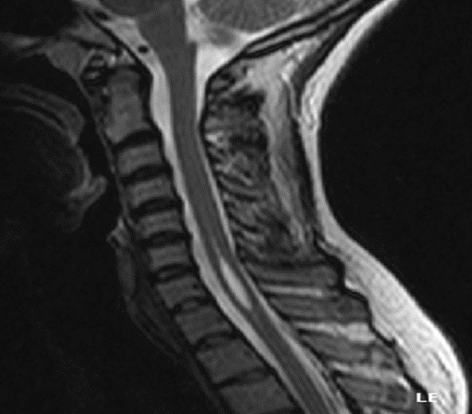
18- Features of this condition include all of the following except:
It causes bilateral but not symmetrical pain and temperature loss

Slide 16
19- Patient presented with optic neuritis and didn’t have any episode of neurological symptoms before, then MRI shows no lesions, what is the diagnosis ?
Clinically isolated syndrome
20- patient presented with symmetrical loss of position,touch,vibration sensation of both feet up to the ankle joint he is likely suffering from :
1-MS
2-tumor in left brain
3-thoracic disc prolapse

Slide 17
21- a patient presented with status epilepticus, he was given 10mg of diazepam but didn’t get better, he was given another 10mgs but it also didn’t work. What is the next step ?
20mg of phenytoin + saline for 2 minutes
20mg of phenytoin + glucose infusion
20mg of phenytoin + saline infusion
20mg of phenytoin + glucose for 2 minutes
Propofol

Slide 18
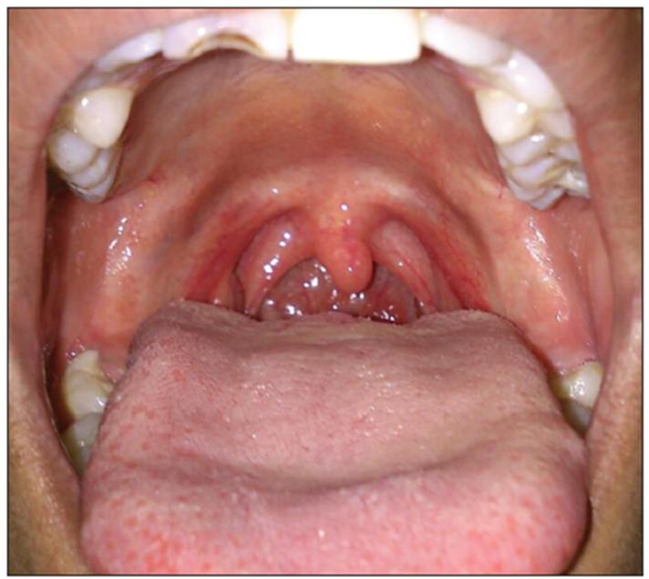
22 Which of the following can not be found in this patient:
Hoarseness
aphasia
Loss of gag reflex
Palate collapse
Loss of taste sensation in the posterior 1/3 of the tongue

Slide 19
23 -A 20 years old patient came with weakness and numbness of lower extremities more than upper extremities. He was found to have generalized areflexia. The most important next step in diagnosis will be
Perform brain MRI
Perform lumbar MRI
CSF analysis
Examine for dermatomal sensory loss
Examine for glove and stocking sensory loss

Slide 20
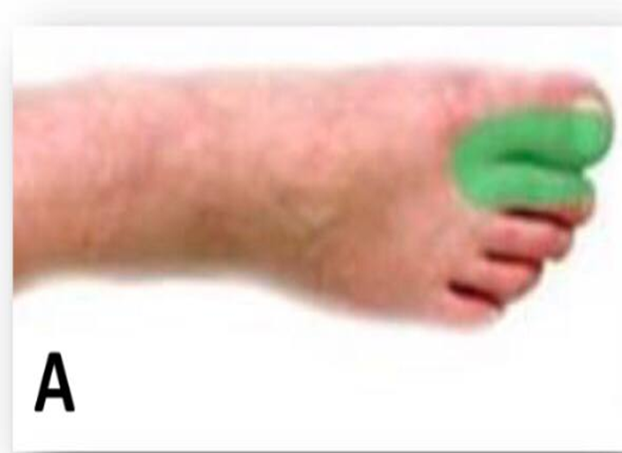
24 the patient is looking to the right;All of the following patient may have except
weakness in the left medial rectus
25 Clinical sign associated with lesion of the nerve supply the area shown in the picture
Weak dorsflexion مش متاكدين

Slide 21
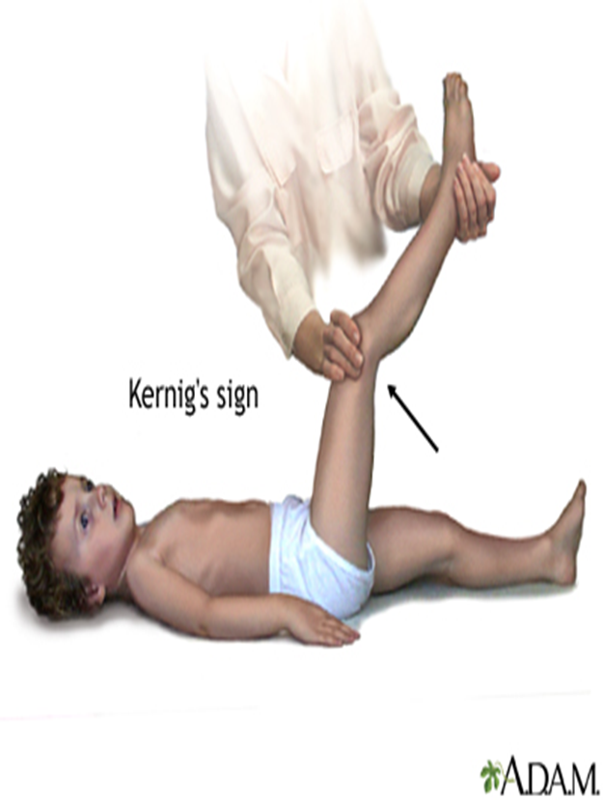
26 The patient has fever and nuchal rigidity, what is the name of the test?
Leg raise test
Brudzinski test
Kernig test
Babinski test
Hoffman test

Slide 22
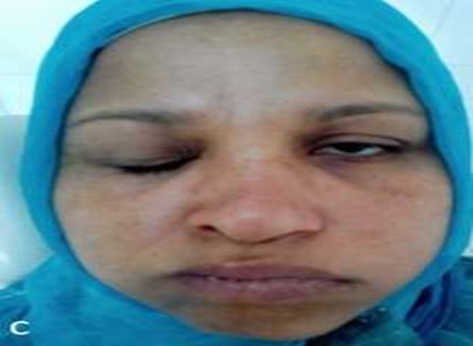
27 Which of the following can be found in this patient
A. Tongue deviation
B. Loss of facial sensation the left side
C.UMNL
D. Loss of stapedial reflex in left side

Slide 23
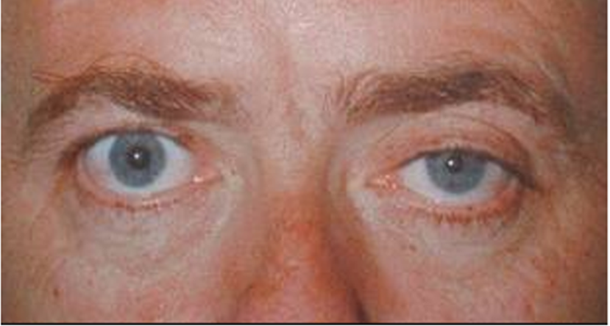
28 All the following conditions are associated with Horner except:
Its due to parasympathetic denervation of the face
المفروض sympathetic denervation

Slide 24
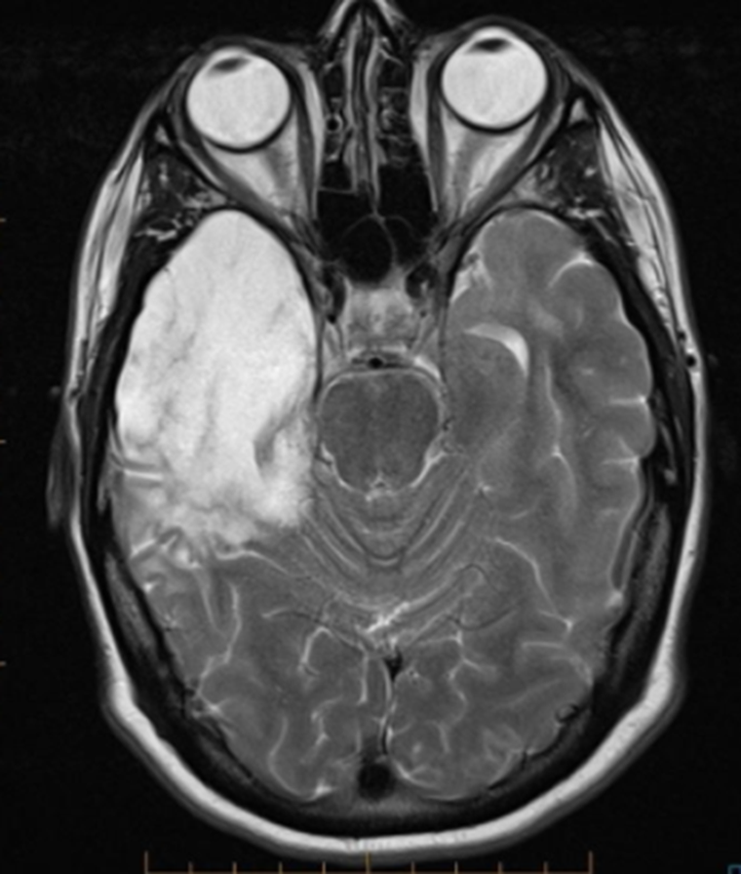
29 Which of the following is wrong ?
The protein is high
The sugar is usually normal
Surgery is not recommended for treating this condition
We can delay in treatment or we start treatment after investigation

Slide 25
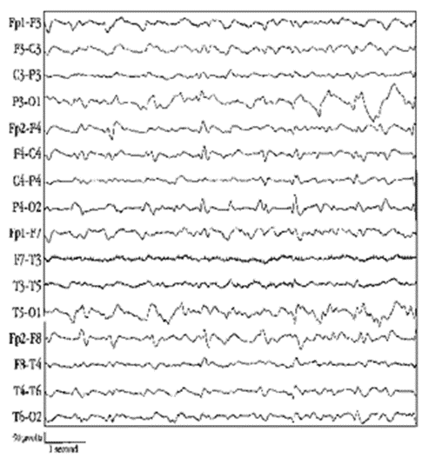
30:EEG what is wrong ?
EEG could be abnormal in normal people.
EEG could be normal in epileptic patient
EEG shows spike wave in epilepsy
We give antiepileptic drugs in 1st attack

Slide 26
31wrong ?
Athetosis is slow writhing movement
Tics are semivoluntary movement
Hemiballismus due to contralateral lesion in subthalamic nucleus
Cerebellar tremors contralateral
Myoclonus sudden, brief, uncontrolled muscle contraction

Slide 27
32 How to differentiate migraine headache from cluster ?
Migraine longer duration
33 If the patient has normal sweating, where is the lesion without anhidrosis ?سؤال ارشيف من سنين سابقه وكان مجاوب internal carotid aneurysm ف مش متاكدين
-Internal carotid aneurysm or
-carotid dissection ?
34 Patient with Non fluent speech, Grammar errors ?
Broca’s aphasia

Slide 28
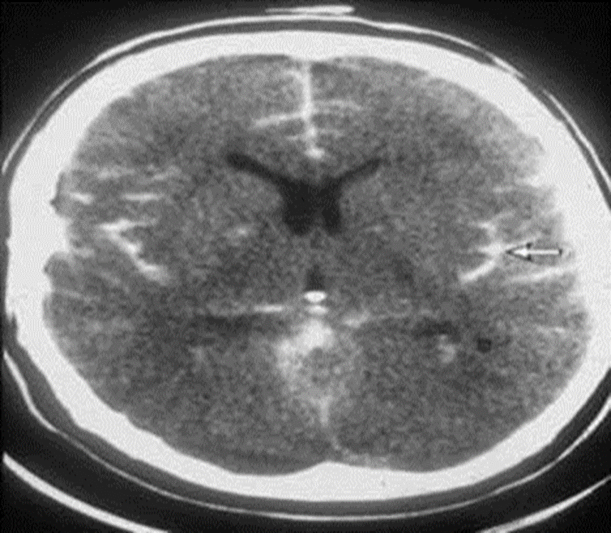
35 This patient has fever, headache, neck stiffness and photophobia , what’s your next step ? Start empirical treatment and dexamethasone
-36 wrong about manegment ?
Reduced warfarine without antidote
-37 true about subarchnoid hemorrhage?
Reduced warfarine to get INR below 2
مش متاكديين

Slide 29
38 : true about transverse myelitis ?
Transverse myelitis associated with more urine symptoms than GBS

Slide 30
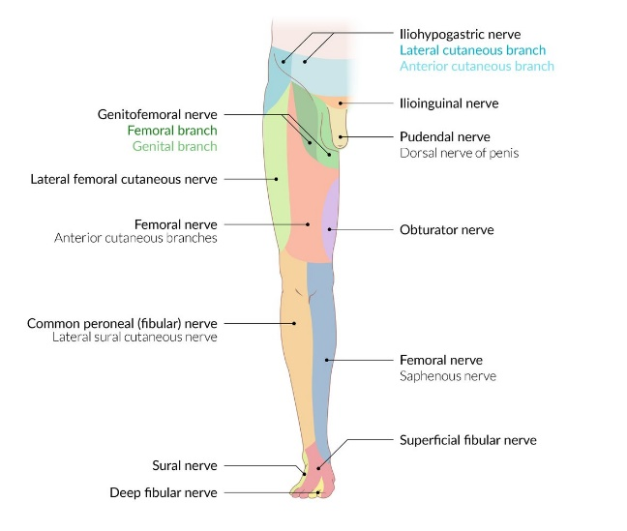
39 pt has sensory loss in this area (anteriolateral) , pt suffer from?
Compression on sensory nerve without weakness
مش نفس الصوره

Slide 31
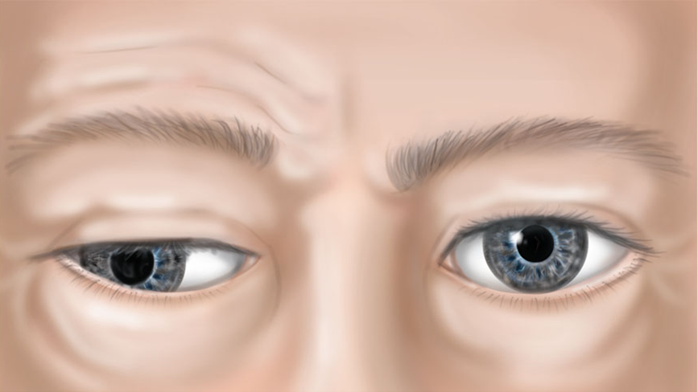
40 wrong about this palsy ?
Ptosis due to muller weakness

Slide 32
Neuromedicine Mini-OSCE Archive
Eslam Al-Tarawneh
Walid Azayzeh
Laith Najada

Slide 33
Q1 -50 years female come with persistent severe headache from last week, what is the next step:
Brain MRI
ESR and CRP
Lumbar puncture
Head CT scan

Slide 34
Q2 - a patient presented with status epilepticus, he was given 10mg of diazepam but didn’t get better, he was given another 10mgs but it also didn’t work. What is the next step ?
20mg of phenytoin + saline for 2 minutes
20mg of phenytoin + glucose infusion
20mg of phenytoin + saline infusion
20mg of phenytoin + glucose for 2 minutes
Propofol

Slide 35
Q3-This test is used for detect the function of:
Right cerebellum
Left cerebellum
Right cerebral
Left cerebral
Dorsal columns

Slide 36
Q4- Which of the following can not be found in this patient:
Loss of taste sensation
Loss of facial sensation
Left ear vesicles
Excessive lacrimation
Impairment in hearing
Remember E is right as the facial nerve supply the stapedius muscle which damp loud noises, palsy of this muscle result in hyperacusis

Slide 37
Q5- This test called ?
Tandem test
Romberg’s test
Trendelenburg’s test
Heel-knee-shin test
Babinski’s sign

Slide 38
Q6- What is the diagnosis ?
Normal CT scan
Sub-arachenoid hemorrhage
Cerebral infarction
Multiple sclerosis
Watershed infarction

Slide 39
Q7- What is the diagnosis ?
Curschmann-Steinert disease
proximal myotonic myopathy
Polymyositis
Dermatomyositis
Duchenne muscular dystrophy

Slide 40
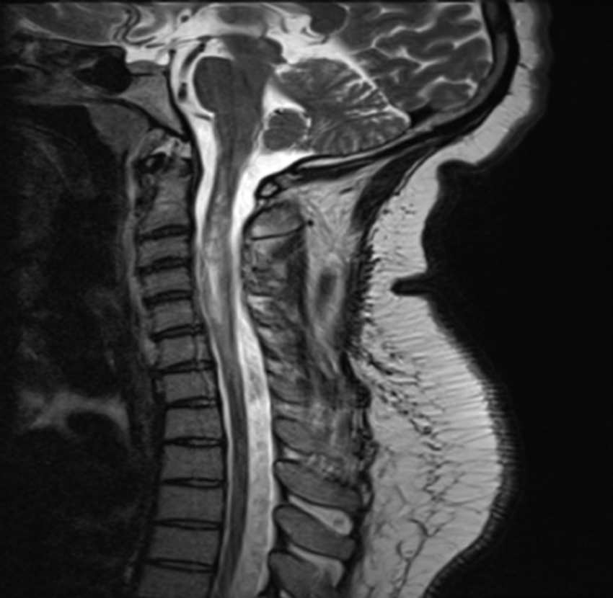
Q8- What is the diagnosis?
T1 Transverse myelitis
T2 Transverse myelitis
T1 syringomyelia
T2 syringomyelia
None of the above
Note: T1 and T2 are meant to mean T1-weighted MRI & T2-weighted MRI and not T1 spine
NOT THE SAME PICTURE

Slide 41
Q9- patient opens his eye to verbal command , produces incomprehensive sounds and withdraws from pain , GCS is:
7
8
9
10
11

Slide 42
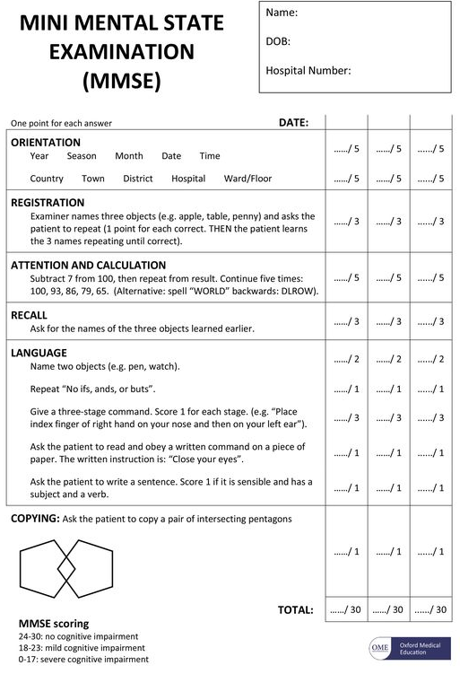
Q10- all are true about mini mental status examination except
MMSE is 30 points screening tool
used to diagnose dementia
100-7 tests registration
score of 23 risk for mild dementia
It’s affected by the patient education

Slide 43
Q11- All the following conditions are associated with Horner except:
Cervical spine injury
Carotid aneurysm
Tumor in the apex of the lung
Posterior neck trauma
Non-reactive pupil

Slide 44
Q12- What is the cause for this ?
Right optic neuritis
Left optic neuritis
Right oculomotor palsy
Left oculomotor palsy
Horner’s syndrome

Slide 45
Q13- A patient had head trauma and MRI was performed, Lesions consistent with multiple sclerosis were seen in his MRI. what is the patient diagnosis ?
relapsing remitting multiple sclerosis
clinically isolated syndrome
Radiological isolated syndrome
Possible multiple sclerosis
Probable multiple sclerosis

Slide 46
Q14- A patient presented with symmetrical loss of position, touch, vibration sensations of both feet up to the ankle joints. He is likely suffering from:
Brain lesion
Spinal cord lesion
Upper Cervical Syringomyelia
Peripheral polyneuropathy
Diffuse L5 S1 disc prolapses

Slide 47
Q15- This test used to diagnose ?
Meniere's disease
BPPV
Vestibular neuritis
Acoustic neuroma
Central vertigo

Slide 48
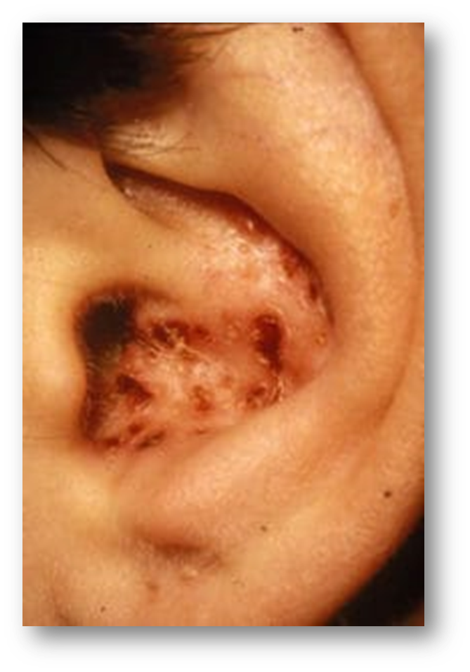
Q16- If the patient came to your clinic with these vesicles, which cranial nerve you have to exam?
Trigeminal nerve
Facial nerve
Trochlear nerve
Vagus nerve
Oculomotor nerve

Slide 49
Q17- If the patient with this CT scan is right-handed, which of the following symptom is not founded with him?
Hemiparesis
Paresthesia
Aphasia
Homonymous hemianopia
Hemineglect
NOTE: The patient is Rt. Handed so the cerebral hemisphere domain is the LEFT → Aphasia occurs only if the dominant hemisphere is affected, while with our case here the
non-dominant (right) hemisphere is affected

Slide 50
Q18- This condition is caused by ?
Severe hypertension
Severe hypotension
Encephalitis
Meningitis
Vasculitis

Slide 51
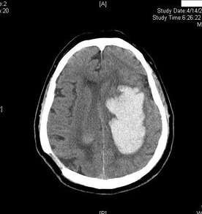
Q19- What is the diagnosis?
Intracranial hemorrhage
Vasogenic edema
Cerebral infarction
Multiple sclerosis
Watershed infarction

Slide 52
Q20- EEG what is wrong ?
EEG could be abnormal in normal people.
EEG could be normal in epileptic patient.
Neuroimaging is recommended after first unprovoked seizure
We give antiepileptic drugs after first attack
EEG shows spike wave in epilepsy

Slide 53
Q21- Features of syringomyelia include all of the following except:
It causes bilateral but not symmetrical pain and temperature loss.
Proprioception and vibration sense are not affected early in the disease.
It usually causes gloves and stocking sensory loss distribution.
Cranial nerves may be affected with syringobulbia
Syringobulbia can cause Horner’s syndrome

Slide 54
Q22- what is the affected muscle?
Left pterygoid muscle
Right pterygoid muscle
Left buccinator
Right buccinator
Left temporalis

Slide 55
Q23- Patient look to right, fast phase of nystagmus to left, patient look to right again, fast phase of nystagmus to right, what the type of nystagmus? A- Left jerky nystagmus.
B- right jerky nystagmus.
C- Right pendular nystagmus.
D- Left pendular nystagmus.
E- Multidirectional nystagmus.

Slide 56
Q24- What is wrong ?
Athetosis is slow writhing movement
Tics are semivoluntary movement
Hemiballismus due to contralateral lesion in subthalamic nucleus
Intention tremors frequency is the same through out the movement
Myoclonus sudden, brief, uncontrolled muscle contraction

Slide 57
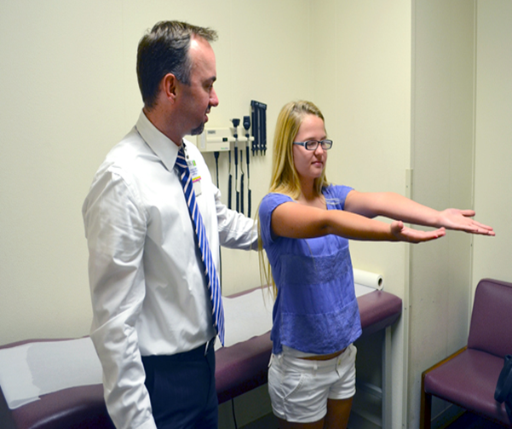
Q25- which of the following result in a positive Romberg test?
Dorsal column lesion
Vit B12 deficiency
Diabetic neuropathy
Impaired proprioception
All of the above

Slide 58
Q26- Which of the following is wrong ?
The protein is high
The sugar is usually normal
Surgery is recommended for treating this condition
It is usually caused by herpes simplex virus
Start acyclovir as soon as possible

Slide 59
Q27- Which of the following can not be found in this patient:
Hoarseness
Dysphagia
Nasal regurgitation of food
Palate collapse
Absent jaw reflex

Slide 60
Q28- Patient is asked to look to the right , the lesion is in?
Right abducent palsy
Left abducent palsy
Right INO
Left INO
Bilateral INO

Slide 61
Q29- The lesion is may one of the following except?
Right medial rectus
Left medial rectus
Myasthenia gravis
Space-occupying lesion
Increased ICP

Slide 62
Q30- A 20 years old patient came with weakness and numbness of lower extremities more than upper extremities, urine retention, & normal reflexes. The most important next step in diagnosis will be:
Nerve conduction study
Perform spinal MRI
Perform lumbar puncture and CSF analysis
Examine for dermatomal sensory loss
Examine for glove and stocking sensory loss
الله اعلم

Slide 63
Q31- The patient has fever and nuchal rigidity, what is the name of the test?
Leg raise test
Brudzinski test
Kernig test
Babinski test
Hoffman test

Slide 64
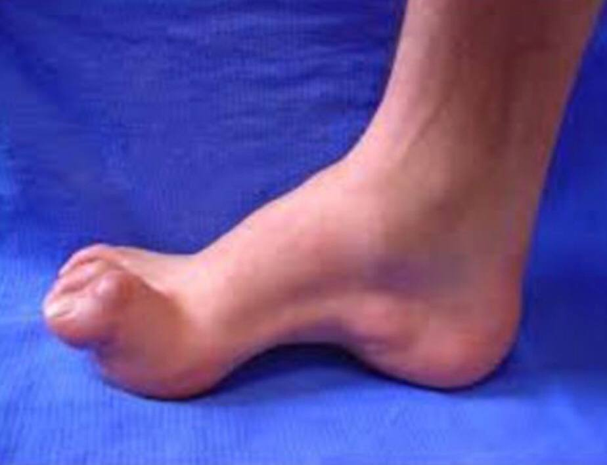
Q32- In NCS (nerve conduction study) the patient showed demyelination so what's the diagnosis ?
A- Charcot–Marie–Tooth disease
B- Rheumatoid arthritis
C- Guillain-Barre syndrome
D- Multiple Sclerosis
E- SCD

Slide 65
Q33- Which Guillain-Barre variant is associated with ophthalmoplegia, ataxia and areflexia and tends to be associated with GQ16 antibodies?
Sensory GBS
Acute inflammatory demyelinating polyneuropathy
Acute motor sensory axonal polyneuropathy
Miller-Fisher syndrome
Acute motor axonal polyneuropathy

Slide 66
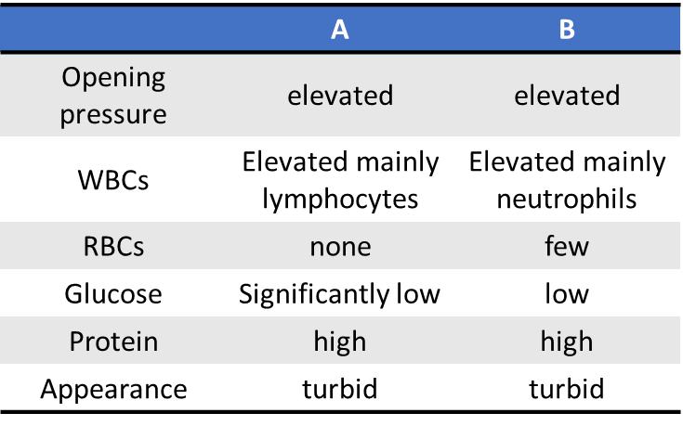
Q34- These are CSF results, what do you expect the cause of these findings in A and in B?
A: TB & B: Bacterial
A: Fungal & B: TB
A: TB & B: Viral
A: Viral & B: Bacterial
A: Bacterial & B: TB

Slide 67
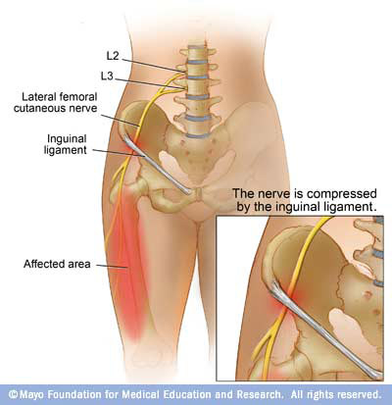
Q35- The name of this condition is?
Meralgia paresthetica
Genitofemoral neuropathy
Sciatica
L5 radiculopathy
Becker muscular dystrophy

Slide 68
Q36- Clinical sign associated with lesion of the nerve supply the area shown in the picture?
Tibialis anterior weakness
Weak plantar flexion
Calf muscle atrophy
Absent ankle reflex
Cannot stands on tip of toes

Slide 69
Q37- A 75 years old male came with acute stroke. He has right side weakness. He has spontaneous speech with occasional paraphrasic errors. He cannot understand and follow commands, and repetition is affected, which of the following best explains his speech pattern?
Broca aphasia
Transcortical aphasia
Conduction aphasia
Wernicke aphasia
Global aphasia

Slide 70
Q38- Sensation loss over the area shown in the picture, where is the lesion?
C5 radiculopathy
C6 radiculopathy
C7 radiculopathy
C8 radiculopathy
T1 radiculopathy

Slide 71
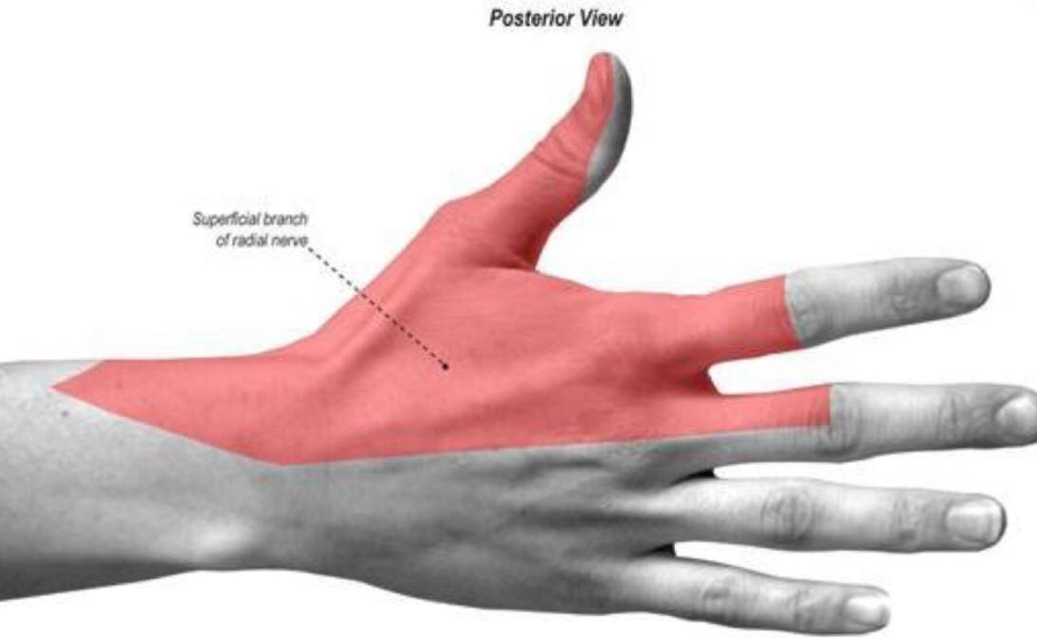
Q39- Sensation loss over the area shown in the picture, where is the lesion?
Ulnar nerve
Median nerve
Radial nerve
Anterior interosseous nerve
C7/T1 disc prolapse

Slide 72
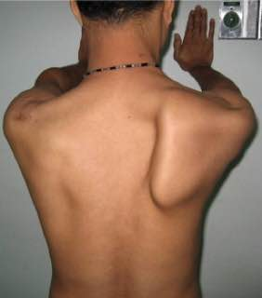
Q40- Which nerve is affected?
Long thoracic nerve
Dorsal scapular nerve
Suprascapular nerve
Axillary nerve
Musculocutaneous nerve

Slide 73
Neuro-medicine Mini-Osce
10/5/2022
Noon Abdullah
Mohammad Amayreh
Mahmoud Barakt

Slide 74
Q1 -50 years female come with persistent severe headache from last week, what is the next step:
Brain MRI
ESR and CRP
Lumbar puncture
Head CT scan

Slide 75
Q2 - a patient presented with status epilepticus, he was given 10mg of diazepam but didn’t get better, he was given another 10mgs but it also didn’t work. What is the next step ?
20mg of phenytoin + saline for 2 minutes
20mg of phenytoin + glucose infusion
20mg of phenytoin + saline infusion
20mg of phenytoin + glucose for 2 minutes
Propofol

Slide 76
Q3-This test is used for detect the function of:
Right cerebellum
Left cerebellum
Right cerebral
Left cerebral
Dorsal columns

Slide 77
Q4- Which of the following can not be found in this patient:
Loss of taste sensation
Loss of facial sensation
Ear vesicles
Excessive lacrimation
Impairment in hearing
Remember E is right as the facial nerve supply the stapedius muscle which damp loud noises, palsy of this muscle result in hyperacusis

Slide 78
Q5- This test called ?
Tandem test
Romberg’s test
Trendelenburg’s test
Heel-knee-shin test
Babinski’s sign

Slide 79
Q6- What is the diagnosis ?
Intracranial hemorrhage
Sub-arachenoid hemorrhage
Cerebral infarction
Multiple sclerosis
Watershed infarction

Slide 80
Q7- What is the diagnosis ?
Curschmann-Steinert disease
proximal myotonic myopathy
Polymyositis
Dermatomyositis
Duchenne muscular dystrophy

Slide 81
Q8- What is the diagnosis?
T1 Transverse myelitis
T2 Transverse myelitis
T1 syringomyelia
T2 syringomyelia
None of the above
Note: T1 and T2 are meant to mean T1-weighted MRI & T2-weighted MRI and not T1 spine
مشان ما تبلع زينا
NOT THE SAME PICTURE

Slide 82
Q9- patient opens his eye spontaneously , produces incomprehensive sounds and wihdraws to pain , GCS is:
7
8
10
12
15

Slide 83
Q10- all are true about mini mental status examination except
MMSE is 30 points screening tool
used to diagnose dementia
100-7 tests calculation
score of 27 risk for mild dementia

Slide 84
Q11- All the following conditions are associated with Horner except:
Cervical spine injury
Carotid aneurysm
Tumor in the apex of the lung
Posterior neck trauma
Non-reactive pupil

Slide 85
Q12- what is the cause for this ?
Right optic neuritis
Left optic neuritis
Right oculomotor palsy
Left oculomotor palsy
Horner’s syndrome

Slide 86
Q13- How to differentiate cluster headache from migraine
Cluster headache is unilateral
Topiramate is good as a prophylaxis for cluster headache
Have a shorter duration
Cluster is more common in females
Associated with nausea and vomiting

Slide 87
Q14- This pattern can be seen in all of the following except:
Diabetic neuropathy
Chronic polyneuropathy
Brown sequard syndrome
Stroke
MS

Slide 88
Q15- A patient had head trauma and MRI was performed, Lesions consistent with multiple sclerosis were seen in his MRI. what is the patient diagnosis ?
relapsing remitting multiple sclerosis
clinically isolated syndrome
Radiological isolated syndrome
Possible multiple sclerosis
Probable multiple sclerosis

Slide 89
Q16: A patient presented with symmetrical loss of position, touch, vibration sensations of both feet up to the ankle joints. He is likely suffering from:
Brain lesion
Spinal cord lesion
Upper Cervical Syringomyelia
Peripheral polyneuropathy
Diffuse L5 S1 disc prolapses

Slide 90
Q17- this test used to diagnose ?
Meniere's disease
BPPV
Vestibular neuritis
Acoustic neuroma
Central vertigo

Slide 91
Q18- Which is wrong
This condition is known as Ramsay Hunt Syndrome
The geniculate ganglion can be affected in this disease
Cytomegalovirus can cause this condition
Other cranial nerves can be also be involved
Treated with antivirals

Slide 92
Q19- Which is wrong about meningitis
مش نفس الخيارات بالزبط
Blood culture is necessary for the diagnosis
Immunocompromised patients are treated with the same empirical antibiotic as other patients
Meningeal irritation suggests the diagnosis
You can’t do lumber puncture after giving antibiotics
CSF analysis and PCR can confirm the diagnosis

Slide 93
Q20- All are risk factors for this except:
Hypertension.
Patent foramen ovale
Valvular heart disease.
Atrial fibrillation.
Left atrial hypertrophy

Slide 94
Q21- This condition caused by ?
Severe hypertension
Severe hypotension

Slide 95
Q22- This an ICH, which of the following is wrong regarding the management:
controlling blood pressure
antidote for warfarin
antidote for heparin
risk for brain herniation
LP and CSF analysis for Sub-arachenoid hemorrhage

Slide 96
Q23- EEG what is wrong ?
EEG could be abnormal in normal people.
EEG could be normal in epileptic patient.
Neuroimaging is not recommended after first unprovoked seizure
We give antiepileptic drugs for first attack even there is abnormal EEG.
EEG shows spike wave in epilepsy

Slide 97
Q24- Features of syringomyelia include all of the following except:
It causes bilateral but not symmetrical pain and temperature loss.
Proprioception and vibration sense are not affected early in the disease.
It usually causes gloves and stocking sensory loss distribution.
Cranial nerves may be affected with syringobulbia
Syringobulbia can cause Horner’s syndrome

Slide 98
Q25- There is a loss of sensation over the specified area , where is the lesion?
C5 radiculopathy
C6 radiculopathy
C7 radiculopathy
C8 radiculopathy
T1 radiculopathy

Slide 99
Q26- what is the affected muscle ?
Left pterygoid muscle
Right pterygoid muscle
Left buccinator
Right buccinator
Masseter

Slide 100
Q27- Patient look to right, fast phase of nystagmus to lift, what the type of nystagmus? A- Left jerky nystagmus.
B- right jerky nystagmus.
C- Right pendular nystagmus.
D- Left pendular nystagmus.
E- Multidirectional nystagmus.

Slide 101
Q28- wrong ?
Athetosis is slow writhing movement
Tics are semivoluntary movement
Hemiballismus due to contralateral lesion in subthalamic nucleus
Cerebellar tremors frequency is the same through out the movement
Myoclonus sudden, brief, uncontrolled muscle contraction

Slide 102
Q29- which of the following doesn’t result in a positive Romberg test?
Dorsal column lesion
Vit B12 deficiency
Diabetic neuropathy
Impaired proprioception
Cerebellar disease

Slide 103
Q30- About nerve conduction study, Which is true
Reduced amplitude – demyelinating disease
Reduced velocity – neuropathy
Amplitude resembles motor unit
EMG can’t diagnose myopathies
Falafel

Slide 104
Q31: Which of the following is wrong ?
The protein is usually low
The sugar is usually normal
Surgery doesn’t help in treating this condition
It is usually caused by herpes simplex virus
Start acyclovir as soon as possible

Slide 105
Q32: Diagnosis ?
Right Horner
Left Horner
Right oculomotor palsy
Left oculomotor palsy
Right abducent palsy

Slide 106
Q33: Which of the following:
This is Trendelenburg’s test
Due to proximal muscles weakness
Due to sciatic nerve palsy
Due to superior gluteal nerve palsy
Result from gluteus minimums injure

Slide 107
Q34- Which of the following can not be found in this patient:
Hoarseness
Dysphagia
Loss of gag reflex
Palate collapse
Loss of taste sensation in the posterior 1/3 of the tongue

Slide 108
Q35: patient is asked to look to the right , the lesion is in ?
Right abducent palsy
Left abducent palsy
Right INO
Left INO
Bilateral INO

Slide 109
Q36: Which of the following is true
A is TB
B is viral
A is fungal
A is viral
B is TB

Slide 110
Q37: A 20 years old patient came with weakness and numbness of lower extremities more than upper extremities. He was found to have generalized areflexia. The most important next step in diagnosis will be:
Perform brain MRI
Perform lumbar MRI
Perform lumbar puncture and CSF analysis
Examine for dermatomal sensory loss
Examine for glove and stocking sensory loss

Slide 111
Q38: Which of the following is true
BPPV lasts for hours
Central vertigo is associated with fatigable nystagmus
Vestibular neuritis have long duration
Gentamicin result in central vertigo
Meniere's disease is a type of central vertigo

Slide 112
Q39: Which of the following is wrongly paired
Broca’s aphasia – Impaired grammar
Sensory aphasia – Preserved comprehension
Transcortical aphasia – Preserved repetition
Wernicke’s aphasia – Non fluent speech
Sandwich falfel

Slide 113
Q- THE WRONG ?
The more proximal the Ulnar nerve injury the worse
It is due to distal ulnar nerve palsy
Can result from wrist laceration
Shawarma

Slide 114
Neuromedicine Mini-Osci 31/8/2022
Ahmad Abu-Morad
&
Osamah Alawneh

Slide 115
1-50 years female come with persistent severe headche from last week, what is the next step:
A- Brain MRI
B- ESR
C- Lumbar puncture
A patient presented with status epilepticus, he was given 10mg of diazepam but didn’t get better, he was given another 10mgs but it also didn’t work. What is the next step ?
A-20mg of phenytoin + saline for 2 minutes
B-20mg of phenytoin + glucose infusion
C-20mg of phenytoin +saline infusion
D-20mg of phenytoin + glucose for 2 minutes
E-Propofol
Which of the following is wrong about mini mental exam ?
100-7 is to test recall

Slide 116
man with smooth talking, minimal paraphrasic errors, impaired
comprehension ( and poor repetition)
Broca’s aphasia
Wernicke’s aphasia
Transcortical aphasia
Global aphasia
Conductive aphasia
5- Which Guillain-Barre variant is associated with opthalmoplegia, ataxia
and a reflexia and tends to be associated with GQ16 antibodies?
Miller fisher syndrome

Slide 117
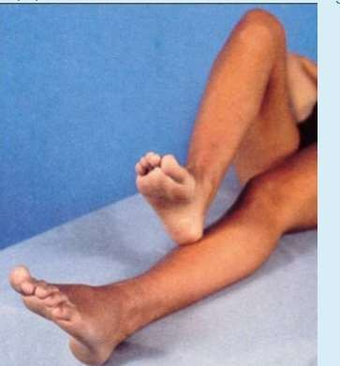
6- All of the following patient may have except:
A-Excessive lacrimation
B- loss of facial sensation the left side
C- loss of taste sensation on the left side
7-This test is used for detect the function of
1. right cerebellum 2.left cerebellum

Slide 118
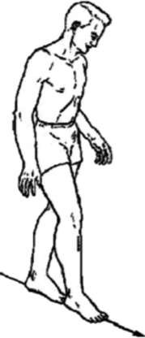
8- This test called ?
Tandem test
9- What is the diagnosis ?
Sub-arachenoid hemorrhage

Slide 119
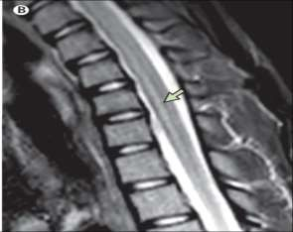
10-What is the diagnosis?
Dermatomyositis.
11-What is the diagnosis?
T2 Transverse myelitis.
T1 syringomyelia

Slide 120
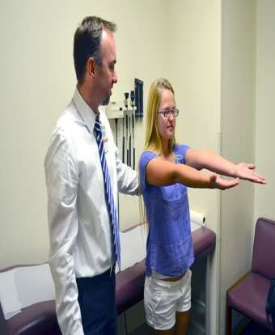
If this test was positive,what is the cause?
A- Dorsal column lesion.
B- Vit B12 deficiency.
C- Diabetic neuropathy.
D- Hypothyroidism.
E- All of the above.
Patient look to right, fast phase of nystagmus to left,
what the type of nystagmus?
A- right jerky nystagmus.
B- left jerky nystagmus.
C- Right pendular nystagmus.
D- Left pendular nystagmus.
E- Multidirectional nystagmus.

Slide 121
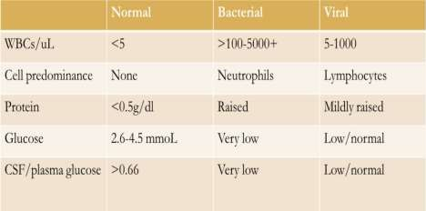
Which type of meningitis is A,B
A, bacterial B, TB
A, TB B, bacterial
A, bacterial B, viral
The answer was bacterial, viral
( glucose marginally low =slightly low مهتطبرخ ياه سان يف)
All the following true excpt?
1.give multiple epileptic drug after unprovoked seizure 2.normal person CAN have epileptic EEG

Slide 122
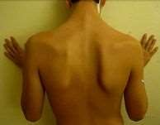
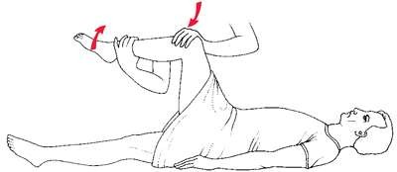
16- Nerve affected ? long thoracic nerve
17- What the name of this sign ? Kernig sign

Slide 123
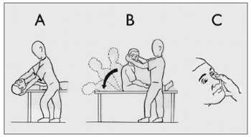
18-This test used for ?
Positionl vertigo ,
posterior semicircular canal
19-What is the diagnosis ? ICH

Slide 124
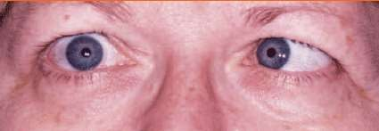
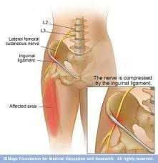
20- the patient is looking to the right;
All of the following patient may have except:
Answer:
weakness in the left medial rectus
21- The name of this condition?
Meralgia parasthetica

Slide 125
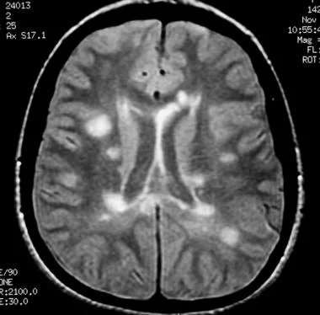
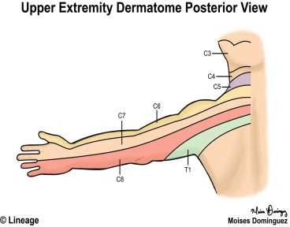
This MRI is taken after head trauma; what is the diagnosis?
A- relapsing remitting
B- clinically isolated syndrome
C- Radiological isolated syndrome
There is a loss of sensation over the specified area , where is the lesion?
C7 radiculopathy

Slide 126
24- Symmetrical loss of senensation
,proprioception,tem in the foot until ankle , this condition caused by :
1.disc L5/S1

Slide 128
Neuromedicine Mini-osci 9/3/2022
Noor Al-Huda Al-Karaki
&
Dania Ma’aitah
40 MCQ Questions In 30 Minutes

Slide 129
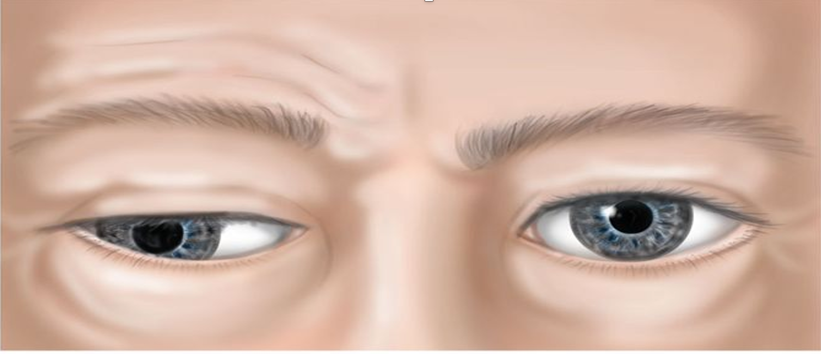
Patient presented with downward and outward pupils and intact pupillary reflex ,diagnosis : 1-medical 3ed nerve palsy 2-surgical 3ed nerve palsy 3-horner syndrome
What is the diagnosis?
Dermatomyositis.

Slide 130
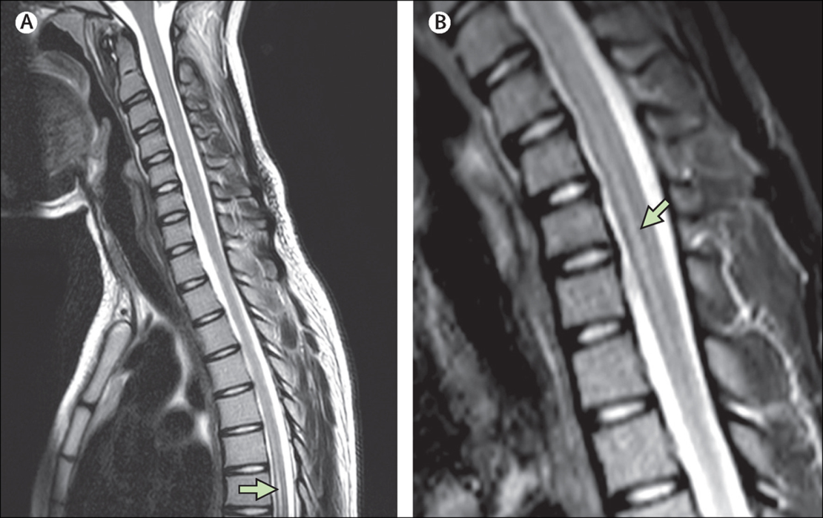
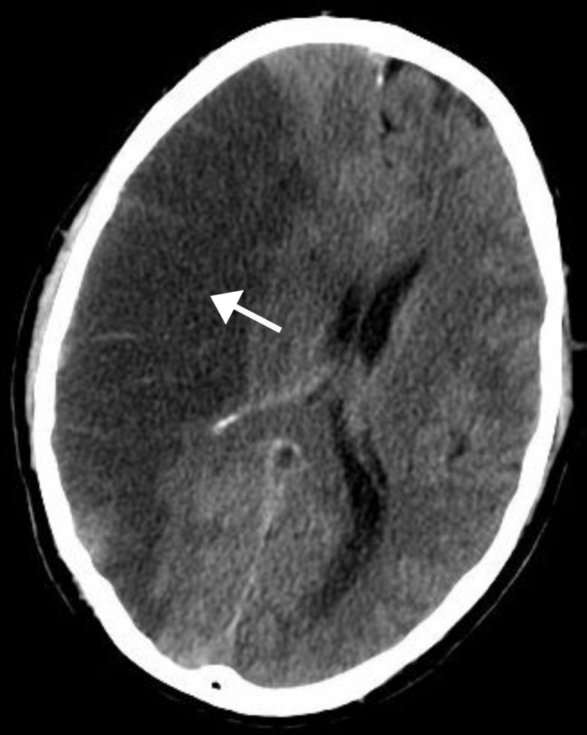
What is the diagnosis?
T2 Transverse myelitis.
T1 syringomyelia
All are causes of this lesion except:
A- Hypertension.
B- right carotid artery stenosis
C- valvular heart disease.
D- Atrial fibrillation.
E- DVT with normal wsophageal echo

Slide 131
50 years female come with persistent severe headche from last week, what is the next step:
A- Brain MRI
B- ESR
C- Lumbar puncture
A patient presented with status epilepticus, he was given 10mg of diazepam but didn’t get better, he was given another 10mgs but it also didn’t work. What is the next step ?
A-20mg of phenytoin + saline for 2 minutes
B-20mg of phenytoin + glucose infusion
C-20mg of phenytoin +saline infusion
D-20mg of phenytoin + glucose for 2 minutes
E-Propofol

Slide 132
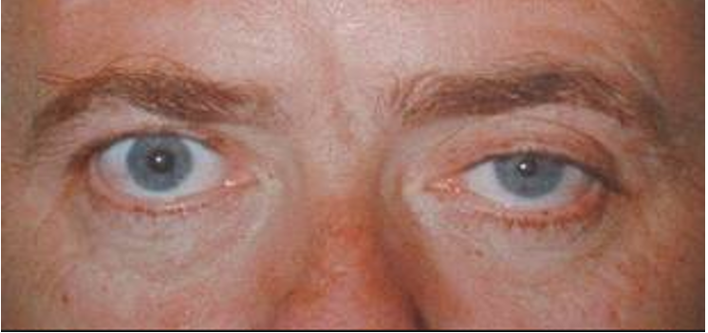
Which of the following is wrong about mini mental exam ?
100-7 is to test recall
If sweating was intact in the left side where is the lesion ?
A-internal carotid artery aneurysm
B-Sympathetic trunk damage
C-Middle cerebral artery stenosis

Slide 133
A man with smooth talking, minimal paraphrasic errors, impaired comprehension ( and poor repetition)
Broca’s aphasia
Wernicke’s aphasia
Transcortical aphasia
Global aphasia
Conductive aphasia
Which Guillain-Barre variant is associated with opthalmoplegia, ataxia and a reflexia and tends to be associated with GQ16 antibodies? Miller fisher syndrome

Slide 134
The condition caused by excessive endolymph is called ?
Menieres disease
The pt may have also : 1.tounge deviation 2. loss of taste sensation on right side of tongue 3. loss of taste sensation on left side of tongue 4.palate drop 5.hyperreflxia of jaw

Slide 135
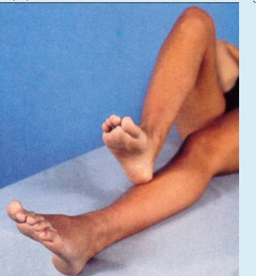
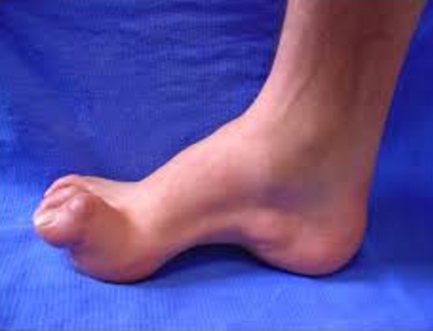
This test is used for detect the function of 1. right cerebellum 2.left cerebellum
In NCS the pt showed demelination so whats the dx ? CMT disesase

Slide 136
A patient presented with symmetrical loss of position, touch, vibration sensations of both feet up to the ankle joints. He is likely suffering from: polyneuropathy
This test called ? Tandem test

Slide 137
D: one of the following is true :
Opening pressure | elevated | elevated
WBCs | Elevated mainly lymphocytes | Elevated mainly neutrophils
RBCs | none | few
Glucose | Significantly low | low
Protein | high | high
Appearance | turbid | turbid
 | A | B
A: TB meningitis
B: Acute bacterial meningitis
What is the diagnosis ? Sub-arachenoid hemorrhage

Slide 138
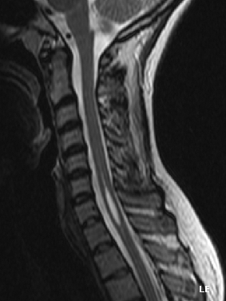
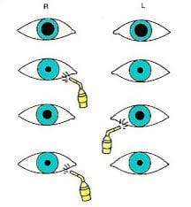
All the following true except? Asymetrical loss of sensation
Where is the lesion?
Left optic nerve

Slide 139
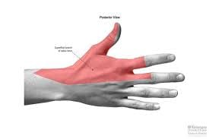
Sensation by which nerve?
Superficial Radial N.
Eye open to verbal command
Incomperhensible sound
Withdraws from pain
GCS =9

Slide 140
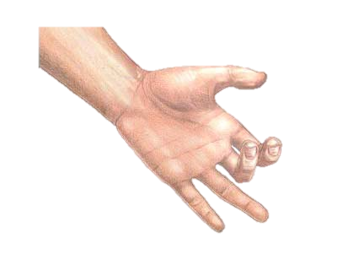
patient in resting position ,Which nerve is affected ?
median nerve
What is the abnormality ?
Watershed area infarction

Slide 141
viral encephalitis,,one is true
MRI with contrast can confirm the diagnosis
Start acyclovir as soon as possible
Which sign
brudinizki

Slide 142
EEG what is wrong ?
Neuroimaging is not recommended after first seizure
You can give antiepileptic after first seizure in patient with brain mass
One is false right tongue deviation

Slide 143
Needle EMG one is false
single nerve fiber
motor unite
can’t diagnose neural disease
Can’t diagnose neoromuscular one
Deep peroneal nerve injury ,,where is the lesion ? 1- around ankle 2- around knee 3- L5 radiculopathy ?? 4- S1 radiculopathy

Slide 144
Patient presented with optic neuritis and didn’t have any episode of neurological symptoms before , then MRI suggest multiple sclerosis ,,what is the diagnosis ?
-relapsing remitting MS
-primary progressive
-secondary progressive
-clinically isolated syndrome
-radiologically isolated syndrome
All true exept -DM -drug induced neuropathy -chronic polyneuropathy -severe thyroid disease - mononuritis multiplex ??

Slide 145
Positive romberg disease
All above
Compound muscle action potential)CMAP( ,,If the amplitude low
Axonal injury
Demylination
Loss of motor fibers

Slide 146
Involuntary movements and brief postictal symptoms
Epileptic fits
Regarding neurophysiological study ,,which of the following is true ?

Slide 147
Meningitis, one is true
You can do lumber puncture after giving antibiotics
One is true about migrane
need 5 attacks to diagnose
Can be diagnosed without phonophbia and photophobia
One is false
Myclonus is regular jerky movment

Slide 148
Neuromedicine Mini-osci
دانية أحمد الرواشدة

Slide 149
What is the diagnosis?
Dermatomyositis.

Slide 150
What is the diagnosis?
T2 Transverse myelitis.

Slide 151
All are causes of this lesion except:
A- Hypertension.
B- Left carotid artery stenosis?
C- valvular heart disease.
D- Atrial fibrillation.
E- Patent foramen ovale with DVT.

Slide 152
If this test was positive,what is the cause?
A- Dorsal column lesion.
B- Vit B12 deficiency.
C- Diabetic neuropathy.
D- Hypothyroidism.
E- All of the above.

Slide 153
All are true except:
A- EEG could be abnormal in normal people.
B- EEG could be normal in epileptic patient.
C- MRI not recommended after first seizure.
D- We don’t give antiepilptic drugs for first attack even there is abnormal EEG.
E- EEG shows spike wave in epilepsy.
الصورة مش نفسها، وآخر خيار مش حرفي قريب منه تقريبا.

Slide 154
Patient look to left, fast phase of nystagmus to right, what the type of nystagmus?
A- Left jerky nystagmus.
B- right jerky nystagmus.
C- Right pendular nystagmus.
D- Left pendular nystagmus.
E- Multidirectional nystagmus.

Slide 155
50 years female come with persistent severe headche from last week, what is the next step:
A- Brain MRI
B- ESR
C- Lumbar puncture

Slide 156
الباقي مكرر

Slide 157
Neuromedicine 3/11/2021
Hashem Tarawneh

Slide 158
Which type of meningitis is A,B
A, bacterial B, TB
A, TB B, bacterial
A, bacterial B, viral
The answer was bacterial, viral ( glucose marginally low =slightly low في ناس هاي خربطتهم)

Slide 159
In what disease do we find otoliths in the endolymphatic fluid ?
A-Meniere’s disease
B-Benign paroxysmal positional vertigo
B

Slide 160
A patient presented with status epilepticus, he was given 10mg of diazepam but didn’t get better, he was given another 10mgs but it also didn’t work. What is the next step ?
A-20mg of phenytoin + saline for 2 minutes
B-20mg of phenytoin + glucose infusion
C-20mg of phenytoin +saline infusion
D-20mg of phenytoin + glucose for 2 minutes
E-Propofol
C

Slide 161
Which of the following is wrong about mini mental exam ?
100-7 is to test recall

Slide 162
If sweating was intact in this patient, what would be the cause of this condition ?
A-internal carotid artery dissection
B-Sympathetic trunk damage
C-Middle cerebral artery stenosis

Slide 163
A man with smooth talking, minimal paraphrasic errors, impaired comprehension ( and poor repetition)
Broca’s aphasia
Wernicke’s aphasia
Transcortical aphasia
Global aphasia
B

Slide 164
Which of the following is true
We don’t give medications after the first unprovoked seizure
الباقي ارشيف ( ميني اوسكي + فاينل مهمات)

Slide 165
Neuromedicine 1-9-2021
Done by :
Thara anwar
Nebal atallah

Slide 166
The diagnosis confirmed by: 1.pcr for hsv

Slide 167
The affected nerve ? Right vagus nerve

Slide 168
The name of this ? Meralgia parasthetica

Slide 169
GBS variant ass with arflexia , ophthalamplagia ,ataxia and GQIB antibody is ? Miller fisher syndrome

Slide 170
The condition caused by excessive endolymph is called ?
Menieres disease
(هاي المعلومة مش موجودة بالسلايدات بس حكاها في محاضرةneurological symptpms ) عشان هيك ركزوا في الي بحكيه

Slide 171
The pt may have also : 1.tounge deviation 2.loss of taste sensation 3.palate drop 3.hyperreflxia of jaw

Slide 172
Sensation loss over thumb and lateral part of forearm ? C6 radiculopathy

Slide 173
Last year,Pt suffered from lower limb weakness that improved spontaneously after several weeks? 1.relapsing remitting 2.secondary progressive 3.isolated radiological 4.isolated clinical

Slide 174
This test is used for detect the function of 1. right cerebellum 2.left cerebellum

Slide 175
In NCS the pt showed demelination so whats the dx ? CMT disesase

Slide 176
Pt come to ED with history of bilateral symmetrical lower limb weakness ,loss of sensation and arflexia ,the dx confirmed by ?
NCS
المفروض يكون الجواب LP albuminocytological dissicaistion بس ما كان موجود الخيار

Slide 177
This condition caused by ? Sever hypotention

Slide 178
Symmetrical loss of senensation ,proprioception,tem in the foot until ankle , this condition caused by : 1.disc L1/L2? 2.polyneuropathy? 3.sc injury 4.cortex injury

Slide 179
The pt will presented with all the following except ? 1.motor aphasia 2.sensory aphasia 3.left upper limb weakness 4.left lower limb weakness

Slide 180
This test called ? Tandem test

Slide 181
D: These are CSF results, what do you expect the cause of these findings in A and in B?
Opening pressure | elevated | elevated
WBCs | Elevated mainly lymphocytes | Elevated mainly neutrophils
RBCs | none | few
Glucose | Significantly low | low
Protein | high | high
Appearance | turbid | turbid
 | A | B
A: TB meningitis
B: Acute bacterial meningitis

Slide 182
If the nerve- that supply the yellow area – injuried ,the pt will cpmplain of all the following except ? Intact tibilais anteriot power

Slide 183
All the following true excpt? 1.give multiple epileptic drug after unprovoked seizure 2.normal person CAN have epileptic EEG

Slide 184
Nerve affected ? long thoracic nerve

Slide 185
You should do examination for ? facial nerve

Slide 186
What is the diagnosis ? SAH

Slide 187
what is the affected muscle ? left pterygoid muscle

Slide 188
What is the cause of ptosis ? Paralysis of superior tarsal muscle

Slide 189
All the following true except? Asymetrical loss of sensation

Slide 190
Q13
Where is the lesion?
Left optic nerve

Slide 191
The affected nerve is ? Ulnar

Slide 192
What the name of this sign ? Kernig sign

Slide 193
This test used for ? Positionl vertigo ,posterior semicircular canal

Slide 194
Question about GCS
Question about determine aphasia typeلازم تعرفوهم كلهم و تقدروا تفرقوا بينهم

Slide 195
What is the diagnosis ? ICH

Slide 196
Serotonin 4/august/2021

Slide 197
Q1) Differentiate between Migraine, Cluster headache and Temporal arteritis headache in the following aspects:
يعني هو حدد الأمراض وحدد الجوانب اللي لازم نفرق بينها والجدول كان موجود وجاهز على الورقة
 | Migraine | Cluster Headache | Temporal Arteritis
Epidemiology (Age, Sex) | Common in females (75%) Common in adolescence | Common in males (2:1) Older than 30 | Common in females Older than 50
Duration | Few hours to three days | 15 mins to few hours | Few minutes
Location | Unilateral frontotemporal and ocular | unilateral Periorbital, may radiate to the neck and shoulder | Temporal region
Nature | Throbbing | Stabbing | Throbbing
Associated symptoms | Nausea, vomiting, photophobia, phonophobia, fatigue, light-headedness | Ptosis, meiosis, conjunctival injection, lid edema, rhinorrhea, lacrimation | Jaw and tongue claudication, tinnitus, decreased visual acuity or sudden visual loss
Treatment | NSAIDs, triptans, opioids, ergotamine | Sumatriptan, Dihydroergotamine | High does prednisolone

Slide 198
Q2) To exclude oculomotor nerve lesion what do you examine and what are the abnormal findings:
هنا ما كان محدد شي وكان مطلوب مننا نعبي الخانتين بس كان فيه 5 خلايا مطلوب تعبئتها
Structure examined | Abnormal finding
Extraocular muscles | Eye shifted down and out (due to unopposed action of SO and LR)
Sphincter pupillae | Mydriasis
Levator palpebrae superiors | Ptosis
Accommodation reflex | Absent accommodation reflex
Light reflex | Absent pupillary construction

Slide 199
Q3: Differentiate between epilepsy and syncope:
هنا كانت الجوانب محددة ومطلوب مننا نقارن
 | Epilepsy | Syncope
Aura | Yes | No
Involuntary movements | Yes | No
Triggers | Tumor, trauma, fever, ischemia, infection, hyponatremia | Vasovagal syncope, hypoglycemia, dehydration, pain, hyperventilation. cardiac causes e.g., mitral stenosis, atrial fibrillation.
Associated symptoms | Tongue biting, urine incontinence, involuntary movements, aura | Lightheadedness, visual changes, pallor, sweating, nausea
Duration | Less than 1 min | More than 1 min

Slide 200
Q4) Differentiate between sensory (receptive) and motor (expressive) aphasia:
هنا كمان كانت الجوانب محددة ومطلوب مننا نقارن بناء عليها
 | Expressive (Motor) | Receptive (Sensory)
Area of lesion | Broca’s area (inferior frontal gyrus) | Wernicke’s area (superior temporal gyrus)
Fluency | Not fluent | Fluent speech
Comprehension | Not impaired | Impaired
Ability to repeat | Unable to repeat | Able to repeat

Slide 201
Neuromedicine
Group 4 A+B

Slide 202
Q1
1. chorea : movement disorder that causes involuntary , irregular , unpredictable muscle movement .
2. empirical treatment of meningitis : vancomycin ,cefotaxime
3. cardiac risk of stroke : atrial fibrillation , valvular vegetation , ventricular septal defect , sudden hypotension, HTN .

Slide 203
Q2 MS
Clinically isolated syndrome : initial presentation with localized deficit , pt may not develop ms , and the presentation is not sufficient to fulfill the criteria of ms .
Radiological isolated syndrome : white matter lesions fulfilling the criteria for multiple sclerosis occur in individuals without a history of a clinical demyelinating attack or alternative etiology
Primary progressive : accumulating disability from the onset
2ry progressive :start with relapsing remitting then changes to gradual worsening .

Slide 204
Q3 Differentiate between syncope and epilepsy
 | Syncope | Epilepsy
Associated symp | Pale skin, lightheaded , blurred vision | Tongue biting , urine incontinence , apnea , cyanosis ,
Trigger / cause | mass, trauma , fever , ischemia, infection , hyponatremia | Anemia , hypoglycemia , hypotension , arrhythmia
Duration | >1min | < 1 min
Mechanism | Abnormal electrical discharge | Decrease blood flow to the brain
Postictal | no | yes

Slide 205
Q4 Differentiate between sensory (receptive) and motor (expressive) aphasia
 | Motor | sensory
Area | inferior frontal gyrus | superior temporal gyrus
Fluent | Non fluent | Fluent
Comprehension | Spared | Impaired
Repetition | Impaired | Not impaired

Slide 206
Q5 Test for each nerve
oculomotor : extra ocular ms. Movement except superior oblique and lateral rectus, Papillary consensual light reflex .
Optic nerve : visual equity , visual field , color vision , direct papillary reflex
facial nerve : inspection , facial expression , corneal reflex , eyelid closure .
vestibulocochlear : weber , rinne

Slide 207
Neuromedicine archive group 4 c+d 4 \ 2 \ 2021
Abdelrahman Nour

Slide 208
How to examine oculomotor nerve to exclude nerve injury ?
By testing the pupillary consensual light reflex

Slide 209
What is the sign ? papilledema
What is the pathophysiology?
Due to increased ICP ?

Slide 210
Which nerve is affected ? Ulnar nerve
What is the most common cause ?
Fracture of hook of hamate
الباقي أرشيف

Slide 211
Neuromedicine archive 26/11/2020
Omyma alfageeh

Slide 212
Q1
Definition for
Chorea :
Dystonia:
Athetosis:
Myoclonus:

Slide 213
This pt. Have right hemiplegia where is the lesion ? First order neuron
Q2
1st order neuron → hemiplegia + anhidrosis
2nd order neuron → anhidrosis
3rd order neuron → only myosis + ptosis

Slide 214
Q3
If he have left ptosis ,where is the lesion ?
Third order neuron

Slide 215
A: Which nerve is affected and what side? Mention one cause of nerve lesion ?
Q4+5
Trochlear nerve (CN IV), right
DM , HTN , trauma

Slide 216
This patient has fever, headache, and photophobia
Q6
What is the treatment with dose ?
Benzylpenicilline 2.4 g IV for 5-7 days

Slide 217
Q7+8
Picture for infarction
What is the artery affected ? MCA
Mention one fatal complication ? …..

Slide 218
this is a transverse myelitis of the cord. What is the most peculiar clinical finding for this condition?
Q9
affects both sides of the body below the affected area of the spinal cord
Sensory :Pain, numbness, tingling, coldness or burning
Motor : weakness to paralysis
Bladder and bowel problems (urine retention)

Slide 219
Q10 +11
This area is supported by which nerve?
Radial N.
Mention one clinical sign for nerve lesion ?
Wrist drop

Slide 220
Q12+13
Mention nerve supply this area
*answer : deep peroneal nerve
One clinical sign for nerve lesion ?
Foot drop

Slide 221
Q14 +15
What is the sign ? papilledema
and one complication ? blindness

Slide 222
Dx ?? Which nerve is affected?? Ulnar N.
Q16

Slide 223
Q17
Bilateral limb weakness, paresthesia numbness
More weakness in lower than upper , generalized Areflexia , what's your INVESTIGATION ?
1- Lp: csf increase protein more than 55 without pleocytosis (albumin dissociation
2- EMG (nerve conduction) demylination neuropathy ( normal or mild abnormal in early stage)
3-Antibody gangliosity 1\4 patient

Slide 224
C: this is a cervical MRI. What do you notice? Effect on reflex
Q18
Disc prolapse at level C6-C7 lead to Spinal cord compression
Hyporeflexia

Slide 225
D: These are CSF results, what do you expect the cause of these findings in A and in B?
Q19
Opening pressure | elevated | elevated
WBCs | Elevated mainly lymphocytes | Elevated mainly neutrophils
RBCs | none | few
Glucose | Significantly low | low
Protein | high | high
Appearance | turbid | turbid
 | A | B
A: TB meningitis
B: Acute bacterial meningitis

Slide 226
Q20
Eye open to verbal command
Incomperhensible sound
Withdraws from pain
GCS =9

Slide 227
AND STUDY (INO) TOPIC

Slide 228
Neurology Mini-OSCE
Group 1 (A+B)
2020/2021
(Written Exam)
Done by : jenine nueirat

Slide 229
What is your diagnosis? What are the most common causes?
Subarachnoid hemorrhage;
trauma, aneurysms, arteriovenous malformations

Slide 230
A patient with epilepsy came to the emergency room. When do you start treating for status epilepticus? What is the initial treatment including the dose and route?
Q2
After 5 minutes
**IV or Rectal Diazepam 10-20 mg
** if you consider the patient in the premonitory phase.. If you consider it early status, the answer is IV lorazepam 3-4 mg

Slide 231
This patient has Horner’s syndrome. What is the pathophysiology of the disease, and explain why the ptosis and meiosis occur.
Q3
The sympathetic nervous system is affected. Ptosis occurs due to the weakness of the Muller muscle (aka superior tarsal muscle), and the meiosis occurs due to weakness of the dilator pupillae muscle, which are both supplied by the sympathetic nervous system.

Slide 232
A:This is the finger-to-nose test, that tests coordination. Name 3 other tests that assess coordination.
Q4
Tandem gait, heel-to-shin test, rapid alternating hand movements (not sure if Romberg’s test would be considered a correct answer)

Slide 233
B:This is the pupillary light reflex test. where is the lesion?
Q4
Left optic nerve

Slide 234
C:What is this test name and for what purpose this test is performed?
Q4
Dix-Hallpike Maneuver;
to differentiate between central and peripheral causes of positional vertigo (benign paroxysmal positional vertigo (BPPV) )

Slide 236
This patient has fever, headache, neck stiffness, and photophobia, what your diagnosis and what is the treatment?
Q5
Meningococcemia, IV antibiotics (see next slide)

Slide 237
Meningococemia : most common epidemic
TT: if immunocompromised (AB…..)
caused by the Neisseria meningitides bacteria. This is the same type of bacteria that can cause meningitis
medical emergency and requires immediate medical attention
Symptom:
fever
headache
rash consisting of small spots
vomiting
Photophobia
Complication: seizure, abscess, hydroceph, SIADH, septic shock
N.MENINGITIS : DIC, adrenal hemorrhage, arthritis, septic shock
Diagnosis: 1-blood culture 2-CT… CSF culture LP
3- SKIN biopsy 4- CBC
Treatment: 1-IV fluid 2-plt replacement 3-ampicillin +3rd cs+vancomycin (staph)
4- analgesic+antipyretic+ anti epileptic (if needed)
Prevention: rifampicine… ciprofloxacine (n.mengitis) chemoprophelaxis

Slide 238
A: Which nerve is affected and what side?
Q6
Trochlear nerve (CN IV), right

Slide 239
B: what is the abnormality and where is the lesion?
Q6
Left jaw deviation, mandibular branch of trigeminal nerve CN V on the same side

Slide 240
C: what is this and which side is affected?
Q6
Facial nerve palsy, Left side

Slide 241
D:What cranial nerve is injured and what side?
Q6
Abducent nerve CN VI, right
* Depends on where the patient is looking

Slide 242
A: The patient has sensory loss at the specified area, which nerve is affected? What is the most common site of injury?
Q7
Radial nerve; humeral shaft

Slide 243
B: These are CSF results, what do you expect the cause of these findings in A and in B?
Q7
Opening pressure | elevated | elevated
WBCs | Elevated mainly lymphocytes | Elevated mainly neutrophils
RBCs | none | few
Glucose | Significantly low | low
Protein | high | high
Appearance | turbid | turbid
 | A | B
A: TB meningitis
B: Acute bacterial meningitis

Slide 244
This MRI of a patient with acute confusion, fever, and seizures. There is a hyperintensity of the right temporal lobe. You suspected viral encephalitis
Q8
A: What is the most common cause?
Herpes simplex virus (HSV-1)

Slide 245
This MRI of a patient with acute confusion, fever, and seizures. There is a hyperintensity of the right temporal lobe. You suspected viral encephalitis
Q8
B: how would you confirm the diagnosis?
Lumbar puncher: Lymphocytosis with normal glucose and CSF PCR (is the most specific and sensitive test)

Slide 246
This MRI of a patient with acute confusion, fever, and seizures. There is a hyperintensity of the right temporal lobe. You suspected viral encephalitis (This question had 3 parts)
Q8
C: how would you treat this patient?
Acyclovir

Slide 247
Q6
What do you see? Where is the lesion?
Uvula deviation to the left, vagus nerve CN X on the opposite side (right)

Slide 248
Q6
What is your diagnosis? What is the pathophysiology of this disease?
Ramsay Hunt Syndrome, Herpes Zoster Oticus infection of the geniculate ganglion

Slide 250
Ramsay hunt
(herpes zoster oticus) UNILATERAL
Unilateral LMNL facial palsy (vii) nerve
Vesicle in external auditory meatus
Severe ear pain+ vertigo
Loss of taste at ant 2\3 of tongue
Diagnosis
physical exam
Treatment
Antiviral drugs. acyclovir
Corticosteroids. high-dose prednisone
Anti-anxiety medications diazepam
Pain relievers

Slide 251
Q
What nerve is this? What condition does the impingement of this nerve cause?
Lateral femoral cutaneous nerve of the thigh,
meralgia parasthetica

Slide 252
Compression of lateral cutaneous nerve of thigh as it pass under inguinal ligament …. Sensory loss
Onset ..associated with patients weight(inc, dec)

Slide 253
What is the name of this deformity? Which nerve is affected?
**This picture had no history or context, so there may be two right answers. I decided to answer it as claw hand, median nerve. See the next slide.

Slide 255
Name 3 features of Broca’s aphasia ☺
**From Wikipedia ☺
Broca's (expressive) aphasia is a type of non-fluent aphasia in which an individual's speech is halting and effortful. Misarticulations or distortions of consonants and vowels, namely phonetic dissolution, are common. Individuals with expressive aphasia may only produce single words, or words in groups of two or three.^{[8]} Long pauses between words are common and multi-syllabic words may be produced one syllable at a time with pauses between each syllable.^{[8]} The prosody of a person with Broca's aphasia is compromised by shortened length of utterances and the presence of self-repairs and disfluencies.^{[9]} Intonation and stress patterns are also deficient.^{[10]}
**From step up ☺

Slide 256
23 year old patient with history of headache for one month associated with nausea and vomiting, and blurring of vision. What is the most important initial clinical investigation?
**Not sure of the answer… if we consider the main ddx increased ICP:
Ophthalmic investigations (fundoscopy)
Could be lumbar puncture (for CSF opening pressure)
Could be CT/MRI.. Again not sure of the answer.

Slide 257
Neuromedicine Mini-OSCE
Group 1 (c+d)
29/7/2020
Done by : luma albdairat

Slide 258
Q1
what’s the abnormality?
SAH subarachnoid hg

Slide 259
Q2
Not the same pic in the exam
What’s the abnormality?
intracranial hg

Slide 260
Q3
What is the abnormality ?
Watershed area infarction

Slide 261
Q4
What is the abnormality?
multiple sclerosis

Slide 262
Q5
What’s the abnormality ?
viral encephalitis

Slide 263
Q6
What the effect that will appear on patient arm ?
hyporeflexia
(disc prolapse)

Slide 264
Q7
Not the same pic in the exam
What’s the abnormality ?
PCA infarction

Slide 265
Q8
Diagnosed with transverse myelitis, symptomes?
1-urine incontinence & bowel
problems (most important)
2-Sudden sharp pain in lower back
3-numbness,tingling or burning
sensation
4-weakness in arms or legs

Slide 266
Q9
Pt suffer from bilateral headache,
شو لازم تطلب لحتى تدعم تشخيصك ؟
Ct scan ,MRI &ophthalmic examination

Slide 267
Q10
Management?
Treatment of cause& diuretics(acetozolamide)
& control bp

Slide 268
Q11
Name of abnormality ?
claw hand deformity

Slide 269
Q12
What’s the abnormality ?
And on which side the lesion present?
jaw deviation , on the left

Slide 270
Q13
Not the same pic in the exam
Name of test ? For nerve ?
Jaw jerk reflex test,
for trigeminal nerve (mandibular part V3)

Slide 271
Q14
الطبيب طلب من المريض ينظر للجهة اليمنى ,
Which nerve is affected and on which side?
Right abducent nerve VI

Slide 272
Q15
If he has normal sweating , level of lesion ?
post ganglion (theird order neuron)

Slide 273
Q16
Pupillary reflex ?
In horner’s syndrome ,affected
Eye has fixed myosis
(no pupellary reflex)

Slide 274
Q17
( dermatome) Injury c6 (thumb+ lateral of arm and forarm)
Not the same
pic in the exam

Slide 275
Q18
Not the same pic in the exam
What’s the abnormality?
Bell’s pulsy

Slide 276
Q19
Not the same pic in the exam
Treatment ?
1) Injections or oral medications are improving the outcome and prognosis 2) Eye protection (a patch and eye drops preventing the eye from getting dry and developing keratitis) 3) Exercises of the affected muscles may improve the progress 4) Surgical decompression is generally not recommended
لم يتم ذكر الية العلاج في وقت سابق

Slide 277
Q20
Not the same pic in the exam
Test name ?
Romberg’s test
(sensory ataxia)

Slide 278
Q21
Not the same pic in the exam
Test name? for what ?
finger to nose test
For cerebellar (coordination)

Slide 279
Q22
Nerve affected ?
long thoracic nerve (winged scapula)

Slide 280
Q23
EMG show demyelination
What is the disease?
Charcot Marie tooth ( pes cavus)

Slide 281
Q24
PT has hx of myasthenia gravis , come to ER with difficulty of breathing (&other signs)
You have to distinguish between_____&_____
for manegemant
Myasthenia crisis & colinergic crisis

Slide 282
Q25
Not the same pic in the exam
Pt has facial pulsy, he has ?
Ramsay hunt(herpes zoster oticus)

Slide 283
Q26
Not the same pic in the exam
Meningitis case,,
Examination to do ?
-brudziniski &kernig’s signs

Slide 284
Q27
Not the same pic in the exam
If positive, Tx?
-Benzylpenicillin
-corticosteroid
Vancomysin(prophylactic for staph. Aurus)
- analgesic+ antipyreic + antiepileptic

Slide 285
Q28
Not the same pic in the exam
IF he complaine of headache?
request MRI

Slide 286
Q29
Not the same pic in the exam
IF it negative , what next ?
LP (lumber puncher)

Slide 287
Q30
GCS :
Confused ,open eyes to commands ,moves withdraw from pain
11

Slide 288
Q31
Old patient came to ER with bilateral lower limb weakness,(&other signs) , areflexia .
What’s your diagnose?
GBS (guillain-barre’syndrome)

Slide 289
Q32
Old patient came to ER with bilateral lower limb weakness,(&other signs) , areflexia .
Investigation ?

Slide 290
Q33
Old patient came to ER with bilateral lower limb weakness,(&other signs) , areflexia .
Treatment?
IVIG
plasma exchange

Slide 291
Q34
(about status epilepticus)
what is first line of tx ?
diazipame 10-20 mg IV

Slide 292
Q35
(about status epilepticus)
noresponse, what next ?
lorazipame 4mg IV

Slide 293
Q36
(about status epilepticus)
noresponse, what next ?
Phenyton 15mg IV

Slide 294
Q37
(about status epilepticus)
If he response but still unconscious ?
GA(thiopental), put him on ventilator & EEG MONITORING

Slide 295
Status epilepticus
4 stages ABC (immediate resuscitation) + control seziure + treat cause
STAGE 1: premonitory: diazepam IV, rectal 10-20mg repeated 15min……… alternation: clonazepam IV 1-2 mg
Stage 2: early: BNZ lorazepam IV 4mg repeated once if necessary after 10min
Stage 3: established: phenobarbitone 10mg\kg 100mg\min ……..phenytoin infussion 15mg\kg 50mg\min + ECG monitor
Stage 4: refractory: GA thiopental +ventilation -12h+ EEG MONITOR

Slide 296
Neuromedicine Mini-OSCE
Group 5
6/21/2020
Note: Exceptional exam (MCQ and Easy) during the Corona pandemic
Done by : Abdelrahman Al-wardat

Slide 297
1

Slide 298
2

Slide 299
3

Slide 300
4

Slide 301
5

Slide 302
6

Slide 303
7

Slide 304
8

Slide 305
9

Slide 306
10

Slide 307
Neurology OSCE 1
المئة سلايد القادمات عبارة عن ملفين (OSCE 1 + OSCE 2) اعطاهم الدكتور عمر للطلاب بهدف المساعدةّ وبالغالب هذول الملفين امتحانات سابقة واحتمال كبير يكررهم حرفي .
Fifth year Medical students
First rotation
2017
Dr Omar Alrawashdeh
Answered by: Abdulrahman Alwardat

Slide 308
A-What is this scan?
1
CT without contrast

Slide 309
B- what is the diagnosis?
1
Ischemic stroke in medial surface of right frontal and parietal lobes (ACA distribution)

Slide 310
C- what arterial territory is affected?
1
Right anterior cerebral artery

Slide 311
D- mention one peculiar clinical consequence to this abnormality?
1
Contralateral paralysis and sensory loss -numbness- in lower limb
urinary incontinence

Slide 312
You witnessed adult patient with epilepsy who started to have fits in the ward
2
A: Do you start treating him as status epilepticus directly?
NO

Slide 313
2
B: if you decided to wait, how much you would wait ?
5 minutes

Slide 314
2
C: What will you give him initially and what is the dose and route of administration?
IV or rectal diazepam

Slide 315
2
D-If your patient did not respond to the first medication and continues to have fits, what will you give him next including the dose and route?
intravenous lorazepam (4-mg bolus(

Slide 316
A:What is this abnormality?
3
Ptosis and miosis in left eye
Horner syndrome: ptosis, miosis and anhidrosis

Slide 317
B: What component of the autonomic nervous system is affected?
3
Sympathetic nervous system

Slide 318
C: give one structural lesion that can cause this abnormality?
3

Slide 320
D: if this patient has normal sweating on the left side. Where is the level of lesion?
3
Third order neuron / post ganglionic ; any lesion along internal carotid (dissection, aneurism, mass, etc..) and cavernous sinus

Slide 321
A: What is this test and which is the abnormal one ( A or B ) ?
4
Trendelenburg's gait, B

Slide 322
B:This is the pupillary light reflex test. where is the lesion?
4
Left optic nerve

Slide 323
C:What is this test name and for what purpose this test is performed?
4
Dix-Hallpike Maneuver for benign paroxysmal positional vertigo (BPPV)

Slide 324
D: what is this test and what does it detect?
4
heel–knee–shin test, manly for cerebellar function (coordination) and maybe used for assessment of muscle tone

Slide 325
Meningococemia : most common epidemic
TT: if immunocompromised (AB…..)
caused by the Neisseria meningitides bacteria. This is the same type of bacteria that can cause meningitis
medical emergency and requires immediate medical attention
Symptom:
fever
headache
rash consisting of small spots
vomiting
Photophobia
Complication: seizure, abscess, hydroceph, SIADH, septic shock
N.MENINGITIS : DIC, adrenal hemorrhage, arthritis, septic shock
Diagnosis: 1-blood culture 2-CT… CSF culture LP
3- SKIN biopsy 4- CBC
Treatment: 1-IV fluid 2-plt replacement 3-ampicillin +3rd cs+vancomycin (staph)
4- analgesic+antipyretic+ anti epileptic (if needed)
Prevention: rifampicine… ciprofloxacine (n.mengitis) chemoprophelaxis

Slide 326
This patient has fever, headache, and photophobia
5
A: What would you examine to exclude serious infectious process?
Sign of meningeal irritation; kernigs sign, brudziniski and neck stiffness ???

Slide 327
This patient has fever, headache, and photophobia
5
B: What you have examined was positive, what is the next important urgent step to manage this patient?
IV antibiotic ???

Slide 328
This patient has fever, headache,
5
C: you have done an important step in this patient management, you examined the patient again and you found left abducens nerve palsy, what is the next important investigation ?
CT to exclude increase ICP ???

Slide 329
This patient has fever, headache,
5
D: The previous investigation was normal, what is the next investigation?
????
يا ليت القروب اللي مداوم الان يتاكد من اجابات جميع فروع هذا السؤال من الدكتور عمر

Slide 330
A: The right eye is abnormal, which nerve is affected?
6
Trochlear nerve (CN IV)

Slide 331
B: where is the lesion and which side?
6
Lateral gaze test. In A, the left developed nystagmus
التشخيص هو Internuclear ophthalmoplegia والlesion في هذا المرض بشكل عام بال medial longitudinal fasciculus اللي بتوصل بين nucleus of CN III and CN VI مشان عضلات العين يتحركن بنفس الاتجاه ..
المشكلة بالسؤال هوتحديد مكان الlesion هل يمين او يسار, اذا عتمدنا الصورة بالتشخيص فبكون الجواب bilateral INO لكن اذا اعتمدنا على نص السؤال بكون الجواب Right INO ,واذا اعتمدنا على الصورة ونص السؤال مع بعض فالسؤال خطأ وما بنحل, اختاروا اللي بريحكم ☺

Slide 332
C: what is this and which side is affected?
6
Facial nerve palsy, Left side

Slide 333
D: What should you inspect that may affect your management?
6
External ear and mouth for Ramsay hunt syndrome ???

Slide 334
A: The patient has sensory loss at the specified area, which nerve is affected?
7
Radial nerve

Slide 335
B: What is this deformity?
7
Ulnar claw

Slide 336
C: what is the cause of this deformity?
7
Distal Ulnar nerve injury
(ex: fracture of hook of hamate)

Slide 337
D: These are CSF results, what do you expect the cause of these findings in A and in B?
7
Opening pressure | elevated | elevated
WBCs | Elevated mainly lymphocytes | Elevated mainly neutrophils
RBCs | none | few
Glucose | Significantly low | low
Protein | high | high
Appearance | turbid | turbid
 | A | B
A: TB meningitis
B: Acute bacterial meningitis

Slide 338
This MRI of a patient with acute confusion, fever, and seizures. There is a hyperintensity of the right temporal lobe. You suspected viral encephalitis
8
A: What is the most common cause?
Herpes simplex virus (HSV-1)

Slide 339
This MRI of a patient with acute confusion, fever, and seizures. There is a hyperintensity of the right temporal lobe. You suspected viral encephalitis
8
B: how would you confirm the diagnosis?
Lumper puncher: Lymphocytosis with normal glucose and CSF PCR (is the most specific and sensitive test)

Slide 340
This MRI of a patient with acute confusion, fever, and seizures. There is a hyperintensity of the right temporal lobe. You suspected viral encephalitis
8
C: how would you treat this patient?
Acyclovir

Slide 341
This MRI of a patient with acute confusion, fever, and seizures. There is a hyperintensity of the right temporal lobe. You suspected viral encephalitis
8
D: for how long you treat this patient?
for 2 to 3 weeks

Slide 342
Management of viral encephalitis*
1. Supportive care, mechanical ventilation if necessary
2. Antiviral therapy
a. There is no specific antiviral therapy for most causes of viral encephalitis.
b. HSV encephalitis—acyclovir for 2 to 3 weeks 10mg/kg IV
c. CMV encephalitis—ganciclovir or foscarnet
3. Management of possible complications
a. Seizures—require anticonvulsant therapy
b. Cerebral edema—Treatment may include hyperventilation, osmotic diuresis (mannitol ) , and steroids.
* Step up to medicine 3rd edition
Notes:
Aciclovir: nucleoside analogue, highly effective against HSV and some other herpes viruses (VZV, herpes B virus)
Rare risk of renal failure (and hepatitis, bone marrow failure)
Oral aciclovir should not be used in HSE as levels achieved in CSF are inadequate
However, oral valaciclovir may have a role after 10 days iv aciclovir given
Valaciclovir is converted to aciclovir after absorption and has good oral bioavailability
Corticosteroids/mannitol may be useful in brain swelling (decompressive hemicraniectomy)
Recent trial suggests steroids may be beneficial in HSE even if no brain swelling
VZV encephalitis steroids and aciclovir given as vasculitic component too
Risk of seizures greatest in those who had seizures during acute period (20% after 5 years) otheriwse risk is 10% after 5 years

Slide 343
A: What is his Glasgow coma scale?
9
A patient in coma. You examined him and you found that he produced noises (2), he can localise pain (5) and responds to verbal orders by only opening his eyes (3).
10

Slide 344
B: what is the most serious complication that you should warn the patient about?
9
A patient with epilepsy who was prescribed Lamictal
Stevens Johnsons Syndrome ???

Slide 345
C: this is a cervical MRI. What do you notice?
9
Disc prolapse at level C6-C7 lead to Spinal cord compression

Slide 346
D: The nerve conduction study of this patient showed demyelination, what is the most probable diagnosis?
9
This deformity called (pes cavus) seen in Charcot Marie Tooth disease

Slide 347
A: what is the serious condition that you should think about?
10
A 20 years old patient came with weakness and numbness of lower extremities more than upper extremities. He was found to have generalised arefelxia?
GBS (acute inflammatory demylination polyneuropathy)

Slide 348
B: how would you confirm your diagnosis?
10
A 20 years old patient came with weakness and numbness of lower extremities more than upper extremities. He was found to have generalised arefelxia.
Lp : CSF increase protein more than 55 without pleocytosis (albumin cytologic dissociation )
EMG (nerve conduction) demylination neuropathy( normal or mild abnormal in early stage)

Slide 349
B: how would you treat this condition?
10
A 20 years old patient came with weakness and numbness of lower extremities more than upper extremities. He was found to have generalised arefelxia.
admission
ventilation (vital capacity) less than 12-15 or pco2 less than 70 mmhg
immunoglobulin(5 days)
plasma exchange (first 2 weeks) 4-6 exchange

Slide 350
D: how would you monitor this patient respiratory function ?
10
A 20 years old patient came with weakness and numbness of lower extremities more than upper extremities after non specific febrile illness. He was found to have generalised arefelxia.
ventilation (vital capacity) less than 12-15 or pco2 less than 70 mmhg

Slide 351
GBS (acute inflammatory demylination polyneuropathy)
Presention:
progressive assending symmetrical muscle weakness begin in legs moving upward + mild distal parasthesia + AREFlexia (sensory normal)
Cause : unknown, ascend infection (campylobacter jejuni, URTI)
Diagnosis:
1- Lp:csf increase protein more than 55 without pleocytosis (albumin dissosiation
2- EMG (nerve conduction) demylination neuropathy( normal or mild abnormal in early stage)
3-Antibody gangliosity 1\4 patient
Complication:
Respiratory compromise ,arrhythmia , hypotension, aspiration

Slide 352
Management:
admission
ventilation (vital capacity) less than 12-15 or pco2 less than 70 mmhg
immunoglobulin(5 days)
plasma exchange (first 2 weeks) 4-6 exchange
Prognosis: 5% die complication , 10% permantly disable
Differential diagnosis:
Acute spinal cord lesion
Poliomyelitis
MG
botulism

Slide 353
Bonus: this is a transverse myelitis of the cord. What is the most peculiar clinical finding for this condition?
11
affects both sides of the body below the affected area of the spinal cord
Sensory :Pain, numbness, tingling, coldness or burning
Motor : weakness to paralysis
Bladder and bowel problems

Slide 354
This is a nerve conduction study of a patient with weakness, what do you notice?
12
There is decrease in velocity
Causes: nerve entrapment, demyelination
????

Slide 355
Neurology OSCE 2
Fifth year Medical students
First rotation
2017
Dr Omar Alrawashdeh

Slide 356
A-What is this scan?
1
CT without contrast

Slide 357
B- what is the diagnosis?
1
Ischemic stroke in left occipital lobe

Slide 358
C- what arterial territory is affected?
1
Left posterior cerebral artery

Slide 359
D- mention one peculiar clinical consequence to this abnormality?
1
Contralateral homonymous hemianopia with MACULAR SPARING
alexia (can't understand written words) without agraphia
cortical blindness
memory impairment
Prosopagnosia
CN 3 palsy

Slide 360
Status epilepticus
هذا العلاج بكامل تفاصيله لstatus epilepticus من كتاب lecture note , حطيته هون لانه معلومات السؤال اتوقع مش كافية ,ادرسوه مشان تقدروا تجاوبوا السؤال على اي شكل كان فيه
Status epilepticus is defined as recurring seizures, without the patient regaining consciousness between attacks, for 30 minutes or more. It is a medical emergency because, if untreated, the resultant anoxia may lead to permanent brain damage or death.
Management may be divided into three components:
● immediate resuscitative measures – airway, breathing, circulation,
● control of seizures,
● identification (and treatment) of underlying cause

Slide 361
Control of seizures is further subdivided according to the clinical stage:
● Premonitory phase – diazepam (10–20 mg) may be given intravenously or rectally, repeated once 15 minutes later if status continues to threaten. Alternatively, an intravenous bolus of clonazepam (1–2 mg) may be used.
● Early status – the preferred benzodiazepine is intravenous lorazepam (usually a 4-mg bolus) repeated once only, if necessary, after 10 minutes.
● Established status – phenobarbitone bolus (10 mg/kg; 100 mg/min) and/or phenytoin infusion (15 mg/kg; 50 mg/min, with ECG monitoring). A benzodiazepine (e.g., clonazepam, 0.5–1.5 mg/h), though carrying a small risk of respiratory depression, may be required to achieve early control while phenytoin is being administered.
● Refractory status – if seizures continue for longer than 30 minutes despite the above measures, general anaesthesia should be instituted, using thiopentone (intravenous bolus then infusion). Artificial ventilation is usually required. The anaesthetic dosage should not be tapered until at least 12 hours after the last seizure (which may require EEG monitoring [see below] if the patient is ventilated and hence paralysed with muscle relaxants).

Slide 362
A patient with epilepsy came to the emergency room with status epilepticus
2
A: what do you give him initially including the dose?
intravenous lorazepam (4-mg bolus(
اذا اعتبرناه بال Early status
مش متأكد ☹

Slide 363
2
B: if the patient did not improve, what do you give him next?
phenobarbitone bolus (10 mg/kg; 100 mg/min) and/or phenytoin infusion (15 mg/kg; 50 mg/min(

Slide 364
2
C: if the patient did not improve, what do you give him next?
General anesthesia: thiopentone (intravenous bolus then infusion)

Slide 365
2
D-the patient improved but he is unconscious what do you do next??
Maybe thiopental therapeutic coma ????
Supportive management (respiratory and blood pressure monitoring)

Slide 366
A:What is this abnormality?
3
Ptosis and miosis in left eye
Horner syndrome: ptosis, miosis and anhidrosis

Slide 367
B: What component of the autonomic nervous system is affected?
3
Sympathetic nervous system

Slide 368
C: if the patient has anhidrosis, where is the lesion?
3
1st or 2nd order neuron / central or preganglionic

Slide 370
D: if the patient has hemiplegia of the right side of the body, where is the lesion?
3
1st order neuron / central lesion above level of pyramidal decussation(lower medulla)

Slide 371
A: What is this test and what does it detect?
4
Tandem walking test/ Tandem gait / (heel to toe walking) : used as a neurological test of balance and coordination especially for cerebellar lesion

Slide 372
B:what is this abnormality and where is the lesion?
4
Ptosis, oculomotor nerve CN III ???

Slide 373
C:What is this test name and for what purpose this test is performed?
4
finger–nose–finger test: test of coordination. Cerebellar disease leads to inaccuracy in this test (past-pointing) because of inability to judge distances (dysmetria). As the finger approaches the target, it may oscillate increasingly wildly (intention tremor)

Slide 374
D: what is this test and what does it detect?
4
Babinski sign, UMN damage

Slide 375
Meningococemia : most common epidemic
TT: if immunocompromised (AB…..)
caused by the Neisseria meningitides bacteria. This is the same type of bacteria that can cause meningitis
medical emergency and requires immediate medical attention
Symptom:
fever
headache
rash consisting of small spots
vomiting
Photophobia
Complication: seizure, abscess, hydroceph, SIADH, septic shock
N.MENINGITIS : DIC, adrenal hemorrhage, arthritis, septic shock
Diagnosis: 1-blood culture 2-CT… CSF culture LP
3- SKIN biopsy 4- CBC
Treatment: 1-IV fluid 2-plt replacement 3-ampicillin +3rd cs+vancomycin (staph)
4- analgesic+antipyretic+ anti epileptic (if needed)
Prevention: rifampicine… ciprofloxacine (n.mengitis) chemoprophelaxis

Slide 376
This patient has fever, headache, and photophobia
5
A: what would you examine?
Sign of meningeal irritation; kernigs sign, brudziniski and neck stiffness ???

Slide 377
This patient has fever, headache, and photophobia
5
B: what you examined is positive. What would you do next regarding treatment?
IV antibiotic ???

Slide 378
This patient has fever, headache,
5
C: the patient fundoscopic examination showed papilledema, what would do next?
????

Slide 379
This patient has fever, headache,
5
D: The previous investigation was normal, what is the next investigation?
????

Slide 380
A: the examiner asked the patient to look to the right, what cranial nerve is injured?
6
Abducent nerve CN VI

Slide 381
B: what is the abnormality and where is the lesion?
6
Left jaw deviation, mandibular branch of left trigeminal nerve CN V

Slide 382
C: what is this and which side is affected?
6
Facial palsy, Left side

Slide 383
D: how would you treat this patient?
6
Corticosteroid, acyclovir, analgesia, protect the exposed eye (artificial tears taping the eye lid down ,Lubricants)

Slide 384
A: what is the abnromality?
7
Intracerebral / intraparenchymal hemorrhage

Slide 385
B: what is the abnormality and what is the possible diagnosis?
7
Brain MRI showing high intensity periventricular plaques, DX: MS

Slide 386
C: what is the cause of this deformity?
7
Distal Ulnar nerve injury

Slide 387
D: These are CSF results, what do you expect the cause of these findings in A and in B?
7
Opening pressure | elevated | elevated
WBCs | Elevated mainly lymphocytes | Elevated mainly neutrophils
RBCs | none | few
Glucose | Significantly low | low
Protein | high | high
Appearance | turbid | turbid
 | A | B
A: TB meningitis
B: Acute bacterial meningitis

Slide 388
A: What is his Glasgow coma scale?
9
A patient in coma. You examined him and you found that he can say words (3), he can localise pain (5) and responds to verbal orders by only opening his eyes (3).
11

Slide 389
This MRI of a patient with acute confusion, fever, and seizures. There is a hyperintensity of the right temporal lobe. You suspected viral encephalitis
8
A: What is the most common cause?
Herpes simplex virus (HSV-1)

Slide 390
This MRI of a patient with acute confusion, fever, and seizures. There is a hyperintensity of the right temporal lobe. You suspected viral encephalitis
8
B: how would you confirm the diagnosis?
Lumper puncher: Lymphocytosis with normal glucose and CSF PCR (is the most specific and sensitive test)

Slide 391
This MRI of a patient with acute confusion, fever, and seizures. There is a hyperintensity of the right temporal lobe. You suspected viral encephalitis
8
C: how would you treat this patient?
Acyclovir

Slide 392
This MRI of a patient with acute confusion, fever, and seizures. There is a hyperintensity of the right temporal lobe. You suspected viral encephalitis
8
D: for how long you treat this patient?
for 2 to 3 weeks

Slide 393
Management of viral encephalitis*
1. Supportive care, mechanical ventilation if necessary
2. Antiviral therapy
a. There is no specific antiviral therapy for most causes of viral encephalitis.
b. HSV encephalitis—acyclovir for 2 to 3 weeks 10mg/kg IV
c. CMV encephalitis—ganciclovir or foscarnet
3. Management of possible complications
a. Seizures—require anticonvulsant therapy
b. Cerebral edema—Treatment may include hyperventilation, osmotic diuresis,
and steroids.
* Step up to medicine 3rd edition
Notes:
Aciclovir: nucleoside analogue, highly effective against HSV and some other herpes viruses (VZV, herpes B virus)
Rare risk of renal failure (and hepatitis, bone marrow failure)
Oral aciclovir should not be used in HSE as levels achieved in CSF are inadequate
However, oral valaciclovir may have a role after 10 days iv aciclovir given
Valaciclovir is converted to aciclovir after absorption and has good oral bioavailability
Corticosteroids/mannitol may be useful in brain swelling (decompressive hemicraniectomy)
Recent trial suggests steroids may be beneficial in HSE even if no brain swelling
VZV encephalitis steroids and aciclovir given as vasculitic component too
Risk of seizures greatest in those who had seizures during acute period (20% after 5 years) otheriwse risk is 10% after 5 years

Slide 394
B: what is this test and what does it detect?
9
Jaw jerk reflex, is a stretch reflex used in neurological examinations to determine the status of the trigeminal nerve (cranial nerve V).

Slide 395
C: this is a cervical MRI. What do you notice?
9
Disc prolapse at level C6-C7 lead to Spinal cord compression

Slide 396
D: The nerve conduction study of this patient showed demyelination, what is the most probable diagnosis?
9
Charcot Marie Tooth disease

Slide 397
A: what is the serious condition that you should think about?
10
A 20 years old patient came with weakness and numbness of lower extremities more than upper extremities. He was found to have generalised arefelxia?
GBS (acute inflammatory demylination polyneuropathy)

Slide 398
B: how would you confirm your diagnosis?
10
A 20 years old patient came with weakness and numbness of lower extremities more than upper extremities. He was found to have generalised arefelxia.
Lp : CSF increase protein more than 55 without pleocytosis (albumin cytologic dissociation )
EMG (nerve conduction) demylination neuropathy( normal or mild abnormal in early stage)

Slide 399
B: how would you treat this condition?
10
A 20 years old patient came with weakness and numbness of lower extremities more than upper extremities. He was found to have generalised arefelxia.
admission
ventilation (vital capacity) less than 12-15 or pco2 less than 70 mmhg
immunoglobulin(5 days)
plasma exchange (first 2 weeks) 4-6 exchange

Slide 400
D: how would you monitor this patient respiratory function ?
10
A 20 years old patient came with weakness and numbness of lower extremities more than upper extremities after non specific febrile illness. He was found to have generalised arefelxia.
ventilation (vital capacity) less than 12-15 or pco2 less than 70 mmhg

Slide 401
GBS (acute inflammatory demylination polyneuropathy)
Presention:
progressive assending symmetrical muscle weakness begin in legs moving upward + mild distal parasthesia + AREFlexia (sensory normal)
Cause : unknown, ascend infection (campylobacter jejuni, URTI)
Diagnosis:
1- Lp:csf increase protein more than 55 without pleocytosis (albumin dissosiation
2- EMG (nerve conduction) demylination neuropathy( normal or mild abnormal in early stage)
3-Antibody gangliosity 1\4 patient
Complication:
Respiratory compromise ,arrhythmia , hypotension, aspiration

Slide 402
Management:
admission
ventilation (vital capacity) less than 12-15 or pco2 less than 70 mmhg
immunoglobulin(5 days)
plasma exchange (first 2 weeks) 4-6 exchange
Prognosis: 5% die complication , 10% permantly disable
Differential diagnosis:
Acute spinal cord lesion
Poliomyelitis
MG
botulism

Slide 403
Bonus: this is a transverse myelitis of the cord. What is the most peculiar clinical finding for this condition?
11
affects both sides of the body below the affected area of the spinal cord
Sensory :Pain, numbness, tingling, coldness or burning
Motor : weakness to paralysis
Bladder and bowel problems

Slide 404
This is an EEG record, what is the abnormality and diagnosis?
12
Abnormality: Multiple spike, evolution in frequency, evolution in amplitude
Diagnosis: Generalized epilepsy ????

Slide 405
Mini-OSCE neuromedicine Prepared by : Rayan Nihad

Slide 406
Q1
-a patient comes to ER with epileptic fits
What do you do initially ?
If he is not improved after 10 minutes what do you do?
Another 10 minutes and the patient didn’t improve what do
You do?

Slide 407
Q2
Pt in coma produce noises , open eye to verbal command , can localize pain , GCS ??
10/15

Slide 408
Q3
Bilateral limb weakness, paresthesia numbness
More weakness in lower than upper , generalized Areflexia , what's your management?
IVIG / Plasmapheresis

Slide 409
Q4
صورة رجلين ولد صغير ما عليهن اشي
Hx: fever, headache , photophobia, vomiting
-What is your next step to exclude serious infections? (Examination)
-If the tests was positive, what's your emergent management?
-If the abducent nerve affected , what is your investigations?
-If it was negative , what is your next investigation?

Slide 410
Q5
Which side is affected?
Thing u should inspect and it would affect your ?management

Slide 411
Q6
What do you see?
Where is the lesion?

Slide 412
Q7
What do you see?
Where is the lesion?

Slide 413
Q8
What is the name of this test? Jaw jerk
Which nerve is examined?trigeminal

Slide 414
Q9
What is this ? Claw hand
Which nerve is affected ? Ulnar nerve

Slide 415
Q10
This area is supported by which nerve?
Radial

Slide 416
Q11
What is the name of this test? Trendelenburg
Which one is abnormal ? B

Slide 417
Q12
Which nerve is affected and on which side?
Right abducent nerve

Slide 418
Q13
Where is the lesion?
Left optic nerve

Slide 419
Q15
What is the abnormality ? Water shed area infarction
What is the pathophysiology?

Slide 420
Q16
If the patient has left eye meiosis and right hemiplegia where is the lesion?
If the patient doesn’t have anhydrosis where is the lesion?
What is the pathophysiology of the ptosis?

Slide 421
Q17
What do you see ? Hypodense area
which artery is affected ? ACA

Slide 422
Q18
What is the name of this test ? Babinski
What does it indicate? Upper motor neuron lesion

Slide 423
Q19
CSF analysis
A: turbid , high glucose, low protein, high neutrophils
B: turbid, high protein, normal to low glucose, mainly lymphocyte
What caused A and B
TB meningitis / bacterial meningitis

Slide 424
Q20
What is the abnormality?

Slide 425
Q21
EMG show demyelination
What is the disease? Charcot Marie tooth ( pes cavus)

Slide 426
Q22
What do you see?
What do you think about the reflex?

Slide 427
Q23
What nerve is this ?

Slide 428
Q24
What is this test ? Dix-hallpike
What does it indicate ? Benign paroxysmal positional Vertigo

Slide 429
Mini-OSCE neuromedicine
2ed group 9/8/2019
Prepared by : AMR Mohammed Al-Khattab Answered by : Ibrahim Ghayyadah

Slide 430
Q1- Compare between cluster headache and trigeminal neuralgia in :
1- nature of pain
2- duration
3- frequency
4- associated symptoms
5- treatment

Slide 431
 | Trigeminal neuralgia | Cluster headache
nature of the pain | severe, sudden, shock-like in one side of the face(sensory distribution of cranial nerve V ) | unilateral headache (dull or aching) around the eye or temporal area
duration | seconds to a few minutes | 15 minutes to 3 hours
frequency | More frequent ( from less than 1 per day to 12 per day or more ) | Less frequent (once every other day to 8 times a day)
associated symptoms | grimace, wince, or make an aversive head movement, as if trying to escape the pain, thus producing a tic; hence the term "tic douloureux" | conjunctival injection, lacrimation, nasal congestion, rhinorrhea, forehead and facial sweating, miosis, ptosis, or eyelid edema
treatment | Carbamazepine lamotrigine gabapentin | symptomatic (oxygen, triptans, ergotamine , and anesthetics) prophylactic (calcium channel blockers, mood stabilizers, and anticonvulsants)

Slide 432
Q2- Explain Glasgow Coma Scale
كان بده تكتبله جدول فيه ال15 نقطة تبعات GCS

Slide 434
Q3 - By your studying to SAH mention :
1- causes
2- symptoms
3-investigation
4- treatment
5- what you see in Lumber Puncture

Slide 435
 | SAH
Causes | Traumatic Spontaneous ( aneurysmal , AV malformations , mycotic aneurysm ,tumor..)
Symptoms | Thundercalp Headache ,Dizziness ,Orbital pain,Diplopia ,Visual loss
investigations | Non-contrasrt CT , LP , CT angiography
Tx | strict blood pressure control, with fluid restriction and antihypertensive therapy . Diuretics preferably osmotic (mannitol) Patients with signs of increased ICP or herniation should be intubated and hyperventilated Surgical treatment to prevent rebleeding consists of clipping the ruptured berry aneurysm or endovascular coiling .
LP findings | presence of red blood cells (RBCs) and xanthochromia

Slide 436
Q4 – Compare between epilepsy and syncope in :
1- causes
2- associated symptoms
3- Aura
4- Treatment
5- Investigation

Slide 437
 | Epilepsy | syncope
causes | Imbalance between stimulatory and inhibitory signals caused by genetic or acquired factors (such as infection , stroke ,trauma ,,) | Decreased blood flow to the brain mostly due hypotension could be due anemia hypoglycemia orthostatic hypotension vasovagal attack arrythmia >> etc
Associated symptoms | Aura , urine incontinence , tongue bites , broken bones , epileptic cry , psychosis ,depression … | lightheadedness, sweating, pale skin, blurred vision, nausea, vomiting, or feeling warm
aura | Frequently occur | does not associated with aura
Tx | حسب ال epileptic syndrome :l | Recover spontaneously ,,, elevate the legs transfer the pt to a cool place and treat the underlying cause if there is a certain disorder like arryhmia or anemia ,, etc
investigations | CT , MRI , EEG , LP | CBC , serum glucose ,electrolytes, ECG , cardiac enzymes ,CK ,KFT

Slide 438
Q5- what is the treatment of status epilepticus ?

Slide 439
2016 guidelines for Tx of status epilepticus
In the stabilization phase, standard first-aid for seizures should be initiated.
In the initial therapy phase, a benzodiazepine (specifically IM midazolam, IV lorazepam, or IV diazepam) is recommended as initial therapy.
In the second phase, options include IV fosphenytoin, valproic acid, or levetiracetam. If none of these is available, IV phenobarbital is a reasonable alternative.
In the third phase, if a patient experiences 40+ minutes of seizure activity, treatment considerations should include repeating second-line therapy or anesthetic doses of thiopental, midazolam, pentobarbital, or propofol.
Doses as doctor taught you .

Slide 440
Neuromedicine osce group 2
Done by : mahmoud m. Younis

Slide 441
If this patient doesn’t suffer from sweating .which nerve affected

Slide 443
If this patient doesn’t suffer from miosis. Which nerve affected

Slide 446
Mention site of injury

Slide 448
Mention pathological findings you see in picture

Slide 449
I think it’s a papilledema

Slide 450
If this patient suffer from headache .what you suspect the cause

Slide 451
Increase the ICP

Slide 452
Mention nerve supply this area
*answer : deep peroneal nerve

Slide 453
Describe what you see in picture
Mention the cause of changes in this picture

Slide 454
Brain CT scan without contrast
Showing hypo dense lesion on the right side
Suspected of acute right middle cerebral artery infarction

Slide 455
Describe what you see
What you suspect the cause of this change

Slide 456
Not the same pic in the exam
I think the answer has been :
Intracerebral hemorrhage

Slide 457
what you suspect the cause of this picture

Slide 458
Meningiococemia

Slide 459
Your emergent management

Slide 461
If this patient immunocompromised ,
What your management

Slide 462
Descripe what you see

Slide 464
Mention 3 symptoms in this patient

Slide 466
What you think about reflexes
Hyper (UML)

Slide 467
Which nerve affected ?
Name of the sign?

Slide 469
Which sign // your dx

Slide 471
Which sign // your management

Slide 472
Deformity name is …
In which disease you see
Charcot–Marie–Tooth disease

Slide 473
Descripe what you see
I think it’s a cervical not a lumbar disc in the exam , here as you see it’s a lumber one !

Slide 474
Name of sign
Which nerve affect
Carpal tunnel syndrome (median nerve)

Slide 475
Name of sign >> babinski
It indicate for ……UML
What you suspect about reflexes.. HYPER

Slide 476
Case scenario
Medically free Young patient , come to your clinic with progressive bilateral lower limb weakness
**first step in your approach

Slide 477
Case scenario
Medically free Young patient , come to your clinic with progressive bilateral lower limb weakness
After first step result ,,
Mention your second step or management
As I remember it’s a case of guillain barre syndrome >> not sure

Slide 478
WATEEN

Slide 479
Neuro mini OSCE exam Done by : ether maani

Slide 480
Dx?? Cause?? Complication if not treated??

Slide 481
Dx?? In which side does the lesion present?? Manage

Slide 482
Name of study?? Dx?? Which side of brain??

Slide 483
Dx?? Which nerve is affected??

Slide 484
Name of the test?? When we consider it positive??

Slide 485
Dx?? Treatment??

