Slide 1
Frank- starling mechanism
DR. Arwa Rawashdeh

Slide 2
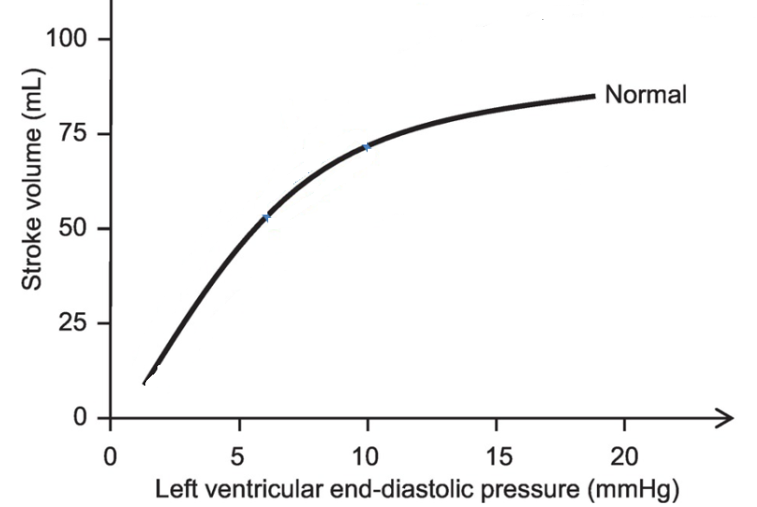
Frank starling mechanism

Slide 3
Frank – Starling Principle
The Frank–Starling law of the heart (also known as Starling's law and the Frank–Starling mechanism) represents the relationship between stroke volume and end diastolic pressure
This principle illustrates the relationship between cardiac output and left ventricular end diastolic volume
The law states that the stroke volume of the heart increases in response to an increase in the volume of blood in the ventricles, before contraction (the end diastolic volume), when all other factors remain constant.
As a larger volume of blood flows into the ventricle, the blood stretches the cardiac muscle fibers, leading to an increase in the force of contraction.
The Frank-Starling mechanism allows the cardiac output to be synchronized with the venous return, arterial blood supply
The physiological importance of the mechanism lies mainly in maintaining left and right ventricular output equality
If this mechanism did not exist and the right and left cardiac outputs were not equivalent, blood would accumulate in the pulmonary circulation (were the right ventricle producing more output than the left) or the systemic circulation (were the left ventricle producing more output than the right).

Slide 4
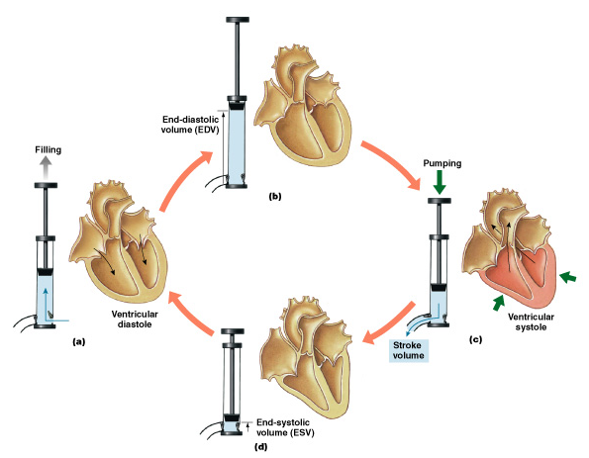
Frank – Starling Principle
Stroke Volume(SV)
End diastolic volume: volume: The amount of blood that remains in the ventricle just before ventricular early systole is the EDV
End systolic volume: The amount of blood that remains in the ventricle at the end of ventricular systole is the ESV
SV = EDV - ESV

Slide 5
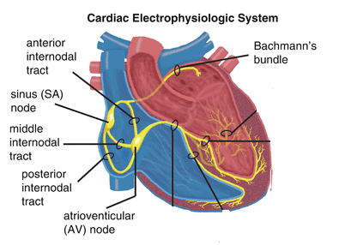
Conduction system or Electrophysiology system
SA node
Crescent shape structure ;Superior component of the right atrium just beneath the large vessel here called superior vena cava;
Sets the pace at around 60 to about 80 beats per minute (normal heartbeat) on its own without any extrinsic innervation and this is called sinus rhythm
Bachman's bundle
The electrical potential conducted from the right atrium by SA node to the left atrium through Bachman's bundle
Internodal pathway
This will supply all the other parts of the right atrium but eventually all this internodal pathways converge on this second important structure to the AV node
AV node
Runs from the actual right atrium to the interventricular septum so it is acting as a connection, the gateway between the atria and the ventricles because what happened is some potentials of Bachman's bundle can make their way over here to the AV node also
So, all the action potentials that are coming from the SA node that are being spread out to the internodal pathway or the Bachman's bundle are converging to the AV node

Slide 6
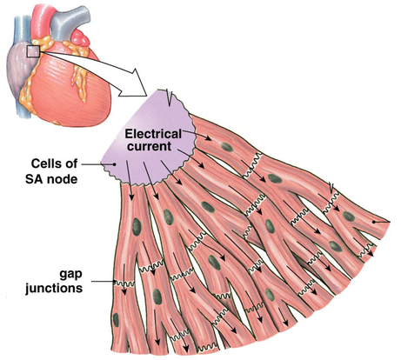
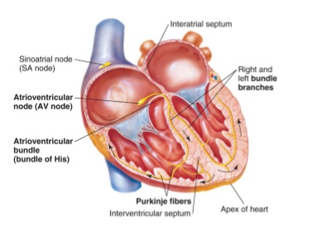
Conduction pathway
Once the AV node receives the signals it is going to take
From AV node it is going to move to bundle of his
Bundle of his to two bundle of branches( right bundle branch and left bundle branch)
From there to purkinje fibers

Slide 7
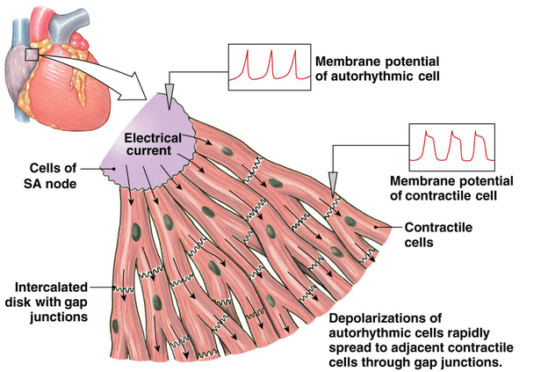
Intercalated disks
Desmosomes is basically acting like adhesion molecules from cell to cell and keeping the cells very tightly connecting and that’s really really important
This led us to concept whenever we have two cells communicating to each other and I have a combination of desmosomes and gap junctions they called together intercalated disks
Intercalated disks are basically a bunch of gap junctions and desmosomes connecting the actual cardiac cells together

