Slide 1
Breast Pathology I Benign & Non-neoplastic

Slide 2
Overview .. anatomy

Slide 3
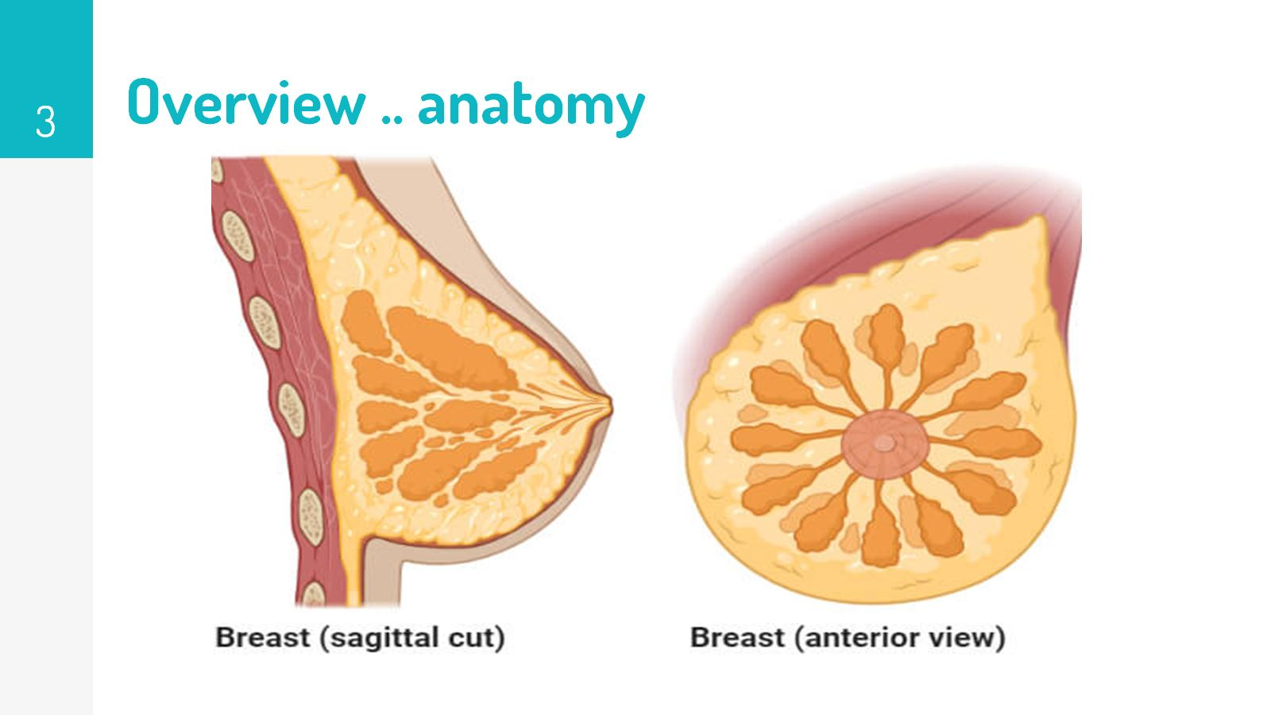
Overview .. anatomy

Slide 4
Overview .. histology

Slide 5
Overview .. histology

Slide 6
Clinical presentations of breast disease

Slide 7
Mammographic screening..

Slide 8
Mammographic screening

Slide 9
Age is important

Slide 10
Inflammatory Processes

Slide 11
Inflammatory Processes - Acute Mastitis

Slide 12
Inflammatory Processes - Acute Mastitis

Slide 13
Stromal neoplasms

Slide 14
Stromal neoplasms

Slide 15
Stromal neoplasms - Fibroadenomas

Slide 16
Stromal neoplasms - fibroadenomas

Slide 17
Stromal neoplasms - Phyllodes tumors

Slide 18
Stromal neoplasms - Phyllodes tumors

Slide 19
Benign epithelial lesions

Slide 20
Nonproliferative disease - fibrocystic changes

Slide 21
Nonproliferative disease - fibrocystic changes

Slide 22
Proliferative disease without atypia

Slide 23
Proliferative disease with atypia

