Slide 1
Rh ISO-Immunisation
|PRICE: 0.15|
Dr. Seham Abu fraijeh

Slide 2
Introduction
Rhesus (Rh) negative women who deliver an Rh positive baby or who are otherwise exposed to Rh positive red blood cells are at risk of developing anti-Rh antibodies.
Rh positive fetuses/neonates of these mothers are at risk of developing hemolytic disease of the fetus and newborn, which can be lethal or associated with serious morbidity.
Anti-D is the most commonly encountered antibody during pregnancy.
Before routine antenatal anti-D prophylaxis, late immunization during a first pregnancy was responsible for 18–27% of cases.
This rate fell to 2% with routine postpartum administration of a single dose of anti-D immune globulin and was further reduced to as low as 0.1 % with the addition of routine antenatal administration in the third trimester.
Immunisation during a second or subsequent pregnancy probably accounts for a similar proportion of cases, although it is often impossible to distinguish late sensitisation from failure of prophylaxis at the end of the preceding pregnancy

Slide 3
Rh system
Rh factor is a Protein (antigens) occurring only on surface of RBC’s.
Rh + if proteins present.
Rh – if proteins absent.
Possible blood groups (A+, A-, B+, B-, AB+, AB-, O+, O-)
Most important for pregnancy.
Inheritance is Autosomal Dominant.
15% Caucasian population are Rh negative.
Rh blood system has other antigens: C, c, D, E, e.
Weak D (Du) also exists.
RhD, C/c, and E/e antigens are the product two genes localized to the short arm of chromosome 1 .
D antigen is the most common, the only preventable one, and associated most commonly with severe haemolytic disease.
40% of Rh-positive individuals are homozygous at the D locus (DD); the remainder is heterozygous (Dd).

Slide 4
Why studying Rh Status is important?
Fetal RBC cross to maternal circulation
Maternal immune system recognizes foreign
antigens if fetus Rh + and mother Rh –
Antibodies are formed against fetal antigens
Subsequent pregnancy with Rh+ fetus,
immune system activated
and large amounts of Ab formed
IgG Ab cross placenta & attack fetal RBC
Fetal anemia, hydrops, etc

Slide 5
Pathogenesis
By 30 days of gestation, the Rh(D) antigen is expressed as part of the RBC membrane.
In most cases, the antigenic load of a putative antigen on the fetal RBCs is insufficient to stimulate the maternal immune system.
Transplacental fetomaternal bleeding accounts for virtually all cases of maternal Rh(D) alloimmunization. Other possible causes:
Injection with needles contaminated by Rh(D)-positive blood
Inadvertent transfusion of Rh(D)-positive blood
Tiny (0.1 mL) quantities of fetal RBCs gain access to the maternal circulation in nearly all pregnancies.

Slide 6
Pathogenesis
The frequency and volume of spontaneous fetomaternal hemorrhage increase with advancing gestational age and are highest at delivery.
Fetomaternal hemorrhage can also be associated with:
Miscarriage
Pregnancy termination
Ectopic pregnancy
Invasive in-utero procedures
Fetal death, aminosentesis
Maternal abdominal trauma
Antepartum maternal hemorrhage
External cephalic version.
لازم كلهم اعطيهم حتى لو معطيها من قبل anti d

Slide 7
Pathogenesis
In the case of a large fetomaternal hemorrhage before birth or at delivery, B lymphocyte clones that recognize the foreign red cell antigen are established.
The initial maternal production of IgM is short-lived and is followed by a rapid change to an IgG response. (A human antiglobulin titer can usually be detected by 5 to 16 weeks after the sensitizing event).
In a subsequent pregnancy, B lymphocyte stimulated by fetal erythrocytes, and differentiate into plasma cells that can rapidly proliferate and produce IgG antibodies and an increase in the maternal titer.
Maternal IgG crosses the placenta and attaches to fetal erythrocytes that have expressed the paternal antigen.

Slide 8
Pathogenesis
These cells are then sequestered by macrophages in the fetal spleen, where they undergo extravascular hemolysis, producing fetal anemia.
Enhanced bone marrow and fetal liver production of reticulocytes and erythroblasts, cardiac output increases. And HF
Hydrops fetalis (collection of fluid in at least two serous compartments , body cavity) typically heralds end-stage disease, and it occurs with hemoglobin deficits of 7 g/dL or greater.
The initial ultrasound finding of hydrops is usually fetal ascites, followed later by pleural effusion and finally scalp edema.

Slide 9
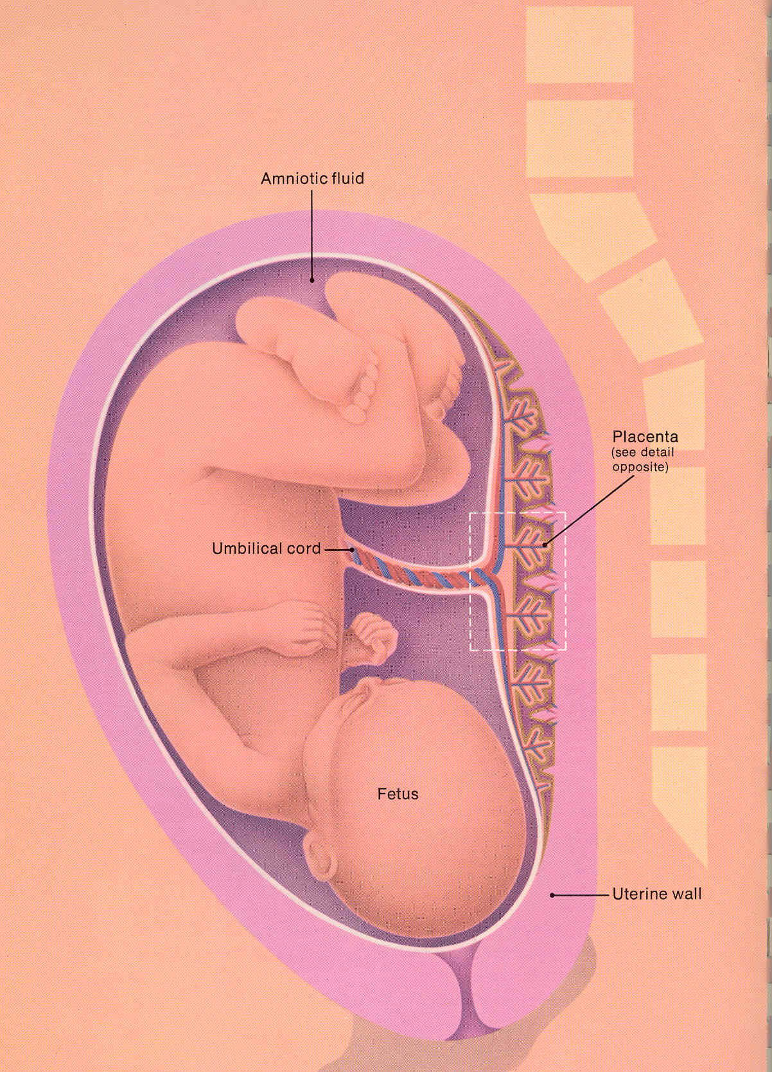

Slide 10
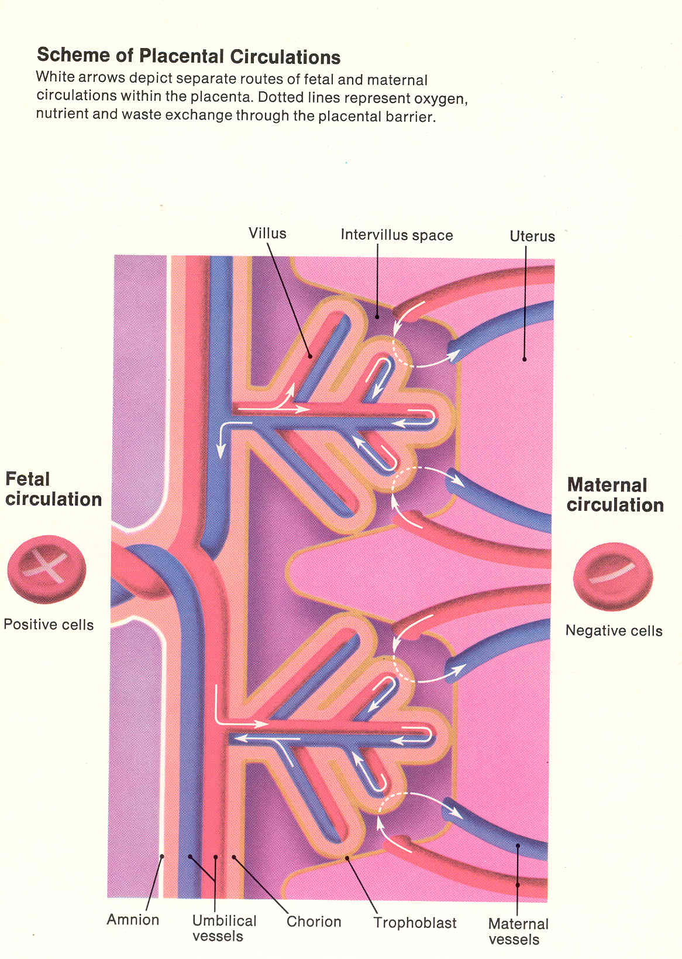

Slide 11
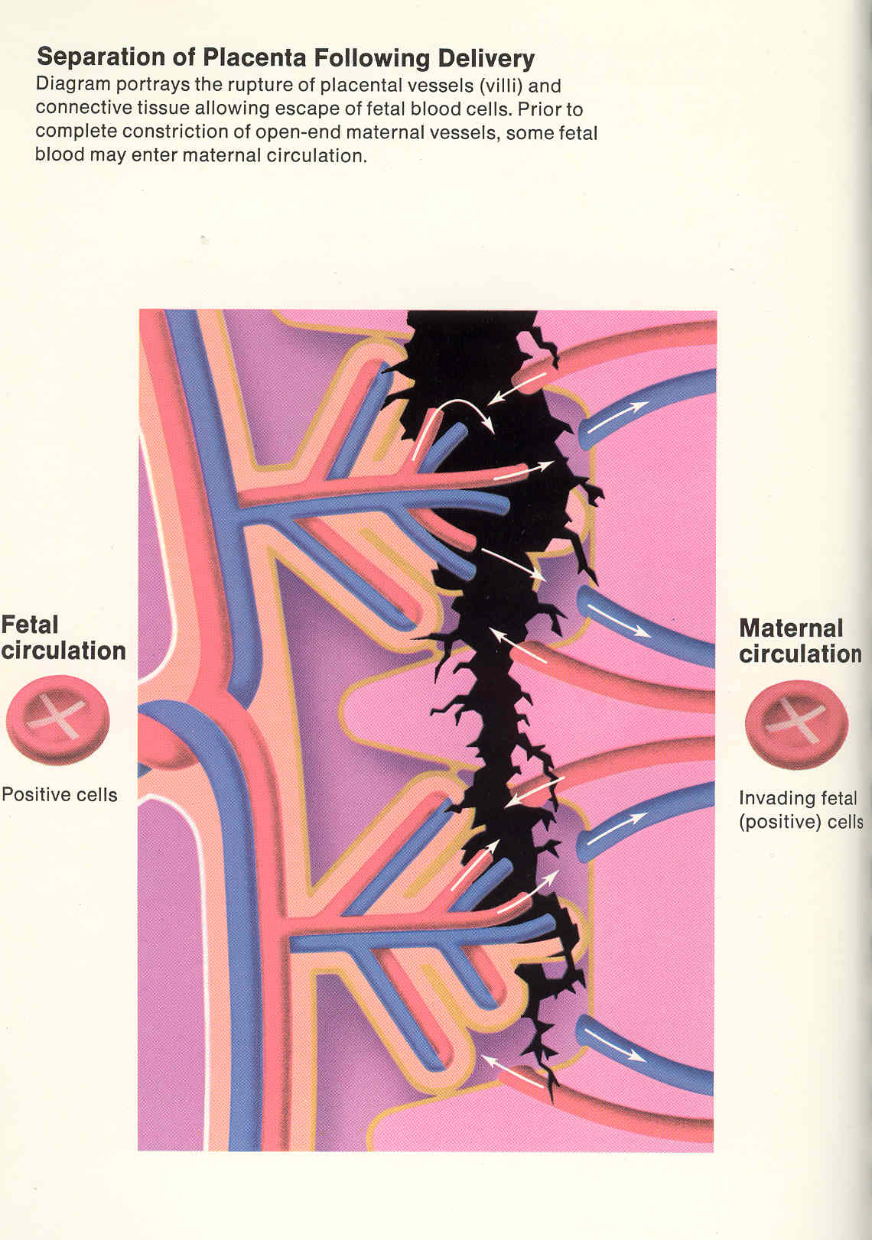

Slide 12
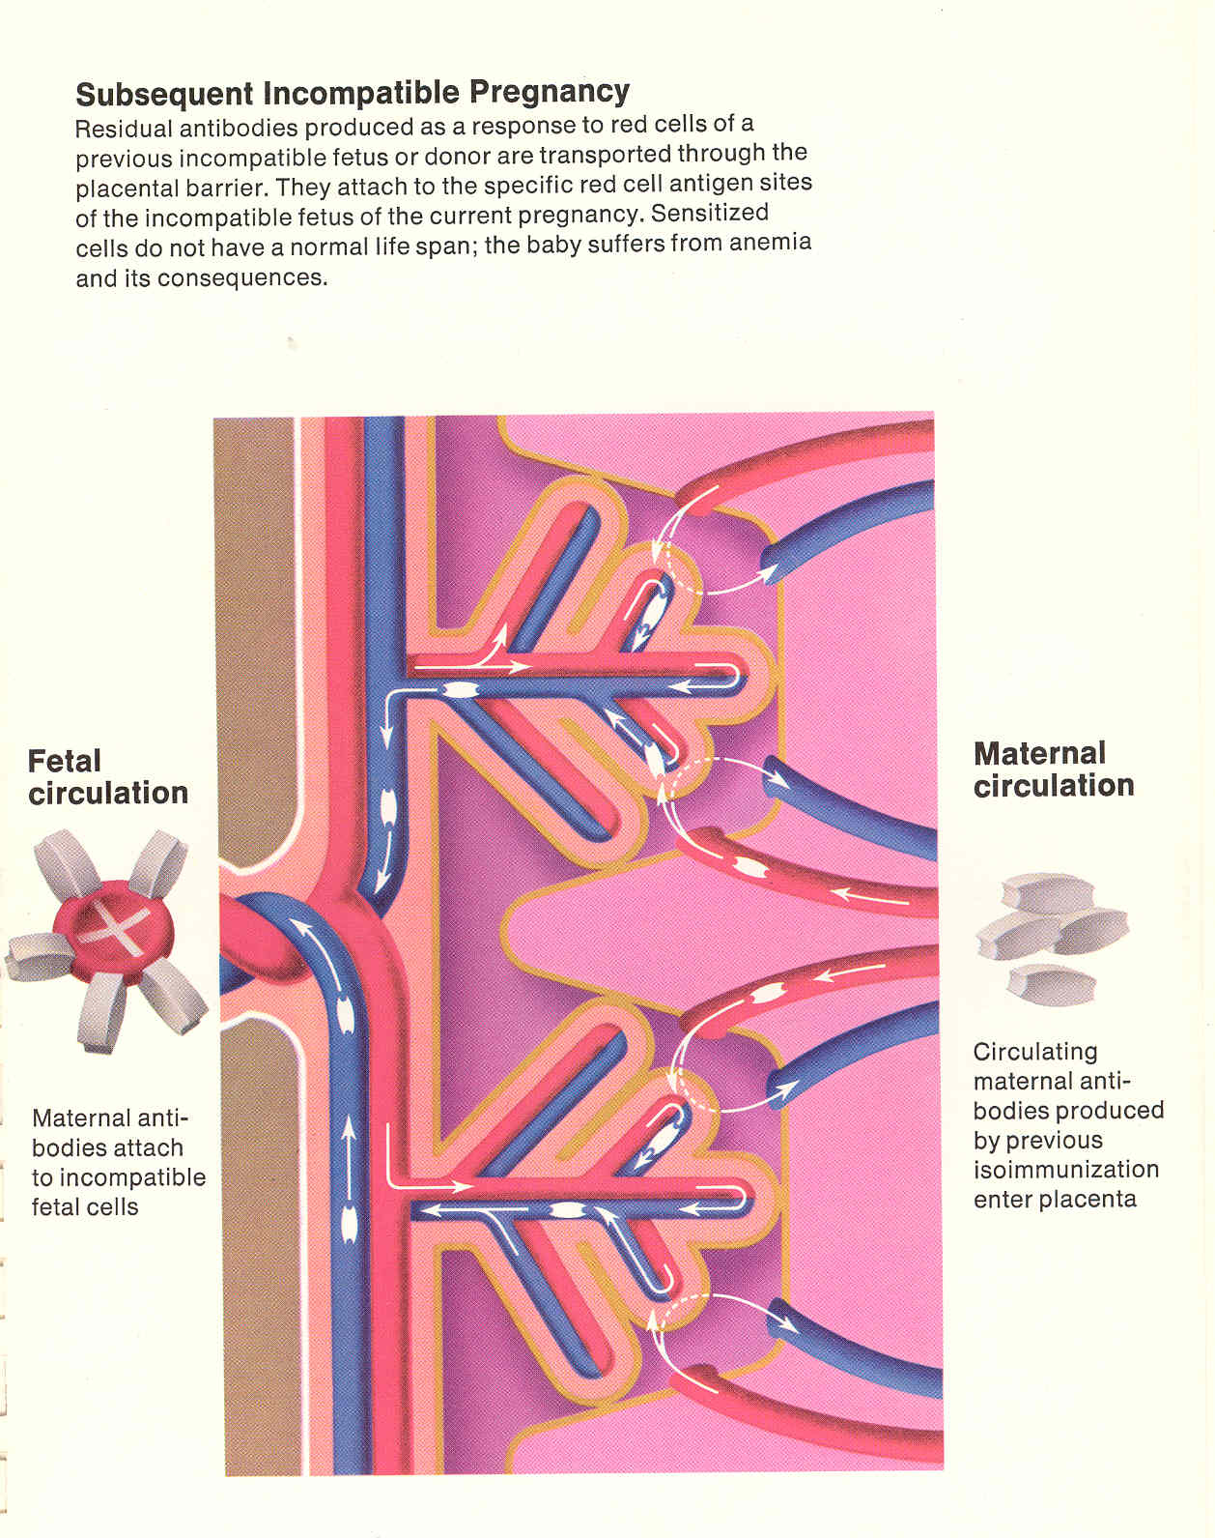

Slide 13
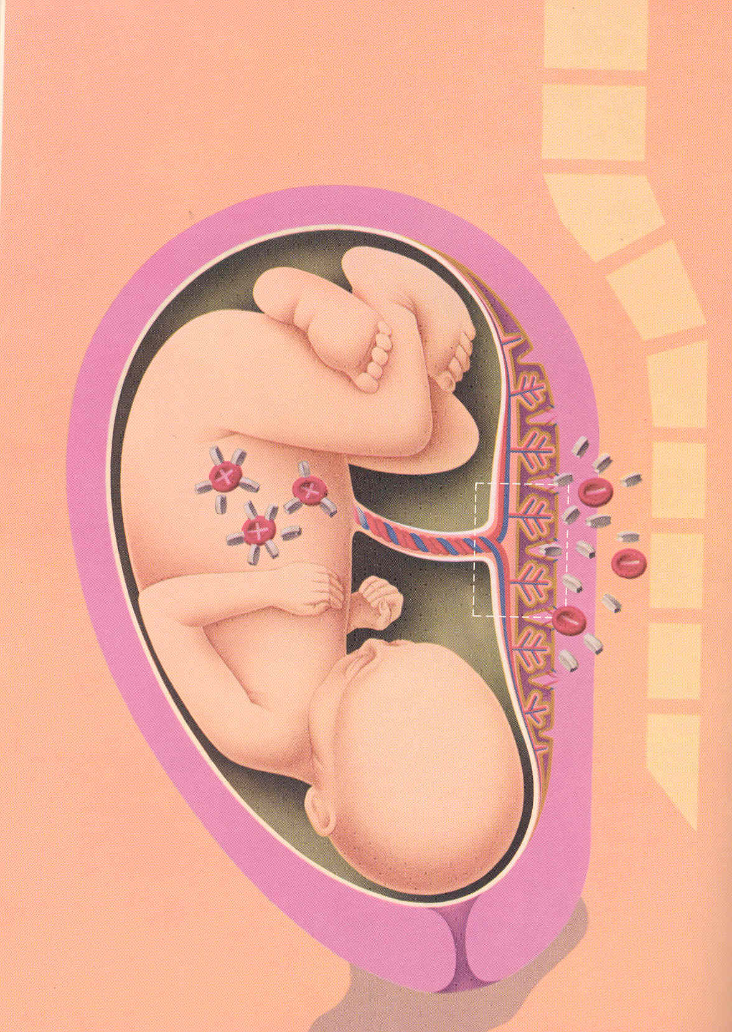

Slide 14
Diagnosis
Maternal Antibody Determination:
Rh(D) typing and an antibody screen should be performed at the first prenatal visit.
Test husband for Rh(D) type and, if Rh(D)-positive, zygosity is determined by Quantitative polymerase chain reaction (PCR) DNA testing.
If an antibody is detected, it is first identified to determine its clinical significance. Then human antiglobulin titer (indirect Coombs ICT) is used to determine the degree of alloimmunization, because it measures the maternal IgG response.
If negative antibody screen and uncomplicated pregnancy, repeat at 28 weeks of gestation.
A critical titer is defined as the titer associated with a significant risk for fetal hydrops. This titer varies with the institution and the methodologies used; however, most centers use a critical value for anti-D, and most other antibodies, of 32 (value of 15 IU/mL).

Slide 15
Diagnosis
Fetal Genotype Testing:
Cell free fetal DNA (cffDNA) may be detected in the maternal circulation as early as 38 days of gestation.
the amount of DNA increases with advancing gestational age and disappears soon after delivery.
Fetal Rh(D) status can be determined by evaluation of cffDNA sequences in maternal plasma using a reverse transcriptase PCR.
cffDNA testing to determine the fetal antigen status is available in Europe for the C, c, E, and Kell (K1) antigens.
If cffDNA testing is not available, then amniocentesis can be performed at 15 weeks of gestation to obtain amniocytes.
Transplacental amniocentesis , uis avoided, if possible, as it may worsen alloimmunization.

Slide 16
Management
First alloimmunized pregnancy with Rh(D) positive fetus:
fetal effects is less sever in the first affected pregnancy, and worsen with each subsequent affected pregnancy.
serial antibody titers are determined every 2-4 weeks after 20 weeks.
If the critical titer is reached or exceeded, then further assessment to determine whether sever fetal anemia is present is required and checking maternal titers can be discontinued.
Subsequent pregnancies with Rh(D) positive fetus:
If the patient has had a prior significantly affected pregnancy, then sever fetal anemia, in subsequent pregnancies with an Rh(D)-positive fetus is almost certain.
The severity of fetal anemia is assessed beginning at 16 -18 weeks of gestation and maternal antibody titers are not routinely evaluated, as they do not reliably predict the severity of fetal anemia.

Slide 17
Assessment for severity of fetal anemia
Measurement of the peak systolic velocity (PSV) in the fetal middle cerebral artery (MCA) has been shown to be an accurate noninvasive method for detecting fetal anemia.
MCA-PSV increases with advancing gestation, and values should be reported in MoM to account for changes in gestational age.
A threshold value of 1.5 MoM was used to predict moderate to severe anemia (<0.65 MoM for fetal hemoglobin).
The fetus should be in a quiescent state during examination, as accelerations of the fetal heart rate can result in a false depression in the MCA-PSV, especially late in the third trimester.
Measurements can be initiated at as early as 16 to 18 weeks gestation and should be performed weekly.

Slide 18
Middle Cerebral Artery Doppler

Slide 19
Middle Cerebral Artery Doppler

Slide 20
Middle cerebral artery doppler

Slide 21
Other methods to assess fetal anemia
Spectral analysis of amniotic fluid :
In the past, amniocentesis to determine amniotic fluid bilirubin levels was the usual method for indirectly estimating the severity of fetal anemia.
Bilirubin present in amniotic fluid derives from fetal pulmonary and tracheal effluents and correlates with the degree of fetal hemolysis.
Doppler velocimetry is as, or more, sensitive and specific for detection of severe fetal anemia and noninvasive.
Fetal blood sampling:
Fetal blood sampling allows direct access to the fetal circulation to study hematocrit, direct Coombs, fetal blood type, reticulocyte count, and platelet count.
Reserved for patients with increased MCA-PSV.
Can be followed by intrauterine transfusion.

Slide 22
Intrauterine transfusion
Severe fetal anemia can be defined as a hematocrit of 30 % or 2 SDs below the mean hematocrit for the gestational age.
Intrauterine transfusions for severe fetal anemia are generally performed between 18 and 35 weeks of gestation.
Intrauterine transfusions can be performed via 2 methods:
Intravascular transfusion(cord insertion into the placenta, intrahepatic vein, direct cardiac puncture).
Intraperitoneal transfusion.
Red cells to be used for IUT should be:
CMV seronegative.
The unit should be packed to a final hematocrit of 75% to 85%.
The leukocyte number reduced using specialized micropore filters.
The unit irradiated with 25 Gy to prevent graft-versus-host reaction.

Slide 23
Time of delivery
Until the introduction of the direct Intravascular transfusion, fetuses with hemolytic disease were routinely delivered by 32 weeks gestation.
Most experienced centers now perform the final IUT at up to 35 weeks gestation, with delivery anticipated at 37 to 38 weeks.
After 35 weeks, the procedure is generally considered riskier than late preterm delivery for neonatal treatment of severe anemia.
The administration of maternal oral phenobarbital may be considered 7 -10 days before delivery.
(This has been proposed to induce hepatic maturity to allow improved conjugation of bilirubin)

Slide 24
Prevention
Anti-D immune globulin:
Is a sterile solution containing IgG anti-D (anti-Rh) manufactured from human plasma.
A single 300 microgram dose (1 microgram = 5 IU) contains sufficient anti-D to suppress the immune response to 15 mL of Rh-positive red blood cells 30 mL fetal whole blood.
A single 50 microgram dose contains sufficient anti-D to suppress the immune response to 2.5 mL of Rh-positive red blood cells.
Formulations (RhoGAM, HyperRHO S/D, Rhophlac, WinRho-SDF).
Anti-D immune globulin is not effective once alloimmunization to the Rh(D) antigen has occurred.

Slide 25
Prevention
Indications for administration of anti-(D) immune globulin:
At 28 weeks of gestation
Spontaneous abortion, threatened abortion, induced abortion
Ectopic pregnancy
Invasive procedures: genetic amniocentesis; chorionic villus sampling; multi-fetal reduction; fetal blood sampling
Hydatidiform mole
Fetal death in the second or third trimester
Blunt trauma to the abdomen
Antepartum hemorrhage in the second or third trimester (eg, placenta previa or abruption)
External cephalic version

Slide 26
Prevention
Administration:
All pregnant patients should undergo an antibody screen at the first prenatal visit.
If there is no evidence of alloimmunization in the RhD-negative woman, patients should receive 300 µg of RhIG at 28 weeks gestation.
A dose of 50 µg of RhIG is effective until 12 weeks gestation because of the small volume of red cells in the fetoplacental circulation.
300 µg of RhIG should be administered within 72 hours of delivery, if umbilical cord blood typing reveals an RhD-positive infant.
If RhIG is inadvertently omitted after delivery, some protection has been proven with administration within 13 days; recommendations have been made to administer it as late as 28 days after delivery.
This dose of immune globulin is adequate to protect against maternal sensitization from as much as 15 mL red blood cells (30 mL Rh(D)-positive fetal whole blood).

Slide 27
Screening for Feto-Maternal Hemorrhage(FMH)
Approximately 3/1000 deliveries are associated with an excessive FMH.
Up to 50% of large FMHs occur after normal deliveries.
The following clinical circumstances are more likely to be associated with large FMH:
a- Traumatic deliveries &CS
b-Manual removal of placenta
c-Stillbirths & IUD
d-Abdominal trauma during 3rd trimester
e-Twin pregnancies
f-Unexplained hydrops fetalis

Slide 28
Screening for Feto-Maternal Hemorrhage (FMH)
Rosette test :
A qualitative test (usually performed first).
Results are reported as positive or negative.
Fetal RBCs suspension incubated with IgG anti-D , then washed to remove unbouned anti-D, agglutination will happened ,and according to the number of agglutinations the test designated as positive or negative.
Kleihauer-Betke test:
Fetal RBC contain Hb F, which is resistant to acid elution than Hb A.
After exposure to acid, only fetal cells remain & can be identified with stain.
Evaluate the percentage of fetal cells in maternal circulation.

