Slide 1
THE KIDNEYS & URETERS
Dr. Aiman Qais Afar
Surgical Anatomist
College of Medicine / University of Mutah
2022-2023

Slide 2
KIDNEYS
The ovoid kidneys remove excess water, salts, and wastes of protein metabolism from the blood while returning nutrients and chemicals to the blood.
They lie retroperitoneally on the posterior abdominal wall, one on each side of the vertebral column at the level of the T11-L3 vertebrae
They are largely under cover of the costal margin

Slide 3
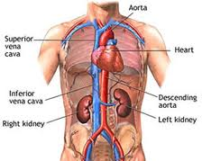
KIDNEYS
The right kidney lies slightly lower than the left kidney because of the large size of the right lobe of the liver.
With contraction of the diaphragm during respiration, both kidneys move downward in a vertical direction by as much as 1 in. (2.5 cm).
On the medial concave border of each kidney is a vertical slit that is bounded by thick lips of renal substance and is called the hilum

Slide 4
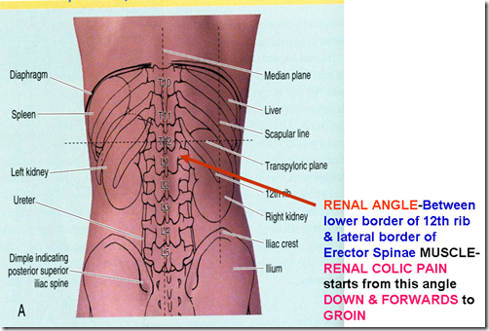
KIDNEYS
The hilum of the left kidney lies near the transpyloric plane, approximately 5 cm from the median plane
The transpyloric plane passes through the superior pole of the right kidney
During life, the kidneys are reddish brown and measure approximately 12cm in length, 6cm in width, and 3cm in thickness.

Slide 5
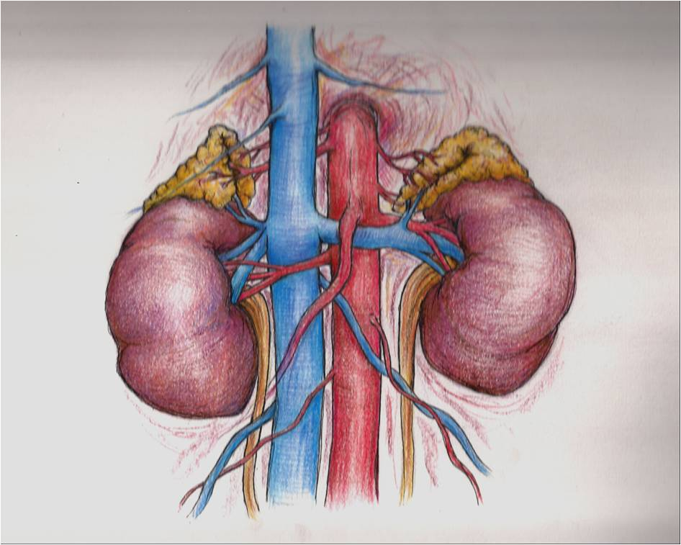
KIDNEYS
The hilum extends into a large cavity called the renal sinus.
The hilum transmits, from the front backward :
The renal vein
Two branches of the renal artery,
The ureter
Third branch of the renal artery (VAUA).
Lymph vessels and sympathetic fibers also pass through the hilum.

Slide 6
Kidneys
The kidneys have the following coverings:
Fibrous capsule : This is closely applied to its outer surface.
Perirenal fat: This is fat that covers the fibrous capsule
Renal fascia: This is a condensation of areolar tissue outside the perirenal fat. It encloses the kidneys and the suprarenal glands.
Pararenal fat: This is external to the renal fascia and is often large in amount
Perirenal fat
Fibrous capsule
Pararenal fat
Renal fascia

Slide 7
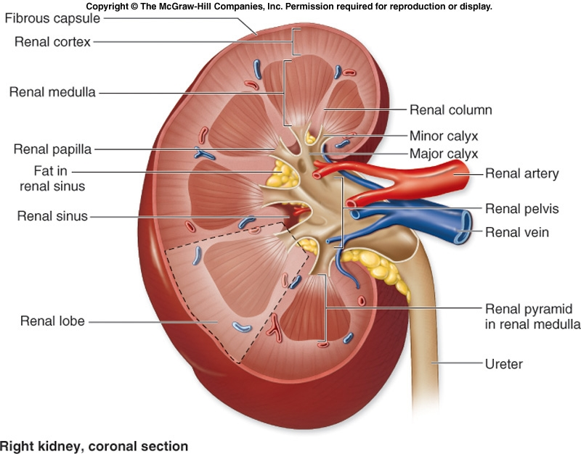
KIDNEYS
Renal Structure
Each kidney has a dark brown outer cortex and a light brown inner medulla.
The medulla is composed of about a dozen renal pyramids, each having its base oriented toward the cortex and its apex, (the renal papilla), projecting medially.

Slide 8
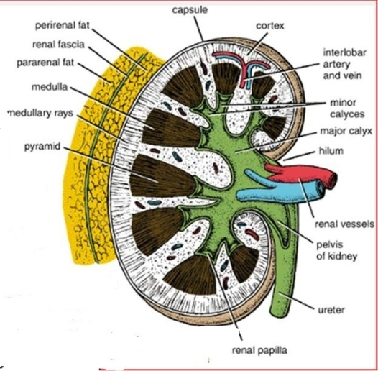
KIDNEYS
The cortex :
Extends into the medulla between adjacent pyramids as the renal columns.
Extending from the bases of the renal pyramids into the cortex are striations known as medullary rays

Slide 9
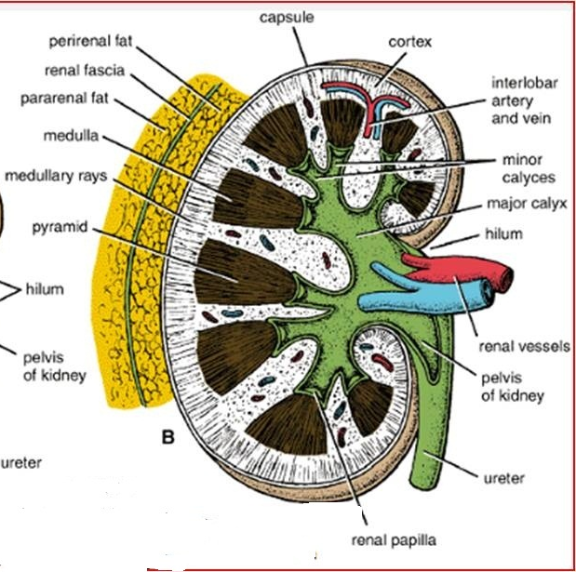
KIDNEYS
The renal sinus, which is the space within the hilum, contains the upper expanded end of the ureter, the renal pelvis.
This divides into two or three major calyces, each of which divides into two or three minor calyces
Each minor calyx is indented by the apex of the renal pyramid, the renal papilla.

Slide 10
KIDNEYS
Important Relations, Right Kidney:
Anteriorly: The suprarenal gland, the liver, the second part of the duodenum, and the right colic flexure

Slide 11
KIDNEYS
Posteriorly
The diaphragm;
The costodiaphragmatic recess of the pleura
The 12th rib
The psoas
Quadratus lumborum
Transversus abdominis muscles.
The subcostal (T12), iliohypogastric, and ilioinguinal nerves (L1) run downward and laterally

Slide 12
KIDNEYS
Important Relations, Left Kidney
Anteriorly: The suprarenal gland, the spleen, the stomach, the pancreas, the left colic flexure, and coils of jejunum

Slide 13
KIDNEYS
Posteriorly:
The diaphragm
The costodiaphragmatic recess of the pleura
The 11th (the left kidney is higher) and 12th rib
The psoas,
Quadratus lumborum
Transversus abdominis muscles.
The subcostal (T12), iliohypogastric, and ilioinguinal nerves (L1) run downward and laterally

Slide 14
KIDNEYS
Blood Supply
Arteries
The renal arteries arise at the level of the IV disc between the L1 and L2 vertebrae
The longer right renal artery passes posterior to the IVC.
Typically, each artery divides close to the hilum into five segmental arteries that are end arteries

Slide 15
KIDNEYS
Each renal artery usually divides into five segmental arteries that enter the hilum of the kidney.
They are distributed to different segments or areas of the kidney.

Slide 16
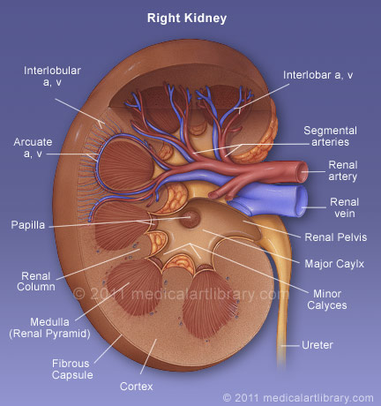
KIDNEYS
Lobar arteries arise from each segmental artery, one for each renal pyramid.
Before entering the renal substance, each lobar artery gives off two or three interlobar arteries
The interlobar arteries run toward the cortex on each side of the renal pyramid.

Slide 17
KIDNEYS
At the junction of the cortex and the medulla, the interlobar arteries give off the arcuate arteries, which arch over the bases of the pyramids
The arcuate arteries give off several interlobular arteries that ascend in the cortex.
The afferent glomerular arterioles arise as branches of the interlobular arteries

Slide 18
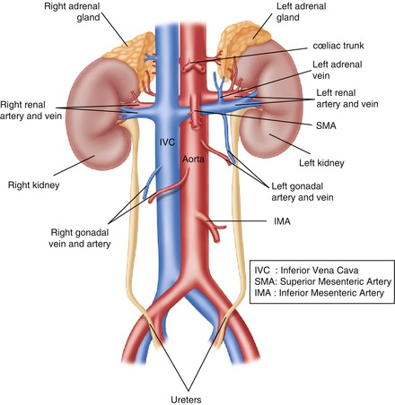
KIDNEYS
Veins
The renal vein emerges from the hilum in front of the renal artery and drains into the inferior vena cava.
Nerve Supply
The nerve supply is the renal sympathetic plexus.
The afferent fibers that travel through the renal plexus enter the spinal cord in the 10th, 11th, and 12th thoracic nerves.

Slide 19
KIDNEYS
Lymph Drainage
Lymph drains to the lateral aortic lymph nodes around the origin of the renal artery
& Lumbar (aoratic and caval) lymph node

Slide 20
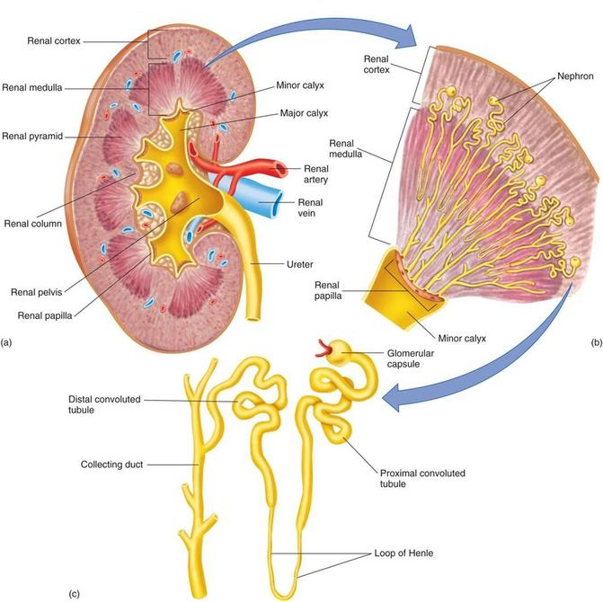

Slide 21
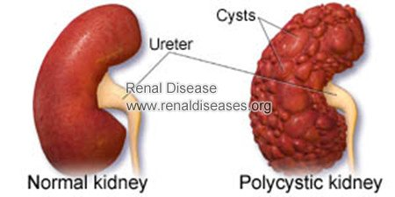
Renal Cysts
Cysts in the kidney, multiple or solitary, are common findings during ultrasound examinations and dissection of cadavers. Adult polycystic disease of the kidneys is an important cause of renal failure;

Slide 22
Renal Vein Entrapment Syndrome
In crossing the midline to reach the IVC, the longer left renal vein traverses an acute angle between the SMA anteriorly and the abdominal aorta posteriorly (and perhaps the third part of the duodenum) resulting in a renal vein entrapment syndrome also known as “nutcracker syndrome”.
left testicular pain in men (related to the left testicular vein draining into the left renal vein proximal to the compression).

Slide 23
Renal and Ureteric Calculi
Calculi are composed of salts of inorganic or organic acids or of other materials. They may form and become located in the calices of the kidneys, ureters, or urinary bladder
A renal calculus (kidney stone) may pass from the kidney into the renal pelvis and then into the ureter.

Slide 24
Congenital Anomalies of Kidneys
Bifid renal pelvis and ureter are fairly common. The bifid renal pelvis and/or ureter may be unilateral or bilateral; however, separate openings into the bladder are uncommon.
An uncommon anomaly is a retrocaval ureter , which leaves the kidney and passes posterior to the IVC.
The kidneys are close together in the embryonic pelvis. the inferior poles (rarely, the superior poles) of the kidneys fuse to form a horseshoe kidney

Slide 25
Congenital Anomalies of Kidneys
This U-shaped kidney usually lies at the level of L3-L5 vertebrae because the root of the inferior mesenteric artery prevented normal relocation of the kidneys.
Horseshoe kidney usually produces no symptoms; however, associated abnormalities of the kidney and renal pelvis may be present, obstructing the ureter.
Awareness of the possibility of an ectopic pelvic kidney should prevent it from being mistaken for a pelvic tumor and removed.

Slide 26
Ureter
The two ureters are muscular tubes that extend from the kidneys to the posterior surface of the urinary bladder
The urine is propelled along the ureter by peristaltic contractions of the muscle coat, assisted by the filtration pressure of the glomeruli.

Slide 27
Ureter
Each ureter measures about 10 in. (25 cm) long and resembles the esophagus (also 10 in. long) in having three constrictions along its course:
where the renal pelvis joins the ureter in the abdomen,
where it is kinked as it crosses the pelvic brim to enter the pelvis.
where it pierces the bladder wall.

Slide 28
Ureter
The renal pelvis is the funnel-shaped expanded upper end of the ureter.
It lies within the hilum of the kidney and receives the major calyces.
The ureter emerges from the hilum of the kidney and runs vertically downward behind the parietal peritoneum (adherent to it) on the psoas muscle, which separates it from the tips of the transverse processes of the lumbar vertebrae.

Slide 29
Ureter
It enters the pelvis by crossing the bifurcation of the common iliac artery in front of the sacroiliac joint
The ureter then runs down the lateral wall of the pelvis to the region of the ischial spine in front of the internal iliac artery and turns forward to enter the lateral angle of the bladder.

Slide 30
Ureter
The ureter passes obliquely through the wall of the bladder for about 0.75 in. (1.9 cm) before opening into the bladder
Near its termination, it is crossed by the vas deferens.

Slide 31
Ureter
Relations, Right Ureter
Anteriorly: The duodenum, the terminal part of the ileum, the right colic and ileocolic vessels, the right testicular or ovarian vessels, and the root of the mesentery of the small intestine
Posteriorly: The right psoas muscle, which separates it from the lumbar transverse processes, and the bifurcation of the right common iliac artery

Slide 32
Ureter
Relations, Left Ureter
Anteriorly: The sigmoid colon and sigmoid mesocolon, the left colic vessels, and the left testicular or ovarian vessels
Posteriorly: The left psoas muscle, which separates it from the lumbar transverse processes, and the bifurcation of the left common iliac artery

Slide 33
Ureter
Blood Supply ::: Arteries
As follows: upper end, the renal artery
middle portion, the testicular or ovarian artery
in the pelvis, the superior vesical artery
Veins
Venous blood drains into veins that correspond to the arteries.

Slide 34
Ureter
Lymph Drainage
The lymph drains to the lateral aortic nodes and the iliac nodes.
Nerve Supply
The nerve supply is the renal, testicular (or ovarian), and hypogastric plexuses (in the pelvis). Afferent fibers travel with the sympathetic nerves and enter the spinal cord in the first and second lumbar segments

Slide 35
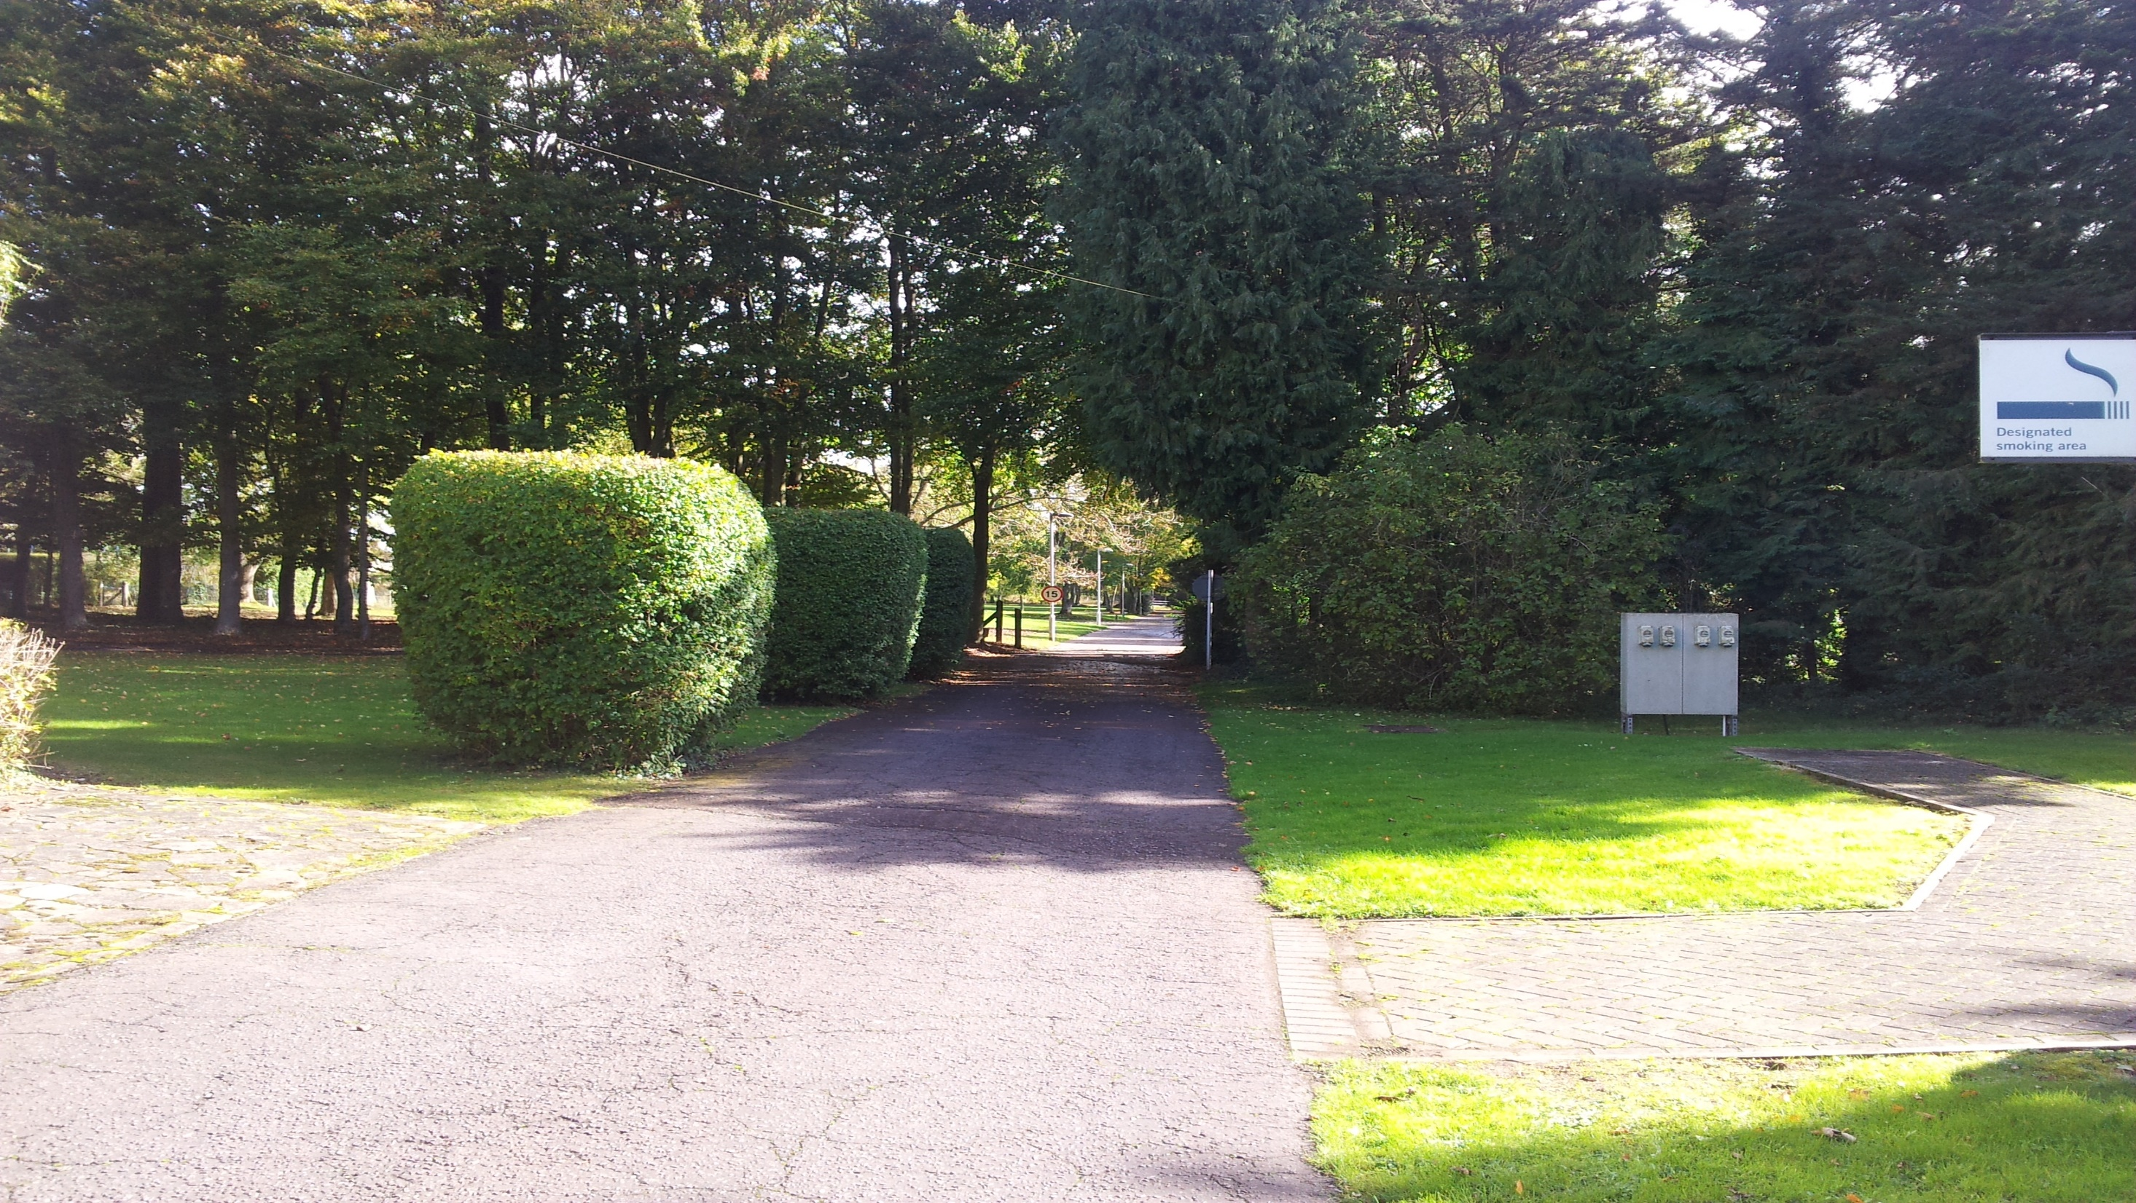
Dr. Aiman Qais Afar
Wednesday 3 May 2023

