Slide 1
وسهلا
أهلا
الأستاذ الدكتور/ يوسف حسين
أستاذ التشريح وعلم الأجنة
كلية الطب – جامعة الزقازيق- مصر
كلية الطب-جامعة مؤتة-الأردن
دكتوراة من جامعة كولونيا المانيا

Slide 2
Development of female
genital system

Slide 3
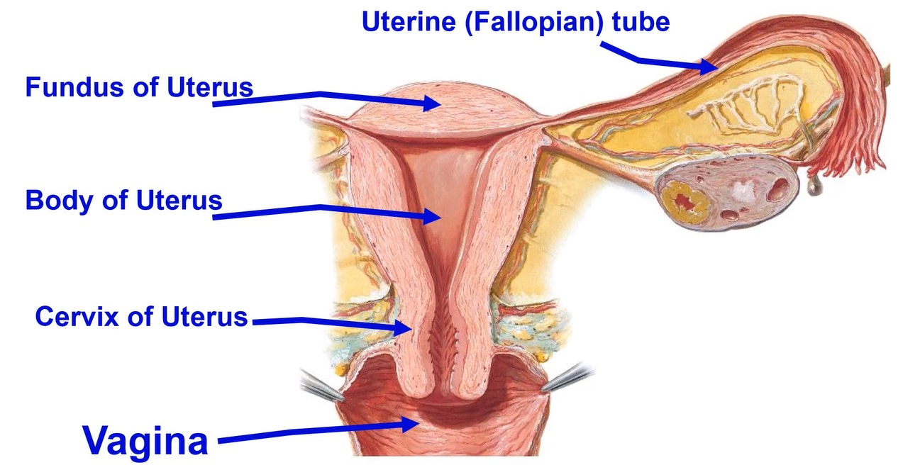

Slide 4
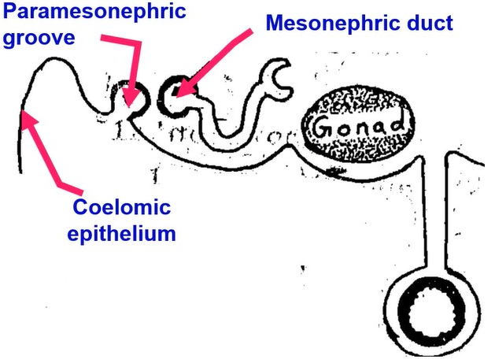
• Development paramesonephric
•(Mullerian duct)
• Indifferentiation Stage:
(in male and female embryos)
* Paramesonephric groove developed from coelomic epithelium covering intermediate mesoderm, lateral to mesonephric duct (Wolffian duct).
* This groove transformed into paramesonephric duct (Mullerian duct).

Slide 5
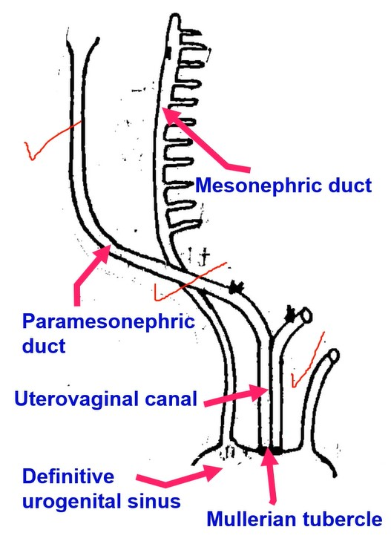
• The cranial end of each paramesonephric duct opens into the peritoneal (coelomic) cavity.
• Caudal end remains blind.
• After lateral folding of the embryo the duct crosses ventral to mesonephric duct till reaching the back of the definitive urogenital sinus.
** Paramesonephric duct is now formed of 3 parts:
1- Cranial vertical part: lateral to mesonephric duct.
2- Intermediate transverse part: ventral to duct.
3- Caudal vertical part: medial to duct.
- The caudal parts of 2 ducts unite with each other forming the uterovaginal canal, separated by septum.
- The tip of the caudal end of the uterovaginal canal project into the posterior wall of the definitive urogenital sinus producing an elevation called Mullerian tubercle.

Slide 6
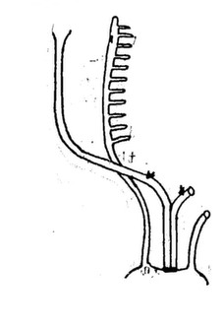
1- Development of uterine (Fallopian) tubes from cranial vertical part.
2- Development of the uterus from horizontal part of 2 paramesonephric ducts and cranial part of the uterovaginal canal after degeneration of the septum.
3- Development of the vagina:
• Upper 4/5 from the caudal part of uterovaginal canal (mesodermal).
• The lower 1/5 from the definitive urogenital sinus (endodermal).
N.B; The muscles formed from the mesoderm of the genital ridge.
• Development of the hymen
- It is a thin membrane separate definitive urogenital sinus from uterovaginal canal
- Hymen about 1.5 cm from the opening of vagina.
- The central part of the hymen degenerate forming an opening.
• Variations of the hymen;
1- Thin membrane with central opening. 2- Ring.
3- Semilunar. 4- Cribriform. 5- Completely absent. 6- Imperforate.

Slide 7
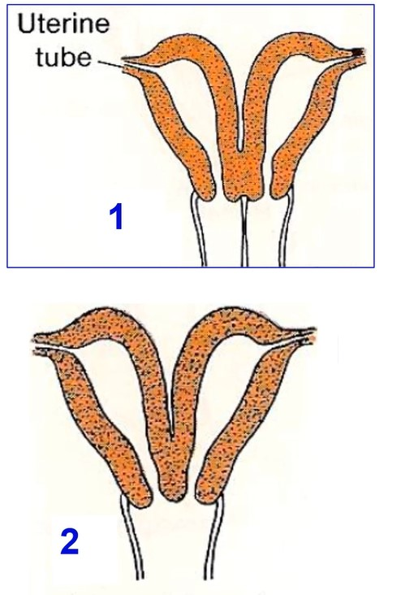
Congenital anomalies of the uterus
1- Uterus didelphys:
- Uterus with 2 bodies, 2 cervices and double vagina.
- It occurs due to complete failure of degeneration of the uterovaginal septum.
2- Uterus bicornis bicollis
(cornis= horn=cavity) (collis=cervix):
- Uterus with 2 bodies, 2 cervices and one vagina.
- It occurs due to incomplete degeneration of the uterovaginal septum.

Slide 8
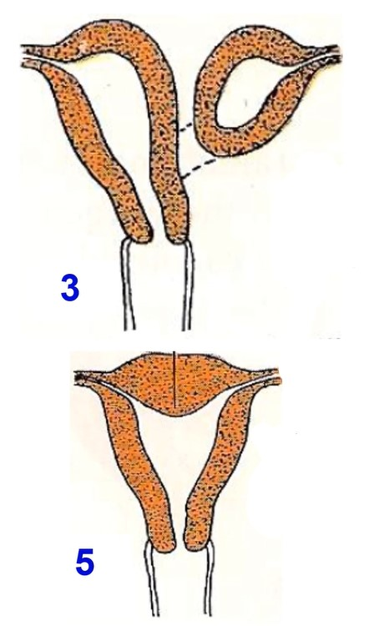
Congenital anomalies of the uterus
3- Uterus bicornis unicollis
- Uterus with 2 bodies and one cervix.
4- Uterus unicornis with rudimentary horn, failure of development of one para-mesonephric duct.
5- Uterus arcuatus: uterus with a depressed fundus.

Slide 10
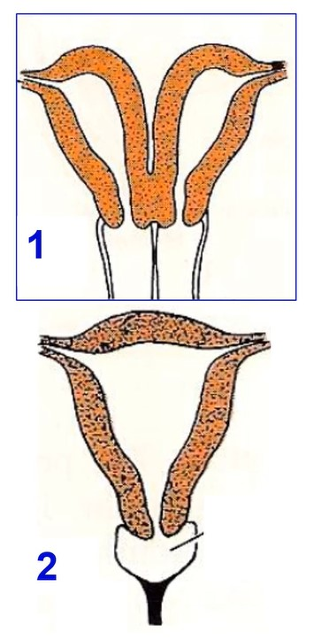
Congenital anomalies of the vagina
1- Double vagina:
- It occurs due to complete failure of degeneration of the uterovaginal septum.
2- Atresia of the vagina: failure of canalization.
3- Imperforate hymen: occurs due to failure of breakdown of the hymen. It leads to collection of the blood in the vagina and uterus after puberty.

Slide 11
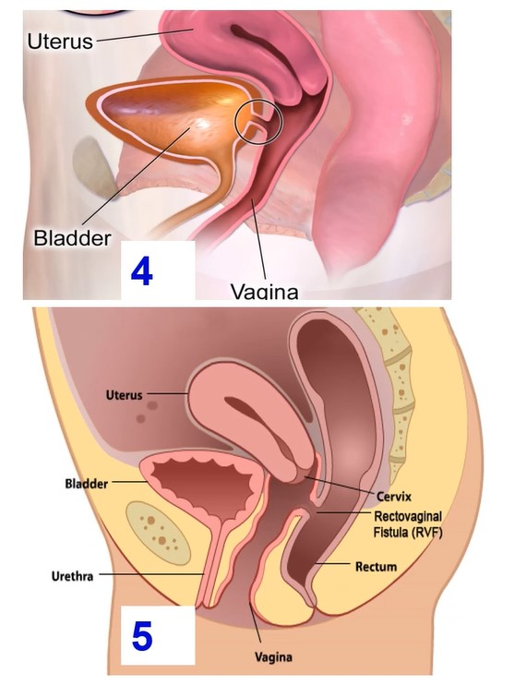
Congenital anomalies of the vagina
4- Vesicovaginal fistula: connection between vagina & urinary baldder
5- Rectovaginal fistula: connection between vagina & rectum

Slide 12
Paramesonephric duct in male

Slide 13
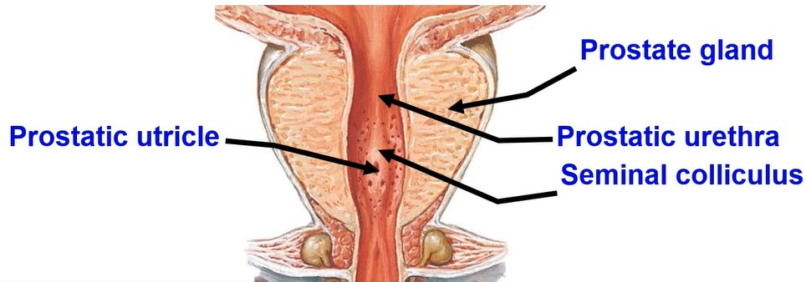
A- In male:
- The paramesonephric duct disappears leaving remnants
a. The cranial part forms the appendix of the testis.
b. The uterovaginal canal forms the prostatic utricle.
c. The Mullerian tubercle forms the seminal colliculus.

Slide 14
Development of gonads
(Testis & Ovary)

Slide 15
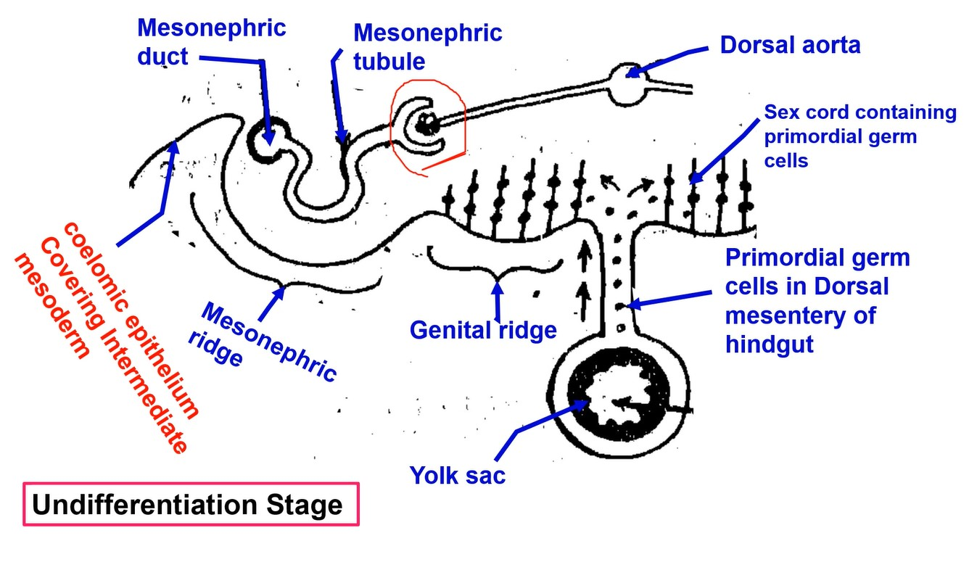

Slide 16
• DEVELOPMENT OF THE GONADS
* The gonads, in both sexes, pass into 2 stages of development:
A- Undifferentiation Stage:
* In the first stage of gonadal development, it is impossible to distinguish between testis and ovary.
• Paired Genital ridges arise from the coelomic epithelium covering intermediate mesoderm medial to the mesonephric ridge, (on each side).
• In the 4th week, primordial germ cells begins to migrate from the endoderm lining yolk sac to the genital ridges via dorsal mesentery of hindgut.
• Simultaneously, the epithelium of genital ridge proliferate and form sex cords opposite the middle part of the mesonephric tubules

Slide 17
Development of Testis

Slide 19
• DEVELOPMENT OF THE TESTIS
* At the 6th week of intrauterine life under the effect of Y-chromosome that has testis detecting factor (SRY gene (Sex-determing region Y protein).
* The sex cords will be separated from genital ridge by a fibrous capsule (tunica albuginea).
* The tunica albuginea send connective tissue septa dividing the testis into 200-300 compartments.
* Each compartment contains 2-3 cords.
* The septa fuse at the dorsal border of the testis to form the mediastinum testis.
* The sex cords communicate with each other at mediastinum testis forming rete testis.
* The sex cords canalize to form seminiferous tubules.
* The rete testis will be canalized forming straight tubules.
* These straight tubules will join with the vasa efferentia (remnant of middle of mesonephric tubule).

Slide 20
• Descent of the Testis
• Aim of descend: Because the process of spermatogenesis requires degree of temperature lower than that of the abdomen.
• The testes descend into the scrotum by age 3 months of pregnancy, In most cases, the testes pass down by age 6 months without any treatment.
• Factors controlling the descent:
• Gubernaculum (after mesonephros has atrophied) Cranially it has its origin at the testis and inserts in the region of the genital swelling (future scrotum).
• Formation of the processes vaginalis on which testes will slide through inguinal canal.
• Human chorionic gonadotrophin hormone from placenta, testosterone and Anti Mullerin Hormone.
• Increasing intra-abdominal pressure due to organ growth.
• Developing of the cells:
1- Primordial germ cells give the spermatogonia.
2- Coelomic epithelium gives rise the supporting cells of Sertoli.
3- Mesenchymal cells, give rise the interstitial cells of Leydig.

Slide 21
• Congenital anomalies of the Testis:
1- Agenesis of one or both testis. Bilateral agenesis resulted in sterility.
2- Primordial Germ cell aplasia (No spermatogonia) either degeneration or failure of migration.
3- Abnormality in the descent of the testis:
a- Cryptorchidism (Undescended testis) remains in the
abdomen. It causes sterility due to atrophy of spermatogenic
cells or malignancy.
b- Incomplete descent: It may be found in inguinal canal or
superficial inguinal ring.
c- Ectopic testis: the testis descends to an abnormal site.
4- Klinefelter syndrome (44+ XXY) leads to sterility

Slide 22
Development of Ovary

Slide 23
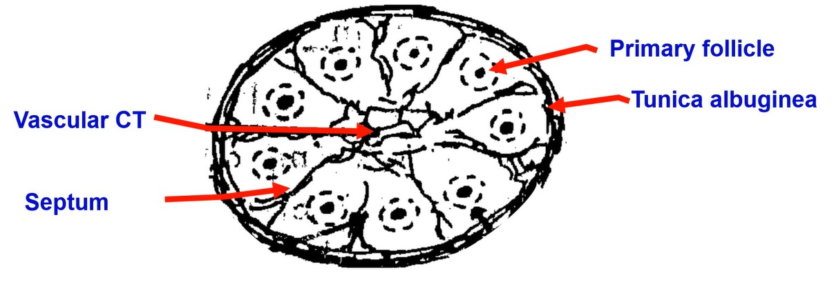
• DEVELOPMENT OF THE OVARY
• The sex cords will be separated by a fibrous capsule (tunica albuginea).
• The sex cords in the medulla (center) degenerated and replaced by a vascular connective tissue.
• In the 3rd month, the sex cords in the cortex (peripheral): flat cells surrounding each primordial germ cells (oogonia) forming primary follicle.

Slide 24
• Congenital Anomalies of the Ovary:
1. Agenesis of one or both ovaries.
2. Primordial Germ cell aplasia (No oogonia) either degeneration or failure of migration
3. Ovarian hypoplasia (Turner's syndrome): (44+x0).
4. Ectopic ovary: It may be found in abnormal site.
5. Hermaphrodism (rare):
a- True hermaphrodism (Ovo-testis): both ovarian and testicular
tissues are present.
b- Pseudo hermaphrodism:
- Male Pseudo hermaphrodism (44+XY): fetus has testis and female external genital organs.
- Female Pseudo hermaphrodism (44+XX): fetus has ovaries and male external genital organs

Slide 25
Thank you
Questions

