Slide 1
T. vaginalis & Candida UGT Module 202-2021
Dr. Mohammad Odaibat

Slide 2
Parasites
Introduction
Protozoa
Helminths
Pseudopodia
Amoebae
Single celled organisms
Flagellates
Flagella
Classification based
on motility
Ciliates
Cilia
Sporozoa
(coccidia)
Non-motile
Obligatory intracellular

Slide 3
Protozoa
Amoebae
Ciliates
Flagellates
Sporozoa
(coccidia)
Entamoeba histolytica
Cryptosporidium
Balantidium coli
Giardia lamblia
Haemoflagellates
Trichomonas Vaginalis

Slide 4
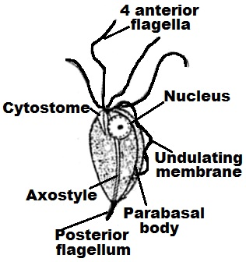
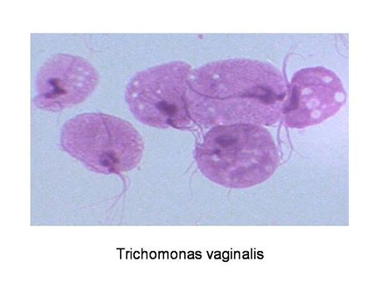
Trichomonas vaginalis
Urogenital flagellate
Geographical distribution: Cosmopolitan.
Habitat: Vagina, cervix and urethra in female & prostate and urethra in male.
D.H: Man
Morphological characters
Trophozoite (D.s & I.S)
Notes:
An axostyle is a sheet of microtubules found in certain microbial eukaryotes. It arises from the bases of the flagella, sometimes projecting beyond the end of the cell, and is often flexible or contractile, and so may be involved in movement and provides support for the cell.

Slide 5
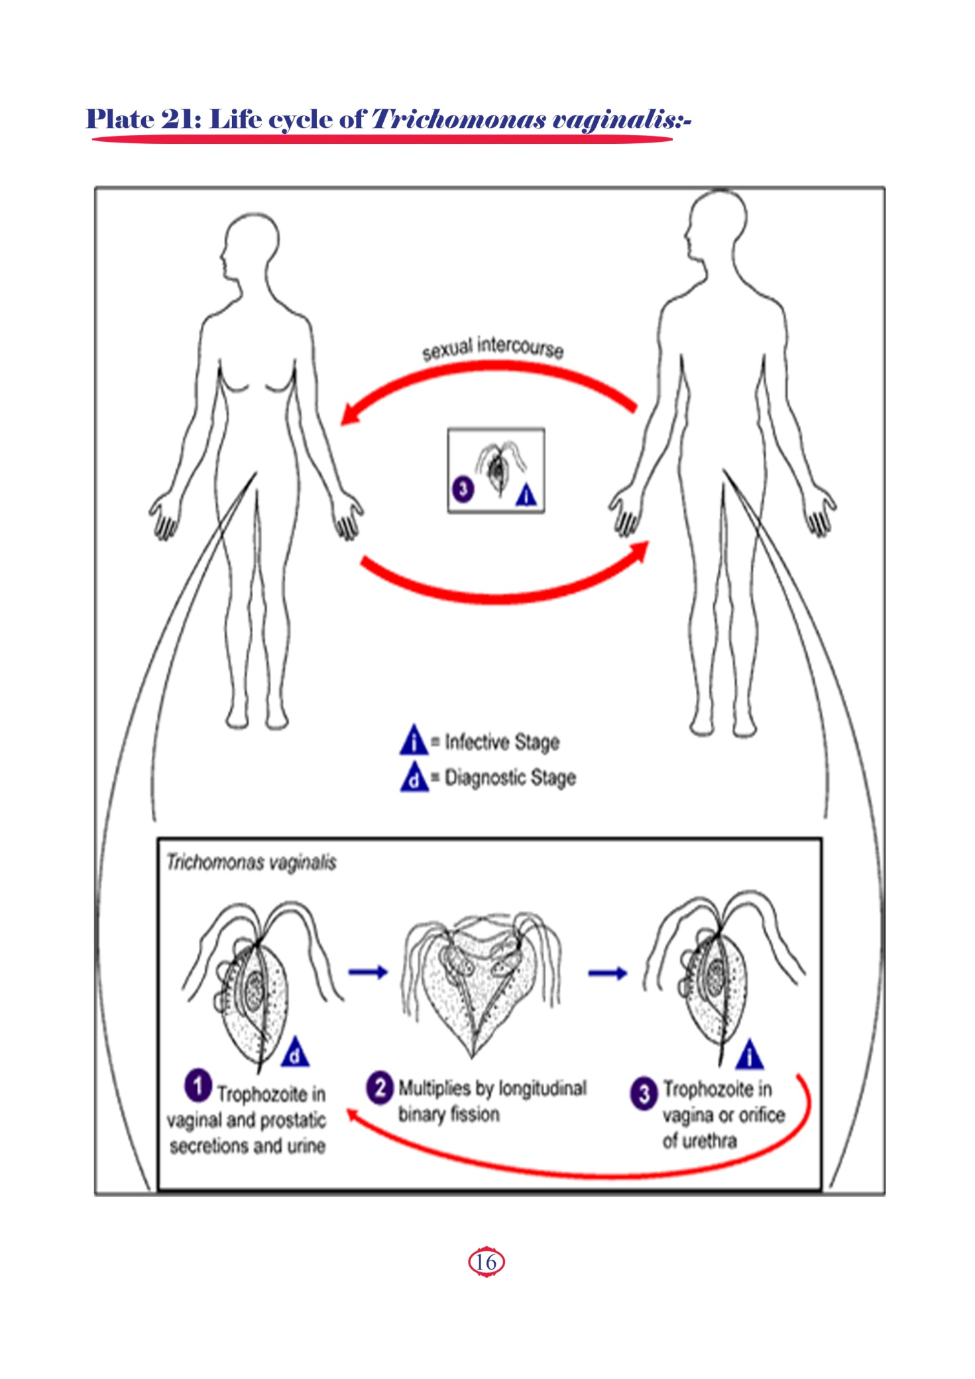
Mode of transmission

Slide 6
Mode of transmission

Slide 7
Pathogenesis
Disease: Trichomoniasis (sexually transmitted disease)
Normally the vaginal acidity (pH 3.8-4.5) is the protective barrier against infections. This acidity is maintained by the action of lactobacilli (vaginal bacterial flora) on the glycogen present in the vaginal epithelium leading to the production of lactic acid.
Due to excess use of vaginal disinfectants or prolonged use of antibiotics the lactobacilli decreases  decrease the production of lactic acid  decrease the vaginal acidity (pH 5-7) which becomes suitable for the growth of T. vaginalis.
The trophozoite exists either free in the vaginal cavity or adherent to the vaginal epithelium causing its damage  micro-ulcerations which increases the woman's susceptibility to an HIV infection (AIDS) and other sexually transmitted diseases.

Slide 8
Pathogenesis
WBCs
WBCs
Discharge

Slide 9
Clinical pictures
In women
In men
Asymptomatic infection
Symptomatic infection
Asymptomatic infection
Symptomatic infection
a) Vaginitis: Accompanied with a frothy yellowish - green odorous vaginal discharge, vulvar irritation, itching and soreness.
b) Urethritis: Accompanied with frequency of micturition and dysuria (pain during urination).
Is common. Men harbour the organism in their urogenital system and usually have no symptoms at all.
Includes urethritis, prostatitis with white discharge and dysuria.
The trophozoites remain in the vagina without causing manifestations.

Slide 10
Laboratory diagnosis
Direct
Indirect
Microscopic:
In women:
1-Wet film preparation from vaginal discharge, vaginal scraping or sedimented urine for trophozoite.
2- Vaginal swab lies in a tube containing 1 ml saline.
In men:
T. vaginalis trophozoite can be detected in urethral discharge, prostatic secretion or sedimented urine.
b) Culture: More sensitive than microscopic examination but not widely used.
c) Direct immunofluorescent antibody staining.
PCR

Slide 11
Treatment
1-Systemic
2-Local
Flagyl vaginal insert.
Acidifying vaginal douches: Lactic acid douche to maintain the acidity of the vagina.
Metronidazole (Flagyl)

Slide 12
Urogenital Candidiasis

Slide 13
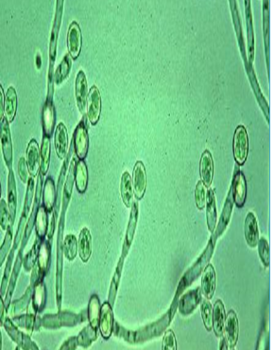
Urogenital Candidiasis
Candida albicans is the most important species of candida.
Candida albicans is oval gram positive budding yeast which produce pseudohyphae.
C. albicans ferments glucose & maltose with acid & gas production.
It is one of the normal flora of the mucous membranes of the upper respiratory, GIT & female genital tracts.
It predominate with lowering in immunity causing infection so it is one of the opportunistic fungi.

Slide 14
Predisposing factors to Candida infections
Risk factors
Weakened Immune
System
Associating Factors
Poor hygiene.
HIV/AIDS.
Cancer Treatments.
Organ Transplantation.
Diabetes •Corticosteroid use • Broad Spectrum Antibiotic use.
Urinary catheters.
Urinary tract obstruction.
Babies less than one month old.
Elderly
Diabetes – Glucose in vaginal secretions promote Yeast growth. (overgrowth)

Slide 15
Urogenital Candidiasis
1-Renal candidiasis
2-Bladder candidiasis
4-Candidal balanitis
in male
3-Vulvovaginal candidiasis
in female

Slide 16
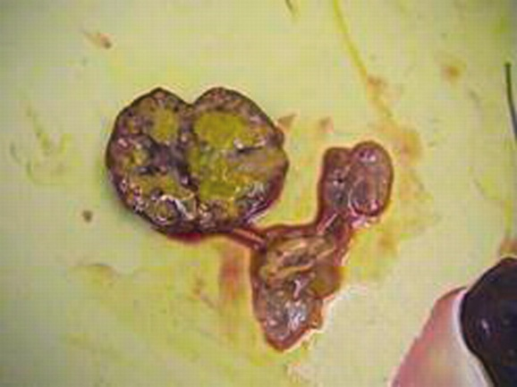
Renal candidiasis
Spreads either by ascending route or hematogenous spread.
Candida may cause a fungus ball or an obstructive fungal mass with symptoms as renal colic.
Risk factors: patients with diabetes, renal stones, or obstruction of the urinary tract.
Diagnosis
Ultrasound & Intravenous urography.
Treatment
Fluconazole (orally).
Amphotericin B (IV).
Percutaneous nephrostomy if urinary obstruction occurs.
Notes:
A percutaneous nephrostomy is the placement of a small, flexible rubber tube (catheter) through your skin into your kidney to drain your urine

Slide 17
Bladder candidiasis
Symptoms
Complications
Dysuria, frequency of micturition; often confused with a bacterial infection.
Candiduria may persist after treatment due to fungal resistances.
Prostatitis & orchitis.
Treatment
Diagnosis
Antifungal drugs as Fluconazole (orally) & Amphotericin B (IV)
If catheter is inserted, it should be removed.
Urine can cultured on MacConkey and blood agar or Sabouraud dextrose (SD) agar.

Slide 18
Vulvovaginal candidiasis
Symptoms
Itching, dysuria, dyspareunia, whitish malodorous thick vaginal discharge.
Vulvar and vaginal erythema, edema & fissures.
Diagnosis
Microscopic examination of discharge using 10% potassium hydroxide (KOH) preparation.
Culture on Sabouraud dextrose (SD) agar.
Treatment
Locally: Azole.
Orally: Fluconazole or ketoconazole .
Vaginal tablets: Fluconazole or ketoconazole

Slide 19
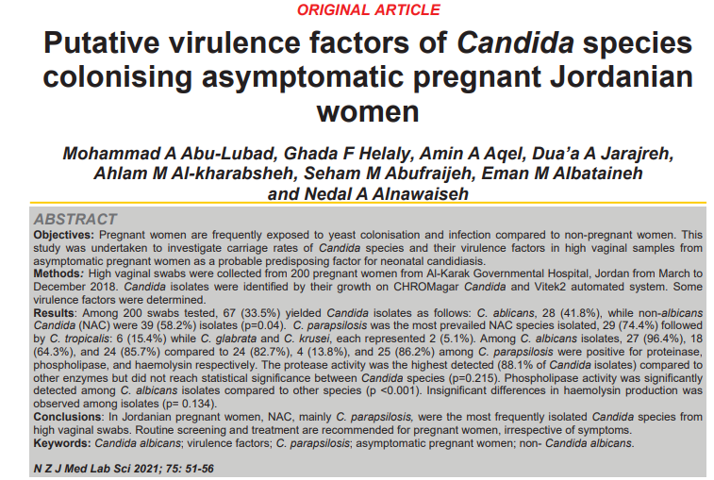

Slide 20
Candidal balanitis in male
Inflammation of the glans penis.
Sexually transmitted.
Risk factors include diabetes mellitus, immunosuppression, and being uncircumcised.
Symptoms
Itching, swelling, and redness of the glans penis.
Diagnosis
Diagnosis is based mostly on clinical appearance.
Confirmed by microscopic examination / or culture.

Slide 21
PREVENTION
By keeping skin clean and dry, by using antibiotics only as your doctor directs, and by following a healthy lifestyle, including proper nutrition.
People with diabetes should try to keep their blood sugar under tight control.
If you have HIV or another cause of recurrent episodes of thrush, then antifungal drugs can help to minimize flare-ups

