Slide 1
Abdomen and gastro -intestinal tract imaging
DR. ESSMAT AL- OMARI Consultant Radiologist
Mu’tah university

Slide 2
Abdomen x-ray
Plain abdomen films still retain as one of the most useful initial investigations. After history and examination
Abdomen x-ray is sometimes abbreviated to AXR and is usually taken with the patient lying in a supine position. Or may be standing(before taking the xray the patient have to stand about 10 min
In erect abdomen x-ray, normally two or three air fluid levels are possible, but more than three are abnormal.
The maximum diameter of the small bowel is 3cm.
The maximum diameter of the large bowel is 6cm, except the caecum and rectum up to 8-9cm.
X-ray ➔ radiation (toxic esp to pregnant and child)
Ultrasound ➔ safe

Slide 3
Abdomen x-ray / 2
The following structures should be checked in 2 views of abdomen x-ray :
Bowel gas pattern. Very important
Extraluminal free gas.in Distension(inside the bowel not free)
Radio-opaque stones or calcification (dense) but normally no opacity
Soft tissue masses.
Signs of intestinal obstruction.
Skeletal abnormalities.
Soft lax ➔ nothing to palpate , no pain

Slide 4
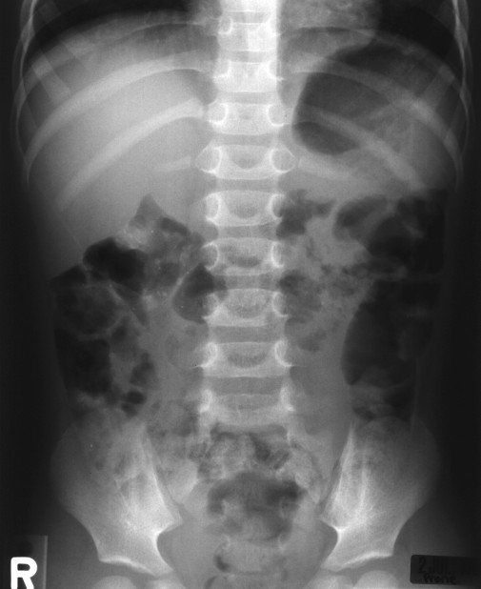
First thing to see : name/date
Rt /Lt
The type of study
1-gas distribution
From stomach to
rectum
2-calsification
3- free gas (v imp)
After standing 10 min ➔ to the diaphragm
4- mass
Esp at epigastrium ➔ aortic aneurysm
5-skeletal system

Slide 5
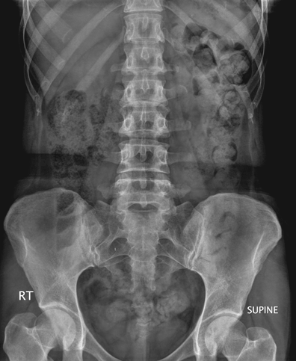
Frontal Supine abdominal X-Ray
1-
2-
3-
4-
5-

Slide 6
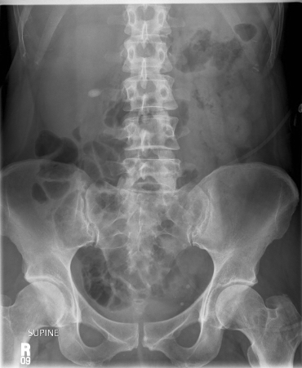
Frontal Supine abdominal X-Ray
1-
2-
OVAL radioopacity at the Rt side of L3
3-
4-
5-

Slide 7
Contrast medium in G.I.T studies
Barium sulfate: is the most commonly used in barium studies of the GIT. ➔ dense
Gastrografin is used in: : (here the barium doesn’t use)
- suspected bowel perforation
- post-operative for leakage.
- meconium ileus (in neonates).
Gastrografin is contra-indicated in Barium swallow and meal if the patient is at risk of aspiration such as in infants, because gastrografin can induce pulmonary edema and chemical pneumonitis.
Non ionic contrast medium: is used in barium swallow studies in infants.

Slide 8
Gastro-intestinal tract investigations
BARIUM SWALLOW
Important to know 1- the type of study 2- by what 3- for what
For final exam ☺ ☺
Is the examination of the esophagus with contrast medium .
The contrast used is barium sulfate for most examination .
Non ionic contrast media is used in infants and small children Gastrografin is used
,

Slide 9
Barium swallow / 2
Indication of Ba. swallow:
Symptoms of gastro-esophageal reflux most common
dysphagia which could be related to :
- Esophageal stricture
- Esophageal tumor important
- Suspected achalasisa
- Vascular abnormalities
- Esophageal web

Slide 10
Barium swallow for the esophegus showing tupuler structure with filling defect and mass lesion

Slide 11
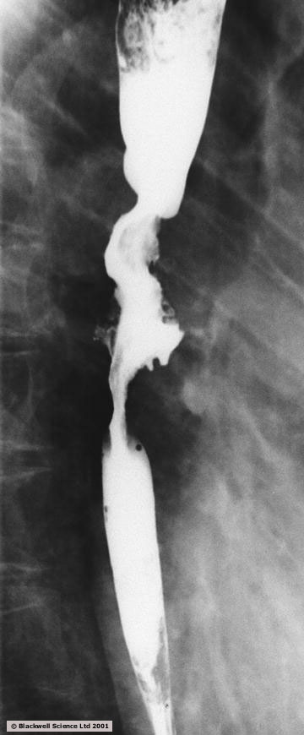

Slide 12
Barium swallow for the esophegus showing
dileated end of the esophegus (bired shape) ➔
- Suspected achalasisa

Slide 13
Frontal chest X-Ray
Normal heart size
Normal lung appearance
Very will defined circular
Structure at mideastainum (rolled in by lateral view which approve that is in the chest not outside)

Slide 14
BARIUM MEAL
Is the examination of the stomach and duodenum with barium sulfate .
Double contrast is obtained by introduction of gas into the stomach using effervescent powders and barium.
The gastro-esophageal junction is observed for reflux .
Indication :
Gastro esophageal reflux
Gastric or duodenal ulcer
Hiatus hernia
Suspected gastric tumor

Slide 15
Hiatus hernia

Slide 16
Duodenum C shape
and head of the pancreas

Slide 17
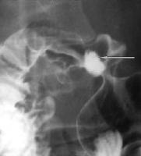

Slide 19
Frontal X-Ray of chest and abdomen in infant
1-gas distribution : stomach filled with gas and no gas distally(in large and small bowel and
at the rectal area)
Dx : pyloric stenosis or duodenal atresia

Slide 20
Dx : pyloric stenosis or duodenal atresia
Barium meal

Slide 21
Barium follow-through
Is the investigation of the small intestine with contrast - medium (usually barium sulfate )
Transit of barium is observed through the small bowels .
Abdominal films are taken every half hour until barium reaches the large bowel .
Spot films of the terminal ileum are obtained .
Indication :
Inflammatory bowel disease, most often Crohn’s disease.imp*most common
Small bowel tumors / lymphoma imp**
Small bowel obstruction

Slide 22
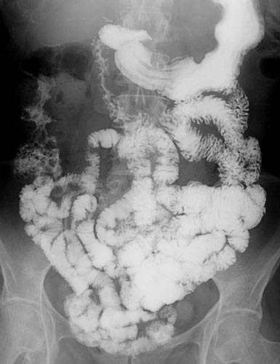
normal

Slide 23
Barium follow-through
Showing multiple strictures and stenosis and mostly there is
complete cut in crohns

Slide 24
Barium enema
Is the study of the large bowel with double contrast (Barium and air).
Barium is run into the colon by Foleys catheter placed in the rectum.
Air insufflation into the large bowel produces a double contrast examination .
Indication :
Investigation of abdominal mass
Large bowel obstruction .
Suspected colonic tumor
Diverticular disease
volvulus

Slide 25
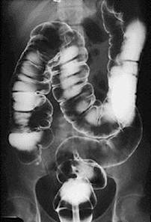

Slide 27
Barium enema
Stricture /eaten apple appearance ➔malignant appearance

Slide 28
ACUTE APPENDICITIS محذوف
Signs of appendicitis on plain film:
An appendiculith: found in less than 5% of patients.
Abnormal bowel gas pattern, including focal ileus in the right lower quadrant.
Loss of the normal fat planes, including the right psoas shadow.
Scoliosis of the lumbar spine convex to the left.
With perforation: free intraperitoneal gas, periappendiceal abscess or mass formation with signs of small bowel obstruction.

Slide 29
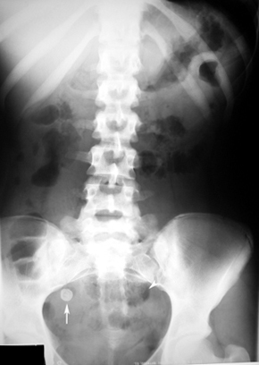

Slide 30
Acute appendicitis in ultrasound
Longitudinal scan:
dilated tubular structure with blind end tip.
Transverse scan (cross-section):
the appendix is dilated more than 7mm and non compressible.

Slide 33
Small bowel obstruction
Mechanical small bowel obstruction develops when there is impairment to the onward flow of bowel contents.
Gas and fluid accumulating proximal to the site of obstruction causing progressive dilatation of small bowel.
The initial radiological investigation for suspected small bowel obstruction is supine and erect plain abdominal films.
The 5 main points➔ have to be checked

Slide 34
Causes of small bowel obstruction
The most common causes are:
Adhesions: is the most common cause of mechanical obstruction, about 70% of cases.
Most common cause of functional obsruction ➔ ischemia
Strangulated hernias
Tumors of small bowels
Inflammatory bowel disease

Slide 35
What are the common signs of small bowel obstrucion ?
Dilatation of small bowel loops, usually centrally placed in abdomen.
The dilatation up to 3 cm ➔ acceptable
Multiple air fluid levels .more than 3.
Absence of gas in the colon.
If gas is still present, it indicate that the obstruction is recent or that it is incomplete.

Slide 36
Distinction between small and large bowel dilatation
Small bowel Large bowel
Distribution of loops Central Peripheral
Number of loops Many Few
Diameter 2.5-3 cm 6 cm
Haustra Absent Present
Valvulae conniventes Present in jejunum Absent
Solid feces Absent Present

Slide 37
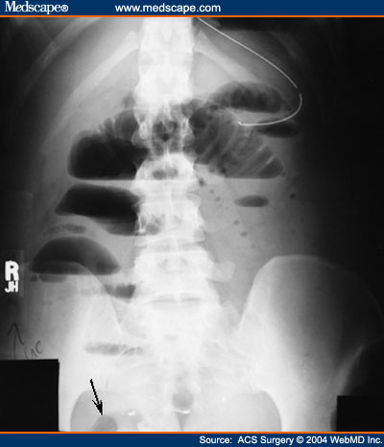
Frontal Abdominal
X-Ray
1- Dilatation of small bowel loops
more than 5 cm
2-
Multiple air fluid
Level
3-
Absence of gas in
the colon
4- normal skeletal/no mass/no free gas(no perfortion)
Dx:
small bowel obstruction

Slide 38
Frontal Abdominal
X-Ray
1- Dilatation of small bowel loops
more than 5 cm
2-
Multiple air fluid
Level
3-
Absence of gas in
the colon
4- normal skeletal/no mass/no free gas(no perforation)
Dx:
small bowel obstruction

Slide 39
Large bowel obstruction
The plain abdominal film is useful for the diagnosis of large bowel obstruction.
The large bowel proximal to the obstruction is dilated.
Fluid levels are present in the erect position and tend to be long.
In equivocal cases, a barium enema can be performed and locate the site and cause of obstruction.

Slide 40
Large bowel obstruction / 2
Most common Causes are:
Colonic carcinoma num.1 esp. in old males
Screening ➔ common /curable
Diverticulr disease
Volvulus of sigmoid colon.
Paralytic ileus: causes functional small and large bowel obstruction, especially in the post operative stage

Slide 41
Sigmoid Volvulus محذوف الا المحدد بالحمر
Is twisting of an elongated section of sigmoid colon on its mesenteric axis.
Is the most common form of volvulus of the gastro-intestinal tract.
Sigmoid volvulus is particularly common in elderly persons.
Predisposing factors include chronic constipation, megacolon , and large redundant sigmoid colon.

Slide 42
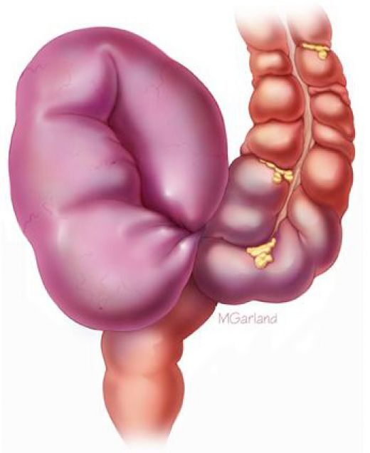

Slide 43
Radiological features of sigmoid volvulus in abdomen x-Ray
Markedly dilated sigmoid that almost fills the entire abdomen.
Double- loop obstruction (50% of patients).
Coffee bean sign or Omega sign: inverted U shaped appearance of distended sigmoid loop (the bowel loop points to right upper quadrant).
Loss of haustra.

Slide 45
Air under the diaphragm
Free abdominal air is called pneumoperitonium and is usually due to perforation.
It accumulates under one or both diaphragms when the patient is in erect position.
Lateral decubitus film can be used for very ill patients.
Free air is not seen in up to 20% of patients.

Slide 46
Causes of free abdominal air
Post laparotomy or laparoscopy.
(are usually absorbed within 1 week)
Post peritoneal dialysis.
Viscus perforation, the most common causes are:
perforated peptic ulcer
perforated appendix (appendicitis)
rupture diverticulum (diverticulitis)
Necrotizing enterocolitis (In small children)
The patient have to stand about 10 min ➔ below the diaphragm

Slide 48
There is 2 radiolucent area below the diaphragm ➔ free gas

Slide 49
Radiology of the liver, Gallbladder And Biliary system X
Plain film is used for:
Detection of radio-opaque calculi.
Calcification in the liver or in the gallbladder wall.
Gas in the biliary tree.

Slide 50
Ultrasound and CT of the liver X
Liver ultrasound is an accurate imaging modality for focal or diffuse disease of the liver, detecting tumors and secondary deposits.
Ultrasound will visualize the gallbladder, CBD, hepatic and portal veins.
If ultrasound is not conclusive for liver disease or mass lesion, CT is indicated.
CT demonstrate the full range of liver disease, including cirrhosis and tumors.

Slide 51
LIVER MRI X
MRI provide excellent images of the liver as does CT, but without the risk of radiation.
Blood vessels and bile ducts may be shown without injection of contrast by using magnetic resonance angiography (MRA) and magnetic resonance cholangiography (MRCP).

Slide 52
X

Slide 53
X

Slide 54
X

Slide 55
GALLSTONES
Stones in the gallbladder are relatively common and occur in approximately 10% of population.
Types of gallstones:
Cholesterol gallstones: are the most common, accounting for more than 80 % of cases
WE cant see it.
Pigment gallstones: usually form when there is excess bilirubin and calcium salts in bile.
Mixed stones: are mixture of cholesterol and calcium salts.
WE can see them.
The predisposing causes include:
Obesity, diabetes, liver cirrhosis, and blood disorders such as sickle-cell anaemia.

Slide 56
Radiological features of gallstones
Plain film reveal approximately 10 to 20% of calculi as they are radio-opaque.
Ultrasound is the best test for gallstones, which is non-invasive and very accurate.
A gallstone on ultrasound is echogenic, it appears as a white structure that casts a dark shadow behind it.

Slide 57
Echogenic stones

Slide 62
Acute cholecystitis
Is a sudden inflammation of the gallbladder that causes severe abdominal pain.
In the vast majority of cases this result from stone obstructing the cystic duct which lead to infection of static bile and the gallbladder mucosa.
The ultrasound features are:
Distended gallbladder with gallstones.
The gallbladder wall is thickened (greater than 3 mm) and edematous
Pericholecystic fluid, and in some complicated cases pericholecystic abscess.

Slide 64
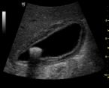

Slide 65
Acalculous cholecystitis X
Cholecystitis can develop in patients without gallstones, but it is extremely rare.
Hospitalized patient, such as those in cardiac intensive care units, are most likely to develop this condition, which may be due to ischemia.

Slide 66
Endoscopic retrograde X cholangiopancreatography (ERCP)
Indication:
Obstructive jaundice
Removal of known CBD stones
Pancreatic tumors, that cause bile duct obstruction and jaundice
An endoscope is introduced and advanced through the mouth into the duodenum, with injection of contrast into the ampula of Vater, to demonstrate both the bile ducts and the pancreatic ducts.
CBD stones can be removed through the endoscope by insertion of a catheter with a basket or balloon.
Malignant CBD strictures can also be stented.

Slide 67
X

Slide 68
X

Slide 69
X

Slide 70
Thank You

