Slide 1
BRAIN HERNIATION
DONE BY : DANIA JAMAL ALSINJLAWI

Slide 2
Causes:
Brain herniation occurs when something inside the skull produces pressure that moves brain tissues. This is most often the result of brain swelling or bleeding from a head injury, stroke, or brain tumor.
Herniation of the brain can also be caused by other factors that lead to increased pressure inside the skull, including:
Collection of pus and other material in the brain, usually from a bacterial or fungal infection (abscess)
Bleeding in the brain (hemorrhage)
Buildup of fluid inside the skull that leads to brain swelling (hydrocephalus)
Strokes that cause brain swelling
Swelling after radiation therapy
Defect in brain structure, such as a condition called Arnold-Chiari malformation

Slide 3
Signs and symptoms may include:
High blood pressure
Irregular or slow pulse
Severe headache
Weakness
Cardiac arrest (no pulse)
Loss of consciousness, coma
Loss of all brainstem reflexes (blinking, gagging, and pupils reacting to light)
Respiratory arrest (no breathing)
Wide (dilated) pupils and no movement in one or both eyes

Slide 4
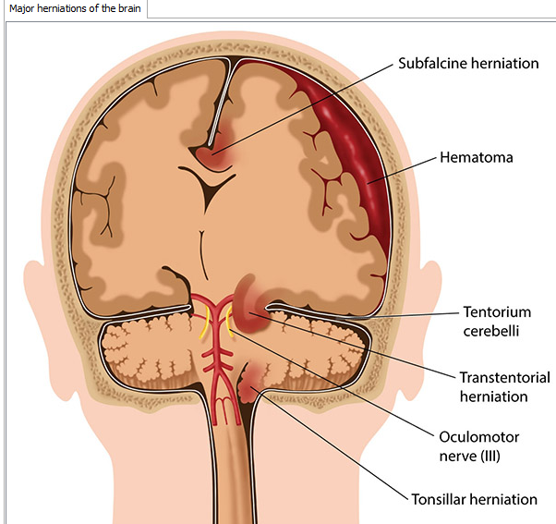
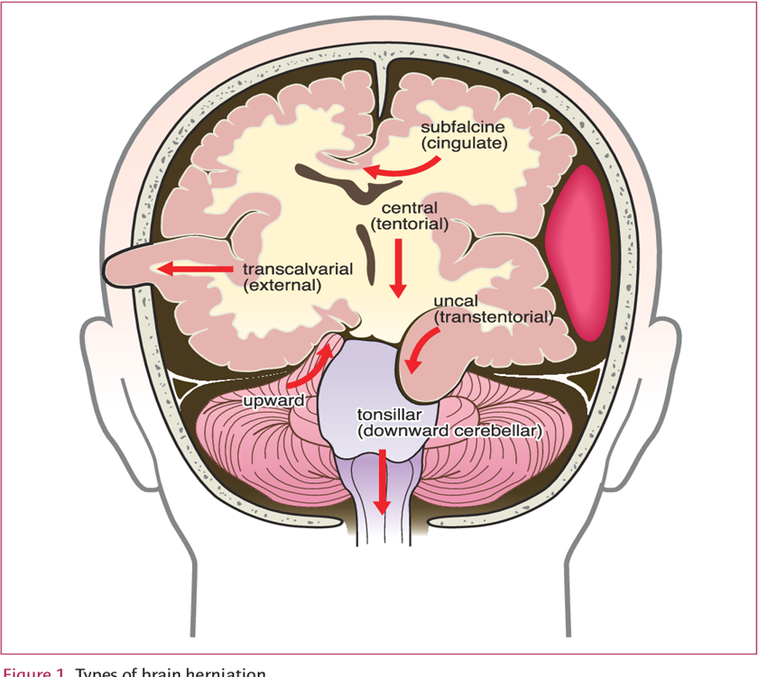
Supratentorial herniation displacement of
Cerebrum above tentorum :
Uncal (transtentorial)
Central
Cingulate (subfalcine/transfalcine)
Transcalvarial
Infratentorial herniation displacement
Of crerbellum below the tentorum :
Upward (upward cerebellar or
upward transtentorial)
Tonsillar (downward cerebellar)

Slide 6
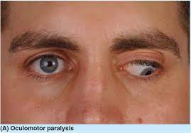
Supratentorial herniation
((1)) Uncal herniation (transtentorial):
the innermost part of the temporal lobe= uncus—>slip down to tentorium and put pressure on brainstem most notably the midbrain.
The uncus can squeeze the oculomotor nerve CN III
which may affect the parasympathetic input to the eye on the side of the affected nerve.
causing the pupil of the affected eye to dilate and fail to constrict in response to light
. oculomotor nerve palsy or third nerve palsy: the eye to a "down and out" position due to loss of innervation to all ocular motility muscles except for the lateral rectus (innervated by abducens nerve CN VI) and the superior oblique (innervated by trochlear nerve CN IV)
posterior cerebral artery comprerssed >> ischemia stroke of occipital part of brain(response to visual information)>>lead to contralateral homonymous hemianopsia (loos of vision in LtorRT halves of the visual fields of both eye
Uncal herniation stretch and breaks branches of paramedial basilar artery causing them to tear and bleed>>Duret hemorrhage seen in autopsy

Slide 7
Kernohan's notch:
false localizing sign
Focal mass effect on RT>>squeeze the uncus down to brainstem >>
*directly compress RT side of brain steam
*indirectly pushes LT side of brainstem against free edge of tentorium >>form Kernohan's notch >> compress part of brainstem ((LT cerebral peduncle>>rich in motor fiber that travel from cortex in LT side of brain to muscle on RT side of body.)) >> As side of focal mass effect ((ipsilateral weakness)) normally damage to brain tissue result weakness in contralateral side >>SO Kernohan's notch cause
false localizing sign

Slide 8
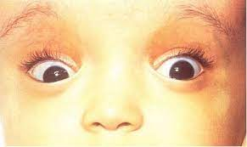
((2)) In central herniation: -when diencephalon(part of the temporal lobes processes sensory information ,emotions and regulates hormone production >>slipped under free edge of tentorium . Cause : *dilated and fixed pupils *paralysis of upward eye movement >> which lead to ((sunset eyes sign >>eye balls downward position and part of lower pupil cover by lower eyelid -duret hemorrhages can see

Slide 9
((3))In cingulate or subfalcine herniation:
the most common type, the innermost part of the frontal lobe called (cingulate gyrus) get squeeze below the free edge of falx cerebri to opposite side of skull .
Displaced part of brain compress (anterior cerebral artery) >>cause ischemic stroke
may progress to central herniation
may present with abnormal posturing and coma.

Slide 10
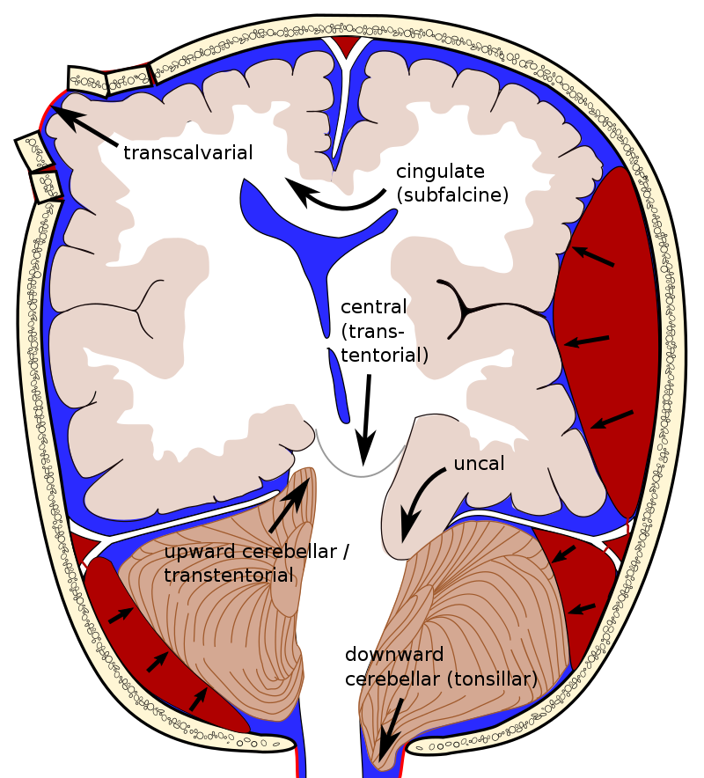
((4)) Transcalvarial herniation (external herniation)
the brain squeezes through a fracture or a surgical site in the skull or surgical site during operation.

Slide 11
Infratentorial herniation:
1 .upward hern :
Increased pressure in the posterior fossa>> cause the cerebellum to move up through the tentorial opening in upward,
The midbrain is pushed through the tentorial notch upward. This is also known as ascending transtentorial herniation since it occurs across the tentorium cerebelli.
2. Tonsillar herniation
also called downward cerebellar herniation, transforaminal herniation, the cerebellum tonsillar >>move downward through the foramen magnum >>
-causing compression of the lower brainstem and upper cervical spina. Increased pressure on the brainstem >>
dysfunction of the centers in the brain responsible for controlling respiratory and cardiac function.(dangerous )
-The most common signs are headache and neck stiffness, The level of consciousness may decrease and flaccid paralysis (reduce muscle tone ), Blood pressure instability

Slide 12
Exams and Tests A brain and nervous system exam shows changes in alertness. Depending on the severity of the herniation and the part of the brain that is being pressed on, there will be problems with one or more brain-related reflexes and nerve functions.
In physical examination in increased ICP :
- level of consciousness
-focal neurological signs
-papilledema (swelling of optic disc)
- blood pressure
-Irregular breathing
-bradycardia
Cushing triaid : cns response due to increase ICP

Slide 13
Lumbar puncture relatively contraindication >>to possible herniation
Confirm presence of mass effect with CT , MRI
No mass lesion >>lumbar puncture >>needle to spinal canal attach to Manometer >> measure CSF pressure>>MORE THAN 8-15mmHg >>increase ICP
Blood tests if an abscess or a bleeding disorder is suspected

Slide 14
Management of Cerebral Herniation
The first treatment of raised ICP is to remove the lesion causing mass effect within the brain such as a tumor, hematoma or abscess
Positioning:
Moderate head elevation at an angle of 15-30⁰
To decrease ICP
External ventricular drain
Decompressive craniectomy >>part of skull remove to decrease pressure
Hyperventilation
Hyperventilation Pco2 vasoconstriction decrease cerebral blood flow decrease ICP
Osmotic therapy (Mannitol)
Disrupts the blood brain barrier this results in moving of fluid from brain to body
Osmotic action remove excess water from body

Slide 15
Thank you♥

