Slide 1
Pulmonary Case

Slide 2
A 32-year-old female patient, currently working as a research assistant in a healthcare facility presented with a second episode of massive haemoptysis within a 5-month period.
She had been diagnosed with microbiologically proven Pulmonary TB 6 years prior to her admission and completed 6 months of therapy.. Over the course of her follow up at the pulmonology clinic, and 2 years prior to this current presentation, she developed occasional blood-streaked sputum and dyspnea grade II,No orthopnea or PND.
She was investigated by doing CXR and computed topographical scan of the chest .

Slide 3
What is your provisional Diagnosis??

Slide 4
On examination during this admission, she was haemodynamically stable with a blood pressure of 127/82 mmHg and a sinus tachycardia of 110 beats/min. She was afebrile, her respiratory rate measured 20 breaths/min and she was a-cyanotic on room air with an oxygen saturation of 93%. Marked digital clubbing and subconjunctival pallor were noted.

Slide 5
On respiratory examination, evidence of left sided volume loss was present with tracheal deviation to the left side ,decreased expansion of the left chest wall. The breath sounds on the right were vesicular in nature but the left side had breath sounds of reduced intensity with coarse crackles predominantly in the upper zone.
A parasternal heave with a palpable P2 were elicited, as was a loud pulmonary component of the second heart sound. Her apex beat was displaced to the anterior axillary line in the fifth intercostal space.

Slide 6
What are these local chest examination signs consistent with??

Slide 7
Initial laboratory results showed :
a haemoglobin of 7.7 g/dL (MCV=70.8fl, MCHC=28.4g/dL)
a platelet count of 487×109/l.
Her renal and liver function tests were normal.
Her C-Reactive Protein was 32mg/L and her INR measured 1.2.
A MTB assay of a sputum sample was performed and was reported as negative for mycobacterium tuberculosis.

Slide 8
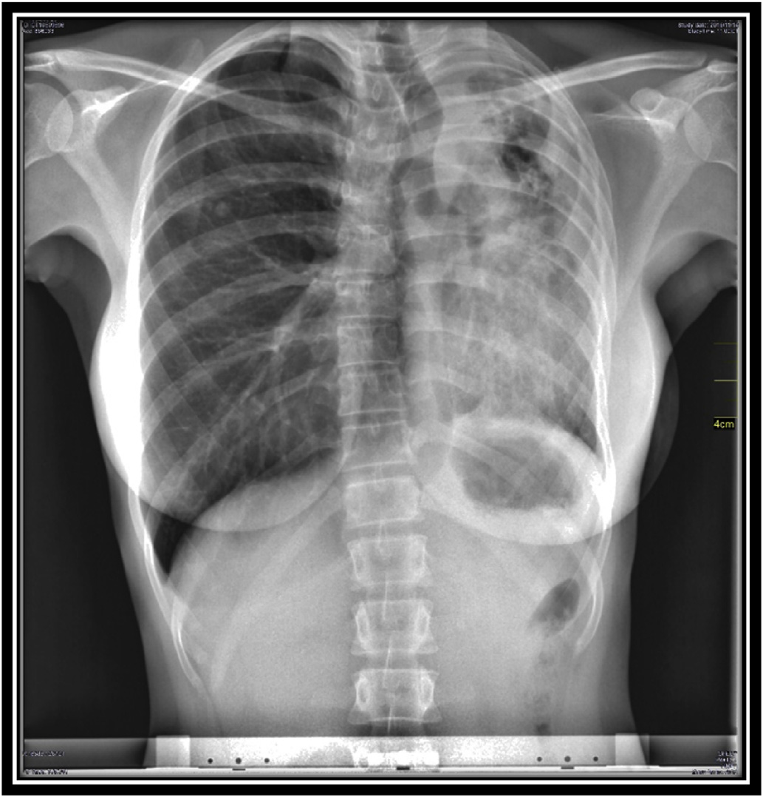

Slide 9
What are the abnormal radiologic findings??

Slide 10
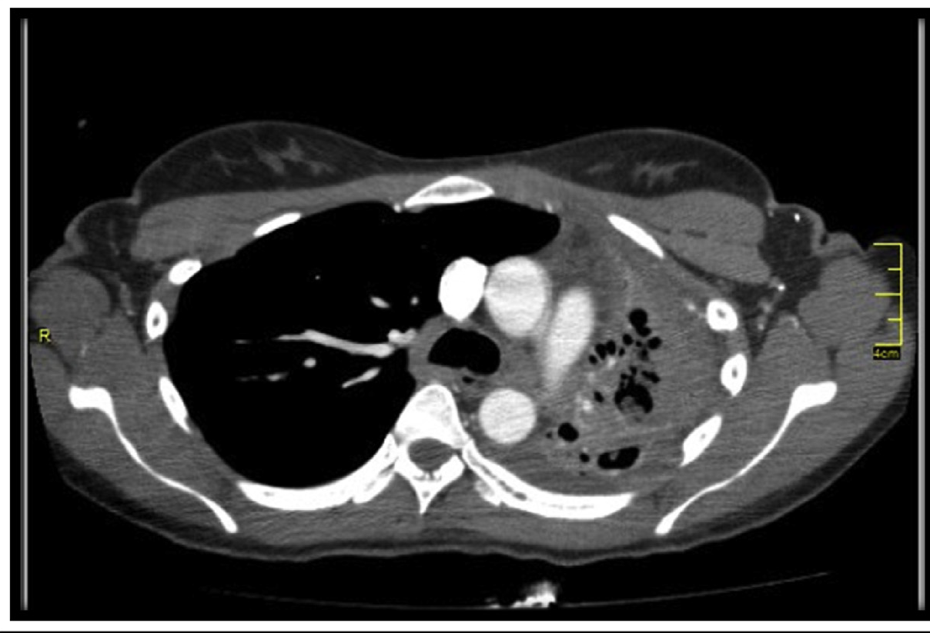

Slide 11
Spirometry

Slide 12
Interpret the previous spirometry??

Slide 13
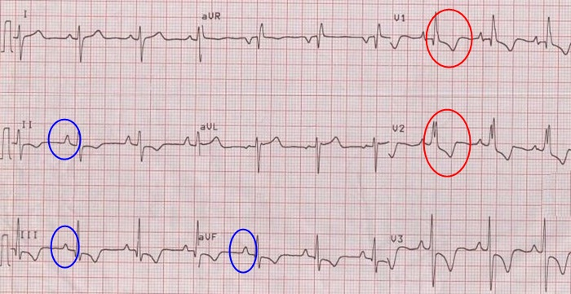
ECG

Slide 14
Comment on the ECG??

Slide 15
What is your final Diagnosis??

Slide 16
MCQs
Multiple drug resistant (MDR) TB is defined as resistance to:
More than three anti tubercular drugs
Isoniazid and rifampin irrespective of resistance to any other drug
INH, PZA and Rifampicin
INH, ethambutol and Rifampicin
Fluoroquinolones and at least one of the three injectable second-line drugs used to treat TB

Slide 17
A 67-year-old man, recently diagnosed with pulmonary tuberculosis, is started on a treatment with antitubercular drugs. The man has been suffering from atrial fibrillation, and he is presently taking warfarin as one his drugs. At this point, which of the following changes in the therapeutic regimen of the patient would be most appropriate?
To increase the dose of warfarin
To reduce the dose of isoniazid
To increase the dose of rifampin
To stop pyrazinamide
To decrease the dose of warfarin

Slide 18
A 45-year-old woman complained of blurred vision and inability to distinguish green objects from red objects. The woman, recently diagnosed with cavitary pulmonary tuberculosis, has been receiving a 4 drug combination regimen for two months. Which of the following drug has most likely caused these adverse effects?
A. Isoniazid
B. Pyrazinamide
C. Rifampin
D. Ethambutol
E. Streptomycin

Slide 19
A 35 year old pregnant female develops breathlessness and a non productive cough. She has mild fever and has weight loss over the past six months. Sputum samples are acid- fast bacilli (AFB) positive. Her chest X-ray shows nodular shadowing in the upper zone.
What is the best intial treatment?
A. Isoniazid , rifampicin , streptomycin
B. Isoniazid ,pyrazenamide and ethambutal
C. Rifampicin,pyrazenamide and ethambutal
D. Isoniazid,rifampicin,streptomycin and pyrazenamide
E. Isoniazid,rifampicin and ethambutal

