Slide 1
Approach to Abdominal Pain

Slide 2
Why is this important?

Slide 4
Just a few diagnoses to ponder…

Slide 6
So how do we organize this?

Slide 8
Acute abdominal pain

Slide 9
Chronic abdominal pain

Slide 14
Approach to the patient

Slide 15
Approach to the patient

Slide 16
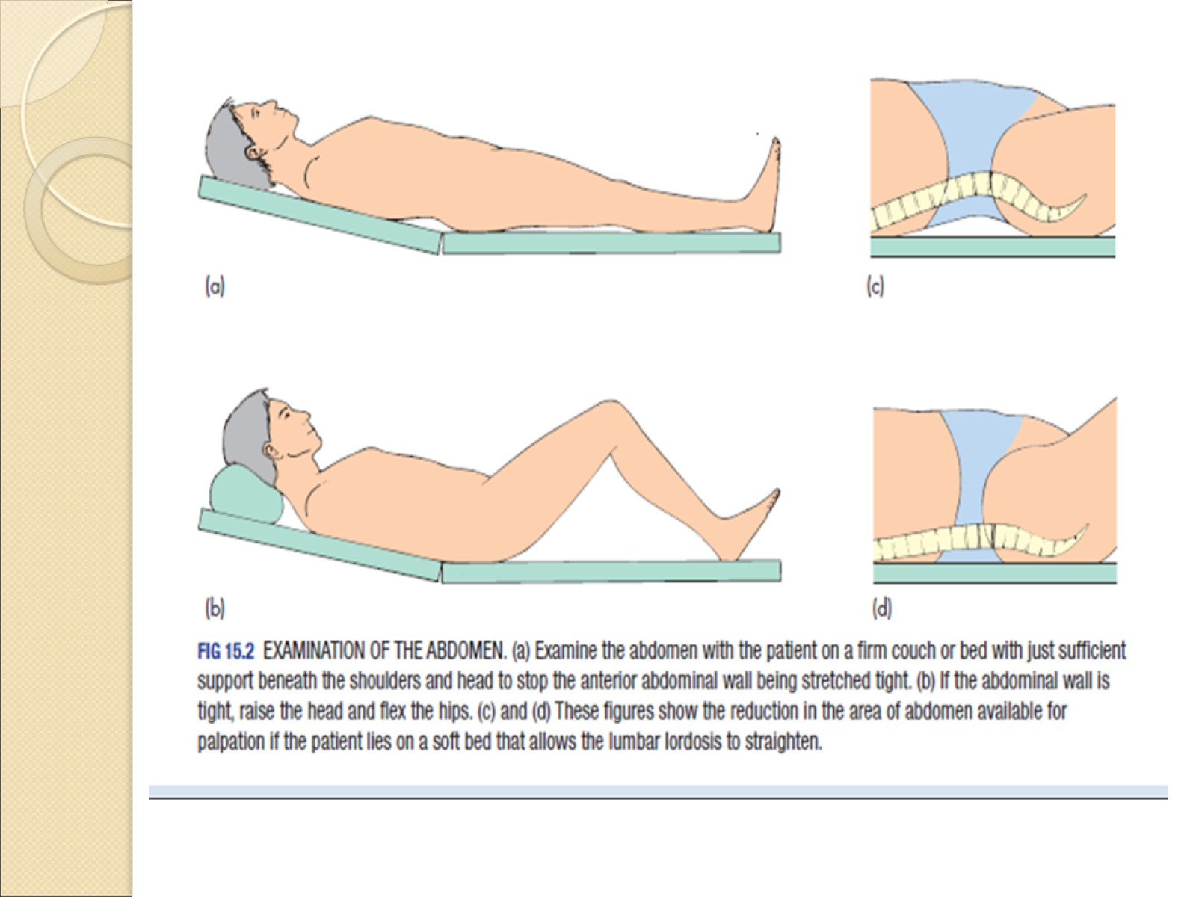

Slide 18
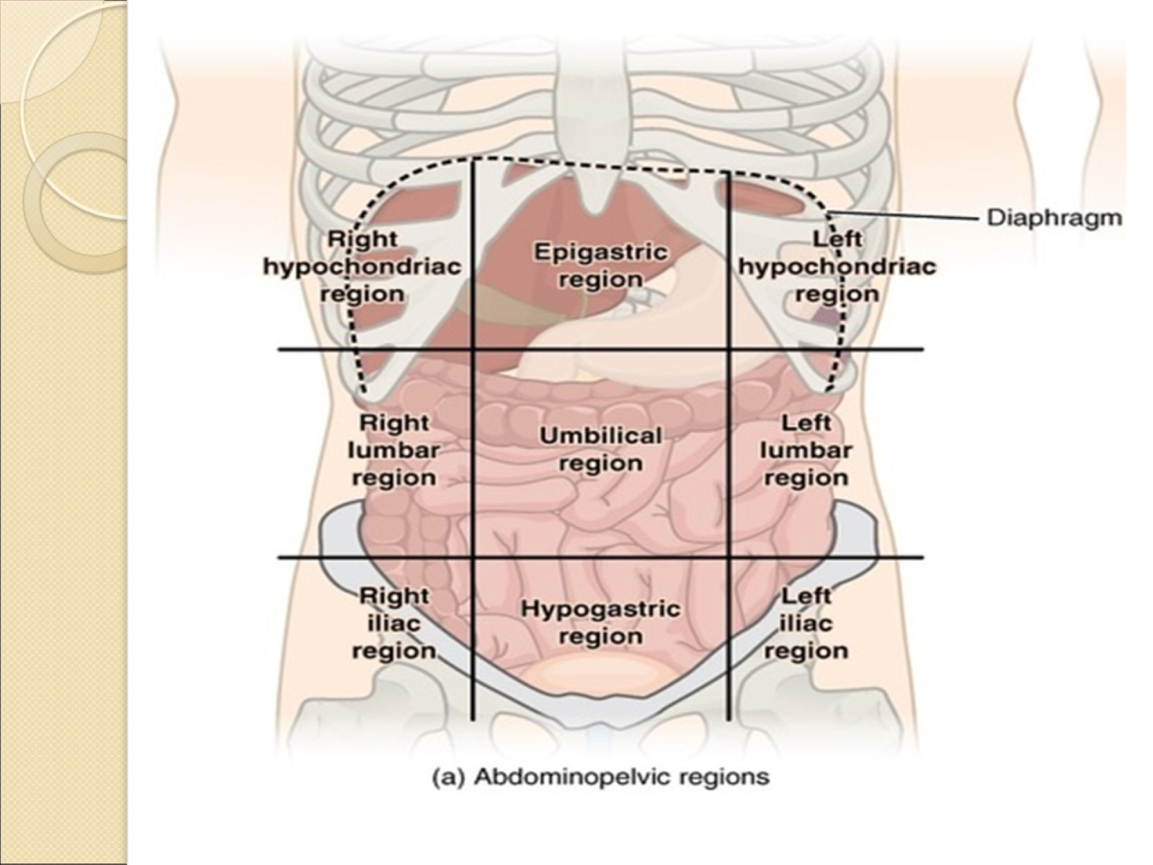

Slide 21
Cullen’s sign

Slide 22
grey turner sign

Slide 23
Carnett sign

Slide 24
Approach to the patient

Slide 25
Approach to the patient

Slide 26
Surgical abdomen

Slide 27
Surgical abdomen

Slide 28
Surgical abdomen

Slide 29
Surgical abdomen

Slide 30
(Red Flags for endoscopy)

Slide 31
Colon Cancer Check Screening Recommendations

Slide 32
