Slide 1
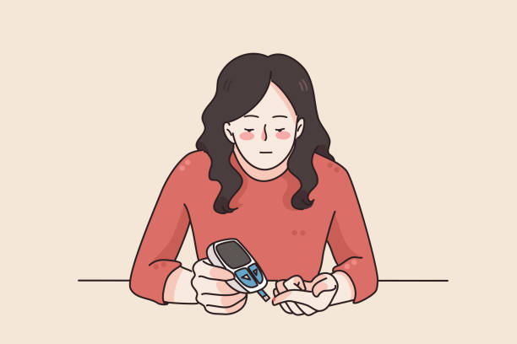
Management of diabetes
Presesnted by : Supervised by :
Malak Ajour Dr. Meeran bataineh

Slide 2
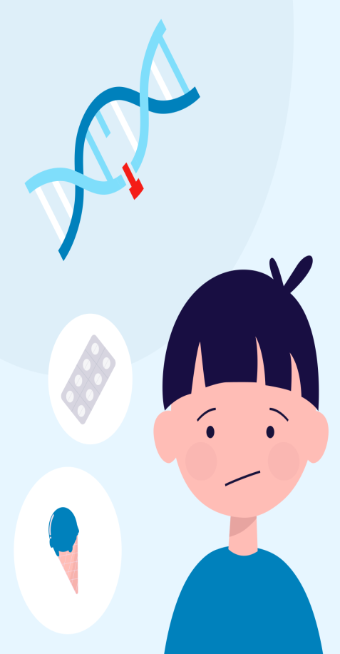
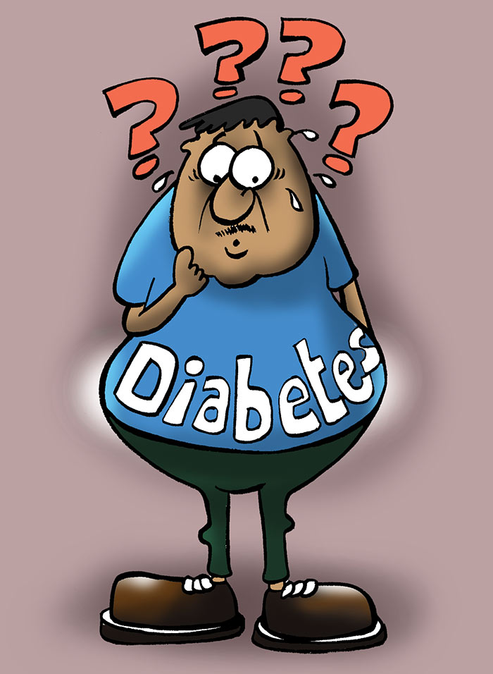
DM types
Other types
Type 1
Type 2
gestational

Slide 3
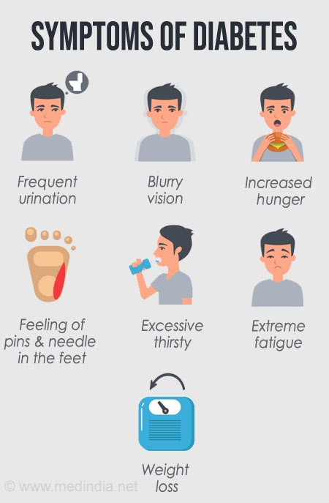

Slide 4
Diagnosis

Slide 5
Treatment
Lifestyle changes
Oral hypoglycemic drugs
Insulin

Slide 6
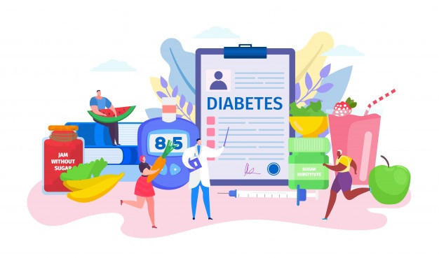
Diet and lifestyle
Lifestyle changes, such as taking regular exercise, weight loss - In extreme cases, bariatric surgery can induce marked weight loss and improvement in HbA1cin patients with type 2 diabetes- , observing a healthy diet, reducing alcohol consumption and stopping smoking, are important but difficult for many to sustain.
Should be implemented 1st in all patients with T2DM

Slide 7
Oral hypoglycemic drugs

Slide 8
Oral hypoglycemics should be prescribed for all type 2 diabetics. Metformin is
the drug of choice and along with lifestyle intervention should be used in all
newly diagnosed patients.
If a patient is initiated on metformin yet the diabetes does not become wellcontrolled, add a sulfonylurea.
If a patient is already on sulfonylurea but the diabetes is not well-controlle add metformin.
If a patient is already taking both metformin and a sulfonylurea yet there is still poor glycemic control, then either switch to insulin or add a glitazone.

Slide 9
Biguanides
Metformin
It is the 1st line medication.
Metformin is given with food, 2–3 times daily , the usual starting dose is 500mg twice daily
It improves insulin sensitivity and peripheral glucose uptake, and impairs both glucose absorption by the gut and hepatic gluconeogenesis.
Advantages :
it does not increase insulin secretion and seldom causes hypoglycaemia.
does not increase body wt
Improves lipids and endothelial function
Notes:
Mechanism of action
Act by decrease hepatic glucose producion
Increase glucose utilization
Decrease insulin resistance
Contraindication:
Serum Creatinine >1.5 mg in men/dl,1.4 mg in women
Radiographic contrast studies
Seriously ill patients
Acidosis
Reduce HbA1C by 1-2%

Slide 10
Side effects and precautions:
dose – related abdominal pain and diarrhea, lactic acidosis and metallic taste.
Contraidicated in patients with:
severe renal dysfunction (GFR < 30 ,, Cr >1.5)
Decompensated HF
Acute or chronic metabolic acidosis
Metformin may induce vitamin B12 malabsorption, so regular B12 monitoring is advised.

Slide 11
Secretagogues
Sulfonylurease
Meglitinides

Slide 12
sulphonylureas
Glimeperide
Glyburide (very long half life )
Glipizide.
Induce insulin secretion from pancreatic B cells.
Side effects and precaution :
Hypoglycemia.
Weight gain.
They should be taken with in 30 min before meals to induce insulin secretion.
sulfonylureas lose efficacy over time.
Glyburide has the greatest potential for hypoglycemia and cannot be used in renal failure
Notes:
First generation (chlorpropamide,tolbutamide)
Second generation (Glibenclamide,Gliclizide, glipizide)
Third generation as glimperide
Mode of action:
Act by stimulating a receptor on Beta cells,closing potassium channels and opening a Ca channel with subsequent insulin release

Slide 13
Meglitinides
Induce insulin secretion
These are rapid-acting with a very short – half life
Repaglinide
Nateglinide
The major effect is on postprandial glucose
Side effects and precaution :
Weight gain
Use with caution in patients with chronin kidney disease

Slide 14
Alpha-glucosidase inhibitors
miglitol
Acarbose
These delay carbohydrate absorption in the gut by selectively inhibiting disaccharidases.
taken with each meal and lowers post prandial blood glucose.
Side effects are:
flatulence
abdominal bloating
diarrhoea
Notes:
Mechanism of Action: by decrease glucose absorption esp. postprandial hyperglycemia, by inhibiting the enzyme that convert oligosaccharides to glucose

Slide 15
Thiazolidinediones
pioglitazone
Rosiglitazone
These drugs (glitazones) bind and activate receptor found in adipose tissue, and work by enhancing the actions of endogenous insulin. Plasma insulin concentrations are not increased and hypoglycaemia is not a problem.
Pioglitazone decreases triglyceride levels and increases HDL
Side effects and precaution :
Was reported to increase the risk of myocardial infarction and was withdrawn
fluid retention
Exacerbation of stable heart failure
weight gain
increases the risk of bone fracture
Pioglitazone has been shown to increase the risk of bladder cancer
rare hepatotoxicity has been reported

Slide 16
Incretin-based therapies
Glucagon-like peptide 1 receptor agonist
The incretin is hormone released by gut and regulate glucose by stimulating insulin release, inhibiting postprandial glucagon release, slowing nutrition absorption and accelrate satiety.
DPP-4 inhibitors: slow the inactivation of neutral incretins, and increase endogenous GLP1 and GIP levels.

Slide 17
Glu-1 receptor agonists
Mimic GLP1 but are modified to resist DPP4
semaglutide (Rybelsus, oral, taken by mouth once daily)
exenatide (once weekly) (SC)
liraglutide (once daily) (SC)
Dulaglutide (once weekly) (SC)
have a key advantage over DPP4 inhibitors: they decrease appetite at the level of the hypothalamus. Thus lower blood glucose and result in weight loss
GLP-1 RECEPTOR AGONIST are recommended for patients who cannot tolerate or take metformin . Otherwise , they are useful add-ons to metformin

Slide 18
Side effects:
Vomiting and diarrhea
initial data showed some association with pancreatitis
C.I in patient with family history of medullary thyroid cancer (liraglutide)
They should not be used in patient with GFR >30

Slide 19
DPP4Is
Slow the inactivation of endogenous incretins
Sitagliptin
Saxagliptin
Linagliptin
Alogliptin
The biggest effect is on decreasing postprandial hyperglycemia
Do not tend to cause hypoglycemia
recommended for patients who cannot tolerate or take metformin , sulfonylureas , TZDs ,they also considered add-on drugs.

Slide 20
Side effects:
Rarely cause severe skin reactions
Concerns about increased pancreatitis with DPP4Is
Increased risk of heart failure hospitalization

Slide 21
Newer Agents - Amylin Analogs
Amylin is a hormone secreted by pancreatic beta cells along with insulin and helps to regulate glucose influx by suppressing glucagon and slowing stomach emptying.
Pramlintide is an analog that comes as an injection given before meals. It is intended to be used with prandial insulin, because it helps insulin to work more effectively so Cut the insulin dose by 50% when initiating treatment.
Gastroparesis and insensitivity to hypoglycemia are contraindications.

Slide 22
Sodium-Glucose Co-transport Inhibitors (SGLT-2 Inhibitors)
SGLT-2 inhibitors block the co-transport of sodium glucose in the proximal tubule, reducing glucose reabsorption and causing renal excretion of glucose.
Canagliflozin is the 1" agent in this class that works by inhibiting glucose reabsorption in the renal tubules. It is oral agent approved monotherapy and in combination with metformin, sulfonylureas, glitazones, and insulin
It is contraindicated in Type 1 diabetes and in patients with a GFR <45.
Common side effects are dehydration, renal impairment, urinary tract infections, genital mycotic infections, There is an increased risk of vulvovaginal infections in females.

Slide 25
Insulin should be added after oral drugs are used except in the following special situations, where insulin should be instituted early:
Patients who have consistently high random plasma glucoses (> 300-350 mg/dL)
A1c >10-12%
A1c >9% with symptoms
Signs of ketosis on physical exam
Severe symptoms of hyperglycemia or history of DKA
in these groups, oral agents can be added later, after the glucose have stabilized with insulin-and, eventually, you may be able to stop the insulin entirely.

Slide 26
The basal/bolus insulin concept
Basal insulin
Suppress glucose production between meals and overnight .
Nearly constant levels.
50 % of daily needs.
Bolus insulin (mealtime or prandial )
Limits hyperglycemia after meals .
Immediate rise and sharp peak at 1 hour .
10% to 20% of total daily insulin requirement.

Slide 27
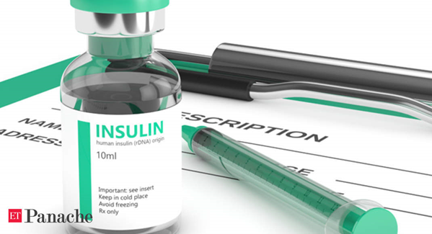
Insulin
Subcutaneous multiple dose insulin therapy
The rate of absorption of insulin may be influenced by the insulin formulation, the site, depth and volume of injection, skin temperature (warming), local massage
once absorbed into the blood, insulin has a half life of just a few minutes.
Excretion is hepatic and renal, so insulin levels are elevated in hepatic or renal failure.

Slide 28
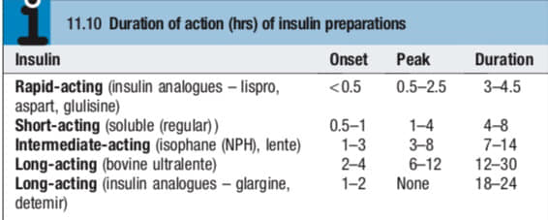

Slide 29
The complications of insulin therapy include:
Hypoglycaemia
Weight gain.
Peripheral oedema
Insulin antibodies
Local allergy (rare).
Lipodystrophy at injection site
A common problem is fasting hyperglycaemia (the ‘dawn phenomenon’) caused by the release of counter regulatory hormones during the night, which increases insulin requirement before wakening
Notes:
Somagi

Slide 30
insulin dosing regimens
The choice of regimen depends on the desired degree of glycemic control, the severity of insulin deficiency, the patient’s lifestyle, and their ability to adjust the insulin dose.
Most people with type 1 diabetes require two or more insulin injections daily. In type 2 diabetes, insulin is usually initiated as a once daily long acting insulin, with or without oral hypoglycaemic agents
Twice-daily administration:
A short acting and intermediate acting insulin (usually soluble and isophane), given before breakfast and the evening meal, is the simplest regimen. Initially, two thirds of the daily insulin is given in the morning in a ratio of short to intermediate acting of 1 to 2; the remainder is given in the evening.

Slide 31
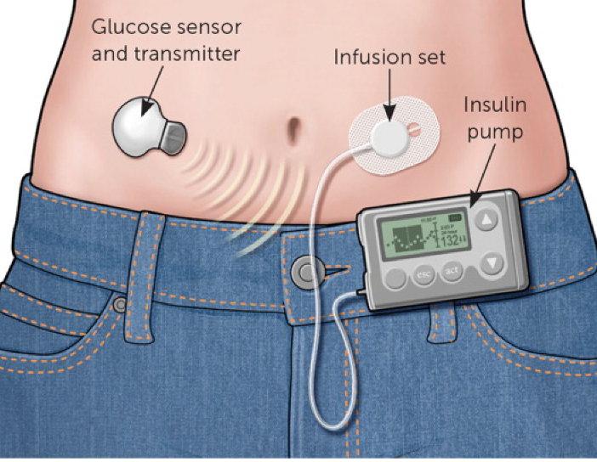
Multiple injection regimens:
These are popular, with short acting insulin before each meal, plus intermediate or long acting insulin injected once or twice daily (basal bolus regimen). This regimen allows greater freedom of meal timing and more variable day to day physical activity.
Portable pumps:
Pumps infusing continuous SC or
IV insulin can achieve
excellent glycaemic control
Notes:
Continuous subcutaneous insulin infusion

Slide 32
Fixed daily doses of each type of insulin do not always correct hyperglycemia, especially in patients whose intake of carbohydrates varies dramatically.
A recent approach is to use nutritional counseling to teach patients how to effectively estimate the grams of carbohydrate in their next meal. Then, they use a pre-established carbohydrate:insulin ratio to calculate the dose of their pre-meal short-acting insulin. (For example, if using regular insulin and the patient's individualized C:I ratio is 15:1, then when the intake is estimated at 130 gm carbs, the dose would be 130/15, or 8.5 u of short- acting pre-meal).
This route for dosing gives patients a little more dietary flexibility and still prevents hyperglycemia. The counseling aspect is important because both physicians and diabetic patients erroneously estimate the carbohydrate content of most meals.

Slide 33
Transplantation
Whole pancreas transplantation presents problems relating to exocrine pancreatic secretions and long term immunosuppression is necessary. At present, the procedure is usually undertaken only in patients with ESRF who require a combined pancreas/kidney transplantation and in whom diabetes control is particularly difficult, e.g. because of recurrent hypoglycaemia.
Transplantation of isolated pancreatic islets (usually into the liver via the portal vein) has been achieved safely in an increasing number of centres around the world. Progress is being made towards meeting the needs of supply, purification and storage of islets, but the problems of transplant rejection, and of destruction by the patient’s autoantibodies against β cells, remain

Slide 34
Thank you

