Slide 1
Polycystic kidney disease
By:
Sura Al-lasasmeh
Lujain Al-bawaliez
Misyana Hijazeen

Slide 2
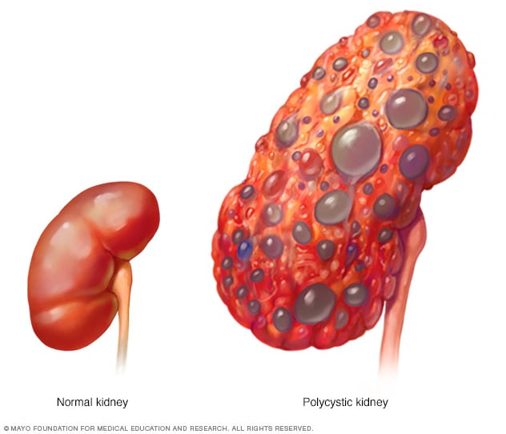
Polycystic kidney disease
Etiology: Mutation of 85% to 95% of cases are ADPKD1, located on chromosome 16; the remaining 5% to 15% are ADPKD2, located on chromosome 4.
Autosomal dominant polycystic kidney disease (ADPKD) is the most common genetic cause of CKD.
The course is variable, but ESRD commonly develops in 50% of the patients (by late 50s or 60s); remainder have a normal lifespan.
Pathophysiology: Renal failure occurs from cysts replacing renal parenchyma over time, as well as recurrent episodes of pyelonephritis and nephrolithiasis

Slide 3
Clinical features
1. Hematuria: usually visible and thought to be due to rupture of cysts into the collecting system
2. Abdominal pain: sources include pyelonephritis, stones, and hemorrhaging into cysts
3. HTN (in >50% of the cases)
4. Palpable kidneys on abdominal examination

Slide 4
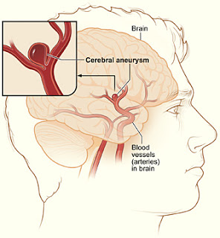
Complications
Renal problems:
1. Infection of renal cysts; bleeding into cysts - Most patients with polycystic kidney disease complain of pain at some point
2. Renal failure (late in the disease) - once renal failure sets in, almost all patients develop severe hypertension.
This may be marked by symptoms such as dizziness, vomiting, dyspnea and headache.
3. Kidney stones - Up to 20% of patients.
CVS problems:
1. Heart valve abnormalities (especially mitral valve prolapse)
2. Intracerebral berry aneurysm (in 5% to 20% of cases)—most do not rupture

Slide 5
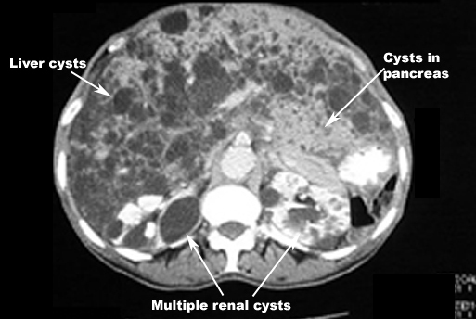
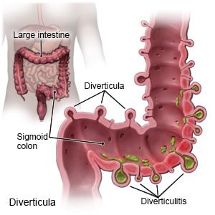
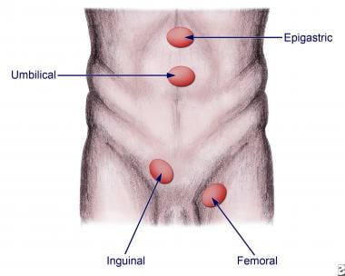
Complications
GI cysts:
1. Cysts in other organs (liver, spleen, pancreas, brain)
2. Diverticula (colon) - may lead to colicky pain in the abdomen, characteristically left-sided, with bloating, at this stage the patient usually has end-stage renal disease. However, in most patients the condition is asymptomatic, though it may be complicated by hemorrhage into or infection of the diverticula.
3. Hernias (abdominal/inguinal)

Slide 6
Investigations
The diagnosis is usually based on family history, clinical findings and ultrasound examination.
Ultrasound demonstrates cysts in approximately 95% of affected patients over the age of 20 and is the screening method of choice,but may not detect small developing cysts in younger subjects.
Cysts may also be identified by other imaging modalities, such as MRI.
Simple renal cysts may occur in normal individuals but are uncommon below the age of 30.
The following criteria exist for an ultrasound diagnosis of PKD in patients with a family history but unknown genotype:
▪ 15–39 years of age: at least
▪ 40–59 years of age: at
▪ 60 years or older: at least four cysts in each kidney.

Slide 7
It is now possible to make a molecular diagnosis by mutation screening of PDK1 or PDK2 but this is seldom used in routine clinical practice because the PKD1 gene is so large and has many possible mutations.
▪ Indications for molecular studies :
✓ This is likely to be used in cases with an uncertain diagnosis (young patients, few cysts, lack of family history
✓ screening for mutations associated with a worse prognosis
✓ workup of living kidney donors

Slide 8
Managment
Blood pressure control is important because cardiovascular morbidity and
mortality are so common in renal disease, but evidence is lacking that
controlling blood pressure to generally recommended CKD targets (e.g.
<130/80 mmHg) influences renal outcomes.
The vasopressin V2 receptor antagonist may retard kidney volume
increase and slow the rate of GFR decline.
▪ Risk factors for progression include
✓ large kidneys (more specifically height-adjusted kidney volume)
✓ truncating PKD1 mutation
✓ family history of early progression
✓ male sex
✓ hypertension
✓ proteinuria and development of early symptomatic cysts.
Note :
Patients with PKD are usually good candidates for dialysis and transplantation.
Sometimes kidneys are so large that one or both have to be removed to make space for a renal transplant. Otherwise, they are usually
left in situ unless they are a source of pain or infection.

