Slide 1
Infective Endocarditis
Dr. Amin Aqel
CVS Module
16th Nov 2021

Slide 2
Infective endocarditis
Microbial infection of the endothelial surface
Valves
Septal defect
chordae tendineae
mural endothelium
NVE: native valve endocarditis
PVE: prosthetic valve endocarditis
Acute
Subacute

Slide 3
Infective endocarditis-classification
Duration (incubation)
Culture results
Heart side
Infection setting
Valve type (Prosthetic valve endocarditis can be early (< 60 days of valvular surgery), intermediate (60 days to 1 year) or late (> 1 year following valvular surgery).

Slide 4
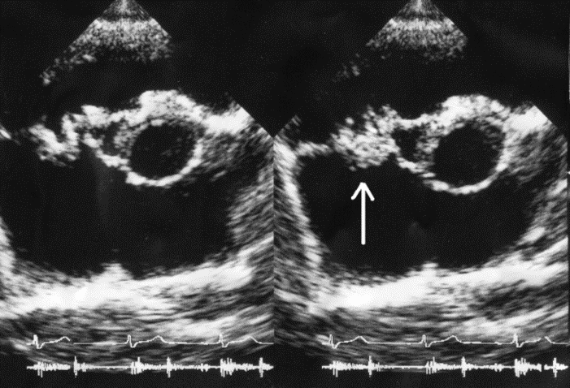
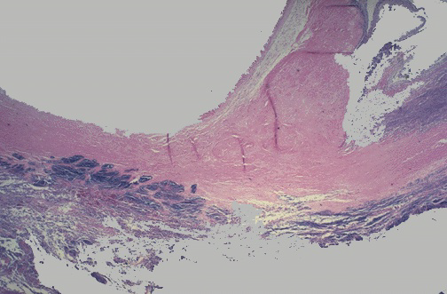
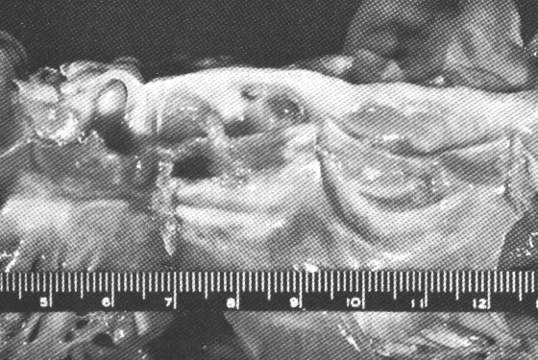
Infection
Growth of vegetation by platelet-fibrin deposition
yields a sanctuary for bacteria.

Slide 5
Infective endocarditis
Occurs on
Defective valves
Prosthetic valves
Normal valves
Congenital heart defects e.g.
Ventricular septal defect
Patent ductus arteriosus
40% with IE have
Normal heart
Undiagnosed defect

Slide 6
Infective Endocarditis
Febrile illness
Persistent bacteremia
Characteristic lesion of microbial infection of the endothelial surface of the heart
Variable in size
Amorphous mass of fibrin & platelets
Abundant organisms
Few inflammatory cells
the vegetation

Slide 7
Infective Endocarditis
Acute
Toxic presentation
Progressive valve destruction & metastatic infection developing in days to weeks
Most commonly caused by S. aureus

Slide 8
Infective Endocarditis
Subacute
Mild toxicity
Presentation over weeks to months
Rarely leads to metastatic infection
Most commonly
viridans streptococci or enterococcus

Slide 9
Infective endocarditis
Incidence: 2 / 100,000 patient-years,
15—30 / 100,000 patient-years ( >60 y/o)
Rheumatic heart disease
Congenital heart disease
Mitral valve prolapse with regurgitation
Degenerative heart disease
Asymmetrical septal hypertrophy
Intravenous drug abuse
Prosthetic valve (7—25%)

Slide 10
Infective endocarditis: patient groups
Children with IE:
Congenital heart disease (aortic valve),
Normal structure (tricuspid valve),
Staphylococcus (neonate),
Streptococcus group B (children), S. pneumonia (rare)
Adults with IE:
Rheumatic heart disease
Congenital heart disease

Slide 11
Notes:
Table 47-1

Slide 12
Infective Endocarditis
Intravenous Drug Abuse
Risk is 2 – 5% per pt./year
Tendency to involve right-sided valves
Distribution in clinical series
46 – 78% tricuspid
24 – 32% mitral
8 – 19% aortic
S. aureus predominant organism (>50%, 60-70% of tricuspid cases)

Slide 13
Infective Endocarditis
Prosthetic Valve Endocarditis (PVE)
10 – 30% of all cases in developed nations
Cumulative incidence
1.4 – 3.1% at 12 months
3.2 – 5.7% at 5 years
Early PVE – within 60 days
Nosocomial (S. epidermidis predominates)
Late PVE – after 60 days
Community (same organisms as NVE)

Slide 14
Infective endocarditis: nosocomial
Infected intracardiac device and catheter
GI or GU tract surgery or instrumentation
High mortality (40—56%)
( S. aureus, CONS, Enterococcus)
S. aureus catheter related bacteremia (23%)

Slide 15
Infective endocarditis: microorganism
viridans streptococcus:
35 — 65% NVE
normal inhabitants of the oropharynx
penicillin sensitive
penicillin plus aminoglycoside

Slide 16
Infective endocarditis: microorganism
Streptococcus pneumoniae:
alcoholism
aortic valve
concurrent pneumonia or meningitis
Penicillin / Rocephin → Vancomycin
Enterococcus:
normal GI tract flora and cause GU infection
5—15% NVE and PVE
Penicillin / Ampicillin / Vancomycin / Teicoplanin + GM

Slide 17
Infective endocarditis: microorganism
Staphylococcus:
Coagulase-positive: S. aureus
highly toxic febrile
30—50% CNS involvement
Mortality: 16—46% (L’t), 2—4% (R’t)
Oxacillin / 1st cephalosporin
Coagulase-negative: S epidermidis
Major cause of PVE

Slide 18
Infective Endocarditis
Gram negative organisms
P. aeruginosa most common
HACEK - slow growing, fastidious organisms that may need 3 weeks to grow out of culture
Haemophilus sp.
Actinobacillus
Cardiobacterium
Eikenella
Kingella
Other Organisms like Aspergillus species, Brucella species, Coxiella burnetii, Chlamydia species

Slide 19
Pathogenesis
Vegetations along valve edges: mass of fibrin, platelets and infectious organisms
Endothelial damage
Platelet-fibrin thrombi
Microorganism adherence

Slide 20
Turbulent blood flow traumatises endothelium
Nonbacterial thrombotic endocarditis
Bacteraemia
Further deposition of fibrin and platelets
Underwood 2004

Slide 21
Pathophysiology
Clinical manifestations
Direct
Constitutional symptoms of infection (cytokine)
Indirect
Local destructive effects of infection
Embolization – septic or bland
Hematogenous seeding of infection
N.B. may present as local infection or persistent fever, metastatic abscesses may be small, miliary
Immune response
Immune complex or complement-mediated

Slide 22
Infective Endocarditis
Outcome
Fatal 10-70% of cases

Slide 23
Clinical Features
Malaise, fever, night sweats, weight loss, anaemia, Chills, Anorexia, Arthralgia
Valve destruction → heart failure
→ new/changing murmurs
Embolic events → abscesses in brain, liver
Immune complex deposition → vasculitis
→ arthralgia
→ glomerulonephritis

Slide 24
Infective Endocarditis
Petechial Hemorrhages
Linear Hemorrhages
Osler Nodes
Janeway Lesions
Retinal Hemorrhages
Splenomegaly

Slide 25
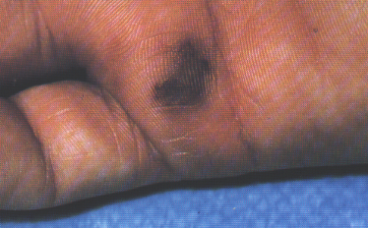
Peripheral Manifestations
Janeway Lesions:
erythematous, macular, non tender.
septic emboli?
Osler’s Nodes:
Tender, subcutaneous nodules.
4 P’s:
Pink
Painful
Pea-sized
Pulp of the fingers/toes.
Immunologic origin?

Slide 26
Osler’s Nodes

Slide 27
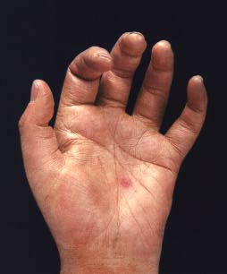
Janeway Lesions

Slide 28
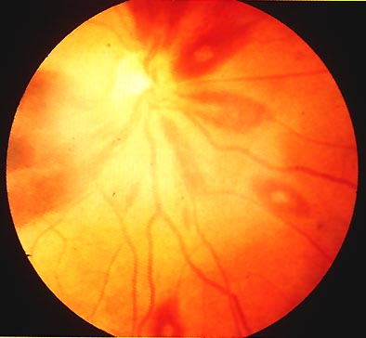
Bleeding
Subungual (splinter) hemorrhage
Conjunctival hemorrhage
Retinal hemorrhage: Roth Spot

Slide 29
Infective Endocarditis Complications
Reinfection
Systemic emboli
Neurological sequelae
Congestive heart failure
Due to mechanical disruption
Renal insufficiency
Immune complex mediated
Impaired hemodynamics/drug toxicity

Slide 30
Lab Investigations
Normochromic normocytic anaemia
↑ WCC – white cell count
↑ ESR – erythrocyte sedimentation rate
Blood cultures – repeated samples, 3/24h
Echocardiography

Slide 31
Diagnosis
Frequently difficult to diagnose with certainty.
Highly variable and often non-specific presentation.
Overdiagnosis and Underdiagnosis are common.

Slide 32
Diagnosis
Classic Clinical Approach:
Von Reyn Criteria
Limitations:
No Use of Echo.
Lacks sensitivity for “acute” cases.
Incorporation of Echo:
Durack (Duke) Criteria
Increases proportion of definite diagnoses.

Slide 33
Surgical Treatment of Intra-Cardiac Complications
Valve dysfunction
Unstable prosthetic valve
Uncontrolled infection
Unavailable effective antimicrobial therapy
Fungal endocarditis
Brucella
S. aureus PVE with any intra-cardiac complication
Relapse of PVE after optimal therapy

Slide 34
Pericarditis
Description
Inflammation of the pericardium which surrounds the heart
Fluid accumulates in the pericardium
Adhesions may occur
Constriction can cause acute symptoms
Causes:
Bacterial, fungal, or viral
Neoplasms form lungs, breasts or other organs
Autoimmune diseases (lupus, RA)
Post cardiac injury
Medications
Aortic aneurysm leakage

Slide 35
Myocarditis
Definition: Myocarditis is an inflammatory disease of cardiac muscle
It can be acute, subacute, or chronic, and there may be either focal or diffuse involvement of the myocardium
Infection
Viral
Bacterial, rickettsial, spirochetal
Protozoal, Helminths
Fungal
Toxic
Hypersensitivity

