Slide 1
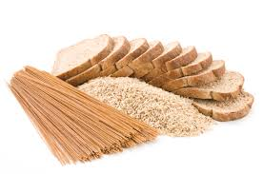
Carbohydrates
Dr. Nesrin Mwafi
Biochemistry & Molecular Biology Department
Faculty of Medicine, Mutah University

Slide 2
Disaccharides
These are two monosaccharides linked together via the
glycosidic bond. Three common disaccharides:
Maltose “malt sugar” consists of two α-glucose units, is a
disaccharide released during the hydrolysis of the starch
Reducing
end
α-D-glucopyranosyl-(1 4)-α-D-glucopyranose

Slide 3
Glycosidic bond
Glycosidic bond is a type of covalent bond where the anomeric group of a sugar can condense with an alcohol. This type of bond is called O-glycosidic bond.
N-glycosidic bond is another type of glycosidic bond which forms between the anomeric carbon of sugar and an amine.
e.g. the bonds that link D-ribose and
D-deoxyribose to purines and pyrimidines in the nucleic acids: RNA & DNA, respectively.

Slide 4
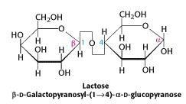
Disaccharides
These are two monosaccharides linked together via the glycosidic bond. Three common disaccharides:
Maltose “malt sugar” consists of two α-glucose units, is a disaccharide released during the hydrolysis of the starch
Reducing
end
α-D-glucopyranosyl-(1 4)-α-D-glucopyranose
Lactose “milk sugar” consists of glucose & galactose, is a disaccharide occurs naturally in the milk
Reducing
end
OH
Reducing
end
β
H
α-
β-
β-

Slide 5
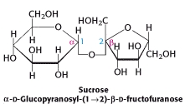
Disaccharides
Sucrose “table sugar” consists of glucose & fructose, is a disaccharide obtained commercially from cane or beet.
Sucrose is not a reducing sugar because the anomeric carbon of the second residue (the reducing end) is not free but involved in the glycosidic bond formation.

Slide 6
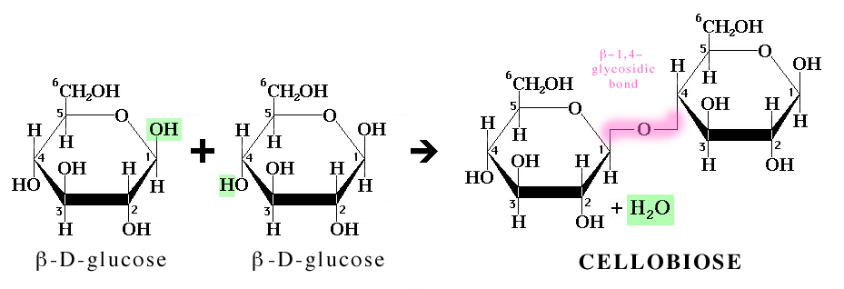
Disaccharides
Cellobiose consists of two D-glucose residues linked by the β-glycosidic bond (C1 of one residue is joined to the oxygen atom attached at C4 of the second residue). It is released during cellulose degradation
Reducing
end
β-D-Glucopyranosyl-(1 4)- β-D-glucopyranose

Slide 7
Polysaccharides
Polysaccharides “glycans” are polymeric molecules consist of long chains of monosaccharide units bound together via the glycosidic linkages.
Polysaccharides composed of same type of monosaccharides are called homopolysaccharides “homoglycans” and those consisting of more than one type are called heteropolysaccharides “heteroglycans” .
They form branched as well as linear polymers.
They are classified into:
Storage polysaccharides like starch and glycogen
Structural polysaccharides like cellulose and chitin

Slide 8
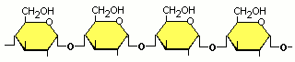
Storage Polysaccharides
Starch: is the storage polysaccharides in plants.
Polymer composed of glucose monomers
a mixture of amylose (20%, water soluble) and amylopectin (80%, water insoluble) stored in plant cells as insoluble granules.
unbranched starch(linear)
α
1
4
α
4
α
1
1
4
α
O
Amylose : α (1 4) glycosidic bonds
The helical structure of amylose

Slide 9
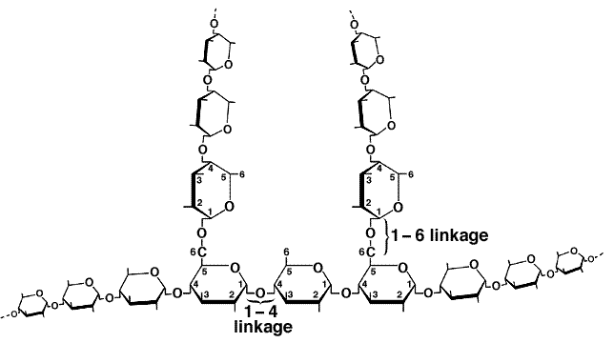
Storage Polysaccharides
branched starch
1- 4 linkage
Amylopectin: α (1 4) glycosidic bonds
with α (1 6) branch points (every 24-30 units)

Slide 10
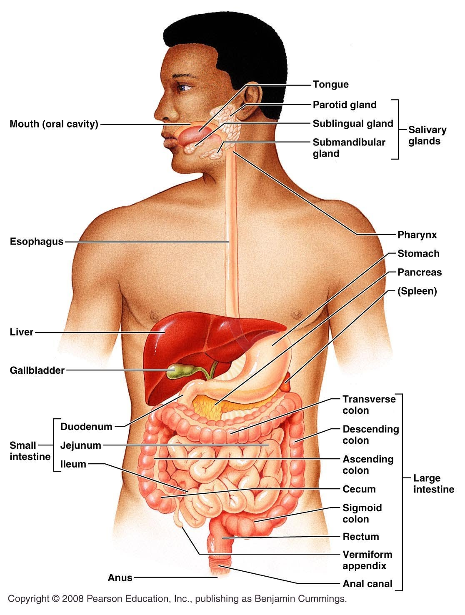
Digestion of starch
The salivary amylase enzyme randomly
hydrolyses the α-(1 4) bonds
Starch digestion to small oligosaccharides
continues in the small intestine by
pancreatic amylase
Further hydrolysis by α-glucosidase (which
remove one glucose residue at time) and by
a debranching enzyme (which hydrolyzes
specifically α-[ 1 6] bond
The produced monosaccharides (glucose residues)
are absorbed by the intestine and transported
to the bloodstream

Slide 11
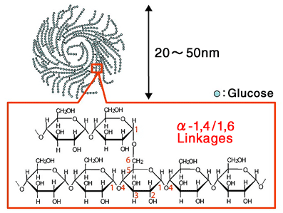
Storage Polysaccharides
Glycogen: is the storage polysaccharide in animal & human
Polymer composed of glucose units like amylopectin but glycogen is more highly branched with branch points occurring every 8-14 residues
Mainly found in skeletal muscle (up to 1-2% of muscle mass) and liver cells (up to 10% of liver mass)

Slide 12
Storage Polysaccharides
Starch and glycogen have one reducing end (the molecule end containing a free anomeric carbon C1). On the other hand, the branches ends are all called non-reducing ends and being sites where enzymatic lengthening and degradation occur.
non-reducing
end (NRE)
reducing
end (RE)
NRE
NRE
NRE
NRE
NRE
NRE
NRE
NRE
NRE
RE
RE
NRE
NRE
NRE
NRE
NRE
NRE
NRE
NRE
NRE
NRE

Slide 13
Synthesis & Breakdown of Glycogen
The brain and other tissues require a constant supply of blood glucose for survival
Some tissues particularly liver and skeletal muscles store glucose in a form that can be rapidly mobilized (i.e. glycogen)
Glycogen in synthesized (glycogenesis) when blood glucose is high and glycogen is degraded (glycogenolysis) releasing glucose into the blood stream when blood glucose is low (normal blood glucose level is 80-100 mg/dl)
This balance between the need and availability is called metabolic homeostasis

Slide 14
Structural Polysaccharides
Cellulose: the primary structural component of plant cell walls.
A linear polymer of D-glucose residues linked via β-(1-4) glycosidic bonds.
It is the most abundant organic molecule on the earth. cellulose accounts for over half of the carbon in the biosphere.
It adopts a very different molecular architecture from that of starch (hollow helix) due to its β-linkages.

Slide 15
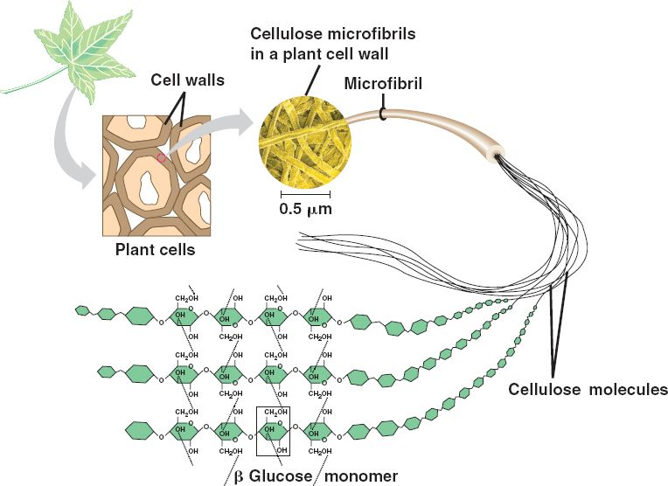
Structural Polysaccharides
Cellulose forms very long straight chains. The parallel chains interact with one another through H-bonds

Slide 16
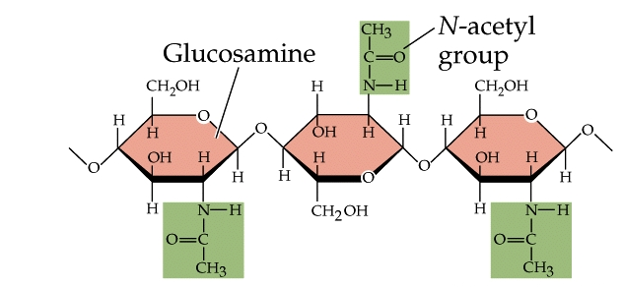
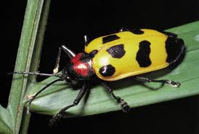
Structural Polysaccharides
Compared to humans, herbivores and termites can digest cellulose because they have cellulases enzymes “enzymes capable of hydrolyzing the β-(1-4) bonds of cellulose ”.
Chitin:
It is the structural component of the exoskeletons of the invertebrates like insects and spiders. Also, it is the main component of the cell walls of fungi.
A long chain polymer of N-acetyl-D-glucosamine residues joined by β-(1-4) bonds.

Slide 17
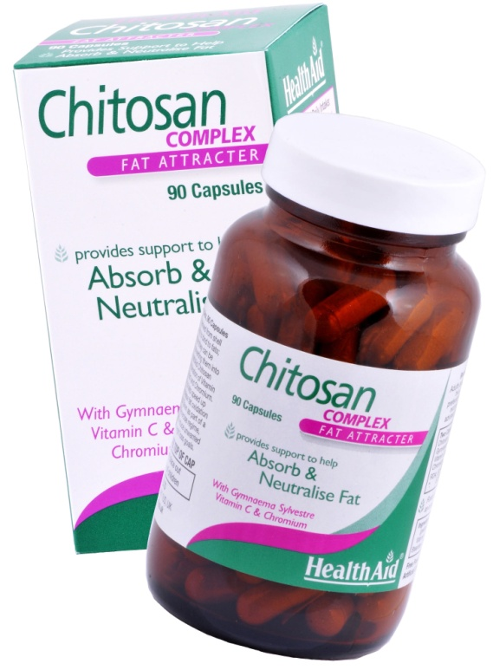
Structural Polysaccharides
It has similar structure to cellulose with the only difference is the replacement of OH at C2 of each monomer with acetyl amine group
Chitosan: is a linear polysaccharide composed of randomly distributed β-(1-4)-linked D-glucosamine (deacetylated unit) and N-acetyl-D-glucosamine (acetylated unit). It is produced commercially by deacetylation of chitin (e.g. by treating shrimp shells with the alkali sodium hydroxide).
Medical uses: it is useful in weight loss
and obesity treatment plans because it
can reduce fat absorption

Slide 18
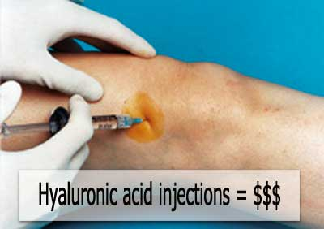
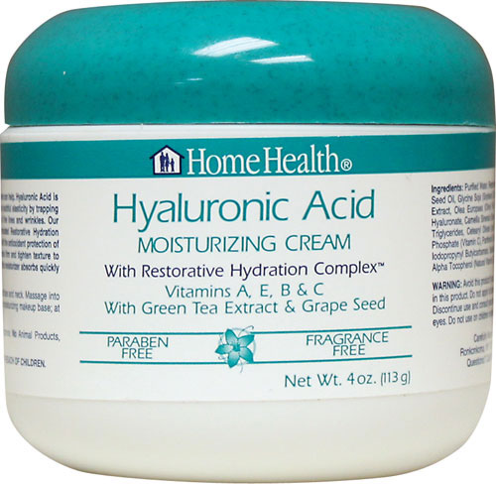
Heteropolysaccharides
Consist of two or more different monosaccharide units and are closely associated with lipid (glycolipids) or protein (glycoproteins)
The naturally occurring heteroglycans are mostly found in the connective tissues (such as cartilage, tendon, blood vessel walls,…..etc)
Hyaluronic acid (Hyaluronate)
It is the major component of joint fluid (synovial fluid). It acts as a lubricating agent and shock absorber.
It is also a major component of skin, where it is involved in tissue repair. Dry and scaly skin such as that caused by eczema may be treated with a prescription skin lotion containing sodium hyaluronate as its active ingredient.

Slide 19
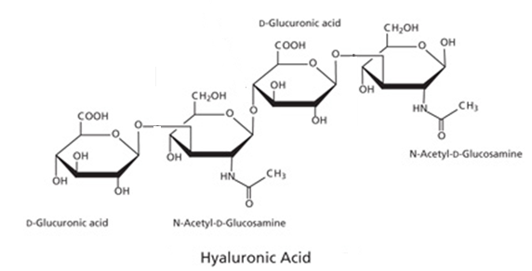
Heteropolysaccharides
Hyaluronic acid is a linear polymer of the disaccharides “ D-glucuronic acid and N-acetyl-D-glucosamine “ linked via alternating β-1,4 and β-1,3 glycosidic bonds.
4
4
1
3
n
1
1
3

Slide 20
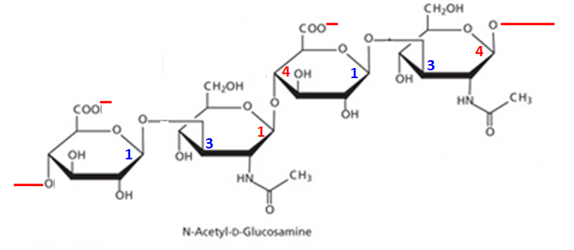
Heteropolysaccharides
n
D-Glucuronate
(anion)
Hyaluronate

Slide 21
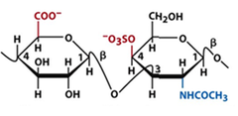
Heteropolysaccharides
Sulfated heteroglycans these consist of sulfated disaccharide units such as: chondroitin sulfate, dermatan sulfate, keratan sulfate and heparin
Chondroitin-4-sulfate & Chondroitin-6-sulfate are unbranched polymers containing the disaccharide “ D-glucuronic acid and N-acetyl-D-galactosamine ” with the N-acetyl-D-galactosamine OH groups at position 4 and 6 being sulfated, respectively.
OSO₃
HO
D-Glucuronate N-acetyl-D-galactosamine-
4-sulfate
D-Glucuronate N-acetyl-D-galactosamine-
6-sulfate
Chondroitin-4-sulfate
Chondroitin-6-sulfate

Slide 22
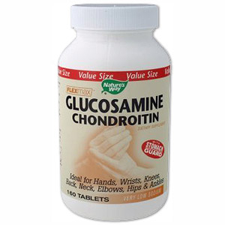
Heteropolysaccharides
Chondroitin sulfate is a major component of cartilages. They provide them with resistance to compression. Loss of chondroitin sulfate from the cartilage is a major cause of osteoarthritis.
Chondroitin is used as dietary supplement to treat osteoarthritis. It is commonly sold together with glucosamine

Slide 23
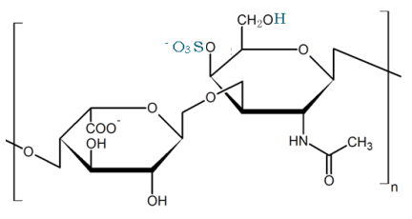
Heteropolysaccharides
Dermatan sulfate: is a natural polysaccharide found mostly in the skin. It is a linear polymer of a disaccharide containing L-Iduronic acid (modified L-Idose sugar) and N-acetyl-D-galactosamine-4-sulfate
L-Iduronate
N-acetyl-D-galactosamine-4-sulfate
Dermatan sulfate

Slide 24
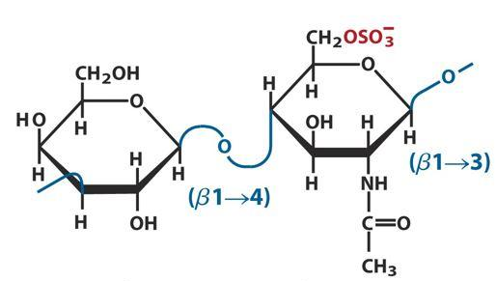
Heteropolysaccharides
Keratan sulfate: is a natural polysaccharide mainly found in the cartilage and bone. It is highly hydrated molecules which in joints can act as a cushion to absorb mechanical shock.This linear polymer is consisting of repeating disaccharide unit containing
D-galactose and N-acetyl-D-glucosamine-6-sulfate
D-galactose
N-acetyl-D-glucosamine-6-sulfate
Keratan sulfate

Slide 25
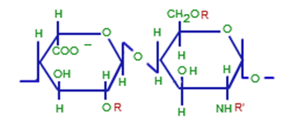
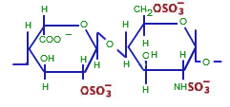
Heteropolysaccharides
Heparin: is the most highly charged polymer of any known biological molecule. Heparin is a complex mixture of linear polysaccharide and it varies in the degree of sulphation of its sugar units. One example is the sulfated disaccharide unit containing L-Iduronate-2-sulfate and N-sulfo-D-glucosamine-6-sulfate
L-Iduronic acid
D-glucosamine
L-Iduronate-2-sulfate
N-sulfo-D-glucosamine-
6-sulfate
Heparin

Slide 26
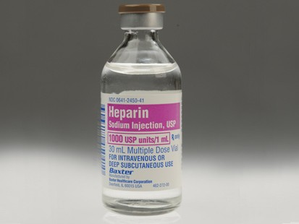
Heteropolysaccharides
Heparin is stored almost exclusively within the secretory granules of mast cells and it inhibits blood clotting. So, heparin is widely used as an injectable anticoagulant (e.g. postsurgical patients)

