Slide 1
ECG interpretation
Yousef Tarawneh
Rakan Al-jabsheh

Slide 2
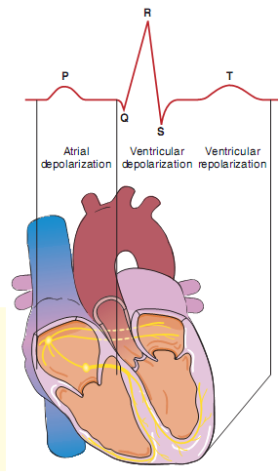

Slide 3
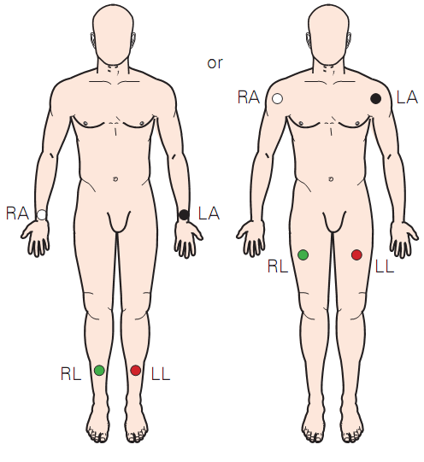

Slide 4
EKG Paper
حفظ
EKG paper is a long, continuous roll of graph paper, with light and dark lines running vertically and horizontally. The light lines circumscribe small squares of 1 × 1 mm; the dark lines delineate large squares of 5 × 5 mm.
The horizontal axis measures time.
The distance across one small square represents 0.04 seconds.
The distance across one large square is five times greater, or 0.2 seconds.
The vertical axis measures voltage.
The distance along one small square represents 0.1 mV.
The distance across one large square is five times greater, or 0.5 mV.

Slide 5
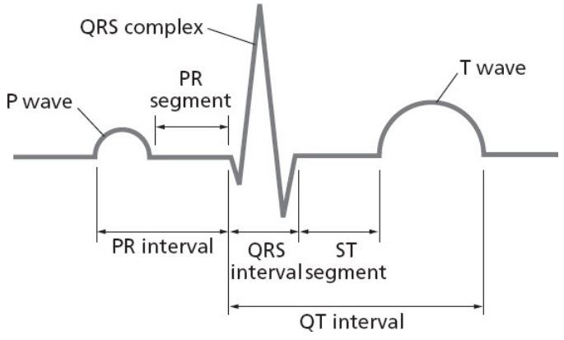
What differentiates a segment from an interval?
A segment is a straight line connecting two waves
An interval encompasses at least one wave plus, in most instances, the connecting straight line.

Slide 6
The basic waves and lines of the standard EKG
Various segments and intervals describe the time between these events:
The PR interval measures the time from the start of atrial depolarization to the start of ventricular depolarization
The PR segment measures the time from the end of atrial depolarization to the start of ventricular depolarization
The ST segment records the time from the end of ventricular depolarization to the start of ventricular repolarization
The QT interval measures the time from the start of ventricular depolarization to the end of ventricular repolarization
The QRS interval measures the time of ventricular depolarization

Slide 7
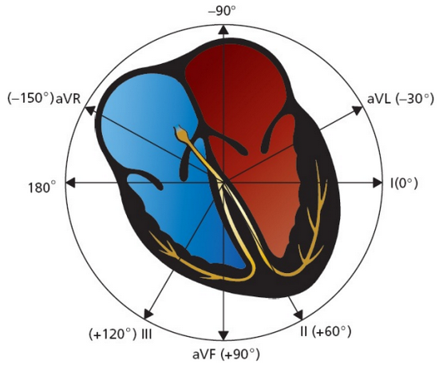
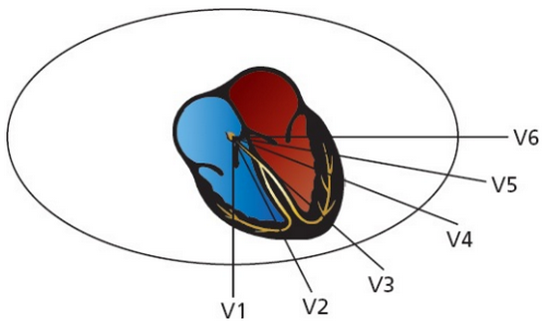
Leads Grouping
حفظ
Group | Leads
Anterior | V2, V3, V4
Left lateral | I, aVL, V5, V6
Inferior | II, III, aVF
Right ventricular | aVR, V1

Slide 8
Measure the length of
PR interval length
The PR interval normally lasts from 0.12 to 0.2 seconds (3 to 5 mm on the EKG paper).
QT interval length
The QT interval constitutes about 40% of each cardiac cycle (R–R interval).
The faster the heart beats, the shorter the QT interval.
QRS complex width
A normal QRS interval, representing the duration of the QRS complex, is 0.06 to 0.1 seconds in duration (1.5 to 2.5 mm on the EKG paper).
The DDx of abnormalities is discussed in Miscellaneous Conditions

Slide 9
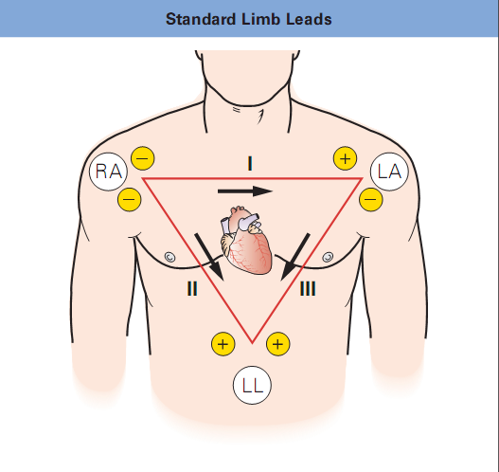

Slide 10
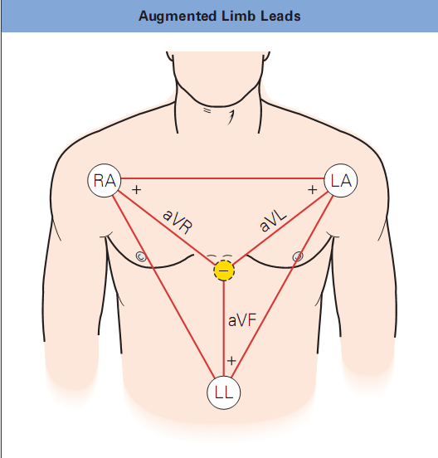

Slide 11
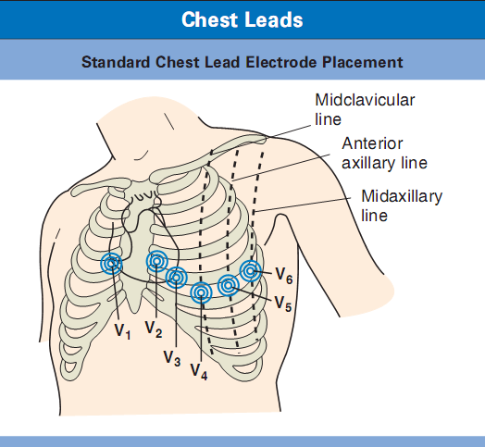
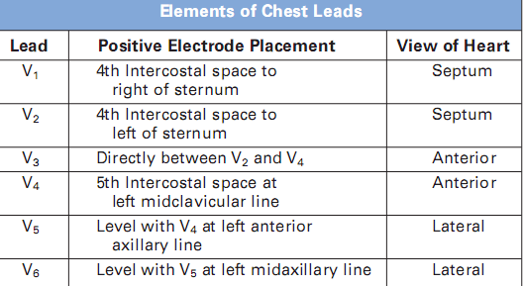

Slide 12
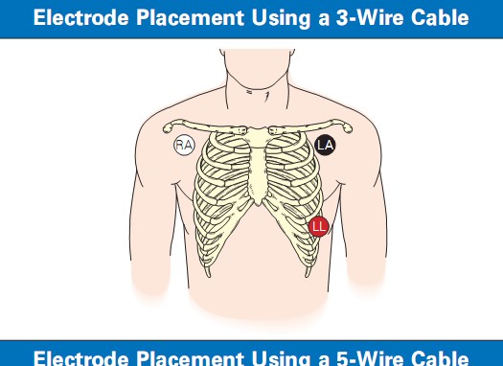
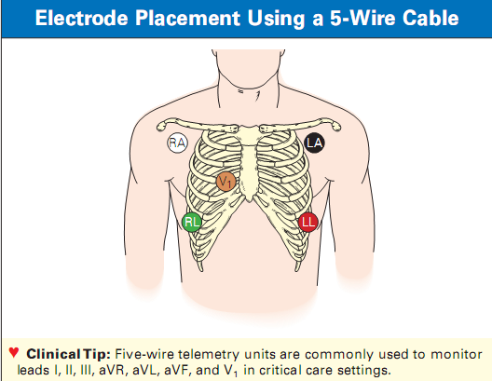

Slide 13
A thorough ECG interpretation algorithm should assess:
Heart rhythm (best seen in lead II)
Heart rate (any lead)
Cardiac axis (leads I and aVF)
P-wave morphology and size (best seen in lead II)
PR-interval duration (best seen in lead II)
QRS-complex morphology and duration (assessed in all leads individually)
ST-segment morphology (assessed in all leads individually)
T-wave morphology (assessed in all leads individually)
QT-interval duration (lead aVL)
U-wave morphology (leads V₂–V₄)

Slide 15
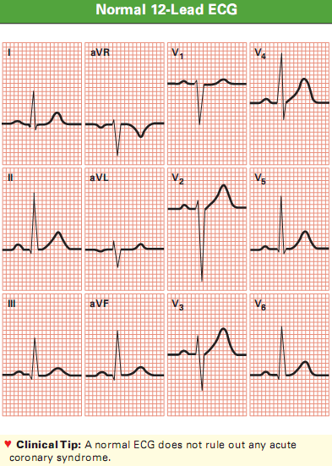

Slide 17
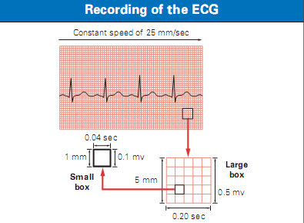

Slide 18
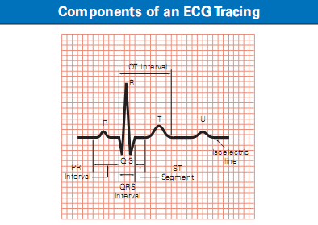

Slide 19
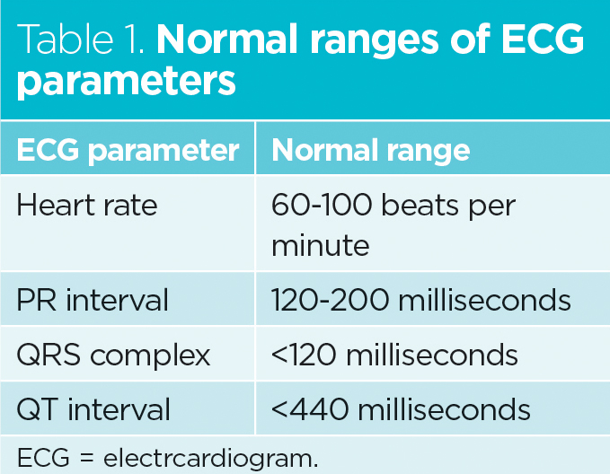

Slide 20
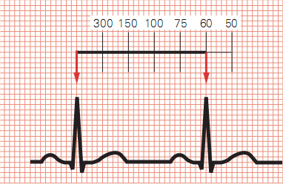

Slide 21
Determine the heart rate
If the rhythm is regular, we can use the fast method of dividing 300 by the number of large squares between two subsequence R waves or more precisely by dividing 1500 by the number of small squares
Another way to calculate the heart rate that can also be used for irregular rhythms is the number of R waves in 30 large squares × 10 or more precisely by calculating the number of R waves in 50 large squares × 6

Slide 23
Axis summary
The term axis refers to the direction of the mean electrical vector, representing the average direction of current flow. It is defined in the frontal plane only
To determine the axis of any wave, find the lead in which the wave is most nearly biphasic. The axis must lie approximately perpendicular to that lead
A quick estimate of the axis can be made by looking at leads I and aVF: → →
Things might get clearer with the examples in the next 2 slides
Axis | Lead I | Lead aVF
Normal axis | Positive | Positive
Left axis deviation | Positive | Negative
Right axis deviation | Negative | Positive
Extreme right axis deviation | Negative | Negative

Slide 25
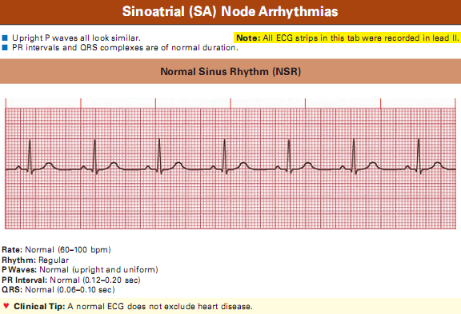

Slide 26
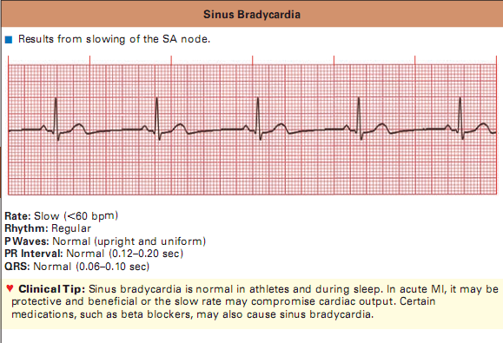

Slide 27
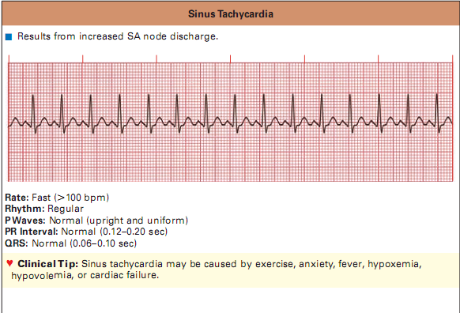

Slide 28
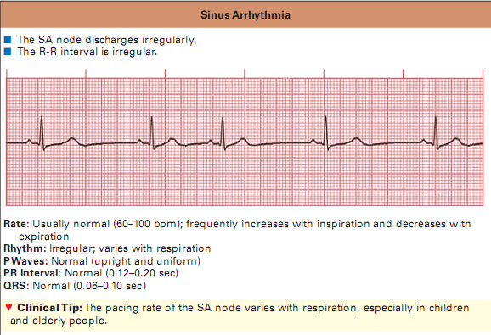

Slide 29
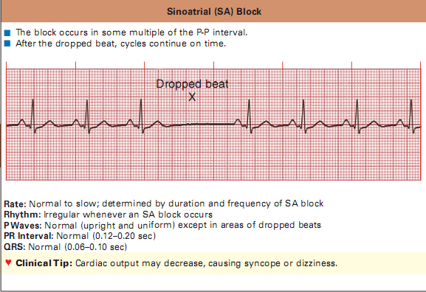

Slide 30
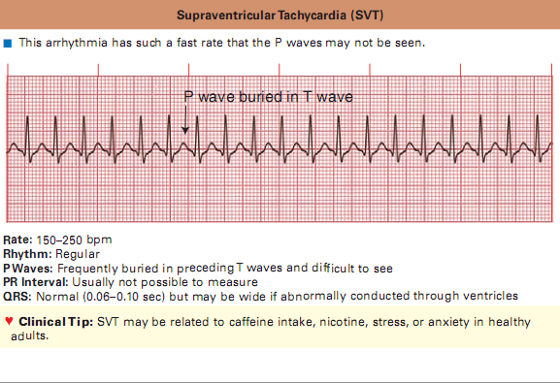

Slide 31
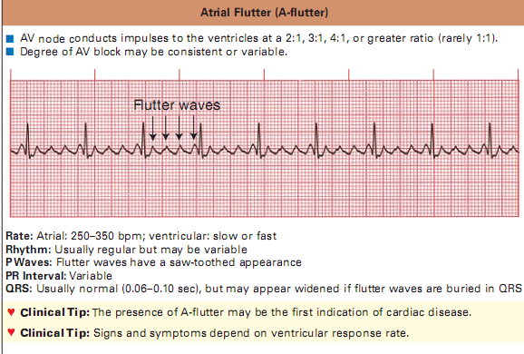

Slide 32
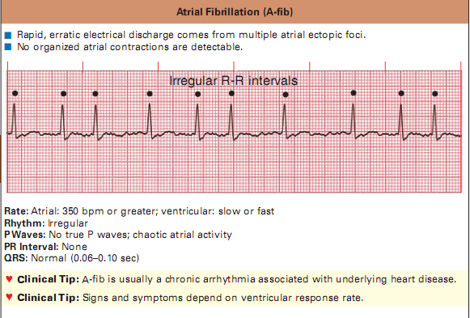

Slide 33
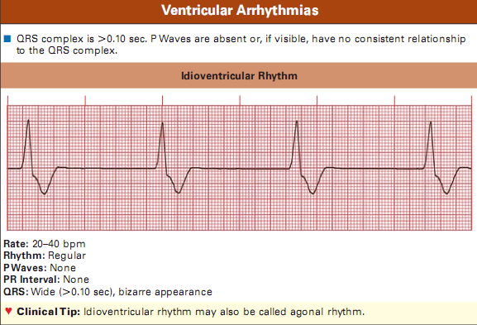

Slide 34
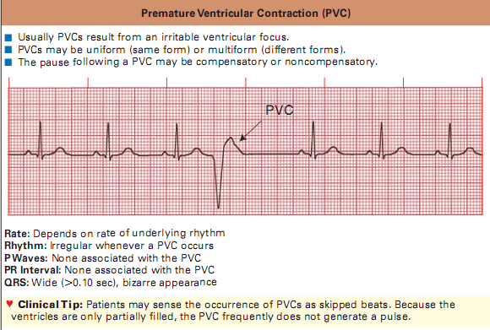

Slide 35
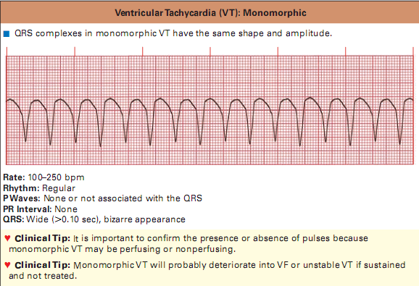

Slide 36
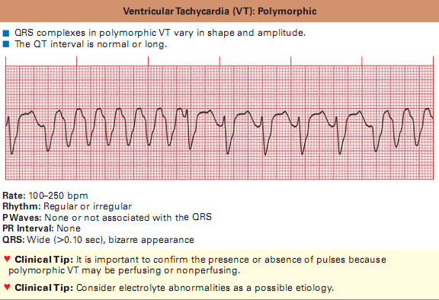

Slide 37
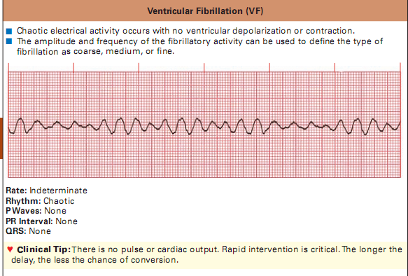

Slide 38
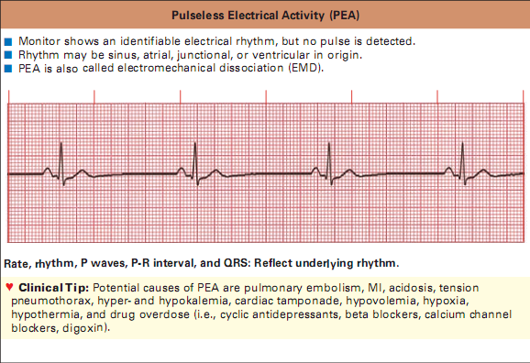

Slide 39
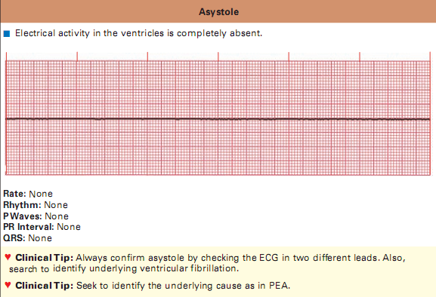

Slide 40
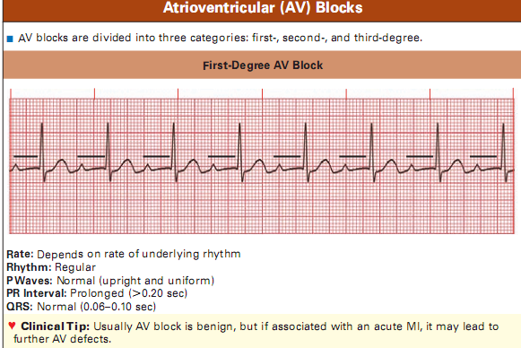

Slide 41
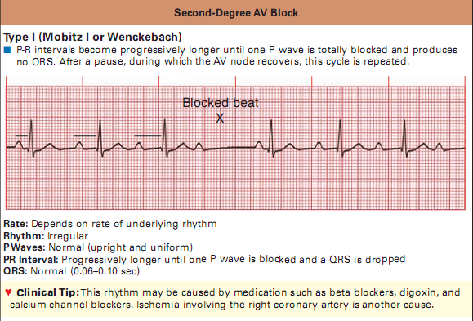

Slide 42
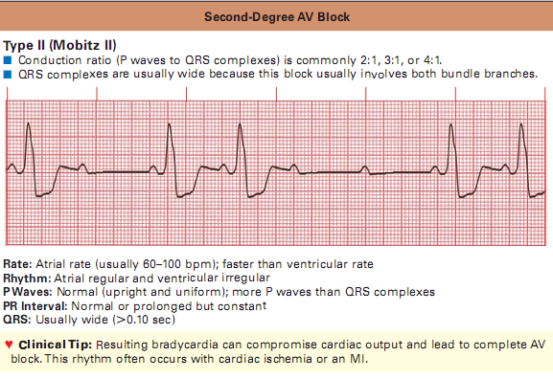

Slide 43
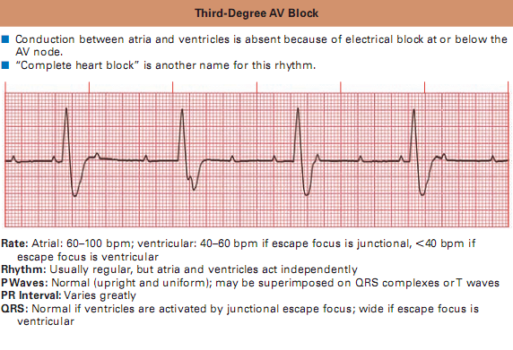

Slide 44
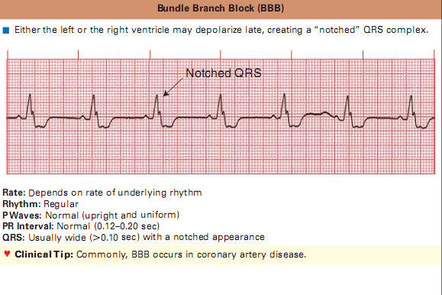

Slide 45
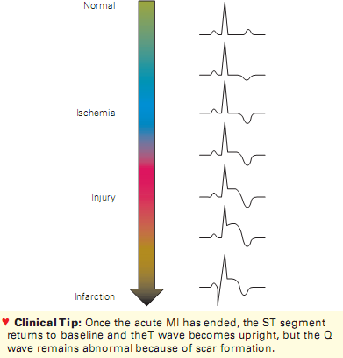

Slide 46
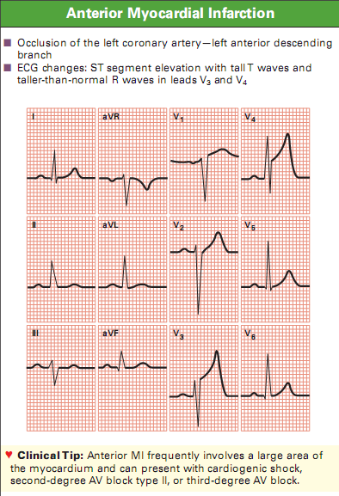

Slide 47
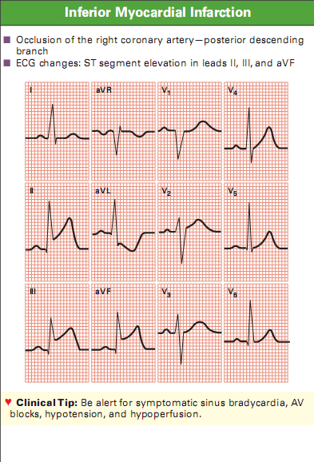

Slide 48
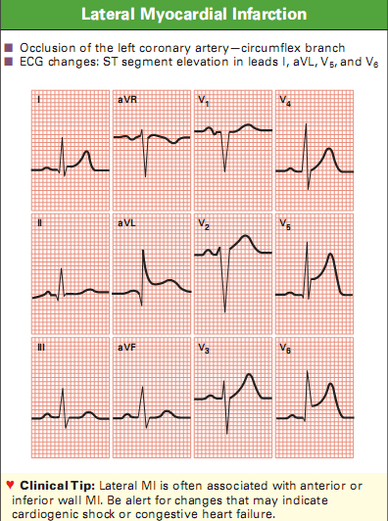

Slide 49
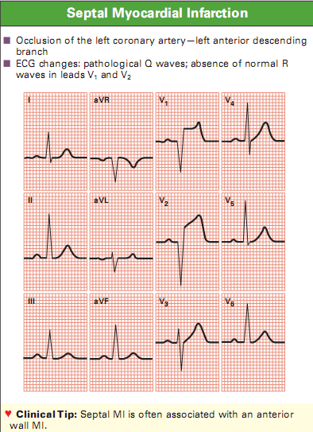

Slide 50
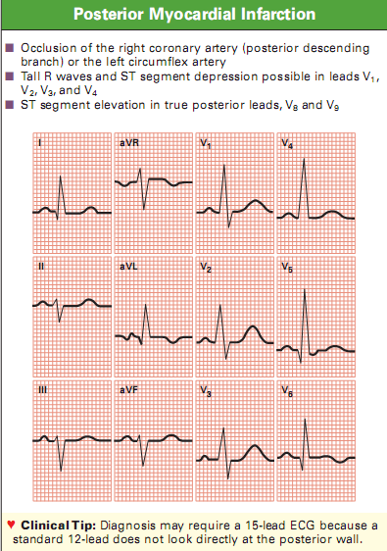

Slide 51
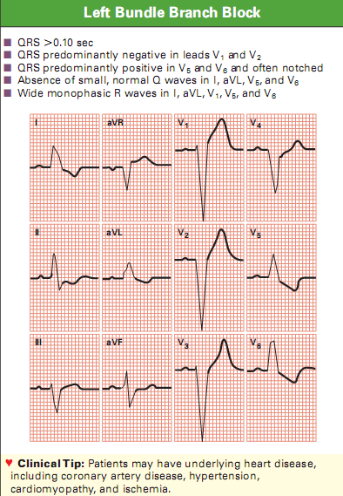

Slide 52
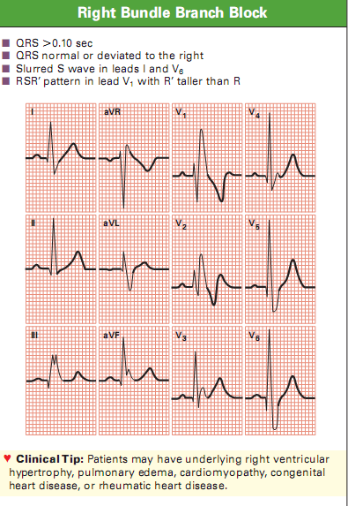

Slide 53
THANK YOU

