Slide 1
Pediatric malignancies

Slide 2
Lymphoma

Slide 3
Neoplastic proliferation of lymphoid cells that forms a mass; may arise in a lymph node or in extranodal tissue
Lymphoma is the third most common cancer among U.S. children (≤14 yrs old), with an annual incidence of 15 cases per 1 million children.
It is the most common cancer in adolescents, accounting for >25% of newly diagnosed cancers in those 15-19 yrs old.
The 2 broad categories of lymphoma, Hodgkin lymphoma and
non-Hodgkin lymphoma, have different clinical manifestations and treatments.*

Slide 5
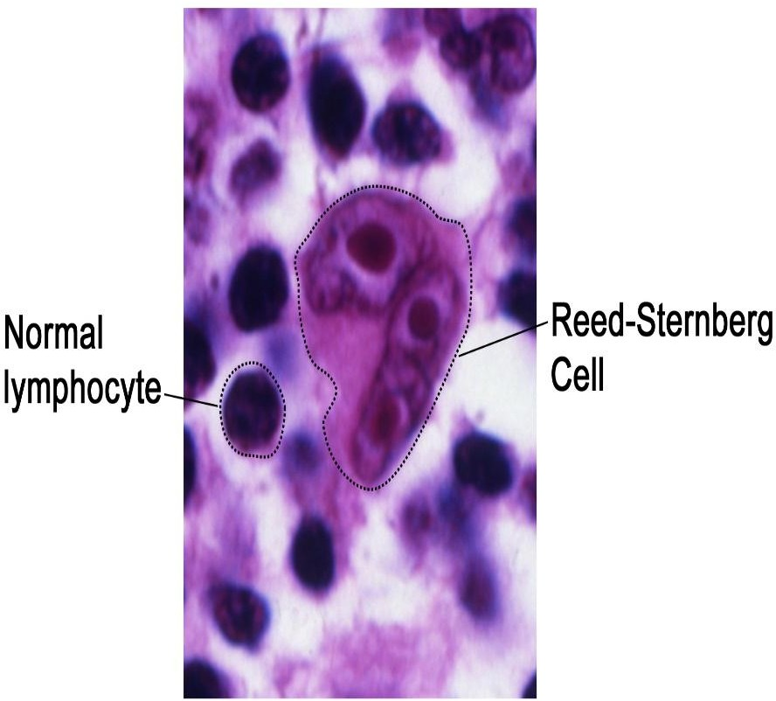
The Reed-Sternberg (RS) cell, a pathognomonic feature of HL, is a large cell (15-45 μm in diameter) with multiple or multilobulated nuclei.
This cell type is considered the hallmark of HL, although similar cells are seen in infectious mononucleosis, non-Hodgkin lymphoma, and other conditions. The RS cell is clonal in origin and arises from the germinal center B cells but typically has lost most B-cell gene expression and function.

Slide 7
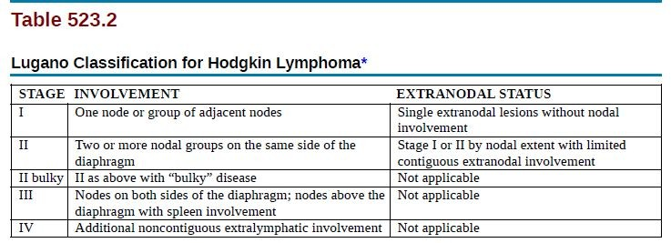

Slide 8
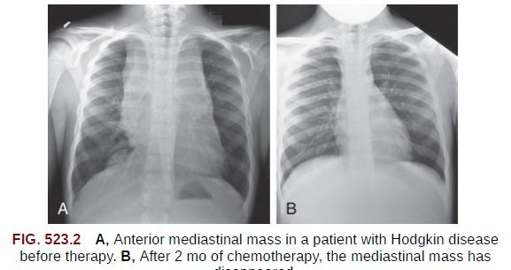
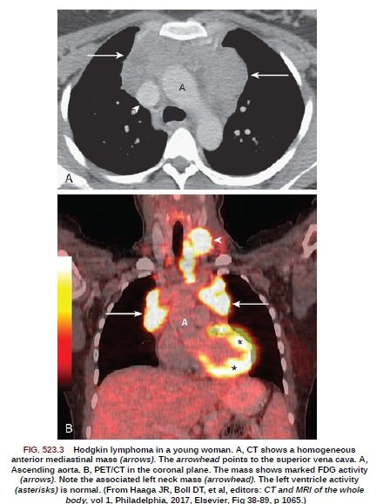

Slide 9
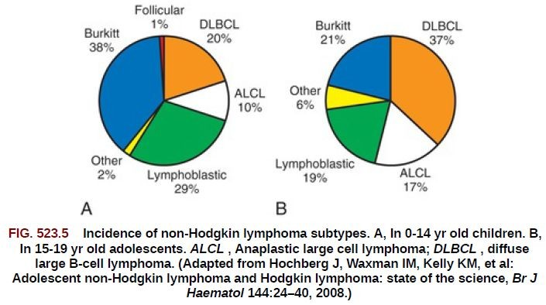
Non-Hodgkin Lymphoma

Slide 10
Clinical manifestation
Very high proliferation rate, early diagnosis and treatment matters.
High risk for tumor lysis syndrome (TLS).
Can invade CNS and Bone marrow
Mediastinal lymphadenopathy producing cough or shortness of breath.
B symptoms:
Fever >38° C for 3 consecutive days
drenching night sweats
unintentional weight loss of 10% or more within 6 months
Burkitt lymphoma may present with abdominal mass or jaw mass

Slide 11
Tumor lysis syndrome

Slide 12
Definition
potentially life-threatening oncologic emergency; resulting from the rapid destruction of tumor cells, which leads to a massive release of intracellular components; , e.g., potassium (K+), phosphate(PO43-), and uric acid, that can damage the kidneys and cause renal failure
Etiology
TLS most commonly occurs after initiating cytotoxic treatment in patients with hematologic malignancies (e.g., ALL, AML, or NHL).
Can also manifest unrelated to therapy in patients with a very high tumor burden

Slide 13
Pathophysiology
Tumor cell lysis → release of intracellular components (e.g., K⁺, PO43-, nucleic acids) into the bloodstream
↑ Nucleic acids → conversion to uric acid→ hyperuricemia→ urate nephropathy and risk of AKI
Hyperphosphatemia: PO43- binds Ca2+ and forms calcium phosphate crystals that obstruct renal tubules → acute kidney injury
↓ Ca2+ secondary to PO43- binding → hypocalcemia → neuronal excitability → risk of seizures
Hyperkalemia: changes in resting membrane potential → risk of cardiac arrhythmias

Slide 15
Clinical features
Signs and symptoms are closely related to the degree of electrolyte
abnormalities and AKI
Renal failure : e.g., edema, oliguria and decreased urine output
Hyperkalemia: e.g., cardiac arrhythmias, which can lead to palpitations and syncope
Hypocalcemia: e.g., tetany, muscle cramps, seizures
Nausea, vomiting and diarrhea

Slide 17
Treatment
Start with IV isotonic Fluids to correct electrolytes abnormalities
Hyperkalemia : Cardiac monitoring and standard therapy for hyperkalemia IV insulin and dextrose
Hyperphosphatemia : hydration and possibly oral phosphate binders, e.g., sevelamer
Hypocalcemia : Usually resolves with the management of hyperphosphatemia
Hyperuricemia : Can be managed with medications like allopurinol which decreases the production of uric acid or with rasburicase which breaks down uric acid to allantoin
If the level of potassium, phosphate or uric acid is too high, urgent hemodialysis might be needed TLS can be prevented by taking certain measures before starting chemotherapy, such as aggressive intravenous hydration as well as medications to prevent hyperuricemia like allopurinol or rasburicase.

Slide 18
Central Nervous System Tumors

Slide 19
An overall annual incidence of approximately 47 cases per 1 million children
<20 yrs of age. The incidence of CNS tumors is highest in infants and children ≤5 yrs old (approximately 52 cases/1 million children).
The overall mortality among this group approaches 30%. Patients with CNS tumors have the highest morbidity—primarily neurologic—of all children with malignancies.
The treatment approach for these tumors is multimodal. Surgery with complete resection, if feasible, is the foundation, with radiation therapy and chemotherapy used according to the diagnosis, patient age, and other factors.

Slide 20
CNS tumors are the most common solid tumors in children.
Most central nervous system (CNS) tumors in children are primary tumors: low-grade astrocytomas or embryonic neoplasms (medulloblastoma, ependymoma, germ cell tumor).
Most CNS tumors etiology is unknown.
certain inherited syndromes increase risk of CNS tumors including NF (types 1 and 2), Li-Fraumeni syndrome, and von Hippel-Lindau syndrome.

Slide 21
According to the site
Infratentorial
Supratentorial
Make up the majority of ped. brain tumor
* Most common malignant : medalloblastoma (originate from embryoic stem cells)
Most common : craniopharyngioma (remenant of rathkes pouch of ant .pituitary gland)

Slide 22
The National Cancer Institute (NCI) Surveillance, Epidemiology, and End Results (SEER) Program reported:
Infratentorial tumor location (43.2%).
Supratentorial region (40.9%).
Spinal cord (4.9%).
Multiple sites (11%).

Slide 23
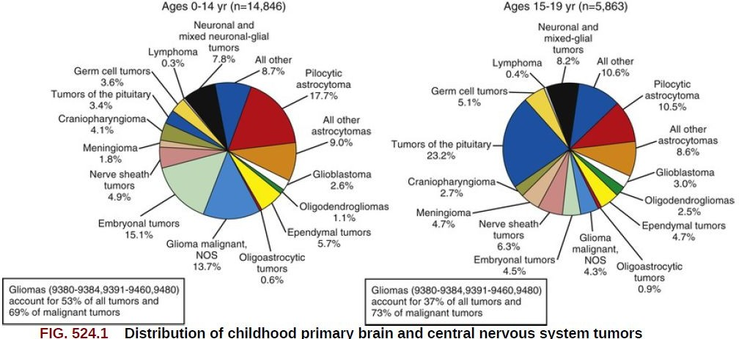

Slide 24
Signs and Symptoms:
General and nonlocalizing symptoms.
Increased intracranial pressure.
Localizing signs.

Slide 25
General and Nonlocalizing Symptoms
Headache
Vomiting
Behavioral changes (e.g. listlessness)
Developmental delay
Weight gain/loss
Others (e.g. endocrine or autonomic dysfunction, failure to thrive)

Slide 26
Increased Intracranial Pressure
Headache, irritability, lethargy and vomiting
Bulging fontanelle/separation of sutures
Papilledema
Parinaud syndrome, upward gaze palsy.
Others (e.g. anisocoria (unequal pupil size), ataxia, head tilt)

Slide 27
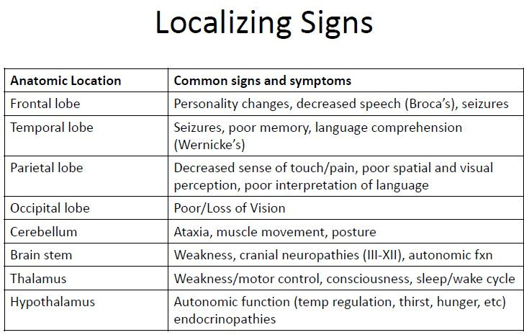

Slide 28
Laboratory/Imaging Studies
Magnetic resonance imaging (MRI) brain and spine is currently the examination of choice
CSF histologic testing is essential to determine the presence of metastatic disease
LP is contraindicated in presence of increased ICP

Slide 29
Differential Diagnosis
The differential diagnosis of a CNS mass lesion :
Malignant tumor.
Benign tumor.
AV malformation, aneurysm.
Brain abscess.
Intracranial hemorrhage.
Pseudotumor cerebri.
Vasculitis.
Metastatic tumor.

Slide 30
Treatment
Depends on the tumor type, histopathology, location, size, and associated symptoms.
High-dose dexamethasone often is administered immediately to reduce tumor-associated edema.
Surgical complete excision, or maximal debulking.
Radiation therapy often is combined with chemotherapy.
The 5-year overall survival rate associated with all childhood CNS tumors is approximately 50% to 60%.

Slide 31
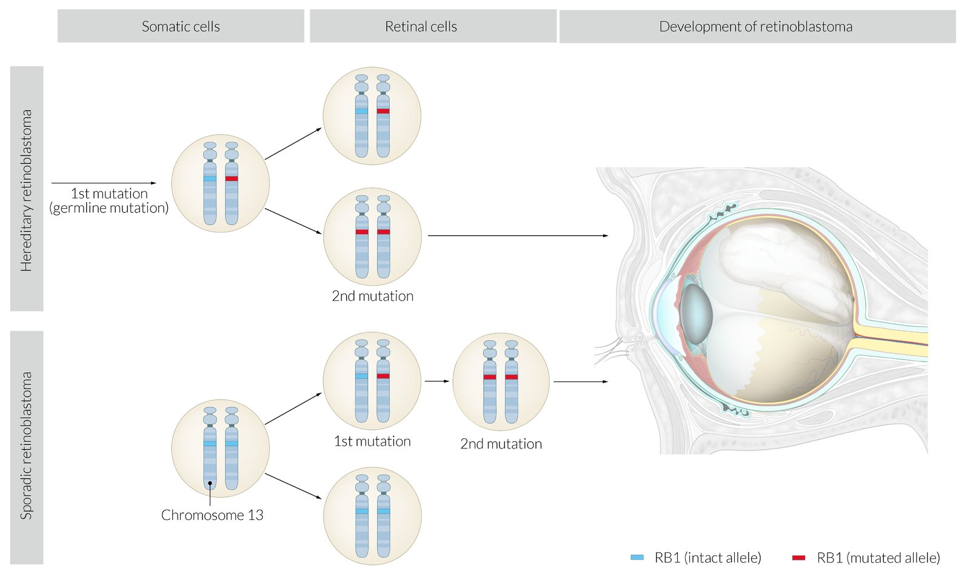
Retinoblastoma
Rare childhood tumor affecting the retina
Most present by the age of 5 years.
2 major forms:
hereditary, 25% of patients, usually bilateral and multifocal and is due to germline mutations in the RB1(retinoblastoma gene ). Median age of presentation is around 15 months.
Non-hereditary form: majority of cases, unilateral or unifocal and is due to mutations in RB1 gene in somatic cells. Median age of presentation is about 30 months.

Slide 32
Clinical features
Leukocoria :Most common presenting feature
Strabismus
A painful, red eye
Loss of vision
Retinal detachment (later stages)
Rarely: orbital cellulitis, nystagmus, proptosis
Diagnosis
examination under anesthesia of the retina for direct visualization of the tumors and evaluation of intraocular pressure in addition to ocular ultrasound, orbit and brain MRI, bone scan and bone marrow studies ( evaluate for metastasis).
Most common metastatic sites: bone, bone marrow, liver and CNS.
CT scan should be avoided because of the risk of radiation-induced tumors in patients with Rb1 mutation!!!!!!
Biopsies of retinoblastomas are contraindicated because of the risk of tumor seeding!!!!!
Treatment: Surgical excision, chemotherapy , radiation and laser photocoagulation are all used modalities for this type of tumor.

Slide 33
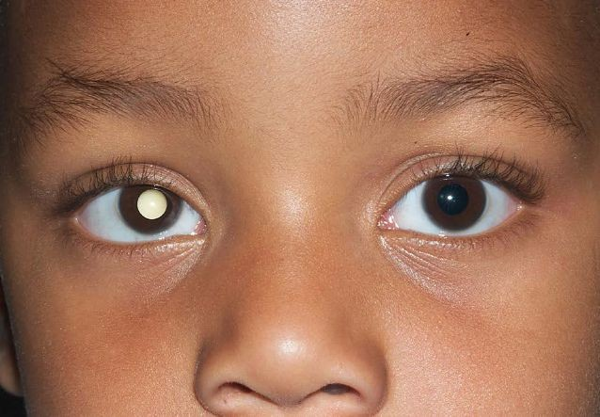
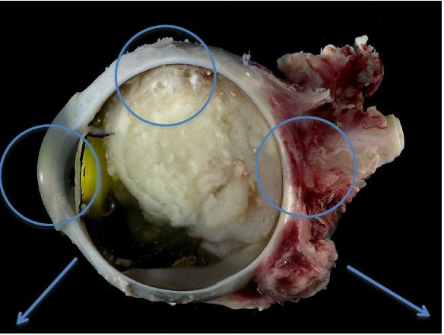
leukocoria
white fundal reflex instead of the usual red

Slide 34
Neuroblastoma
The median age is 22 month ^^ 5 or younger ^^
Its an embryonal malignancy
is a malignant neuroendocrine tumor of the sympathetic nervous system that originates from neural crest cells potentially secretes catecholamines, and is usually found in the adrenal glands or sympathetic ganglia..
most common childhood malignancy
leukemias
brain and other CNS tumors
lymphomas
neuroblastoma
kidney tumors
malignant bone tumors
# fourth most common childhood malignancy.
Is the most common extracranial solid tumor of childhood (8-10%).
The most common malignancy in infancy.

Slide 35
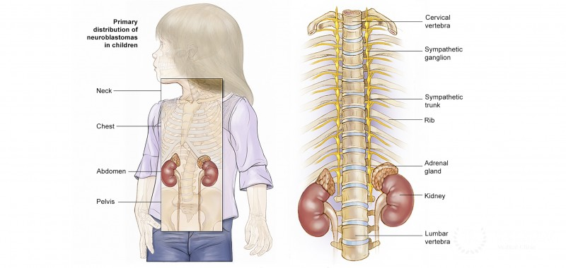
Given its origin, neuroblastoma can occur in any aggregation of sympathetic nervous tissue, including the adrenal glands, the sympathetic chain, and the paraganglia (e.g., the carotid body).
but the classical presentation is an abdominal suprarenal mass.
- Adrenal glands (45%)
Retroperitoneal sympathetic ganglia (25%)
Paravertebral ganglia of chest (15%)
Neck (5%)
- Pelvic sympathetic (5%)

Slide 36
Clinical features The clinical presentation is mainly determined by the site of the primary tumor, if it secretes catecholamines, and whether it has metastasized.
General symptoms
Failure to thrive or weight loss
Fever
Nausea, vomiting, loss of appetite
Hypertension
Localized symptoms
Location of primary tumors | Associated signs and symptoms
Abdomen | Palpable, firm, irregular abdominal mass that may cross the midline (in contrast to nephroblastoma, which is smooth and usually does not cross the midline) Abdominal distension and pain Hepatomegaly Constipation
Chest : particularly paravertebral ganglia | Spinal cord compression → back pain, weakness, numbness, ataxia, loss of bowel or bladder control Dyspnea, cough Inspiratory stridor
Neck | Horner syndrome *if the stellate ganglion is involved Symptoms due to spinal cord compressions

Slide 37
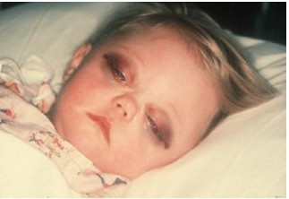
Location of metastases | Associated signs and symptoms
Orbit of the eye | Periorbital ecchymoses (“raccoon eyes”) Proptosis
Bones | Bone pain Anemia (bone marrow suppression)
Skin | Subcutaneous nodules
Paraneoplastic effects:
vasoactive intestinal peptide secreting tumors and opsoclonus myoclonus syndrome.

Slide 38
Laboratory/Imaging Studies
CBC
X-ray: Calcification within abdominal
urinary catecholamines: About 90% of neuroblastomas produce catecholamines (Vanillylmandelic acid; Homovanillic acid)
A computed tomography (CT) scan of the chest, abdomen, and pelvis;
Metaiodobenzylguanidine “MIBG” scan;
Bilateral bone marrow aspiration and biopsies;
Definitive diagnosis of neuroblastoma requires tissue biopsy

Slide 39
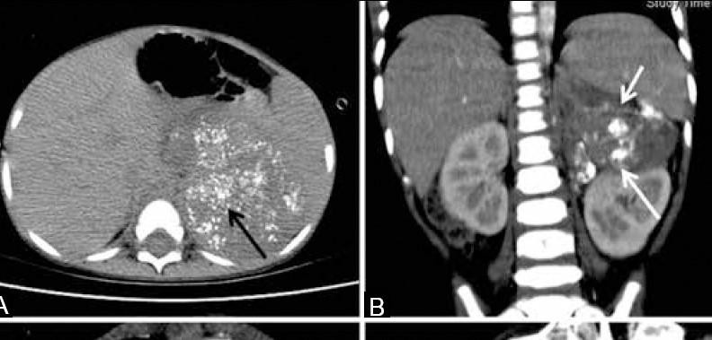
The mass often contains calcification and hemorrhage that can be appreciated on plain radiography or CT.
a left supra-renal mass with typical stippled calcifications (arrow in A) and a mass with calcifications (arrow in B) displacing the left kidney inferiorly.
Treatment is determined mainly by patient age at the time of diagnosis, clinical stage,
.
Spontaneous remission may occur even in cases of metastatic disease.

Slide 40
International Neuroblastoma Staging System (INSS) ^{[13]}
Stage | Definition
1 | Localized tumor Complete gross excision with or without microscopic residuals Negative ipsilateral lymph nodes
2A | Localized tumor Incomplete gross excision Negative ipsilateral lymph nodes
2B | Localized tumor Complete or incomplete gross excision Positive ipsilateral lymph nodes
3 | Unresectable unilateral tumor that crosses the midline with or without lymph node involvement Any tumor with positive contralateral lymph nodes Midline tumor with bilateral tumor or lymph node involvement
4 | Any tumor with dissemination to distant lymph nodes or other organs (e.g., bone, liver, skin), with the exception of Stage 4S disease
4S | Localized primary tumor with dissemination to skin, liver, or bone marrow, occurring in infants < 12 months

Slide 41
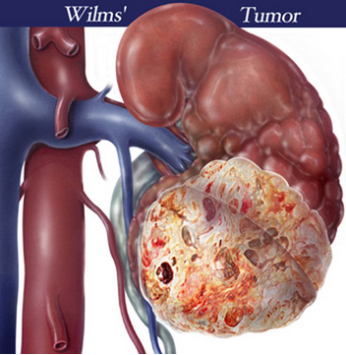
Wilms Tumor

Slide 42
Whats the wilims tumor?
Wilms tumor also known as nephroblastoma , is the most common primary malignant renal tumor of childhood.
It is the second most common malignant abdominal tumor in childhood after neuroblastoma.
The mean age at diagnosis is 3 to 3.5 years of age. Most are unilateral,up to 10% can be bilateral.
Median age of unilateral wilms ? 44 months
Median age of bilateral wilms ? 31 months

Slide 43
Whats the Pathology of wilims tumor ?
Wilm’s tumor is thought to arise from primative metanephric blastema
,the precursor of normal kidney Whats the direct cause of it ? The exact etiology remains unknown ,but it’s associated with several genetic mutations and syndromes

Slide 44
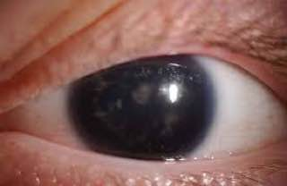
Wilms tumors in syndroms ?
WAGR syndrome : due to WT1 Gene deletion on chr11
Consisting of
Wilm’s tumor, Aniridia,Genitourinary anomalies and Mental Retardation
Wilms tumor develops
in 50% of patients with
WAGR
.

Slide 45
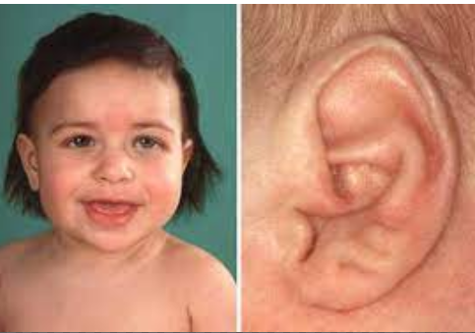
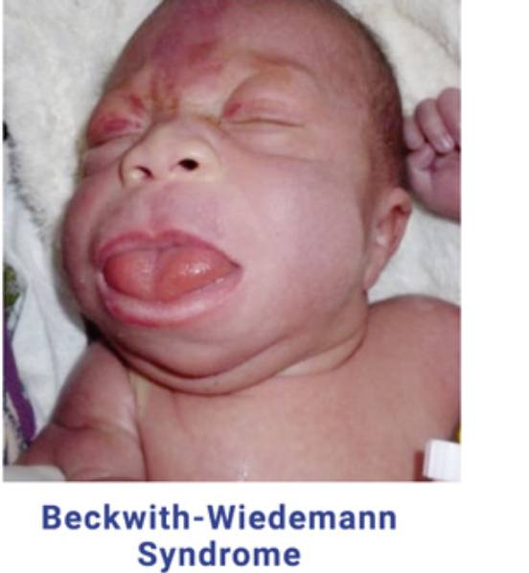
Beckwith –wiedemann syndrome : mutation of WT2 gene mutations in short arm of chromosome11, that leads to overactivity of the IGF-2 gene (growth factor)
“presented with hyperinsulism, neonatal somatic gigantism, macrosomia, macroglossia, omphalocele,visceromegaly, and earlobe creases,hemihyperplasia

Slide 46
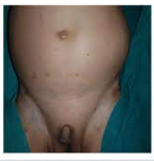
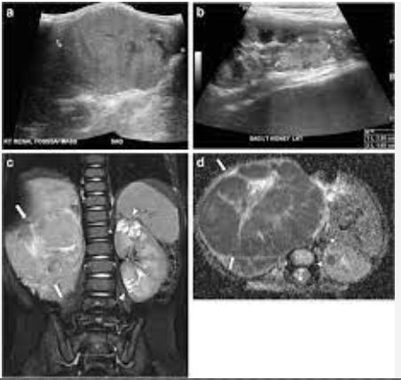
DENYS DRASH 1- diffuse mesangial sclerosis 2- wilms tumor 3- male pseudohermaphroditism

Slide 47
Clincal features: Palpable abdominal mass,smooth,non tender, unilateral ,Not cross midline Other associated symptoms: abdominal pain (20-40%), fever, hypertension, and hematuria

Slide 48
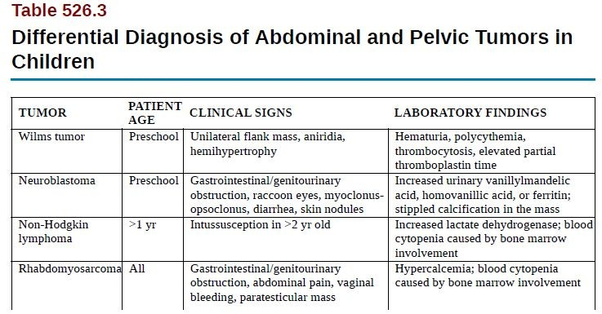
Most common presentation is abdominal mass that is discovered by the parents.(incidentally)

Slide 49
Diagnosis : History: pre-existing conditions, family hx of cancer or congenital defects Physical examination:Bp,weight,height,presence of Abd masses,congenital anomalies Investigation: U/S , Ct or MRI ,Brain imaging and Biobsy CBC ,platelet count , urine analysis,KFT,LFT,serum electrolytes

Slide 51
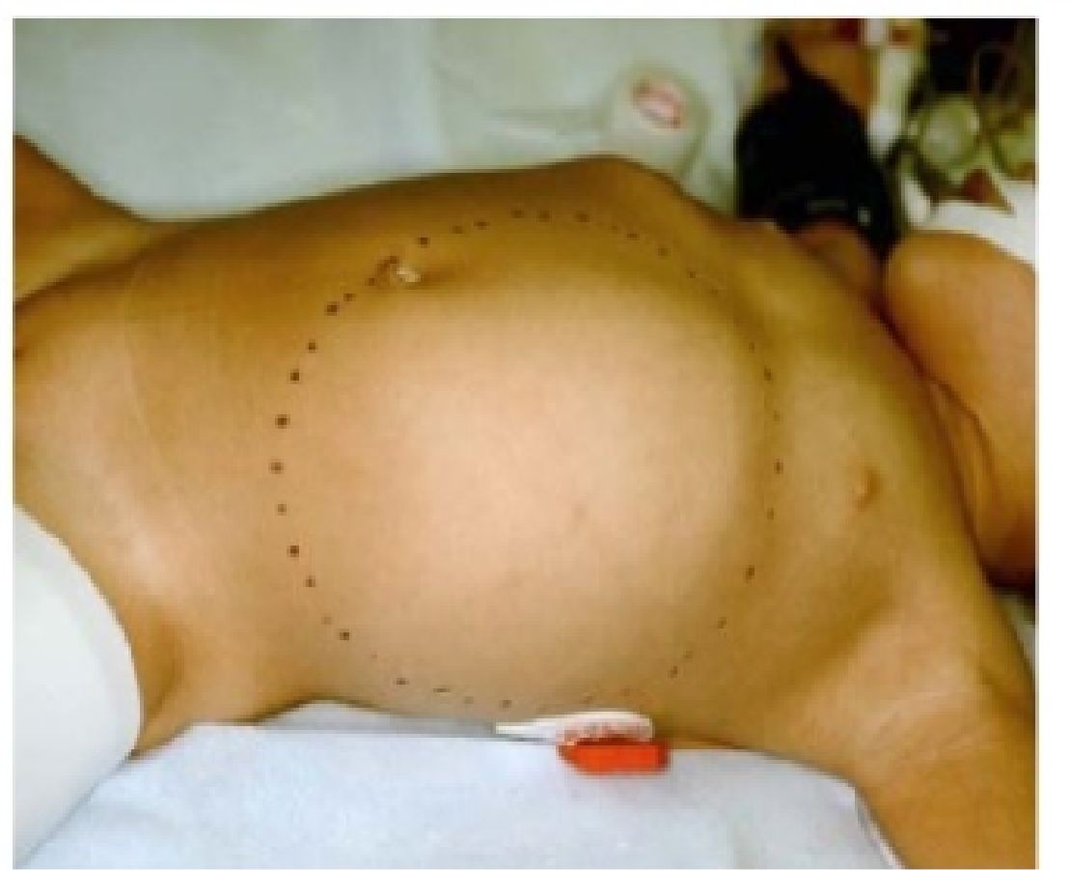
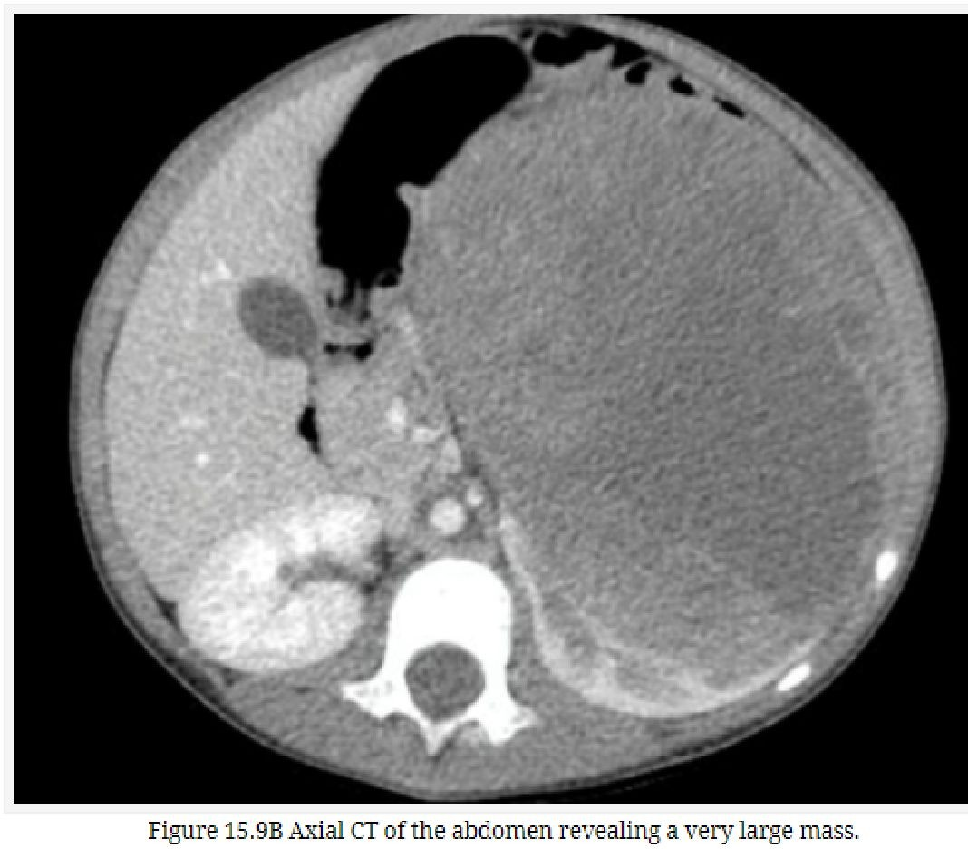
Wilms tumor

Slide 52
imaging → On US ;focal areas of necrosis or hemorrhage imaging modality the and hydronephrosis (due to obstruction of renal pelvis ). → On US with Doppler ; it will evaluate the collecting system, and demonstrate tumor thrombi in the renal veins and IVC → On CT SCAN ; the extent of the disease, integrity of the contralateral kidney, and metastasis Chest CT to screen for pulmonary metastasis CT best to be performed before surgery. → On MRI ; Not routinely used. MRI may be helpful in defining an extensive tumor thrombus that extends up to the level of the hepatic veins, or even into the right atrium, and to distinguish Wilms tumor from nephrogenic rests .

Slide 53
CT is useful to define the extent of disease, Integrity of contralateral kidney and metastasis
Chest CT to screen for pulmonary metastasie

Slide 56
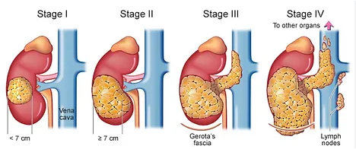

Slide 57
Treatment:
ITS DEPENDED ON STAGE
Neoadjuvant chemotherapy followed by Nephrectomy then adjuvant chemotherapy

Slide 58
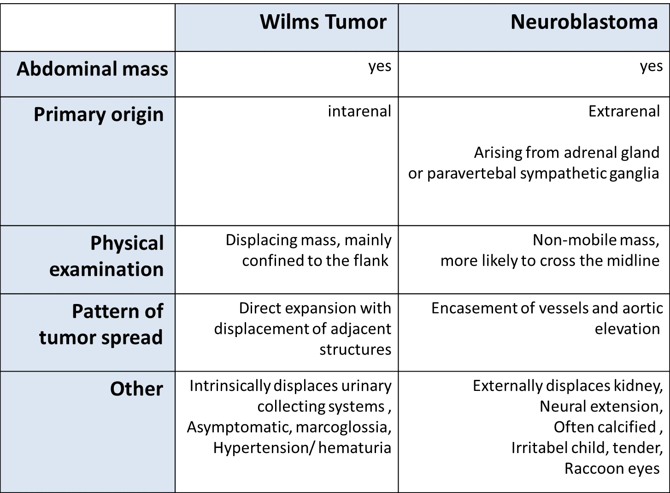

Slide 59
Sarcomas

Slide 60
Two types: soft tissue sarcomas and bone cancers.
Rhabdomyosarcoma, the most common soft tissue sarcoma in children.
Osteosarcoma often is located at the epiphysis or metaphysis.
Ewing sarcoma is located at the diaphysis, the femur and pelvis are the most common sites.

Slide 61
Osteosarcoma
Can occur de novo or as a long-term side effect to radiation therapy.
It can be part of Li-Fraumeni syndrome ( Tp53 mutation).
Classical clinical presentation: pain and a mass at the site of the primary tumor.
Typically involves the metaphysis of long bones.
Most common sites are the distal femur followed by the proximal tibia followed by proximal humerus.
Can spread in skip lesions pattern or through hematogenous spread to the lung and other bone locations.

Slide 62
Osteosarcoma
Diagnostic work up: plain X ray ( osteoblastic , osteolytic or a mixture) Classical X ray findings include a Codman triangle caused by elevation of the periosteum and a sunburst pattern due to extension of the tumor through the periosteum.
Chest CT scan is done to rule out pulmonary metastasis in addition to a biopsy.
Treatment relies on surgery and chemotherapy administration. Radiation is not part of treating osteosarcoma.

Slide 63
Ewing sarcoma
Primitive neuroectodermal tumor PNET family.
Tends to affect the axial skeleton more often than OS.
Most common location: pelvis. Other locations: femur and ribs.
Can present with systemic symptoms as fever and weight loss.
Metastasis can affect the lungs, bone and bone marrow.
Work up includes bilateral bone marrow biopsies ( marrow mets).
Plain X ray finding described is the onion skin appearance, but Codman triangles and sunburst patterns can be seen too.
Treatment: surgery, chemotherapy and radiation.

Slide 65
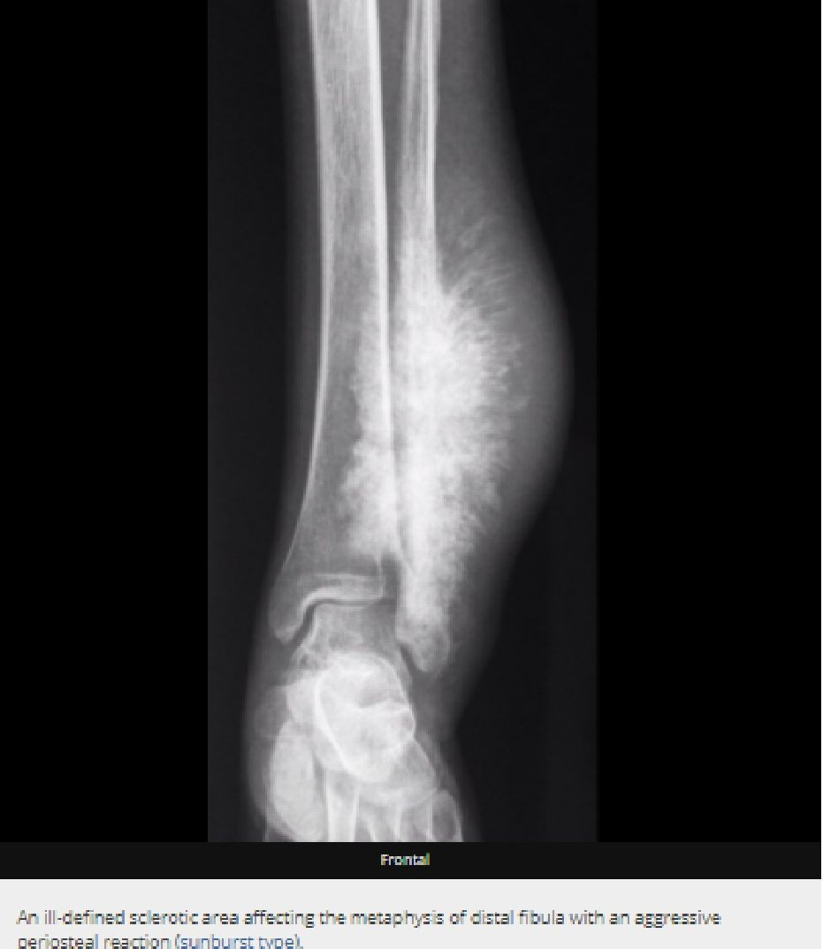
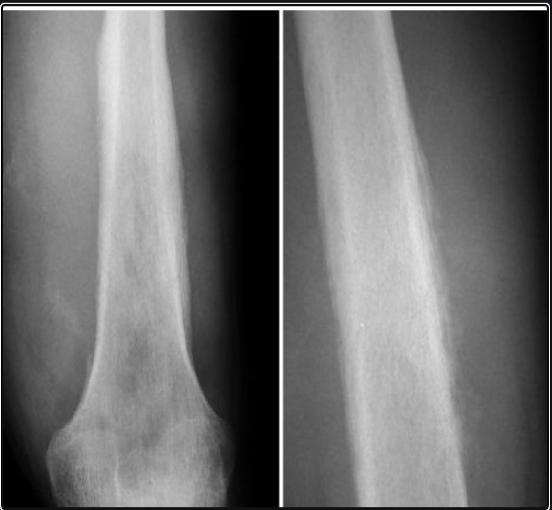
Ewing sarcoma onion skin

Slide 66
