Slide 1
Plasma Cell Neoplasms & Related Entities
Dr. Bushra AlTarawneh, MD
Anatomical pathology Mutah University School of Medicine- Department of Microbiology & Pathology HLS lectures 2023

Slide 2
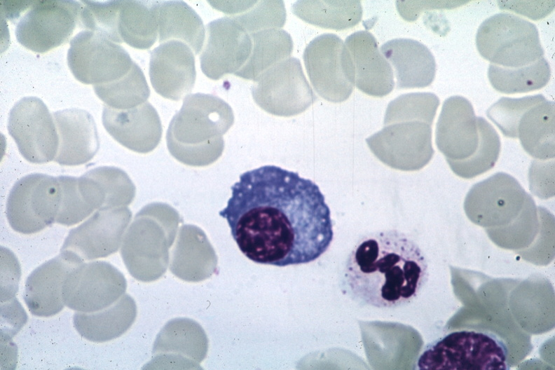
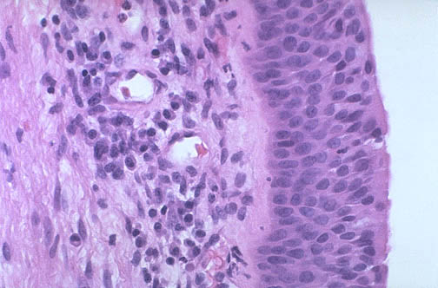
The last stage of B cell maturation, express CD38 but lose CD19: + cannot switch antibody classes. +can only produce a single kind of antibody in a single class of immunoglobulin.

Slide 3
Plasma Cell Neoplasms and Related Entities
B cell proliferations contain neoplastic plasma cells
Always secrete a monoclonal immunoglobulin or their fragment.
These serve as tumor markers and often have pathologic consequences.
The most common & deadly of these neoplasms is multiple myeloma.

Slide 4
Plasma Cell Neoplasms and Related Entities
M protein: A monoclonal immunoglobulin identified in the blood. They have high molecular weight, so they are restricted to plasma & extracellular fluid & excluded from urine.
Neoplastic plasma cells also synthesize excess immunoglobulin light chains → smaller in size → excreted in the urine, where they are called → Bence Jones proteins.
Monoclonal immunoglobulin can be detected by simple serum test → Serum protein Electrophoresis!

Slide 5
The abnormal Igs associated with plasma cell neoplasms include monoclonal gammopathy and paraproteinemia. These abnormal proteins are associated with the following clinicopathologic entities:
Multiple myeloma (plasma cell myeloma)
Waldenström macroglobulinemia . It occurs in older adults, most commonly in association with lymphoplasmacytic lymphoma
Heavy-chain disease (Mediterranean lymphoma)
Monoclonal gammopathy of undetermined significance (MGUS)

Slide 6
Multiple Myeloma
One of the most common lymphoid malignancies.Median age 70 years, more common in males.
Principally involves the bone marrow and ass with lytic lesions throughout the skeletal system.
Most myelomas are associated with more than 3 g/dL of serum Ig and/or more than 6 mg/dL of urine Bence Jones protein
The most frequent M protein produced by myeloma cells is IgG (60%), followed by IgA(20%), only rarely are IgM, IgD, or IgE M proteins obsereved.
Plasma cells produce κ or λ light chains.

Slide 7
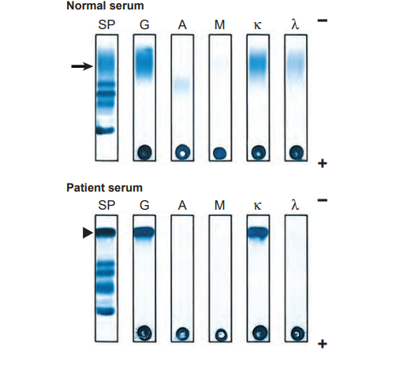
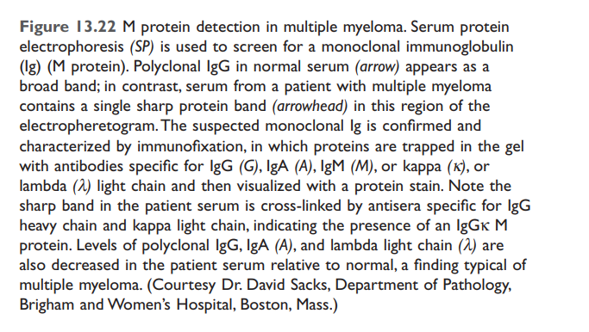

Slide 8
Multiple Myeloma - pathogenesis
Myeloma often has chromosomal translocations that fuse the IgH locus on chromosome 14 to oncogenes such as the cyclin D1 and cyclin D3 genes.
Multiple myeloma has a number of effects on the skeleton, the immune system, and the kidney, all of which contribute to morbidity and mortality of the disease.

Slide 9
The clinicopathologic diagnosis of multiple myeloma
relies on :
identification of clonal plasma cells in the marrow and the presence of CRAB criteria (hypercalcemia, renal dysfunction, anemia, and bone lesions).

Slide 10
Multiple Myeloma - Bone
Bone destruction → the major pathologic feature of multiple myeloma.
MM release factors that :
+ upregulates the expression of the receptor activator of NF-κB ligand (RANKL) by bone marrow stromal cells → activate osteoclasts.
+ are potent inhibitors of osteoblast function.
Net effect: increased bone resorption →hypercalcemia & pathologic fractures.

Slide 11
Multiple Myeloma - Humoral immunity
MM Compromises the function of normal B cells → production of functional antibodies often is profoundly depressed → patients are at high risk for bacterial infections.

Slide 12
Multiple Myeloma - Renal dysfunction
Several pathologic effects of MM:
obstructive proteinaceous casts; composed of Bence jones proteins in the distal tubules.
Light chain deposition in the glomeruli or the interstitium, either as amyloid or linear deposits →may contribute to renal damage.
Hypercalcemia, lead to dehydration and renal stones,
Bacterial pyelonephritis,

Slide 13
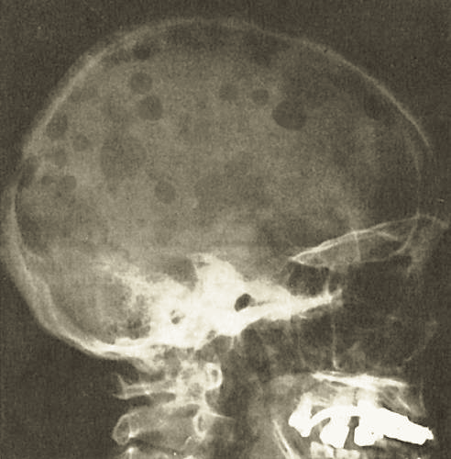
Multiple Myeloma - Morphology
Multifocal destructive skeletal lesions mostly involve the vertebral column, ribs, skull, pelvis, femur.
The lesions arise in the medullary cavity.
Bone destruction leads to pathologic fractures.

Slide 14
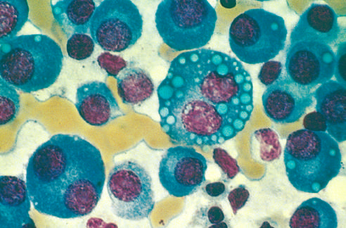
Multiple Myeloma - Morphology
Microscopically: the marrow shows increased numbers of plasma cells, usually > 30% of the cellularity.

Slide 15
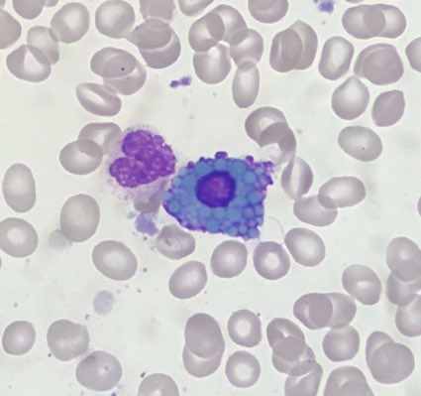
Multiple Myeloma - Morphology
Mott cells are plasma cells that have spherical inclusions packed with Ig in their cytoplasm, Inclusions: Russell bodies

Slide 16
Multiple Myeloma - Clinical Features.
Bone resorption: Bone pain & pathologic fractures
Hypercalcemia: neurological manifestations; + Confusion, lethargy and weakness.
Recurrent bacterial infections:
+The most common of death.
Renal dysfunction: +Second most common cause of death.
Median survival is 4-7 years
No cure yet.

Slide 17
Multiple Myeloma - Laboratory analyses
Increased levels of:
Immunoglobulins in the blood.
and/or Bence Jones proteins in the urine.
Patients have Both in ~ 70% of cases, 20% have only free light chains, & 1% of myelomas are nonsecretory.
Anemia, thrombocytopenia and leukopenia.
Elevated creatinine or urea (Renal dysfunction).

Slide 18
+Monoclonal gammopathy of undetermined significance (MGUS) : By definition, patients are asymptomatic and the serum M protein level is less than 3 g/dL. + MGUS is very common in older adult. + Has a low but constant rate of transformation to MM
+Smoldering myeloma: This entity defines a middle ground between multiple myeloma and MGUS. Plasma cells make up 10% to 30% of the marrow cellularity, and the serum M protein level is greater than 3 g/dL, but patients are asymptomatic.

Slide 19
+Solitary plasmacytoma: An infrequent variant that presents as a single mass in bone or soft tissue.
+ Waldenström macroglobulinemia: A syndrome in which high levels of IgM lead to symptoms related to hyperviscosity of the blood. (ass with lymphoplasmacytic lymphoma).

Slide 20
Lymphoplasmacytic Lymphoma
A B-cell neoplasm that usually presents in old age.
Most commonly, the plasma cell component secretes monoclonal IgM.
Amounts sufficient to cause a hyperviscosity syndrome → Waldenström macroglobulinemia.
Complications from the secretion of free light chains (e.g.; renal failure) are relatively rare & no bone destruction.

Slide 21
Lymphoplasmacytic Lymphoma - Pathogenesis
All cases of lymphoplasmacytic lymphoma are associated with acquired mutations in MYD88.

Slide 22
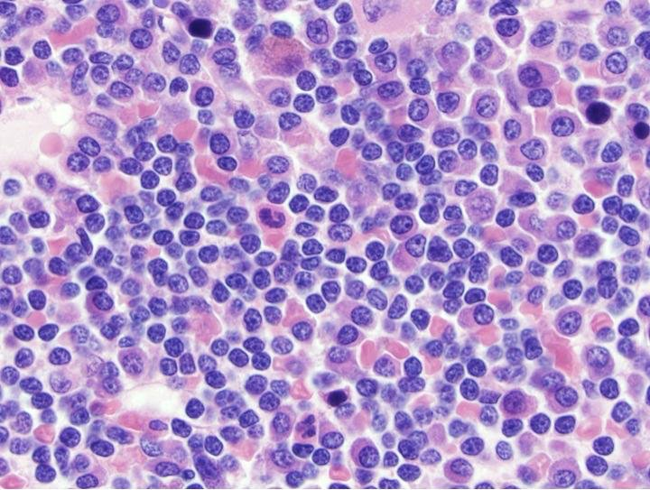
Lymphoplasmacytic Lymphoma - Morphology
The marrow is infiltrated by lymphocytes, plasma cells, & plasmacytoid lymphocytes in varying proportions.

Slide 23
Waldenström macroglobulinemia
Patients with IgM-secreting tumors have signs & symptoms stemming from the physicochemical properties of IgM. (large size → at high concentrations IgM greatly increases the blood viscosity → hyperviscosity syndrome.

Slide 24
Waldenström macroglobulinemia
Characterized by the following:
Visual impairment: due to venous congestion & retinal hemorrhages.
Neurologic problems such as headaches, dizziness, deafness, due to sluggish venous blood flow.
Bleeding due to formation of complexes between macroglobulins & clotting factors as well as interference with platelet function.
Cryoglobulinemia the precipitation of macroglobulins at low temperatures →Raynaud phenomenon.

Slide 25
Lymphoplasmacytic Lymphoma – Clinical features
An incurable progressive disease.
Median survival 4 year

