Slide 1
HISTORY AND PHYSICAL EXAMINATION - UROLOGY
DR. MALIK AYYAD
MUTAH UNIVERSITY

Slide 2
urology
Urology is the field of medicine that deals with disorders or conditions affecting the urinary tract and the male reproductive tract.
Urological admissions account for one third of surgical admissions.
Subspecialties include ( urodynamics / stone diseases/ paediatric/ reconstructive/ andrology / oncology/minimal invasive / renal transplant …etc

Slide 3
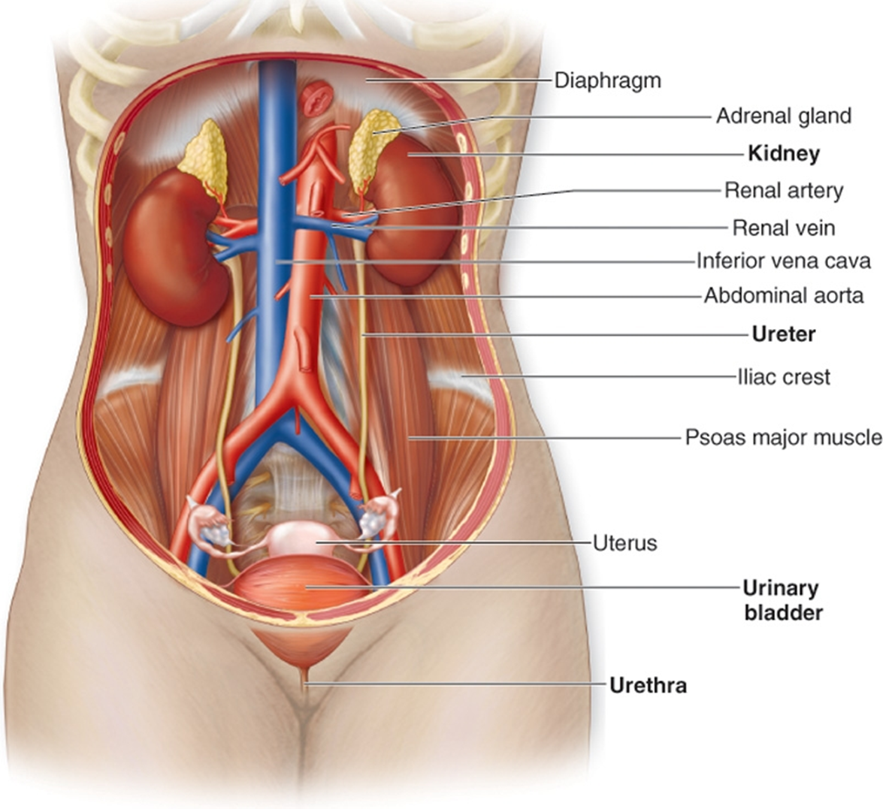
anatomy
The urinary tract :
1- two kidneys : lie retroperitoneally from T12-L3 right kidney is usually
lower due to the presence of liver.
2- two ureters : Two thick tubes that act to transport urine
to the bladder… 25cm long
3- urinary bladder : voiding and storage phases
4- urethra :
Male urethra : 17-20 cm .. 3 parts ( prostatic , membranous , penile)
Female urethra : 4 cm

Slide 4
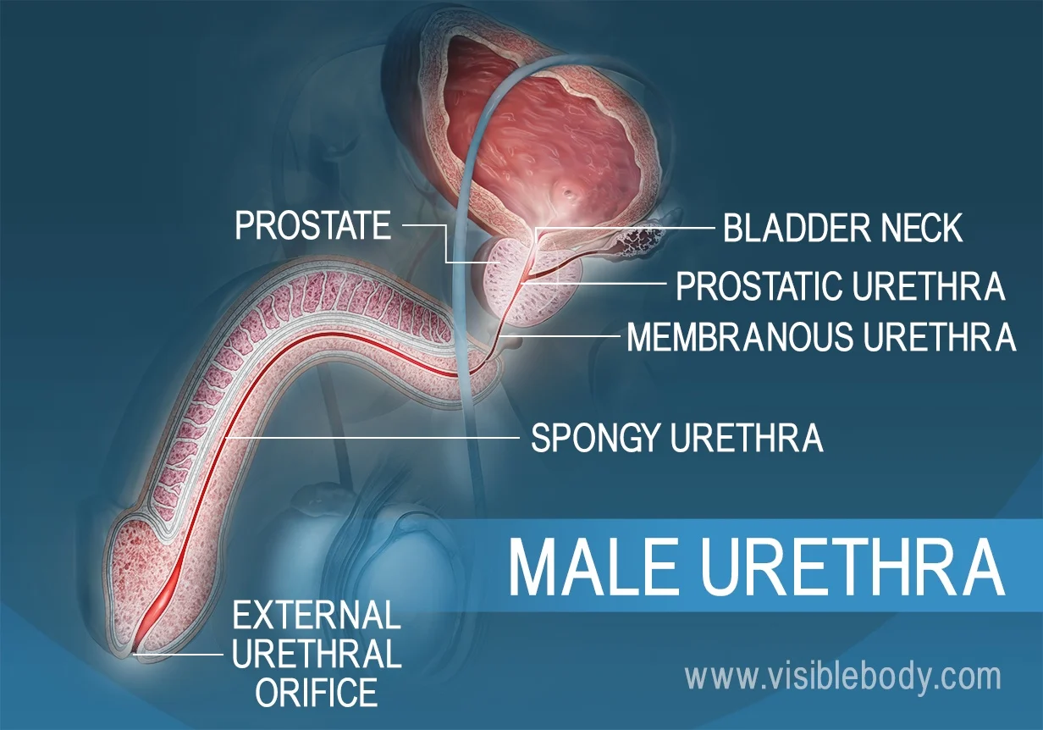

Slide 5
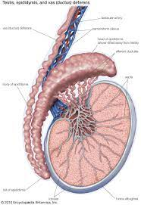
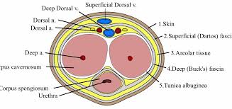
male genitalia
The penis (root/ body/ glans)
The scrotum :
- testis : production
- epididymis : storage
- spermatic cord

Slide 6
HISTORY TAKING

Slide 7
GENERAL HISTORY TAKING
1- patients profile (name, age, marital status ,address ,occupation )
2- history of presenting complaint (urinary symptoms / genital or pelvic pain / genital swelling/sexual dysfunction and infertility )
3- past medical and surgical history
chronic diseases, rheumatoid , STDs , infertility
CVS / endocrine / neurologic/ psychiatric diseases
urological procedures including neonatal / pelvic operations

Slide 8
4- past drug history
note drugs such as diuretic, alpha blockers , antihypertensives , antidepressants and antipsychotics
5- family history : urological cancers , BPH
6- social history :
smoking , alcohol , recent travel, sexual history.

Slide 9
URINARY SYMPTOMS
PAIN PRESENTATIONS
1- Loin pain :
Renal causes : renal and ureteric stones (m.c) ,infection (pyelonephritis) , tumour , bleeding
Non renal causes : Leaking aortic aneurysm , ectopic pregnancy ,appendicitis , cholecystitis , bowel obstruction , muscle spasm
-Acute pyelonephritis : clinical dx ( fever , loin pain , chills ,rigor, nausea , vomiting )
-Renal and ureteric colic : usually due to obstructing stone , caused by distention of renal capsule, very sever , spasmodic , lumbar region; radiates to abdomen, groin, testes, thigh . Maybe associated with vomiting and sweating.

Slide 10
2-Suprapubic pain
urinary : UTI, ureteric stone, urinary retention, bladder rupture
non urinary : appendicitis, diverticulosis, ovarian cysts, constipation

Slide 11
Hematuria
the presence of RBCs in the urine
- Macroscopic (gross) haematuria is visible to the naked eye (red urine ,overtly bloody, smoky or blood clots)
- Microscopic or dipstick haematuria is when blood is identified by urine microscopy or dipstick testing

Slide 13
Polyuria : abnormally large volume of urine, and is most commonly due to excessive fluid intake .
Oliguria : reduction in urine volume to <800 ml/day , Acute renal failure
Anuria : total absent of urine production
Pneumaturia : passing gas bubbles in the urine
Nocturia : frequent need to get up and urinate at night . Awakening 2 or more times at night considered as nocturia
Enuresis (bed wetting) in that the person does not wake and the bladder empties.
Nocturnal polyuria (NP) refers to a condition in which the rate of urine output is excessive only at night and total 24-hour output is within normal limits.

Slide 14
Lower Urinary Tract Symptoms (LUTS)
1. Filling (Storage) or irritative symptoms :
- Frequency : micturating more often with no increase in the total urine output.
- Urgency : a sudden strong non-resistible desire to pass urine
- Dysuria : painful urination
- Nocturia and nocturnal enuresis
- Incontenence

Slide 15
2- Voiding or obstructive symptoms :
- Poor stream (unimproved by straining)
- Hesitancy :difficulty in the initiation of urination
- Terminal dribbling and post voiding dribbling
- Incomplete voiding
Urinary retention : inability to pass urine
Intermittency and interrupted voiding : urine flow increased with each abdominal straining

Slide 16
Incontenence
Involuntary leakage of urine
1- Urge Urinary Incontinence (UUI) : Involuntary leakage of urine preceded by sudden desire to void (urgency)
2- Stress Urinary Incontinence (SUI) : Urine leakage associated with increased abdominal pressure laughing, sneezing, coughing, climbing stairs ..etc), more in women , seen in men after prostate cancer surgery .
3- Mixed incontinence : A combination of stress and urge incontinence.
4- Overflow incontinence: increased residual or chronic urinary retention leads to urinary leakage from bladder overdistention.
5- Functional incontinence : loss of urine related to deficits of cognition and mobility (eg, delirium, psychiatric disorders, impaired mobility)
6- Continuous incontinence :continuous urine flow associated with fistulas ( vesicovaginal , urethrovaginal ) and ectopic ureter inserted distal to external sphincter

Slide 17
Scrotal swelling
painful : torsion of testis, torsion of appendages, orchitis, epididymitis.
painless : testicular cancer, varicocele, hematocele, hydrocele
always keep hernia in mind
Sudden onset of unilateral scrotal pain should be treated as testicular torsion until proven otherwise
it occurs most commonly between 10-30 yrs , acute pain that’s not relieved by lying still ,associated with nausea and vomiting
epididymo-orchitis : insidious in onset dull ache initially associated fever dysuria and urethral discharge worst when standing or moving around

Slide 18
PHYSICAL EXAMINATION

Slide 19
Abdominal exam
Basic steps ( well lit room – identify yourself , exposure from xyphoid to mid-thigh ,name and age of the patient ,permission , chaperone )
1- kidney : inspection and palpation as part of abdominal exam
ballot of the kidneys : left hand behind the patient’s back below the ribs ,right hand on anterior abdominal wall just below the costal margin , press upward with your left hand and downward with your right hand ask the patient to take a deep breath .
In healthy individuals the kidneys are not usually ballotable
an enlarged kidney is usually ballotable

Slide 20
2- bladder
the bladder is palpable when it is full , you can palpate the bladder in supra pubic area .
felt as rounded swelling and dull to percussion , tender in UTI or retention

Slide 21
EXAMINATION OF THE GENITALIA
EXAMINATION OF THE GENITALIA
1- inspection (penis , groin, abdomen ):
Skin changes: bruising, swelling, warts , erythema ,Scars ,Masses ,Swelling, erythema , Bruising , Necrotic tissue( consider Fournier’s gangrene)
2- palpation
Penis : inspect the glans , open the urethral meatus
Testicle: always start with the normal testicle ,Use both of your thumbs and index fingers to gently palpate the whole testicle.
Assess any scrotal mass for the following Site / size / shape/ consistency /tenderness / fluctuation/ transillumination/ cough impulse/ability to get Above the mass
Epididymis :Palpate for tenderness on the posterior aspect of the testicle
Spermatic cord assess for mass (spermatocele )and tenderness

Slide 22
3- Special tests
cremasteric reflex : is a superficial reflex which is elicited when the inner part of the thigh is stroked. Stroking of the skin causes the cremaster muscle to contract and pull up the ipsilateral testicle toward the inguinal canal.
Loss of the cremasteric reflex is associated with testicular torsion.
- Phren’s test : ( acute epididymitis vs. testicular torsion)
The test involves elevating the testes to assess the impact on the testicular pain. A reduction in testicular pain is associated with epididymitis

Slide 23
4- digital rectal examination
prostate examination In males :palpate the prostate gland anteriorly and assess the size, symmetry and texture of the gland.
A normal prostate is approximately walnut-sized with a palpable midline sulcus.
It should be symmetrical and its consistency should be similar to that of the tip of the nose.
Round rubbery and non tender
In BPH : firm , enlarged
In prostate CA : stony hard

Slide 24
FINDINGS IN PHYSICAL EXAM AND THEIR CLINICAL RELEVANCE
Inguinoscrotal hernia : unable to get above the swelling - does not transilluminate , associated with bowel sounds on auscultation - may be reducible and have a cough impulse
Hydrocele : can’t get above the swelling - not reducible - transilluminates - no bowel sounds
Epididymal cyst: firm - well circumscribed -separate from testicular body - transilluminates - able to go above the swelling
Testicular tumor : able to go above the swelling - hard mass - no transillumination
Varicocele : bag of worms - present on standing or valsalva maneuver usually resolves with lying flat
Testicular torsion - retracted or high riding testicle - global swelling

Slide 25
Thank you

