Slide 1
Hemolytic Anemia
Done by:
Laith Najada
Abdulsalam alBtoush

Slide 2
Introduction
Hemolytic anemia is characterized by the breakdown of red blood cells (RBCs), that causes mainly a normocytic anemia.
Hemolytic anemia causes varying degrees of fatigue, pallor, and weakness, ranging from asymptomatic disease to life-threatening hemolytic crisis.
Hemolytic anemia should be suspected in patients with anemia and laboratory findings of hemolysis (e.g., elevated indirect bilirubin and lactate dehydrogenase, reticulocytosis, and decreased haptoglobin levels).

Slide 3
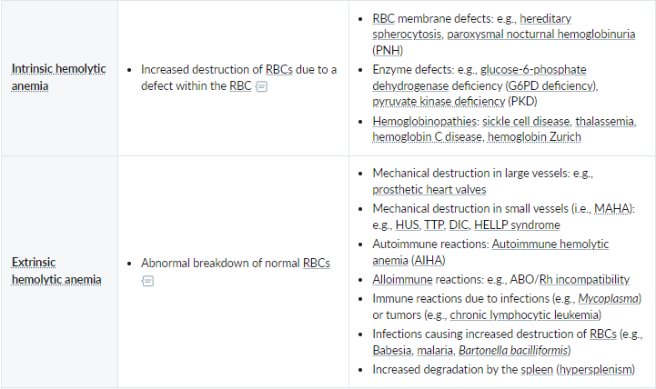
Classification
Hemolysis can either be caused by abnormalities in RBCs (hemoglobin, the RBC membrane, or intracellular enzymes), which is called intrinsic hemolytic anemia, or by external causes (immune-mediated or mechanical damage), which is called extrinsic hemolytic anemia

Slide 4
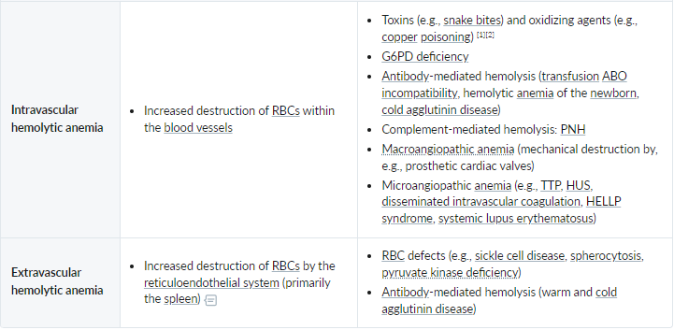
Classification
Hemolysis can be further categorized depending on whether it occurs inside the blood vessels (intravascular hemolysis), in the reticuloendothelial system (extravascular hemolysis), or both.

Slide 5
Clinical feature:
Signs of anemia
Fatigue
Pallor
Exertional dyspnea
Tachycardia
Signs of hemolysis:
Jaundice
Pigmented gallstones (due to increased indirect bilirubin)
Splenomegaly (due to extravascular hemolysis)
Back pain and dark urine in severe hemolysis and hemoglobinuria

Slide 6
Diagnostics and workup:
Anemia workup: CBC with MCV, reticulocyte count
↓ Hb, Hct, and RBC count
Normocytosis: typical finding for most hemolytic anemias
Microcytosis: consider thalassemia
Reticulocytosis (corrected reticulocyte count >2%)
WBC count: can be elevated due to inflammation or malignancy
Platelets: decreased in MAHA
Hemolysis workup: LDH, haptoglobin, bilirubin, urinalysis, and peripheral blood smear (PBS)
Obtain a direct Coombs test (i.e., DAT) to narrow the differential:
DAT positive: antibody-mediated hemolytic anemia (e.g. AIHA)
DAT negative: nonantibody-mediated hemolytic anemia

Slide 7
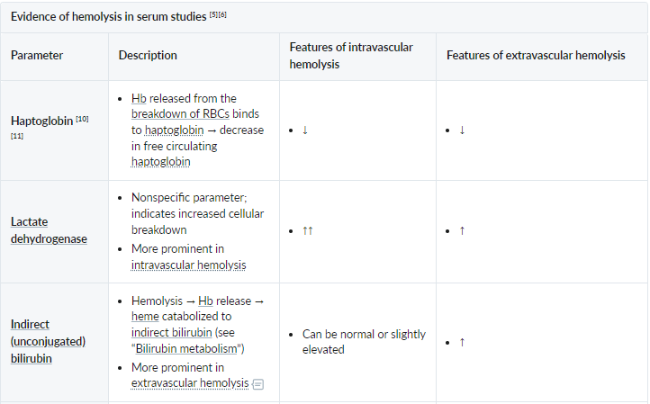
Diagnostics and workup:

Slide 8
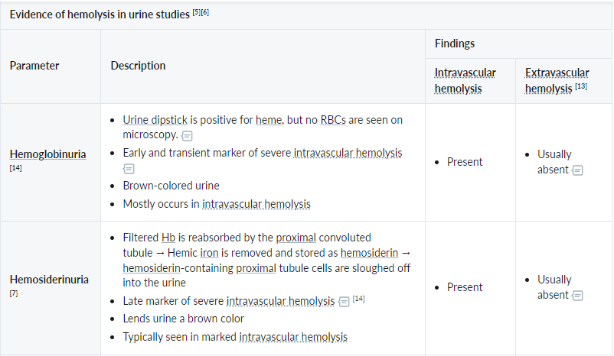
Diagnostics and workup:

Slide 9
Paroxysmal Nocturnal Hemoglobinuria

Slide 10
PNH
An acquired genetic defect of the hematopoietic stem cell characterized by a triad of hemolytic anemia, pancytopenia, and thrombosis.
Median age of onset: approx. 35–40 years.
Physiologically, a membrane-bound glycosylphosphatidylinositol (GPI) anchor (CD55/DAF, CD59) protects RBCs against complement-mediated hemolysis.
Acquired mutation on the PIGA gene located on the X chromosome → GPI anchor loses its protective effect → RBC destruction by complement and reticuloendothelial system → intravascular and extravascular hemolysis

Slide 11
PNH
Clinical features:
Signs of anemia and hemolysis
Vasoconstriction (due to scavenging of nitric oxide by free Hb results in smooth muscle contraction)
Headache, pulmonary hypertension
Abdominal pain, dysphagia, erectile dysfunction
Venous thrombosis in unusual locations (e.g., hepatic, cerebral, mesentric)
Increased risk of infections (in case of pancytopenia)
Diagnosis:
Flow cytometry of peripheral blood (confirmatory test for PNH): can show deficiency of GPI-linked proteins on the surface of RBCs and WBCs (e.g., CD55, CD59)
Complications:
Thrombotic complications (e.g. Budd-Chiari syndrome)
Some patients develop acute myeloid leukemia (AML)

Slide 12
PNH
Treatment:
Patients with mild or no clinical manifestations: watchful waiting with close surveillance
Patients with significant clinical manifestations: Start targeted therapy.
Provide supportive care for all patients.
Targeted therapy:
complement inhibition with an anti-C5 antibody (e.g., eculizumab, ravulizumab)
Supportive therapy:
Consider RBC transfusion in symptomatic or severe anemia (e.g., Hb < 7.0 mg/dL).
Start therapeutic anticoagulation without delay for any venous thromboembolic event
Consider vaccination and antibiotic prophylaxis for Neisseria meningitidis infection

Slide 13
Glucose-6-Phosphate Dehydrogenase Deficiency
(Favism)

Slide 14
G6PD deficiency
Glucose-6-phosphate dehydrogenase (G6PD) deficiency leads to an impaired regeneration of reduced glutathione, an important antioxidant, which makes RBCs more susceptible to oxidative stress and can result in episodic hemolytic anemia
The condition is inherited in an X-linked recessive pattern and is the most common human enzyme deficiency worldwide
Affects primarily males of African, Mediterranean, and Asian descent
Causes of increased oxidative stress are triggers of hemolytic crisis and include:
Fava beans
Drugs: antimalarial drugs (e.g., chloroquine, primaquine), sulfa drugs (e.g., trimethoprim-sulfamethoxazole), nitrofurantoin, isoniazid, dapsone, NSAIDs
Bacterial and viral infections (most common cause)

Slide 15
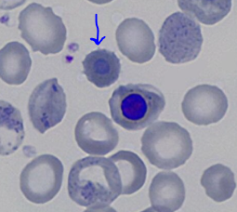
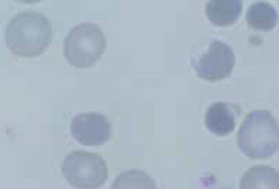
G6PD deficiency
Clinical features:
Most patients are asymptomatic
Recurring hemolytic crises may occur, especially following triggers
Arise within 2–3 days after increased oxidative stress
Sudden onset of back or abdominal pain, jaundice, dark urine, transient splenomegaly
Diagnosis:
Blood smear
Heinz bodies: Oxidative stress causes hemoglobin denaturation. Hemoglobin then precipitates as small inclusions within the erythrocytes.
Bite cells: due to macrophages selectively removing the denatured hemoglobin inclusions of RBCs

Slide 16
G6PD deficiency
Diagnosis:
Screening test: fluorescent spot test
Add glucose-6-phosphate and NADP → measure NADPH fluorescence
Normal G6PD activity produces fluorescent NADPH out of NADP, while in G6PD deficiency a lack of fluorescence is seen.
Semi-quantitative
Confirmatory test: quantitative G6PD enzyme analysis
Ideally, both the screening and confirmatory tests should be performed during remission.
Carriers of the G6PD deficiency may be less severely affected by malaria, especially if the disease is caused by Plasmodium falciparum.
Treatment:
Avoid triggers

Slide 17
Pyruvate Kinase Deficiency

Slide 18
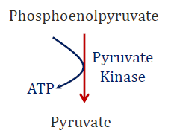
PK deficiency
Autosomal recessive defect of pyruvate kinase
Pathophysiology
Glucose is the only energy source in RBCs
Pyruvate kinase catalyzes the last step of glycolysis (i.e., irreversibly converts phosphoenolpyruvate into pyruvate)
Absence of pyruvate kinase → ATP deficiency in RBC
ATP deficiency disrupts the cation gradient along the RBC membrane → rigid RBCs → ↑ hemolysis (extravascular)

Slide 19
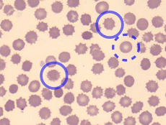
PK deficiency
Clinical features:
Unlike patients with G6PD deficiency, the majority of patients with pyruvate kinase deficiency display clinical symptoms.
Typically newborn jaundice due to hemolysis and history of exchange transfusions
Splenomegaly
Pallor, fatigue, weakness
In rare cases: hydrops fetalis
Diagnosis:
↓ Pyruvate kinase enzyme activity
PKLR gene mutation
Blood smear: burr cells
Treatment:
Phototherapy and/or exchange transfusions
In the case of severe anemia or excessively enlarged spleen: splenectomy

Slide 20
Hereditary Spherocytosis

Slide 21
Hereditary Spherocytosis
Most common inherited hemolytic disease among individuals of Northern European descent
Can be inherited as autosomal dominant (75%) or autosomal recessive (25%)
Caused by red blood cell (RBC) membrane protein defects (Spectrin, Ankyrin, Band 3, Protein 4.2), which render the RBCs more vulnerable to osmotic stress and hemolysis
Pathophysiology:
Genetic mutation → defects in RBC membrane proteins (especially spectrin and/or ankyrin) responsible for tying the inner membrane skeleton with the outer lipid bilayer → continuous loss of lipid bilayer components → decreased surface area of RBCs in relation to volume → sphere-shaped RBCs with decreased membrane stability → inability to change form while going through narrowed vessels → entrapment within splenic vasculature → splenomegaly →destruction via splenic macrophages → extravascular hemolysis

Slide 22
Hereditary Spherocytosis
Presentation is variable.
Mild HS (20–30% of cases): often asymptomatic
Moderate HS (60–75% of cases): onset of symptoms (symptoms of anemia and hemolysis) in infancy or childhood
Severe HS (5% of cases): onset of symptoms in newborns or even in utero (hydrops fetalis)
Diagnosis:
CBC: ↑ MCHC, RDW and reticulocytes
Eosin-5-maleimide binding test (EMA binding test)
Test of choice, as results are readily available (within two hours)
Decreased binding between dye (eosin-5-maleimide) and RBC membrane proteins
Binding is quantified using flow cytometry, which shows decreased mean fluorescence
The most sensitive and specific test (Confirm the diagnosis)

Slide 23
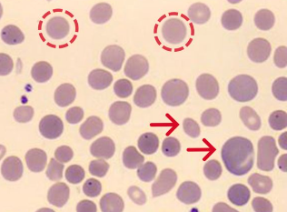
Hereditary Spherocytosis
Cont. diagnosis:
Negative Coombs test: to exclude autoimmune hemolytic anemia (positive Coombs test), since spherocytosis is seen in both
Positive osmotic fragility test:
Measures the ability of RBCs to resist hemolysis when exposed to different degrees of salt dilution (e.g., RBCs swell and eventually lyse when incubated in hypotonic saline due to water influx)
Whether or not RBCs lyse depends on their surface area to volume ratio. This ratio is decreased in patients with HS, so their RBCs are more fragile and more vulnerable to osmotic stress.
Blood smear:
Characteristic spherocytes (small round cells without central pallor)
Potentially anisocytosis

Slide 24
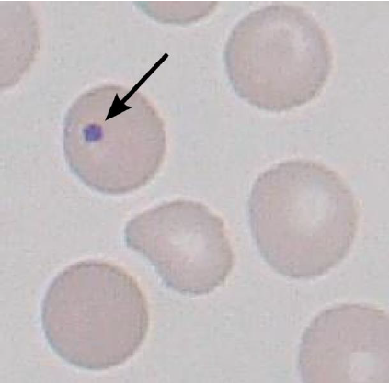
Hereditary Spherocytosis
Complications:
Hemolytic crisis: esp. as a result of viral infection
Aplastic crisis: following infection with parvovirus B19; characterized by a low reticulocyte count (< 0.1% of total RBC count)
Bilirubinate gallstone formation, possibly leading to cholecystitis, cholangitis, and pancreatitis
Growth retardation and skeletal abnormalities due to bone marrow expansion
Treatment:
Splenectomy
Sole definitive treatment
Spherocytes will persist but hemolysis resolves
Howell Jolly bodies appear
Some RBCs leave marrow with nuclear remnants
Normally cleared by spleen

Slide 25
Sickle Cell Disease

Slide 26
SCD
Sickle cell disease:
A group of conditions characterized by mutations in the HbS genotype that result in phenotypic manifestations similar to sickle cell anemia
Genotypes include HbSS, HbSβ0thal, HbSβ+thal, HbSC
Symptoms range from mild to severe
Sickle cell anemia:
The most severe clinical presentation of sickle cell disease
Genotypes include homozygous HbSS and compound heterozygous HbSβ0thal (a form of sickle beta thalassemia).
Sickle cell trait:
Refers to the sickle cell carrier genotype (HbAS)
Not considered a form of sickle cell disease
Complications occur rarely

Slide 27
SCD
Predominantly affects individuals of African and Eastern Mediterranean descent.
Sickle cell anemia is the most common form of intrinsic hemolytic anemia worldwide.
Inherited as autosomal recessive
Pathophysiology:
Point mutation in the β-globin gene (chromosome 11) → glutamic acid replaced with valine (single amino acid substitution) → 2 α-globin and 2 mutated β-globin subunits create pathological hemoglobin S (HbS).
Heterozygotes (HbAS): carry one sickle allele and one other (usually normal) → sickle cell trait
Homozygotes (HbSS): carry two sickle alleles → sickle cell anemia
Glutamic acid can also be replaced with a lysine, creating hemoglobin C
Heterozygosity for hemoglobin S and hemoglobin C → hemoglobin SC disease → phenotype more severe than sickle cell trait but not as severe as sickle cell disease (e.g., fewer acute sickling events)

Slide 28
SCD
HbS polymerizes when deoxygenated, causing deformation of erythrocytes (“sickling”). This can be triggered by:
Hypoxia, infections, dehydration, acidosis, stress, pregnancy
Sickle cells lack elasticity and adhere to vascular endothelium, which disrupts microcirculation and causes vascular occlusion and subsequent tissue infarction.
Extravascular hemolysis and intravascular hemolysis are common and result in anemia.
The body increases the production of fetal hemoglobin (HbF) to compensate for low levels of HbA in sickle cell disease.

Slide 29
SCD
Clinical features of sickle cell trait:
Often asymptomatic
Painless gross hematuria due to renal papillary necrosis: often the only symptom
Nocturia and enuresis
Recurrent UTIs
Symptoms of sickle cell disease may manifest due to severe oxygen deficiency
Exertional collapse and sudden death can occur during or after extreme physical exertion (e.g., during sports, military training)
Increased risk of renal medullary cancer
Individuals with sickle cell trait are less likely to develop severe forms of malaria and have reduced parasite prevalence.

Slide 30
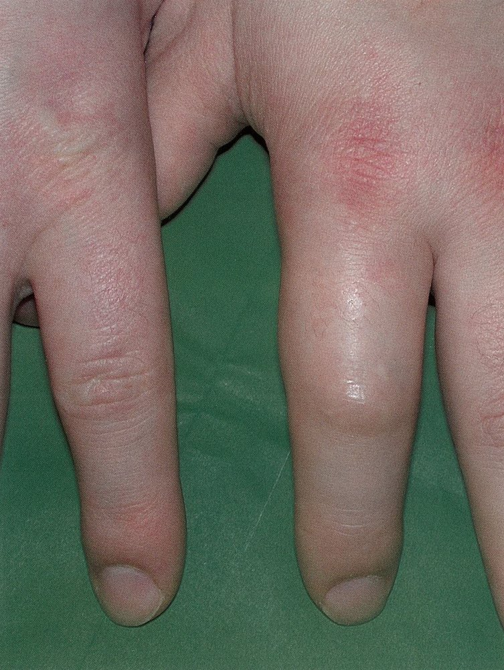
SCD
Clinical features of sickle cell anemia:
∼ 30% develop symptoms in the first year of life; > 90% by age 6 years
Typically manifests after 3–6 months of age as the production of HbF decreases and HbS levels increase
Vaso-occlusive events:
Dactylitis in children < 5 years of age
Typically the earliest manifestation of sickle cell disease
Most common in children between 6 months and 2 years of age;
uncommon in older children and adults
Vaso-occlusive crises (sickle cell pain crisis)
Most common acute complication of sickle cell disease
Characterized by recurrent episodes of severe throbbing or sharp pain
Typically affects the limbs, chest, and back and lasts for ∼ 7 days
Often associated with other vaso-occlusive events (especially dactylitis in children)

Slide 31
SCD
Cont. clinical features of sickle cell anemia:
Vaso-occlusive events:
Acute chest syndrome
Characterized by new chest infiltrate and respiratory symptoms.
Typically presents with chest pain, dyspnea, and hypoxia.
The most common cause of mortality in patients with sickle cell disease.
Sickle cell hepatopathy
Suspect life-threatening acute intrahepatic cholestasis when laboratory studies suggest a cholestatic jaundice but imaging does not identify common bile duct obstruction or cholangitis.
Organ infarctions (any organ; particularly the spleen)
Priapism
Stroke (common in children)
Avascular necrosis
Infections
Patients with sickle cell disease are at particularly high risk of developing infections due to the early loss of splenic function
Pneumonia, meningitis, osteomyelitis (most common cause: Salmonella spp., Staphylococcus aureus), sepsis (most common cause: Streptococcus pneumoniae)

Slide 32
SCD
Cont. clinical features of sickle cell anemia:
Acute hemolytic crisis
Splenic sequestration
splenic vaso-occlusion and entrapment and pooling of large amounts of blood in the spleen
Most commonly affects children < 5 years of age
Acute left upper quadrant pain, splenomegaly
Hypotension and/or hypovolemic shock, especially in infants
Symptoms of anemia (e.g., pallor, fatigue)
Anemia (Hb drop of ≥ 2 g/dL) with reticulocytosis
Thrombocytopenia
Aplastic crisis
Red blood cell aplasia with an acute, severe drop in hemoglobin and associated reticulocytopenia due to an infection with parvovirus B19
Fever, pallor, fatigue, lethargy, dyspnea, syncope, heart failure (rare)
Anemia (Hb drop of ≥ 2 g/dL) with reticulocytopenia

Slide 33
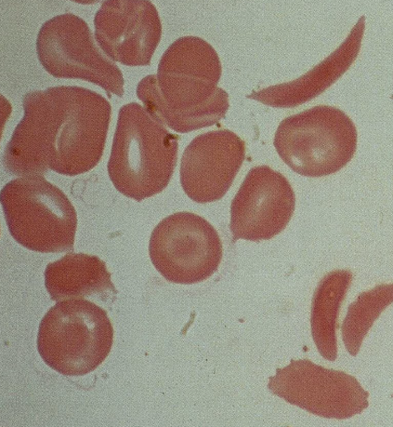
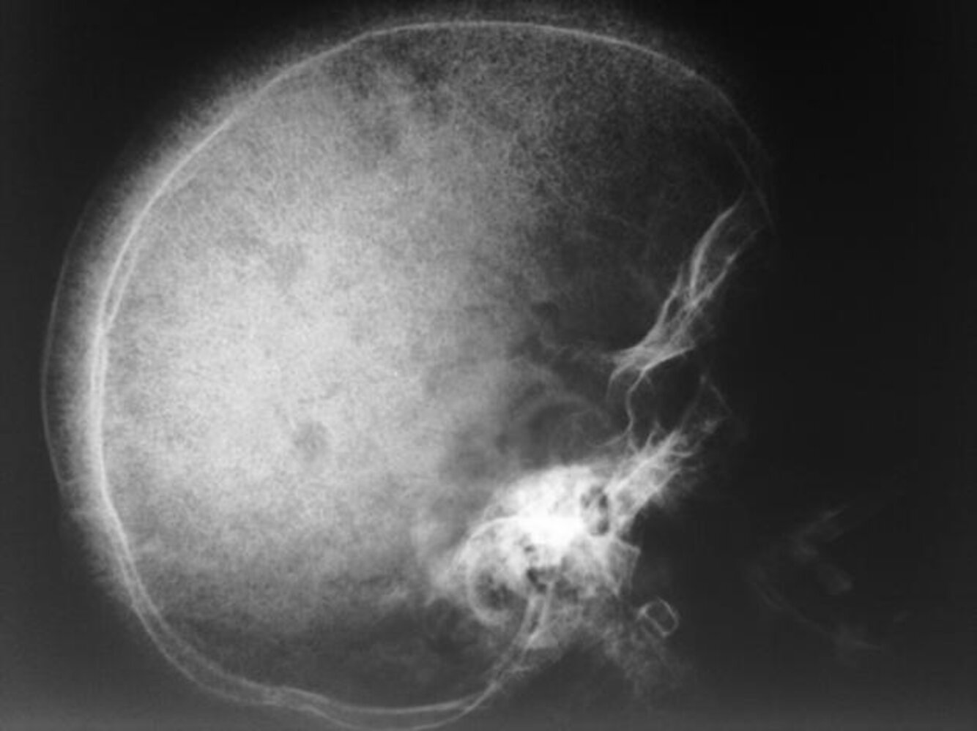
SCD
Diagnosis:
CBC: mild-to-severe anemia with reticulocytosis
Peripheral blood smear findings may include:
Crescent-shaped sickled RBCs (drepanocytes)
Target cells
Howell-Jolly bodies: occur with splenic dysfunction
Reticulocytosis: indicates the presence of hemolysis
Skull x-ray
May show hair-on-end (“crew cut”) sign
Caused by periosteal reaction to
erythropoietic bone marrow hyperplasia

Slide 34
SCD
Diagnosis:
Sickle cell trait and/or disease is most commonly diagnosed on routine neonatal screening.
Confirmatory studies should be performed for all individuals with a positive or inconclusive result on initial screening.
Hemoglobin electrophoresis (Qualitative)
No sickle cell trait/disease: hemoglobin A and F only
Sickle cell trait/disease:
Hemoglobin S is also present.
Hemoglobin C in hemoglobin SC disease
High performance liquid chromatography (Quantitative)

Slide 35
SCD
Management:
Infants and children
Immunizations
Patients should receive all vaccines recommended for their age.
Pneumococcal vaccines and meningococcal vaccines are particularly important; earlier/additional doses may be required.
Antibiotic prophylaxis
Daily prophylactic penicillin
Recommended from early infancy (1–2 months of age) until 5 years of age for children with HbSS
Continue penicillin prophylaxis in children who have had a splenectomy or history of invasive pneumococcal infection.
Hydroxyurea therapy to minimize disease-related complications
All infants > 9 months, children, and adolescents with SCA regardless of symptom severity
Annual transcranial doppler to screen for stroke risk from 2 months till 16 years of age

Slide 36
SCD
Management:
Adult
Immunizations
Hydroxyurea therapy if clinically indicated
Frequent (≥ 3 episodes/year) acute pain episodes or other vaso-occlusive events
Severe symptomatic anemia
History of severe and/or recurrent acute chest syndrome
Reproduction counselling and contraception
Allogeneic bone marrow transplantation
Currently the only potentially curative option
Associated with better outcomes if performed at a younger age (< 16 years)
Blood transfusion

Slide 37
Hemoglobin C Disease

Slide 38
Hemoglobin C Disease
Hemoglobin C disease: occurs in individuals who are homozygous for the hemoglobin C mutation (HbCC)
Hemoglobin C trait: occurs in individuals who are heterozygous carriers of the hemoglobin C mutation (HbAC)
Inherited as autosomal recessive
Pathophysiology:
β-globin mutation (glutamate replaced by lysine) creating hemoglobin C
HbC precipitates as crystals → ↑ RBC rigidity and ↓ deformability → extravascular hemolysis
HbC is less soluble than HbA and tends to form hexagonal crystals, which lead to RBC dehydration (↑ MCHC)
RBCs have reduced oxygen-binding capacity and a shorter lifespan
Clinical features:
Hemolytic anemia (usually mild), cholelithiasis, jaundice, splenomegaly
Patients with HbSC gene mutation (one HbC and one HbS trait) have milder symptoms than HbSS patients.

Slide 39
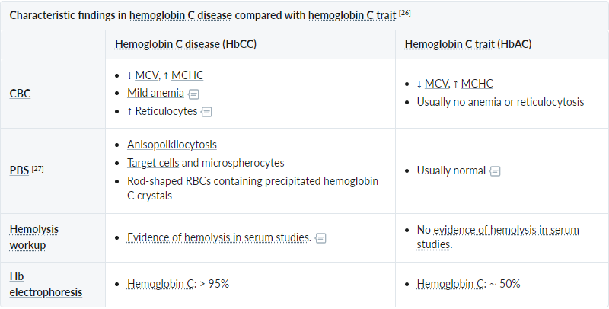
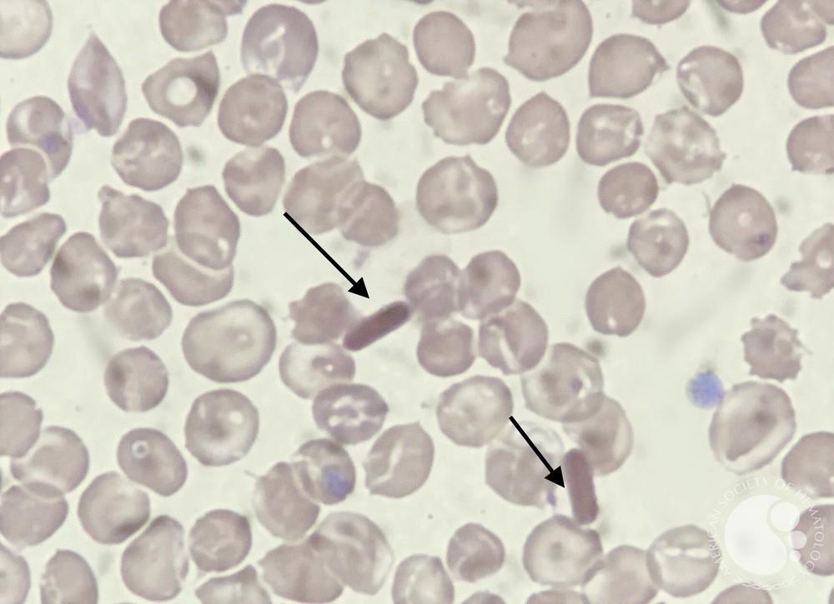
Hemoglobin C Disease
Diagnosis:
Treatment:
Most patients do not require treatment.
Consider folic acid supplements in hemoglobin C disease.
Consider cholecystectomy in patients with symptomatic gallstones.
Splenectomy is rarely indicated.
(Hb 10–12 mg/dL)

Slide 40
Extrinsic Hemolytic
Antibody-mediated destruction of RBCs
◦ Alloimmune hemolytic anemia
▪ Hemolytic transfusion reaction
▪ Hemolytic disease of the fetus and newborn
◦ Autoimmune hemolytic anemia
▪ Cold agglutinin hemolytic anemia
▪ Warm agglutinin hemolytic anemia
• Mechanical destruction of RBCs
◦ MAHA
◦ Macroangiopathic hemolytic anemia
Other
◦ Toxin-mediated RBC destruction, e.g., from a snake bite, oxidizing agents (e.g., dapsone, nitrofurantoin, phenazopyridine, primaquine)
◦ RBC destruction by intracellular pathogens, e.g., in malaria, babesiosis, bartonellosis, rickettsiosis
◦ RBC destruction due to hypersplenism

Slide 41
MAHA (Microangiopathic hemolytic anemia)
Medical emergency !!!!!!!!
Hemolytic anemia (↑LDH, ↓ haptoglobin)
Caused by shearing of RBCs as they pass through thrombi in small vessels
Blood smear: schistocytes
Seen in:
TTP
HUS
DIC

Slide 42
TTP Thrombotic thrombocytopenic purpura
Fever
Inflammation from small vessel occlusion and tissue damage
Neurological symptoms
Headache, confusion, seizures
Renal failure
Petechiae and bleeding

Slide 43
TTP Thrombotic thrombocytopenic purpura
Lab tests:
• Hemolytic anemia
• Thrombocytopenia
• Schistocytes on blood smear
• PT/PTT should be normal
• Contrast with DIC
• May see elevated d-dimer

Slide 44
TTP Thrombotic thrombocytopenic purpura
Treatment
• Plasma exchange: removes antibodies
• Platelet counts monitored to determine efficacy

Slide 45
HUS Hemolytic Uremic Syndrome
Many similarities with TTP
Also caused by platelet-rich thrombi in small vessels
MAHA, thrombocytopenia, acute kidney injury
Usually no fever or CNS symptoms
Renal thrombi → kidney injury
Commonly seen in children
Commonly follow GI infection E. Coli
Shiga-like toxin causes microthrombi

Slide 46
DIC Disseminated Intravascular Coagulation
• Widespread activation of clotting cascade
• Diffuse thrombi (platelets/fibrin) → ischemia
• Consumption of clotting factors and platelets
• Destruction of red blood cells → anemia

Slide 47
DIC Disseminated Intravascular Coagulation
Occurs secondary to another process
Obstetrical emergencies
Amniotic fluid contains tissue factor
DIC seen in conjunction with amniotic fluid embolism
Sepsis
Endotoxin –> activates coagulation cascade
Cytokines

Slide 48
DIC Disseminated Intravascular Coagulation
Leukemia
Especially acute promyelocytic leukemia (APML)
Cancer: well-described hypercoagulable state
Excess coagulation: DIC
Rattlesnake bites
Thrombin-like glycoproteins within venom
Diffuse activation of clotting

Slide 49
DIC Disseminated Intravascular Coagulation
- Elevated PT/PTT/Thrombin time
Consumption of factors
- Low platelets
Consumption of platelets
- Low fibrinogen (consumption)
- Microangiopathic hemolytic anemia
Low RBC (anemia)
Schistocytes on blood smear
- Elevated D-dimer

Slide 50
DIC Disseminated Intravascular Coagulation
• Treatment: underlying disorder
• Fresh frozen plasma: replace clotting factors
• RBCs, platelets
• Cryoprecipitate (for low fibrinogen)

Slide 51
Malignant Hypertension
• Associated with MAHA
• Endothelial injury → thrombus formation
• Improved with BP control

Slide 52
Macroangiopathic hemolytic anemia
Etiology
◦ Congenital cardiovascular anomalies (e.g., bicuspid aortic valve, coarctation of the aorta)
◦ Moderate and severe aortic stenosis: Heart valve replacement usually resolves the anemia.
◦ In other patient groups: Prosthetic heart valves can cause anemia.
◦ Extracorporeal circulation, dialysis
◦ Exertional hemoglobinuria (“march hemoglobinuria”): RBC destruction in the feet during strenuous exercise (e.g., running on hard surfaces)
Pathophysiology:
RBC destruction in the systemic circulation (large vessels) due to mechanical forces applied to RBC membrane → intravascular hemolysis, schistocytes, ↑ free Hb

Slide 53
Macroangiopathic hemolytic anemia
Clinical features
◦ Features of anemia (e.g., pallor, fatigue)
◦ Jaundice
Diagnostics
◦ Evidence of hemolysis (e.g., ↑ Indirect bilirubin, ↑ LDH, ↓ haptoglobin, reticulocytosis)
◦ DAT: Negative
◦ Blood smear: Schistocytes
◦ Consider echocardiography
Treatment
◦ Address the underlying cause.

Slide 54
AIHA Autoimmune Hemolytic Anemia
• Red cell destruction from autoantibodies
• Results in extravascular hemolysis
• Red cell membrane removed in pieces by spleen
• Can be “warm” or “cold”

Slide 55
Warm AIHA
• Most common type of AIHA
• Antibodies bind at body temp 37 C (“warm”)
• IgG antibodies against RBC surface antigens

Slide 56
Warm AIHA
Signs and symptoms
Anemia
Fatigue
Pallor (pale skin)
Dyspnea
Tachycardia
Extravascular hemolysis
Jaundice
Splenomegaly

Slide 57
Warm AIHA
Spherocytes
Smaller than normal RBCs
Spherical

Slide 58
Direct Antiglobulin Test DAT or Coombs Test
• Test for red blood cell antibodies
• Patient RBCs plus anti IgG antiserum
• Positive if agglutination occurs
• Indicates patient’s RBCs covered with IgG

Slide 60
Indirect Antiglobulin Test Indirect Coombs
• Also a test for red blood cell antibodies
• Not generally used in warm/cold AIHA
• Tests for antibodies in the serum
• Patient’s serum (not RBCs) tested
• Added to RBCs
• Indicates antibodies to RBC components

Slide 62
Antiglobulin Tests
Direct antiglobulin test
Test for antibodies bound to RBCs
Commonly used in hemolytic anemias
Indirect antiglobulin test
Test for antibodies in serum
Will serum react with RBCs?

Slide 63
Warm AIHA
• Mostly idiopathic
• Secondary causes
◦ Malignancy (lymphoma, chronic lymphocytic leukemia)
◦ Autoimmune diseases (e.g., SLE)
◦ Certain drugs (e.g., rifampin, phenytoin, penicillins, α-methyldopa)

Slide 64
Methyldopa α methyldopa
Antihypertensive drug of choice in pregnancy
Agonists to CNS α2 receptors
Synapses believe too much sympathetic outflow
Decrease sympathetic tone in body
Associated with warm AIHA

Slide 65
Methyldopa α methyldopa
Triggers production of RBC antibodies
Unclear mechanism
Drug may alter Rh antigens on red cells
Red cells bind antibody in absence of drug
Direct Coombs test: positive

Slide 66
Penicillin
High doses can lead to hemolytic anemia
PCN binds to surface RBCs (“hapten”)
Elicits immune response only when bound
Antibodies against PCN bound to RBCs
Direct Coombs test: positive

Slide 67
Warm AIHA managment
Acute therapy
• Indications: Severe symptoms of anemia or Hb < 6–7 mg/dL
• Management
◦ Consider an RBC transfusion under specialist guidance.
◦ Consider temporizing measures.
▪ Early treatment with high-dose glucocorticoids (e.g., methylprednisolone)
▪ Rescue therapy with IVIG or plasma exchange
Do not delay a potentially life-saving blood transfusion in unstable patients with severe anemia.
Long-term therapy
• Indications: Consider in most patients to reduce autoantibody production.
• Treatment: typically involves systemic immunomodulators
◦ First-line: high-dose glucocorticoids
◦ Second-line: rituximab
◦ Third-line: steroid-sparing immunosuppressants or splenectomy

Slide 68
Cold AIHA
Less common type of AIHA
Antibodies bind at <30oC (“cold”)
Occurs in limbs
Also fingertips, toes, nose, ears
May present with painful fingers/toes
Purple discoloration
Symptoms associated with cold exposure

Slide 69
Cold AIHA
◦ Cold agglutinin disease (CAD): a primary (idiopathic) form of cold AIHA in which hemolysis is mediated by monoclonal cold-sensitive IgM autoantibodies produced by a low-grade clonal B-cell lymphoproliferative disorder of the bone marrow
◦ Cold agglutinin syndrome (CAS): a rare form of cold AIHA in which cold-sensitive autoantibody-mediated hemolysis occurs secondary to another condition (e.g., infection, lymphoma)

Slide 70
Cold AIHA Cold Agglutinin Disease
• Caused by IgM antibodies that agglutinate RBCs
• RBCs warmed in central organs → IgM lost
• Leaves bound C3 on RBCs
• DAT positive only for C3

Slide 71
Direct Antiglobulin Test DAT or Coombs Test

Slide 72
Cold AIHA Cold Agglutinin Disease
Usually causes extravascular hemolysis
C3 coated RBCs removed by spleen
Often engulfed whole
Spherocytosis less common than in warm AIHA
Intravascular hemolysis rarely occurs
Complement usually does not activate
RBCs: complement inhibitory molecules (CD55/CD59)
Complement must be significantly activated to lyse cells

Slide 73
Cold AIHA Cold Agglutinin Disease
• CAD: idiopathic
• CAS occurs secondary to other diseases, including:
◦ Mycoplasma pneumoniae or EBV infection
◦ Malignancy (e.g., non-Hodgkin lymphoma, CLL)
◦ Waldenstrom macroglobulinemia
Cold weather is MMMMiserable: Cold (IgM) AIHA is seen in Malignancy (CLL), Mycoplasma pneumonia, and Mononucleosis.

Slide 74
Cold AIHA
Management
The goal is to reduce cold-induced symptoms, control hemolysis, and improve anemia.
• CAD: Consider chronic therapy (systemic immunomodulatory).
• CAS: Treat the underlying condition
• Advise all patients to avoid exposure to the cold.

Slide 75
Management
Acute therapy
• Indications: Severe symptoms of anemia or Hb < 7 mg/dL
• Management
◦ RBC transfusions as needed
◦ Consider temporizing measures.
▪ Plasmapheresis
▪ Trial of glucocorticoids: e.g., prednisolone (however, the response is often poor)
Long-term therapy
• Indications: CAD with either symptomatic anemia or significant cold-induced symptoms
• Treatment: Systemic immunomodulators
◦ First-line treatment: rituximab (anti-CD20 antibody) [6]
◦ Combination therapy (i.e., rituximab PLUS bendamustine OR fludarabine) is often recommended in severe disease. [11][6]

Slide 76
Mechanical Hemolysis
Shear forces destroy RBCs in large blood vessels
Seen in:
Aortic stenosis
Mechanical heart valves
Left ventricular assist devices
Hemolytic anemia may occur
Schistocytes can be seen on blood smear

Slide 77
Red Blood Cell Infections
• May cause hemolytic anemia
• Classic infectious agents: Malaria, Babesia

