Slide 1
Lung Collapse *Atelectasis*
Abrar Tarawneh
Daniah Tarawneh
Leen Tarawneh

Slide 2
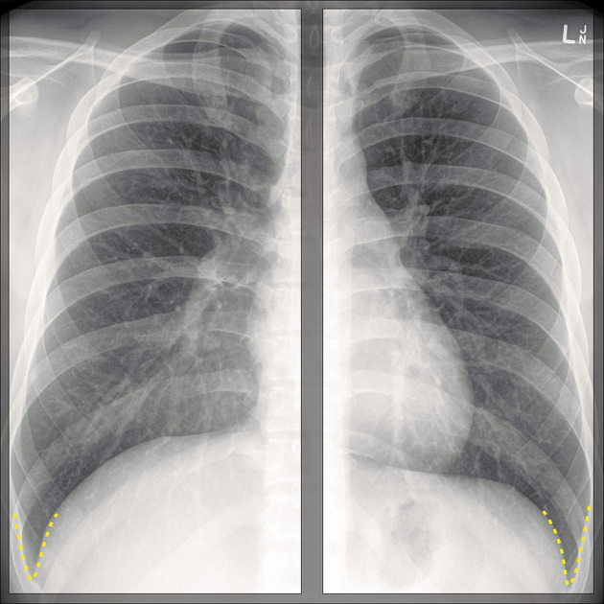
Normal PA Chest X-Ray
Name : S. A.
Sex : male
Age : 20y
Date : 3-12-2020
Projection : PA
Image Quality :
Centralized position ( no rotation )
Full inspiration
First ribs | costophrenic angles | lateral edges of the ribs are all visible
Optimum exposure

Slide 3
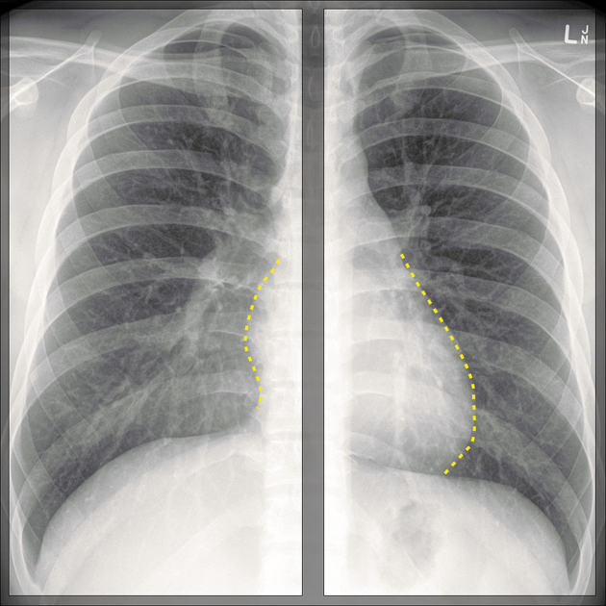
Normal equally sized inflated clear lungs
Patent costophrenic angles
Centrally located trachea
Normal cardiothoracic ratio
No bone fractures
clear heart contour
Normal bronchovesicular tapering
3

Slide 5
Definition and causes
Atelectasis : a condition in which alveoli are deflated, collapsed or inadequately expanded resulting in air-devoid alveoli and thus decreased normal parenchymal volume usually unilateral.
Causes :
1. Mucus plug
2. Foreign body in airways
3. Tumor inside airways
4. Chest trauma
5. Pleural effusion
6. Pneumonia
7. Pneumothorax
8. Scarring of lung tissue

Slide 6
Sign and symptoms :
1.Difficulty breathing
2.Rapid, shallow breathing
3.Wheezing
4.Cough
Complications :
1. systemic hypoxia if atelectasis is significant enough (affected ventilation/perfusion ratio).
2. increased incidence of pneumonia (infections due to settled secretions that accumulate in the affected area).
3. Respiratory failure.

Slide 7
Common signs seen on chest X-ray:
Indirect signs include:
1. pulmonary opacification.
2. signs related to shift of other structures to compensate for the loss of volume (trachea and mediastinum).
3. hilar shadow displacement.
4. diaphragm elevation (tenting).
Direct signs include:
1. displacement of the interlobar fissures.
2. crowding of bronchi and vessels within the area of atelectasis.

Slide 8
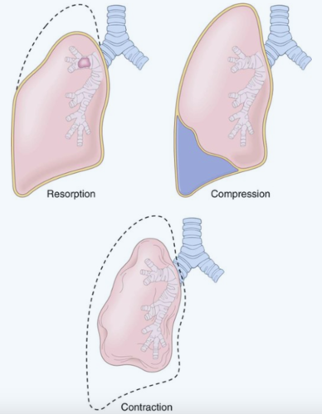
Types of Atelectasis
Both obstructive resorptive & compression atelectasis are reversible | on the contrary contraction (cicatrisation) atelectasis is irreversible
Mediastinal and tracheal shift to the affected side in obstructive atelectasis, to the counter side in compressive atelectasis and mostly (not always) absent in contraction atelectasis.

Slide 9
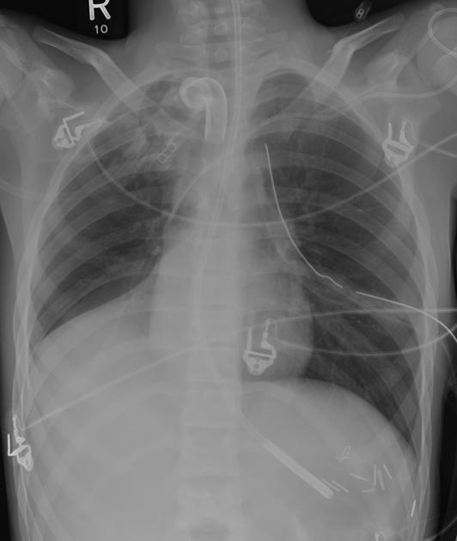
1. Resorptive Atelectasis (obstructive)
Resorptive or obstructive atelectasis
is a form of lung collapse that is due to obstruction of the airways supplying a lung segment or lobe.
Obstruction is often :
1. Mucus plug (asthma, pneumonia, postoperative, post anesthetic)
2. Foreign body
3. Neoplasm (mass)
4. Pus (bacterial pneumonia)
5. Blood (post-traumatic lung injury)
6. Fibrotic stricture
7. Malpositioned endotracheal tube.
RLL Collapse (red arrow)

Slide 10
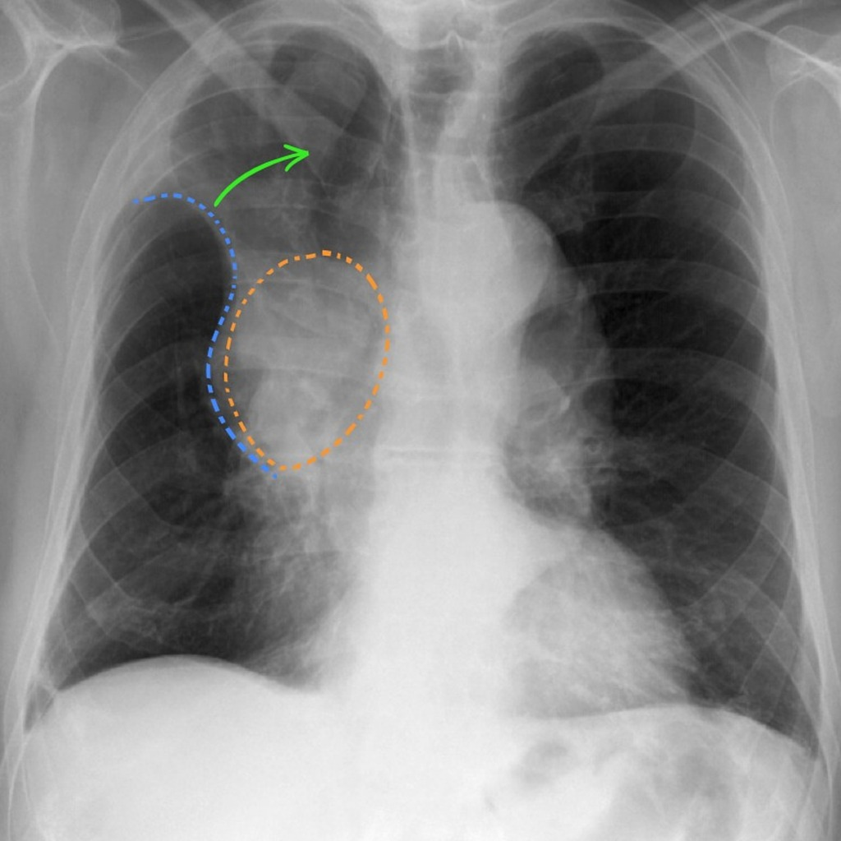
Example 1
R
S-sign of Golden
Right hilar mass (orange) obstructing the right upper lobe bronchus results in collapse of the right upper lobe (green arrow). This results in a reverse S shape to the pleural edge.
Note the ipsilateral tracheal deviation (the trachea is deviated to the right).
RUL Collapse (green arrow)

Slide 11
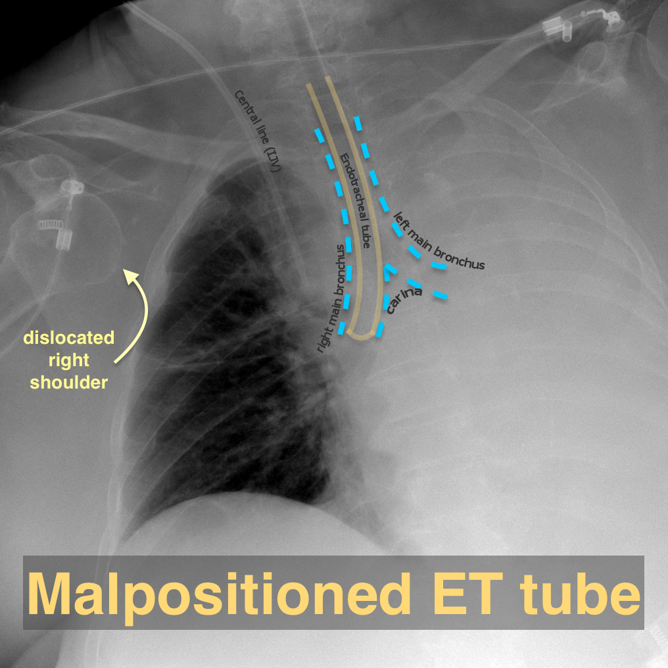
Example 2
R
Resorptive Atelectasis. Malpositioned Endotracheal tube in right main bronchus. Totally atelectatic left lung.
Note how the cardiac shadow was not seen in the right hemithorax as the central mediastinal structures have all shifted to the left due to the total atelectasis of the left lung.

Slide 12
Example 3
L
Although the descending aortic contour is distinct superiorly (straight arrows) , the distal descending aortic silhouette is obscured (curved arrow) because of the adjacent collapsed left lower lobe.
Chest x-ray of a patient with asthma and a mucus plug shows lower left lobe collapse

Slide 13
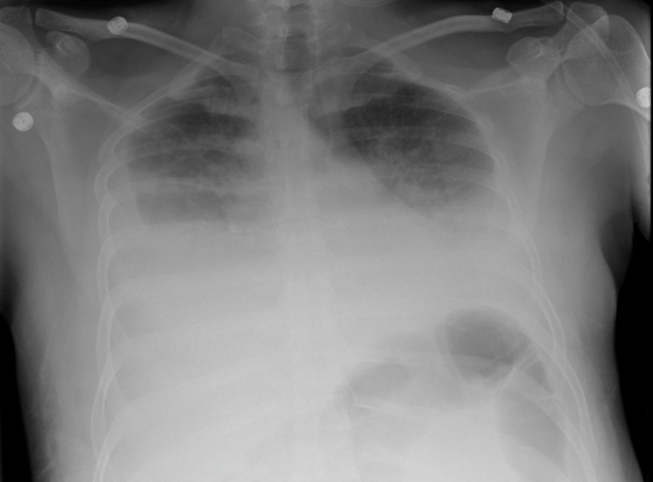
2. Compressive Atelectasis
a form of lung atelectasis due to compression by a space-occupying process.
Etiology :
1. Extrapulmonary (pleural effusion, empyema, hemothorax, pneumothorax, pleural tumor, chest wall mass lesion)
2. Intrapulmonary (lung cancer)
3. Abdominal distension (hepatosplenomegaly, massive ascites, large intra-abdominal tumor, morbid obesity, pregnancy)
R
Large Pleural Effusions : compressive atelectasis

Slide 14
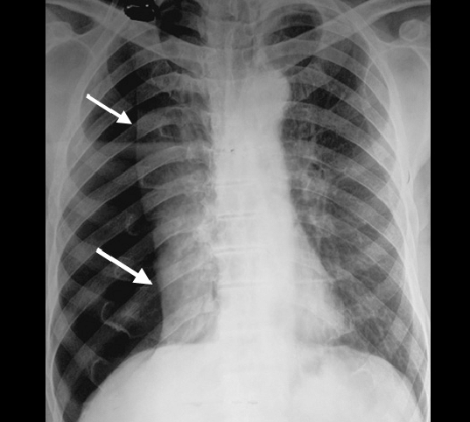
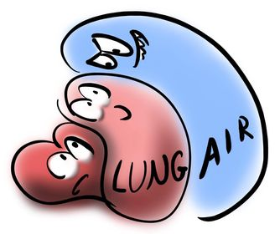
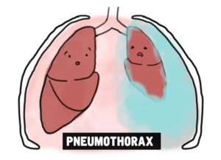
Example 1
Right sided pneumothorax. Collapsed lung is demarcated by arrows
L
Note the Positive silhouette sign (disappearance of right heart border) due to collapsed lung

Slide 15
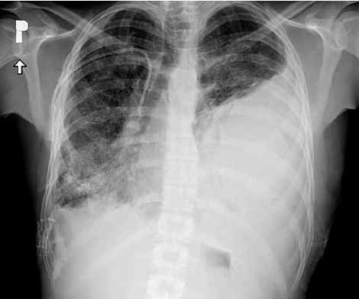
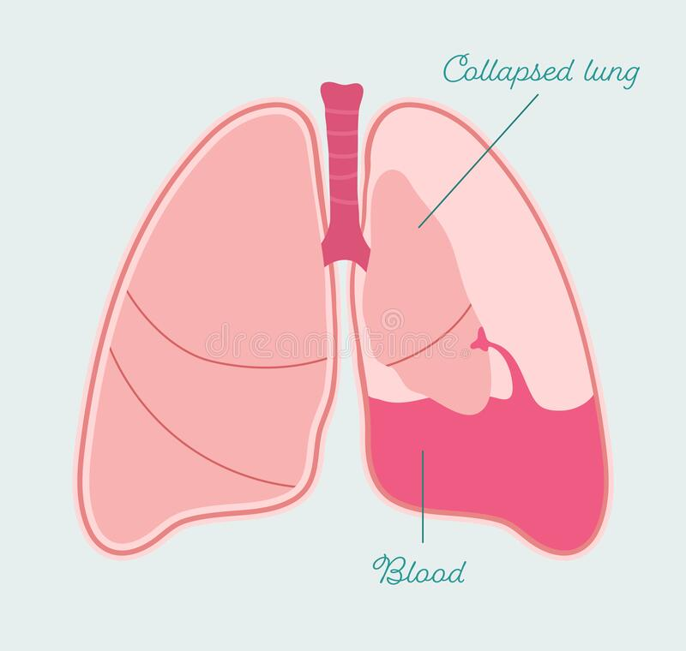
Example 2
L
Chest X-ray – left-sided massive hemothorax resulting in progressing left lung collapse

Slide 16
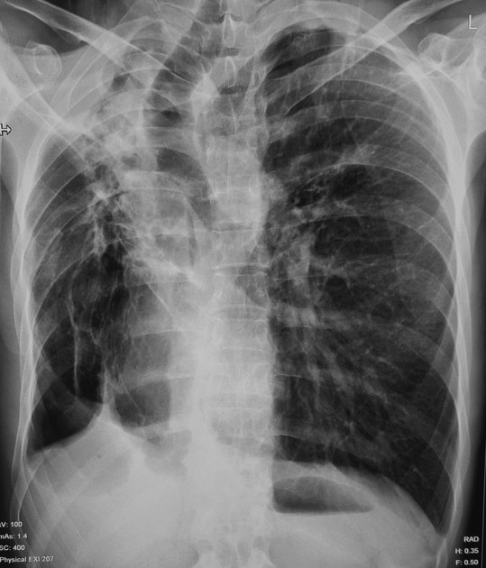
3. Contraction (Cicatrisation) atelectasis
is a form of lung atelectasis which occurs as a result of scarring or fibrosis that reduces lung expansion.
* Cicatrisation atelectasis is classic in tuberculosis.
Etiology :
1. granulomatous disease especially tuberculosis
2. necrotizing pneumonia
3. any fibrosing process (silicosis, scleroderma, idiopathic pulmonary fibrosis)
chronic pulmonary tuberculosis resulting in contraction atelectasis.

Slide 17
Example 1
Cicatrisation collapse of right upper lobe in a patient with chronic pulmonary tuberculosis.
Right upper lobe collapse (red arrow) due to fibrosis and pleural thickening with right sided tracheal (yellow arrow) and mediastinal shift (blue arrow), crowding of right upper ribs, uplifting of right hilum (not well demarcated in figure)
The left lung is hyperinflated compensating the mediastinal shift (note the large shadow of left lung).

Slide 18
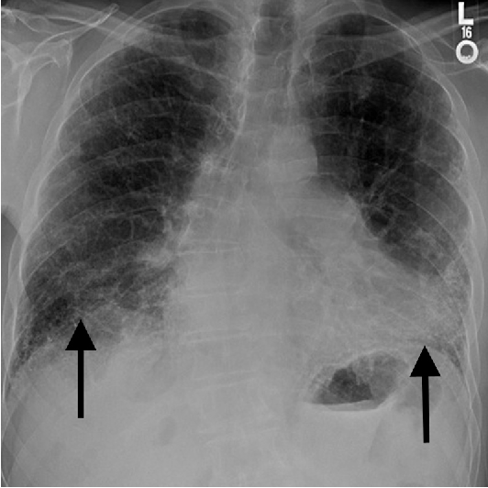
Example 2
Interstitial pneumonitis (scleroderma):In contrast to tuberculosis this diseases do not usually result in segmental or lobar opacities. The volume loss tends to be bilateral in the radiologic appearance and increased basilar opacity, crowding of vessels, and elevation of the diaphragm.
Chest x-ray in a patient with advanced interstitial lung disease and pulmonary fibrosis shows coarse interstitial markings at the lung bases (arrows) and volume loss (clear in left lung)

Slide 19
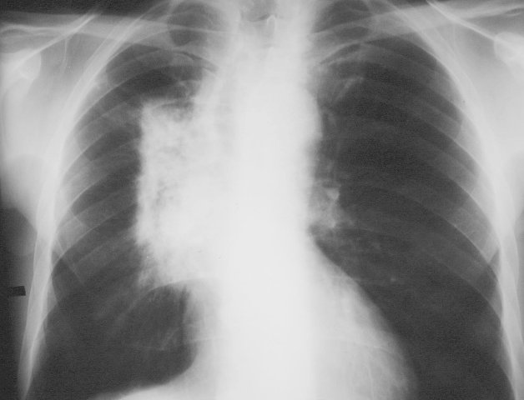
Example 3
Radiation pneumonitis (radiation therapy induced fibrosis) leaves scarring in the lung with significant volume loss during its later stages
L
L
It is frequently localized by sharply defined lines (red arrows) that coincide with the portals of the radiation therapy beam to which the patient was exposed.

Slide 20
* A 30 years old female patient presenting with acute shortness of breath
* She also complained of a pleuritic chest pain
* She was a known asthmatic for five years yet uncompliant with her medications
* An angiogram was preformed to rule out PE, then a chest X-ray was preformed
Case
1
The following findings were found:

Slide 21
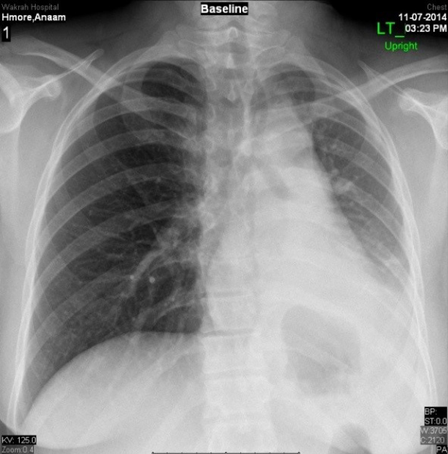
* Chest X-ray showed opacity on the lower portion of the left lung. Sings of lobar collapse
* left heart border and diaphragmatic silhouette are not identifiable (+ve silhouette sign)
* Left tracheo-mediastinal shift
* Abrupt cut off of the bronchus (a sign of atelectasis)
* Absent lung marking
* normal right lung
Notes:
Normal chest expansion
Normal clavicle distance
Normally expanded lung fields (inspiration)
Good exposure
Normal gasses in the fundus of the stomach

Slide 22
* 60-year-old man experiencing a recent change in nature of his pre-existing chronic cough
* He has a long history of tobacco abuse * A chest X-ray was preformed
Case 2
The following findings were found:

Slide 23
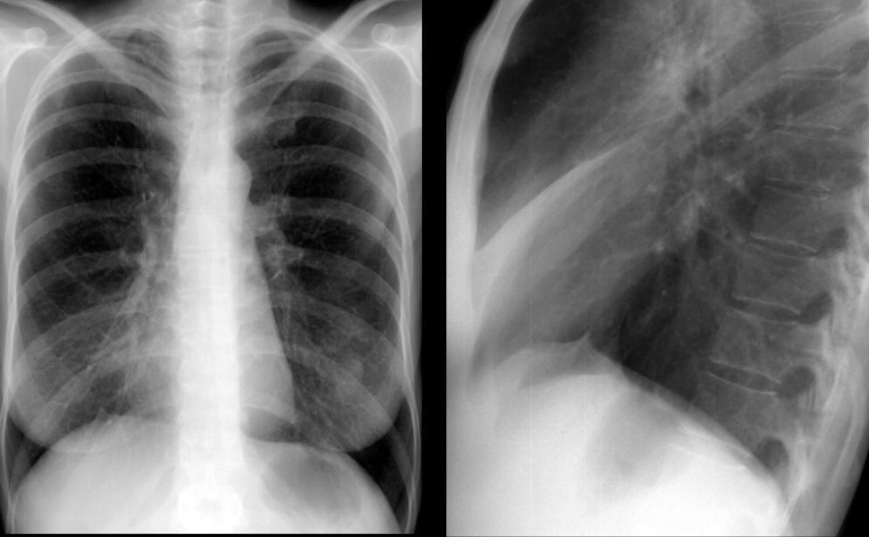
* ill-defined right peri-hilar opacity
* On lateral radiograph, there is a corresponding triangular opacity
* elevation of the right diaphragm
* Right middle lobe collapse

Slide 24
THANK YOU

