Slide 1
Vascular diseases of the nervous system
Dr Omar Alrawashdeh
MBBS, PhD, RCP
Clinical Neurology

Slide 2
Stroke
a.30% are due to small-artery occlusion
b. 30% are due to large-artery thromboembolism
c. 20% are due to cardioembolism
d. 20% are due to other mechanisms or are cryptogenic

Slide 3
Epidemiology
Age is the most predictive factor for stroke
Sex: male predominance?
Race: more common in blacks and hispanics

Slide 4
Risk factors
Previous stroke: clinical or radiological
Previous TIA
Hypertension: more than 140 mmHg and 90 mmHg
Diabetes: adequate control of glucose reduces only small vessel disease.
Carotid stenosis: the degree of stenosis increases risk of stroke whether this stenosis is symptomatic or asymptommatic

Slide 5
Risk factors
Heart disease including:
Atrial fibrillation especially with chronic fibrillation, hyperthyroidism,
Atrial enlargement with or without A Fib
Valvular heart disease (mechanical more than biological valve). Echogenic material attached to the valve, calcification or stenosis.
Patent foramen ovale (paradoxical thromboembloic stroke).

Slide 6
Risk factors
Alcohol : heavy alcohol. Moderate amount may be protective.
Intracranial atherosclerosis (more common in blacks and Hispanics)
Cigarette smoking
Dyslipidemia
Elevated homocysetein

Slide 7
Risk factors
Estrogen use: in OCP and HRT.
Progesterone does not seem to increase the risk of stroke
Genetic factors: ApO E, Notch 3, Factor V.
Life style: obesity and diet, physical inactivity

Slide 8
symptoms
Focal neurological deficit > 24 hours
Headache in 40 % of patients which is usually due to involvement of the meninges
seizures

Slide 9
Diagnosis
CT (computed tomography): acute infarction may be identified by hypodensities at the interface of the gray and white matter (e.g., the insula and external capsule, the basal ganglia and internal capsule) or by sulcal effacement. however, CT within the first 3 hours is often normal

Slide 10
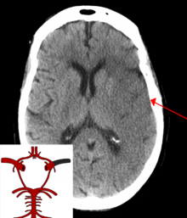
Left middle cerebral artery

Slide 11
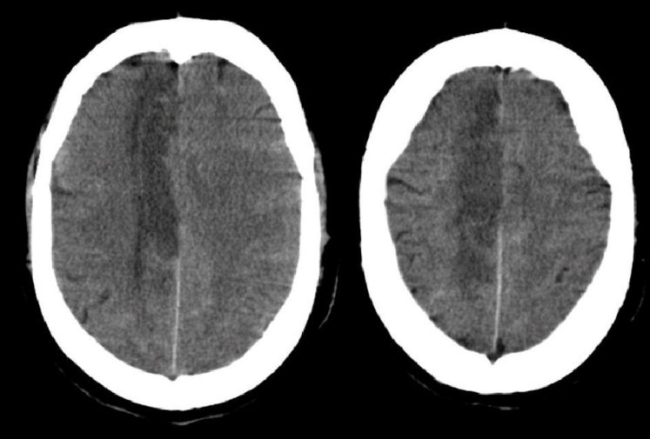
ACA stroke
Anterior cerebral artery

Slide 12
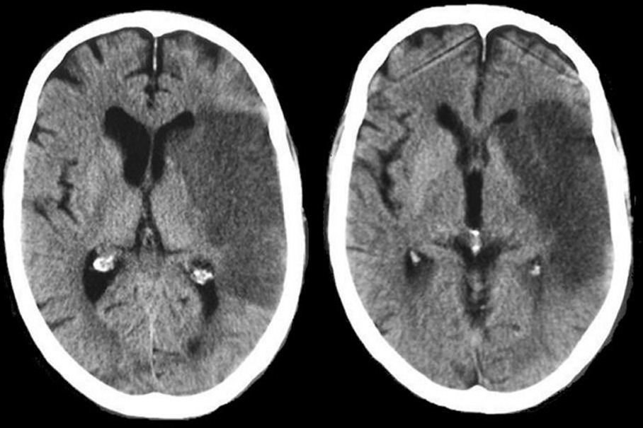
MCS stroke
middle cerebral artery

Slide 13
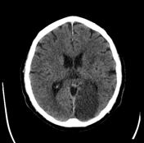
PCA stroke
posterior cerebral artery

Slide 14
Diagnosis
MRI (magnetic resonance imaging): 90% of acute infarctions are identified with diffusion-weighted imaging (DWI) and apparent diffusion coefficient (ADC) mapping.

Slide 15
diagnosis
TIA: 40% exhibit neuroanatomically relevant DWI and ADC changes despite symptomatic resolution
Carotid artery stenosis: For the purpose of identifying endarterectomy and stent candidates, cerebral angiography should be used
Cardiac abnormalities: echocardiography may identify an enlarged left atrium, intracardiac thrombi, and coagulated material

Slide 16
diagnosis
For patients > 45 years of age: evaluation of risk factors; sedimentation rate and C-reactive protein when suspecting temporal arteritis in patients > 50 years of age
For patients < 45 years of age: evaluation of risk factors, as per older patients; consider evaluation for antiphospholipid antibodies , coagulation cascade disorders, and genetic-based stroke disorders

Slide 17
Acute treatment
IV tissue plasminogen activator (tPA)/ alteplase: time window for treatment up to 4.5 hours from the time the patient was last known normal

Slide 18
Acute treatment
Acute endovascular interventional procedures: used in select patients, typically with National Institutes of Health Stroke Scale (NIHSS) ≥ 10 and evidence of MCA occlusion or basilar occlusion on vascular imaging; time window for use may extend beyond 4.5 hours

Slide 19
Acute treatment
Carotid endarterectomy: may be performed on an urgent basis in patients with TIAs that are referable to a severe stenosis
Aspirin: given acutely, relative risk reduction of recurrent stroke within 14 days = 30%; also has small benefit in terms of mortality (a) Do not give aspirin (or other antiplatelet or anticoagulant agents) within 24 hours of thrombolytic administration

Slide 20
Acute treatment
Blood pressure management: elevated blood pressures following a stroke are associated with better outcomes, thus hypertension is often left untreated 2– 3 days post-stroke unless systolic blood pressure (SBP) > 220 mmHg, diastolic blood pressure (DBP) > 130 mmHg, mean arterial pressure (MAP) > 130 mmHg, or if the patient is treated with tPA
Avoid using clonidine or diazoxide because they reduce cerebral blood flow

Slide 21
Acute treatment
Hyperglycemia management: elevated blood glucose is associated with worsened outcomes in stroke patients irrespective of the patient's diabetic status
Seizure prophylaxis: no indication in the absence of a seizure. With a single seizure occurring < 2 weeks from the time of stroke, treat with antiepileptics for 3– 6 months before considering discontinuation (low risk of epilepsy). For a single seizure > 2 weeks from the time of stroke or for multiple seizures, treat for 2– 3 years before considering discontinuation (high risk of epilepsy)

Slide 22
Subarachnoid haemorrhage
It accounts for 10% of all strokes
Causes
Aneurysms: account for 80% of all nontraumatic SAH
Other vascular malformations: arteriovenous malformations (AVMs), moyamoya disease
Head trauma: the most common cause of SAH
Perimesencephalic hemorrhage: caused by venous or capillary bleeding into the prepontine and/ or ambient cisterns; not associated with aneurysms
Venous thrombosis

Slide 23
Risk factors for SAH
Hypertension
Coagulopathy or anticoagulant use
Smoking
Drug use, particularly cocaine and amphetamines: suspecting drug abuse as the cause of SAH does not eliminate the need to search for a vascular malformation
Estrogen use: high-dose preparations (e.g., birth control pills) may increase SAH risk; no effect of hormone replacement therapy

Slide 24
Symptoms of SAH
pronounced headache
Nausea ± focal neurological deficits; severity of nonfocal symptoms in SAH is generally greater than in intracranial hemorrhage
Seizure at the time of SAH (5%)
Vision loss may be due to intracranial focal injury or to simultaneous retinal haemorhage (terson haemorrhage)
Mild nonfocal symptoms often occur with small SAH {sentinel hemorrhage}

Slide 25
Diagnosis
CT scan to determine the Fisher scale for SAH
Fisher scale:
1- no haemorrhage
2- thin and diffuse
3- local and thick
4- intraparnchymal or intraventricular

Slide 26
Diagnosis of SAH
CT without contrast identifies only 95% of SAH cases within the first 24 hours; therefore, must evaluate for nonclearing hemorrhagic cerebrospinal fluid and xanthochromia if CT scan is negative but suspicion of SAH is high
Cerebrospinal fluid xanthochromia is present in 70% within 6 hours and in 90% within 12 hours of SAH, but is rarely present within 2 hours of SAH

Slide 27
Diagnosis
Angiography, either conventional or CTA
MRA detects only 70% of aneurysms and has high false-positive rate in the MCA and ACA territories.
Angiography is negative for aneurysms in 20% of SAH cases, probably because the aneurysm is hidden by the blood clot; therefore, if the first angiogram is negative, repeat it after 2– 3 weeks
50% of angiography-negative SAH is perimesencephalic hemorrhage

Slide 28
Treatment
Blood pressure management: with an untreated aneurysm, reduce blood pressure to premorbid levels or to a mean arterial pressure 130 mmHg while keeping cerebral perfusion pressure > 70 mmHg
Controlled (clipped aneurysm) allows for more aggressive therapy

Slide 29
Treatment
Surgery:
Early clipping or coiling of the aneurysm reduced risk of rebleeding but increases the risk of iatrogenic brain injury; generally reserved for patients exhibiting focal neurological deficits and lethargy

Slide 30
Treatment of SAH
Vasospasm: a focal arterial constriction related to a loss of vasodilatory substances vascular reaction
Period of highest risk is 4– 7 days post-SAH, but may occur up to 3 weeks post-SAH ii. Symptomatic effects of vasospasm may be focal or diffuse
Diagnostic testing: screen patients for vasospasm with daily transcranial Doppler ultrasonography to detect increased flow velocities in major arteries

Slide 31
Treatment of vasospasm SAH
Nimodipine 60 mg PO q 4 hours for 21 days beginning immediately after SAH
May have direct protective effect on the brain since it does not have much effect on vascular caliber
Hypervolemic-hypertensive-hemodilution (“ triple H”) therapy has no proven benefit, but is commonly employed
Intravascular papavarine or angioplasty of the vasospastic artery segments has no established benefit

Slide 32
Intracranial haemorrhage
hemorrhage within the brain parenchyma that separates tissue planes, forming a well-demarcated hematoma; ICHs are commonly located in the putamen, cortex, thalamus, cerebellum, and pons

Slide 33
Intracranial haemorrhage
ICH from large-vessel disease is rare, occurs after rupture of an AVM or extension of SAH into the brain parenchyma
ICH from small vessels disease is caused by hypertensive angiopathy, amyloid angiopathy,

Slide 34
Risk factors
Coagulopathy/ anticoagulant use: risk of ICH is greatly increased with INR > 3
Drug use (amphetamines, cocaine): tend to cause ICH in cortex; IV route of administration is more prone to cause ICH than other routes
Alcohol use, which is linearly related to the risk of ICH d. Hyperperfusion states (e.g., after carotid endarterectomy)
Brain tumor, either primary (e.g., high-grade astrocytomas, pituitary adenoma) or meta-static (e.g., lymphoma, choriocarcinoma, melanoma)
Previous ICH g. Cerebral venous sinus thrombosis
Thrombocytopenia

Slide 35
Symptoms of ICH
focal neurological deficits, often resembling ischemic infarction; symptoms are always persistent
Headache (30%)
Seizures: occur in 30% with cortical hemorrhage, but only in 5% with subcortical hemorrhage
Decrease level of consciousness

Slide 36
Diagnosis
Diagnostic testing: neuroimaging may demonstrate some enlargement of the ICH within the first 12 hours, but generally the hemorrhage is a monophasic event a. MRI signal characteristics of ICH.
Small spots (< 2 mm) of decreased T2 signal are suggestive of microhemorrhages, which are typically observed in amyloid angiopathy.

Slide 37
Treatment
Acute treatment
Medical: reduce blood pressure to pre-morbid levels or keep the MAP < 130 mmHg with cerebral perfusion pressure > 70 mmHg if premorbid blood pressure is unknown;
reverse anticoagulation.
Surgery: first-line treatment for cerebellar ICH > 3 cm or in patients exhibiting clinical deterioration; otherwise, surgery is only reasonable in cases of expanding ICH with simultaneous worsening of the patient's clinical condition
More favorable locations for surgery are in the putamen, frontal cortex, and temporal cortex
Chronic and preventative treatment:
control of hypertension; avoidance of anticoagulants

Slide 38
Inherited stroke disorders
CADASIL
MELAS

Slide 39
Special stroke conditions
Marantic endocarditis: caused by the hypercoaguable state associated with chronic disseminated intravascular coagulation, AIDS, mucin-secreting tumors, or lupus (i.e., Libman-Sacks endocarditis
Infectious endocarditis: mycotic aneurysms and microabcesses
Watershed infarction

Slide 40
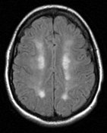
Watershed infarction

