Slide 1
Alveolar surfactant and Overview of the renal system
Dr. Arwa Rawashdeh

Slide 2
Objectives
Identify alveolar Surfactant
Overview of the renal system
Functional anatomy of nephron
Net filtration

Slide 3
Plain water
Surface
tension
Water & surfactant
add surfactant

Slide 4
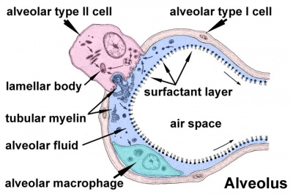
Surfactant
Type II cuboidal epithelial cells are scattered in alveolar walls
Surfactant is a detergent-like substance which is secreted in fluid coating alveolar surfaces – it decreases tension
Without it the walls would stick together during exhalation
Premature babies – problem breathing is largely because lack surfactant

Slide 5
For the average-sized alveolus with a radius of about 100 micrometers and lined with normal surfactant, this calculates to be about 4 centimeters of water pressure (3 mm Hg).
If the alveoli were lined with pure water without any surfactant, the pressure would calculate to be about 18 centimeters of water pressure, 4.5 times as great.
Thus, one sees how important surfactant is in reducing alveolar surface tension and therefore also reducing the effort required by the respiratory muscles to expand the lungs.
Law of Laplace

Slide 6
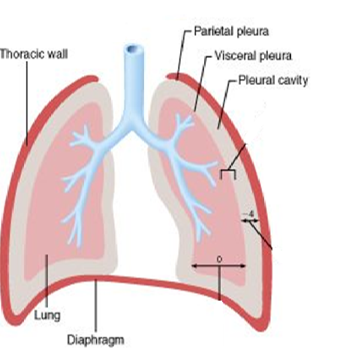
surface tension; this concept that because of the water molecule interaction between the air in the alveoli and the water molecules it causes that tension at the water air interface and the whole thing is the alveoli wants to collapse it wants to assume the small size as possible and the whole purpose again the lung wants to pull the visceral plural away from parietal plural and increase the volume in the chest
Elasticity of the chest wall; when breathing the elasticity is going to pull the chest wall away so increase the volume in the chest wall and pulling the parietal plural away from the visceral plural

Slide 7
Function of the renal system
Excretion
The removal of organic waste products from body fluids
Homeostasis
Excretion of metabolic waste products and foreign chemicals
Regulation of water and electrolyte balances
Regulation of body fluid osmolarity and electrolyte concentrations
Regulation of arterial pressure
Regulation of acid-base balance
Secretion, metabolism, and excretion of hormones (erythropoietin, Regulation of 1,25–Dihydroxyvitamin D3 Production)
Gluconeogenesis
Notes:
is 7.4 ph

Slide 8
Nephron
The Nephron is the smallest functional unit of the kidney
Each kidney in the human contains about 1 million Nephrons, each is capable of forming urine
The kidney cannot regenerate new Nephrons. Therefore, with renal injury, disease, or normal aging, there is a gradual decrease in Nephron number.
After age 40, the number of functioning Nephrons usually decreases about 10 per cent every 10 years; thus, at age 80, many people have 40 per cent fewer functioning Nephrons than they did at age 40.
This loss is not life threatening because adaptive changes in the remaining Nephrons allow them to excrete the proper amounts of water

Slide 9
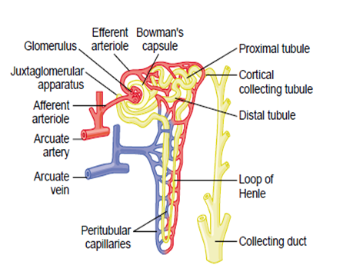
Each nephron begins with a corpuscle that contains a tuft of glomerular capillaries called the glomerulus, through which large amounts of fluid are filtered from the blood
The glomerulus contains capillaries that have high hydrostatic pressure (about 60 mm Hg).
The glomerular capillaries are covered by epithelial cells, and the total glomerulus is encased in Bowman’s capsule
Filtrate from the glomerular capillaries flows into Bowman’s capsule and then into the proximal tubule, which lies in the cortex of the kidney
From the proximal tubule, filtrate flows into the loop of Henle, which dips into the renal medulla.

Slide 10
Loop of Henle
Each loop consists of a descending and an ascending limb. At the end of the thick ascending limb is a short segment, which contains a plaque known as the macula densa
Beyond the macula densa, fluid enters the distal tubule, which, like the proximal tubule, lies in the renal cortex.
Distal tubule terminates into the cortical collecting tubule, which leads to the cortical collecting duct.
The initial parts of 8 to 10 cortical collecting ducts join to form a single larger collecting duct that runs downward into the medulla and becomes the medullary collecting duct.
The collecting ducts eventually empty into the renal pelvis through the tips of the renal papillae.

Slide 11
Cortical and Juxtamedullary Nephrons
Those nephrons that have glomeruli located in the outer cortex are called cortical nephrons; they have short loops of Henle that penetrate only a short distance into the medulla
About 20 to 30 per cent of the nephrons have glomeruli that lie deep in the renal cortex near the medulla and are called juxtamedullary nephrons. These nephrons have long loops of Henle that dip deeply into the medulla, in some cases all the way to the tips of the renal papillae

Slide 12
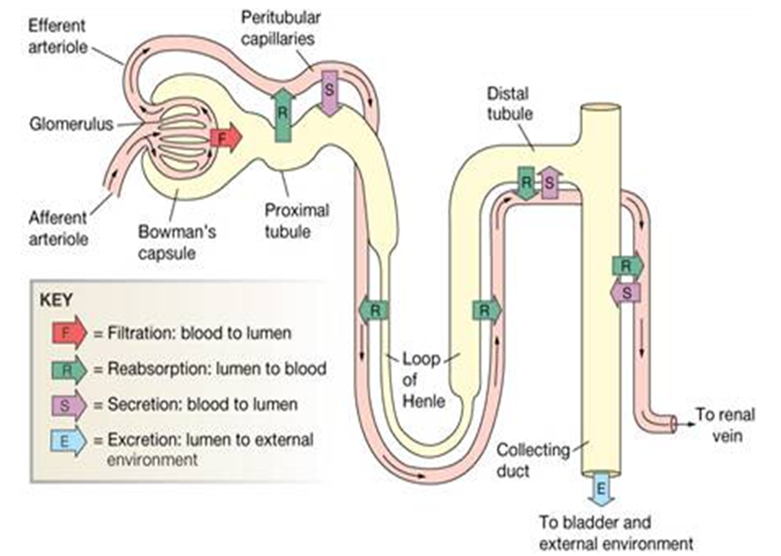
urine formation
Filtration:
It is directly proportional to renal blood pressure and renal blood flow. Water and solutes is filtered across glomerular capillaries
Reabsorption:
Is the removal of water and solutes from the renal filtrate
Secretion:
Transport of solutes from peritubular fluid into the tubular fluid

Slide 13
Net filtration
Direction of movement : From glomerular capillaries to capsule space
Driving force: Pressure gradient (net filtration pressure, NFP)
Types of pressure:
Favoring Force: Capillary Hydrostatic Blood Pressure (BP)
Opposing Force: Plasma colloid osmotic pressure (COP) and Capsular Hydrostatic Pressure (CP)

Slide 14
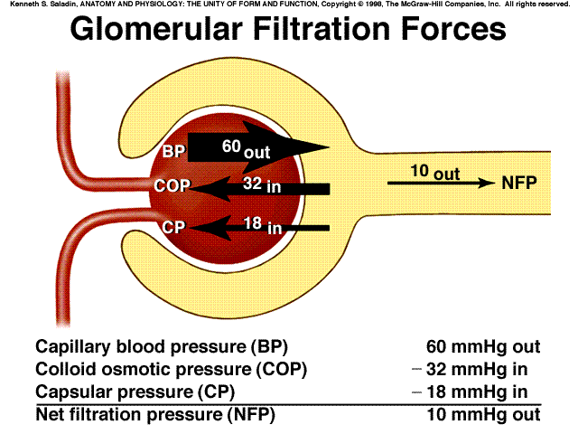

Slide 15
Factors that alter filtration pressure change GFR
These factors include:
Increased renal blood flow → Increased GFR
Decreased plasma protein → Increased GFR → edema.
Hemorrhage → Decreased capillary hydrostatic pressure → Decreased GFR

