Slide 1
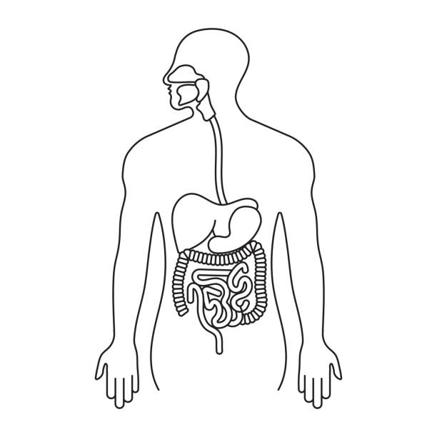
UPPER GASTRO-INTESTINAL BLEEDING
Supervised by: Dr. Saad Azzawi
Done by:
-Esraa Hawawreh
-Dania Alhmeed
-Mona Al Aoutani
-Ali AL hwitat

Slide 2
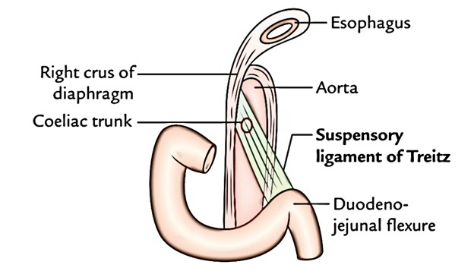
*UGIB -Definition:
Bleeding derived from a source proximal to ligament of Treitz.
Significant morbidity and mortality so need early intervention

Slide 3
Epidemiology .the upper gi bleeding is 5 time as common as bleeding from lower gi .the most common cause peptic ulcer (duodenal ulcer more common than the gastric ulcer ) .80%are self limiting .the mortality rate 5-10%for severe ughb .more in male than female .the incidence increase with age .using nsaids increase the risk of bleeding

Slide 4
 |  | UGIB | LGIB
 | Typical presentation | Hematemisis Coffee grounds emises And/or melena | Hematochezia
 | Bowel sound | Hyperactive | Normal
 | Bun\creatinine | Increase | normal
 | Site | Above ligament of teriz | Below ligament of teriz
 | Nasogastric aspiration | Blood | Clear fluid

Slide 5
Factors that increase mortality
Age >65 years
Severity of initial bleed
Extensive comorbid illnesses
Onset or recurrence of bleeding while hospitalized for another condition
Need for emergency surgery
Significant transfusion requirements
Diagnosis (oesophageal varices have a 30% mortality rate)
Endoscopic stigmata of recent haemorrhage

Slide 6
Blood supply and venous drainage of upper gastrointestinal tract

Slide 7
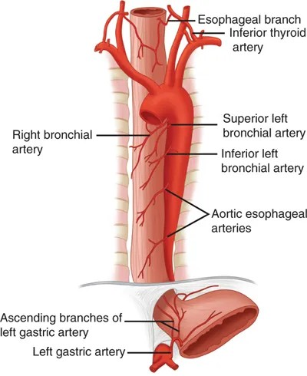
Esophagus
the upper third(cervical oesophagus )supplied by branch from the inferior thyroid artery
the middle third (thoracic oesophagus ) supplied by branches from the descending thoracic aorta and bronchial arteries
the lower third ( abdominal oesophagus ) :
supplied by branches from the left gastric artery

Slide 8
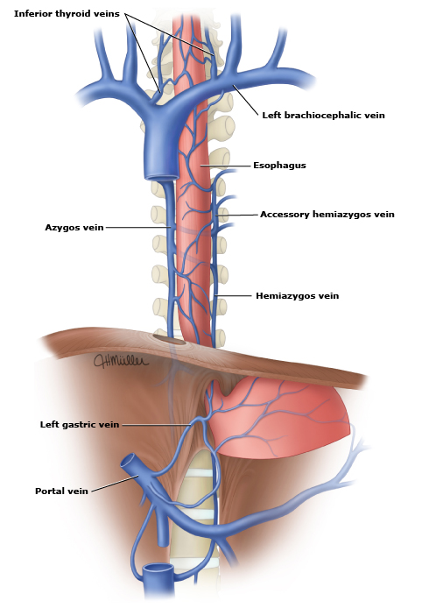
The venous from the upper oesophagus drain into the inferior thyroid veins
The vein from the middle oesophagus drain into the azygos veins
The vain from the lower oesophagus drain into the left gastric vein , a tributary of the portal vein

Slide 9
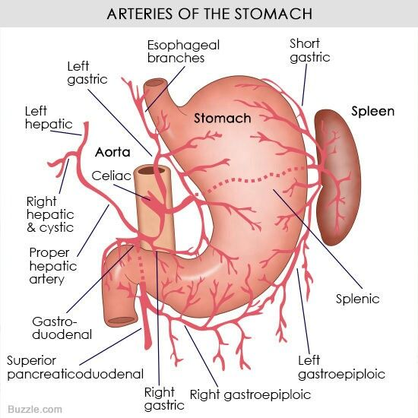
Stomach
The lesser curvature supplied by the left gastric artery (branch from celiac artery ) and right gastric artery(branch from common hepatic artery)
• The greater curvature supplied by the left gastro-epiploic artery ( from splenic artery )and right gastro-epiploic artery ( from gastroduodenal artery )
• The fundus and upper part of the body supplied by the short gastric artery ( from splenic artery )
• The pylorusis supplied by the gastroduodenal artery (from the common hepatic artery )

Slide 10
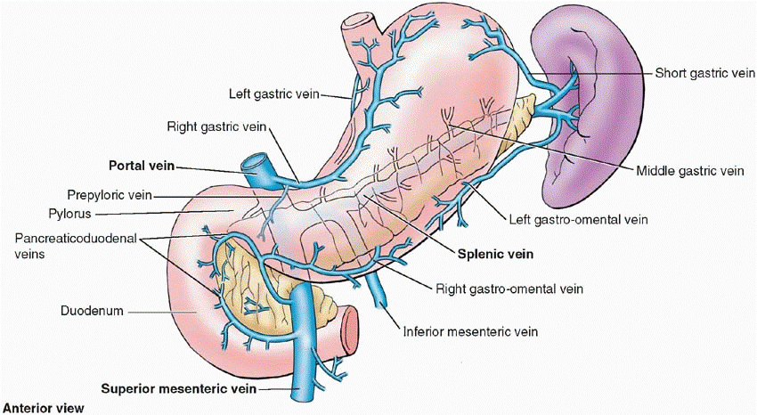
Veins drain into the portal circulation
• Left and right gastric veins drain directly into portal vein
• Short gastric vein and left gastroepiploic veins join splenic vein
• Right gastroepiploic vein join the superior mesenteric vein

Slide 11
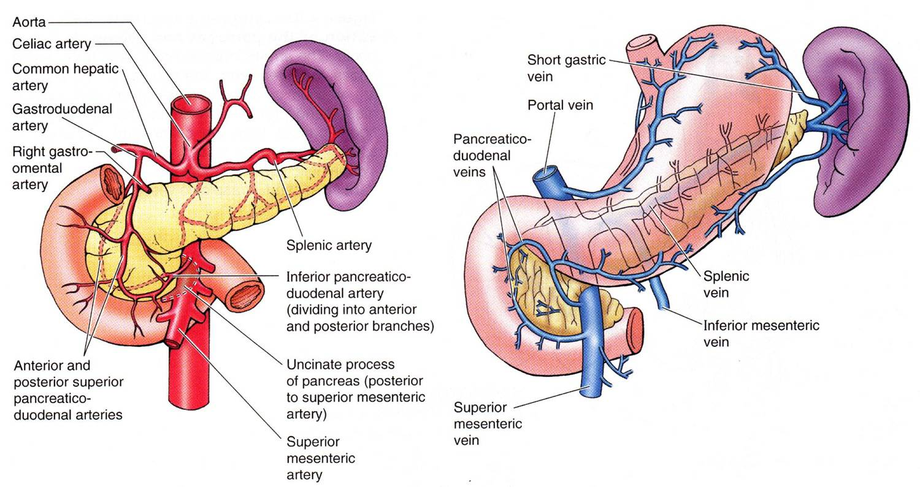
Duodenum
• the upper half is supplied by the superior pancreaticoduodenal artery ( branch of gastroduodenal artery )
• The lower half is supplied by the inferior pancreaticoduodenal artery ( branch of superior mesenteric artery )

Slide 12
Venous drainage
• pancreaticoduodenal veins drains into superior mesenteric vein then to portal vein

Slide 13
UGIB CLASSIFICATION
NON-VARICEAL BLEEDING (80%) | PORTAL HYPERTENSIVE BLEEDING (20%)
Peptic ulcer disease 35-50% Gastroesophageal erosions 10-20% Mallory- weiss tear Vascular lesions 5% Tumors 2% Others 5% | Gastroesophageal varices Hypertensive portal gastropathy <5% Isolated gastric varices (rare)

Slide 14
1-ressucitation in sever case
2-history
3-examination
4-investigation

Slide 15
Resuscitation
Airway
Breathing
Circulation

Slide 16
Airway
Secure to prevent aspiration
Endotracheal tube and give oxygen if needed
Breathing
Support respiratory function
Circulation
2 large bore i.v cannula
Take blood for hemoglobin, urea, electrolytes, liver biochemistry, coagulation screen, blood grouping and crossmatch
Normal saline is given until the blood becomes available
A central venous catheter is considered when there are signs of cardiovascular instability.
Bladder catheterization for monitoring urine output
Insertion of a nasogastric tube to confirm wither there is blood in the stomach

Slide 17
•Indications for blood transfusion are: 1.Shock (pallor, cold peripheries, systolic BP below 100 mmHg, pulse > 100/min) 2.Hemoglobin < 10 g/dL in patients with recent or active bleeding

Slide 18
History
Hematamesis : vomiting of blood ( red blood or “coffee-grounds” material)
• Melena : tarry, shiny , semi solid , black stool with distinctive odor containing partly digested blood
• Hematochezia : passage of fresh blood through the anus ( in massive bleeding )
• Abdominal pain / epigastric pain
• Odynophagia , dysphagia
• Retching
• symptoms of blood loss : shock , anemia ,syncope
• Non specific symptoms : dyspepsia , weight loss , anorexia

Slide 19
❑ Drug history : NSAIDs , aspirin , corticosteroid , anticoagulants
❑ Past medical history : DM , coronary artery disease , chronic liver disease , chronic renal disease , H. pylori and previous upper GI bleed
❑ Past surgery history : Previous abdominal surgery
❑ Family history
❑ Social history Smoking

Slide 20
Physical examination
Inspection
Palpation
percussion
Auscultation
Digital rectal examination

Slide 21
Inspection
Pale
Lymph node swelling
Feature of chronic liver disease **
Cyanosis
Abdominal distension
Dilated vein
Visible peristalsis
Sign of dehydration (dry tongue, sunken eyes)

Slide 22
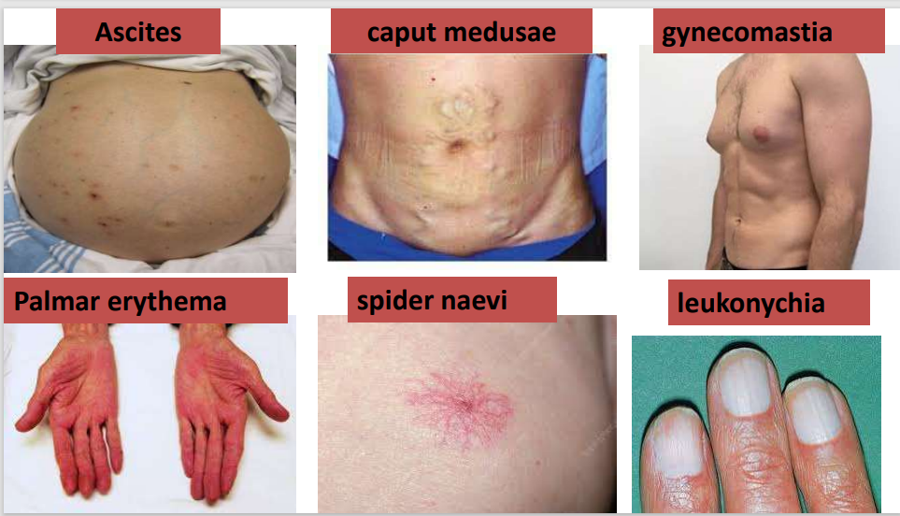

Slide 23
Features of chronic liver disease

Slide 24
Palpation
Auscultation
Absent bowel sound
Bruit
Tenderness
Abdominal mass
Digital rectal examination
Percussion
Hemorrhoid
Fresh blood
fissures
Shifting dullness

Slide 25
Investigations

Slide 26
Investigation
Cbc => (q4-6h) during the 1st day
platelet count => (q4-6h) during the 1st day
Hb%
blood grouping (cross matching)
blood urea
LFT => underlying liver disease
RFT => underlying renal disease

Slide 27
Investigation
Ca levels => monitoring patients receiving multiple transfusions of citrated blood
serum creatinine (BUN-to-creatinine ratio) {>36} => UGIB
prothrombin time (PT)
arterial blood gas analysis
Endoscopy
Notes:
PT , activated partial thromboplastin should be checked to document any coagulopathy
BUN-to-creatinine ratio > 36 {w/o renal insufficiency) indicates UGIB

Slide 28
Endoscopy
Is basically a thin tube with a small camera at the tip of the tube inserted in the patients’ throat
Diagnostic and therapeutic ( gold standard )
Can detect the cause of the hemorrhage in 95% or more of cases
Should be performed immediately after: - Hemodynamic stabilization - Adequate monitoring in the ICU is established - (if indicated) endotracheal tube intubation
Is the initial diagnostic examination for patients PRESUMED to have UGIB

Slide 29
Nasogastric lavage
Is an important diagnostic tool
May confirm -recent bleeding => coffee ground appearance - possible active bleeding => red blood in the aspirate that doesn’t clear -lack of blood in the stomach => active bleeding is less likely but doesn’t exclude an upper GI lesion
Should be done ONLY in alert and cooperative patients to avoid bronco-pulmonary aspiration
During gastric lavage use saline and NOT in large volume to avoid water intoxication

Slide 30
Imaging
Chest x ray should be done to exclude aspiration pneumonia, effusion and esophageal perforation
Abdominal x ray - erect and supine - to exclude perforated viscous and ileus
CT and Ultrasonography -might be indicated for the evaluation of biliary colic with obstructive jaundice with hemorrhage, aortoenteric fistula and other unusual causes of UGIB
Nuclear medication scans -useful in determining the area of active hemorrhage
Angiography

Slide 31
Angiography
May be useful if bleeding persists and endoscopy fails to identify a bleeding site
Angiography along with transcatheter arterial embolization (TAE) should be considered for all patients with a known source of UGIB that don’t respond to endoscopic management, with active bleeding and negative endoscopy
In case of aortoenteric fistula, angiography requires active bleeding of 1 mL/min to be diagnostic

Slide 32
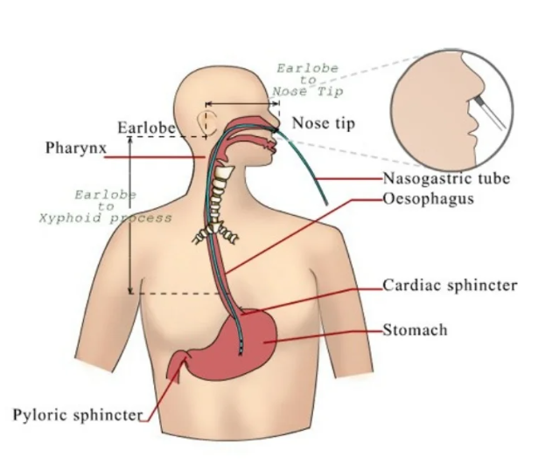

Slide 33
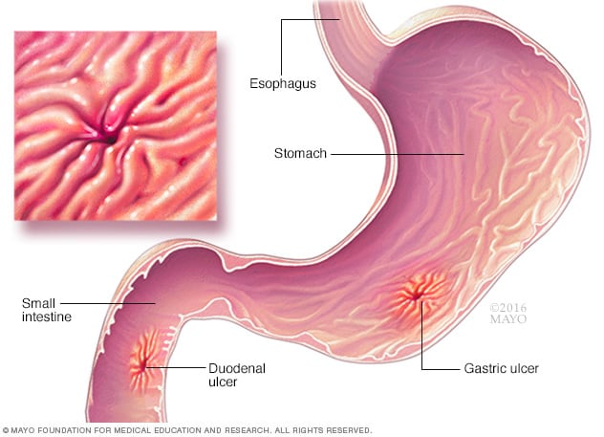
Bleeding peptic ulcer disease

Slide 34
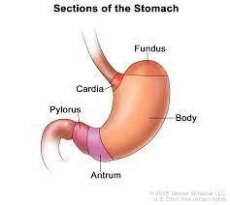
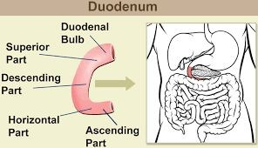
Peptic ulcer disease
PUD is the discontinuation of the mucosa of the gastrointestinal tract that extends deep into the muscularis propria layer of the gastric mucosa caused by the corrosive action of pepsin and hydrochloric acid. It usually occurs in the stomach and the proximal duodenum and it can involve the lower esophagus, distal duodenum or jejunum
Types:
Gastric ulcer (mostly in the antrum, most susceptible part to bleed is the lesser curvature)
Duodenal ulcer (Duodenal bulb, the posterior wall is the most common site for bleeding)
Esophageal ulcer Although uncommon, esophageal ulcers are a cause of significant acute gastrointestinal bleeding that appears to respond to endoscopic treatment.

Slide 35
Peptic ulcer is the primary cause of non-variceal upper gastrointestinal bleeding occurring in 50-70 %of patients. However, bleeding is the presenting symptom in only 10% of patients with peptic ulcers , hypovolemic shock or its consequences is a major cause of mortality in acute setting
Bleeding from duodenal ulcers is four times more common than from gastric ulcers
This complication occurs as the PUD remains untreated for a period of time .

Slide 36
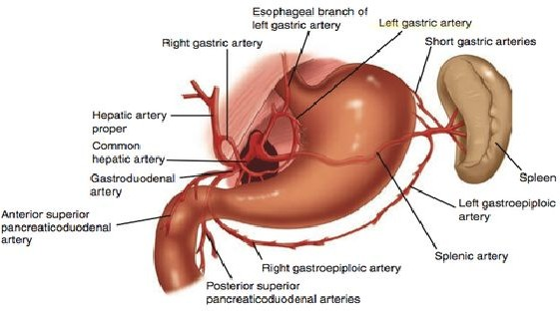
Source of bleeding in Peptic ulcers ?
In case of gastric ulcers the most common site that is susceptible to bleed due to erosion in the lesser curvature out of the left gastric artery .
While in duodenal ulcers , the posterior wall of the duodenal bulb ( the first part of duodenum closest to the pylorus ) is the most common site bleeding out of the gastroduodenal artery .

Slide 37
Presentation of a patient with bleeding peptic ulcer :
It depends on the rate of bleeding :
-The ulcer can either bleed slowly and chronically which makes it go unnoticed, as the symptoms will be similar to that of anemia:
1.Pallor of skin and mucous membranes
2.Shortness of breath and lack of energy
3.Fatigue
4.Palpitations
- Or the bleeding occurs heavily and profusely that cause :
1.Melena
2.Hematemesis
3.Hematochezia

Slide 38
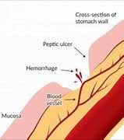
Signs
general signs (anemia if bleeds slowly and chronically, hypovolemic shock if bleeds heavily and profusely
Tachycardia
Hypotension
Little or no urine output
Loss of consciousness or confusion
Burning stomach pain
Feeling of fullness, bloating or belching.
Intolerance to fatty foods.
Nausea.
Heartburn.
local signs (epigastric tenderness )

Slide 39
General Management (intervention) :
-Resuscitation
Rapid resuscitation to reduce mortality. Restoration of physiological parameters with a mean arterial pressure 65 mm Hg or higher, urine output of 0.5 mL/kg/h or greater, and lactate normalization.
-Laboratory tests for H. pylori
-Endoscopy
After the patient becomes stabilized :
Endoscopy ( EGD) is the preferred diagnostic and therapeutic tool in suspected bleeding peptic ulcers due to low complications and the high accuracy in decreasing the risk of rebleeding ,. It is recommended to be performed as soon as possible ( up to 24 hours after presentation is considered early endoscopy ) especially in high risk patients .

Slide 40
High risk: active bleeding (spurting, oozing) or non-bleeding visible vessel
Perform endoscopic hemostasis using contact thermal therapy alone, mechanical therapy using clips, or injection with vasoconstrictive (epinephrine, vasopressin) epinephrine injection. Dual therapy is preferred.
Epinephrine injection as definitive hemostasis therapy is not recommended.
High risk : Adherent clot
Consider endoscopic removal of the adherent clot
followed by endoscopic hemostasis (as mentioned previously) If underlying active bleeding or non-bleeding visible vessel is present.
Admit the patient to a monitored or ICU setting
Treat with Intravenous PPI (80mg bolus dose + continuous infusion at 8mg/hour ) for 72 hours after endoscopic hemostasis
initiate oral intake of clear liquids 6 hours after endoscopy in patients with hemodynamic stability
Transition to oral PPI after completion of intravenous therapy
Perform testing for H.pylori ; initiate treatment if the result is positive

Slide 41
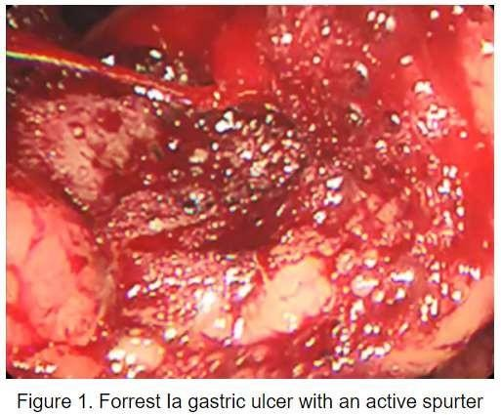
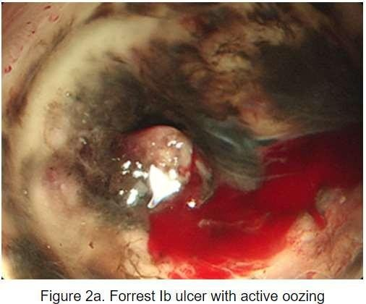

Slide 42
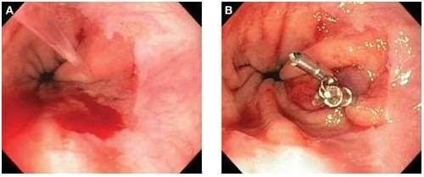

Slide 43
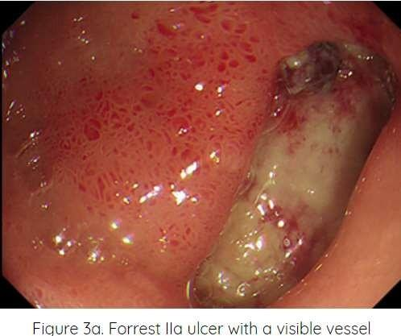
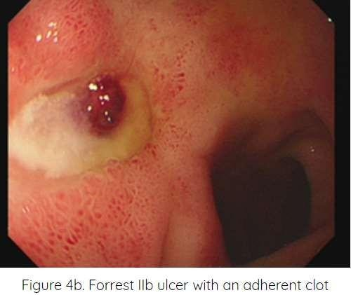

Slide 44
Low risk: Flat pigmented (hematin) spot or clear base
Do not perform endoscopic hemostasis, consider early hospital discharge after endoscopy if the patient has an otherwise low clinical risk and safe home environment
Treat with an oral PPI
Initiate oral intake with a regular diet 6 hours after endoscopy in patients with hemodynamic stability.
Perform testing for H.pylori, initiate treatment if the result is positive.

Slide 45
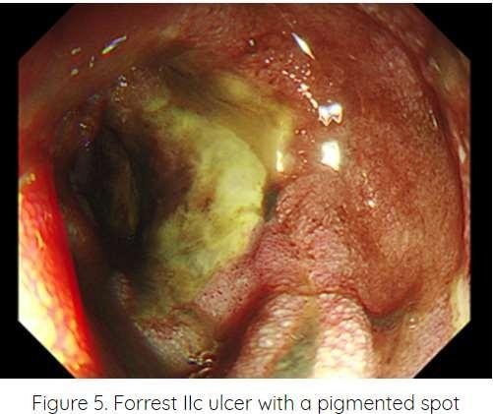
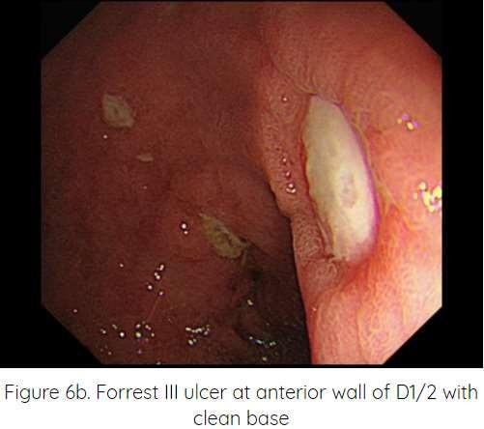

Slide 46
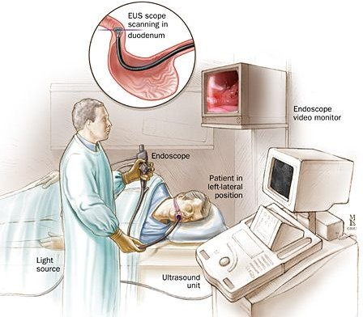
After endoscopy :
If there is clinical evidence of ulcer rebleeding, the guideline is to repeat endoscopy with an attempt at endoscopic hemostasis.

Slide 47
Predictors of failure of endoscopic treatment:
History of peptic ulcer disease
Previous ulcer bleeding
Presence of shock at presentation
Active bleeding during endoscopy
Large ulcers (>2cm in diameter)
Large underlying bleeding vessel (2mm in diameter)
7. Ulcers located on the lesser curvature, posterior or superior duodenal bulb

Slide 48
Surgery
Indications:
A. Absolute indications:
Patient under adequate medical therapy and bleeds
Severe bleeding from the start of about 2L or more (>4 units of blood needed for correction)
Continuous bleeding (as evidenced by the need to transfuse 1000 ml of blood
/day to maintain stability)
If bleeding recurs while patient is in the hospital
B. Relative indications :
Old patient
Associated with serious diseases (the risk of surgery is far less than the risk of bleeding)
Long history of ulcer disease

Slide 49
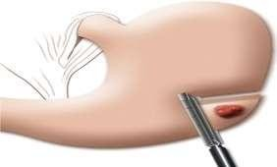
1.Bleeding gastric ulcer : is generally the excision of the ulcer and repair of the gastric defect . biopsy of the ulcer is important, as 4–5% of benign appearing ulcers are actually malignant ulcers
For ulcers along the greater curvature of the stomach, antrum or body of the stomach wedge excision of the ulcer and closure of the resulting defect can easily be achieved in most cases without causing significant deformation of the stomach.
For ulcers in the lesser curvature , due to the rich arcades of the left gastric artery , wedge excision would leave a stomach deformation, So distal gastrectomy with Bilroth I or Bilroth II as a reconstruction surgery to resume GI continuity .

Slide 50
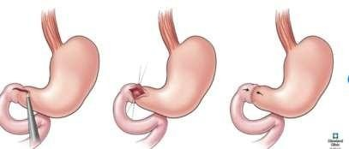
2.Bleeding duodenal ulcer
Dissection is carried out to expose the pylorus and first part of the duodenum. An anterior longitudinal duodenotomy is made extending through the pyloric channel to the distal stomach. Bleeding from the GDA complex is controlled with a ligation , then close the horizontal incision in a vertical fashion

Slide 51
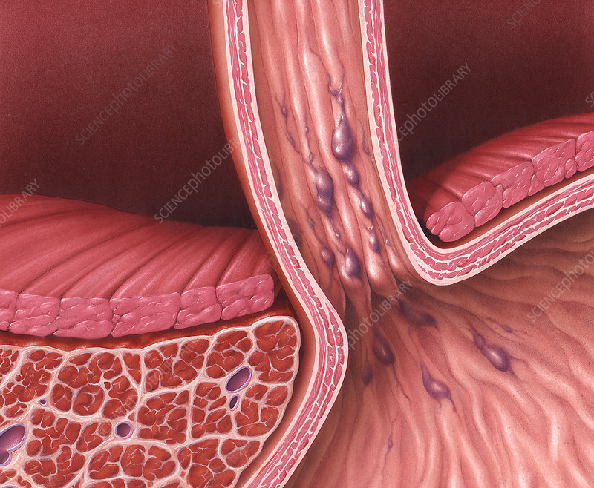
Esophageal varices(bleeding)

Slide 52
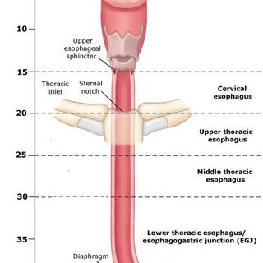
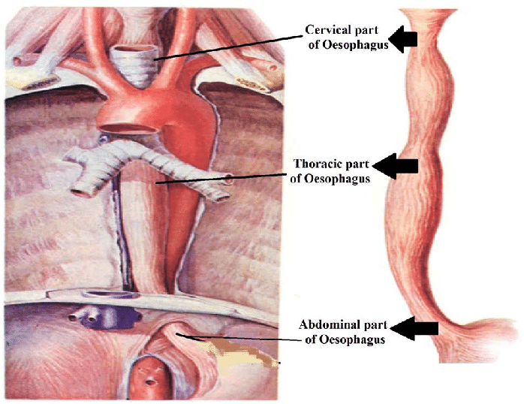
Anatomy of esophagus
the esophagus is a 25 cm long fibromuscular tube extending from the pharynx (c6 level) to the stomach (t11 level).
parts:-
esophagus is mainly studied in 3 parts:

Slide 53
Blood supply
ARTEREAL SUPPLAY
the venous drainage of upper esophagus is through the superior vena cava. mid esophagus through azygous veins. distal esophagus through portal vein by means of left and short gastric veins. through these veins there is a porta-systemic communication.

Slide 54
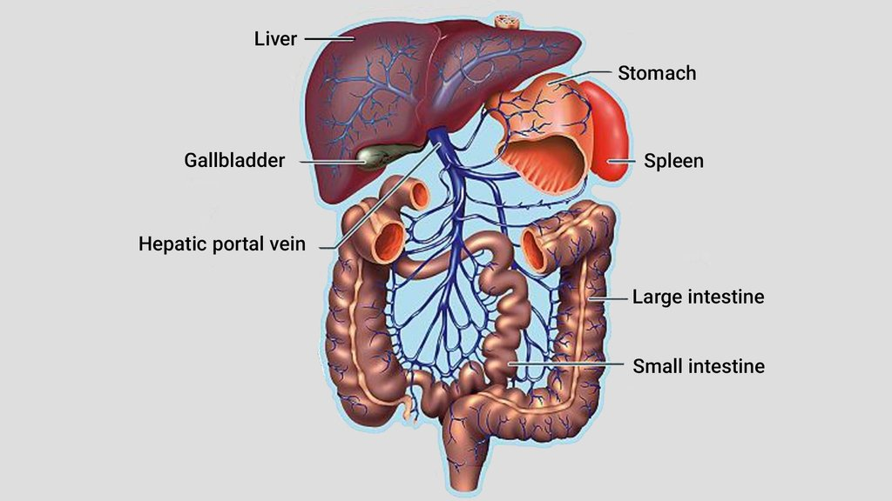
Higher blood pressure in portal vein expands in all the veins that carry blood to the portal vein. ​
There are anatomical junctions between gastric vein (→ portal vein) and esophageal vein (→ superior vena cava). These junctions are called portocaval anastomoses. ​
Because of the higher venous pressure, these junctions become dilated, and this pressure can be transferred to esophageal veins as well. ​
Esophageal veins are localized in submucosa, over the muscular layer of esophagus.
There is scope for the development of varices, which can expand into lumen of esophagus.
Their perforation and bleeding is just a question of time.​

Slide 55
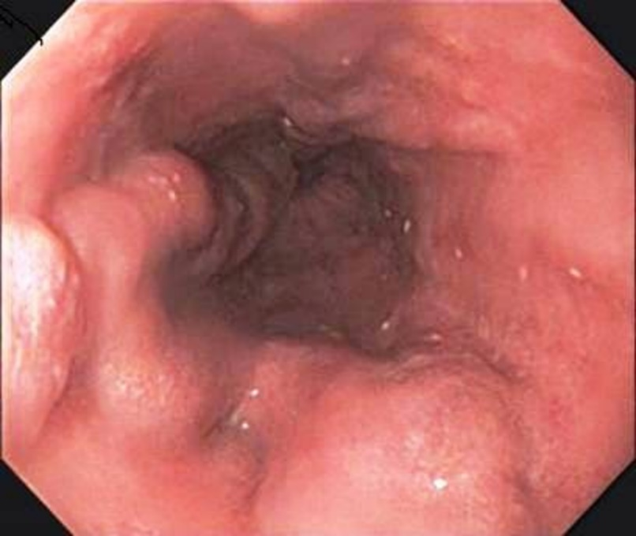
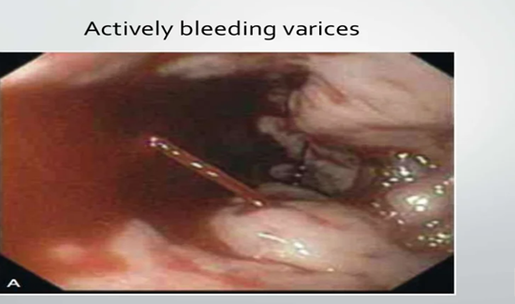
Definition:
esophageal varices are abnormal dilated, elongated, and tortuous veins, they are prone to rupture and they might cause massive upper gastrointestinal bleeding
-Esophageal varices are venous varices localized in the submucosal layer of the esophagus.
-They are a consequence of portal hypertension.
-All the patients with esophageal varices have a risk of acute bleeding, which can be fatal.
-The most common cause of portal hypertension and esophageal varices is liver cirrhosis. 30–60% of patients with liver cirrhosis have a risk of esophageal varices bleeding.
-Rebleeding is very often (60–100% patients with a history of previous variceal bleeding will rebleed in 2 years)

Slide 56
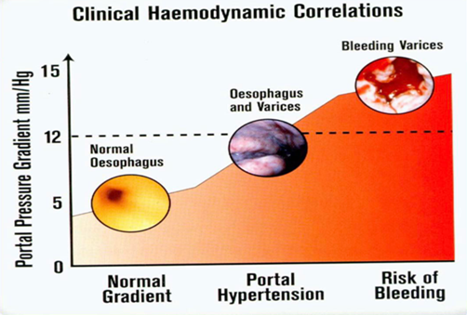
pathophysiology :
Portal vein is formed by union of superior mesentric &splenic vein so portal hypertension leads to : 1- spleen congesion 2- intestinal congestion 3- porto-systemic shunt
Normal HVPG = 5 mm Hg
** Portal hypertension
> 5 mm Hg
** Esophageal hemorrhage
Only with HVPG > 12 mm Hg

Slide 57
Portal hypertension:
*DEFIITION:
Elevation of portal venous pressure above 12mmHg
*ETIOLOGY :
SUPRA HEPATIC | HEPATIC | INFRA HEPATIC
CARDIAC CIRRHOSIS (RSHF – TR – IVC obstruction – Budd chiari syndrome ) | Liver cirrhosis Schistosomiasis Congenital fibrosis | Portal vein thrombosis Extrinsic compression

Slide 58
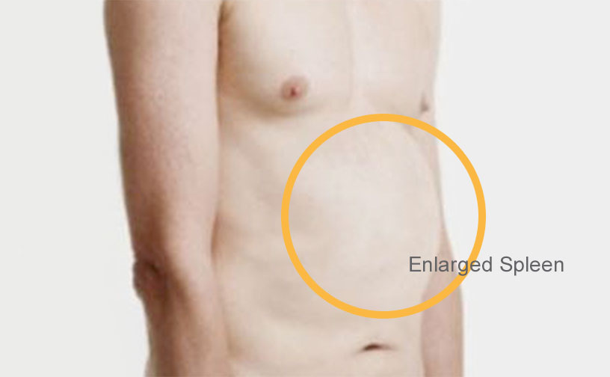
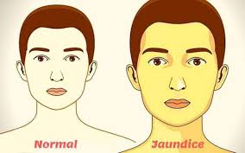
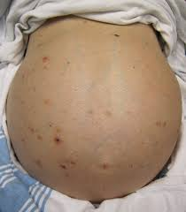
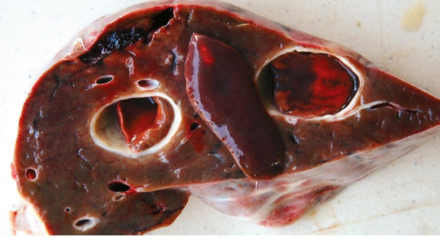
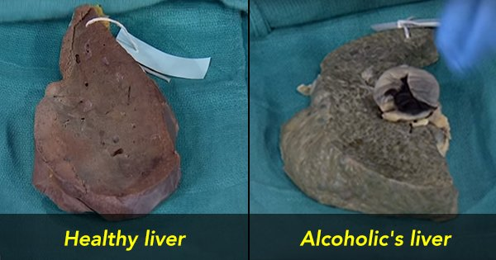
Symptoms of the cause:
Splenomegaly
Jaundice
Ascites
Parasitic infection

Slide 59
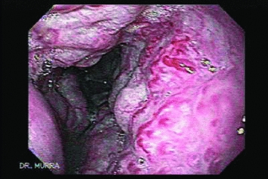
Risk factors although many people with advanced liver disease develop oesophageal varices, most won't have bleeding. but our focus is on the severe ones that will rupture and cause massive bleeding
varices are more likely to rupture and bleed if: *1- high portal vein pressure . - the risk of bleeding increases with the amount of pressure in the portal vein (portal hypertention ).
( > 12 mmhg ) *2- large varices (red marks). -the larger the varices, the more likely they are to bleed.
red marks on the varices. when viewed through an endoscope passed down your throat, some varices show long, red streaks or red spots. these marks indicate a high risk of bleeding. 3-severe cirrhosis or liver failure. most often, the more severe your liver disease, the more likely varices are to bleed. 4-alcohol. your risk of variceal bleeding is far greater if you continue to drink than if you stop, especially if your disease is alcohol related.

Slide 60
CLINICAL MANIFESTATIONS :
When it ruptures :
1- hematemesis
2- melena
3- hematochezia

Slide 61
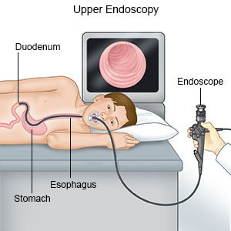
DIAGNOSTIC EVALUATION :
1-Upper gastrointestinal endoscopy : gastroscopy is the only diagnostic method, which can prove existence of esophageal varices (visualization) and bring therapeutic solution in the same moment
2-Labe tests
Pt / ptt
LFT
CBC

Slide 62
Treatment
1- medication
2 – interventional method
3- surgery
Medications
vasoconstrictor therapy
1- vasopressin
2- somatostatin
3- terlipressin
4- octreotide

Slide 63
Interventional methods
OGD (oesophagealgastroduodenoscpy) interventional gastroenterology) : performed within 12 hours, should be used to make the diagnosis and to treat variceal haemorrhage, either with ligation or sclerotherapy
balloon tamponade (pressure procedure): should be used as a temporizing measure ( maximum 24 hours ) in patients with uncontrollable bleeding for whom a more definitive therapy (e.g. tips or endoscopic therapy ) is planned
transjugular intrahepatic portosystemic shunt (interventional radiology): is indicated in patients in whom haemorrhage from oesophageal varices cannot be controlled or in whom bleeding recurs despite combined pharmacological and endoscopic therapy

Slide 64
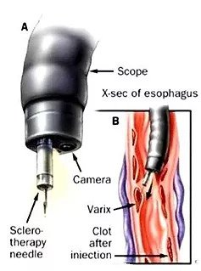
A
During endoscopic sclerotherapy, a chemical called a sclerosant may be injected directly into an enlarged vein or into the wall of the esophagus next to the enlarged veins. The substance causes inflammation of the inside lining of the vein. Over time this causes the vein to close off and scar.
Common sclerosants Ethanolamine oleate Absolute alcohol Sodium morrhuate Sodium tetradecyl Hypertonic saline Polidocanol

Slide 65
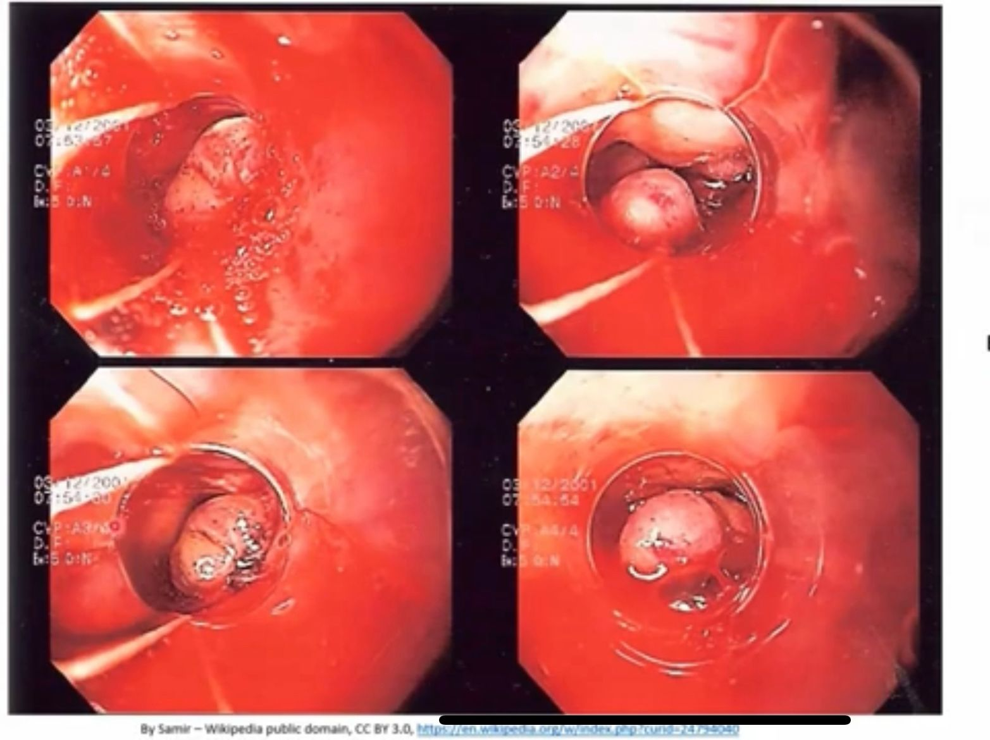
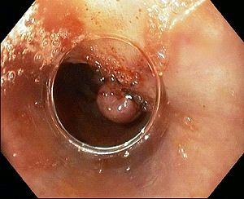
B- Endoscopic band ligation
esophageal varices are ligated with endoscopically placed small elastic o-rings
*is the preferred endoscopic modality.
* variceal ligation is simpler to perform than injection sclerotherapy.
* endoscopic variceal ligation is associated with fewer complications
than sclerotherapy

Slide 66
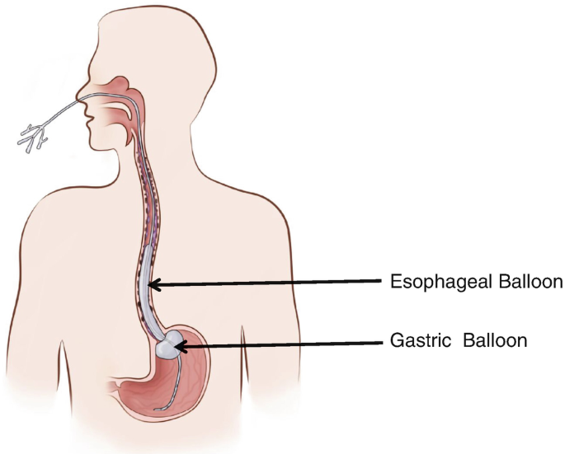
C-Balloon tamponade
when there is failure of vasopressin or endoscopy
control active bleeding in > 90%
is a pressure technique
Serious complications :
1-esophageal rupture
2-aspiration pneumonia
perform endotracheal intubation before placing these tubes to avoid it.
3-airway obstruction

Slide 67
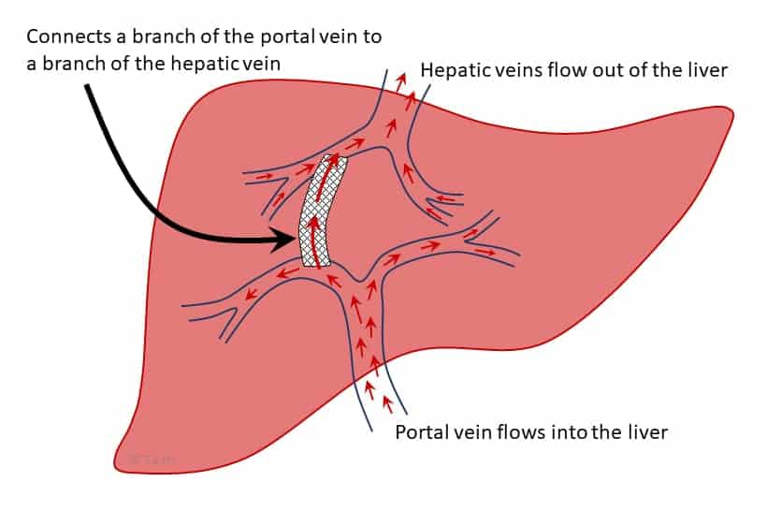
E-Trans-jugular intrahepatic portosystemic shunt (TIPS)
*tips reduces elevated portal pressure by creating a communication between the hepatic vein and an intrahepatic branch of the portal vein.
*therapy of choice for acute variceal bleeding after failure of drug and endoscopic therapy
-indication :
-when endoscopic or drug treatments have failed
- high surgical risks

Slide 68
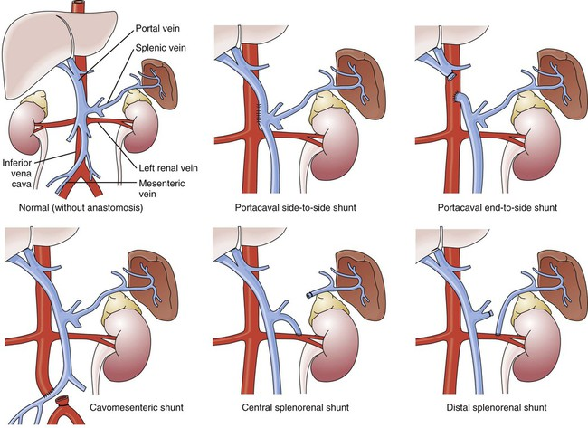
Role of Surgery • Severe hemorrhage unresponsive to initial resuscitation • Unavailable or failure of endoscopic therapy • Coexisting 2nd indication to operations such as perforation, obstruction or suspicious of malignancy

Slide 69
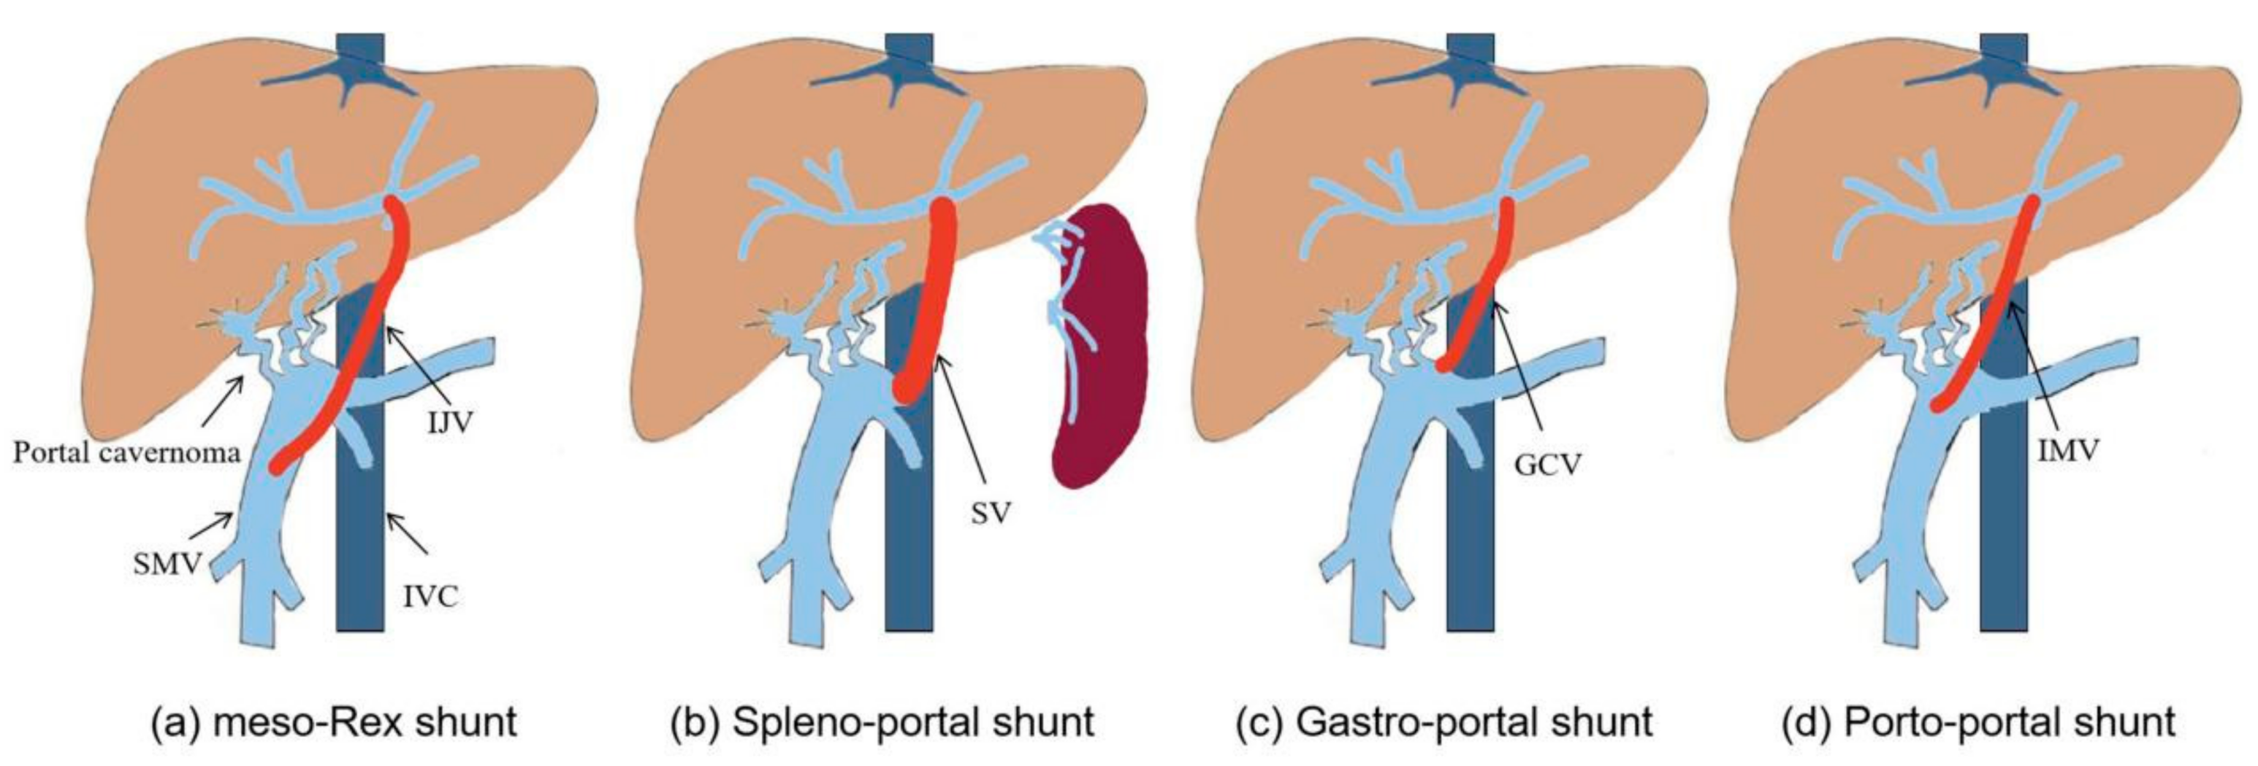
Surgical procedures
1-esophageal transection.
2-operative portocaval shunt or spleno-renal shunt
•a common method for reducing portal hypertension is to divert blood from the portal venous system to the systemic venous system by creating a communication between the hepatic portal vein and the ivc.
another way of reducing portal pressure is to join the splenic vein to the left renal vein, after splenectomy. (splenorenal anastomosis or shunt)
3-liver transplant

Slide 70
Erosive gastritis

Slide 71
Erosive gastritis [Gastric Erosions]
erosive gastritis is gastric mucosal erosion caused by damage to mucosal defenses. it is typically acute, manifesting with bleeding, but may be subacute or chronic with few or no symptoms. diagnosis is by endoscopy. treatment is supportive, with removal of the inciting cause and initiation of acid-suppressant therapy. certain intensive care unit patients (eg, ventilator-bound, head trauma, burn, multisystem trauma) benefit from prophylaxis with acid suppressants.
Notes:
Google search !!!!!!!!!!!!

Slide 72
Site
Could be at the Antrum
Mainly at the BODY

Slide 73
Causes
Common causes -NSAIDs -Alcohol -Stress
Less common causes -radiation -viral infection (eg, cytomegalovirus) -vascular injury -direct trauma (eg, nasogastric tubes) -crohn's disease

Slide 74
Classification
@superficial erosions , punctate mucosal lesions -develop as soon as 12 hours after initial insult
@deep erosions , ulcer and sometimes perforation -occur in severe or untreated cases
@acute stress gastritis -5% of critically ill patients ( icu patients ) -incidence increases with duration of icu stay -incidence increases with duration of receiving no enteric feeding (npo) -presented with massive ( severe ) upper gi bleeding

Slide 75
Signs and symptoms
mild : mainly asymptomatic but some complain from dyspepsia, nausea or vomiting
first sign is hematemisis , melena or blood in the nasogastric aspirate usually 2-5 days of the inciting event
it can be massive bleeding if deep ulceration is present >>> acute stress gastritis { icu / npo }
Notes:
Remember , nasogastric aspirate >> red , coffee ground and NO blood . Red > active bleeding , coffee ground > recent bleeding . No blood > no bleeding but don’t rule out lesions

Slide 76
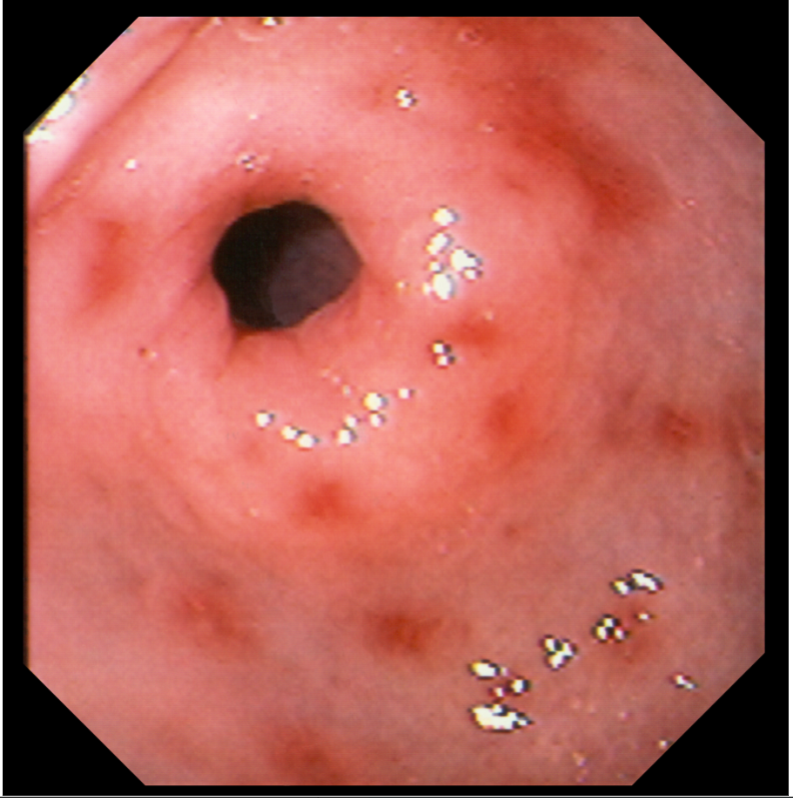
Diagnosis
ENDOSCOPY
this photo shows eroded and erythematous areas in the stomach lining resulting from prolonged nonsteroidal anti-inflammatory drug use.

Slide 77
Treatment
in severe gastritis, bleeding is managed with iv fluids and blood transfusion as needed. endoscopic hemostasis should be attempted, with surgery a fallback procedure if bleeding cannot be controlled endoscopically.
for bleeding: endoscopic hemostasis
for acid suppression: -should be started if the patient isn’t already receiving it -ppis -h2 blockers
angiography is unlikely to stop severe bleeding because of the many collateral vessels supplying the stomach

Slide 78
Treatment
PPI -esomeprazole -lansoprazole -pantoprazole available orally and IV
H2 blockers ( histamine 2 receptor antagonists ) -cimetidine -famotidine available orally and IV -nizatidine available orally
Notes:
*PPI ( prazole ) >>> H+ , K+ ATPase This enzyme, located in the apical secretory membrane of the parietal cell These drugs can completely inhibit acid secretion and have a long duration of action *H2 BLOCKERS >>> suppressing gastrin-stimulated acid secretion and proportionately reducing gastric juice volume

Slide 79
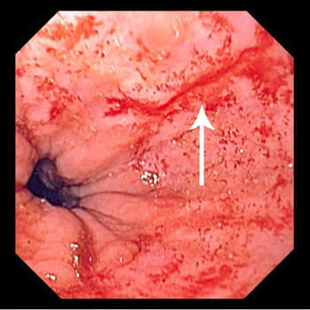
Mallory-Weiss tear

Slide 80
What is Mallory-Weiss tear?
as a definition: it is a post retching, post emesis superficial vertical split of the mucous membrane of esophagus. especially at the gastroesophageal junction (the contact point between esophagus and stomach) and it involves only partial thickness of esophagus (mucosa and submucosa) - it accounts for 10 % of upper gi bleeds

Slide 81
.

Slide 82
CAUSES:
increased pressure in the abdomen such as:
retching
vomiting
straining
hiccup
coughing
blunt abdominal trauma
cardiopulmonary resuscitation

Slide 83
Who is more susceptible to Mallory Weiss tear?
alcoholic people (because alcohol irritates the gastric cells and induce vomiting)
ages between 40 and 60
it affects males more than females

Slide 84
Does everyone with repeated vomit develop Mallory Weiss?
not everyone with repeated vomiting develops mallory weiss tear, it should be severe and vigorous vomit enough to cause a pressure and tear the mucosa and submucosa.

Slide 85
What is the clinical presentation?
patients present with :
severe epigastric pain
retching
mild hematemesis that is bright red or that looks like coffee grounds
black or tar-like stools
hematochezia (in severe cases)
weakness, dizziness, faintness
shortness of breath
diarrhea
abdominal or chest pain

Slide 86
Can we depend on the clinical features to confirm the diagnosis?
no, because the clinical differential diagnosis for such symptoms includes duodenal perforation, acute pancreatitis, myocardial infarction and oesophageal perforation. “endoscopy”confirms the diagnosis.

Slide 87
How is Mallory Weiss treated?
usually a mallory-weiss tear will stop bleeding and begin to heal on its own in most cases.
sometimes you will need treatment.
an endoscope may be used to give you an injection or a heat treatment to stop the bleeding, or insert a clip that closes the tear and stops the bleeding.

