Slide 1
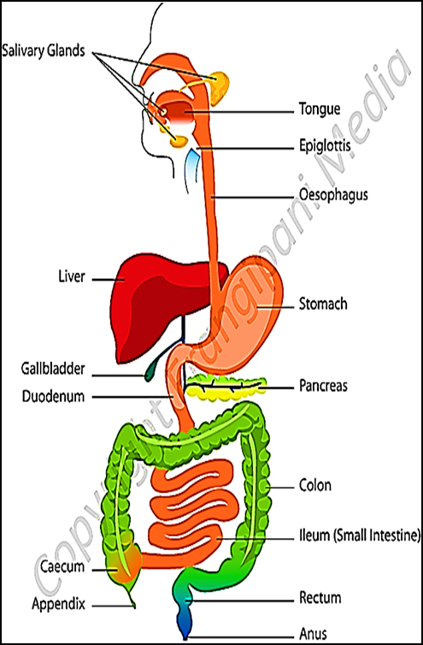
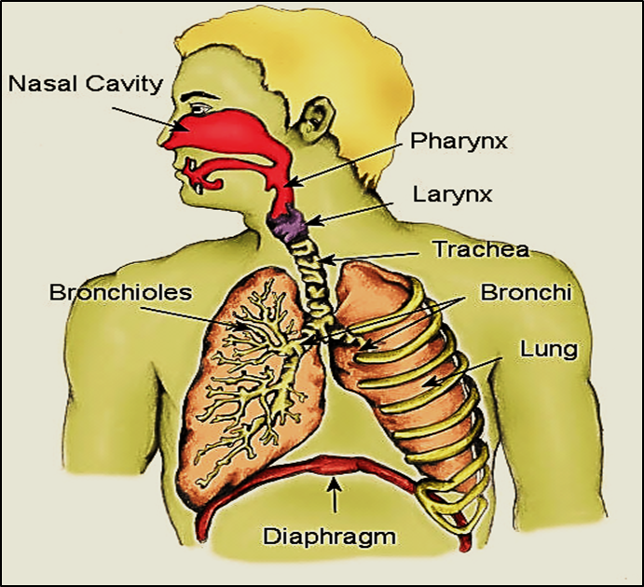
Introduction to GIT & RS Practical slides 2020 Professor Dr. Hala El- mazar

Slide 2
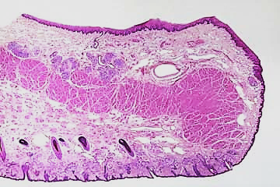
Lip
Non- keratinized stratified squamous epith.
Orbicularis oris ms
Keratinized stratified squamous epith (skin)

Slide 3
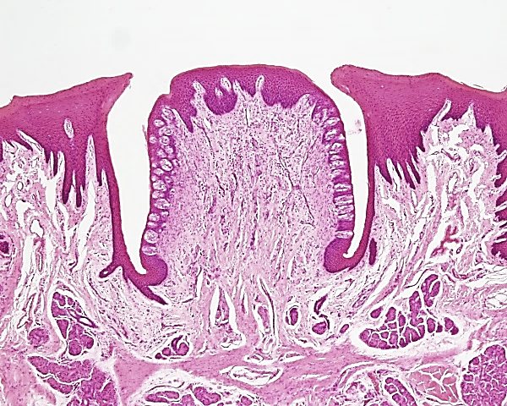
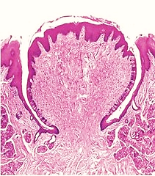
Lingual papillae (1)
Epithelium covering lingual papillae : non keratinized stratified squamous epith.
Taste buds
Von-Ebner’s serous glands
Circumvallate papillae

Slide 4
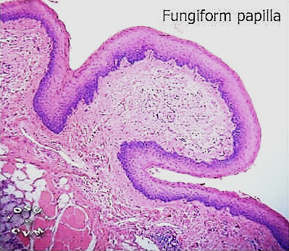
Lingual papillae (2)
Fungiform papillae

Slide 5
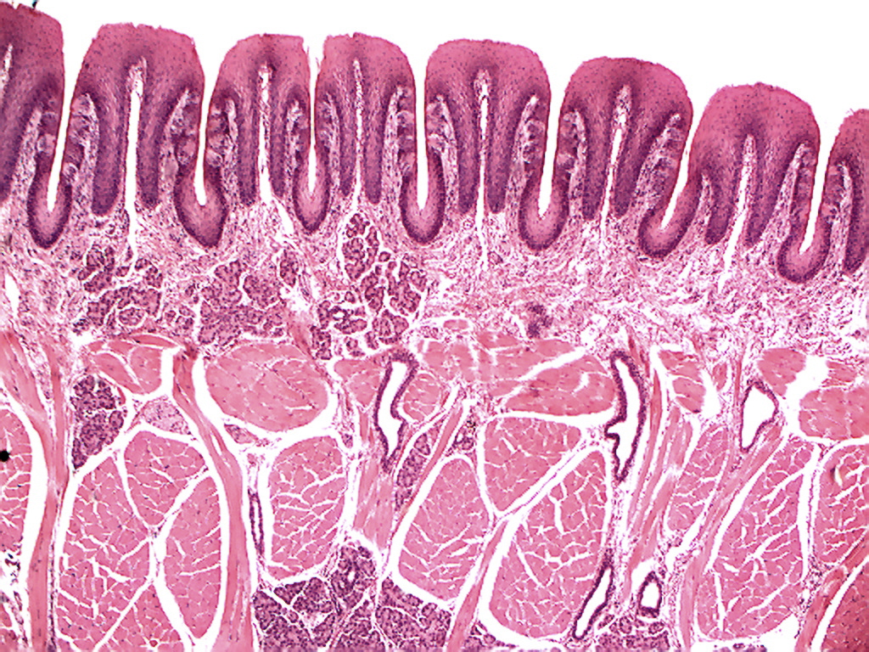
Lingual papillae (3)
Taste buds
Lingual salivary
gland
Foliate papillae

Slide 6
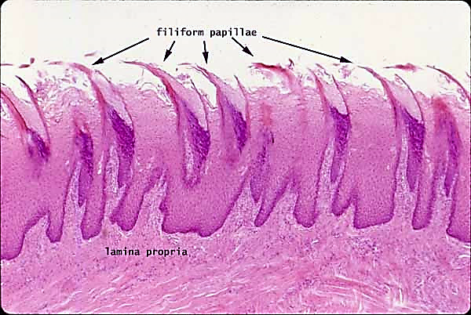
Lingual papillae(4)
Epithelium covering: keratinized stratified squamous epith
Filiform papillae

Slide 7
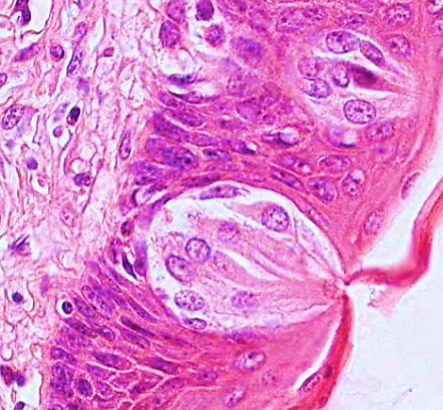
Taste buds

Slide 8
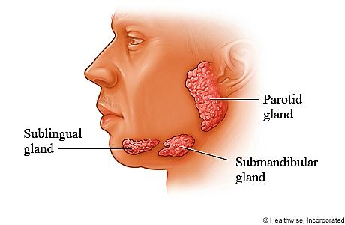
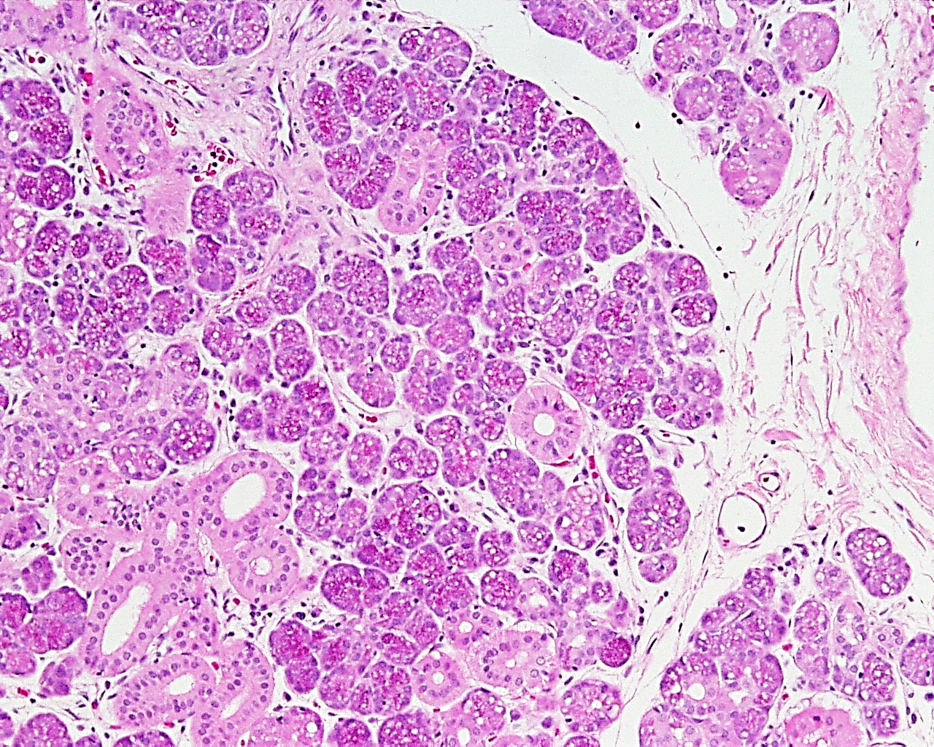
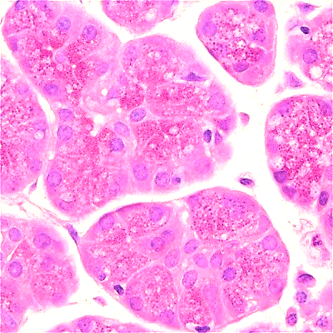
Parotid salivary gland
Serous acini
Striated ducts

Slide 9
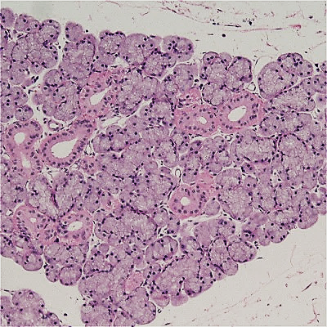
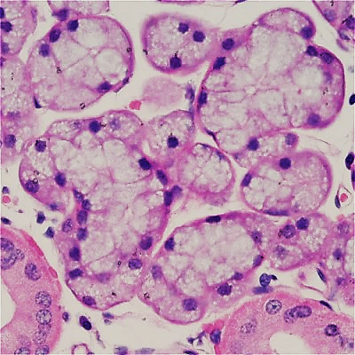
Sublingual salivary gland
Mucous acini

Slide 10
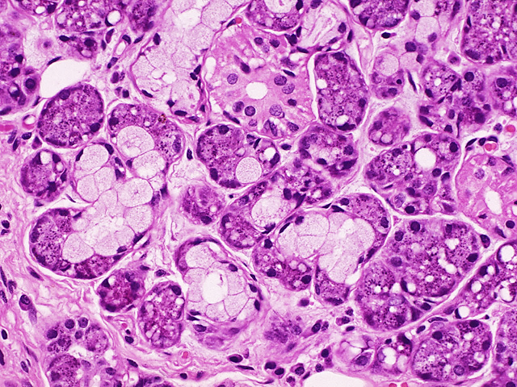
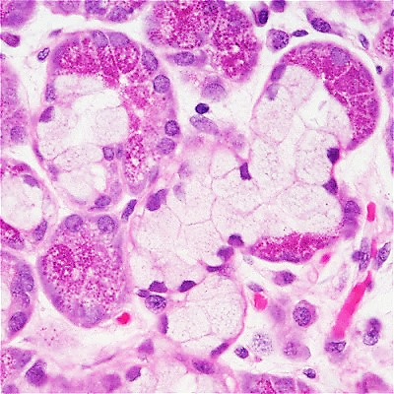
Submandibular salivary gland
Mixed muco-serous acini
Serous demilune (Cresent of Gianuzzi)

Slide 11
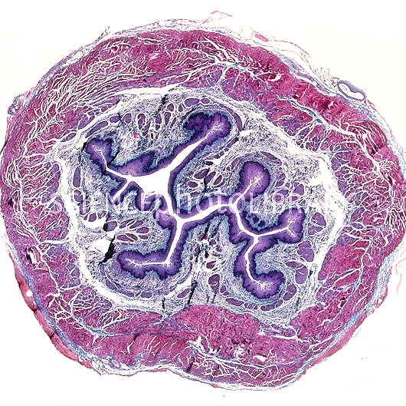
Esophagus
Musculosa
Mucosa
Submucosa

Slide 12
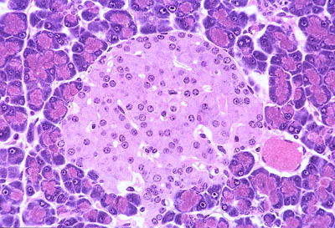
Pancreas
Exocrine pancreas
Islets of Langerhans

Slide 13
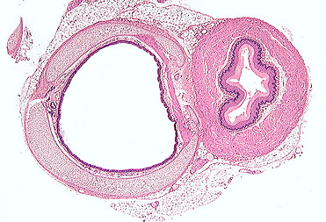
Trachea & Esophagus

Slide 14
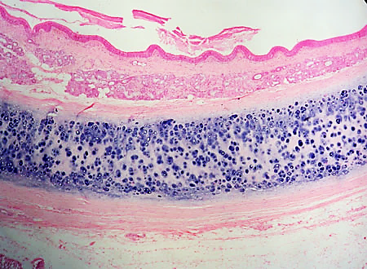
Cross section in trachea
Respiratory epithelium
Tracheal glands
Tracheal (hyaline) cartilage
Adventitia

Slide 15
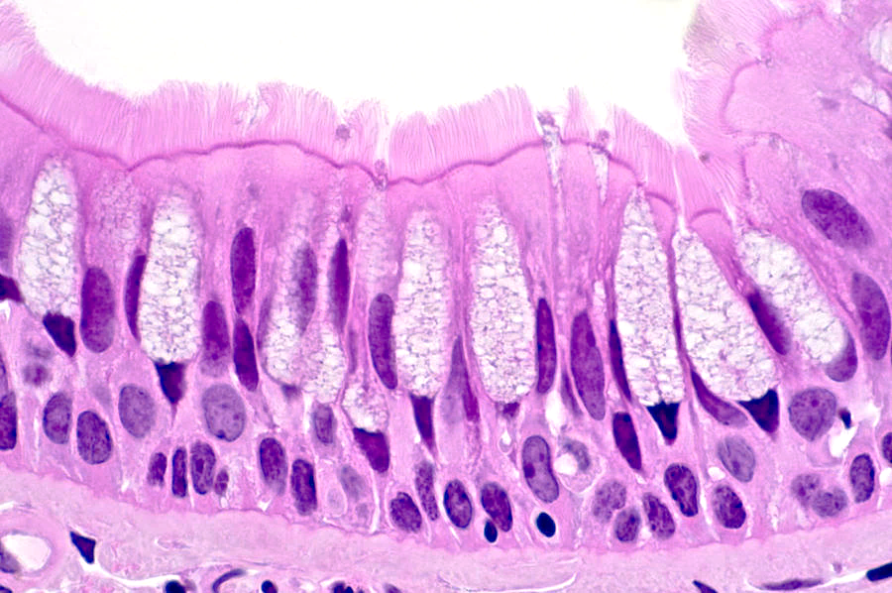
Respiratory epithelium
Pseudo stratified columnar ciliated with goblet cells

Slide 16
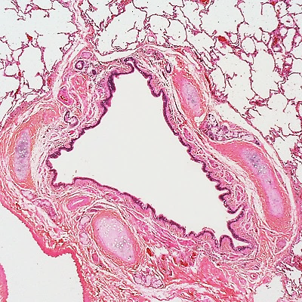
Bronchus
Cartilage plates

Slide 17
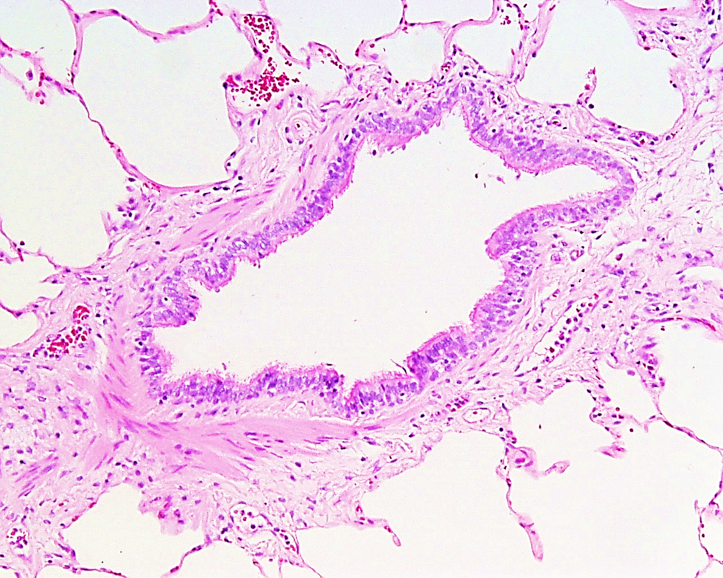
Bronchiole
Layer of circularly
arranged
smooth muscle

Slide 18
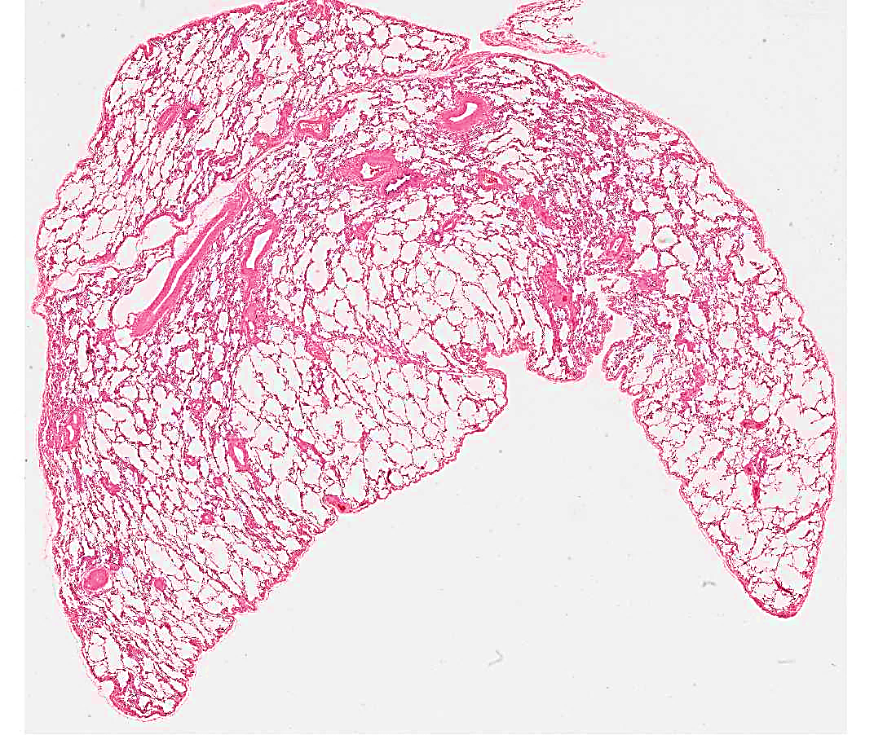
Lung

Slide 19
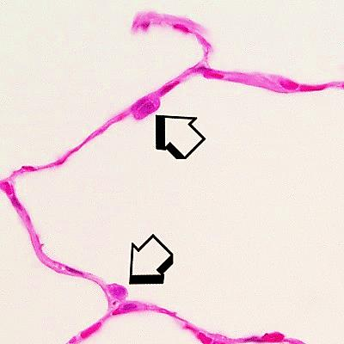
Alveolar type II pneumocyte

Slide 20
Thank you

