Slide 1
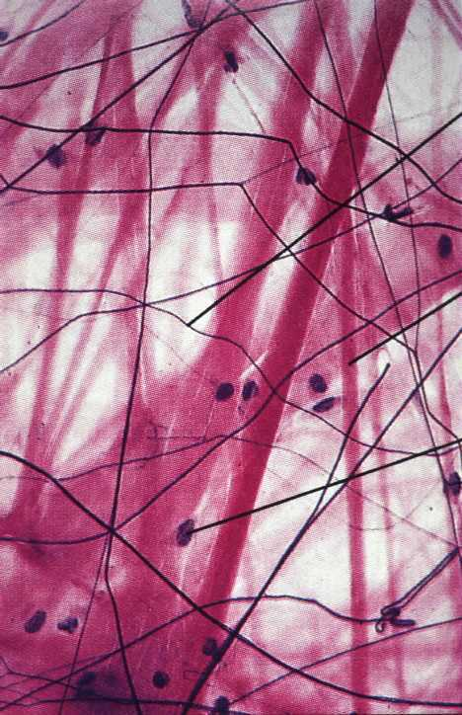
Epithelium Connective T.
Cells: closely aggregated, tight by junctional complexes
Intercellular substance: very little
No fibers in the ground substance
Blood vessels: Avascular
Origin: ectodermal, endodermal, mesodermal
Function: covering or secretion (glands)
Cells: few, widely separated
Intercellular substance: abundant
fibers are present in the ground substance
Blood vessels: rich Origin: mesodermal
Function: support, defence and nutrition

Slide 2
General Properties of Connective Tissue
3. Functions:
Architectural framework of the body
Bind together and provide mechanical support for other tissue (metabolic, defense, transport, storage)
Nutrition
Wound repair
Protection: inflammatory response
One of the four basic types of tissues (epithelium, connective tissue, muscle, and nervous tissue)
Composition:
cells
Extracellular matrix
fibers
ground substance

Slide 3
Extracellular Matrix (ECM) Ground Substance of the
Glycosaminoglycans (GAG)
linear (unbranched) polysaccharides, e.g. heparan sulfate, condroitin sulfate, keratan sulfate, hyaluronic acid
attract sodium & hold water
very hydrophilic due to abundant negative charges.
except for hyaluronic acid, are usually bound covalently to protein core as part of a proteoglycan
Proteoglycans: Forms thick gel that slows the spread of pathogens
core protein + GAG side chains (like a bottle brush)
bind cells, other proteins, and/or ECM components
Multiadhesive glycoproteins
small glycosylated proteins containing NUMEROUS binding sites to cells, signaling molecules, and other ECM components
e.g. fibronectin and laminin: important for adhesion of epithelial cells to the basal lamina via transmembrane integrin receptors.
Tissue fluid: Similar to blood plasma
FUNCTION:
- Nutrition
- Barrier to bacterial penetration

Slide 5
Connective Tissue Fibers
Collagen
most abundant protein in human body
Several types: fibril-forming or fibril-associated (in skin, tendon, cartilage, bone, dentin, blood vessels); cross-linked networks (in all basement membranes)
Reticular Fibers – specialized type of collagen (Type III; reticulin) associated with smooth muscle in organs subjected to changes in volume, forms the stroma in lymphatic and hematopoietic organs
Elastic Fibers –thin fibers or fenestrated sheets composed of various glycoproteins, including the protein elastin, providing elastic properties to tissues that experience repeated deformation (in skin, blood vessels, lung, bladder)

Slide 6
C.T. fibers
The proportion of different fiber types varies depending on the structural needs or function of the particular CT.
Collagen fibers are the most abundant fiber type. All connective tissues have collagen fibers, but the number and organization varies in different types. They are flexible and have a high tensile strength.
Reticular fibers means ‘network’. are especially abundant in arteries, spleen, liver, uterus and intestinal muscle layers, and they form the primary framework for hematopoietic organs, the parencyma of cellular organs such as liver and endocrine glands. Reticular fibers are also associated with the reticular lamina of basement membrane.
Elastic fibers are especially abundant in elastic ligaments (ligamenta flava of the vertebral column, ligamentum nuchae of the neck, and vocal folds of the larynx, and in the walls of arteries (where elastic fibers are produced by smooth muscle cells, not fibroblasts)

Slide 7
Collagen fibers (white fibers)
The most numerous
are extremely tough.
Formed of collagen protein
They are stronger than steel fibers of the same size.
They provide high tensile strength, which is the ability to resist longitudinal stress.
Since fresh collagen fibers have a glistening white appearance they are sometime called "white fibers".
Fibers do not branch but bundles can do
Stain pink with eosin

Slide 8
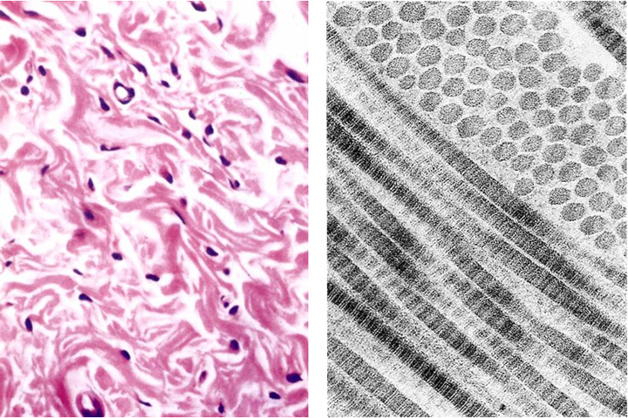
Collagen Fibers
H & E
fibrils
fibers

Slide 9
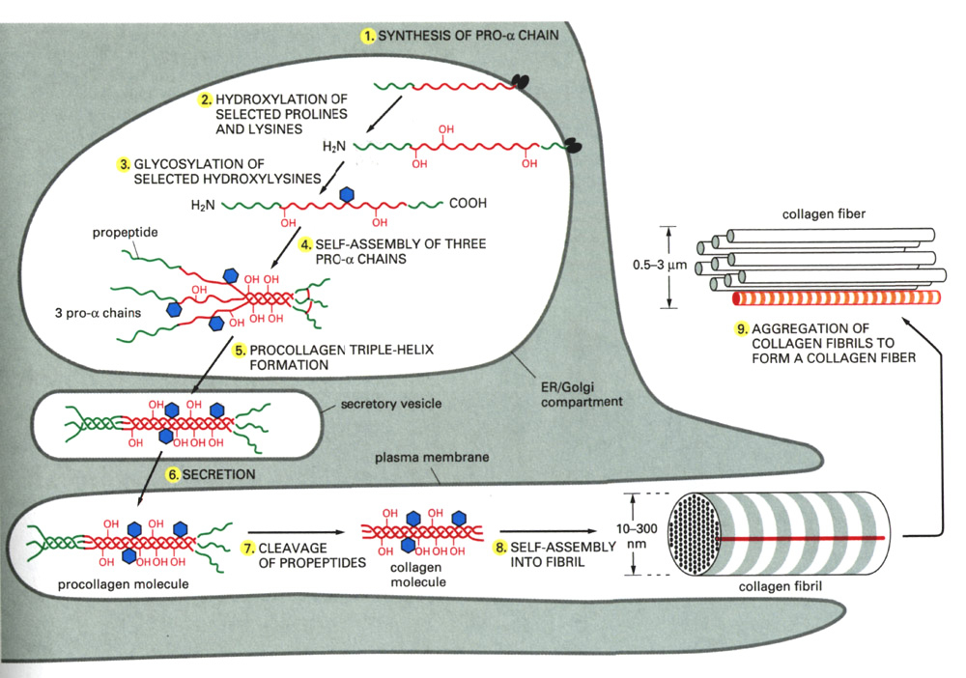
Collagen Synthesis
DISULFIDE
BONDS
ALDOL
CONDENSATION

Slide 10
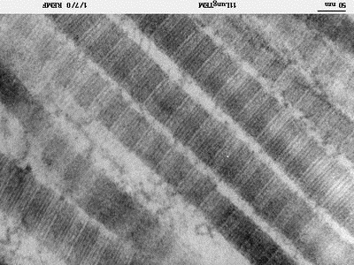
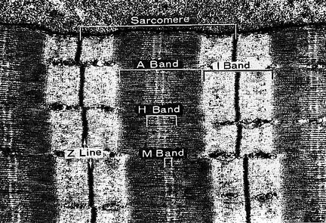

Slide 11
Assembly of collagen fiber bundles

Slide 12
Major Collagen Fiber Types (out of at least 20) According to the chemical composition of collagen molecules
Collagen Type | Tissues | Function
Fibril-forming collagens (these are visible)
I (most abundant) | Skin, tendon, bone, dentin | Resistance to tension
II | Cartilage, vitreous of eye | Resistance to pressure
III (reticulin) | Skin, muscle, blood vessels, liver, etc. | Structural framework and stability
Network-forming collagens
IV | All basement membranes | Support and filtration
Fibril-associated collagens with interrupted triple helices (FACIT)
VI, IX | Assoc. w/ type I and II fibrils | Fibril-fibril / fibril-ECM binding
Anchoring filament collagens
VII | Epithelia | Epidermis to basal lamina

Slide 13
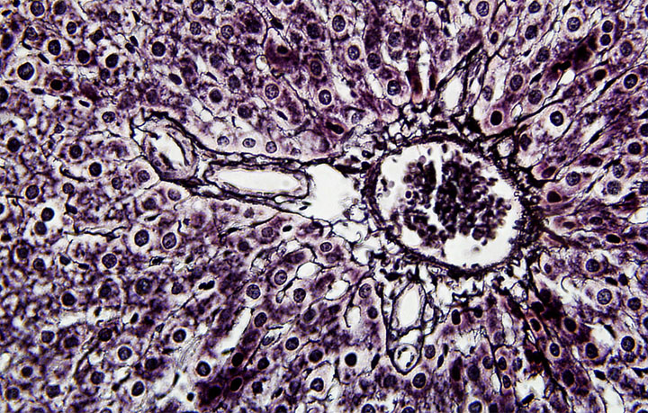
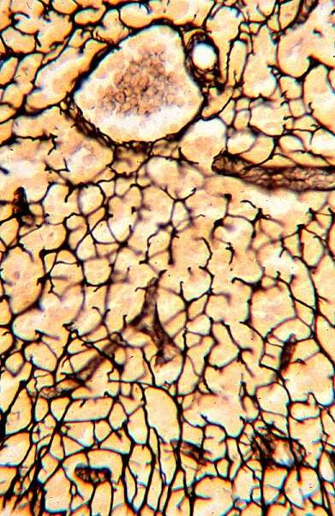
Reticular (Reticulin) Fibers
Form a delicate supporting framework for highly cellular tissues (endocrine glands, lymph nodes, liver, bone marrow, spleen, smooth muscle).
Composed mainly of Type III collagen, with a carbohydrate moiety that reduces Ag+ to metallic sliver = argyrophilic.
Special stain: silver impregnation to visualize.
Thinner than type I collagen (Type III fibrils are 30-40 nm diameter; type I fibrils are ~200 nm diameter)
made by reticular cells (specialized fibroblasts) and vascular smooth muscle cells

Slide 14
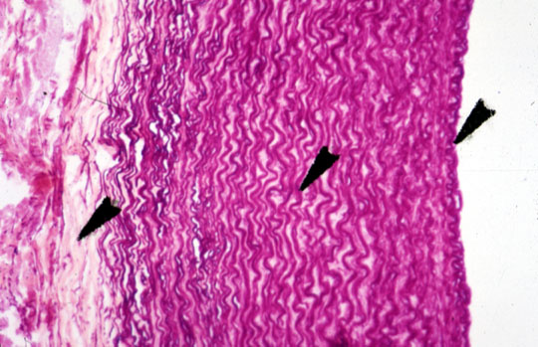
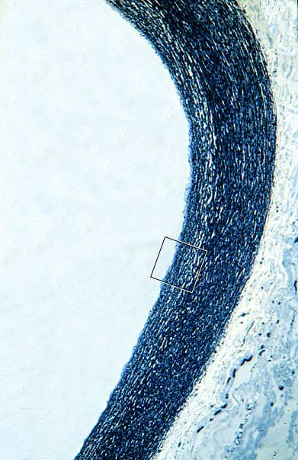
Elastic Fibers
Elastic fibers (yellow fibers): can be stretched to one and one-half times their length, but recoil to their initial length when released.
Fresh elastic fibers appear yellow and are also called yellow fibers.
Stain : H&E , Orcein , VVG
Elastin: is rich in glycine and proline, but it contains little or no hydroxyproline and hydroxylysine . uniquely contains desmosine and isodesmosine, which are thought to cross-link the molecules into a network of randomly coiled chains. This cross-linking is responsible for its rubber-like properties.
They are found where greater elasticity is needed present in large amounts in ligaments, lung, skin, bladder, and walls of blood vessels.

Slide 15
Network of elastin molecules can stretch and recoil like a rubber band
Notes:
.

Slide 16
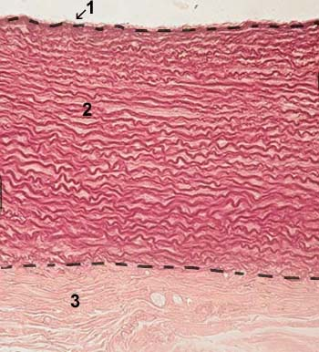
Fibers
The most numerous
White if in great number (white fibers)
Strong and flexible
Fibers do not branch but bundles can do
Formed of collagen protein
Stain pink with eosin
Types of Collagen Fibres
Thin branching
Not stained by H&E
Stained dark brown
with silver stain
Consist of type III collagen
Supportive function
Yellow if in great number (Yellow fibers)
Elastic and stretchable
Fibers can branch and unit
Formed of elastin protein
Stained weakly by H&E
Stain brick red by orcein
Stain dark violet with V.V.G stain.

Slide 17
Fibers
Fiber Components Location
Collagenous
Fibers
Elastic fibers
Reticular fibers
Alpha polypeptide chains
elastic microfibril & elastin
Type-III collagen
tendon, ligament, skin, cornea, cartilage, bone, blood vessels, gut, and intervertebral disc.
extracellular matrix (blood vessels)
liver, bone marrow, lymphatic organs

Slide 18
Connective Tissue Cells
Resident cells Immigrant cells Specialised cells
Monocytes/
histocytes/
macrophages
Plasmocytes
Mast cells
Leucocytes
Fibroblasts
Adipocytes
Pigment cells
Reticular cells
(reticular tissue)
Pericytes
(blood vessels)
Schwan cells
(nerve fibers)
Glial cells
(CNS)
CHondriocytes
(cartillage)
Osteocytes
(bone)
Blood cells
derived from hematopoietic stem cells and involved in immune function and inflammation

Slide 19
Connective Cell Lineages

Slide 20
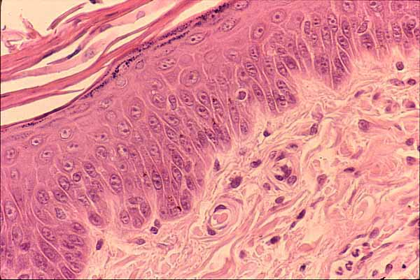
C.T. CELLS
Origin
Structure
LM
EM
Function

Slide 21
Undifferentiated Mesenchymal Cell
Spindle shaped cells
Many processes
Oval nucleus
Basophilic cytoplasm
Divide and differentiate into other C.T. cells
L.M.

Slide 22
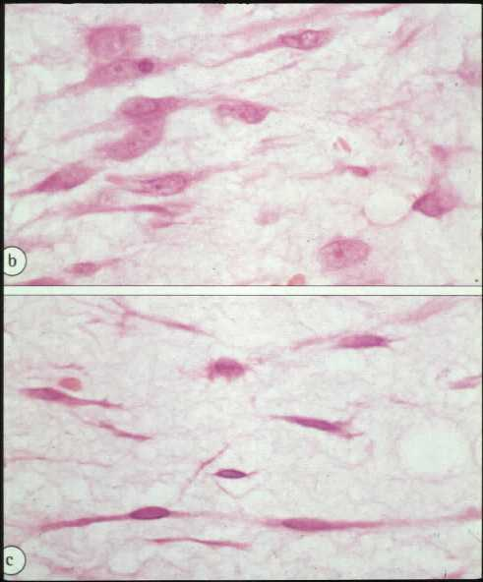
Fibroblasts the most common type
Origin : from UDMC
2 types
Young fibroblast:
Large in size
Fusiform with processes
oval central paler nucleus
Basophilic cytoplasm
Function
synthesis of C.T. fibers and matrix
mature (Fibrocytes):
Small in size
Fusiform smaller
oval central darker nucleus
acidophilic cytoplasm

Slide 23
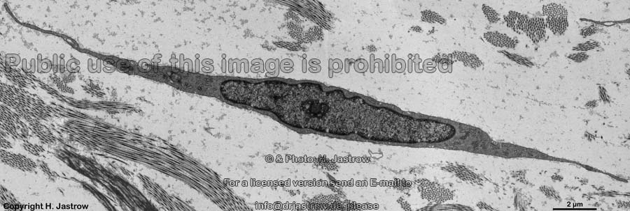
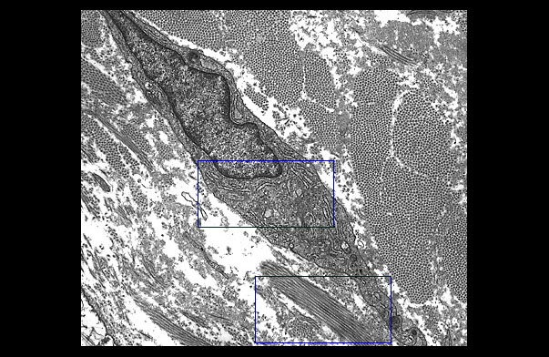

Slide 24
Fibroblasts are the most common cells in connective tissue
Active and quiescent stages (when quiescent sometimes called fibrocytes or mature fibroblasts).
Synthesize and secrete components of the ECM: fibers and ground substance.
Synthesize growth factors.
Rarely undergo cell division unless tissue is injured, which activates the quiescent cells.
Play a major role in the process of wound healing and respond to an injury by proliferating and enhanced fiber formation.
Notes:
.

Slide 25
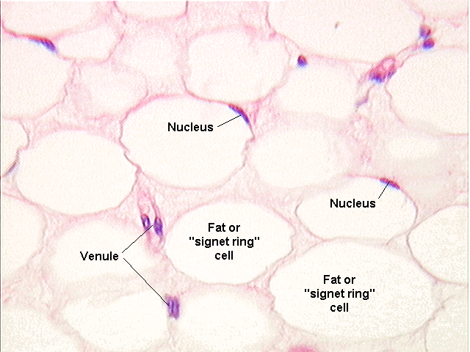
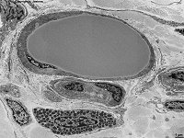
Fat Cell
Origin : UDMC
large, sperical or polyhedral
Single or several lipid droplets
flattened peripheral nucleus
Function :
storage of fat
ُEM
Lipocytes stained black with osmic acid

Slide 26
Adipocytes
Fat cells or adipocytes are fixed cells in loose connective tissue. Their main function is the storage of lipids. The cytoplasm only forms a very narrow rim around a large central lipid droplet. The flattened nucleus may be found in a slightly thickened part of this cytoplasmic rim - if it is present in the section, which may not be the case since the diameter of an adipocyte (up to 100 µm).
A "starving" adipocyte may contain multiple small lipid droplets and gradually comes to resemble a fibrocyte.
Lipid storage/mobilisation is under nervous (sympathetic) and hormonal (insulin) control.
Adipocytes also have an endocrine function - they secrete the protein leptin which provides brain centers which regulate appetite with feedback about the bodies fat reserves.
Adipocytes are very long-lived cells. Their number is determined by the number of preadipocytes (or lipoblast) generated during foetal and early postnatal development.

Slide 27
Pigment Cells
branched cells
Contain pigment granules:
Melanin (melanocytes)
Function :
gives the color of skin and iris of the eye

Slide 28
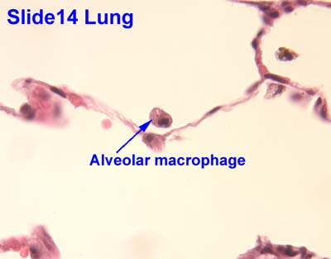
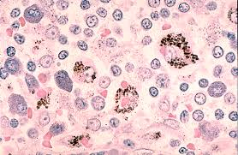
Macrophages
Origin : From blood monocytes
Three types:
Resident :resting
Elicited: moving to a stimulus
Activated: active in phagcytosis:
-pseudopodea
-Kidny shaped eccentric nucleus-
large number of lysosomes
Function : Phagocytosis

Slide 29
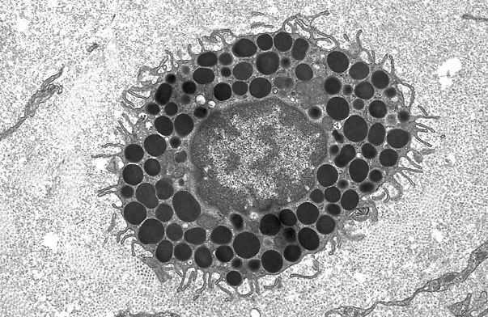
Mast Cells
Origin : from haemopoetic stem cell in B. M
the largest of free cells
Contain basophilic granules
granules stain red with toluidine blue (metachromatic staining)
Function :
secretion of histamine and heparin

Slide 30
Mast Cells
Principal function is storage in secretory granules and REGULATED release (degranulation) of histamine and other vasoactive mediators of inflammation.
Responsible for the immediate hypersensitivity response characteristic of allergies, asthma and anaphylactic shock.
Connective tissue mast cells are found in skin (dermis) and peritoneal cavity; mucosal mast cells are in the mucosa of the digestive and respiratory tracts.
Metachromasia – when stained with toluidine blue, the granules bind the dye and change its color to red.

Slide 31
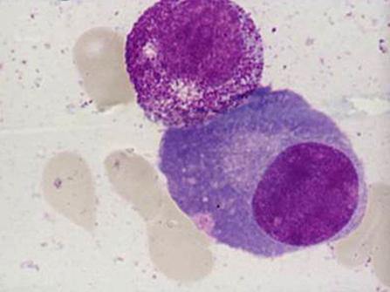
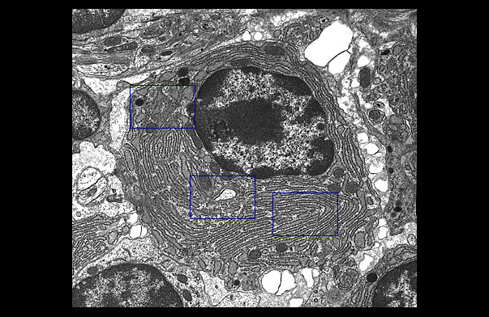
Plasma Cells
Origin : from activated B –lymphocytes
large ovoid cells
Basophilic cytoplasm (rER)
spherical eccentric nucleus
Cart wheel appearance of the nucleus
Large negative golgi image
Function :
formation of antibodies

Slide 32
Thank You

