Slide 1
Transport through the cell membrane
Dr. Arwa Rawashdeh

Slide 2
Simple diffusion
Non- polar, uncharged, lipid soluble and high membrane permeability ( O2, steroid hormone, CO2)
Rate is linear
Facilitated diffusion
Ion leak channels specific ions , open
Voltage gated channels open based on membrane potential
Ligand gated channels open in response to the binding of chemical messenger
Carrier protein changing the shape of carrier
Rate can be never greater than transporter protein

Slide 3
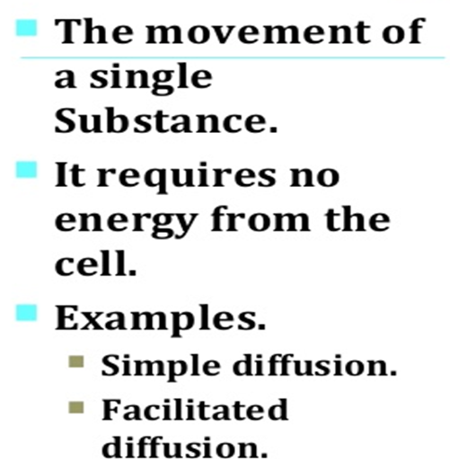
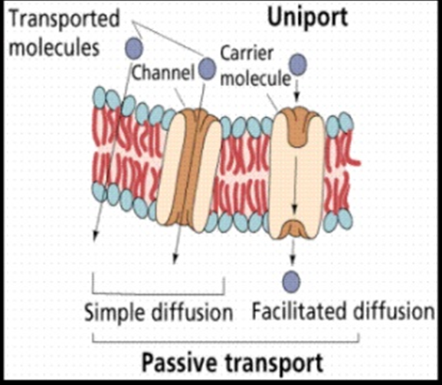
Uniport

Slide 4
Objectives
Identify active transport
Characteristics
Mechanisms
Types of pumps

Slide 6
Active transport involves the use of carrier proteins, like those of facilitated diffusion, but these carrier proteins act as pumps, using the energy from splitting ATP to pump specific molecules against the concentration gradient

Slide 7
Why??

Slide 8
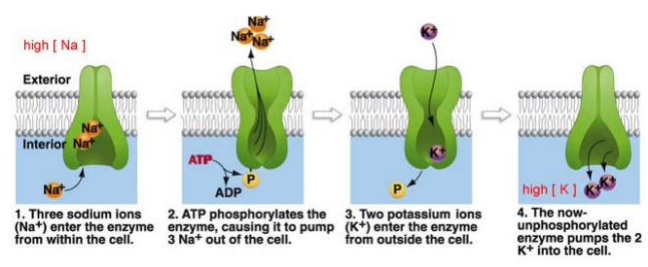

Slide 10
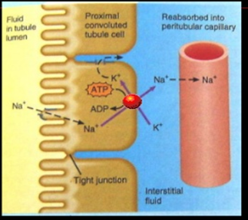

Slide 12
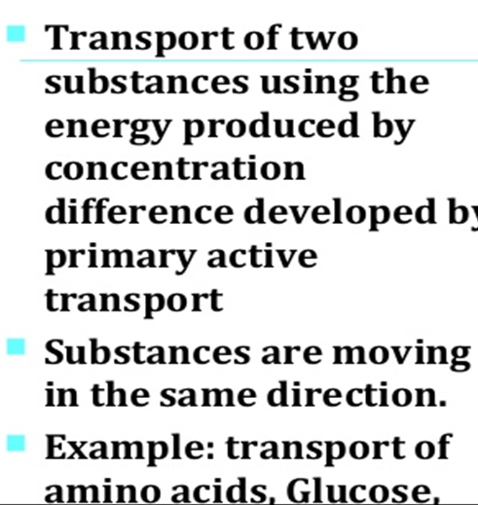
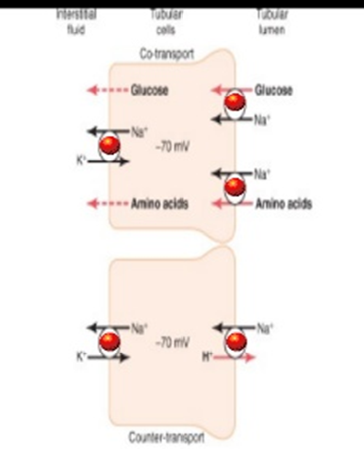
Symport ( Co- transport)

Slide 13
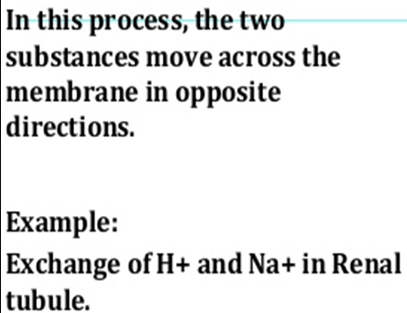
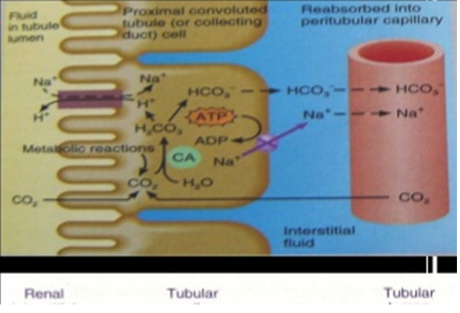
Anti port ( Counter- Transport)

Slide 14
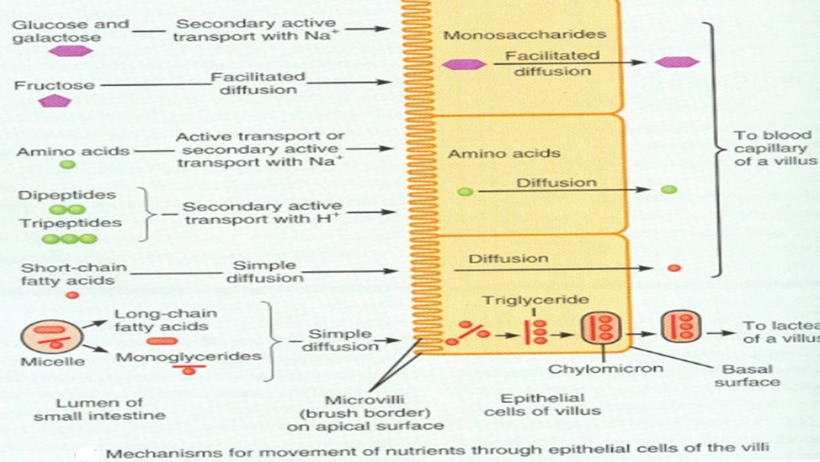

Slide 15
