Slide 1
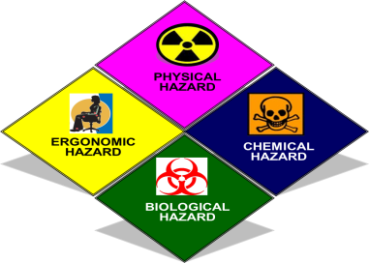
OCCUPATIONAL HEALTH
9
Chemical Hazards
Prof. Dr. WAQAR AL-KUBAISY

Slide 2
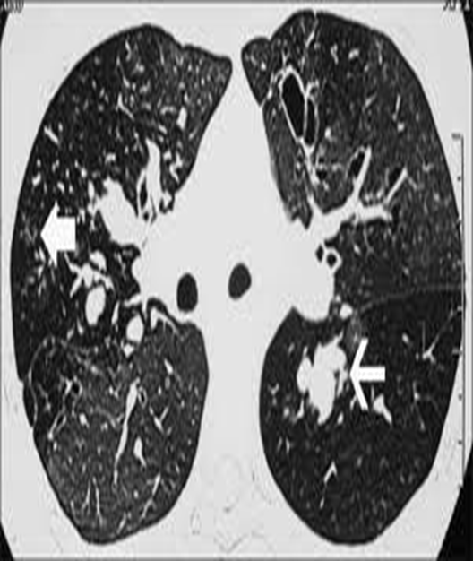
Pneumoconiosis
contents
• Definitions
• Pathogenesis
• Types
Preventive measures
• Individual diseases
– Silicosis
– Asbestosis
– Anthracosis
•

Slide 3
Preventive measures in Pneumoconiosis
Medical measures
Engineering measures
Other measures

Slide 4
Preventive measures in Pneumoconiosis
Medical measures
Engineering measures
Other measures
Medical measures:
Pre-placement examination
Periodical examination
Medical and health care services
Notification
Maintenance and analysis of records
Health education and counselling
Practicing good personal hygiene
Washing hands and face before eating, drinking, smoking or use toilet,
Prevent eat, drink, smoke, in areas where such dust is being used.
Wear protective clothes and respiratory protection
Before leaving work, shower and change into clean clothes.
Leave dusty clothes at work.

Slide 5
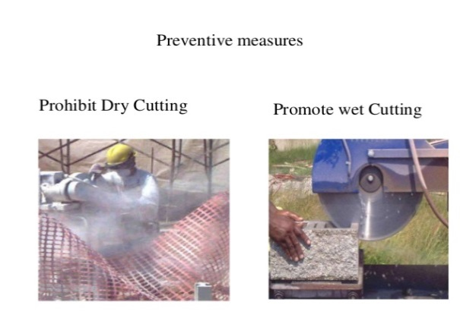
Preventive measures in Pneumoconiosis
Medical measures
Engineering measures
Other measures
Engineering Measures
Design of building
Conduct air monitoring to measure the workers’ exposure to such dust .
Minimize exposures by controlling the creation of airborne
for example, use wet drilling, local exhaust ventilation.
Enclosure / isolation
Environmental monitoring
Prohibit Dry Cutting Promote wet Cutting

Slide 6
Preventive measures in Pneumoconiosis
Medical measures
Engineering measures
Other measures
Other Measures:
Legal measures:
Measures to minimize dust emissions and exposure to dust.
Law compliance mechanisms, including effective workplace inspection systems
Cooperation between management and workers and their representatives
A mechanism for the collection and analysis of data on occupational diseases
Training of health professionals in occupational diseases to diagnose and prevent occupational diseases.

Slide 7
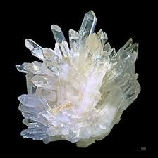
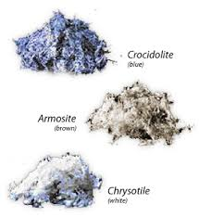
silicosis
Silica crystals

Slide 8
Silica exists in 2 forms
Crystalline and
Amorphous forms.
Crystalline silica not bound to other materials
is called FREE SILICA,
when bound it is referred as combined (silicates).
Amorphous silica have relatively non toxic pulmonary properties.
Silicosis
refers to a spectrum of pulmonary diseases due to inhalation of various forms of FREE crystalline silica (SiO2).

Slide 9
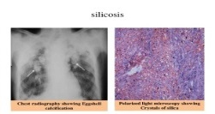
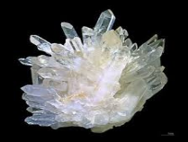
silicosis
Among the occupational diseases,
silicosis is the major cause of
permanent disability and mortality.
Develops with repeated and usually long-term exposure
to crystalline silica (silica dust)
It is caused by inhalation of dust containing free silica or
silicon dioxide free crystalline silica (SiO2).
The silica dust causes irritation & inflammation of the airways & lung tissue.
Scar tissue forms when the inflammation heals, resulting
in fibrosis that gradually overtakes healthy lung tissue.
The fibrosis continues extending through the lungs
even after exposure ends.

Slide 10
The incidence of silicosis depends upon:
the chemical composition of the dust,
size of the particles,
duration of exposure and
individual susceptibility
The higher the concentration of free silica in the dust,
the greater the hazard.
Particles between 0.5 to 3 micron are the most dangerous because they reach the interior of the lungs with ease.
The longer the duration of exposure,
the greater the risk of developing silicosis.
the latent period may vary from a
few months up to ≥20 years of exposure,
depending upon the above factors.
The particles are ingested by the phagocytes which accumulate and block the lymph channels.

Slide 11
The particles are ingested by the phagocytes which accumulate and block the lymph channels.
Pathologically,
silicosis is characterized by
Fibrosis is initiated by silicic acid
leading to a dense "nodular" nodular fibrosis,
the nodules ranging from 3 to 4 mm in diameter in
the upper part of the lung .
Emphysema , and right heart failure ,
Pulmonary TB may intervene in 50% of cases
The presentation and severity of silicosis depend on:
Dust factors: concentration or duration of exposure
Host factors: genetic factors, cigarette smoking, and presence of other pulmonary disease

Slide 12
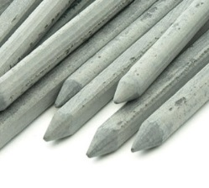
Occupations with risk of exposure to silica dust
Brick-making
Silica flour manufacture
Slate Pencil Industry
Agate Industry صناعة العقيق
Quartz Grinding
millers,
pottery workers,
glass makers
abrasive worker
Mining
Tunneling
Quarrying Stone Quarries: محاجر الحجر
Sandblasting
Ceramics
Presentation and clinical picture:
Spectrum of silicosis include:
Classic silicosis (simple) and complicated Progressive massive fibrosis (PMF)
Accelerated (simple) and complicated (PMF)
Acute

Slide 13
I ) Classic silicosis Chronic silicosis:
the most common form,
results from long-term exposure (10 to 20 years or longer)
Result from low to moderate exposure to dust containing
less than 30% silica content
but may occur with shorter exposure.
In early case patient may complain of cough, expectoration
and if dyspnea is present it is not due to silicosis but is
related to industrial bronchitis or concurrent smoking.
By time dyspnea is apparent and is now related to silica exposure (simple silicosis). Late symptom
Simple silicosis is a risk for development of complications

Slide 14
X-ray:
The characteristic pattern of simple silicosis is
small round opacities that range in size from 1-10 mm.
common in upper lung zones (snow storm appearance).
Hilar lymph nodes are usually enlarged or may calcify circumferentially producing the so called eggshell pattern of calcifications.
Similar x-ray picture are seen in: Sarcoidiosis, Scleroderma, Amyloidosis,……, However the background of small opacities reinforces the
clinical diagnosis of silicosis.
The silicotic nodule is the pathologic hallmark of silicosis,
Large opacities retract toward the hilum resulting in sub pleural areas of air space enlargement (appear as bullae).
Large opacities combine in the upper lung zones result in
loss of upper zone volume and elevation of both hila and
development of basilar emphysema.

Slide 15
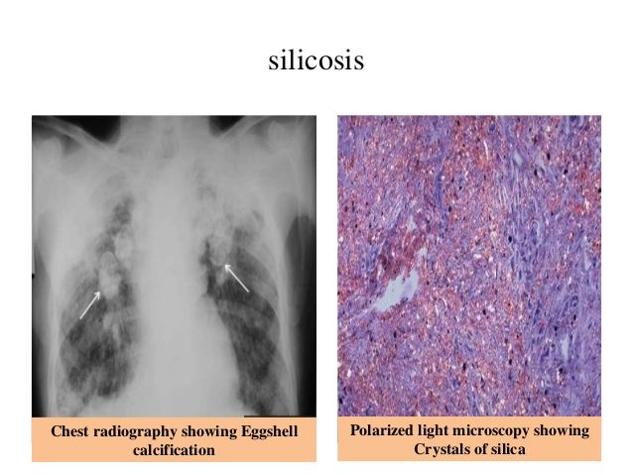
"Eggshell" calcification, when present, is strongly suggestive of silicosis

Slide 16
Diagnosis:
History of silica exposure
Chest radiographic abnormalities
Pulmonary function tests show obstructive lesion.
Absence of other illnesses that mimic silicosis as Miliary T.B,
Lung function: In general when the radiographs show only small
rounded opacities of low profusion of simple silicosis →
no significant impairment in lung capacity is associated.
But later, shows a restrictive pattern lung changes
decreased FEV1 /FVC %)
(forced expiratory volume in one second/ forced vital capacity
significant lung function loss
Lung function tests: ↓ FVC, ↓ TLC, ↓ FEV1, ↓ FEV1/FVC ratio → findings indicate a mix of restrictive and obstructive lung disease

Slide 17
Simple silicosis is a risk for development of complications
(1) Cardiorespiratory complications:
Progressive massive fibrosis (PMF).
About three fold risk of pulmonary and extra pulmonary T.B.
Core pulmonale and Rt. side heart failure.
Basilar emphysema associated with P.M.F increases the
risk of spontaneous pneumothorax.
The stiff lung and inability to expand well eventually lead
to Death due to progressive respiratory insufficiency
(2) Immune mediated complications:
Disseminated sclerosis (DS).
Scleroderma.
Rheumatoid arthritis and caplan's syndrome.

Slide 18
(3) Renal complication (a spectrum of nephropathy):
Glomerulonephritis or nephrotic syndrome
Tubular damage
(4) Cancer: by crystalline silica exposure.
Spectrum of silicosis include:
Classic silicosis (simple) and (PMF)
Accelerated (simple) and complicated (PMF)
Acute
II ) Accelerated silicosis
Results from exposure to higher concentration of silica
over a period of 5-10 years.
Due to a high exposure to fine dust of high silica content.
clinical autoimmune connective tissue diseases are
frequently associated.
Scleroderma
Rheumatoid arthritis
Lupus erythmatosis (LE)
Condition is progressive even if worker is removed from exposure

Slide 19
(III ) Acute silicosis
Results from over whelming(massive)excessive concentrations
very heavy exposure to fine dust for months,
shows symptoms within weeks to months of exposure
80% of cases occur as little as few years or even 1 year
and end in death within several years due to respiratory failure.
Fever , weight loss ,cough and dyspnea.
It occurs more frequent in industrial activities
where silica is fractures or crushed such as in
sand blasting or rock drilling.

Slide 20
silicosis
silicosis Brick-making Sand blasting

Slide 21
Clinical features:
Chronic irritant cough
Dyspnea (shortness of breath) that worsens with exertion.
Fatigue
Loss of appetite
Chest pains
With more advanced disease,
impairment of total lung capacity (TLC) is commonly present
Acute silicosis patients may also have fever and
rapid, unintended weight loss.
Chest X-ray of the shows "snow-storm" appearance
the hallmark of silicosis is the silicotic nodule
Chest radiography showing Eggshell calcification
On histopathology
Polarized light microscopy showing
Crystals of silica

Slide 22
Silico tuberculosis:
Silicosis is progressive and what is more important is
that silicotics are prone to pulmonary tuberculosis, a condition called "silico-tuberculosis.
Pulmonary tuberculosis occurs in about 25% of patients with acute or classic silicosis
in silicotuberculotics sputum rarely shows tubercle bacilli

Slide 23
TREATMENT:
There is no specific effective treatment for the silicosis,
Fibrotic changes that have already taken place cannot be reversed.
There is no known method of intervention to prevent the condition's progression
the only way that silicosis can be controlled is by:
(a) rigorous dust control measures, e.g.,
substitution, complete enclosure, isolation, hydroblasting,
good house-keeping, personal protective measures and
(b) regular physical examination of workers
Silica exposure has to be stopped to prevent further damage to the lungs,
Smokers should quit smoking.
TB positive patients need to be put on anti-tuberculosis treatment
The course of progression often extends over decades even after cessation of exposure.
Prevention remains the most effective therapeutic approach

Slide 25
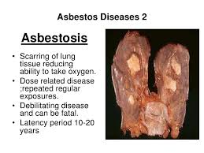
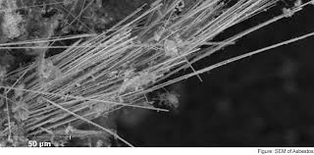
Asbestos fibers

