Slide 1
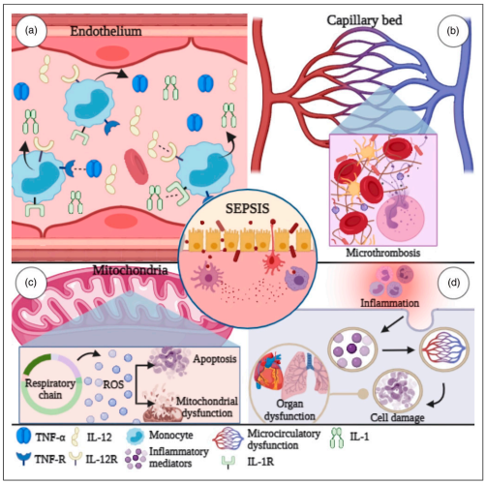
Inflammation 1
Sura Al Rawabdeh, M.D.
25-10-2023

Slide 2
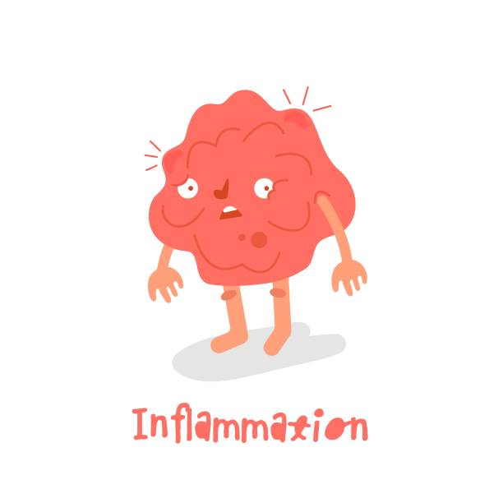
Inflammation
Inflammation is a response of vascularized tissues to infections and tissue damage that brings cells and molecules of host defense from the circulation to the sites where they are needed, to eliminate the offending agents
It serves to rid the host of both the initial cause of cell injury (e.g., microbes, toxins) and the consequences of such injury (e.g., necrotic cells and tissues)

Slide 3
Inflammation
The process of inflammation delivers leukocytes and proteins to foreign invaders, such as microbes, and to damaged or necrotic tissues, and it activates the recruited cells and molecules, which then function to eliminate the harmful or unwanted substances.
Without inflammation, infections would go unchecked, wounds would never heal, and injured tissues might remain permanent festering sores

Slide 4
The typical inflammatory reaction develops through a series of sequential steps:
Recognition of the offending agent.
Recruitment of leukocytes and plasma proteins from the circulation to the site where the offending agent is located.
Activation of the leukocytes and proteins to destroy and eliminate the offending substance.
Termination.
Repair.

Slide 5
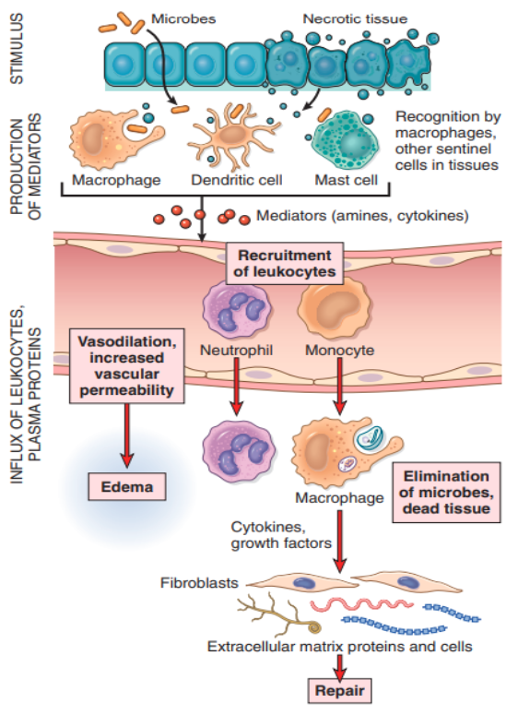
Notes:
When a microbe enters a tissue or the tissue is injured, the presence of the infection or damage is sensed by resident cells, including macrophages, dendritic cells, mast cells, and other cell types. These cells secrete molecules (cytokines and other mediators) that induce and regulate the subsequent inflammatory response Some of these mediators promote the efflux of plasma and the recruitment of circulating leukocytes to the site where the offending agent is located. Mediators also activate the recruited leukocytes, enhancing their ability to destroy and remove the offending agent.

Slide 6
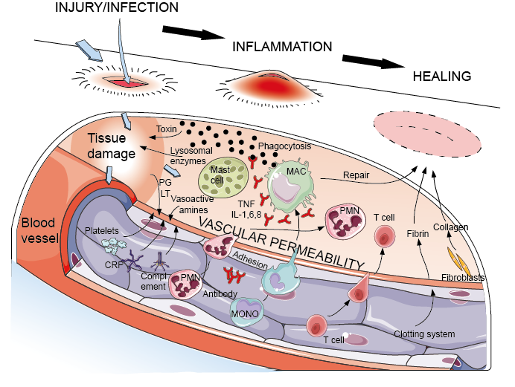

Slide 7
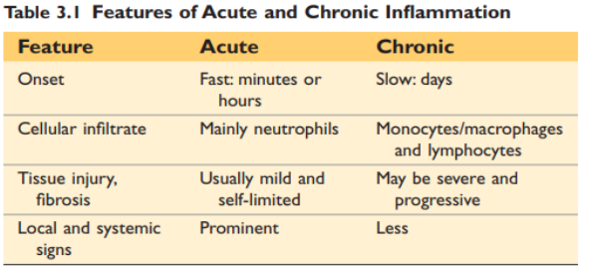
Inflammation may be of two types, acute and chronic.
**if the initial response fails to clear the stimulus, the reaction progresses to chronic inflammation
Notes:
chronic inflammation may follow acute inflammation or arise de novo. It is of longer duration and is associated with more tissue destruction, the presence of lymphocytes and macrophages, the proliferation of blood vessels, and fibrosis

Slide 8
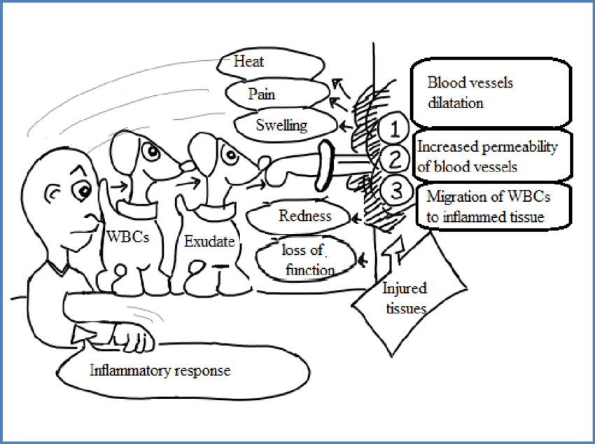
cardinal signs
The external manifestations of inflammation are:
Heat (calor in Latin).
Redness (rubor)
Swelling (tumor),
Pain (dolor),
Loss of function (functio laesa).

Slide 9
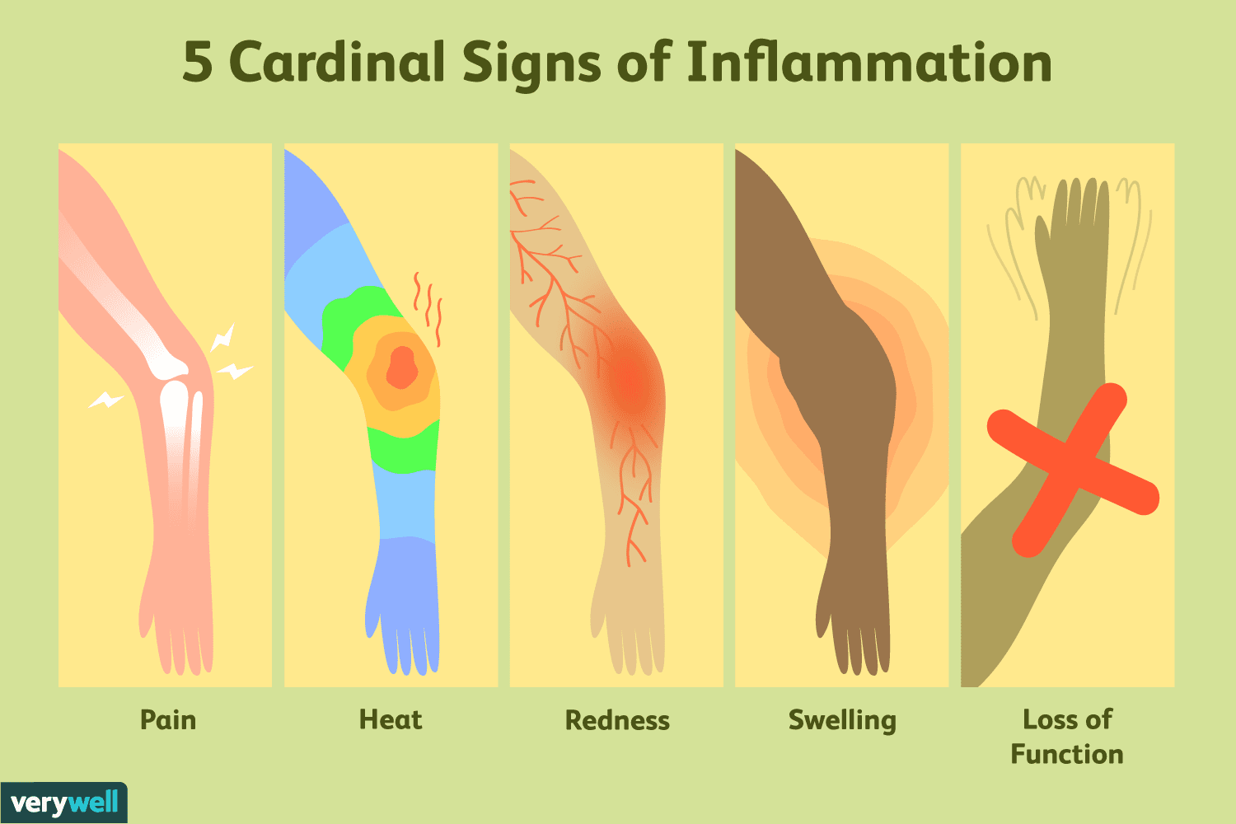

Slide 10
Dose the inflammation always good??
In some situations, the inflammatory reaction becomes the cause of disease, and the damage it produces is its dominant feature e.g:
1. Autoimmune diseases: inflammatory reaction is misdirected against self tissues.
2. Allergies: against normally harmless environmental substances that evoke an immune response.
3. Common chronic diseases.

Slide 11
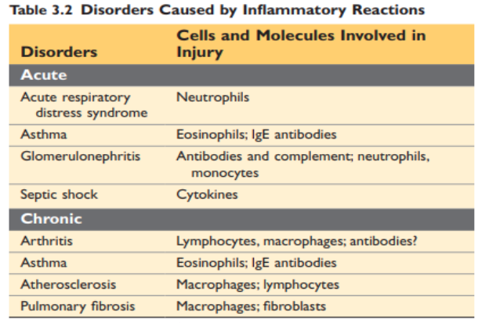
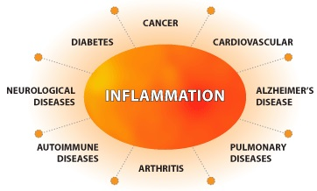

Slide 12
Dose the inflammation always good??
Not only excessive inflammation but also defective inflammation is responsible for serious illness.
Often caused by a reduced number of leukocytes resulting from replacement of the bone marrow by cancers and suppression of the marrow by therapies for cancer and graft rejection

Slide 13
Inflammation is terminated when the offending agent is eliminated, how:
Mediators are broken down .
Leukocytes have short life spans in tissues.
Anti-inflammatory mechanisms are activated, serving to control the response and prevent it from causing excessive damage to the host
Tissue repair:
Repair consists of a series of events that heal damaged tissue. In this process, the injured tissue is replaced through regeneration of surviving cells and filling of residual defects with connective tissue (scarring).

Slide 14
CAUSES OF INFLAMMATION

Slide 15
1.RECOGNITION OF MICROBES AND DAMAGED CELLS
1. Cellular receptors for microbes
The best defined of these receptors belong to the family of Toll-like receptors (TLRs),
Recognition of microbes by these receptors stimulates the production and expression of a number of secreted and membrane proteins.
These proteins include cytokines that induce inflammation, anti-viral cytokines (interferons), and cytokines and membrane proteins that promote lymphocyte activation and even more potent immune responses
Notes:
TLRs are located in plasma membranes and endosomes, so they are able to detect extracellular and ingested microbes.
TLRs recognize motifs common to many microbes, often called pathogen-associated molecular patterns (PAMPs).

Slide 17
2. Sensors of cell damage
All cells have cytosolic receptors that recognize molecules that are liberated or altered as a consequence of cell damage, and are hence appropriately called damage-associated molecular patterns (DAMPs) e.g:
Uric acid (a product of DNA breakdown),
ATP (released from damaged mitochondria),
Reduced intracellular K+ concentrations (reflecting loss of ions because of plasma membrane injury),
DNA (when it is released into the cytoplasm and not sequestered in nuclei, as it should be normally)

Slide 18
2. Sensors of cell damage
The receptors activate a multiprotein cyto-solic complex called the inflammasome, which induces the production of the cytokine interleukin-1 (IL-1)
IL-1 recruits leukocytes and thus induces inflammation
Gain-of-function mutations in the cyto-solic receptors are the cause of rare diseases known as autoinflammatory syndromes that are characterized by spontaneous inflammation; IL-1 antagonists are effective treatments for these disorders.

Slide 19
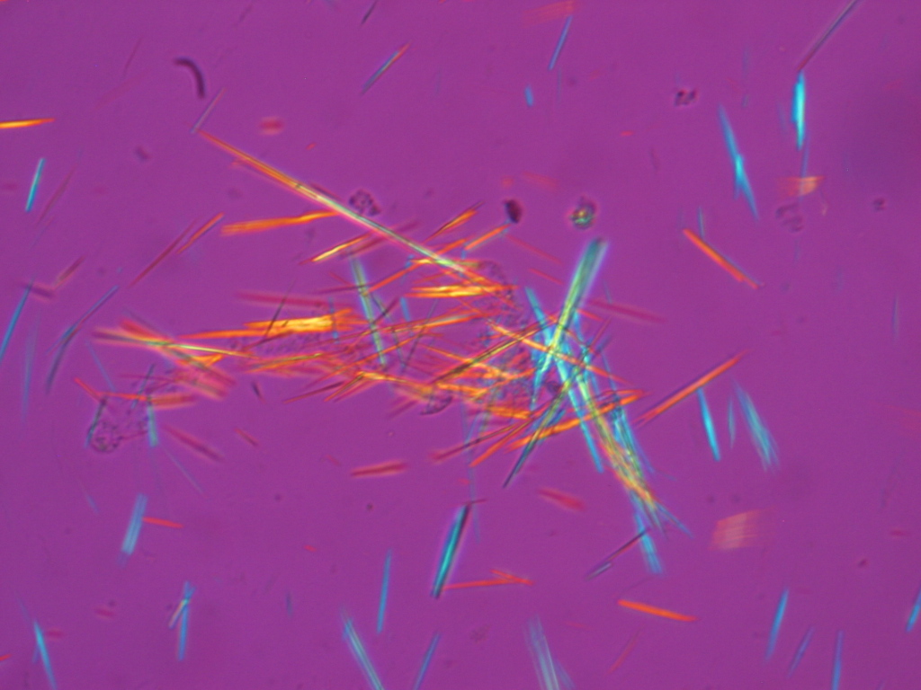
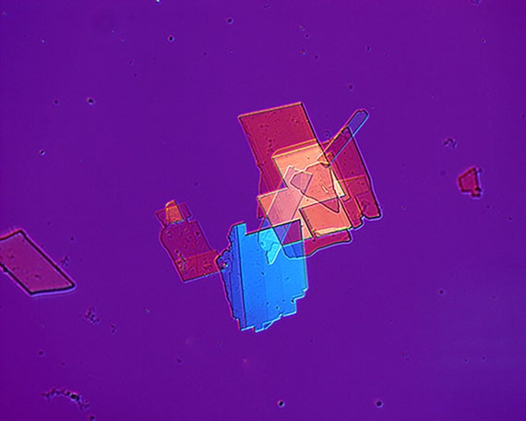
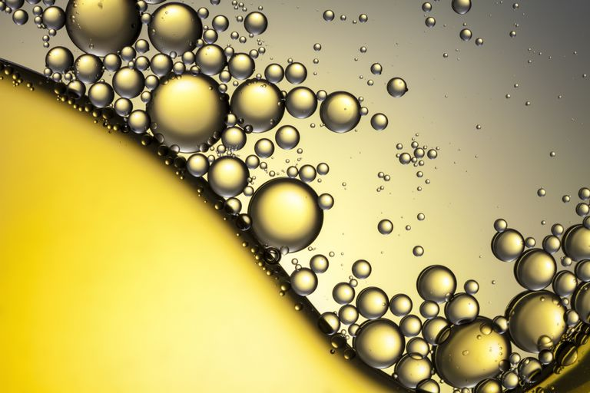
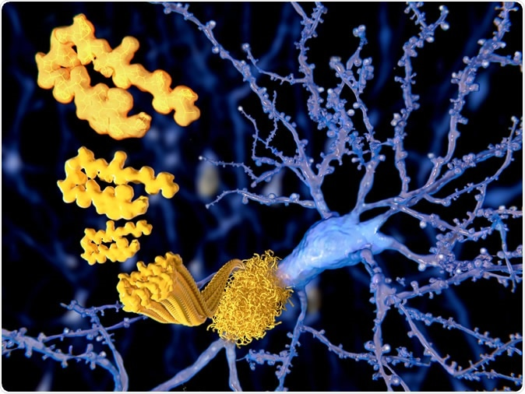
The inflammasome also has been implicated in inflammatory reactions to
Urate crystals (the cause of gout),
Cholesterol crystals (in atherosclerosis),
Lipids (in metabolic syndrome and obesity-associated diabetes),
Amyloid deposits in the brain (in Alzheimer disease).

Slide 20
3. Circulating proteins.
Several plasma proteins recognize microbes and function to destroy blood-borne microbes and to stimulate inflammation at tissue sites of infection.
The complement system reacts against microbes and produces mediators of inflammation
Mannose-binding lectin recognizes microbial sugars and promotes ingestion of microbes and activation of the complement system.
Collectins bind to microbes and promote their phagocytosis.

Slide 21
Acute inflammation
Acute inflammation has three major components:
(1) Dilation of small vessels, leading to an increase in blood flow
(2) Increased permeability of the microvasculature, enabling plasma proteins and leukocytes to leave the circulation,
(3) Emigration of the leukocytes from the microcirculation, their accumulation in the focus of injury, and their activation to eliminate the offending agent

Slide 23
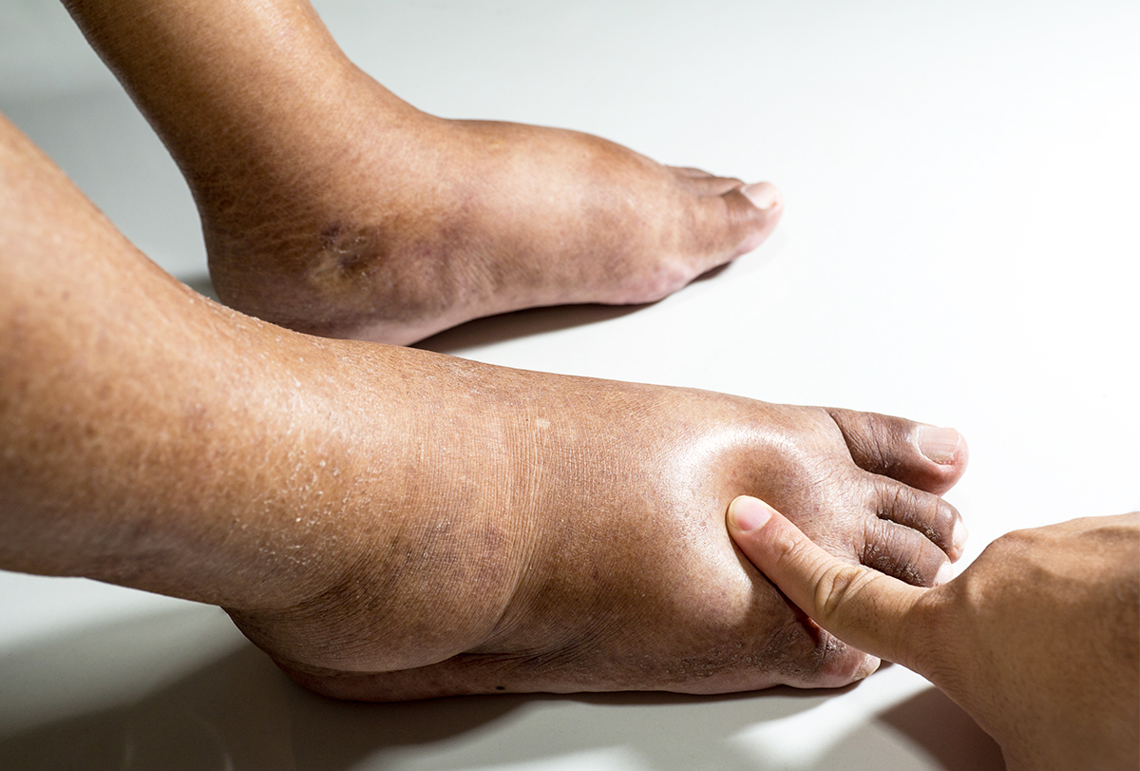
Reactions of Blood Vessels in Acute Inflammation
The vascular reactions of acute inflammation consist of changes in the flow of blood and the permeability of vessels, both designed to maximize the movement of plasma proteins and leukocytes out of the circulation and into the site of infection or injury
Clinically:…. Edema
Edema denotes an excess of fluid in the interstitial tissue or serous cavities; it can be either an exudate or a transudate.
Pus: a purulent exudate, is an inflammatory exudate rich in leukocytes (mostly neutrophils), the debris of dead cells and, in many cases, microbes.

Slide 24
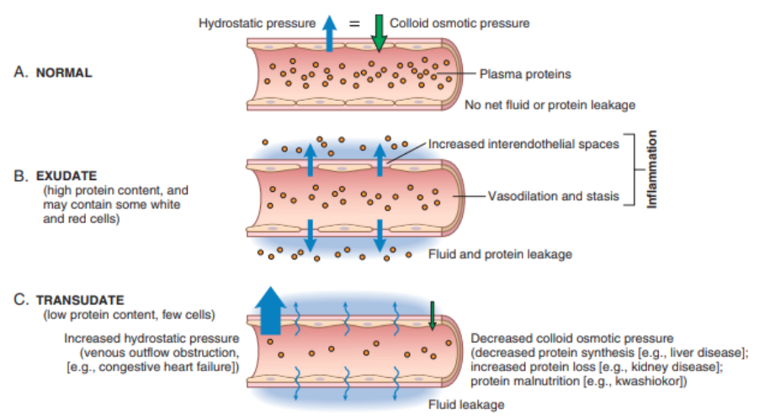
increase in
the permeability
normal vascular
permeability

Slide 25
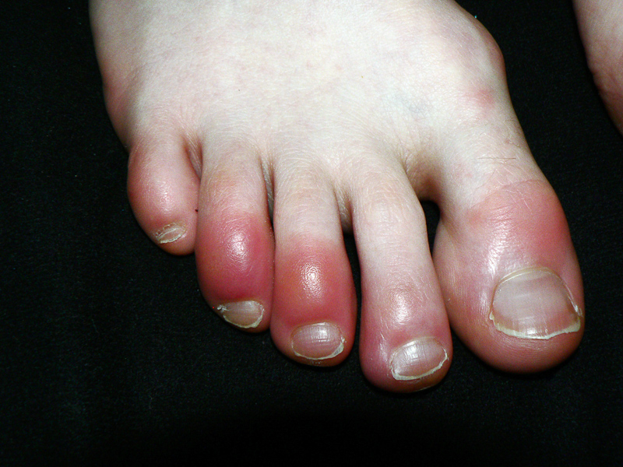
Changes in Vascular Flow and Caliber
Changes in vascular flow and caliber begin early after injury and consist of the following:
1. Vasodilation:
Induced by histamine, acting on vascular smooth muscle
First involves the arterioles and then leads to the opening of new capillary beds in the area.
The result is increased blood flow, which is the cause of heat and redness (erythema) at the site of inflammation.

Slide 26
Changes in Vascular Flow and Caliber
2. Increased permeability of the microvasculature, with the outpouring of protein-rich fluid (an exudate) into the extravascular tissues.
3. Vascular congestion:
stasis of blood flow, engorgement of small vessels due to slow blood flow.
4. Blood leukocytes, principally neutrophils, accumulate along the vascular endothelium, endothelial cells are activated and leukocytes then migrate through the vascular wall into the interstitial tissue
Notes:
At the same time endothelial cells are activated by mediators produced at sites of infection and tissue damage, and express increased levels of adhesion molecules. Leukocytes then adhere to the endothelium, and soon afterward they migrate through the vascular wall into the interstitial tissue

Slide 27
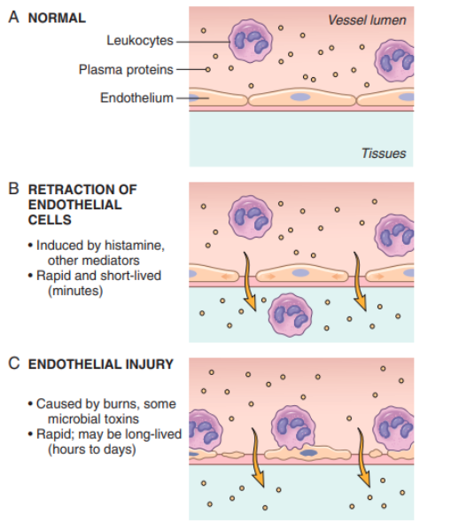
How dose the vascular permeability increased?
1. Retraction of endothelial cells
(immediate transient response):
It is elicited by histamine, bradykinin, leukotrienes.
2. Endothelial injury
3. Transcytosis
Increased transport of fluids and proteins

Slide 28
Responses of Lymphatic Vessels and Lymph Nodes
In inflammation, lymph flow is increased to help drain edema fluid that accumulates because of increased vascular permeability. In addition to fluid, leukocytes and cell debris, as well as microbes, may find their way into lymph.
The lymphatics may become secondarily inflamed (lymphangitis), as may the draining lymph nodes (lymphadenitis).

Slide 29
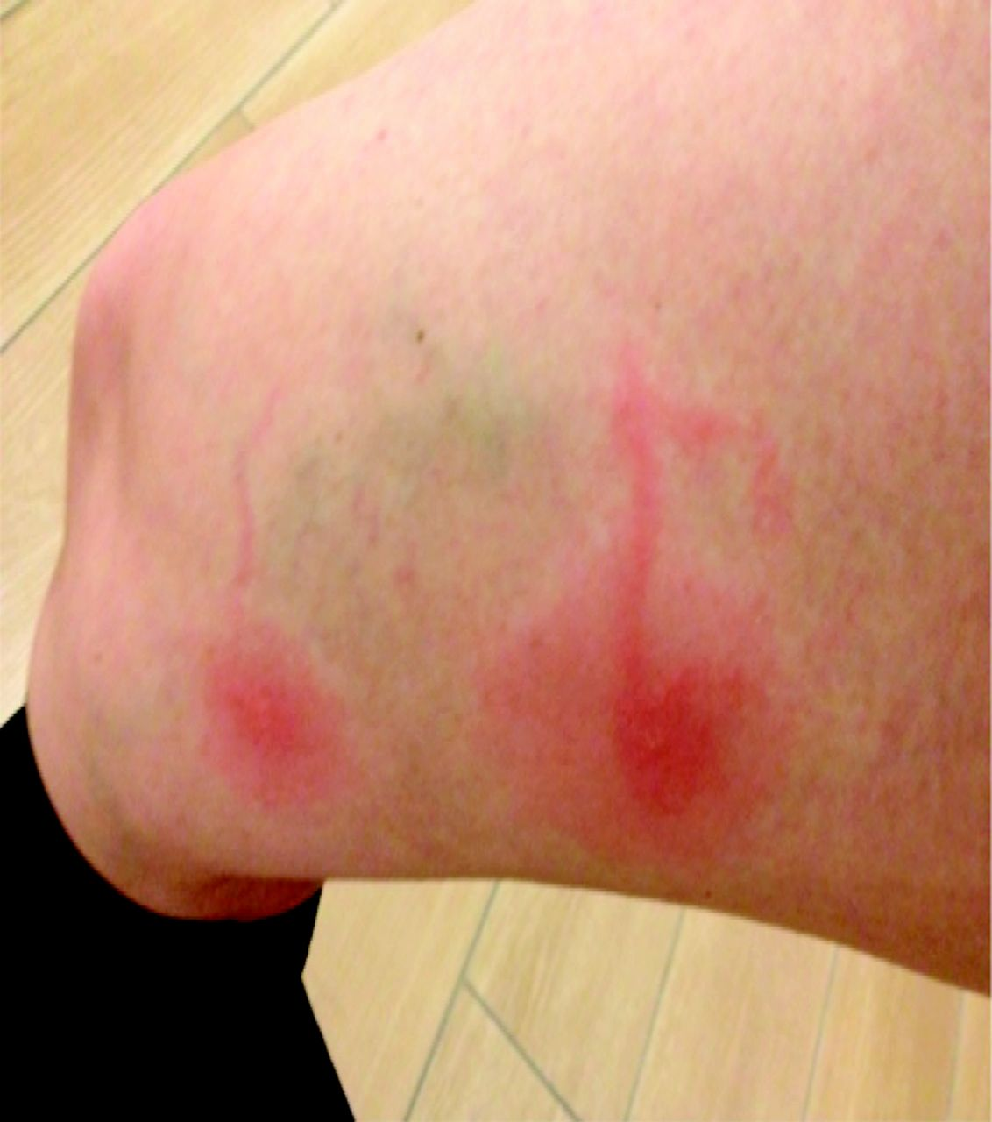
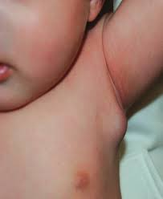
This streaking follows the course of the lymphatic
channels and indicates the presence of lymphangitis
painful enlargement of the draining
lymph nodes, indicating lymphadenitis.

Slide 30
Leukocyte Recruitment to Sites of Inflammation

Slide 31
Leukocyte Recruitment to Sites of Inflammation
Leukocytes that are recruited to sites of inflammation perform the key function of eliminating the offending agents.
The most important leukocytes in typical inflammatory reactions are the ones capable of phagocytosis, namely, neutrophils and macrophages
These leukocytes ingest and destroy bacteria and other microbes, however, they may induce tissue damage and prolong inflammation.

Slide 32
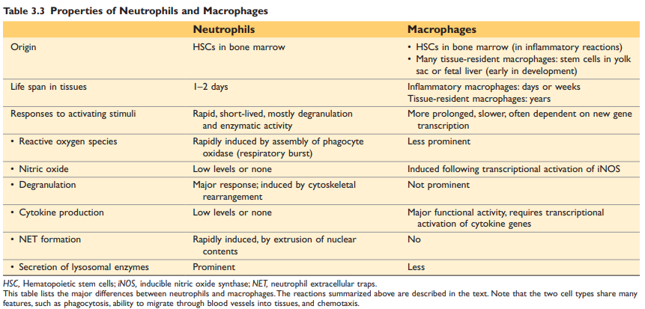

Slide 33
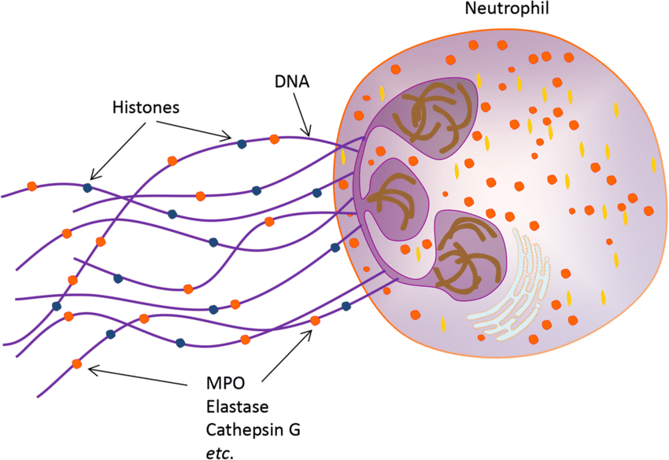
The sticky web-like structure of NET is mainly composed of extracellular DNA. These web-like structures are decorated with histones and neutrophil granule proteins such as myeloperoxidase (MPO), elastase, and cathepsin G.

Slide 34
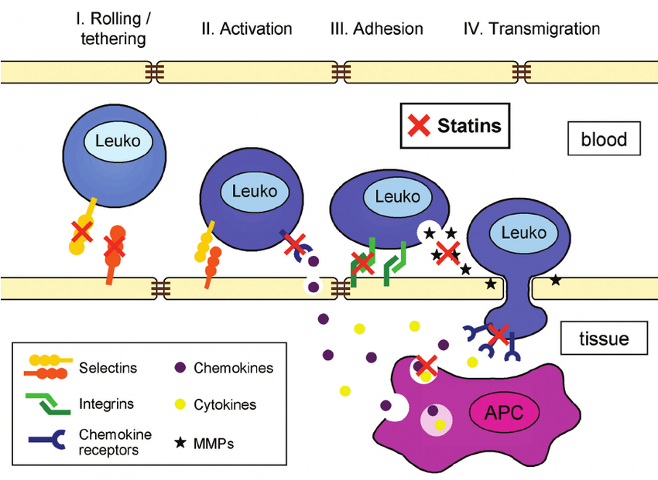
The journey of leukocytes from the vessel lumen to the tissue is a multistep process that is mediated and controlled by adhesion molecules and cytokines, and consist of three phases:
1. Leukocyte Adhesion to Endothelium.
2. Leukocyte Migration Through Endothelium.
3. movement of the cells toward the offending agent

Slide 35
THANK YOU.

