Slide 1
Membrane transport
Abdallah Wasel Hattab
lecture 2&3

Slide 2
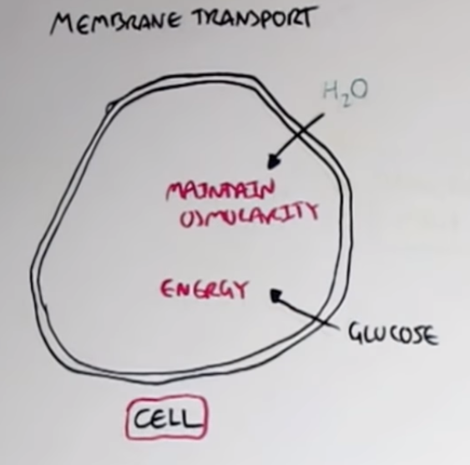
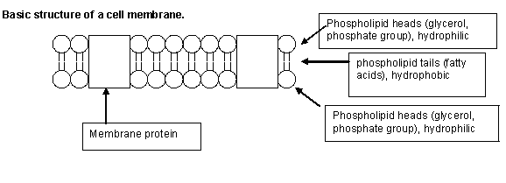
One of the most important functions of membranes is to control what passes into and out of the cell. In this lecture we will discuss the mechanisms of membrane transport.
There are several different types of membrane transport, depending on the characteristics of the substance being transported, the environmental conditions and many others factor..
"Like dissolves like“ Basic example: Water is polar. Oil is non polar. Water will not dissolve oil.

Slide 3
membrane consists almost entirely of a lipid bilayer, but it also contains large numbers of protein molecules in the lipid, many of which penetrate all the way through the membrane.
The lipid bilayer is not miscible with either the extracellular fluid or the intracellular fluid. Therefore, it constitutes a barrier against movement of water molecules and water-soluble substances between the extracellular and intracellular fluid compartments.
The protein molecules in the membrane have entirely different properties for transporting substances. Their molecular structures interrupt the continuity of the lipid bilayer, constituting an alternative pathway through the cell membrane. Many of these penetrating proteins can function as transport proteins.
Some proteins have watery spaces all the way through the molecule and allow free movement of water, as well as selected ions or molecules; these proteins are called channel proteins.
Other proteins, called carrier proteins, bind with molecules or ions that are to be transported, and conformational changes in the protein molecules then move the substances through the interstices of the protein to the other side of the membrane.
Channel proteins and carrier proteins are usually selective for the types of molecules or ions that are allowed to cross the membrane.

Slide 4
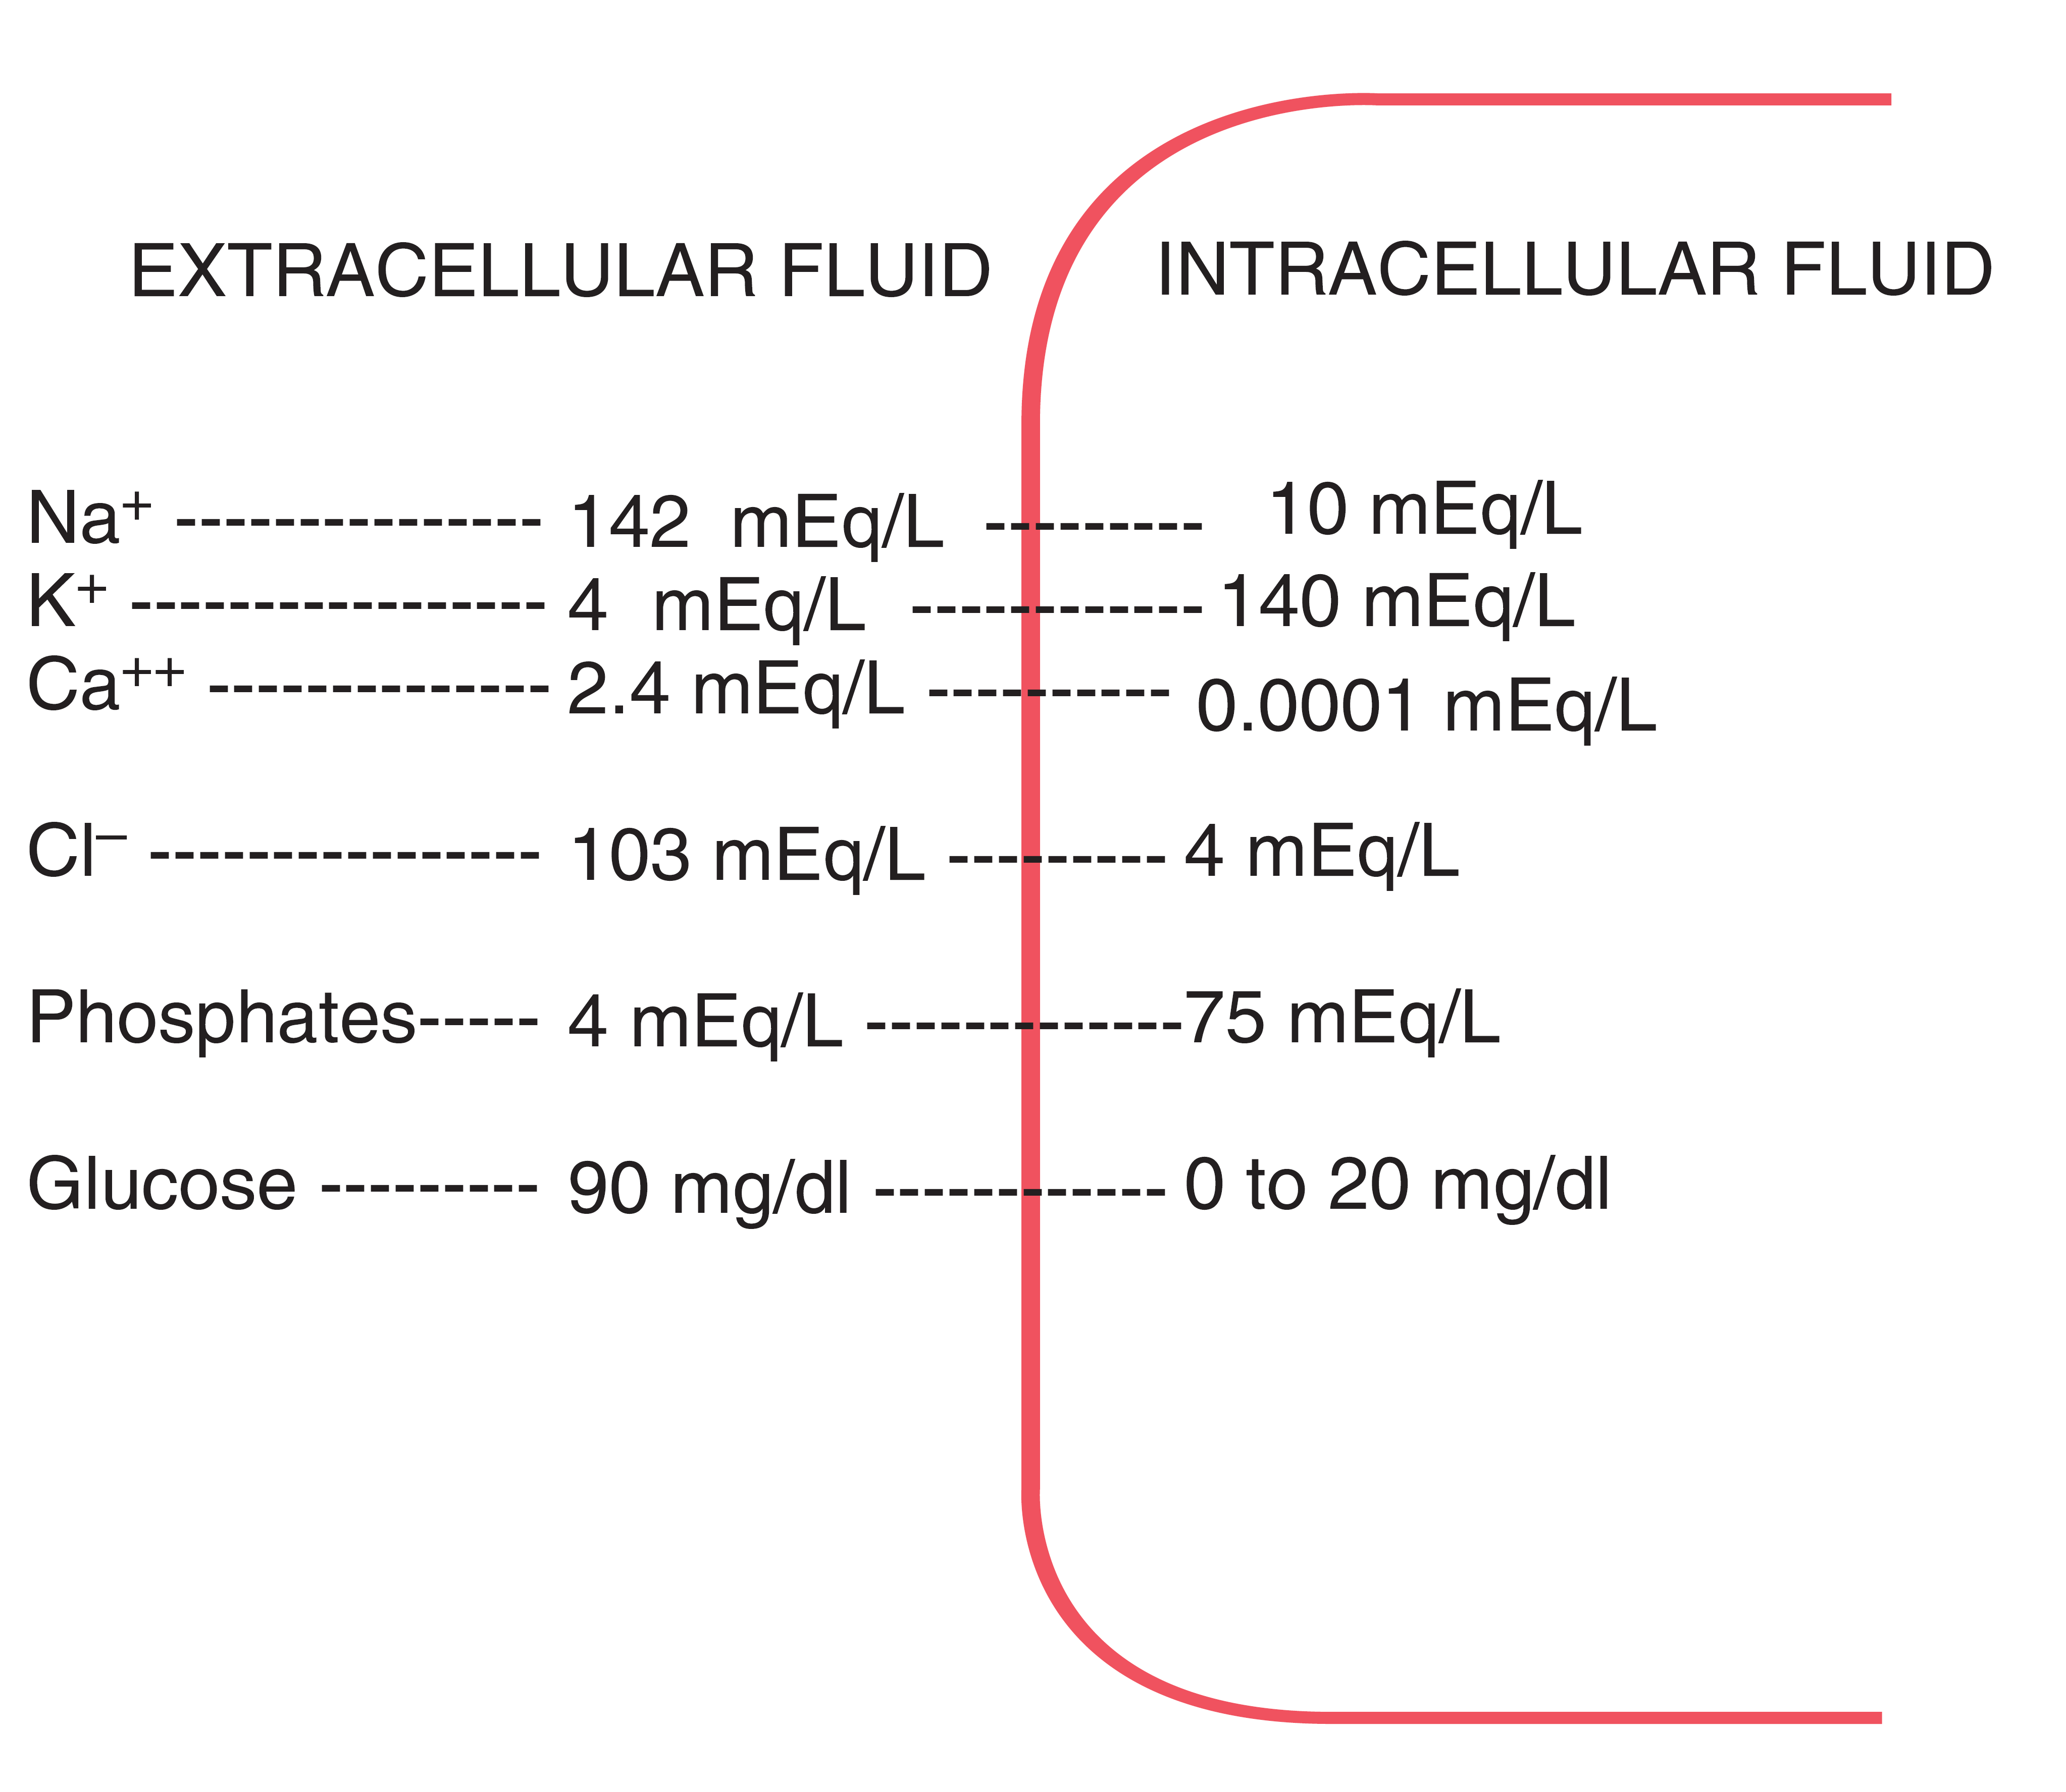
The extracellular fluid contains a large amount of sodium but only a small amount of potassium. The opposite is true of the intracellular fluid. Also, the extracellular fluid contains a large amount of chloride ions, whereas the intracellular fluid contains very little of these ions. However, the concentrations of phosphates and proteins in the intracellular fluid are considerably greater than those in the extracellular fluid. These differences are extremely important to the life of the cell. The purpose of this chapter is to explain how the differences are brought about by the transport mechanisms of the cell membranes.

Slide 5
Substances may be transported down an electro-chemical gradient (downhill) or against an electro-chemical gradient (uphill):
Downhill transport occurs by diffusion(passive transport) , either simple or facilitated, and requires no input of metabolic energy.
Uphill transport occurs by active transport, which may be primary or secondary.
Primary and secondary active transport processes are distinguished by their energy source. Primary active transport requires a direct input of metabolic energy; secondary active transport utilizes an indirect input of metabolic energy.
Further distinctions among transport mechanisms are based on whether the process involves a protein carrier:
Simple diffusion is the only form of transport that is not carrier mediated.
Facilitated diffusion, primary active transport, and secondary active transport all involve integral membrane proteins and are called carrier-mediated transport.
All forms of carrier-mediated transport share the following three features: saturation, stereospecificity, and competition.

Slide 6
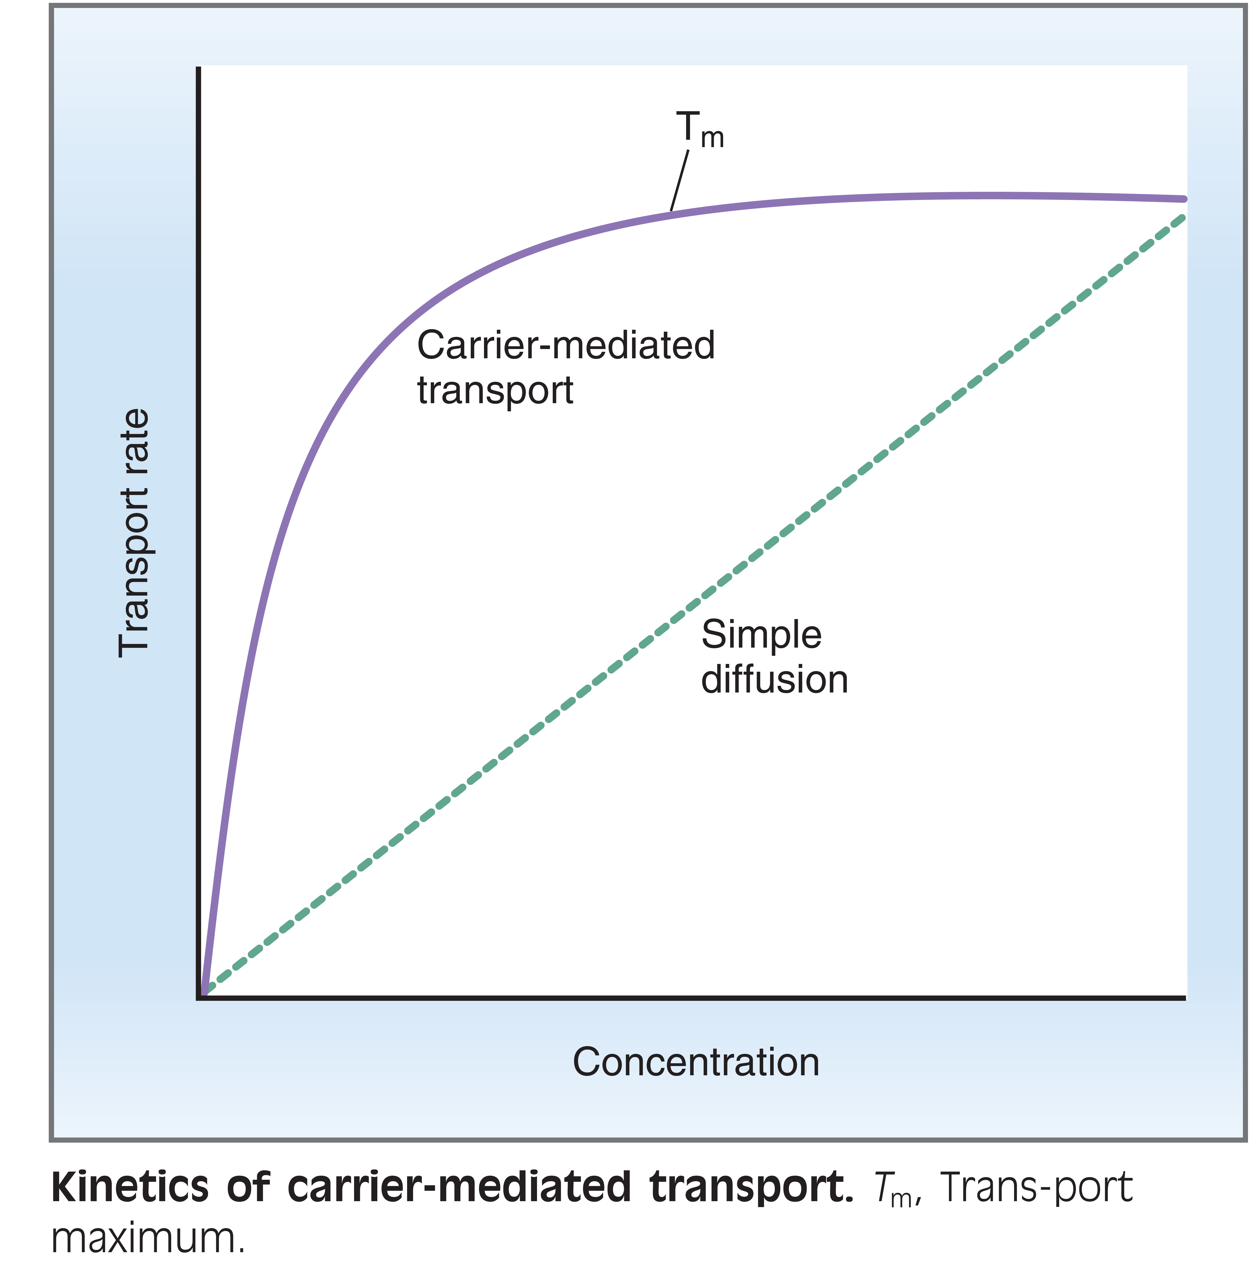
1) Saturation
Saturability is based on the concept that carrier proteins have a limited number of binding sites for the solute. Figure shows the relationship between the rate of carrier-mediated transport and solute concentration.
At low solute concentrations, many binding sites are available and the rate of transport increases steeply as the concentration increases. However, at high solute concentrations, the available binding sites become scarce and the rate of transport levels off. Finally, when all of the binding sites are occupied, saturation is achieved at a point called the transport maximum, or Tm. The kinetics of carrier-mediated transport are similar to Michaelis-Menten enzyme kinetics—both involve proteins with a limited number of binding sites. (The Tm is analogous to the Vmax of enzyme kinetics.) Tm-limited glucose transport in the proximal tubule of the kidney is an example of saturable transport.

Slide 7
2) Stereospecificity.
The binding sites for solute on the transport proteins are stereospecific. For example, the transporter for glucose in the renal proximal tubule recognizes and transports the natural isomer D-glucose, but it does not recognize or transport the unnatural isomer L-glucose. In contrast, simple diffusion does not distinguish between the two glucose isomers because no protein carrier is involved.
3) Competition.
Although the binding sites for transported solutes are quite specific, they may recognize, bind, and even transport chemically related solutes. For example, the transporter for glucose is specific for D-glucose, but it also recognizes and transports a closely related sugar, D-galactose. Therefore the presence of D-galactose inhibits the transport of D-glucose by occupying some of the binding sites and making them unavailable for glucose.

Slide 8
Membrane Transport
Passive transport
Special type of passive transport
Facilitated diffusion
Active transport
Primary
transport
Secondary
transport
Co-transport (symport)
Exocytosis
Endocytosis
Simple diffusion
Osmosis
Filtration (Bulk flow)
Solvent drag
Counter transport (Antiport)
Phagocytosis
pinocytosis

Slide 11
Membrane Transport
Passive transport
Special type of passive transport
Facilitated diffusion
Active transport
Primary
transport
Secondary
transport
Co-transport (symport)
Exocytosis
Endocytosis
Simple diffusion
Osmosis
Filtration (Bulk flow)
Solvent drag
Counter transport (Antiport)
Phagocytosis
pinocytosis

Slide 12
Membrane transport
A. Passive transport (Diffusion)
_ Definition:
It is transport of a substance across a semipermeable membrane down its electrochemical gradient.
_ Another definition: It is the process by which a gas or a substance in a solution expands because of the continuous random motion of its particles to fill all of the available volume.

Slide 13
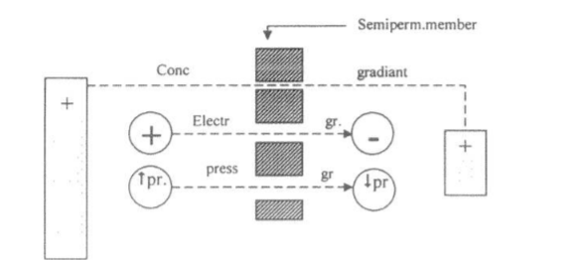
•Criteria of passive transport:
1. Occurs down concentration (chemical), electrical or pressure gradient
2. Does not need energy.

Slide 14
Factors affecting rate of diffusion
A- Directly proportional with:
1.The gradient for diffusion whether chemical, electrical or pressure.
2.Temperature increases the random motion of the molecules.
3. Surface area of the membrane available for diffusion.
4. Permeability of the membrane.
The concentration gradient across the membrane is the driving force for net diffusion. The larger the difference in solute concentration, the greater the driving force and the greater the net diffusion.
It also follows that, if the concentrations in the two solutions are equal, there is no driving force and no net diffusion.
The greater the surface area of membrane available, the higher the rate of diffusion. For example, lipid-soluble gases such as oxygen and carbon dioxide have particularly high rates of diffusion across cell membranes. These high rates can be attributed to the large surface area for diffusion provided by the lipid component of the membrane.

Slide 15
Factors affecting rate of diffusion
B- Inversely proportional with:
1- Molecular weight (molecular size) of the substance
diffusion rate is inversely proportional with the square root of the molecular size.
2- Thickness of the membrane
(the distance across which diffusion takes place).

Slide 17
The factors that effect on substance transport by simple diffusion
1_Related with membrane
surface area of the membrane:
proportional relationship
thickness of membrane:
Inversely relationship
permeability of membrane:
proportional relationship
How the material pass across the cell membrane?!
From the cell membrane semipermeable membrane.

Slide 18
The factors that effect on substance transport by simple diffusion
2_Related with substance
Lipid solubility
Directly proportional
Ex: CO2/O2/Anesthetic gas.
Water solubility
needs ion channel (integral protein)
molecular weight
Inversely relationship
concentration of gradient:
Directly proportional
the temperature
proportional relationship

Slide 19
Membrane Transport
Passive transport
Special type of passive transport
Facilitated diffusion
Active transport
Primary
transport
Secondary
transport
Co-transport (symport)
Exocytosis
Endocytosis
Simple diffusion
Osmosis
Filtration (Bulk flow)
Solvent drag
Counter transport (Antiport)
Phagocytosis
pinocytosis

Slide 20
Types of diffusion
1- SIMPLE DIFFUSION
Definition:
Diffusion without a need for carrier.
-It is concerned with:-
a- Lipid-soluble substances
b- small water-soluble substances. e.g., ions

Slide 21
It occurs through:
A) Lipid bilayer
This is for lipid soluble substances
e.g., 02, CO2, fatty acids, glycerol and urea.
The diffusion of these substances is directly proportional to their lipid solubility.
02 is highly lipid soluble so that it enters the cell in large quantities as if the cell membrane did not exist.
B) Protein channels (permeation)
This is for small water soluble substance
e.g., ions (Na+ , K+, CI- .etc).

Slide 22
Types of channels in the cell membrane:-
1.Leak channels:
has no gate (continuously opened), e.g., Na+ - K+ leak channels.
2. Gated channels:
have gates (open and close), and are of 2 types:
Voltage-gated channels: their gates open as a result of change in the electric potential across the cell membrane
e.g., voltage gated Na4 channel, K4 channel and Cat' channel.
Ligand-gated channels: their gates open as a result of binding (ligation) of a chemical substance with receptor on the channel protein.
e.g., acetylcholine—gated ion channel at motor end plate (neuromuscular junction)

Slide 24
Types of channel:
1) Leak channel:
continuous movement of ions until equilibrium.
Ion concentration in the out side= Ion concentration in the inside
2) Gated channel:
It open according to cell need for open and exit ions.
With electro-chemical gradient
a)Voltage:
When the electricity change the gates open.
b)Ligand:
Chemical.
Most common example:
Acetylcholine.

Slide 25
Neuromuscular junction
“where muscle and nerve connect”
Nerve Secrete Acetylcholine (chemical) bind with receptor.
Muscle contract
Action potential + propagation
Open Na gated channel.

Slide 28
Membrane Transport
Passive transport
Special type of passive transport
Facilitated diffusion
Active transport
Primary
transport
Secondary
transport
Co-transport (symport)
Exocytosis
Endocytosis
Simple diffusion
Osmosis
Filtration (Bulk flow)
Solvent drag
Counter transport (Antiport)
Phagocytosis
pinocytosis

Slide 29
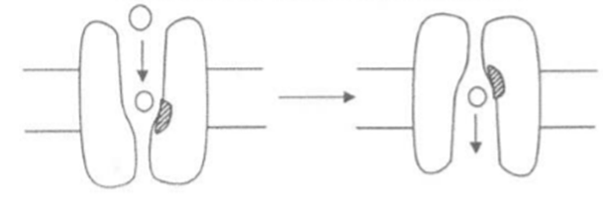
2-FACILITATED(CARRIER MEDIATED) DIFFUSION
Definition:
diffusion that needs carrier protein.
• It is concerned with lipid-insoluble large molecules. e.g.. glucose and most amino acids.

Slide 30
Mechanism
The carrier protein has a channel large enough to transport the specific molecule
e.g., glucose part way but not all the way through the membrane
Binding of the specific molecule (e.g., glucose) with a receptor on the carrier protein (a type of integral proteins)---a widening of the inner part of the channel of the carrier protein facilitation of transport of the molecule across the membrane.

Slide 31
Differences between simple and facilitated diffusion
Simple diffusion | Facilitated diffusion
For lipid -soluble and small lipid insoluble. | For lipid insoluble large molecule.
Does not need carrier | Needs carrier.
No structural specificity because there is no carrier | High structural specificity:- each carrier is specific for one or very few substances
No competitive inhibition because there is no carrier | Competitive inhibition similar molecules compete with each other for the same carrier and the transport of each other.
No saturation, i.e., it increase with increasing the concentration gradient without limit (no carrier) | Saturation: has a maximum limit (v max ) i.e. it increase with increasing the concentration gradient till all the carriers available for this substance become saturated, then it does not increase after that.
Less sensitive to ttemperature changes (no carrier) | More sensitive to temperature changes (3 times that of simple diffusion) because binding of the substance with the carrier is through an enzyme

Slide 32
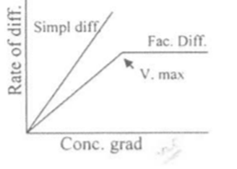
Facilitated diffusion needs protein carrier.
The cell produce specific number of carriers
With time the Carriers saturated.
Max transport : no more increase in rate of diffusion

Slide 33
Membrane Transport
Passive transport
Special type of passive transport
Facilitated diffusion
Active transport
Primary
transport
Secondary
transport
Co-transport (symport)
Exocytosis
Endocytosis
Simple diffusion
Osmosis
Filtration (Bulk flow)
Solvent drag
Counter transport (Antiport)
Phagocytosis
pinocytosis

Slide 34
Special types of Passive Transport:
A) Osmosis
It is the diffusion of water (the solvent) from area of less concentrated solution (more solvent) to the area of more concentrated solution (less solvent).
Osmotic pressure is the pressure needed to stop osmosis. Osmotic pressure depends on number rather than the size of particles in a solution

Slide 35
Diffusion of water (osmosis) takes place through both lipid bilayer and protein channels.
This is because water molecules have very small size and high kinetic energy; so that the molecules penetrate the lipid bilayer like bullets before hydrophobic characters of lipid layer stop them

Slide 36
Special types of Passive Transport
B) Filtration (Bulk flow):
Means diffusion of fluid through a membrane that is caused by difference in hydrostatic pressure. Examples:
a. Filtration at arterial end of systemic capillaries to form interstitial fluid.
b. Filtration through glomerular capillaries in the kidney to form glomerular filtrate.

Slide 37
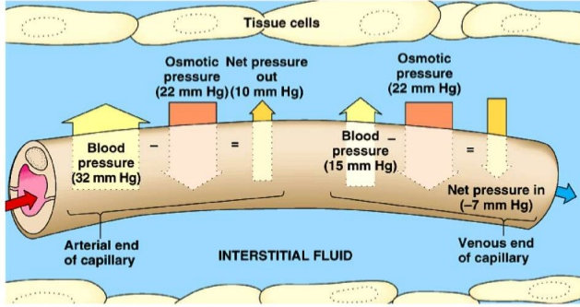

Slide 38
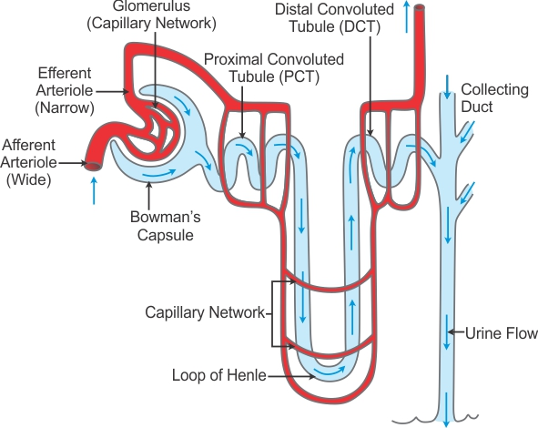

Slide 39
Blood
Capillary
“to filtrate”
Filtrate= urine
inter in Afferent arteriole filtered blood
by Efferent arteriole
_The essential materials reabsorbed, and other secreted
The filtered body passes in tube
The body return material which it need
Collecting duct
Distal convoluted duct
Loop of Henle
Proximal convoluted duct
Bowman capsule is found in the renal cortex of kidney.
Nephrons: the blood filter units “place”

Slide 40
Special types of Passive Transport
C) Solvent drag
Means diffusion of a solute following diffusion of its solvent through the membrane
i.e., the solvent drags the solute after it.
Example:
Reabsorption of urea after H2O reabsorption in renal tubules.

