Slide 1
Overview
Dr. Israa Al-Rawashdeh MD, MPH, PhD
Faculty of Medicine
Mutah University
2021

Slide 2
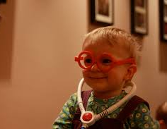
Course title: Health Administration
Course code: 1506304
Credit hours: 1 hour

Slide 3
Outline:
Definitions
Brief history of HA
Levels of HA

Slide 4
Introduction
Healthcare is one of the determinants of health.
Healthcare organizations are complex and dynamic.
The nature of these organizations requires administration and management.

Slide 5
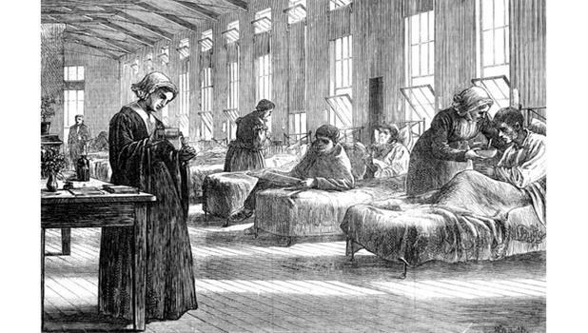
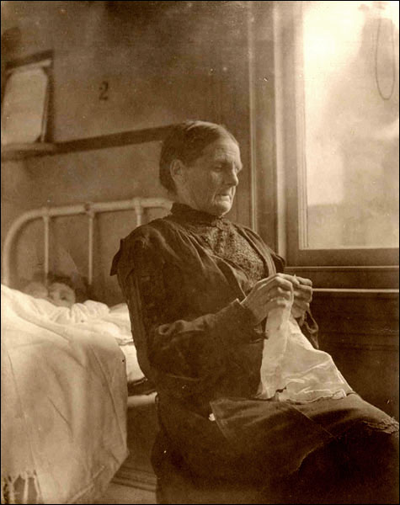
Brief history of HA
Healthcare administration has developed right alongside advances in medical science and the growth of hospitals.
Prior to the 20th century, hospitals were not as organized and efficient as they are today.
Health care administration got its start in the 1920s with the foundation of the American Conference on Hospital Service.
This marked the first step in organized health care.

Slide 6
Today’s Health and Medical Administration Field
Over the last century, healthcare administration has witnessed dramatic changes:
Hospitals have become large, complex organizations
Technology has advanced exponentially
Government has taken on a larger role in healthcare delivery
Healthcare financing has become more complex (private and public systems)

Slide 7
Health system: all activities whose main responsibility is to promote, restore and maintain health.
Health Care Delivery System: A mechanism for providing services that meet the health-related needs of individuals.

Slide 8
Definition of Administration
“ The process of achieving defined goals at a defined time through the guidance, leadership, and control of the efforts of a group of individuals and the efficient utilization of non-human resources bearing in mind adequacy, speed, and economy to the utmost possible level.”

Slide 9
Health Administration
Public health administration is the component of public health that concentrates on management of people and programs.
HA is essential for the success of any public health program whether on the national, intermediate or the local level.
HA involves making both daily and long-term decisions that reflect the healthcare system’s business strategies

Slide 10
HA is a “hidden” career.
Health care administrators are considered health care professionals.
The role of a Public Health Administrator is to oversee non-clinical operations of public and private healthcare organizations and departments.

Slide 11
HA is a dynamic field that combines health policy, business, and science to manage financial and human resources.
HA ultimate goals are:
To improve the business of healthcare; that should always start with sound policy and top-quality patient care.
To ensure the coordinated delivery of healthcare and the efficient management of medical facilities.

Slide 12
Management and Administration
The term “Management” and “Administration” are used interchangeably. However, they don’t mean the same!
Administration- is essentially overall determination of policies and major objectives.
Management- is essentially an executive function, the active direction of human effort

Slide 13
Management
Management is the operational part of administration.
It is defined as:
“ The processes, comprised of social and technical functions and activities occurring within an organization for the purpose of accomplishing predetermined objectives through utilization of human and other resources.”
It is a “conversion mechanism”.

Slide 14
A system’s view of management:
Process
Inputs
Outputs
Conversion
mechanism
Human resources
Non-human resources
Goals and Objectives
achievement

Slide 15
Every program must have an overall (general) goal which confirms with that of the organisation’s policy, and various objectives to be achieved according to a definite plan.

Slide 16
Goals versus Objectives
A GOAL: is a long range specified state of accomplishment towards the activity it is directed. Goals are not constrained by time or existing resources.
AN OBJECTIVE: is a measurable state of accomplishment aimed towards the goal. The objective should include a description of “what” outcome is desired, “when” it is expected, and “where” it will take place. (SMART)

Slide 17
 | Management | Administration
Nature | Executive or doing function | Determinative or thinking function
Scope | Concerned with implementation of policies | Concerned with determination of major objectives and policies
Level | Middle and lower level function | Top level function
Influence | Mainly by objectives and policies of organization | Mainly by public opinion and external forces
Main function | Directing and organizing | Planning and control
Skills required | Technical and human skills | Conceptual and human skills

Slide 18
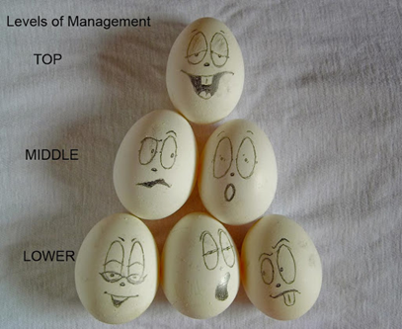
Levels of management
1. Top Level Management
The Top level management is also referred to as the administrative level. They coordinate services and are keen on planning. Examples: the Board of Directors, the Chief Executive Officer (CEO), the Chief Financial Officer (CFO) and the Chief Operating Officer (COO) or the President and the Vice President, etc..
Top level management functions:
To lay down the policies and objective of the organization
Plan and assign competent managers to the departments or middle level to carry them out.
Keeping the communication between the organization and the outside world.

Slide 19
Levels of management
2. Middle Level of Management
The Middle level Management is also referred to as the executory level, they are made up of the departmental managers and branch manager. They could be divided into senior and junior middle-level management if the organization is big.
Functions:
To carry out the plans of the organization according to policies and directives laid down by the top level management.
The communicators between the top level and the lower level as they transfer information, reports, and other data of the organization to the top-level.
To organize the division or departmental activities.
To be an inspiration or create motivation for junior managers to improve their efficiency (are in charge of the employment and training of the lower levels).

Slide 20
Levels of management
3. Lower Level of Management
The lower level Management is also referred to as the supervisory or the operative level of managers.
They direct the operative employees.
They spend most of their time addressing the functions of the firm, as instructed by the managers above them.

Slide 21
Levels of management
The lower level managers are the first line of managers as they feature at the base of operations, so they are essential personnel that communicates the fundamental problems to the higher levels. Examples: the line boss, the shift boss, the section chief, the head nurse.
Functions of the lower-level management:
To allocate tasks and responsibilities to the operative employees.
To ensure quality and be responsible for the production quantity.
To communicate the goals and objective of the firm laid down by the higher level managers to the employees as well as suggestions, recommendations, appeals and information concerning employee problems to the higher level managers.
To give instructions and guided directions to workers on their day to day jobs.
To give periodic reports of the workers to the higher level managers.

Slide 22
Levels of Administration
There are 3 levels of administration.
Central
level
Ministry of health
Intermediate
level
directorates of health
e.g. health office,
Hospital, health
care unit
Local Level

Slide 23
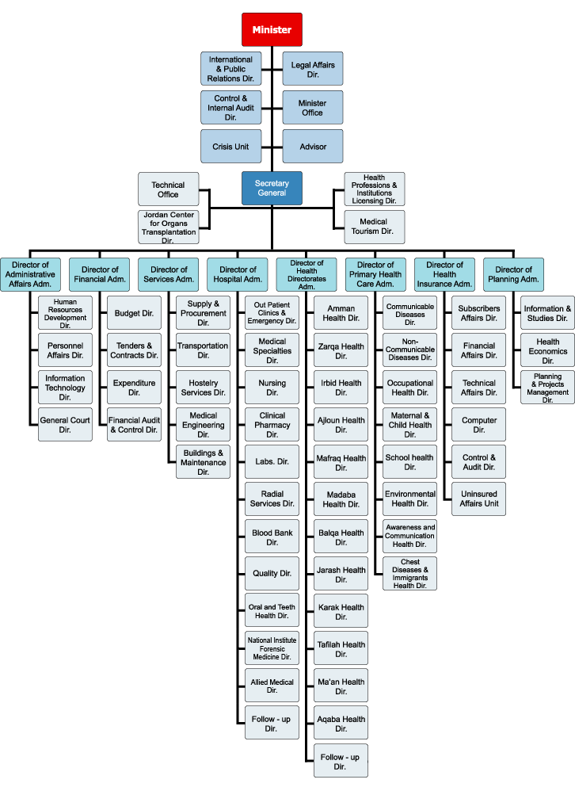
In Jordan:

Slide 24
Leadership
The ability to influence a individuals/group towards the achievement of common goals.

Slide 25
Styles
Autocratic
Democratic (Participative)
Laissez faire (Permissive)
Bureaucratic

Slide 26
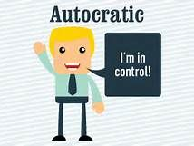
Autocratic
Autocratic leaders, provide clear expectations for what needs to be done, when it should be done, and how it should be done.
There is also a clear division between the leader and the followers. Autocratic leaders make decisions independently with little or no input from the rest of the group.
Autocratic leadership is best applied to situations where there is little time for group decision making or where the leader is the most knowledgeable member of the group.

Slide 27
Democratic
Democratic leaders offer guidance to group members, but they also participate in the group and allow input from other group members.
leaders encourage group members to participate, but retain the final say over the decision making process. Group members feel engaged in the process and are more motivated and creative.

Slide 28
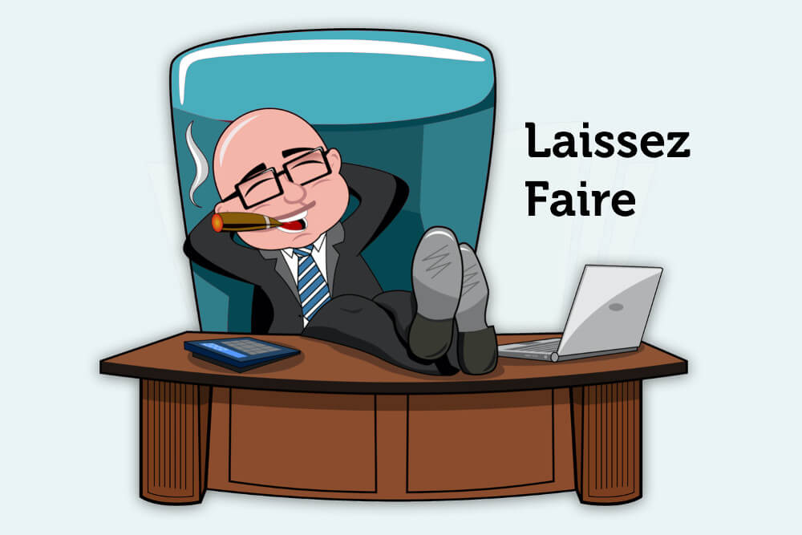
Laissez faire (Permissive)
The laissez-faire leadership style is also known as the "hands-off ¨style.
It is one in which the manager provides little or no direction and gives employees as much freedom as possible.
All authority or power is given to the employees and they must determine goals, make decisions, and resolve problems on their own.
This style can be effective in the situations where group members are highly qualified in specific area

Slide 29
Bureaucratic leadership
Bureaucratic leadership is where the manager manages “by the book¨ Everything must be done according to procedure or policy.
the manager refers to the next level above when encounter a problem.
This style can be effective when:
Employees are performing routine tasks over and over.
Employees need to understand certain standards or procedures

Slide 30
Thank You

