Slide 1
Organophosphorus poisoning
Ne’ma Issa
Sara Alkhamiaseh

Slide 2
Introduction
OP are a group of insecticides or ‘nerve agents ‘ which act on Acetyl-cholinesterase .
Once AChE has been inactivated, ACh accumulates throughout the nervous system, resulting in overstimulation of muscarinic and nicotinic receptors.
Have been used as insecticides , petroleum additives.

Slide 5
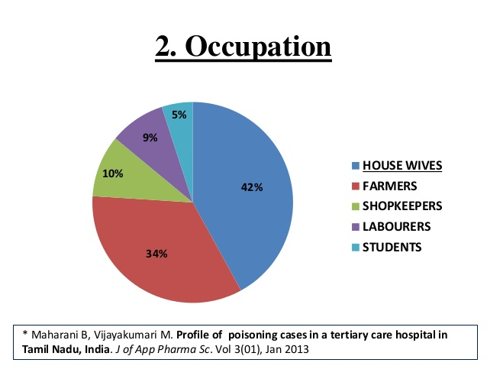

Slide 6
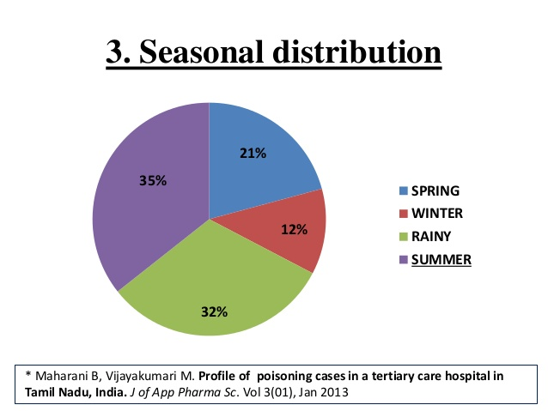

Slide 16
Management of organophosphorus poisoning

Slide 17
Case Scenario:
A 30-year-old man is admitted to hospital in a state of reduced consciousness (Glasgow Coma Scale 9) with froth coming out of his mouth and labored respiration.
According to his family members, he was found collapsed in his room 1 h ago.
He is an otherwise healthy man taking no regular medication.
The accompanying person also brought an unlabeled empty container, found in the same room, which is reported to store pesticides.
The man’s clothing is soaked with vomitus. A strong pungent garlic like odor is apparent and is found to come from the patient’s body; the container also has a similar smell.
Further questioning reveals a family dispute the previous night.
The patient has no past history of psychiatric illness.

Slide 18
Examination
The patient is found to be cyanosed and dyspneic, with small pinpoint pupils. There are muscle fasciculations and reduced tendon jerks. His pulse is 102/min and blood pressure is 80/60 mmHg. He has bilateral crepitations.

Slide 19
Diagnosis of OP poisoning
Diagnosis is mainly clinical, Based on :
1. H/o Ingestion of poison
2. Characteristic clinical features
3. Clinical improvement after atropine or oxime
4. Inhibition of cholinesterase activity

Slide 20
Inhibition of cholinesterase
Demonstrating a decrease in cholinesterase
Definitive or gold standard method
Theoretically RBC/true cholinesterase is more accurate than plasma/pseudo
But, plasma/ pseudo-cholinesterase is more easily available test
Plasma cholinesterase levels usually decline to less than 50% of the normal value(8-18 U/ml) before any symptoms of poisoning are observed.
As a rough guide, plasma cholinesterase levels of 20-50% of the normal value are found with mild poisoning, 10-20% with moderate poisoning, and less than 10% in cases of severe toxicity.

Slide 22
Management:
Step 1: ABC
Patent air way is mandatory with frequent suction of secretions and adequate ventilation and oxygenation .
I.V fluids, by 2 large-bore IV cannula, should be given early and adequately to avoid dehydration due to excessive loss of secretions.
Watch out for convulsions and treat with intravascular (IV) diazepam immediately if they do occur.

Slide 23
Step 2: Decontamination
Dermal Decontamination:
by removal of contaminated clothes by hospital personnel wearing protective gloves and masks.
Then the skin is washed first with soap and water and finally with ethyl alcohol and water to prevent further absorption.
GIT Decontamination:
Syrup of ipecac is used to induce emesis in conscious patients.
Gastric lavage is done in indicated cases after endotracheal intubation to avoid aspiration .
Eye Irrigation:
in case of eye exposure.
using isotonic sodium chloride solution or lactated Ringer's solution.

Slide 24
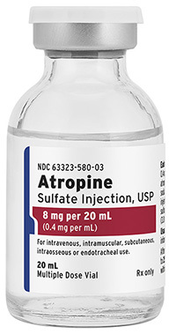
Step 3:
Antagonist therapy.
Atropine:
Atropine should be started immediately at a dose of 1.8–3 mg i.v. bolus and doubled every 5 min, until atropinization (clear lungs, dry tongue/skin, dilated pupils, normal heart rate and blood pressure) has occurred.
Following atropinization, an atropine infusion is given every hour at
20–30% of the dose required for atropinisation (3-5mg/h).

Slide 25
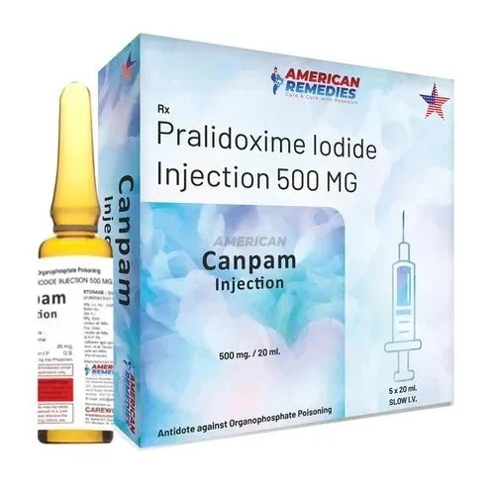
Step 4:
Antidote therapy.
Pralidoxime :
should be given as a 1 g i.v. bolus in 15–30 min, followed by an infusion of 0.5 g/h in adults.

Slide 26
Thank you

