Slide 1
THROMBOEMBOLISM
Sara Bani Hani
Maysa Eyalsalman
Salsabeel Almanaseer
Rana Aqaileh

Slide 2
DEFINITION
Thromboembolism is a condition in which a blood clot forms in a blood vessel and then travels through the bloodstream, the causes of thromboembolism are varied, but they typically involve some combination of blood vessel damage, slowed blood flow, and increased clotting factors in the blood . this can lead to serious and potentially life-threatening consequences if not treated promptly.
Thromboembolism can occur in any part of the body, but the most common sites are in the legs, lungs, heart, and brain.

Slide 4
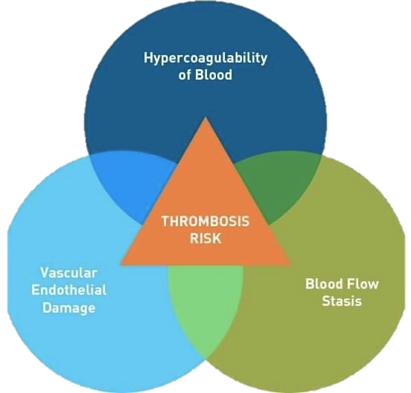
There are several risk factors for thromboembolism, including:
Age: People over the age of 60 are more likely to develop thromboembolism.
Immobility: Prolonged periods of sitting or lying down can increase the risk of blood clots forming.
Obesity: Excess weight can put pressure on blood vessels and slow down blood flow, increasing the risk of clots.
Smoking: Smoking can damage blood vessels and increase the risk of clotting.
Cancer: Certain types of cancer, especially those that affect the blood or lymphatic system, can increase the risk of clotting.

Slide 5
The symptoms of thromboembolism can vary depending on the location and severity of the clot. For example, a clot in the lungs may cause shortness of breath, chest pain, and coughing while a clot in the brain can cause a stroke, which can result in weakness or paralysis on one side of the body, difficulty speaking or understanding language, and loss of vision in one or both eyes. A clot in the legs may cause pain, swelling, and redness ,also palpable cord and Homan’s sign.

Slide 6
Deep Vein Thrombosis
-It’s a clot within deep vein ,mostly legs but it can be in arms, chest, hips, etc.

Slide 7
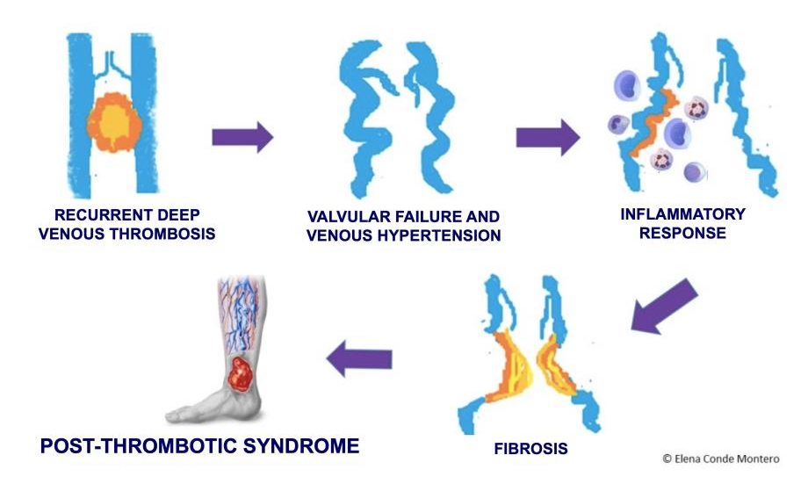
Complications of DVT:
•Pulmonary Embolism: occurs in 10% of patients with confirmed DVT
•Post thrombotic syndrome : chronic complication of DVT ,occurs in approximately half of the patients ,the symptoms range from mild erythema to severe swelling and ulceration
•Phlegmasia cerulea dolens : painful ,blue ,swollen legs that occurs in extreme cases ofDVT that indicate major venous obstruction and petechiae are often present .

Slide 8
Diagnosis:
A- Imaging :
-Doppler analysis and Duplex ultrasound Initial test for DVT; noninvasive, but highly operator dependent
-Venography Most accurate test for diagnosis of DVT Invasive and infrequently used
B-Labs : - D-dimer testing. Has a very high sensitivity (95%), but low specificity (50%); can be used to rule out DVT when combined with Doppler and clinical suspicion
-LFT

Slide 9
Treatment:
DVT treatment mainly to prevent further propagation of thrombus and to prevent occurrence of PE MEDICATIONS: -Injectable LMWH (e.g., enoxaparin, dalteparin) (best choice for DVT/PE associated with malignancy) -DOACs (e.g. apixaban, rivaroxaban, edoxaban, dabigatran) -Warfarin (requires IV heparin bridge as below). -Thrombolytic therapy (streptokinase, urokinase, tissue plasminogen activator [tPA]) Speeds up the resolution of clots. indicated mainly for patients with massive PE who are hemodynamically unstable (hypotension with SBP <90 mm Hg), and with no contraindications for thrombolytics.

Slide 10
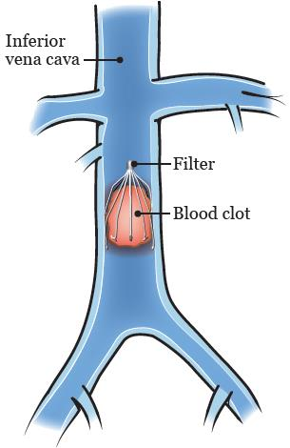
Surgery: Only indicated for large blood clots.
Prophylaxis:
• Inferior vena cava filter placement (Greenfield filter) : -
-Indications for treatment of VTE -If absolute contraindication to anticoagulation (bleeding) .
-If failure of appropriate anticoagulation .
-Low dose aspirin.
-Calf exersice.
-Compression stockings (to prevent stasis)

Slide 11
Pulmonary Embolism ‘PE’
A PE occurs when a thrombus in another region of the body embolizes to the pulmonary vascular tree via the RV and pulmonary artery.
PE is a common complication in hospitalized patients; ICU-related factors (immobility, central venous catheters, drug-induced neuromuscular paralysis) .

Slide 12
1- Lower extremity DVT :
- Most pulmonary emboli arise from thrombosis in the deep veins of lower extremities above the knee (iliofemoral DVT). *Pulmonary emboli can also arise from the deep veins of the pelvis. Pregnancy *Although calf vein thrombi have a low incidence of embolizing to the lungs, in many patients these thrombi progress into the proximal veins, increasing the incidence of PE.
2- Upper extremity DVT : is a rare source of emboli (it may be seen in IV drug abusers)
3- uncommon embolic materials (fat, air, tumor, amniotic fluid or septic emboli )
Sources of PE :

Slide 13
Pathophysiology of PE
Emboli block a portion of pulmonary vasculature
increased pulmonary vascular resistance
increased pulmonary artery pressure
increased right ventricular pressure
Regional decrease in lung perfusion
Dead space (in areas in which there is ventilation , but no perfusion)
Hypoxemia & Hypercarbia
drive respiratory effort, which leads to Tachypnea

Slide 14
Clinical Features of PE:
only one third of PE patients have the signs and symptoms of DVT.
Symptoms:
-SOB
-Pleuritic chest pain
-Cough
-Hemoptysis
-Synocope in large PE.
Signs:
-Tachypnea
-Tachycardia
-Rales(crackles)
-Shock + rapid circulatory collapse ”in massive PE”
-Other signs : low grade fever/ decreased breath sounds/ dullness on
percussion .

Slide 15
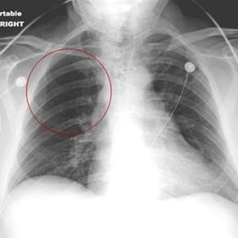
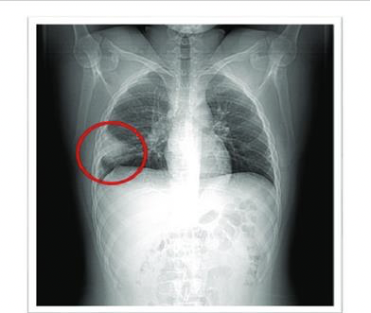
Diagnosis of PE
ABG levels “not diagnostic for PE”
- PaO2 and PaCO2 are low
- pH is high;
There is typically a respiratory alkalosis.
Chest x ray – (usually normal) →(but it is the most useful in excluding alternative diagnoses)
Atelectasis or pleural effusion may be present.
Classic radiographic signs, such as Westermark sign or Hampton hump, are rarely present.
Westermark sign
Hampton’s hump

Slide 16
Venous duplex ultrasound of the lower extremities
D- dimer assay (elevated)
pulmonary angiography “the gold standard”
Spiral CT
V/Q (ventilation–perfusion lung) scan
wells criteria

Slide 18
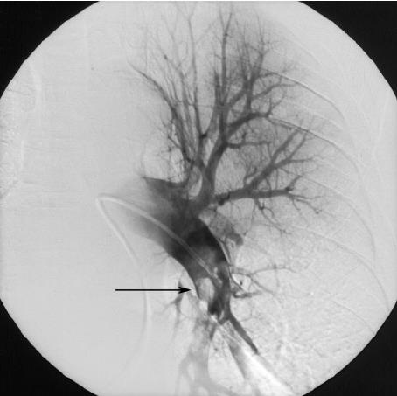
Pulmonary Angiogram
Pulmonary angiogram definitively diagnoses or excludes PE , but is invasive.
*Contrast injected into the pulmonary artery branch after percutaneous catheterization of the femoral vein.
*Rarely performed because it carries a 0.5% mortality

Slide 20
Management of PE :
Supplemental oxygen to correct hypoxemia
Severe hypoxemia or respiratory failure requires intubation and mechanical ventilation.
Oral anticoagulation
with warfarin or one of the novel oral anticoagulants (e.g., rivaroxaban) for long-term treatment.
Thrombolytic therapy (e.g., streptokinase , tPA )
Inferior vena cava interruption (IVC filter placement).
Surgical thrombectomy .

Slide 21
When to stop anticoagulants for a PE patient ?
As long as patients with provoked PE return to their pre-PE baseline, anticoagulation can be stopped after this initial 3-month treatment. Conversely, indefinite anticoagulation is recommended in those patients with unprovoked PE or persistent risk factors
Patients with a first episode of venous thromboembolism have a therapy (about 10% in the first year).
indefinite treatment is recommended in these patients, it is important to reassess the risks and benefits of ongoing anticoagulation at regular intervals.

Slide 23
SYSTEMIC AND ARTERIAL EMBOLISM
80% is an intracardiac mural thrombi
Thrombi occurring in heart chamber or aortic lumen
AFib is the most common cause of embolus from the heart
Left atrium dilatation
Paradoxical emboli
Aortic aneurysm
20% due to atherosclerotic plaque

Slide 24
Major sites of arterial emboli:
Lower extremities (75%)
The common femoral artery is the most common site of occlusion.
Brain (10%)
Kidney, intestine, spleen
Systemic thromboembolism outcome depends on:
Vulnerability of the affected tissue
Calibre of the occluded vessels
Collateral circulation

Slide 25
Complications:
The effect of arterial emboli depend on their size, site of emboli.
Arterial thrombosis can occur in the arteries that supply blood to the heart muscle (coronary arteries). This can lead to a heart attack.
When arterial thrombosis occurs in a blood vessel in the brain, it can lead to a stroke
Infarction.
Gangrene.
Sudden death.

Slide 26
Clinical features:
Pain-acute onset, the patient can tell you precisely when and where it happened.
Pallor
Polikothermia
Paralysis
Paresthesia
Pulselessness (use Doppler to assess pulses)

Slide 27
Diagnosis :
Angiogram to define site of occlusion
ECG to look for MI, AFib
Echocardiogram for evaluation of cardiac source of emboli
Doppler ultrasound
www.traditionalmedicine.com

Slide 28
Treatment:
Medication:
Thrombolytics : lysis existing emboli and enhance perfusion
Anticoagulant drugs to prevent further embolization or clot propagation in partially reperfused areas
Surgery
Embolectomy
Angioplasty : using a balloon to
up blocked or stretch narrowed blood
vessels

Slide 29
THANKS!

