Slide 1
وسهلا
أهلا
الأستاذ الدكتور/ يوسف حسين
أستاذ التشريح وعلم الأجنة
كلية الطب – جامعة الزقازيق- مصر
كلية الطب-جامعة مؤتة-الأردن
دكتوراة من جامعة كولونيا المانيا

Slide 2
Uterus

Slide 3
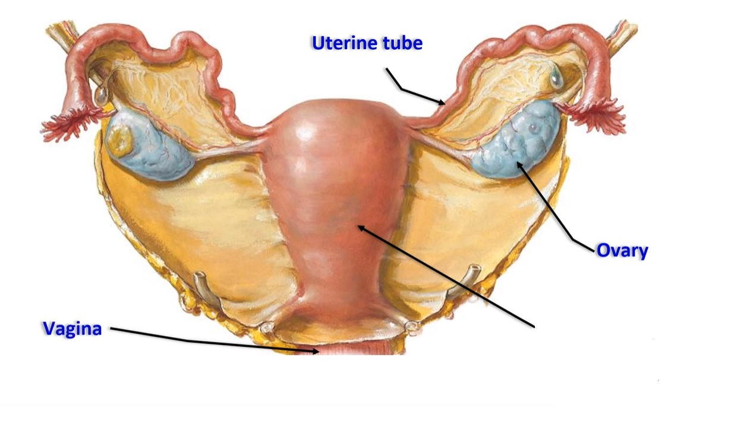
Uterus

Slide 4
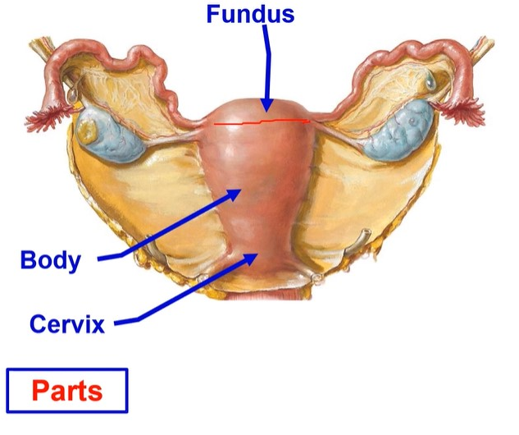
Uterus
- The uterus is a hollow thick- walled muscular organ.
** Site, It lies between the urinary bladder anteriorly and the rectum posteriorly.
** Dimensions
= Measurements
(I inch thickness)
(2 inches breadth)
(3 inches Length)

Slide 5
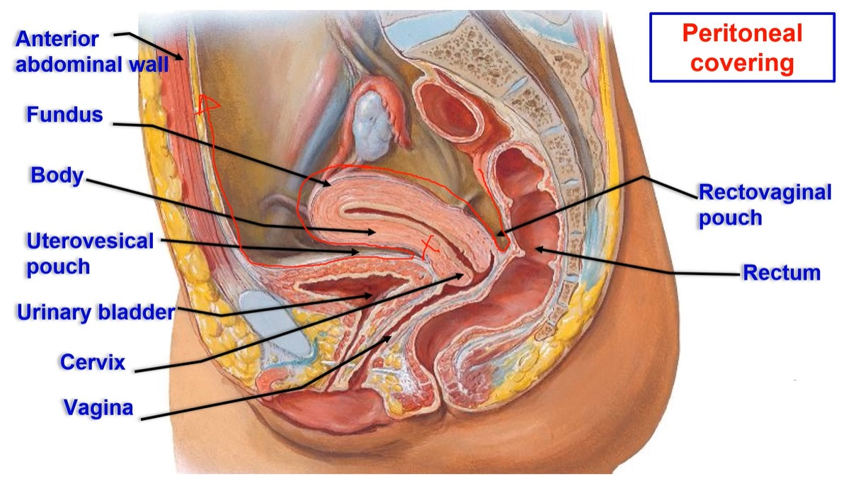

Slide 6
** Peritoneal covering;
1. Fundus; completely covered by peritoneum.
2. Body,
a. Anterior surface is covered by peritoneum, that reflected at the
junction of the body with the cervix to cover the superior surface of
the urinary bladder, forming uterovesical pouch.
b. Posterior surface is covered by peritoneum.
3- Cervix:
- Posteriorly covered by peritoneum of the rectovaginal pouch (Douglas).
- Anteriorly not covered by the peritoneum.

Slide 8
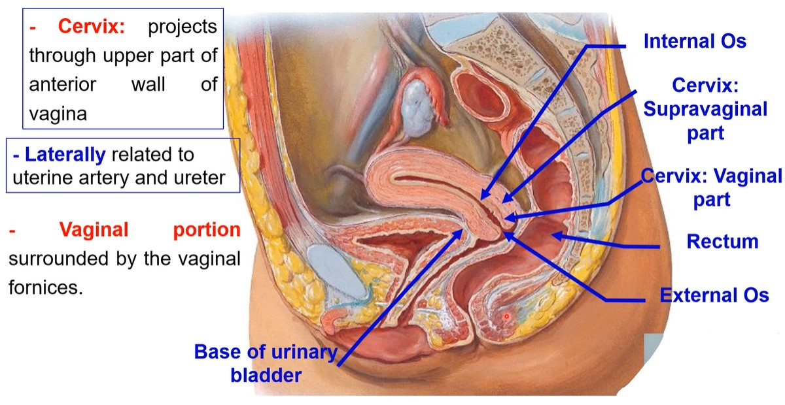

Slide 9
Anatomical position
Uterus

Slide 10
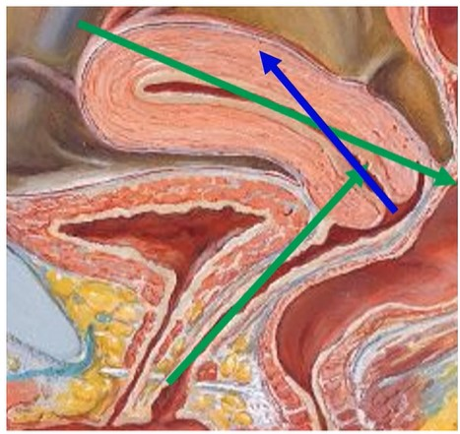
**Anatomical Position of the uterus
• (Anteverted anteflexed)
• a- Anteverted, The cervix of uterus is bent
forwards on the anterior wall of the vagina.
- The angle between axis of vagina and axis
of cervix makes about 90 degree.
• b- Anteflexed, The body of the uterus is bent
forwards on the cervix.
- The angle between axis of cervix and axis of
body makes about 170 degree.
• N.B;
- An abnormal position of the uterus is called Retroflexded The body is bent back on the cervix Retoverted the whole uterus is bent back on the vagina.

Slide 11
Ligaments of Uterus

Slide 13
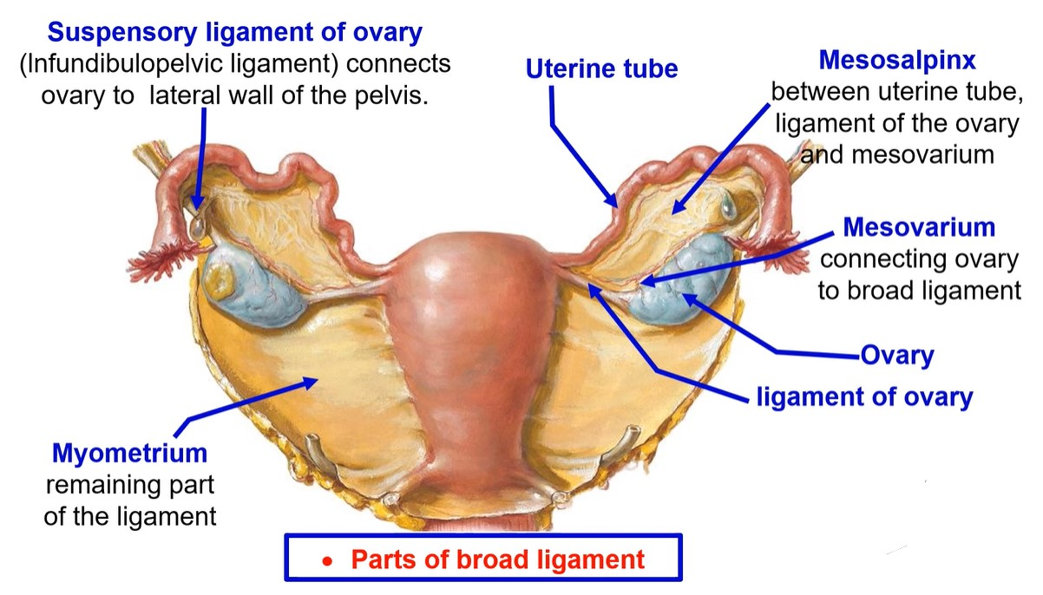

Slide 14
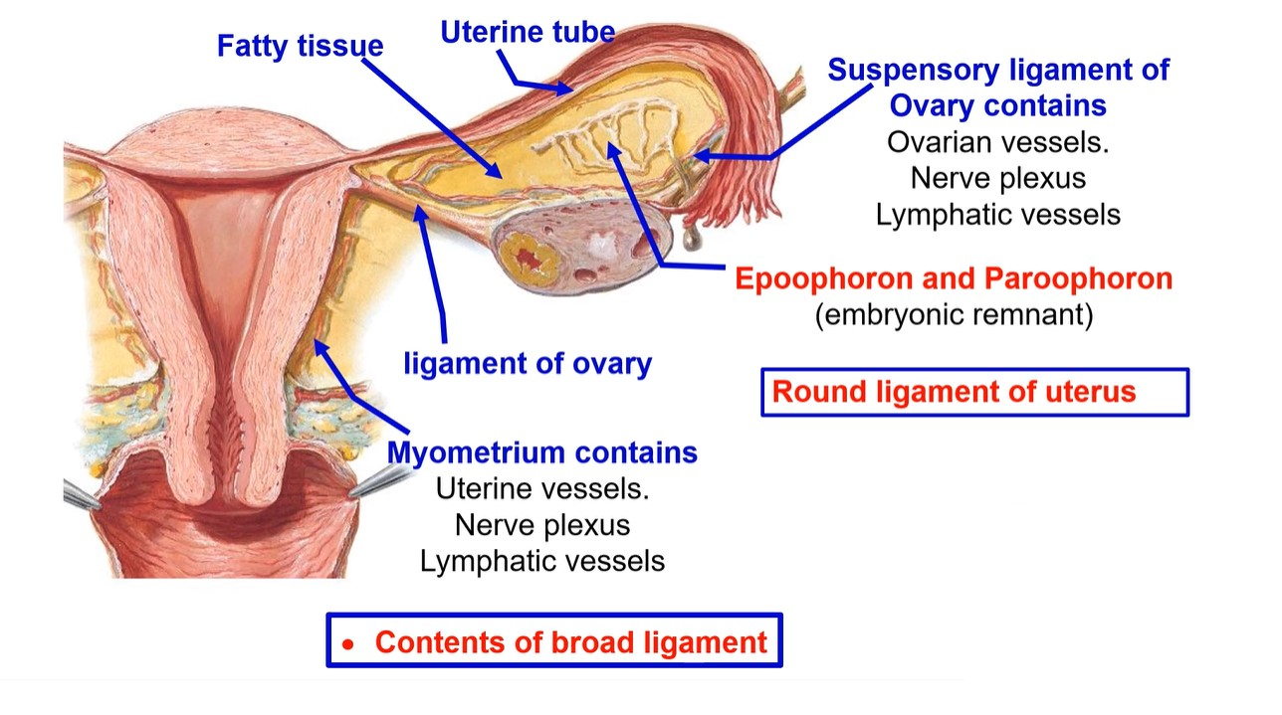

Slide 15
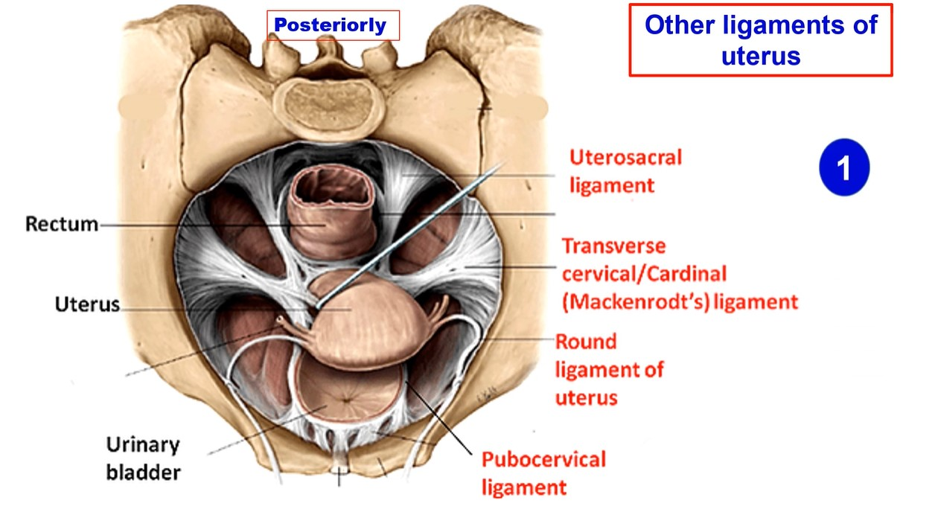
2
4
3

Slide 16
• Other ligaments of uterus
1- Transverse cervical ligaments (Mackenrodt's ligament) (Laterally)
- These are the most important ligaments for maintaining the position of the uterus.
- They extend from the cervix of the uterus to the lateral wall of the pelvis.
2- Uterosacral ligaments (posteriorly): extend from the cervix of the uterus to the sacrum on both sides of the rectum.
3- Pubocervical (anteriorly), extend from the cervix of the uterus to the symphysis pubis on both sides of the urinary bladder.
4- Round ligament of the uterus, connects the uterus below and Infront of the uterine tube to the labia majora. It passes through the inguinal canal.
** Factors support the uterus
1- Ligaments of the uterus. 2- Position of the uterus.
3- Pelvic diaphragm. 4- Urogenital diaphragm.
5- Perineal body.
Uterine prolapse: Uterus descends into vagina
It occurs due to weakness of ligaments, diaphragms and perineal body

Slide 17
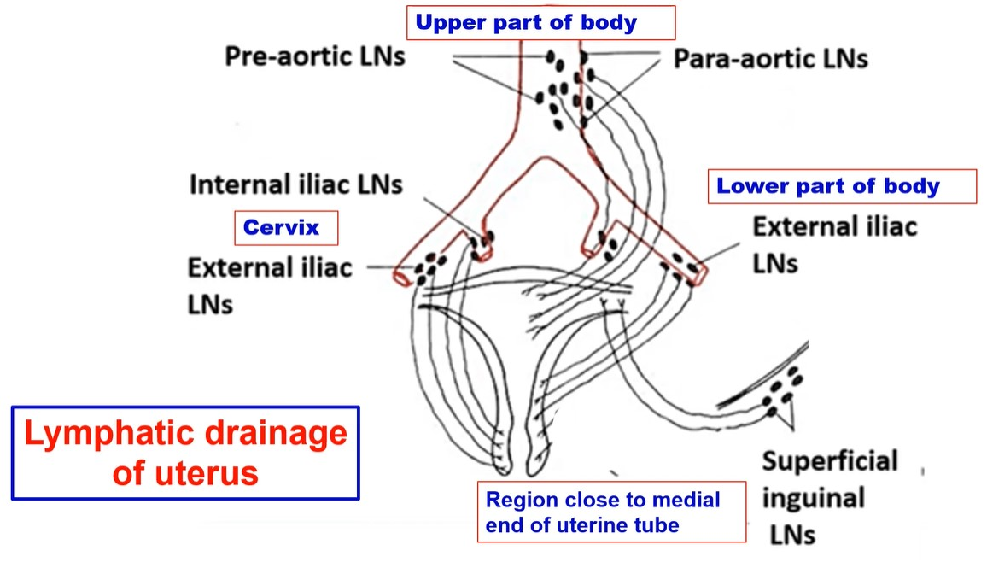

Slide 18
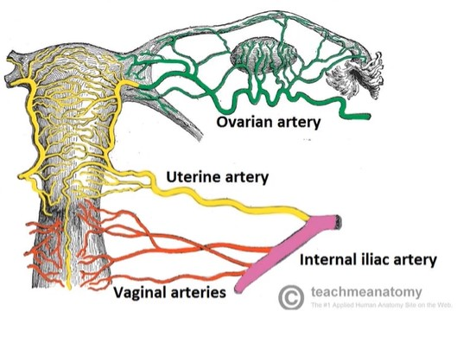
** Arterial supply:
1- Uterine artery from anterior division of internal iliac artery.
- It ascends on the lateral border of uterus in the broad ligament and turns laterally below
the uterine tube to anastomosis with the ovarian artery.
- It is a tortuous artery to allow expansion of the uterus during pregnancy.
2- Vaginal artery from internal iliac artery.
** Venous drainage:
- Uterine venous plexus uterine vein internal iliac vein.
** Nerve supply
- Sympathetic from T12 & L1.
- Parasympathetic fibers, from S2, 3, 4.

Slide 19
Uterine tube
Fallopian tube

Slide 21
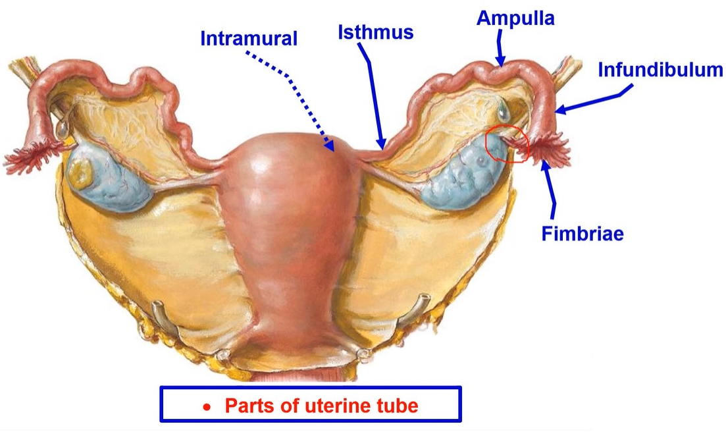

Slide 22
** Parts of the tube: From the lateral to the medial end,
1- Infundibulum: a funnel-shaped which open in the peritoneal cavity.
- It has a number of processes called fimbriae. One of these fimbriae is
large and extends to the ovary and called ovarian fimbria.
2- Ampulla: a dilated, tortuous and thin-walled.
3- Isthmus: a narrow straight part, constituting the medial 1/3 of the tube.
4- Intramural part: the part inside the uterine wall (narrowest part).
** Functions of the tubes:
1. Picks up the ovum.
2. Transport the sperm from the uterine cavity.
3. Site of fertilization in the ampulla.
4. Transport the fertilized ovum to the uterus

Slide 23
** Arterial supply:
1) The lateral part by the ovarian artery.
2) The medial part by the uterine artery.
** Lymphatic drainage: to the preaortic and paraaortic lymph nodes.
** Nerve supply:
- Sympathetic from T 10 to L 2.
- Parasympathetic S2,3,4.
• Rupture of uterine tube In case of ectopic pregnancy after 6 weeks.
• It is life threatening internal bleeding and peritonitis, adhesion and closure of tube.

Slide 24
Ovary

Slide 25
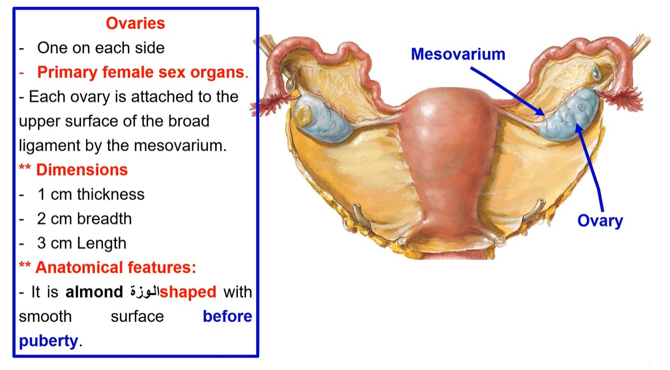

Slide 26
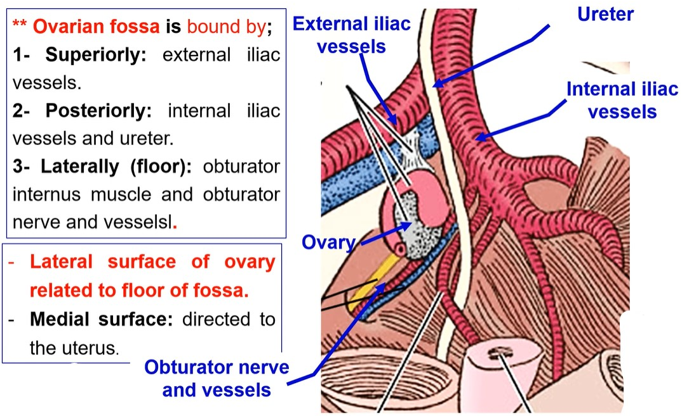

Slide 27
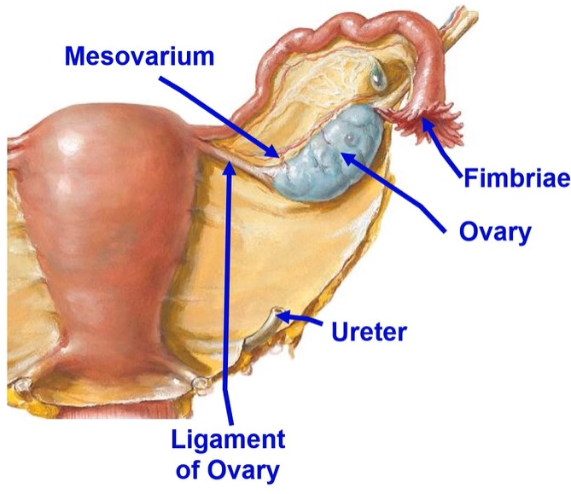
• Ovary
** General features, It has
- 2 ends
1- Tubal (upper) end: covered by
fimbriated end of uterine tube.
2- Uterine (lower) end: gives attachment to ligament of ovary.
- 2 borders
1- Free border directed backward
and related to ureter.
2- Attached border: attached to the
upper layer of the broad ligament
by the mesovarium

Slide 28
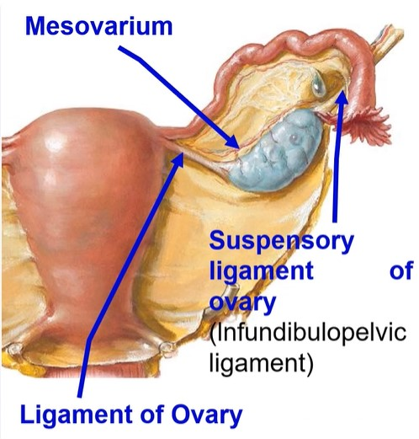
** Ligaments of the ovary,
1- Suspensory ligament of the ovary extends from ovary to wall of pelvis, contains ovarian vessels, nerve plexus and lymph vessels.
2- Ligament of ovary, connects ovary with the uterus below and behind the uterine tube.
** Peritoneal relation
- It is suspended in peritoneal cavity, not covered by peritoneum, the oocyte expelled ovulation passes into peritoneal cavity and then is picked up by the fimbriae of the uterine tube.
- Attached border: attached to the upper layer of the broad ligament by the mesovarium.

Slide 29
**Arterial supply: the ovarian (gonadal) artery from abdominal aorta.
** Venous drainage: The ovarian veins.
1) The right ovarian vein drains into the inferior vena cava;
2) The left ovarian vein drains into the left renal vein.
** Lymphatic drainage: Into paraaortic lymph nodes.
** Nerve supply: sympathetic from T10, 11 while parasympathetic from S2, 3, 4.
Functions: produce eggs and oestrogen and progesterone hormones

Slide 30
Vagina

Slide 35
** Arterial supply:
1) Vaginal artery from internal iliac artery.
2) Uterine artery from internal iliac artery.
** Venous drainage: to the vaginal venous plexus internal iliac vein.
** Lymphatic drainage:
a- The upper part drains into the internal iliac lymph nodes.
b- The lower part drains into the superficial inguinal lymph nodes.
** Nerve supply:
- Upper 2/3 supplied by sympathetic and parasympathetic.
- Lower 1/3 pain sensitive and supplied by pudendal nerve.

Slide 36
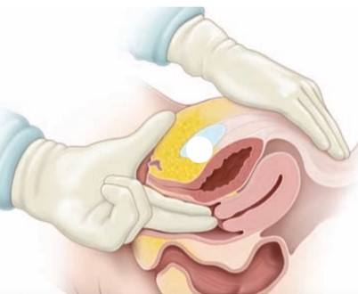
**Applied anatomy
1- Vaginal examination: This is done by inserting both index and middle finger through vagina.
- The structures felt are:
- Cervix of the uterus and fornices of the vagina
- Anteriorly: The base of urinary bladder and urethra,
- Posteriorly: Rectovaginal (Douglas) pouch.
2- Bimanual examination: With the index and middle finger of the right hand inserted high up into the vagina, pressure is done by the left hand on the suprapubic part of the anterior abdominal wall.
- By this method, the size and characteristics of the uterus can be evaluated.

Slide 37
Vulva
External female genital organ

Slide 38
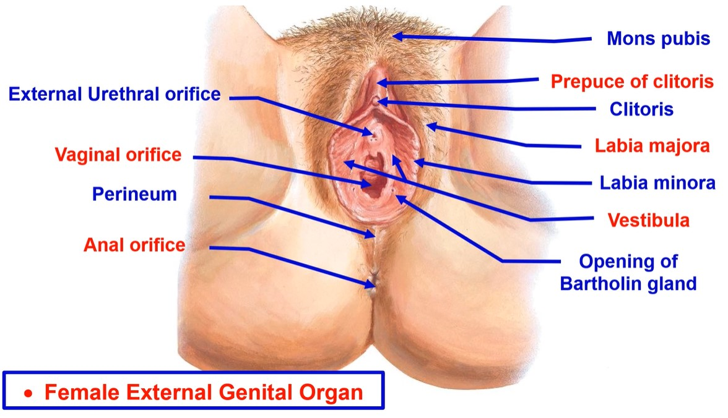

Slide 39
• Female External Genital Organ
• Vulva
1- Mons pubis, collection of fat overlying the symphysis pubes covered by hairs.
2- Labia majora a pair of skin folds, they are covered by hairs after puberty.
3- Labia minora a pair of thin skin folds between the two labia majora devoid of hairs.
- Anteriorly, each fold passes above clitoris to meet its fellow of the opposite
side, forming the prepuce of the clitoris.
4- Clitoris is an erectile corpora cavernosa tissue which becomes engorged with blood (enlarge) during sexual stimulation.
5- Vestibule this is the interval between the two labia minora.
- It receives the external urethral orifice anteriorly and vaginal orifice posteriorly.
6- Greater vestibular glands (Bartholin glands); 2 small rounded glands, one on each side of the vaginal orifice.
- They secret mucus to lubricate the vagina during sexual intercourse

Slide 40
Thank you
Questions

