Slide 1
Fungal infection of the skin
Presented by
Associate Professor Dina Abou Rayia

Slide 2
Superficial mycoses
Stratum corneum with no inflammation
Cutaneous mycoses
Stratum corneum with inflammation
Subcutaneous mycoses

Slide 3
Skin & subcutaneous Mycoses
1-Superficial mycoses such as
2-Cutaneous mycoses
such as
3-Subcutaneous mycoses
Tinea versicolor or Pityriasis versicolor
Ring worm or Tinea
Cutaneous candidiasis
Mycetoma or Madura foot
Caused by
Caused by
Caused by
Caused by
Malassezia furfur
Dermatophytes
Candida albicans
Madurella mycetomatis

Slide 4
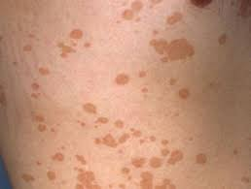
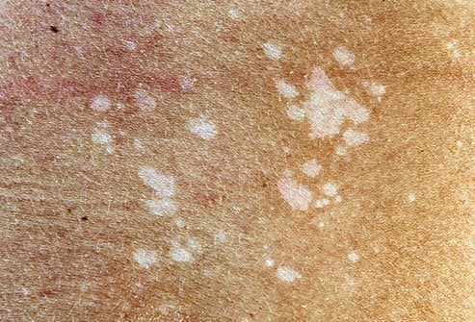
Superficial Mycoses
Tinea versicolor
(Pityriasis versicolor)
It is a superficial chronic fungal skin infection of the stratum corneum.
Caused by Malassezia furfur yeast.
Characterized by superficial brownish scaly areas on light-skinned persons & depigmented areas on dark–skinned persons that affects mainly neck, shoulders, chest and back
Its growth depends upon the skin’s sebum (oily secretion by the sebaceous glands) and increase in hot humid atmosphere
Asymptomatic & only has cosmetic importance.
Not contagious

Slide 5
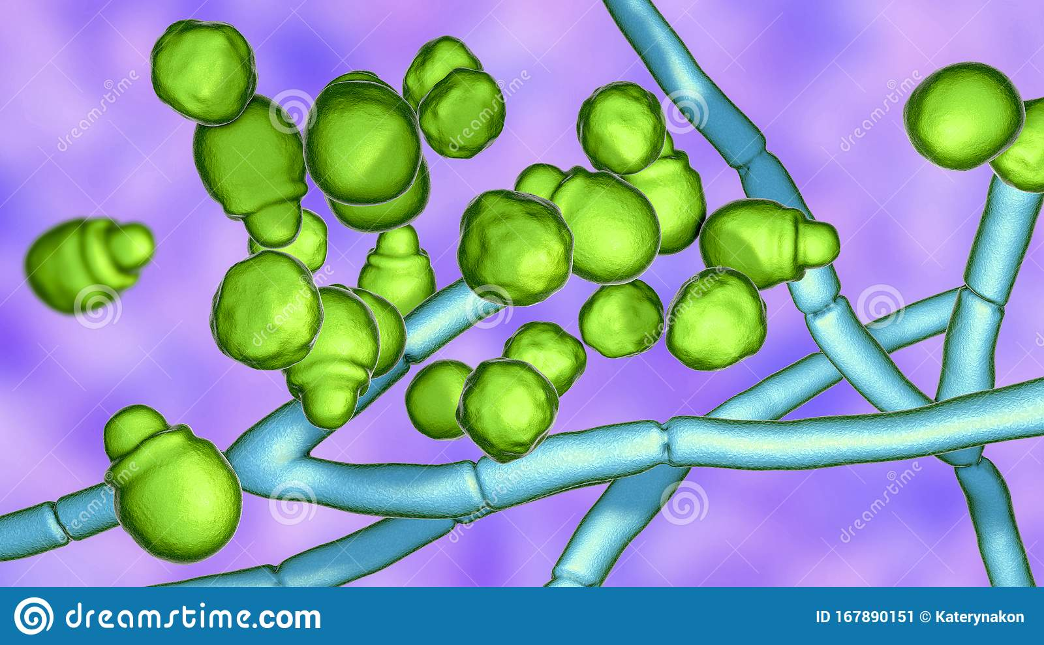
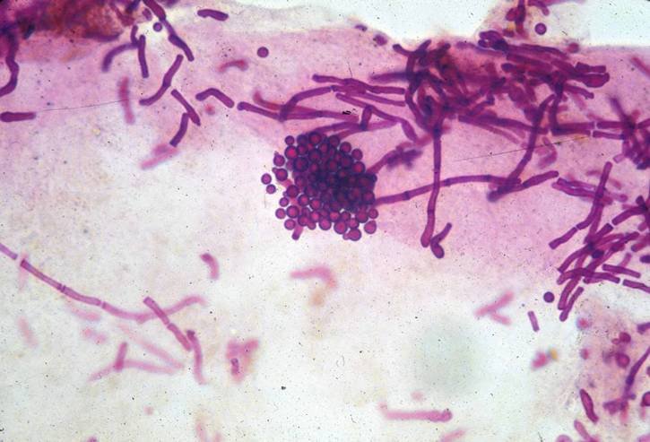
Bottle like yeast
(spaghetti and meatball appearance)
Malassezia furfur is a lipophilic gram-positive yeast showing short thick septate hyphae and clusters of budding yeast cells.

Slide 6
Diagnosis
KOH preparation of skin scales show short thick septate hyphae and clusters of budding yeast cells.
Treatment
Topical miconazole.
Lesions tend to re-occur and a permanent cure is difficult to achieve.

Slide 7
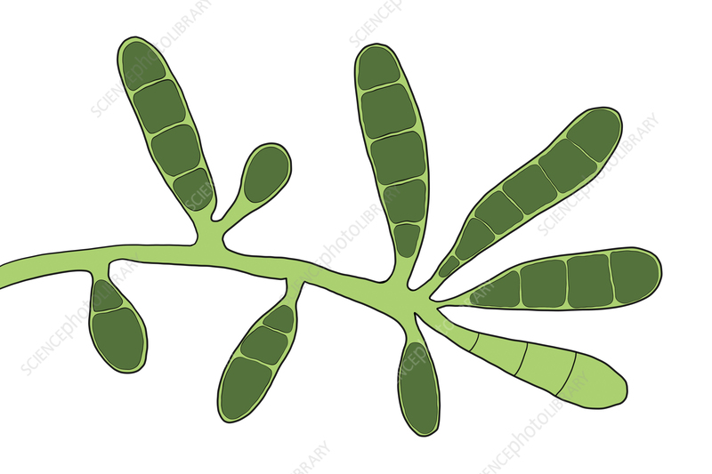
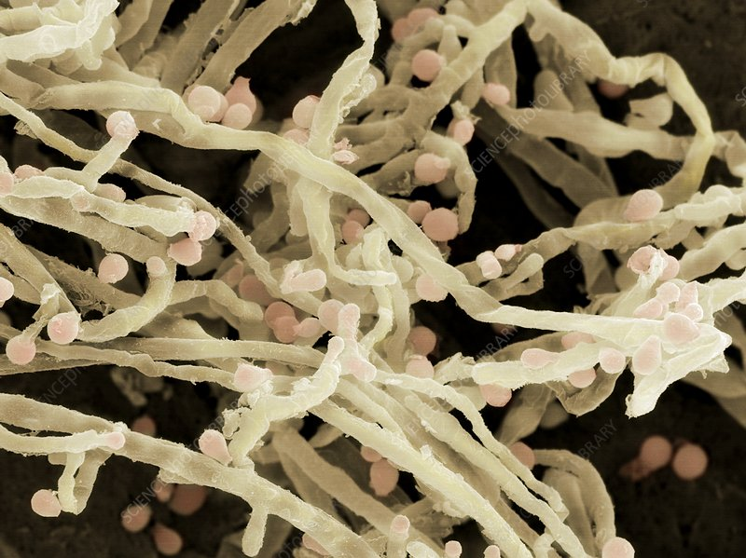
Cutaneous Mycoses
Ring worm or Tinea
Caused by dermatophytes (filamentous fungi) which include 3 genera: Microsporum, Trichophyton & Epidermophyton.
These fungi affect the keratinized tissues such as skin, hair & nails.
They spread peripherally from foci to produce ring-like lesions.
Infection does not spread to deeper tissues.
It is contagious by contact

Slide 8
Source of infection
1- Man to man by direct contact.
2- From animals e.g., dogs and cats.
3- From the soil.
N.B.
The intact skin is an important barrier against infection.
Heat and humidity enhance the infection.

Slide 9
Clinical forms
Tinea pedis or Athlete’s foot
Tinea corporis & cruris
Tinea capitis
Tinea unguium
Head
Nail
Toes web
Body & groin
Loss of hair with different varieties
- Scaly
- Black dot
Kerion
White and opaque, thickened &broken nails
This is the most common kind of athlete's foot. It usually occurs between the two smallest toes it causes itching, burning and scaling
Red, itchy scaly rash, ring-like with a raised border

Slide 10
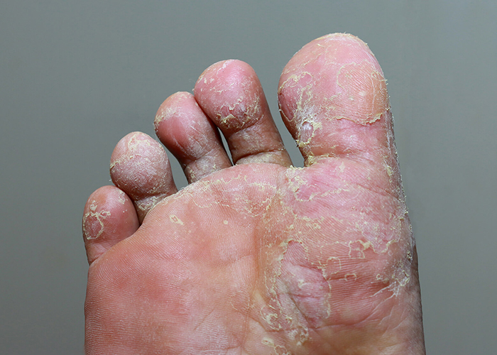
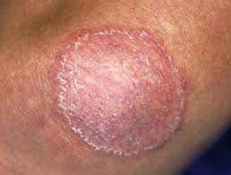
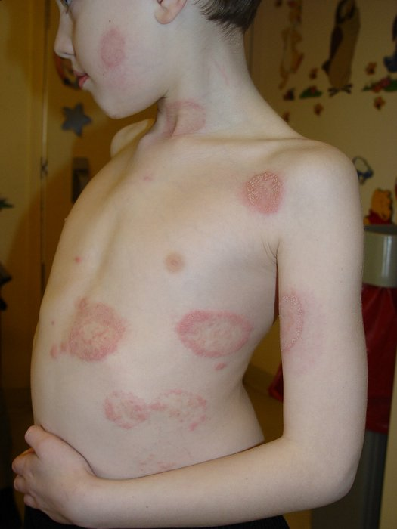
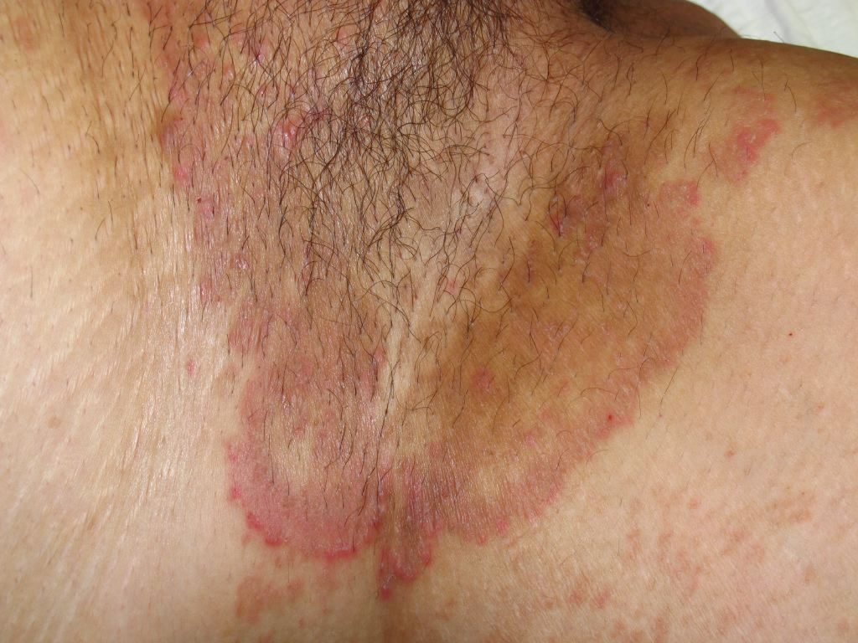
Different forms of tinea

Slide 11
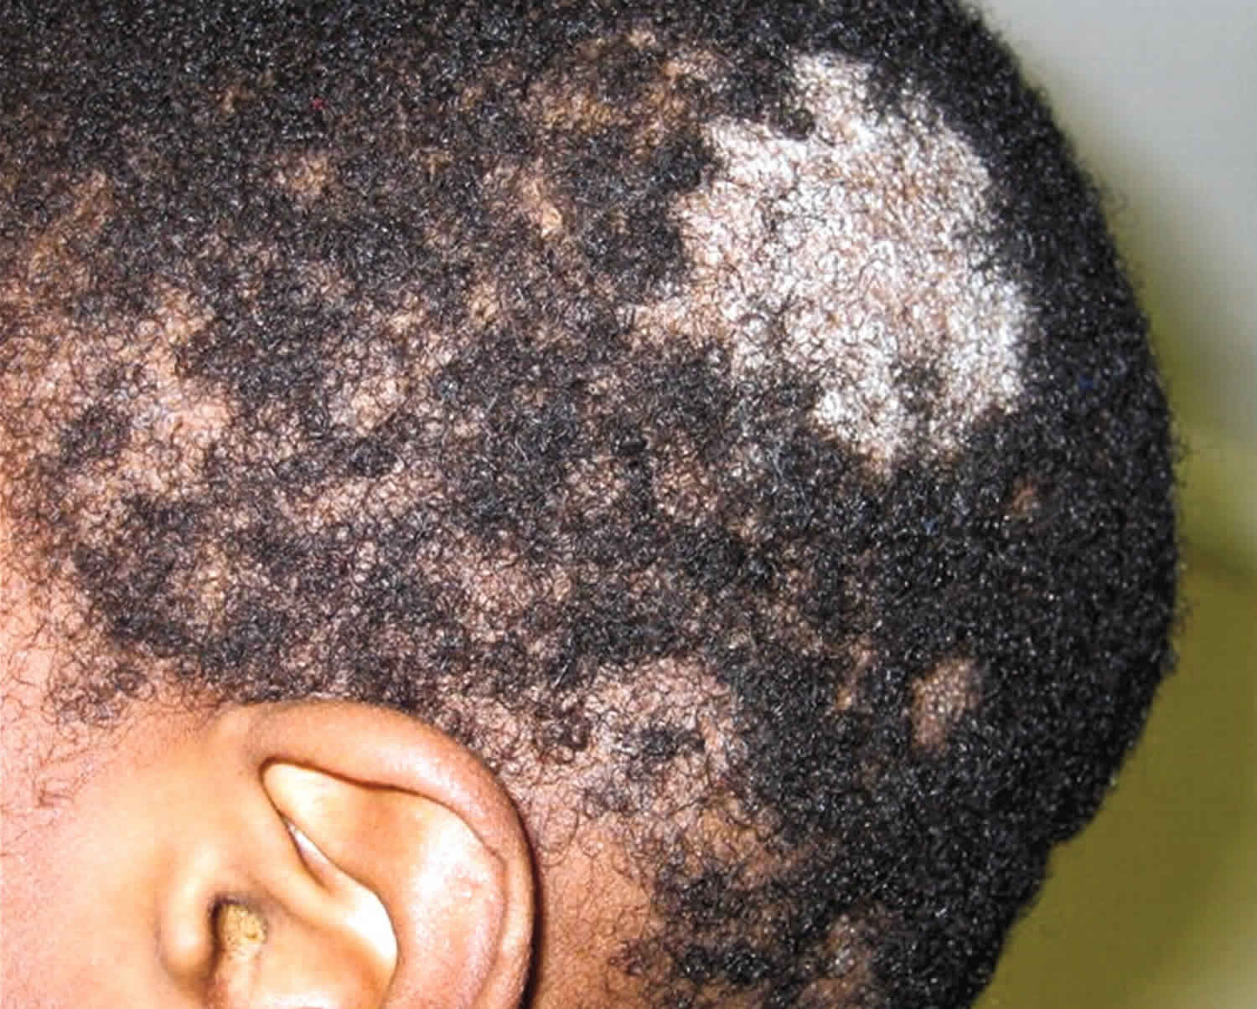
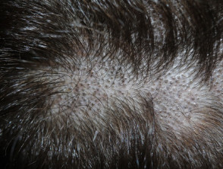
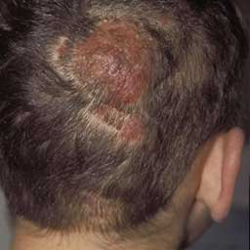
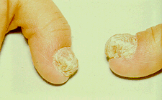

Slide 12
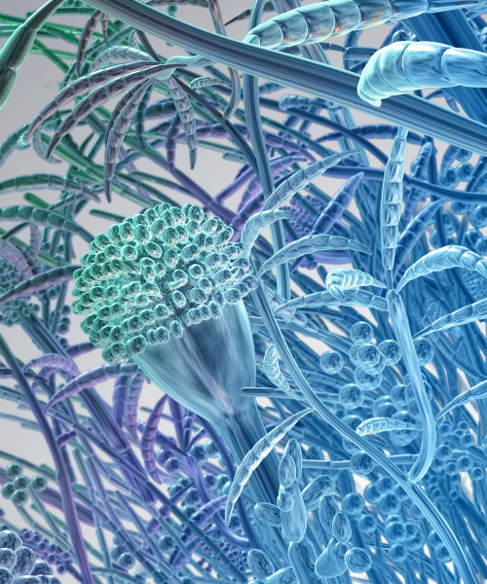
Diagnosis
Culture
Microscopic examination
Culture on Sabouraud’s dextrose agar (SDA) containing:
Actidione to inhibit saprophytes except dermatophytes.
Chloramphenicol to inhibit bacteria.
The agar is incubated at room temperature for 4 wks.
The arising colonies are examined microscopically after staining with lactophenol cotton blue stain.
Skin scales, nail & hair are examined microscopically after digestion using 10% KOH.
Branching hyphyae are detected among epithelial cells of skin & nails.
Hyphae or spores are detected in the hair. Spores either detected inside the hair (endothrix) or outside the hair (ectothrix).
Treatment
Local antifungal cream as miconazole or oral griseofulvin

Slide 13
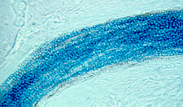
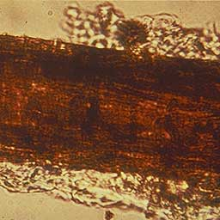
Microscopic examination of infected hair
Endothrix
Ectothrix

Slide 14
Cutaneous Mycoses
Candidiasis
Candida albicans is the most important species of candida.
Candida albicans is an oval gram-positive budding yeast that produces pseudohyphae.
It is one of the normal flora of the mucous membranes of the upper respiratory, GIT & female genital tracts.
It predominates with lowering immunity causing the infection, so it is one of the opportunistic fungi.

Slide 15
Predisposing factors to Candida infections
1- Diseases such as AIDS & diabetes mellitus.
2- Drugs: prolonged treatment with broad-spectrum antibiotics & corticosteroids.
3- General debility.
4- Indwelling urinary catheters.

Slide 16
Pathogenesis & Symptomatology
Skin invasion
Mouth infection
Vulvovaginitis
Nails infection
Systemic candidiasis
-With itching & vaginal discharge .
-Common with diabetic woman & prolonged use of antibiotics
-They are red lesions (have fluid blisters) -satellite pustules.
-Mainly affect warm moist areas such as the axilla, intergluteal folds, or infra mammary folds.
-Mostly in obese & diabetics.
C. albicans produces white patches in the mouth (oral thrush or moniliasis).
-Occurs with repeatedly immersing in water (dish washing).
-Painful redness , swelling of nail folds , thickening & loss of nail (paronychia).
Occur in diabetics &
Immuno -suppressed persons.

Slide 17
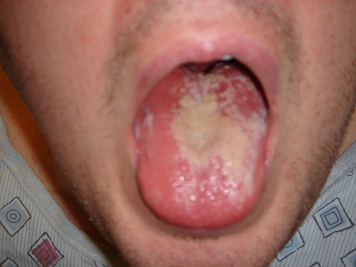
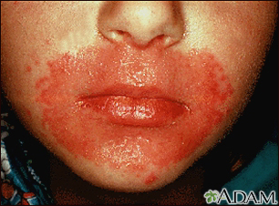
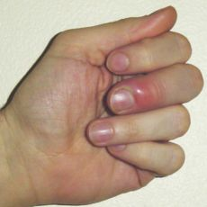
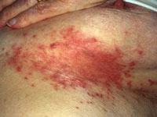
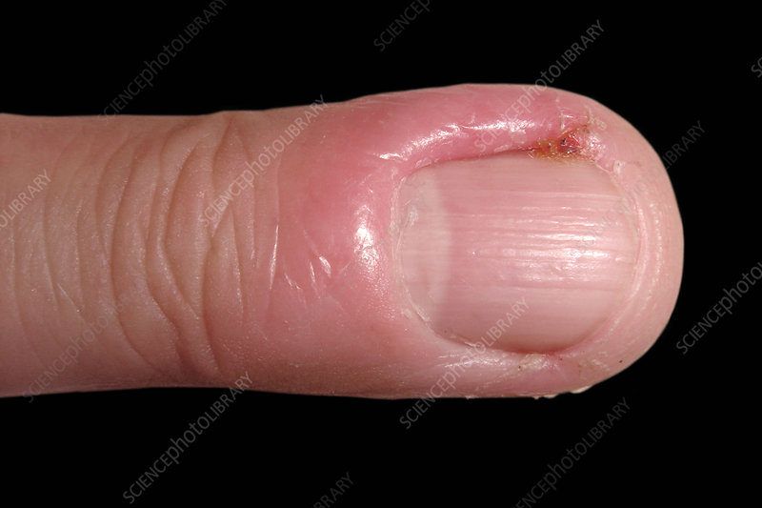

Slide 18
Laboratory diagnosis
Direct microscopic examination
Culture
Specimens from skin, vaginal discharge or exudates from mucous surfaces are examined.
C. albicans is oval gram-positive budding yeast cell with pseudohyphyae.
On nutrient agar, corn meal agar & SDA. Colonies are creamy in color & identified by:
1- Morphology: oval budding gram +ve yeast cells.
2- Differentiation tests:
Germ tube test : germ tube is formed when spores incubated with human serum at 37 C for 30 min.
Chlamydospore thick-walled large resting spore formation on corn meal agar.
Biochemical reactions:C.albicans
ferments glucose & maltose with acid & gas production.
18

Slide 19
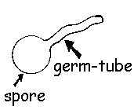
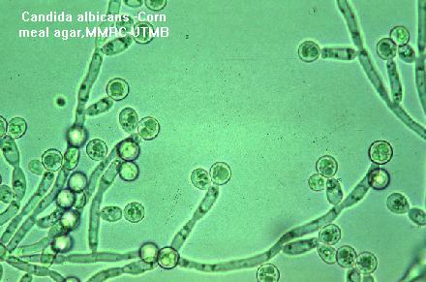
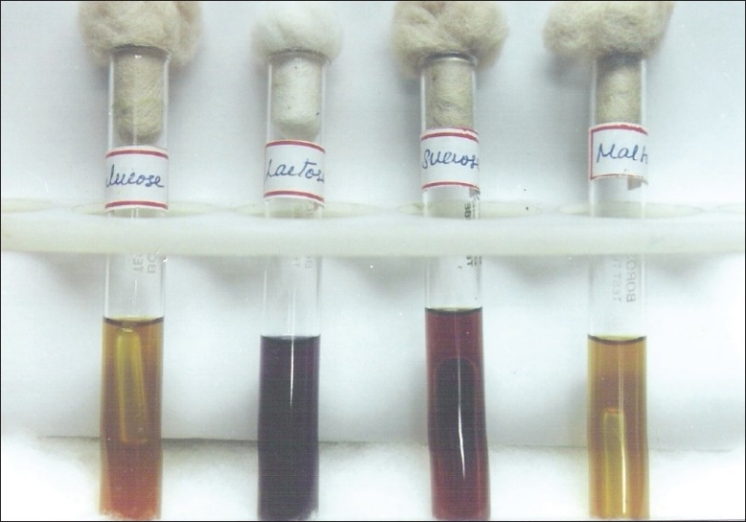
Germ tube
Terminal Chlamydospore & pseudohyphyae
Biochemical reaction of Candida
19

Slide 20
Treatment
Oropharyngeal or oesophageal thrush
Skin lesions
Systemic candidiasis
Nystatin ointment
Ketoconazole (orally)
Amphotericin B (IV)
Fluconazole

Slide 21
Subcutaneous mycoses
Mycetoma (Madura foot)
Mycetoma is a disease caused by certain types of bacteria and fungi found in soil and water.
They are introduced into subcutaneous tissues through trauma.
Mycetoma is a chronic granulomatous infection usually affects the lower limbs.
The disease usually affects farmers.

Slide 22
Causative organism of mycetoma
1- Eumycetoma:
caused by fungi Madurella mycetomatis which having true septate hyphae (divided into cells) and spores.
2- Actinomycetoma: caused by species of actinomycetes (filamentous aerobic bacteria).
Clinical picture
Swelling following trauma, painless, purplish discoloration & multiple sinuses drain pus containing yellow, white, red, or black granules. Black granules are common with fungi.

Slide 23
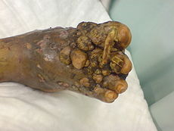
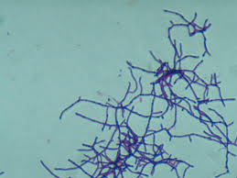
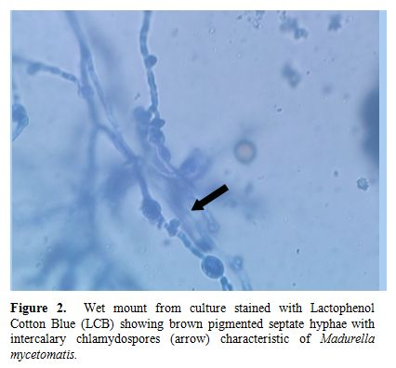
Differentiation between actinomycetes and Madurella is important ?????
Madura foot
Madurella mycetomatis with intercalary chlamydospores
Actinomycetes filaments with no spores
23

Slide 24
Diagnosis
Macroscopic examination
Microscopic examination
Culture
On SDA
Depend on the color of the granules
Septate hyphae with spores in fungal infection.
Filaments with no spores in bacterial infection.
(Fungi are Gram -ve while bacteria are Gram +ve).
Black granules are common with fungal infection.
White, yellow & red granules are common with bacterial infection.
24

Slide 25
Treatment
Fungal mycetoma
Actinomycetoma
Medical:
- Streptomycin
- Trimethoprim
- Sulphamethoxazole
- Dapson.
2. Surgical.
Medical:
- ketoconazole
- Itraconazole
- Amphotericin B
2. Surgical.
25

Slide 27
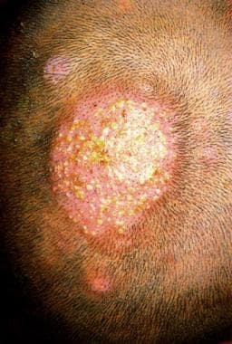
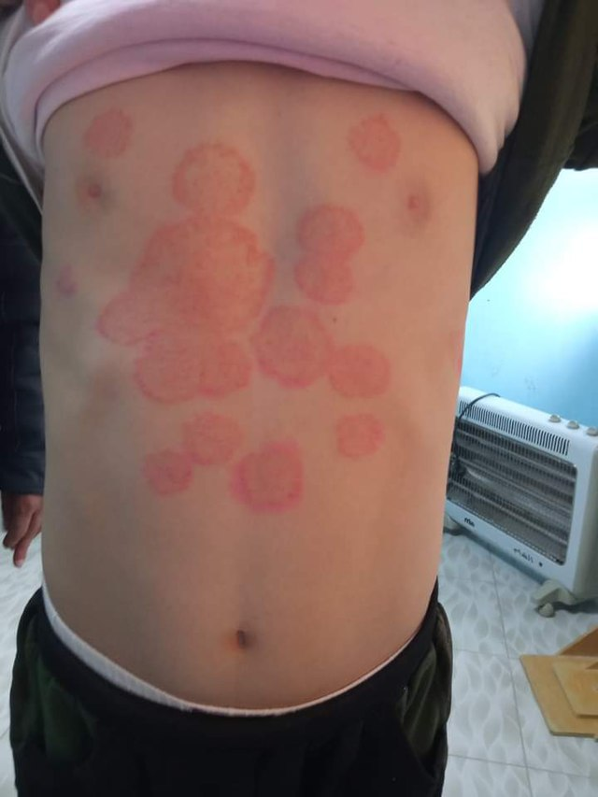
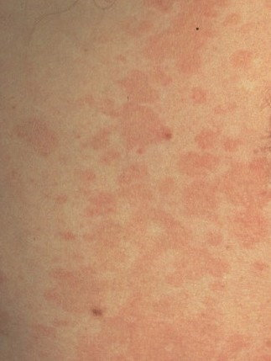
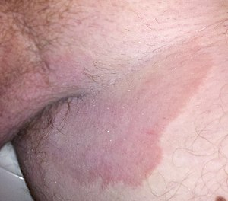
Identify ??????

Slide 28
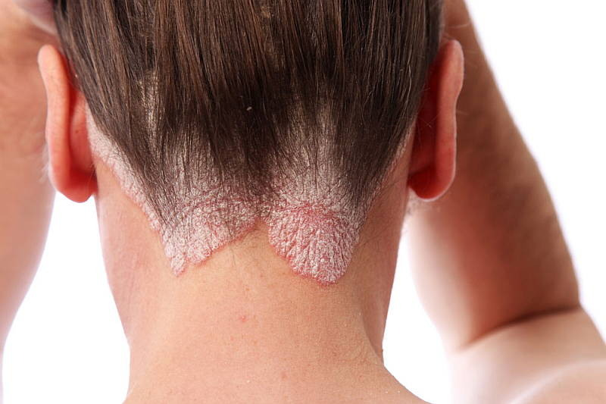
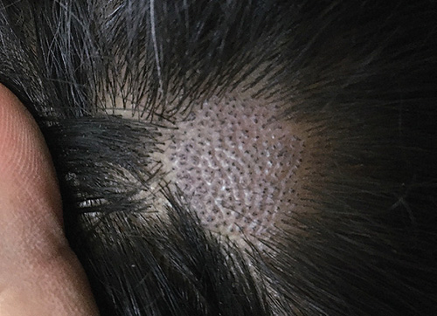
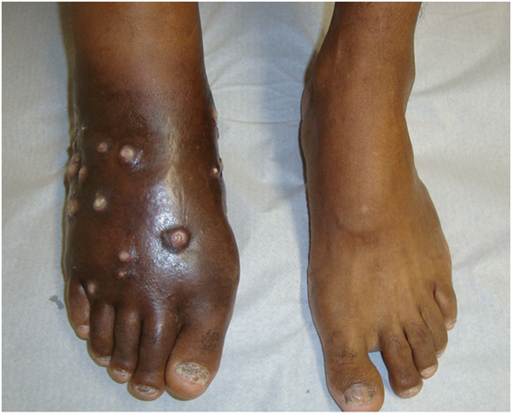
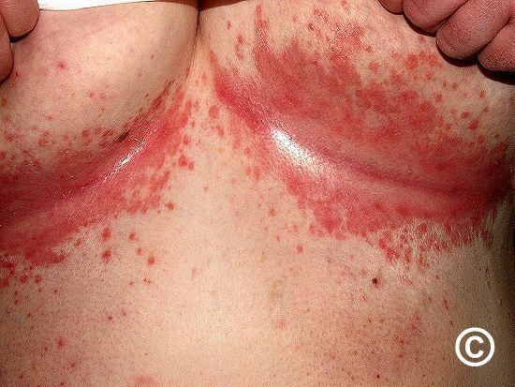
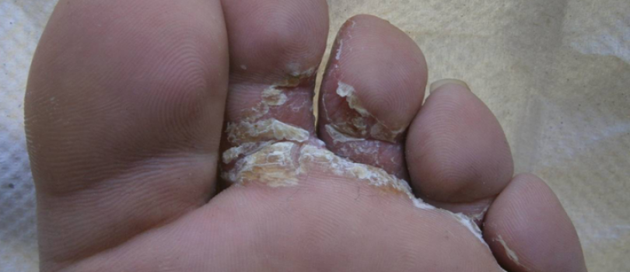
Identify ??????

