Slide 1
Drug Prescribing in Pregnancy
and Lactation
Presented by :
Tamara Zyoud
Mohammad Rabai
Akram Oran
Hadeel salameen
Supervised by :
Dr. hashem yaseen

Slide 2
More than 50% of pregnant women take prescribed or non prescribed (OTC) drug or use social drug ( tobacco an alcohol ) or elicit drugs at some time during pregnancy .
About 2-3% of birth defects result from drugs that are taken during pregnancy to treat a disorder or symptom .

Slide 3
Maternal pharmacokinetic change in pregnancy:
Absorption:
Decreased gastrointestinal motility and tone (probably from increased progesterone production). So, delay absorption of drugs in the small intestine.
Increase HCL formation, weak acids (eg. aspirin) will remain highly ionised and will have delayed absorption.
Increased cardiac output affects changes in skin and muscle blood flow, supposedly increasing the absorption of drugs via subcutaneous and intramuscular routes
Increased blood flow speeds up the rate of onset of IV drugs, eg. muscle relaxants and anaesthetic agents

Slide 4
Distribution:
Increased plasma volume and body fluids
Decreased plasma albumin, resulting in reduction in the available binding sites of drugs
Increased body fat .
This gives rise to three main pharmacokinetic differences:
Increased volume of distribution of drugs.
Increased tissue deposition of fat-soluble drugs.
Increased free fraction due to decreased protein binding.

Slide 5
Metabolism:
Estradiol and progesterone levels are increased, these affect drugs biotransformation on hepatic enzymes. They induce metabolism of some drugs and inhibition of others.
The biliary excretion of certain drugs is slowed due to estrogen induced cholestasis.
Elimination:
Renal blood flow and glomerular filtration rate are increased, so increase the elimination of drugs that are normally excreted by kidney.
Dose should be doubled .

Slide 6
Pharmacodynamics
Increased sensitivity to volatile anaesthetics (decrease MAC).
Increased sensitivity to IV anaesthetics
Increased sensitivity to local anaesthetics
Changed therapeutic indices due to concerns regardin foetal damage and teratogenicity

Slide 7
Passage of drugs across placenta
The placenta functions fully for transport by the fifth week of conception
Nutrient and drug transfer across the placenta are by passive diffusion, facilitated diffusion, active transport, and pinocytosis.
Placental drug transfer is dependent on the physical properties of the placental membrane and on the pharmacological properties of the drug.

Slide 8
Three types of drug transfer across the placenta are recognized:
Complete transfer (type 1 drugs): for example, thiopental
Drugs exhibiting this type of transfer will rapidly cross the placenta with pharmacologically significant concentrations equilibrating in maternal and fetal blood.
Exceeding transfer (type 2 drugs): for example, ketamine
These drugs cross the placenta to reach greater concentrations in fetal compared with maternal blood.
Incomplete transfer (type 3 drugs): for example, succinylcholine
These drugs are unable to cross the placenta completely, resulting in higher concentrations in maternal compared with fetal blood

Slide 9
Factors affecting placental drug transfer
Lipid solubility:
Lipid soluble drugs diffuse readily and enter the fetal circulation, e.g. thiopental
Molecular size:
Molecular weight (M.W) influences rate of transfer and amount of drug transferred across placenta
Drugs with M.W of <500 D cross easily
Those with M.W >1000 D not cross (e.g.: heparin, insulin)
Blood flow:
Increased during gestation
Placental rate of drugs transfer is determined by blood flow for most lipophylic compounds

Slide 10
Protein binding:
Albumin concentration in maternal blood is low, so unbound drug concentration are higher during gestation, making more drug available to cross the placenta
E.g. drugs highly protein bound are: propranolol, salycilate, diazepam
Effect of pH:
Fetal blood is more acid (pH=7.3) than maternal blood (pH=7.4)
Weakly acidic and weakly basic drugs tend to rapidly diffuse across the placental membrane
Highly ionized drugs e.g. succinylcholine and tubocurarine, cross placenta slowly.

Slide 11
Teratogenic effect of drug :
Teratogen : any agent that result in structural or functional abnormalities in the fetus , or in child after birth , as a consequence of maternal exposure during pregnancy.
Teratogenicity risk is determined largely by TIMING of drug exposure :
During first trimester (T1)drugs may produce congenital abnormalities (teratogenesis)
The period of greatest risk is from 3-12th week
During second and third trimesters (T2,T3) drugs may affect growth and functional development of the fetus (e.g. brain development)
Teratogenic effects include: loss of pregnancy, structural abnormalities, growth impairment, functional loss and behavioural changes.

Slide 13
The embryo is most susceptible to teratogenic agents during periods of rapid differentiation. The stage of development of the embryo determines susceptibility to teratogens. The most critical period in the development of an embryo or in the growth of a particular organ is during the time of most rapid cell division.
the critical period for brain growth and development is from three to 16 weeks. However the brain's differentiation continues to extend into infancy. Teratogens can produce mental retardation during both embryonic and fetal periods.

Slide 14
During the first two weeks of gestation, teratogenic agents usually kill the embryo rather than cause congenital malformations.
Establishment of full implantation of the fertilized egg takes 1 to 2 weeks .
Teratogenic exposure during this stage elicit an “ all-or-nothing “ response , leading either to death of the embryo or completely normal development of fetus .
Major malformations are more common in early embryos than in newborns; however, most severely affected embryos are spontaneously aborted during the first six to eight weeks of gestation.

Slide 15
Embryonic stage ( weeks 3-8 post-conception )
The critical time for organogenesis is during the first 8 weeks of pregnancy .
Organogensis occurs during the embryonic stage “exception of CNS ,eye ,teeth, external genitalia and ears is complete by 10W” , so exposure in this time represents the greatest risk of major birth defect .

Slide 16
During organogenesis between days 15 to 60, teratogenic agents are more likely to cause major congenital malformations.
For this reason , women are often advised to avoid or minimize all drug use in the first trimester .
After 8 weeks , most teratogenicity effect are related to fetal growth restrictions or functions deficits such as mental retardation .

Slide 17
Some drugs associated with teratogenicity
(T1):
Thalidomide: phocomelia
Cytotoxic drugs: multiple congenital malformations
Vitamin A derivates (isotretinoin): craniofacial defects
Lithium: ebstein anomaly of tricuspid valve
Steroids: cleft lip and or cleft palate
Warfarin: skeletal abnormalities

Slide 18
T2 and T3:
Tetracycline: tooth and bone defects
Chloramphenicol: Grey baby syndrome, intra-uterine foetal death
Aminoglycoside: ototoxicity
Fluoroquinolone: interference with cartilage growth
Phenytoin: craniofacial defect, mental deficiency
warfarin: CNS malformations
ACE inhibitors: irreversible renal damage
Tobacco smoking: retarded fetal growth

Slide 19
FDA Classification - ( Definitions and examples ) - Vitamins and supplement - Alcohol and smoking - Drugs during lactation
Written By ;
Mohmad Rabai
Akram Oran
Supervised By ;
Dr. Hashem Yaseen

Slide 20
FDA Classification
The Food and Drug (FDA)classifies drugs according to the degree of risk they cause for the fetus if they are used during pregnancy.
In general every medication is classified into Five category (A,B,C,D,X) …
based on how safe or risky it is to use during
pregnancy , And the type and adequacy of studies
which is done .

Slide 21
Category A :
Adequate and well-controlled studies in pregnant women fail to detect risk to the fetus in the first trimester and no evidence of risk in later trimesters.
- Extremely few drugs exist in this category !!
Category B :
Safe on the basis of animal studies , with no controlled study in pregnant women …
OR
- animal studies have shown an adverse effect which was not confirmed in controlled studies in women in the first trimester and there is no evidence of risk to the fetus in later trimesters .

Slide 22
Category C : Risk not ruled out
Studies in women and animals are not available …
OR
studies in animals have shown adverse effects on the fetus and there is no controlled study in women.
Benefits outweigh the risks
Category D :
There is positive evidence of risk to the human fetus (unsafe) …
should not be used unless there are no better alternatives in a life- threatening illness !!
- (Benefits May outweigh the risks in serious condition)

Slide 23
Category X : Highly unsafe :
- risk of use outweighs any potential benefit .
Drugs in this category are contraindicated in pregnant women or in a woman who may become pregnant .

Slide 24
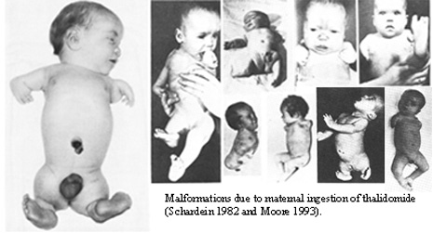
Quick Examples ::
A : levothyroxine, folic acid .
B : Most of the antibiotics ..
• B- lactams : ( Ampicillin .. Amoxicillin .. Cephalosporin ) •prenatal vitamins •Metronidazole • Macrolides • acyclovir •Paracetamol • Metformin •Insulin
C : •fluoroquinolones • gentamicin • Flucanazole
D : • Tetracyclin • ACEi • Losartan ( ARBs )
• Sulfa drugs • Anticonvulsants • Warfarine
X : •Isotretinoin •Thalidomide • Ribaverin • statin

Slide 25
ANTINEOPLASTIC & immunosuppressant
Folate antagonist ( methotrexate) : Category X
- are well known human teratogens .
- end your pregnancy or cause severe birth defects !
IN general, antineoplastic are better to be avoided in pregnancy as some studies consider them all to be teratogenic , unless the benefit overweighs the risk.
Cyclosporine : Category C
Widely used in organ transplantation
harmful effects on the human fetus But without causing malformations
Hydroxychloroquine : safe/can be used once indicated
- Used as Anti-malarial drugs , SLE , …

Slide 26
ANTICONVULSANTS
Phenytoin, Valproic Acid , Carbamazepine …
(Category X)
Women with epilepsy who use anticonvulsants during pregnancy have approximately double the general population risk for malformations , ESP; cleft lip & cleft palate and congenital heart disease .
- Its better to mother to avoid seizure-provoking stimuli .

Slide 27
ANTICOAGULANTS
Warfarin (category D) : it crosses the placenta and should be avoided .
-Fetal warfarin syndrome(warfarin embryopathy) ; *Resulting abnormalities include … low birth weight , mental retardation, deafness, Microcephaly , Nasal hypoplasia , Malformed bones, cartilage, and joints .
Heparin ( does not cross the placenta , because it is a large molecule with a strong negative charge ).
*the drug of choice for patients requiring anticoagulation.
*Heparin can cause thrombocytopenia !

Slide 28
Unfractionated heparin (UFH) and low molecular weight heparin (LMWH) do not cross the placenta and are safe for the fetus, but long-term treatment with UFH is problematic because the need to monitor anticoagulant activity and because of its potential side effects .
(LMWH) may have benefits over standard unfractionated heparin . The molecules still are relatively large and do not cross the placenta .
less risk for heparin-induced thrombocytopenia

Slide 29
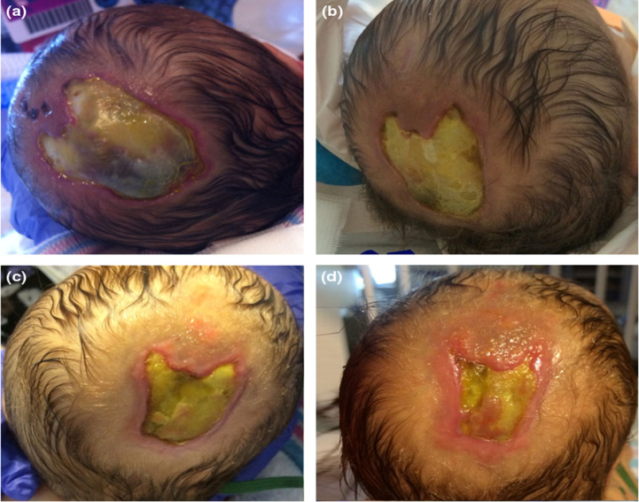
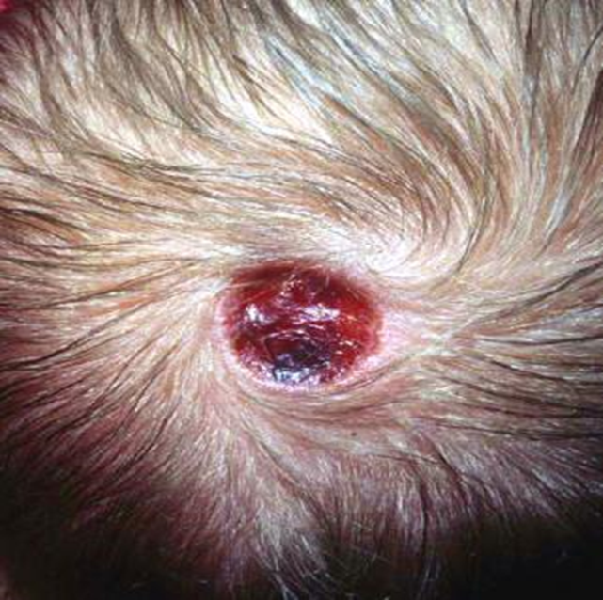
Thyroid and Antithyroid Drug
Thyroxin ( category A) : doesn’t cross the placenta to any extent, so it not associated with congenital anomalies ,(safe during pregnancy) .
Propylthiouracil (PTU) and carbimazole : ( class D )
They are used to treat Hyperthyroidism ( Anti thyroid )
both cross the placenta and may cause fetal hypothyroidism and so some degree of fetal goiter !
(PTU) is the preferred antithyroid drug Because treatment with carbimazole during the ﬁrst trimester has been associated with the occurrence of choanal atresia and (aplasia cutis) .
BUT , Hyperthyroid women who become pregnant while taking carbimazole or PTU should be advised to continue their current drug in pregnancy 
(PTU) is the drug of choice in the breastfeeding mother  , as it is excreted in the milk to a much lesser extent than carbimazole .
- Radioactive iodine-131 is absoulotly contraindicated .

Slide 30
Anti - emetic : Category B
Anti Histamine ( cyclizine ) : first line
Metoclopramide , Odansetron : second line
Acid suppressing :
cimetidine, omeprazole, and ranitidine … has not been found to be associated with any teratogenic risk in pregnancy 

Slide 31
NSAID
Aspirin :
Full dose Aspirin : category D ( avoided )
Low dose aspirin 75mg : category C ( safe )
- maternal ingestion of aspirin in the Third trimester was related to closure of the ductus arteriosus in utero !
Indication for Low Dose Aspirin in Preg. ;
( chronic HTN , Chronic DM , autoimmune dis , thrombophilia … )
Acetaminophen : Category B
no evidence of teratogenicity.
- if a mild analgesic or antipyretic is indicated, acetaminophen is preferred.

Slide 32
Other NSAIDs are considered safe (Ibuprofen , indomethacin, diclofenac , Naproxen) during the first trimester but generally contraindicated in late pregnancy .
Chronic use may lead to oligohydramnios, and constriction of the fetal ductus arteriosus …

Slide 33
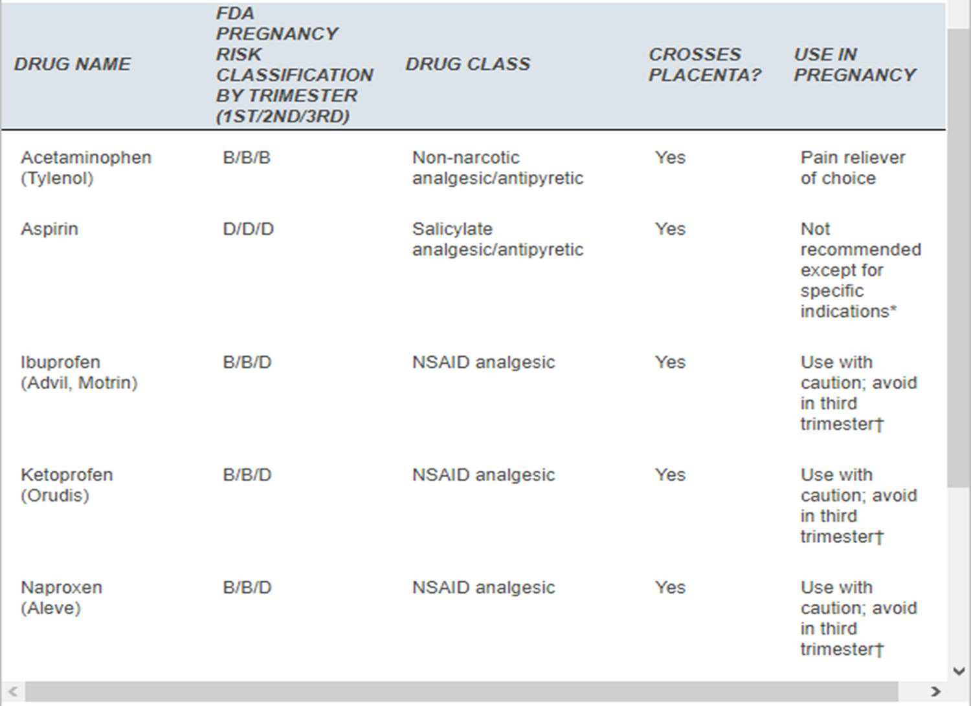

Slide 34
Anti-Biotics
Penicillin : Category B in pregnancy
- Syphilis: the drug of choice is penicillin
There is a risk of premature labour &/or fetal distress for women taking the drug in the 2nd half of pregnancy (due to jarish-herixhimer reaction ).
Compatible with breastfeeding 
Cephalosporin : Category B in pregnancy
- Excreted into breast milk in low concentrations
So , Considered compatible with breastfeeding 

Slide 35
Metronidazole : Category B
no teratogenic risk .
Macrolides (Azithromycin , Clarithromycin , Erythromycin): Category B
No teratogenic risk .
Fluor quinolones : Category C
Not recommended / May be harmful
Aminoglycosides (Streptomycin, gentamycin) : Category C/D
congenital deafness & Ototoxicity
potential benefits may warrant use of the drug in pregnant women despite potential risks .

Slide 36
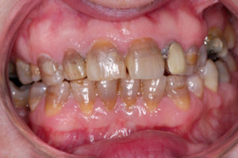
Tetracyclines : Pregnancy Category D
Can cause problems with teeth and bone and other defects/effects
Have been linked to maternal liver toxicity
Not Compatible with breastfeeding
Readily cross the placenta and are firmly bound by chelation to calcium in developing bone and tooth structures. This produces brown discoloration of the teeth (Permenant*) , and inhibition of bone growth.

Slide 38
Anti fungal :
Topical or Vaginal : ( Nystatin .. ) Safe 
Systemic : ( Flucanazole and other azole .. )
Considerd as a toxic medications, and their use in pregnancy has been limited to life-threatening fungal infections !!
Tuberculosis:
Pregnant women with active TB should be treated, even in the first stage of pregnancy .
Isoniazid, rifampin, ethambutol and pyrazinamide may be used.
"Streptomycin” should not be used, because it has been shown to have harmful effects on the fetus (has the heighest risk of ototoxicity).

Slide 39
Lithium
FDA pregnancy category ( D )
Lithium is used in primarily to treat affected mental disorders
If this agent is used in early gestation is associated with increase risk of CVS anomalies in exposed offspring .
Avoid if possible in first trimester and adjustment in 2nd and 3rd trimesters
Side effects in newborn include : Floppy baby syndrome, , hypoglycemia , cardiac arrhythmias , thyroid dysfunction , and premature delivery
1% of lithium exposed pregnancies may have Ebstains anomaly .
Polyhydramanios and fetal diabetes incipedus are possible secondary complication of lithium during 2nd and 3rd trimester .

Slide 40
Ebstein’s anomaly
is a rare heart defect in which the tricuspid valve — the valve between the upper right chamber (right atrium) and the lower right chamber (right ventricle) of the heart — isn't formed properly. As a result, blood leaks back through the valve and into the right atrium. Atrial septal defect is a hole between the two upper chambers of the heart

Slide 41
Cardiovascular diseases
HYPERTENSION
ARBs, ACE inhibitors are cat (C/D).
renal dysgenesis or death (if used in 2nd & 3rd trimesters)
increased risk of cardiovascular and CNS malformations when used in the first trimester
Diuretics avoided in pregnancy, as they prevent the physiologic volume expansion.

Slide 42
Valvular heart diseases:
hydralazine, digoxin, adenosine, and procainamide can be safely used in pregnancy
Amiodarone cat (D), and nitroprusside cat (C) are contraindicated during pregnancy regardless of the indication.
Most other medications carry a potential risk to the fetus and should only be used when the maternal benefit outweighs the fetal risk.

Slide 43
Coronary Artery Disease
Low-dose aspirin is safe but prolonged use of 100 mg aspirin can cause increased maternal bleeding complications and low birth weight.
Beta-blockers are safe in pregnancy
Nitrates and calcium channel blockers should be used with caution to avoid maternal hypotension.

Slide 44
Thrombolytic therapy has limited data in pregnancy. No reports of teratogenic effects exist, but an increased risk of maternal hemorrhage exists
Beta-blockers:
Atenolol cat D
Metoprolol cat C (D at term or prolonged use)
Nadolol cat C (D at term or prolonged use)
Propranolol cat C (D at term or prolonged use)
Timolol cat C (D at term or prolonged use)

Slide 45
HORMONES
Maternal androgen therapy (ie. Testosterone) may result virilization of the external genitelia of female fetus, including clitorial enlargement and labioscrotal fusion.
The anti emdometriosis drug; danazol can cause same effect as testosterone
DES non-steroidal synthetic estrogen is associated with clear cell adenocarcinoma of vagina, in the progeny of women exposed to it during late embrogenesis also can cause vaginal adenosis, T-shaped uterus, uterine hypoplasia, incomplete cervix
In male offspring can cause epididymal cyst, hypoplastic testis
Clearly DES is contraindicated for pregnancy

Slide 46
Corticosteroids
Category c
All steroids cross the placenta to some degree, but prednisone and prednisolone are inactivated by the placenta.
Therefore, these agents are the drugs of choice for treating medical diseases such as asthma.
Inhaled corticosteroids also are effective therapy, and little of the drug is absorbed.
When steroid effects are desired in the fetus, for example, to accelerate lung maturity, betamethasone and dexamethasone are preferred.
However, a five-fold increased risk for cleft lip with or without cleft palate in the infant has been reported after exposure to steroids in the first trimester.

Slide 47
Retinoid’s
They are vitamin A related compounds
Most important compounds are isotretinoin and etretinate
Isotretinoids are first generation retinoids and they are used for cystic acne
Etretinate are second generation retinoids and they are used for psoriasis
They are in category x in FDA classification

Slide 48
Fetal anomalies reported to be associated with maternal isotretinoin use :
Microtia
Anotia
Micrognathia
Cleft palate
Heart defects
Eye anomalies
Brain anomalies
Hydrocephalus
Thymic agenesis
Limb reduction anomalies

Slide 49
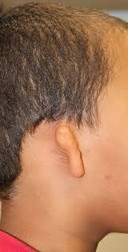
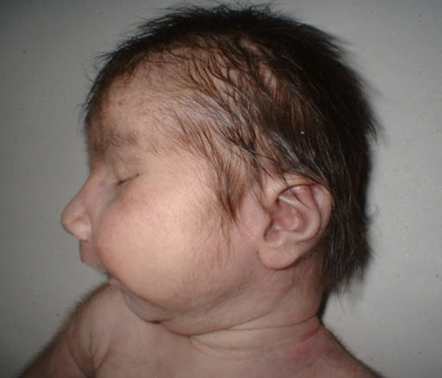
Microtia
Underdeveloped external
ear
Anotia
Not developed external ear
Micrognathia
Underdeveloped lower jaw

Slide 50
Social drug exposure
Smoking: Carbon monoxide and nicotine
Spontaneous abortion (1.2 to 1.8 times greater in smokers than in nonsmokers)
Abruptio placentae, placenta previa, and premature rupture of membranes
Preterm birth
Low infant birth weight
Sudden infant death syndrome
The risks increases with the number of cigarettes smoked.
Smoking cessation and Nicotine replacement therapy

Slide 51
Alcohol:
known teratogen.
Ethanol crosses the placenta and the fetal blood–brain barrier
ethanol toxicity is dose-related but without a defined lower threshold of exposure.
The exposure time of greatest risk is the first trimester.
fetal brain development may be affected throughout gestation.
Although an occasional drink during pregnancy has not been shown to be harmful

Slide 52
Fetal alcohol syndrome
growth retardation
facial abnormalities
central nervous system (CNS) dysfunction microcephaly, mental retardation, and behavioral disorders
Skeletal abnormalities
structural cardiac defects the most common cardiac structural anomaly is ventricular septal defect

Slide 53
Fetal alcohol syndrome

Slide 54
Cocaine:
maternal effects include profound vasoconstriction so malignant hypertension, cardiac ischemia, and cerebral infarction. have a direct cardiotoxic effect, sudden death.
Complications in pregnancy
spontaneous abortion
fetal death in utero
premature rupture of membranes
preterm labor
IUGR
meconium staining
abruptio placenta.
Cocaine is teratogenic, associated with in utero fetal cerebral infarction, microcephaly, and limb reduction defects.
Genitourinary malformations
neurobehavioral abnormalities

Slide 55
Marijuana:
alter brain neurotransmitters so the brain chemistry. remain in the body for up to 30 days, thus prolonging fetal exposure.
produces as much as five times the amount of carbon monoxide as does cigarette smoking .
Opiates:
increased rates of stillbirth, fetal growth restriction, prematurity, and neonatal mortality,
Amphetamines:
a potent stimulant that is inhaled, injected, or snorted, associated with decreased fetal head circumference and increased risk of abruptio placentae, IUGR, and fetal death in utero.
However, no proven teratogenicity exists.
Hallucinogens:
No evidence proves that lysergic acid diethylamide (LSD) or other hallucinogens cause chromosomal damage, No proven teratogenicity to LSD exists

Slide 56
Drugs Used During Lactation

Slide 57
The route of maternal drug administration, dose, Pk, the type of medication, etc…, have influence on breast milk drug concentration
A drug taken 30-60 minutes after breast feeding, and 3-4 hours before next feeding, reduced the amount of drug in baby blood
The baby’s age and maturity level, the frequency and volume of feeding (the baby who is nursing once or twice a day, will receive less of a drug than the baby who is totally breastfed and may nurse 10-12 times a day)
In deciding which drug to be prescribed, physician should always look at the situation from a risk/benefit perspective
The benefits of breastfeeding are well know and undisputed, so doctors should recommend a mother wean only when there is scientific documentation that a drug will be harmful to her infant

Slide 58
Factors affecting drug breastfeeding transfer
Medication enters the breast mainly via passive diffusion or sometimes via active transport. The passage of drugs to milk is directly proportional to the maternal plasma concentration
The pH of breast milk is slightly more acid (pH=7.2) than plasma (pH=7.4), therefore, basic drugs are more un-ionizable (more lipid soluble) in blood than in milk
Lipophilic drugs that pass to breast milk get more ionized farction ( due to higher acidity of milk) and trapped in milk
Drugs which are more lipophilic tends to concentrate in the hind-milk than in the fore-milk which has less lipid content.
Note: Hind-milk is released in the last few minutes of nursing, fore-milk is released from beginning until the last few minutes of the nursing

Slide 60
Thank you

Slide 61
Vaccines in pregnancy
Hadeel salalmeen

Slide 62
CONTENTS
1
Befor
2
During
3
After
4
Breast feeding

Slide 63
BEFORE PREGNANCY
Women should be vaccinated against preventable diseases in their environment according to the recommended adult immunization schedule
Ensuring immunity against -Measles -Mumps -Rubella -Varicella is important
Pregnancy should be avoided for 28 days following administration of a live vaccine.

Slide 64
DURING PREGNANCY
Benefits of vaccinating pregnant women usually outweigh potential risks when the likelihood of disease exposure is high, when infection would pose a risk to the mother or fetus, and when the vaccine is unlikely to cause harm.”
Benefits :
diminish the severity of infections
passive protection against vaccine-preventable infections
improved birth outcomes.

Slide 65
Antenatal screening during each pregnancy:
-Rubella
-HBsAg
Timing of immunization during pregnancy :
-If its medically indicaed: toxoids, inactivated virus vaccines, and immune globulin preparations should be given at any gestational age.
-Not medically indicated: its preferable to delay administration of these agents until the second trimester. why?

Slide 66
1. Possibility of risk to fetal development cannot be definitively excluded.
2. Avoid false associations in the patient's mind between immunization and common adverse first trimester events (eg, miscarriage, birth defects).
3. Between weeks 28 to 32 of gestation may optimize the transfer of antibodies to the fetus

Slide 67
Tetanus
Caused by :Clostridium tetani. This bacterium produces a toxin that affects the brain and nervous system, leading to stiffness in the muscles.
If a pregnant woman has NOTpreviously been vaccinated, or if her immunization status is unknown, she should receive two doses of a tetanus toxoid-containing vaccine (TT-CV) one month apart.
second dose given at least two weeks before delivery.
A third dose is recommended six months after the second dose, which should extend protection to at least five years.
another dose for each subsequent pregnancy culminating in 5 total doses.

Slide 68
Tetanus, Diphtheria, and Pertussis (Tdap)
during each pregnancy ,to all pregnant women,irrespective of the patient’s prior history of receiving
Timing:
Ideally, the vaccine should be given between 27 and 36 weeks of pregnancy. but can be given at any time
Women not previously vaccinated with Tdap:
Tdap should be administered immediately postpartum

Slide 69
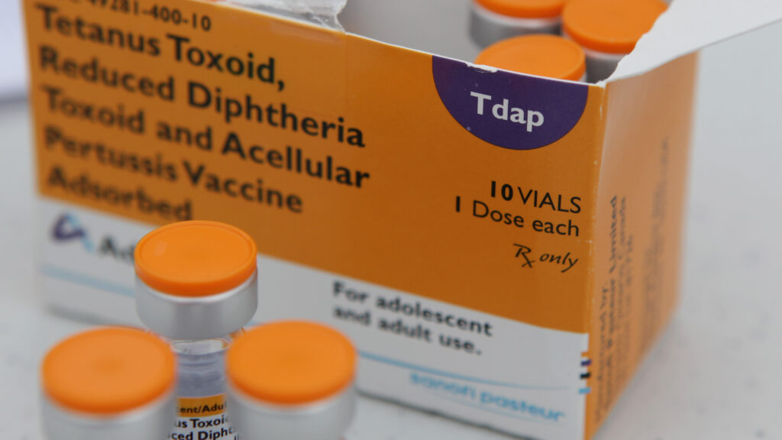
Common Side Effects from Tdap Vaccination during Pregnancy:
Erythema, swelling, pain, and tenderness at the injection site.
Body-ache.
Fatigue.
Fever.

Slide 70
Influenza
The flu shot is recommended for women who are pregnant during flu season at any trimester. The flu shot is made from an inactivated virus, so it's safe for both mother& baby.
Avoid the influenza nasal spray vaccine, which is made from a live virus.
pregnant women should be vaccinated even if they received an influenza vaccine during a previous pregnancy.

Slide 71
Pre-exposure prophylaxis:
=Vaccines for Special Circumstances. =Pregnant women with comorbidities. =exposures that place them at high risk
Including:
Hepatitis B Vaccine.
Pneumococcal Polysaccharide Vaccine.
Hepatitis A Vaccine.
Inactivated Poliovirus Vaccine.
Rabies Vaccine.
Anthrax Vaccine.

Slide 72
Postpartum immunization
Following delivery postpartum women should receive all recommended vaccines that could not be or were not administered during pregnancy
Including:
Measles
mumps
Rubella
Varicella
[Tdap]

Slide 73
Breastfeeding and vaccination
Inactivated, recombinant, subunit, polysaccharide, and conjugate vaccines, as well as toxoids, carry no risk for mothers who are breastfeeding or for their infants.
smallpox and yellow fever vaccines, neither inactivated nor live-virus vaccines administered to a lactating woman affect the safety of breastfeeding for women or their infants. Although live viruses in vaccines can replicate in the mother, the majority of live viruses in vaccines have been demonstrated not to be excreted in human milk.
Rubella vaccine virus might be excreted in human milk, but the virus usually does not infect the infant. If the infection occur, it will be tolerated because the virus is attenuated.

Slide 75
THANK YOU

