Slide 1
Surgical jaundice
Supervised by : Dr.Emad Aborajoh
Presented by :
Aya Deeb Ma’aitah
Diana Al Shalami
Razan Awad

Slide 2
Introduction
In post-hepatic jaundice or obstructive jaundice, there is an impediment to the flow of bile due to a partial or complete obstruction of the extrahepatic biliary passage between the liver and duodenum. Obstruction can occur within the biliary ducts themselves or more distal within the pancreas. This is predominantly a conjugated hyperbilirubinemia.

Slide 5
HISTORY
The history of present illness should elicit a wide range of possible symptoms associated with jaundice. Obstructive jaundice often produces pruritus, pale stools, and dark colored urine.
Abdominal pain along with fevers and jaundice is suggestive of obstruction with an associated infection (cholangitis).
A malignant source of obstruction more often presents with painless jaundice and weight loss.

Slide 7
Risk factors for gallstones and possible choledocholithiasis are important to obtain. This includes the 5 F’s : Fair, Fat, Female, Forty, Fertile.
Prior intraabdominal pathology should be identified, including a history of inflammatory bowel disease, which can have associated hepatic steatosis, cholelithiasis, or primary sclerosing cholangitis.

Slide 8
A history of pancreatitis should be noted as this can lead to biliary strictures.
Any iatrogenic interventions such as surgery or endoscopy are critical to obtain.
A social history should include current and past alcohol consumption as well as risk factors for transmission of viral hepatitis such as intravenous drug abuse and tattoos , lood transfusion .

Slide 10
PHYSICAL EXAMINATION
A thorough but focused physical exam can also help narrow the possible causes of jaundice.
This should include a general, abdominal, and rectal exam. The overall general exam allows the clinician to determine the severity of the illness, and the urgency of intervention and level of care required. Also noted on the general exam is jaundice (or icterus) itself. This is defined as the yellowing of skin and whites of the eye (scleral icterus) that accompanies high levels of bilirubin and is typically seen when the levels are greater than 3 mg/DL.

Slide 11
A palpable gallbladder, mass in the abdomen or lymph nodes in the supraclavicular area (Virchow’s node) are suggestive of a malignancy causing obstructive jaundice.
Stigmata of liver failure or portal hypertension such as caput medusa, spider nevi, and ascites are suggestive of a chronic parenchymal liver disease and an intra-hepatic cause of jaundice.

Slide 12
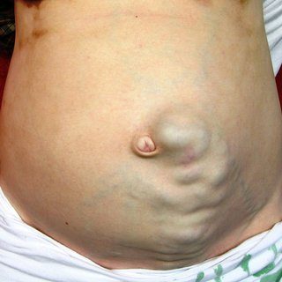

Slide 13
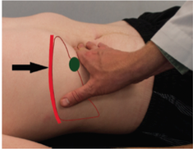
Murphy’s sign
Positive if patient experiences RUQ tenderness and stops breathing upon inspiration as the gallbladder moves down in contact with the examiner’s hand
=Suggestive of
acute cholecystitis

Slide 14
Charcot’s cholangitis Triad
Right upper quadrant pain
Jaundice
Fever
= Ascending cholangitis usually

Slide 15
Reynold’s Pentad
Right upper quadrant pain
Jaundice
Fever
Hypotension
Altered mental status
=Ascending cholangitis + shock

Slide 16
Courvoisier’s sign/law
Enlarged, non-tender, and palpable gallbladder in patients with obstructive jaundice due to tumors of the biliary tree or pancreatic head

Slide 18
Surgical VS. medical Juandice
Obstructive (Surgical) Jaundice Surgical jaundice is suspected over medical jaundice in the following scenarios:
History of abdominal pain and fevers
Painless jaundice with weight loss, pruritus, and clay colored stools
An enlarged gallbladder, abdominal mass, and/or lymph node in left supraclavicular area is considered advanced disease

Slide 19
According to location
Extramural
CA pancreas
Periampullary tumors
Enlarged lymph nodes
Merizzi syndrome
Intramural
Billiary atresia
Iatrogenic stricture
Inflamatory
Trauma
Idiopathic
Intraluminal
Bile duct stones
Parasitic infection : ascaris lumbricoides , hydatid cyst
Billiary tree tumors : cholangiocarcinoma – papillomatosis
Notes:
Mural = within walls

Slide 20
Labratory tests
1-CBC : Hb (for hemloytic anemia ) / wbc (high in cholangitis and cholecystitis )
2- Obstructive jaundice has hallmark findings on the biochemistry profile.
It is primarily a conjugated hyperbilirubinemia with the direct bilirubin > 50% of the total bilirubin.
There is also an associated elevation of alkaline phosphatase \GGT.
Depending on the duration of symptoms and severity of obstruction, coagulation can be altered (Prothrombin time and INR may be elevated in prolonged jaundice due to malabsorption of vitamin k )
3- liver function test ( to exclude hepatic causes)

Slide 21
Imaging Studies
Ultrasound is the gold standard imaging study for evaluation of the gallbladder. It is able to identify dilated intrahepatic and proximal extrahepatic bile ducts (including CBD) in addition to gallstones. Unfortunately, ultrasound is not optimal for visualization of the distal extrahepatic biliary tree and pancreas due to overlying gas in the duodenum. Therefore, further imaging needs to be obtained
Notes:
Operator dependent / 6mm normal // >9 dilated

Slide 22
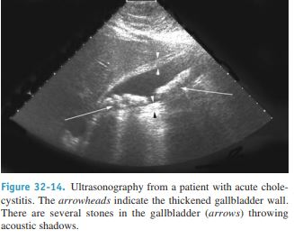
Notes:
Stones →produce an acoustic shadow.
A thickened gallbladder wall and local tenderness indicate cholecystitis.

Slide 23
Endoscopic ultrasound (EUS)
allows visualise the liver and biliary tree from within the stomach and duodenum
It is accurate in imaging the bile duct and detecting the presence of choledocholithiasis. (equal sensitivity to ERCP and MRCO in detection of CBD stones )
EUS is sensitive for detecting small lesions in the head of pancreas and surrounding lymphadenopathy. It also allows for a needle biopsy of the lesion when appropriate.
Sensitive in diagnosing and staging malignacny
Helps in dx of strictures
Notes:
Advanced, for suspected malignancies

Slide 24
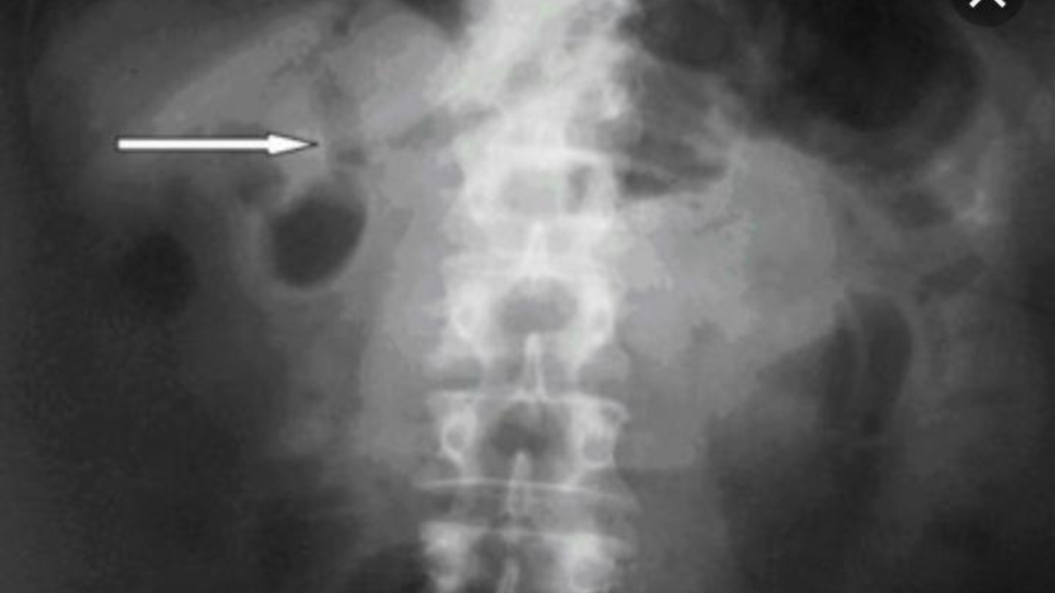
PLAIN ABDOMINAL FILM
It will show gallstones in the 10%-15% of cases when they are radiopaque
In several types of biliary disease, the diagnosis may be suggested by air seen in the bile ducts on a plain film (pneumobilia).
This usually signifies the presence of a biliary-intestinal fistula (from disease or surgery)

Slide 26
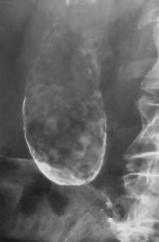
A plain x-ray may also show the rare cases of calcification of the gallbladder, a so-called ‘porcelain’ gallbladder .

Slide 27
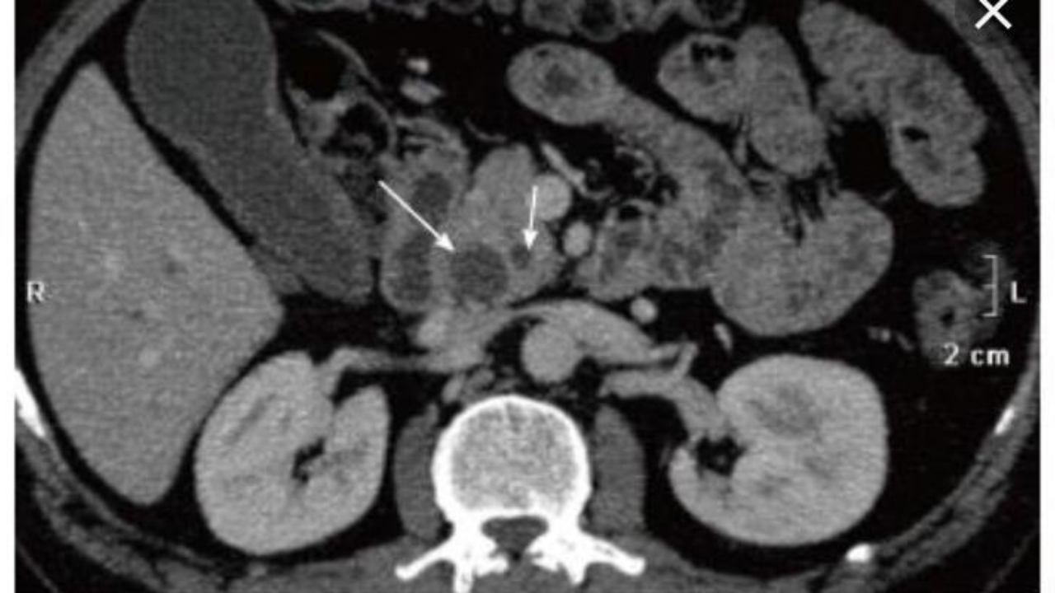
Contrast enhanced CT abdomen
This allows for a global assessment of the abdomen.
Attention should be focused towards mass lesions in the liver, biliary tract, and/or pancreas.
CT also allows for staging of a malignancy by identifying lymph nodes and metastasis.
Highly sensitive for tumours
Detect cause and site of obstruction
Low sensitivity for detection of stones

Slide 28
Cholangiography
MRCP: Magnetic resonance cholangiopancreatography
Allows for evaluation of the ducts and surrounding liver parenchyma (highly sensitive for detection of strictures and stones ) and can distinguish between malignancy and calculous obstruction .
No radiation exposure , no contrast needed, non invasive expensive.
Diagnostic not therapeutic
Contraindications : cardiac pacemaker / cerebral aneurysm clips / cochlear implants.

Slide 29
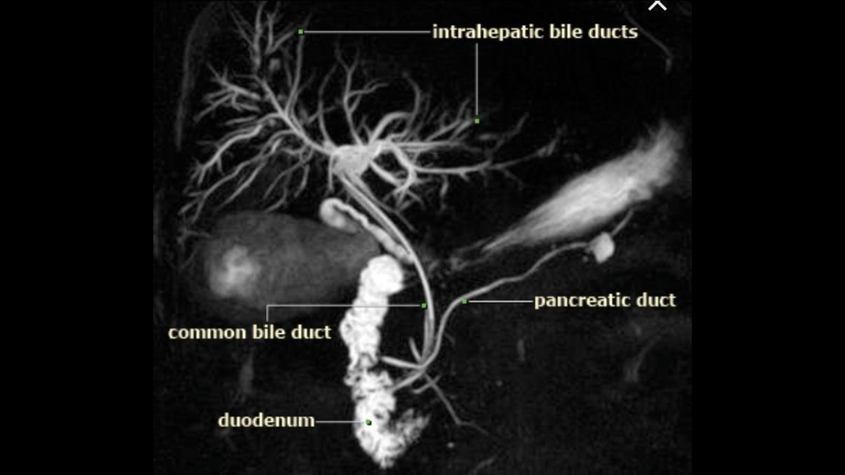

Slide 30
ERCP - Endoscopic retrograde cholangiopancreatography
- Upper endoscopic camera is placed through the mouth down into stomach and subsequently the duodenum
- Cannula is placed through ampulla of Vater
- Contrast is injected and x-rays taken to evaluate patency of the ducts
-Diagnostic and therapeutic
-Allow sphicterotomy, removal of stones, placement of stents, brushings and biopsies.
-Limited view of biliary tree proximal to obstruction.
-Needs sedation.
-Complications: pancreatitis, bleeding, cholangitis, perforation.
-Can’t be used with previous gastric bypass surgery.
*All patient should be premedicated with antibiotic

Slide 31
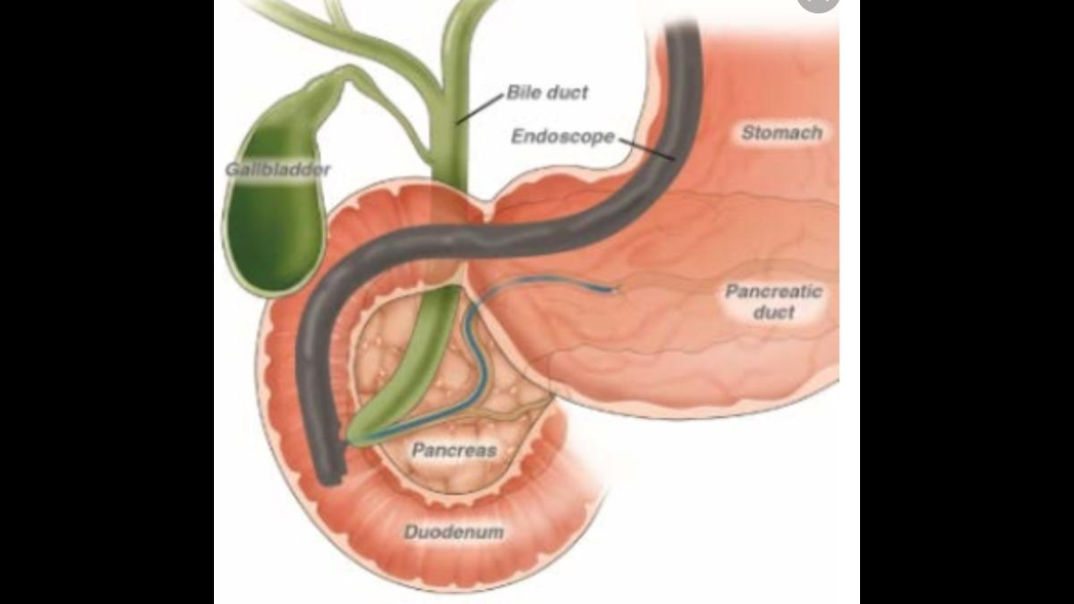

Slide 33
PTC - Percutaneous transhepatic cholangiography
- Under ultrasound guidance the intrahepatic biliary tree is punctured utilizing a needle with subsequent guidewire placement (L hepatic duct via subcostal location is most common)
After catheter placement, contrast can be injected for visualization of the biliary tree
Invasive / higher complications than ERCP therefore used in situations where ERCP is unavailable or unsuccessful .
- Interventions can be performed after crossing the obstruction with a guide wire including dilation, biopsy, and stent placement
- If the obstruction cannot be passed, a drain can be left in place for drainage/decompression

Slide 34
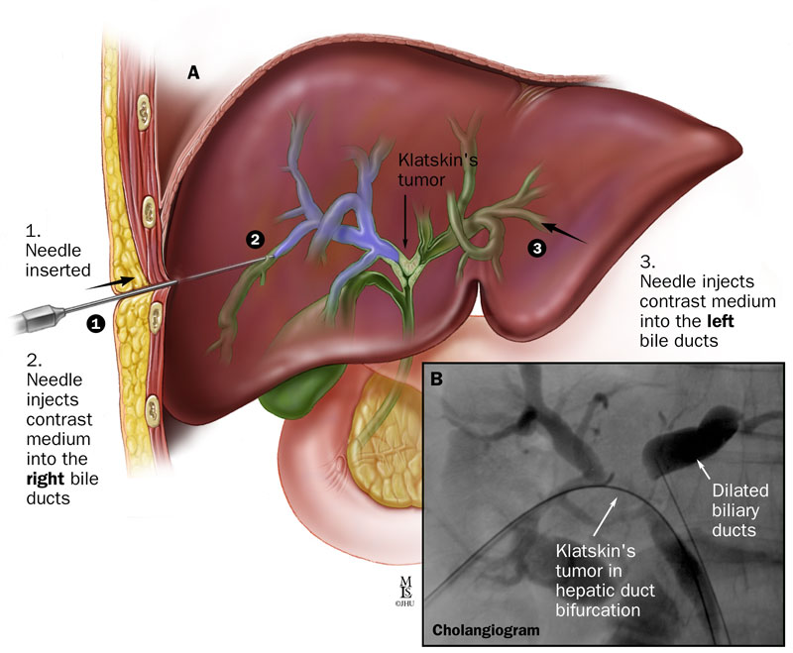
The technique is not easy and requires considerable experience. More than 25% of attempts fail.
Complications: more than ERCP
Bleeding
Bile leak
Allergy to contrast
Notes:
Bile leak> peotinitis

Slide 35
Management- General
. Patients with hemodynamic instability, coagulopathy, and/or renal dysfunction need to be quickly resuscitated prior to managing the specific etiology of the obstruction. In the presence of cholangitis, often it is difficult to stabilize the patient until the obstruction is relieved and source control of the infection achieved. The following algorithms should be considered.

Slide 36
Presents with cholangitis Goal = resuscitation
1) Intravenous fluids to correct dehydration and pre-renal failure
2) Broad spectrum antibiotics - Gram negative coverage is essential
3) Correct coagulopathy, if present
4) Upon stabilization, decompress biliary obstruction without surgical intervention (ERCP or PTC as described above)
5) Further treatment of obstruction based on etiology

Slide 37
Presents with jaundice in the absence of cholangitis Goal = diagnosis and management of obstruction
1) US and blood work to confirm biliary obstruction
2) Advanced imaging to identify site and etiology of obstruction if remains unclear

Slide 38
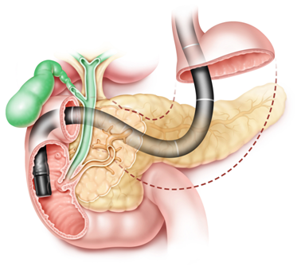
ERCP
Edoscopic Rerograd Cholagiopacreatography

Slide 39
Patient preparation : -NPO from midnight or at least 6 hours before procedure. With adequate hydration. -information about any medications (warfarin ,anticoagulants).Ask about any major illnesses, pregnancy ,allergy. Recent blood test reports :PT,PTT,INR- ,Bilirubin,LFT,KFT,CBC. Respiratory and cardiovascular assessment.- -Antibiotic prophylaxis. Vit k prophylaxis.- -Supplementary oxygen . Monitor cardiac and oxygen sat. -Removal of denatures ,jewelry contact lenses before procedure . -reviewing all previous imaging finding before ERCP -may require deep sedation .

Slide 41
Duodeoscop pylorus 2nd part of the duodenum
altering angle cannulated papilla
pancreatic biliary catheter guidewire
duct tree
contrast injection visualized under fluoroscopy

Slide 42
Indication
Therapeutic > Diagnostic
Most common relief of biliary obstruction due to ; gallstone ,benign or malignant biliary strictures . The pre-procedural diagnosis can confirmed by contrast injection. ( filling defects or luminal narrowing ) delayin relieving may require percutaneous drainage.
Assessment of biliary dysmotility( using manometry)
Pancreatic stone extraction and strictures dilatation
Transgastric drainage of pancreatic pseudocysts

Slide 43
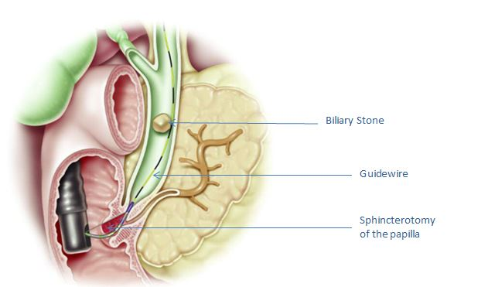
Gallstone
Adequate biliary sphincterotomy (performed over a well positioned guidewire using a sphincterotome).
Most of gallstone less than 1cm in diameter will pass spontaneously but preferred to ensure duct clearance at initial procedure to reduce the risk of inflammation.
This can be achieved by using a balloon catheter or by extraction using a wire basket
If failed can be crushed using mechanical lithotripsy
If failed conseder alternative options include surgery , endoscopically shockwaves

Slide 44
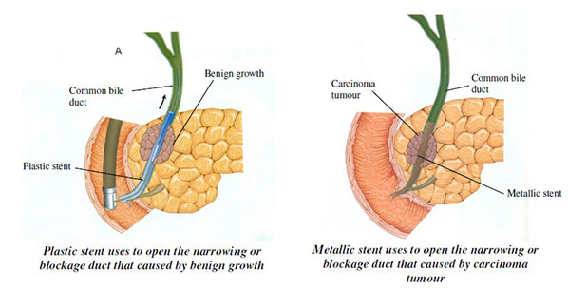
Strictures
Used catheters similar to those used in angioplasty
Insert temporary plastic stent in benign strictures ( self expanding metal stents are most commonly used for palliation of malignant biliary obstruction)

Slide 45
Complications
Pancreatitis (m.c) depends on the pressure used to pump the contrast .
Haemorrhage after insertion or sphincterotomy
Duodenal perforation
sepsis

