Slide 1
MSS MODULE 2023 HISTOLOGY
SKIN HISTOLOGY
Dr AMAL ALBTOOSH

Slide 2
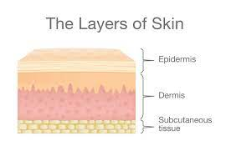
Skin structure
Skin is composed of TWO primary layers
-Epidermis which provides waterproofing and serves as a barrier to infection
-Dermis appendages of the skin
NOTE: Hypodermis /(superfecial facia) /subcuteneous adipose layer (THIRD LAYER FROM ANATOMICAL POINT OF VIEW)
The thickness of the skin varies from less than 1mm to more than 5mm.
Thick skin (hairless skin) contains THICK EPIDERMIS e.g palms of hands soles of feet. It has sweat glands, no hair follicles and no sebaceous glands.
Thin skin (thin epidermis) contains hair follicles, sweat glands and sebaceous glands.

Slide 3
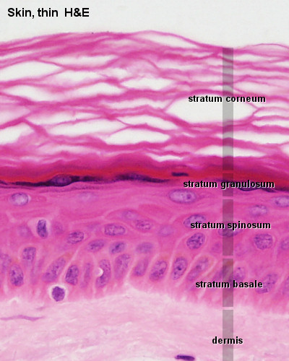
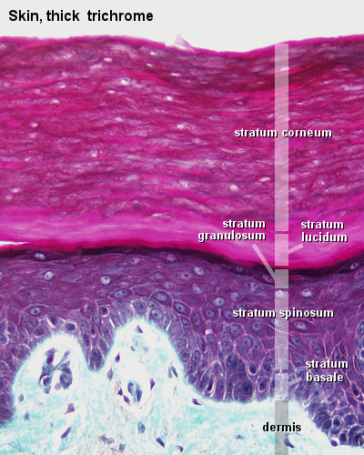

Slide 4
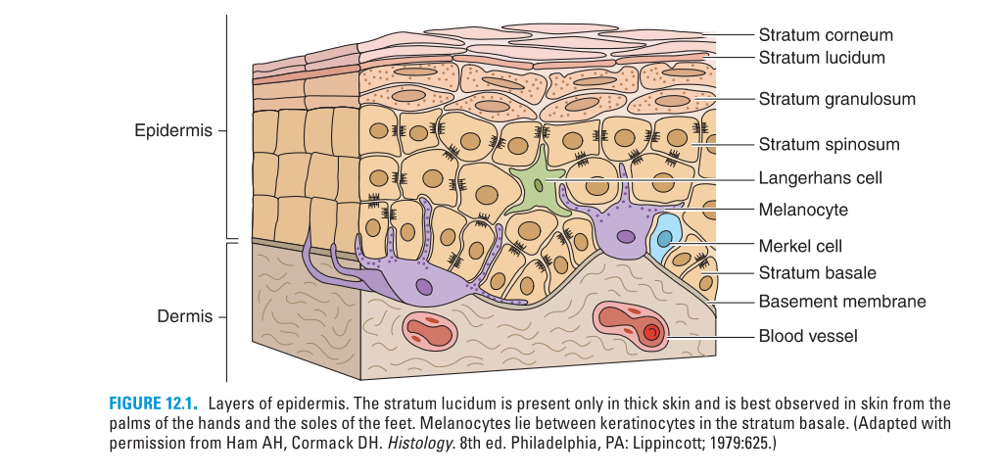

Slide 5
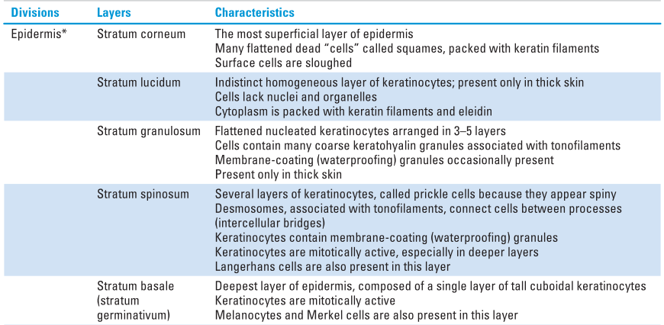
Epidermis
Consists of a keratinized stratified squamous epithelium.
layers of keratenocytes differentiate and become filled with keratin migrates upward through layers (keratinization(

Slide 6
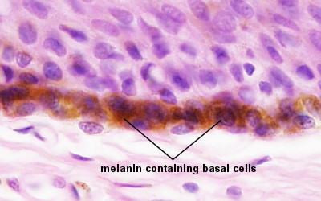
Other cells of the epidermis include
Melanocytes 2. Langerhans cells 3. Merckle cells
Melanocytes
melanin gives the brown colour component of the skin (melanin)
ectodermal in oirgin, neural crest
dendritic cells with no desmosomes with keratenocytes
melanosomes for melanogenesis
mainly in the epidermis basal layer, could not be identified in LM
found in skin, eye and hair
melanogenesis under the effect of
- race - hormones
- exposure to light - age

Slide 7
Langerhans' cells
-dendretic cells
-contain large granules called Birbeck granules
-important in immune reactions of the epidermis/ macrophages (antigen-presenting cells)
-no desmosomes
Merkel cells
large oval cells
numerous cytoplasmic granules
commonly associated with free nerve endings
sensory mechanoreceptors / neuroendocrine cells

Slide 8
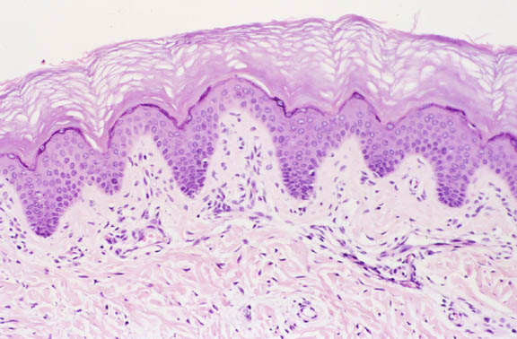
P
R

Slide 9
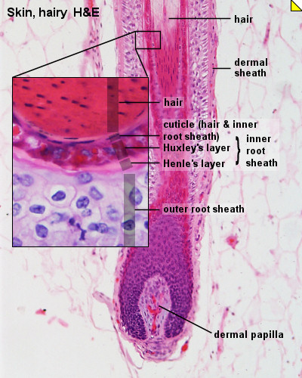
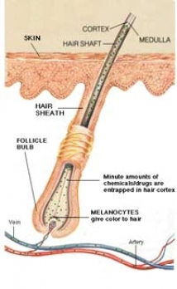
Appendages of the Skin
Hair (hard keratin)
thin filaments of keratin
epithelial invaginations of the epidermis
Shaft, root, sheath, hair follicle, bulb, arrector pili muscle

Slide 10
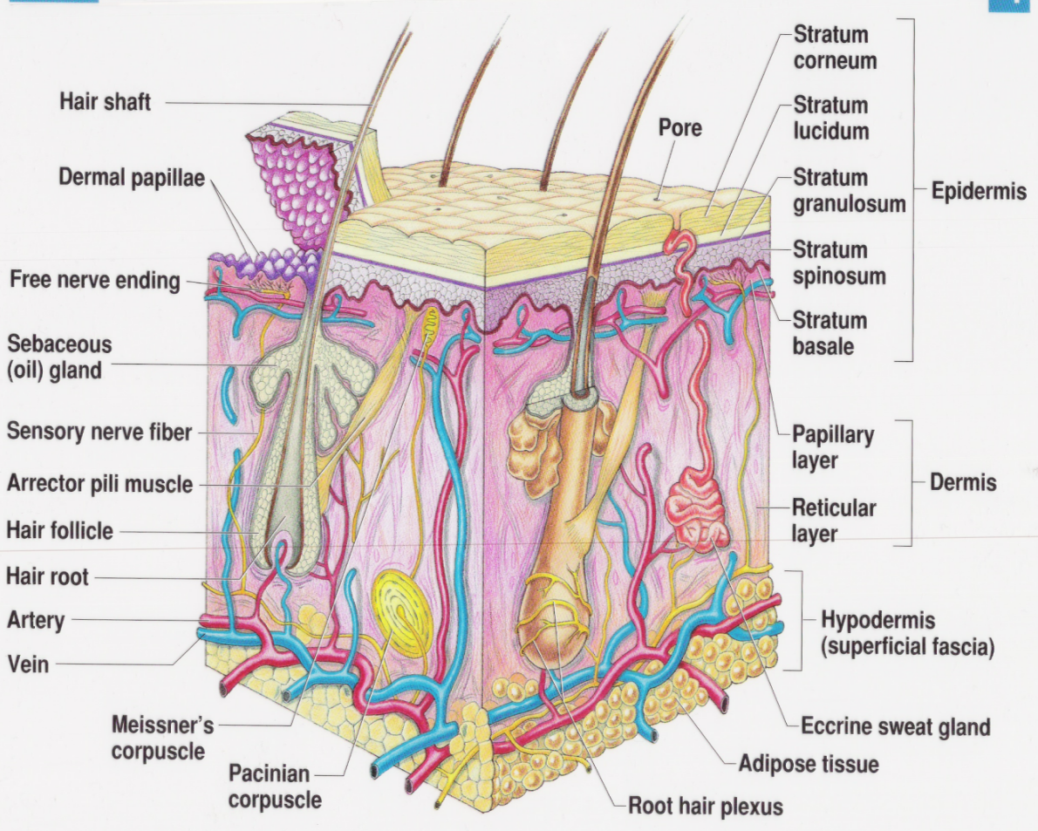
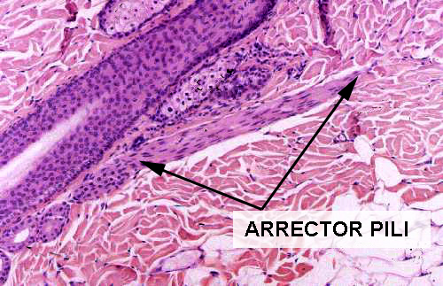
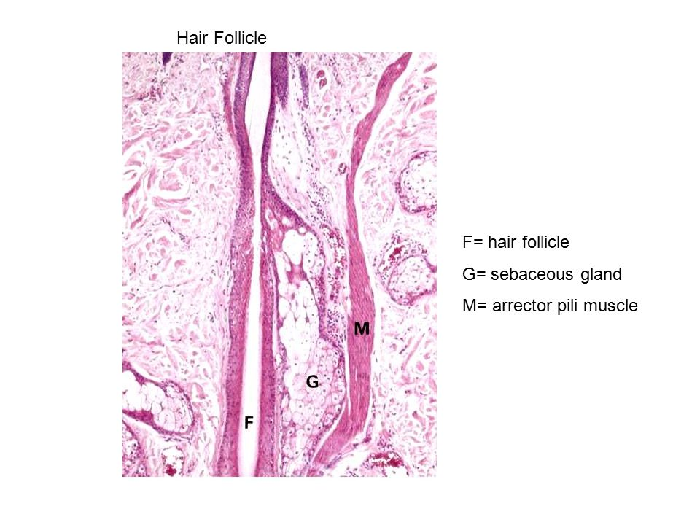
Sebaceous glands
dermal exocrine glands associated with hairs
holocrine secretion
secrete an oily substance (sebum) for hair flexibility
the sebum secretion is influenced by sex hormones/ adolescence acne

Slide 11
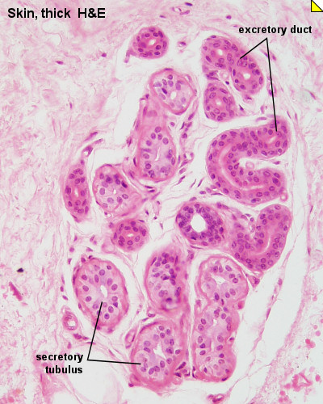
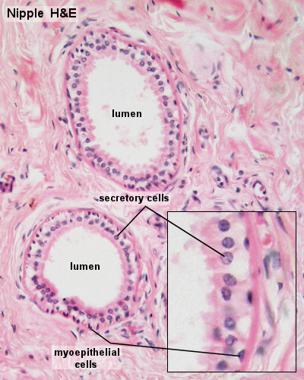
Sweat glands (Sudoriferous glands)
Eccrine sweat glands (Merocrine sweat glands)
all over the body.
coiled tubular glands
body temperature regulation.
cholinergic innervations/ respond to heat.
Apocrine sweat glands
large /axilla /external genitalia and anus
functional at puberty
adrenergic innervation/ respond to emotional and sensory stimuli

Slide 12
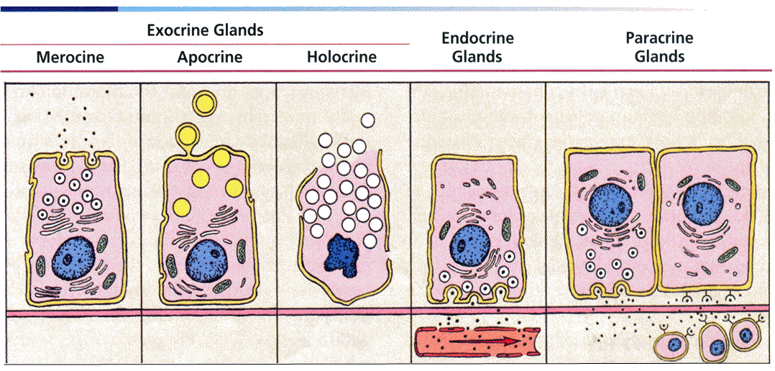
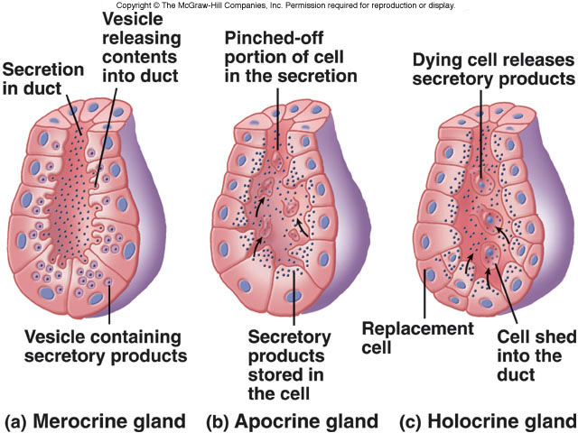

Slide 13
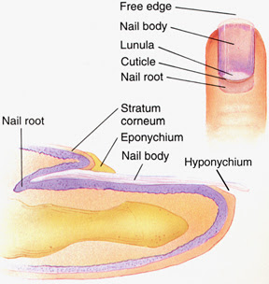
Nails
plates of keratin
nail plate, nail bed, nail groove, nail root, dorsal and ventral matrix, lunula eponychium or cuticle, hyponychium

Slide 14
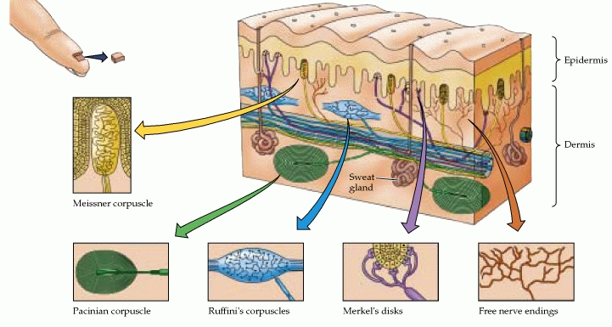
Nerve supply
-Free such as free endings, Merkel’s disc and hair follicle receptors.
- Encapsulated terminals such as tactile (Meissner’s) corpuscles, bulboid corpuscles (Krause’s end bulb), lamellar (Pacinian) corpuscles, and Ruffini’s corpuscles

Slide 15
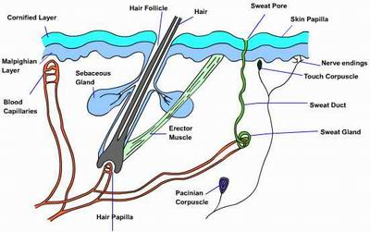
Free nerve endings
no complex sensory structures/ non-encapsulated/ epidermis/ sense pain and temperature.

Slide 16
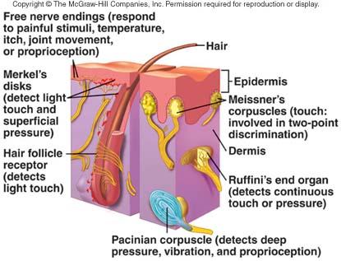
Merkel disk receptor
non- encapsulated mechanoreceptors/ surrounding hair follicles/ touch/ basal layer/ the most sensitive of the main types of mechanoreceptors to vibrations at low frequencies
Hair follicle receptors
these mechanoreceptors sense the presence and direction of hair displacement.

Slide 17
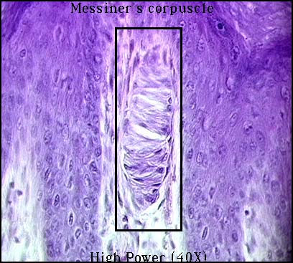
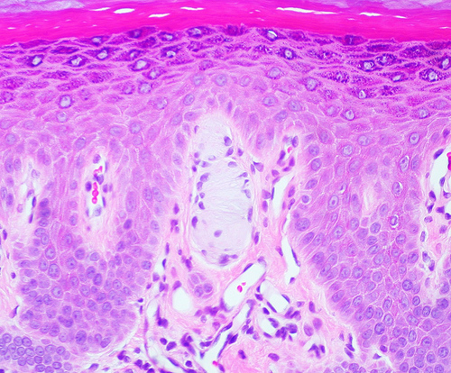
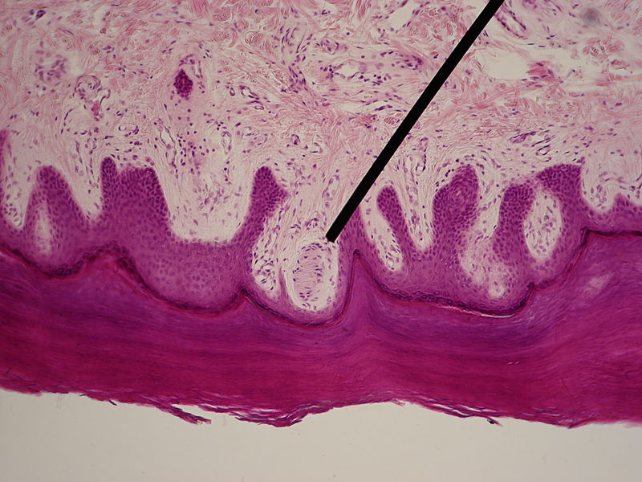
Meissner’s corpuscles (or tactile corpuscles) encapsulated mechanoreceptors present in the dermal papilla / sensitivity to light touch (sensitive to low frequency stimuli) / do not detect pain/ their number drops with age

Slide 18
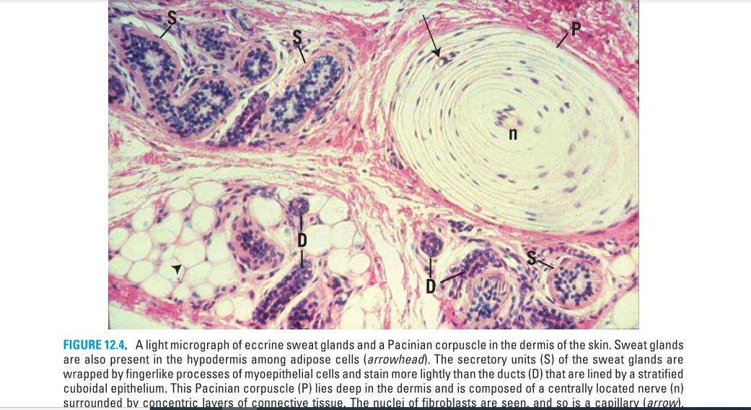
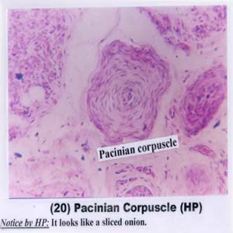
Pacinian corpuscles dermis of thick skin of fingers /respond to pressure and vibration. large receptive field on the skin's surface with an especially sensitive center. larger and fewer than others

Slide 19
Ruffini’s corpuscles – are encapsulated mechanoreceptors /deep in the reticular layer where they respond to distortion or stretching of the skin (sustained or continuous stress)

Slide 20
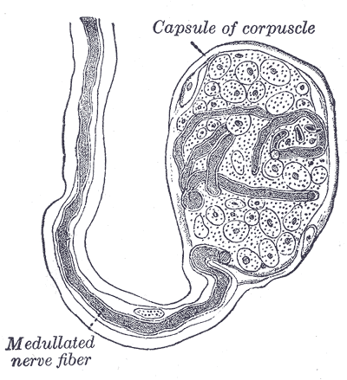
Krause end bulbs (bulboid corpuscles) encapsulated Thermo-mechanoreceptors in:
the papillary layer dermis
oral mucosa of the oral cavity and tongue / respond to cold and low-frequency vibration

Slide 21
